Slide 1
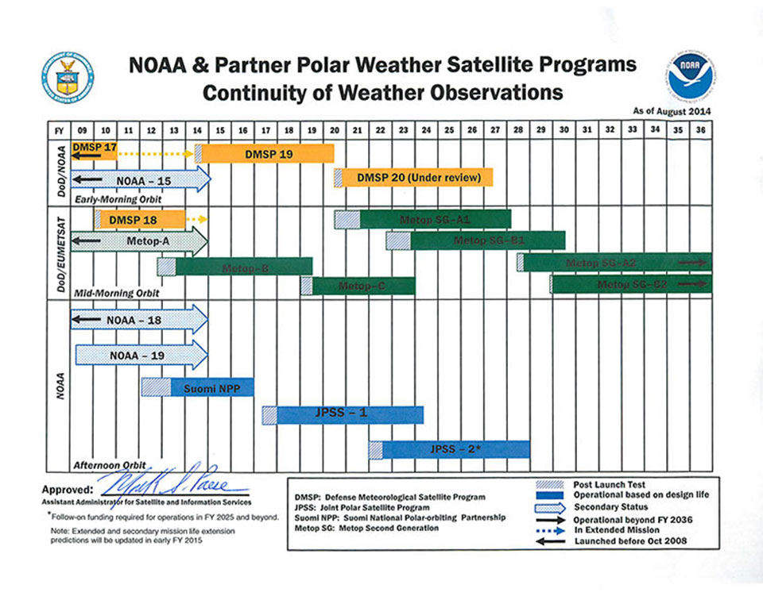
JPSS Overview
JPSS consists of three satellites (Suomi NPP, JPSS-1, JPSS-2), ground system and operations through 2025
  SNPP is now NOAA’s primary weather polar orbiting satellite providing global data.
http://satelliteconferences.noaa.gov/2015/doc/presentation/Session%202/2.3c_NSC2015_Session_2.3c_Goldberg.pptx

Slide 2
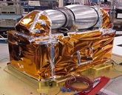
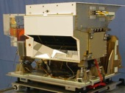
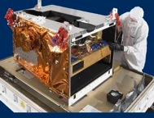
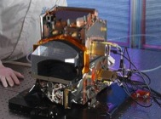
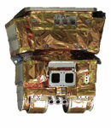
Technology
JPSS Instrument |  | Measurement
 | ATMS - Advanced Technology Microwave Sounder | ATMS and CrIS together provide high vertical resolution temperature and water vapor information needed to maintain and improve forecast skill out to 5 to 7 days in advance for extreme weather events, including hurricanes and severe weather outbreaks
 | CrIS - Cross-track Infrared Sounder
 | VIIRS – Visible Infrared Imaging Radiometer Suite | VIIRS provides many critical imagery products including snow/ice cover, clouds, fog, aerosols, fire, smoke plumes, vegetation health, phytoplankton abundance/chlorophyll
 | OMPS - Ozone Mapping and Profiler Suite | Ozone spectrometers for monitoring ozone hole and recovery of stratospheric ozone and for UV index forecasts
 | CERES - Clouds and the Earth’s Radiant Energy System | Scanning radiometer which supports studies of Earth Radiation Budget

Slide 3
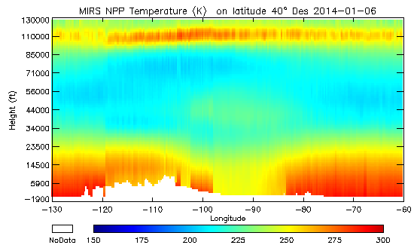
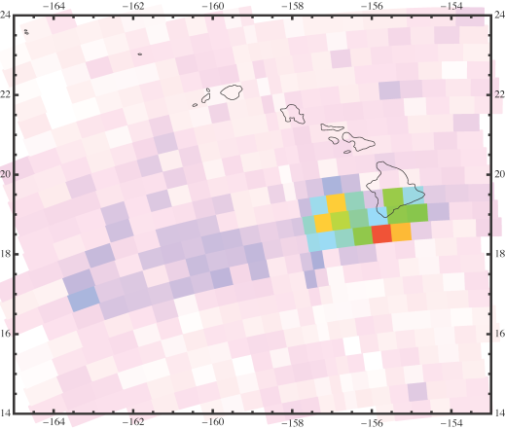
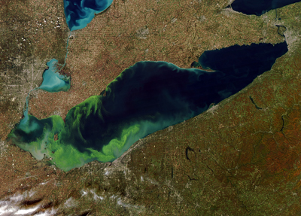
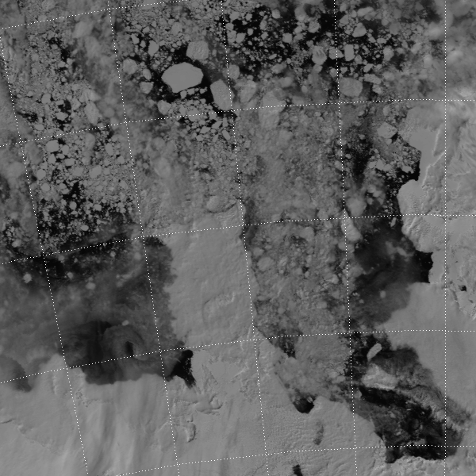
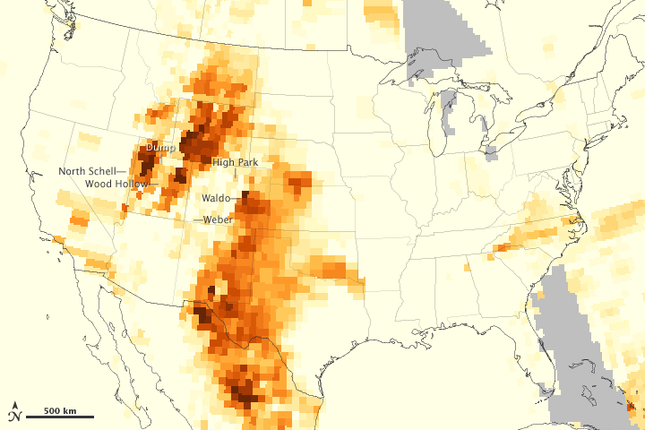
JPSS provides a wide range of capabilities
Microwave – provides temperature and moisture soundings in cloudy conditions and rainfall rates, sea ice, snow, surface temperature
Infrared – provides high vertical resolution temperature and moisture soundings in clear and cloud corrected regions; atmospheric chemistry - CO, CH4, SO2, … and cloud products
Visible (day & night) and Infrared Imagery (including deep blue channels) – chlorophyll, cloud imagery, cloud products, SST, Active Fires, Smoke, Aerosols, land products, Snow, Ice,
oil spills… at exceptional resolution/global coverage
UV - ozone - Aerosols over bright surfaces, SO2 plumes, NOx (air quality)…
Temperature X-Section Polar Vortex
OMPS- Volcano SO2 degassing
Algae in Lake Erie
DNB Ice detection
OMPS Aerosols from Fires

Slide 4
S-NPP and JPSS Data Products
VIIRS (24)
ALBEDO (SURFACE)
CLOUD BASE HEIGHT
CLOUD COVER/LAYERS
CLOUD EFFECTIVE PART SIZE
CLOUD OPTICAL THICKNESS
CLOUD TOP HEIGHT
CLOUD TOP PRESSURE
CLOUD TOP TEMPERATURE
ICE SURFACE TEMPERATURE
OCEAN COLOR/CHLOROPHYLL
SUSPENDED MATTER
VEGETATION INDEX, FRACTION, HEALTH
AEROSOL OPTICAL THICKNESS
AEROSOL PARTICLE SIZE
ACTIVE FIRES
POLAR WINDS
IMAGERY
SEA ICE CHARACTERIZATION
SNOW COVER
SEA SURFACE TEMPERATURE
LAND SURFACE TEMP
SURFACE TYPE
CrIS/ATMS (3)
ATM VERT MOIST PROFILE
ATM VERT TEMP PROFILE
CARBON (CO2, CH4, CO)
OUTGOING LONGWAVE RADIATION
OMPS (2)
O₃ TOTAL COLUMN
O₃ NADIR PROFILE
SO2 and Aerosol Index
ATMS (11)
CLOUD LIQUID WATER
PRECIPITATION RATE
PRECIPITABLE WATER
LAND SURFACE EMISSIVITY
ICE WATER PATH
LAND SURFACE TEMPERATURE
SEA ICE CONCENTRATION
SNOW COVER
SNOW WATER EQUIVALENT
ATM TEMPERATURE PROFILE
ATM MOISTURE PROFILE
CERES(1)
RDRs
GCOM AMSR-2 (11)
CLOUD LIQUID WATER
PRECIPITATION TYPE/RATE
PRECIPITABLE WATER
SEA SURFACE WINDS SPEED
SOIL MOISTURE
SNOW WATER EQUIVALENT
IMAGERY
SEA ICE CHARACTERIZATION
SNOW COVER/DEPTH
SEA SURFACE TEMPERATURE
SURFACE TYPE
Data available through PDA , CLASS, and Direct Readout

Slide 5
S-NPP and JPSS Data Products
VIIRS (24)
ALBEDO (SURFACE)
CLOUD BASE HEIGHT
CLOUD COVER/LAYERS
CLOUD EFFECTIVE PART SIZE
CLOUD OPTICAL THICKNESS
CLOUD TOP HEIGHT
CLOUD TOP PRESSURE
CLOUD TOP TEMPERATURE
ICE SURFACE TEMPERATURE
OCEAN COLOR/CHLOROPHYLL
SUSPENDED MATTER
VEGETATION INDEX, FRACTION, HEALTH
AEROSOL OPTICAL THICKNESS
AEROSOL PARTICLE SIZE
ACTIVE FIRES
POLAR WINDS
IMAGERY
SEA ICE CHARACTERIZATION
SNOW COVER
SEA SURFACE TEMPERATURE
LAND SURFACE TEMP
SURFACE TYPE
CrIS/ATMS (3)
ATM VERT MOIST PROFILE
ATM VERT TEMP PROFILE
CARBON (CO2, CH4, CO)
OUTGOING LONGWAVE RADIATION
OMPS (2)
O₃ TOTAL COLUMN
O₃ NADIR PROFILE
SO2 and Aerosol Index
ATMS (11)
CLOUD LIQUID WATER
PRECIPITATION RATE
PRECIPITABLE WATER
LAND SURFACE EMISSIVITY
ICE WATER PATH
LAND SURFACE TEMPERATURE
SEA ICE CONCENTRATION
SNOW COVER
SNOW WATER EQUIVALENT
ATM TEMPERATURE PROFILE
ATM MOISTURE PROFILE
CERES(1)
RDRs
GCOM AMSR-2 (11)
CLOUD LIQUID WATER
PRECIPITATION TYPE/RATE
PRECIPITABLE WATER
SEA SURFACE WINDS SPEED
SOIL MOISTURE
SNOW WATER EQUIVALENT
IMAGERY
SEA ICE CHARACTERIZATION
SNOW COVER/DEPTH
SEA SURFACE TEMPERATURE
SURFACE TYPE
Data available through PDA , CLASS, and Direct Readout

Slide 6
S-NPP and JPSS Data Products
VIIRS (24)
ALBEDO (SURFACE)
CLOUD BASE HEIGHT
CLOUD COVER/LAYERS
CLOUD EFFECTIVE PART SIZE
CLOUD OPTICAL THICKNESS
CLOUD TOP HEIGHT
CLOUD TOP PRESSURE
CLOUD TOP TEMPERATURE
ICE SURFACE TEMPERATURE
OCEAN COLOR/CHLOROPHYLL
SUSPENDED MATTER
VEGETATION INDEX, FRACTION, HEALTH
AEROSOL OPTICAL THICKNESS
AEROSOL PARTICLE SIZE
ACTIVE FIRES
POLAR WINDS
IMAGERY
SEA ICE CHARACTERIZATION
SNOW COVER
SEA SURFACE TEMPERATURE
LAND SURFACE TEMP
SURFACE TYPE
CrIS/ATMS (3)
ATM VERT MOIST PROFILE
ATM VERT TEMP PROFILE
CARBON (CO2, CH4, CO)
OUTGOING LONGWAVE RADIATION
OMPS (2)
O₃ TOTAL COLUMN
O₃ NADIR PROFILE
SO2 and Aerosol Index
ATMS (11)
CLOUD LIQUID WATER
PRECIPITATION RATE
PRECIPITABLE WATER
LAND SURFACE EMISSIVITY
ICE WATER PATH
LAND SURFACE TEMPERATURE
SEA ICE CONCENTRATION
SNOW COVER
SNOW WATER EQUIVALENT
ATM TEMPERATURE PROFILE
ATM MOISTURE PROFILE
CERES(1)
RDRs
GCOM AMSR-2 (11)
CLOUD LIQUID WATER
PRECIPITATION TYPE/RATE
PRECIPITABLE WATER
SEA SURFACE WINDS SPEED
SOIL MOISTURE
SNOW WATER EQUIVALENT
IMAGERY
SEA ICE CHARACTERIZATION
SNOW COVER/DEPTH
SEA SURFACE TEMPERATURE
SURFACE TYPE
Data available through PDA , CLASS, and Direct Readout

Slide 7
S-NPP and JPSS Data Products
VIIRS (24)
ALBEDO (SURFACE)
CLOUD BASE HEIGHT
CLOUD COVER/LAYERS
CLOUD EFFECTIVE PART SIZE
CLOUD OPTICAL THICKNESS
CLOUD TOP HEIGHT
CLOUD TOP PRESSURE
CLOUD TOP TEMPERATURE
ICE SURFACE TEMPERATURE
OCEAN COLOR/CHLOROPHYLL
SUSPENDED MATTER
VEGETATION INDEX, FRACTION, HEALTH
AEROSOL OPTICAL THICKNESS
AEROSOL PARTICLE SIZE
ACTIVE FIRES
POLAR WINDS
IMAGERY
SEA ICE CHARACTERIZATION
SNOW COVER
SEA SURFACE TEMPERATURE
LAND SURFACE TEMP
SURFACE TYPE
CrIS/ATMS (3)
ATM VERT MOIST PROFILE
ATM VERT TEMP PROFILE
CARBON (CO2, CH4, CO)
OUTGOING LONGWAVE RADIATION
OMPS (2)
O₃ TOTAL COLUMN
O₃ NADIR PROFILE
SO2 and Aerosol Index
ATMS (11)
CLOUD LIQUID WATER
PRECIPITATION RATE
PRECIPITABLE WATER
LAND SURFACE EMISSIVITY
ICE WATER PATH
LAND SURFACE TEMPERATURE
SEA ICE CONCENTRATION
SNOW COVER
SNOW WATER EQUIVALENT
ATM TEMPERATURE PROFILE
ATM MOISTURE PROFILE
CERES(1)
RDRs
GCOM AMSR-2 (11)
CLOUD LIQUID WATER
PRECIPITATION TYPE/RATE
PRECIPITABLE WATER
SEA SURFACE WINDS SPEED
SOIL MOISTURE
SNOW WATER EQUIVALENT
IMAGERY
SEA ICE CHARACTERIZATION
SNOW COVER/DEPTH
SEA SURFACE TEMPERATURE
SURFACE TYPE
Data available through PDA , CLASS, and Direct Readout

Slide 8
Spectral Differences: ATMS vs. AMSU/MHS
AMSU/MHS
ATMS
Ch | GHz | Pol | Ch | GHz | Pol
1 | 23.8 | QV | 1 | 23.8 | QV
2 | 31.399 | QV | 2 | 31.4 | QV
3 | 50.299 | QV | 3 | 50.3 | QH
 |  |  | 4 | 51.76 | QH
4 | 52.8 | QV | 5 | 52.8 | QH
5 | 53.595 ± 0.115 | QH | 6 | 53.596 ± 0.115 | QH
6 | 54.4 | QH | 7 | 54.4 | QH
7 | 54.94 | QV | 8 | 54.94 | QH
8 | 55.5 | QH | 9 | 55.5 | QH
9 | fo = 57.29 | QH | 10 | fo = 57.29 | QH
10 | fo ± 0.217 | QH | 11 | fo±0.3222±0.217 | QH
11 | fo±0.3222±0.048 | QH | 12 | fo± 0.3222±0.048 | QH
12 | fo ±0.3222±0.022 | QH | 13 | fo±0.3222±0.022 | QH
13 | fo± 0.3222±0.010 | QH | 14 | fo±0.3222 ±0.010 | QH
14 | fo±0.3222±0.0045 | QH | 15 | fo± 0.3222±0.0045 | QH
15 | 89.0 | QV
16 | 89.0 | QV | 16 | 88.2 | QV
17 | 157.0 | QV | 17 | 165.5 | QH
18 | 183.31 ± 1 | QH | 18 | 183.31 ± 7 | QH
19 | 183.31 ± 3 | QH | 19 | 183.31 ± 4.5 | QH
20 | 191.31 | QV | 20 | 183.31 ± 3 | QH
 |  |  | 21 | 183.31 ± 1.8 | QH
 |  |  | 22 | 183.31 ± 1 | QH
ATMS has 22 channels and AMSU/MHS have 20, with polarization differences between some channels
− QV = Quasi-vertical; polarization vector is parallel to the scan plane at nadir
− QH = Quasi-horizontal; polarization vector is perpendicular to the scan plane at nadir
AMSU-A
Exact match to AMSU/MHS
Only Polarization different
MHS
Unique Passband
Unique Passband, and Pol. different
from closest AMSU/MHS channels
Notes:
An overview of the principal differences between ATMS and AMSU.

Slide 9
Increased horizontal resolution potentially beneficial for high gradient phenomena (such as hurricanes)
Notes:
SJL: added comments at bottom

Slide 10
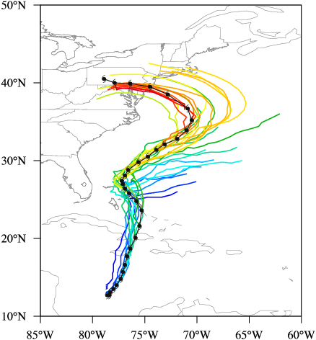
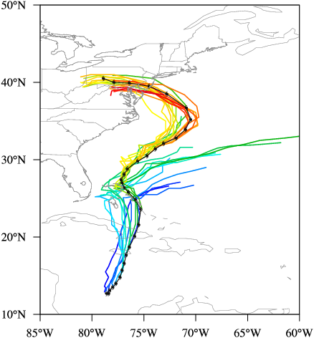

Direct Assimilation of ATMS into Models
Experimental results showing improvements in Sandy track forecasts from Hurricane Weather Research Forecast model with ATMS
HWRF-NCEP Operational
Modified HWRF-NCEP with ATMS
Thanks to Fuzhong Weng

Slide 11
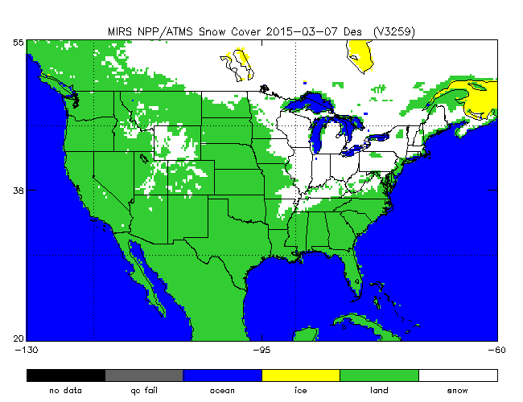
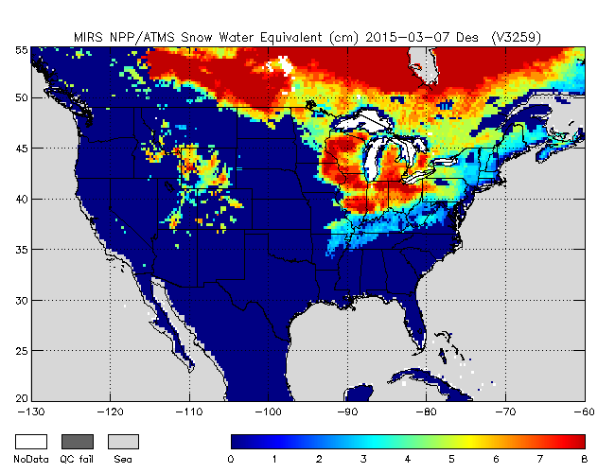
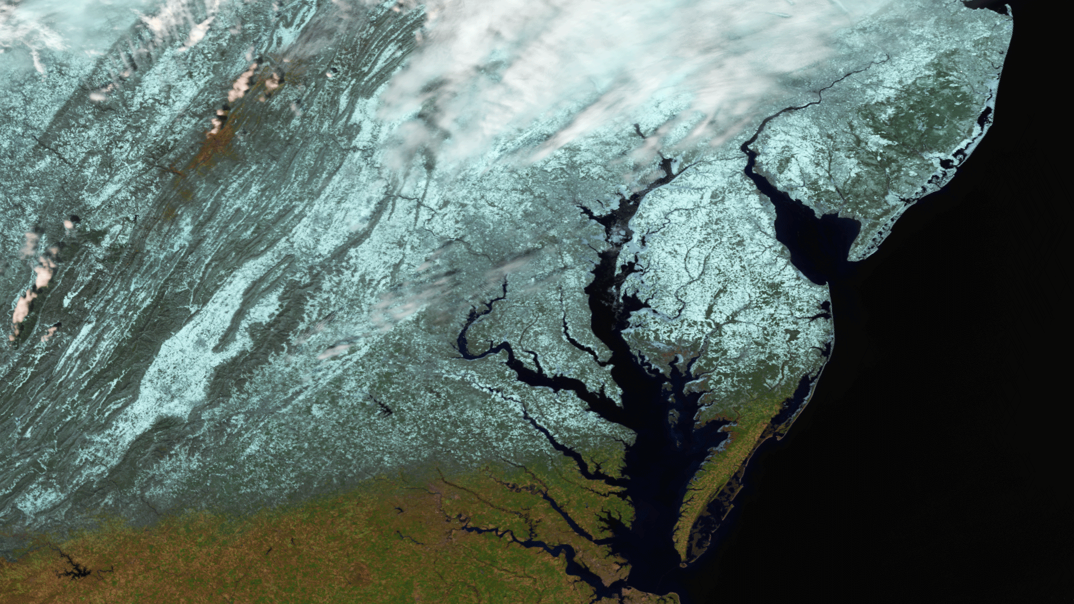
ATMS EDRs supports hydrological applications
Precipitable water & cloud liquid water
Precipitation type and rate
Snow cover and sea ice characterization
Snow water equivalent
Land surface temperature
Land/Surface type

Slide 12
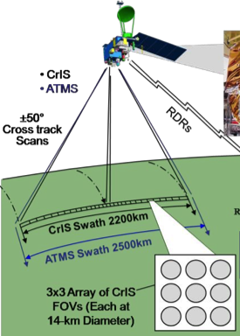
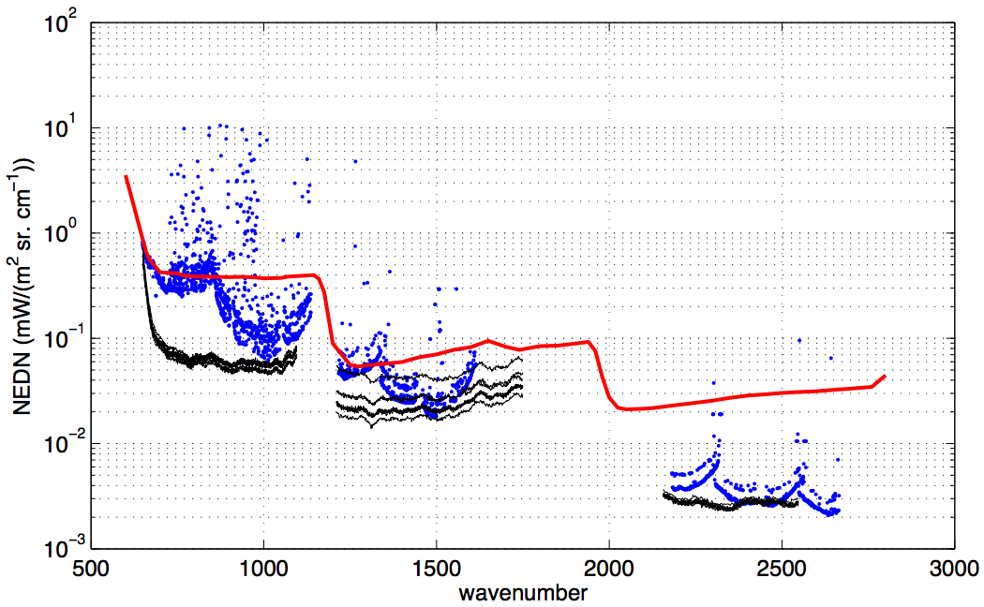
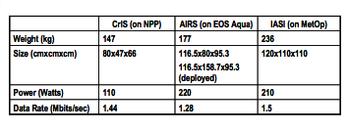
Cross-Track Infrared Sounder (CrIS)
NPP/JPSS
CrIS
Michelson Interferometer: 0.625,1.25, 2.5cm⁻¹
(resolving power of 1000)
Spectral range: 660-2600 cm⁻¹
3 x 3 HdCdTe focal plane passively cooled
(4-stages) to 85K
Focal plane 27 detectors,
1305 spectral channels
310 K Blackbody and space view
provides radiometric calibration
NEDT ranges from 0.05 K to 0. 5 K
AIRS
IASI
CrIS
“CrIS LW Noise << AIRS & IASI LW Noise”

Slide 13
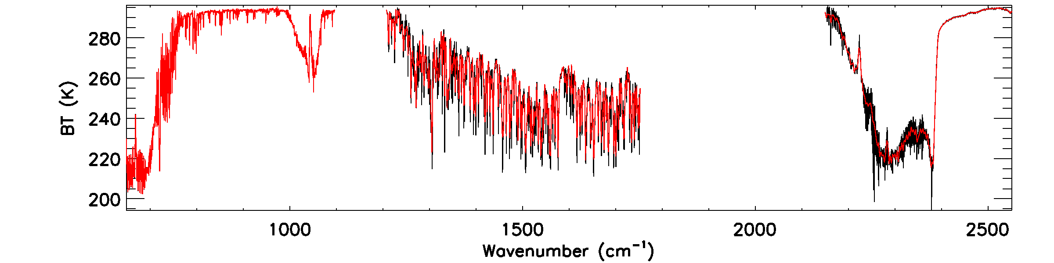
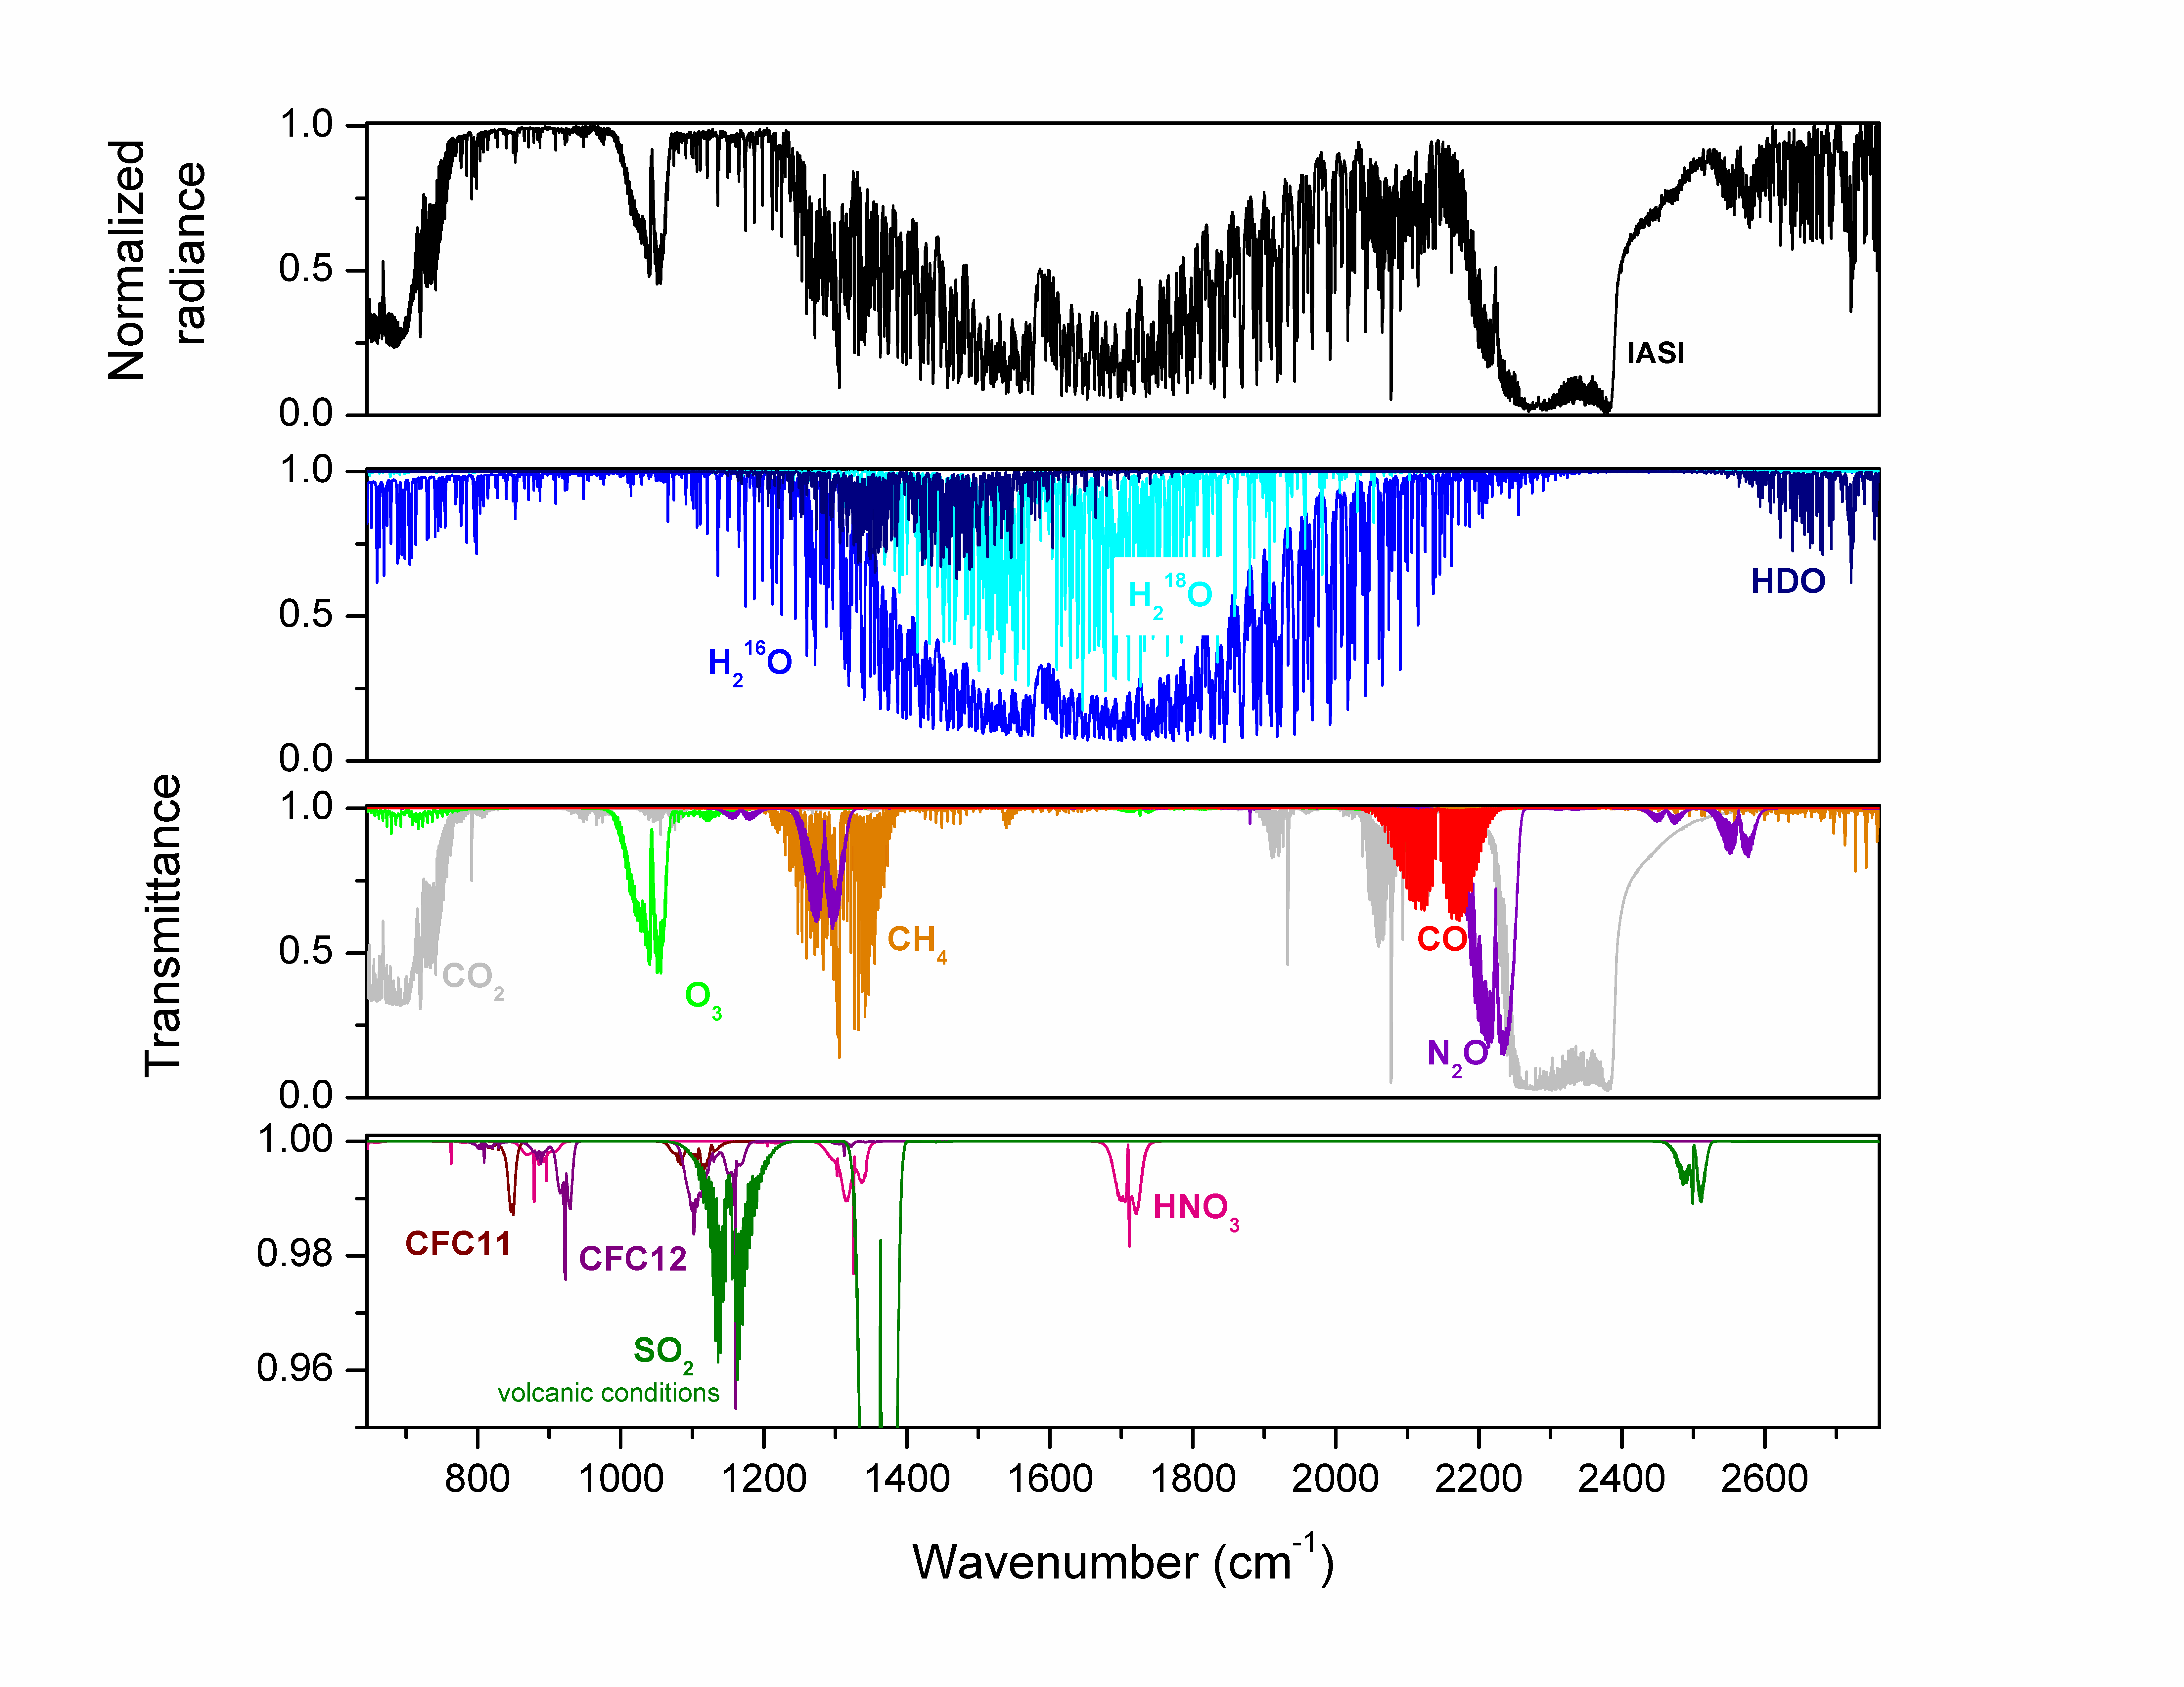
CrIS - SNPP
Full/Truncated Spectral Resolution
On 12/4/15 – full interferograms are now being transmitted from the SNPP instead of them being truncated on the spacecraft
Black - high spectral resolution
Red - truncated spectral resolution
IASI - Metop
645 cm⁻¹
2760 cm⁻¹
Surface
Clouds
Aerosols
Surface
Clouds
Aerosols
Surface
Clouds
CO₂
O₃
CH₄
H₂O
CO
N₂O
CO₂
T profiles

Slide 14
S-NPP and JPSS Data Products
VIIRS (24)
ALBEDO (SURFACE)
CLOUD BASE HEIGHT
CLOUD COVER/LAYERS
CLOUD EFFECTIVE PART SIZE
CLOUD OPTICAL THICKNESS
CLOUD TOP HEIGHT
CLOUD TOP PRESSURE
CLOUD TOP TEMPERATURE
ICE SURFACE TEMPERATURE
OCEAN COLOR/CHLOROPHYLL
SUSPENDED MATTER
VEGETATION INDEX, FRACTION, HEALTH
AEROSOL OPTICAL THICKNESS
AEROSOL PARTICLE SIZE
ACTIVE FIRES
POLAR WINDS
IMAGERY
SEA ICE CHARACTERIZATION
SNOW COVER
SEA SURFACE TEMPERATURE
LAND SURFACE TEMP
SURFACE TYPE
CrIS/ATMS (3)
ATM VERT MOIST PROFILE
ATM VERT TEMP PROFILE
CARBON (CO2, CH4, CO)
OUTGOING LONGWAVE RADIATION
OMPS (2)
O₃ TOTAL COLUMN
O₃ NADIR PROFILE
SO2 and Aerosol Index
ATMS (11)
CLOUD LIQUID WATER
PRECIPITATION RATE
PRECIPITABLE WATER
LAND SURFACE EMISSIVITY
ICE WATER PATH
LAND SURFACE TEMPERATURE
SEA ICE CONCENTRATION
SNOW COVER
SNOW WATER EQUIVALENT
ATM TEMPERATURE PROFILE
ATM MOISTURE PROFILE
CERES(1)
RDRs
GCOM AMSR-2 (11)
CLOUD LIQUID WATER
PRECIPITATION TYPE/RATE
PRECIPITABLE WATER
SEA SURFACE WINDS SPEED
SOIL MOISTURE
SNOW WATER EQUIVALENT
IMAGERY
SEA ICE CHARACTERIZATION
SNOW COVER/DEPTH
SEA SURFACE TEMPERATURE
SURFACE TYPE
Data available through PDA , CLASS, and Direct Readout

Slide 15
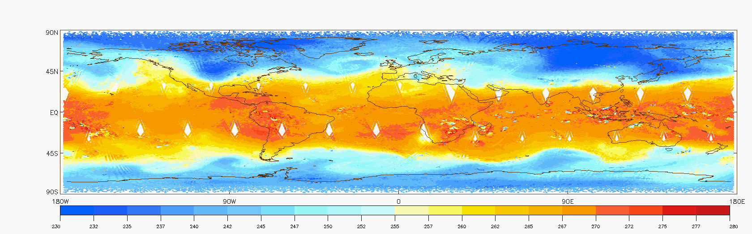
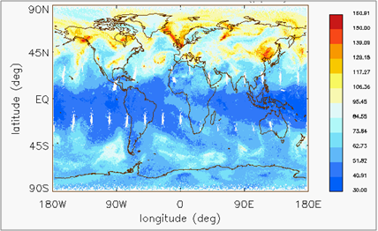
List of operational retrieval products
Credit: Gambacorta, Liu, Reale, Nalli, Barnet…..
NUCAPS Temperature retrieval @ 500mb
Retrieval Products
(January 5th 2014 Polar Vortex Anomaly)
Cloud Cleared Radiances | 660-750 cm-1 2200-2400 cm-1
Cloud fraction and Top Pressure | 660-750 cm-1
Surface temperature | window
Temperature Profile | 660-750 cm-1 2200-2400 cm-1
Water Vapor Profile | 780 – 1090 cm-1 1200-1750 cm-1
O3 | 990 – 1070 cm-1
CO | 2155 – 2220 cm-1
CH4 | 1220-1350 cm-1
CO2 | 660-760 cm-1
N2O | 1290-1300cm-1 2190-2240cm-1
HNO3 | 760-1320cm-1
SO2 | 1343-1383cm-1
NUCAPS Ozone retrieval @ 500mb

Slide 16
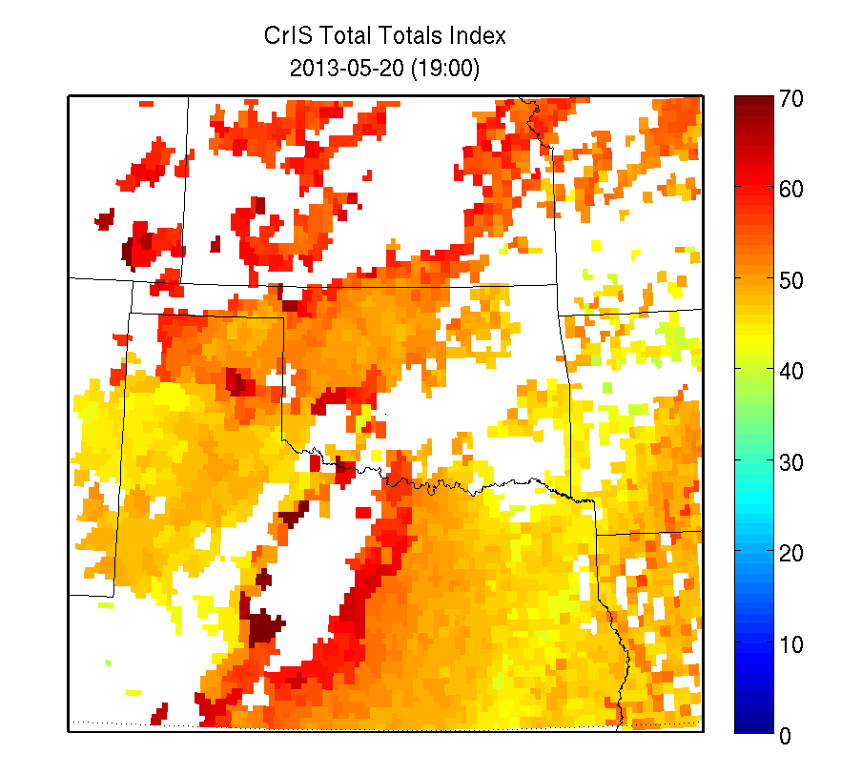
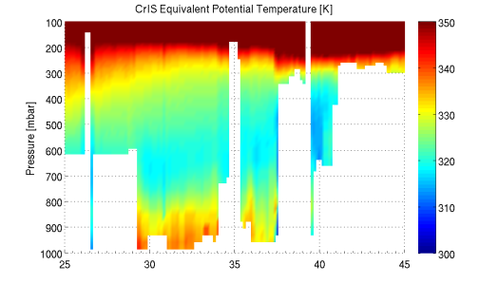
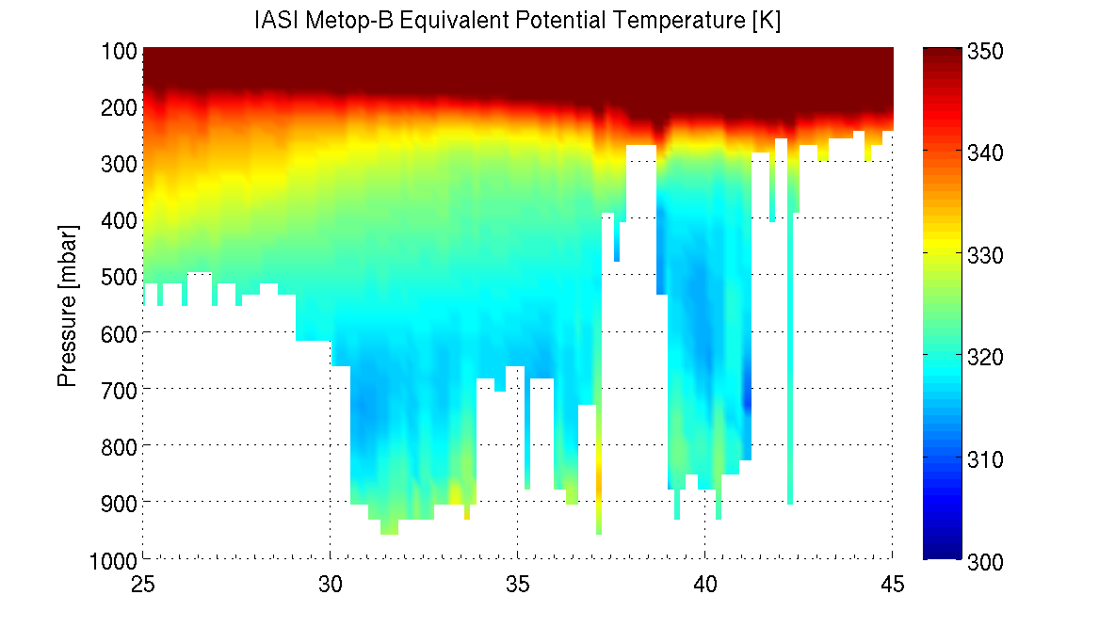
CrIS Applications
Assessing convective instability for potential of severe weather by NWS
Outgoing longwave radiation for a variety of precipitation and tropical dynamical diagnostics applications by the NOAA Climate Prediction Center
CriS – OMPS blended ozone for night-time ozone products
Transport of CO from fires and pollution. SO2 plumes from volcanoes.
> 60
Liklihood of
Moderate
Thunderstorms
With scattered severe t-storms

Slide 17
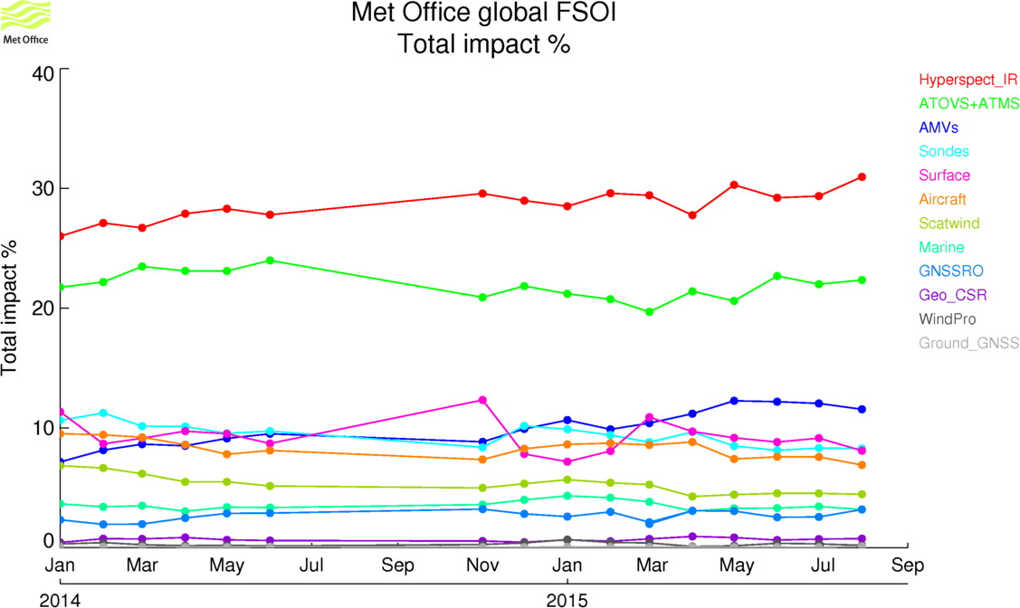
Impact on 24h forecast error (FSOI)
Assimilate LeoGeo and EUMETSAT Metop
Expanded coverage of EUMETSAT Metop
Reintroduce Met-9 low level
GOES hourly data
Contributions to the total observation impact on a moist 24-hour forecast-error energy-norm, surface-150 hPa (James Cotton/UK Met Office)
© Crown copyright Met Office
Notes:
The figure on the left shows the impacts from around the time of the last Winds Workshop in 2012.
The Geo AMVs sit in 8th place on 4.3%, behind the scatterometers.
By mid 2013, the Geo AMVs have jumped up to 5th (6.7%) ahead of Scat, AIRS and SYNOP
AVHRR slightly ahead of MODIS winds due to addition of Metop-B (note: have also since lost Terra WV channel winds)

Slide 18
S-NPP and JPSS Data Products
VIIRS (24)
ALBEDO (SURFACE)
CLOUD BASE HEIGHT
CLOUD COVER/LAYERS
CLOUD EFFECTIVE PART SIZE
CLOUD OPTICAL THICKNESS
CLOUD TOP HEIGHT
CLOUD TOP PRESSURE
CLOUD TOP TEMPERATURE
ICE SURFACE TEMPERATURE
OCEAN COLOR/CHLOROPHYLL
SUSPENDED MATTER
VEGETATION INDEX, FRACTION, HEALTH
AEROSOL OPTICAL THICKNESS
AEROSOL PARTICLE SIZE
ACTIVE FIRES
POLAR WINDS
IMAGERY
SEA ICE CHARACTERIZATION
SNOW COVER
SEA SURFACE TEMPERATURE
LAND SURFACE TEMP
SURFACE TYPE
CrIS/ATMS (3)
ATM VERT MOIST PROFILE
ATM VERT TEMP PROFILE
CARBON (CO2, CH4, CO)
OUTGOING LONGWAVE RADIATION
OMPS (2)
O₃ TOTAL COLUMN
O₃ NADIR PROFILE
SO2 and Aerosol Index
ATMS (11)
CLOUD LIQUID WATER
PRECIPITATION RATE
PRECIPITABLE WATER
LAND SURFACE EMISSIVITY
ICE WATER PATH
LAND SURFACE TEMPERATURE
SEA ICE CONCENTRATION
SNOW COVER
SNOW WATER EQUIVALENT
ATM TEMPERATURE PROFILE
ATM MOISTURE PROFILE
CERES(1)
RDRs
GCOM AMSR-2 (11)
CLOUD LIQUID WATER
PRECIPITATION TYPE/RATE
PRECIPITABLE WATER
SEA SURFACE WINDS SPEED
SOIL MOISTURE
SNOW WATER EQUIVALENT
IMAGERY
SEA ICE CHARACTERIZATION
SNOW COVER/DEPTH
SEA SURFACE TEMPERATURE
SURFACE TYPE
Data available through PDA , CLASS, and Direct Readout

Slide 19
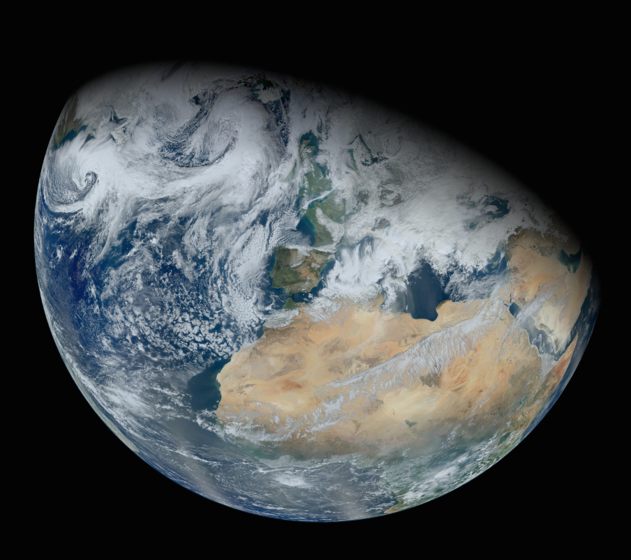


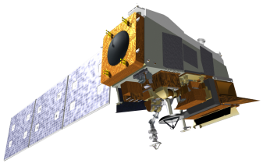
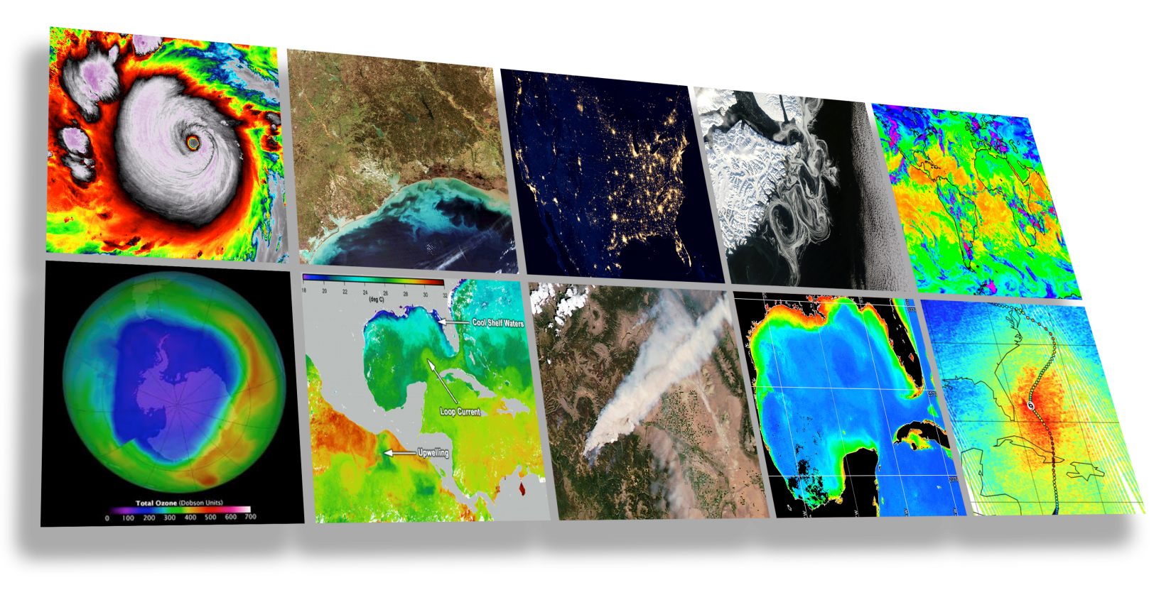
http://satelliteconferences.noaa.gov/2015/doc/presentation/Session%202/2.3b_NSC2015_Session_2.3b_Scott.PDF.pptx
VIIRS Applications
Carven A Scott
Chief, Environmental and Scientific Services Division
NWS Alaska Region
NWS Operational Advisory Team (NOAT), Chair
2015 NOAA Satellite Conference for Direct Readout, GOES/POES, & GOES-R/JPSS Users
April, 2015

Slide 20
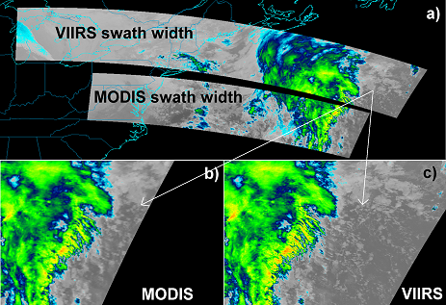
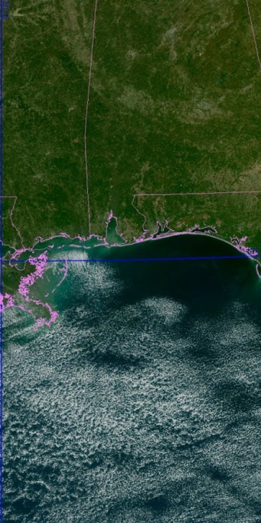
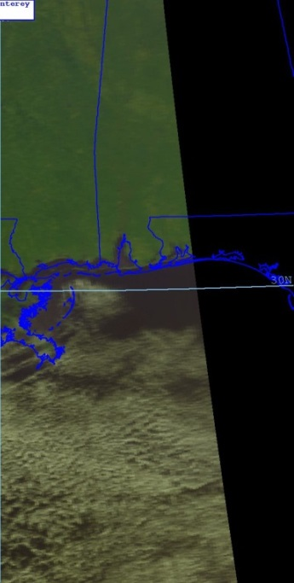
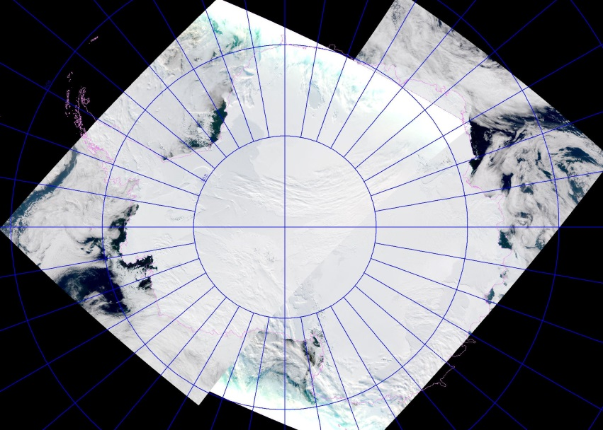
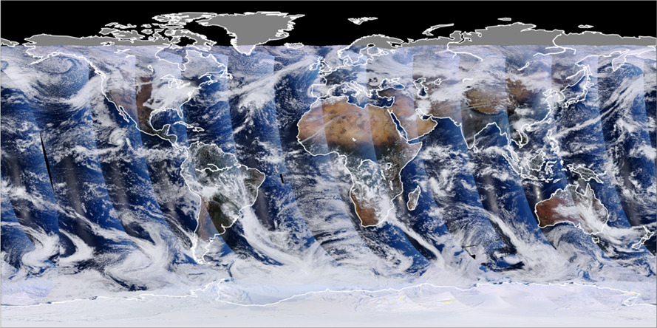
JPSS Next Generation Imager
NPP VIIRS
NOAA-19 AVHRR
The Visible Infrared Imaging Radiometer Suite offers more spectral bands, higher resolution, wider swath and greater accuracy, resulting in a large number of products.
Entire Antarctica observed in 12 hrs.
VIIRS RGB (True Color), 11-22-2011
R: M05 (0.672 µm), G: M04 (0.555 µm), B: M02 (0.445 µm)
Notes:
VIIRS is NOAA’s premier sensor for global environmental assessments.
VIIRS has 22 channels, 5 at 375 m resolution, 17 at 750 m resolution. (Pixel size growth is constrained to no more than twice the nadir value at edge.)
VIIRS has incredible spatial resolution relative to its large swath of 3000 km. Shown here, the entirety of Antarctica is observed from a single instrument in 12 hours. Even though Landsat 8 has 30 m resolution and Radarsat-2 SAR has 100 m resolution, their swath sizes are 185 km and 500 km, respectively, so it takes days to be able to provide the coverage that VIIRS can provide in 12 hours, or even for one pass.
So VIIRS will see features first, such that other satellites can take a closer look when they passes over. The benefits of ice monitoring like this will be discussed later in the presentation.

Slide 21
VIIRS: Next Gen Operational Polar Orbiting Imaging Radiometer
22 spectral bands
  Visible to LWIR
  Spatially registered
Better spatial resolution
  Reduced variation over scan
  Higher resolution imaging bands
High radiometric accuracy
  NIST-traceable
  Supported by on-board calibrators
Day Night Band

Slide 22
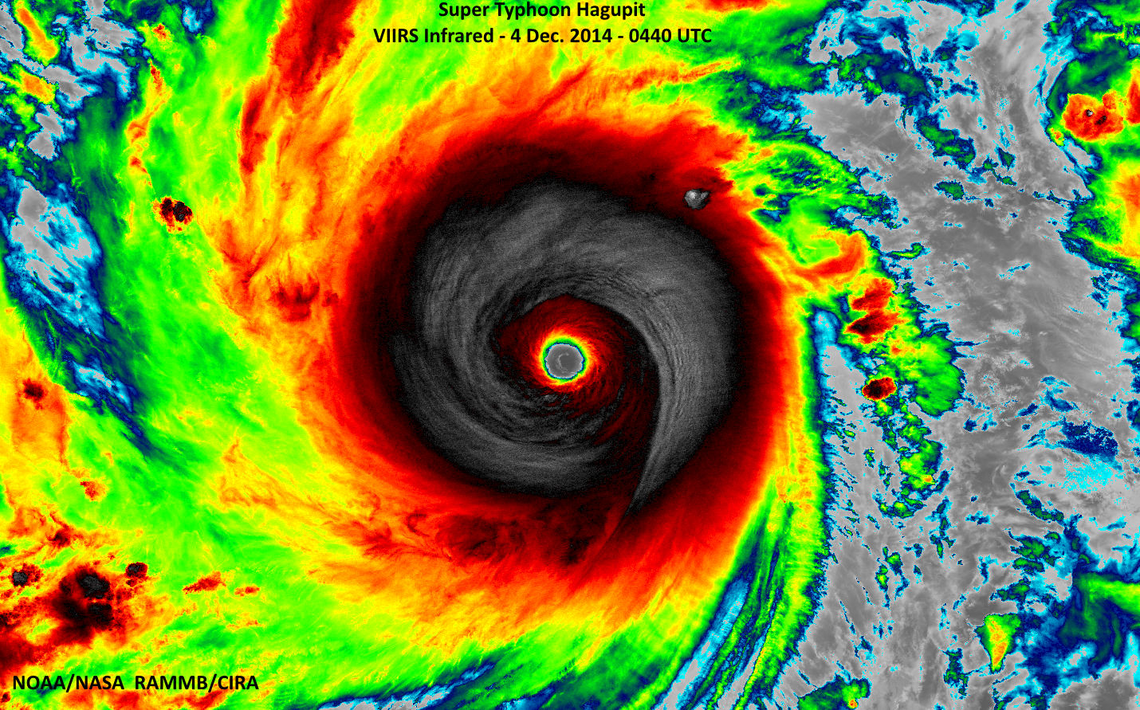
Outstanding imagery
Notes:
VIIRS Imagery of Super Typhoon Hagupit: The Washington Post's Capital Weather Gang featured VIIRS imagery from RAMMB/CIRA in its blog entry: http://www.washingtonpost.com/blogs/capital-weather-gang/wp/2014/12/04/dangerous-super-typhoon-hagupit-on-collision-course-with-philippines/. Below is one of the images they used. (D. Lindsey)

Slide 23
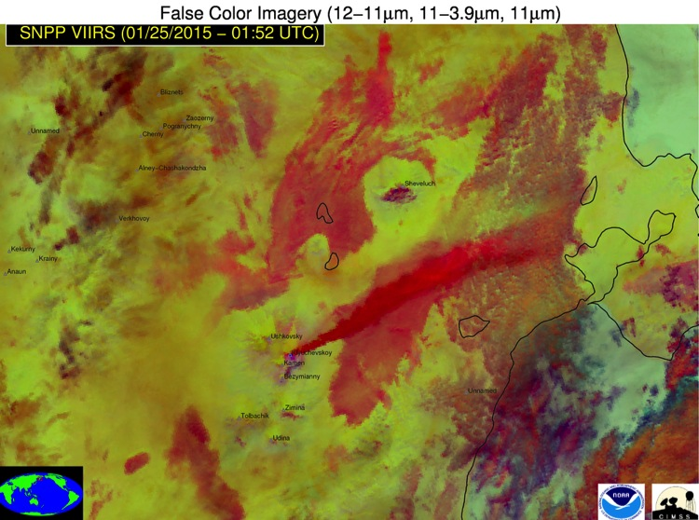
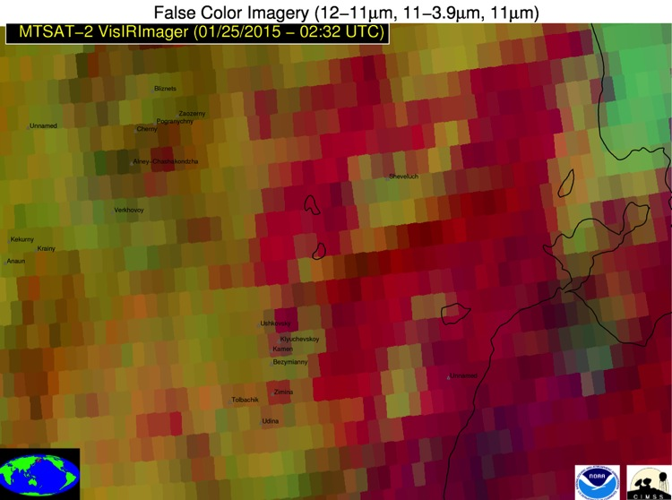
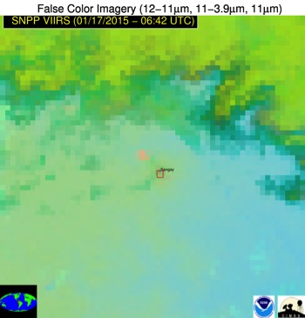
VIIRS is Critical for Mitigating Volcanic Related Aviation Hazards:
Direct and indirect benefits
VIIRS Image
Geostationary Image
VIIRS Image
Volcanic ash
Volcanic ash cannot be confidently identified using geostationary imagery alone
Kamchatka, Russia
Kamchatka, Russia
Direct Benefit: Nearly everyday VIIRS identifies volcanic activity that is not unambiguously identifiable using any other meteorological satellite sensor.
Indirect Benefit: The VIIRS images are used to identify subtle volcanic ash cloud features from geostationary imagery, thereby allowing the clouds to be tracked in time.
Recently, VIIRS was the first space sensor to detect renewed activity at Sangay Volcano in Ecuador (lava and ash emissions)
PI: Mike Pavolonis, NESDIS Center for SaTellite Applications and Research (STAR)

Slide 24
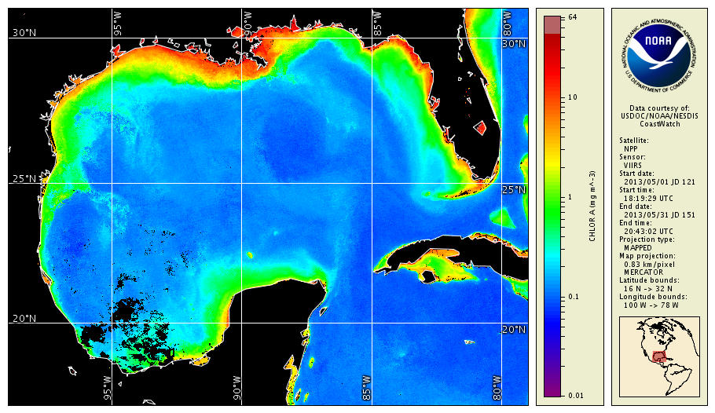
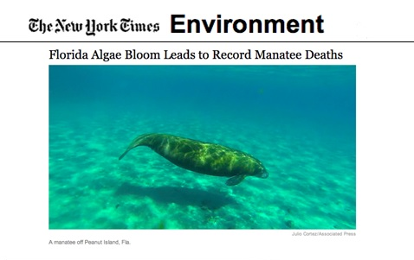
VIIRS Ocean Color is used by NOAA to monitor health of ocean, coastal and large lake ecosystems
Credit: NOAA Coastwatch
April 6, 2013
The state’s annual red tide affects a wide range of aquatic animals and can cause problems in people. The algae contain a nerve poison known as brevetoxin that is not only found underwater but that is also blown through the air when waves break open the algae’s outer casing.
Manatees, birds, dolphins and other animals can be killed by consuming the poison, either by accidentally eating the algae or by ingesting small organisms clinging to sea grass that have soaked up the poison while filtering seawater.
Residents and tourists regularly have respiratory problems after inhaling brevetoxins while strolling on beaches near red tides. People can also become ill after eating oysters and clams that have absorbed the toxin.
Notes:
About 50% of the oxygen we breathe comes from the ocean, where algae not only release oxygen during photosynthesis, but also serve as the base of most oceanic food webs.
Since satellites can measure the different wavelengths of light that are absorbed by the planet surface and reflected back into space, NOAA scientists can use that data to calculate how much green pigment associated with the algae is contained in the surface waters.
NOAA has monitored ocean color since 1997, with VIIRS now being the primary instrument for this measure. This data has been instrumental in understanding global productivity, carbon cycling, fisheries habitats, and biochemical oceanography.
The algae bloom known as the “red tide” occurs almost annually along Florida’s coast. These Harmful Algal Blooms contains nerve poison known as brevetoxin. These blooms can cause severe disruptions in fisheries, because humans can become seriously ill from eating shellfish contaminated the toxin. The blooms can potentially cause eye and respiratory irritation to beachgoers, boaters and coastal residents. By monitoring the red tide, NOAA satellites support public health.

Slide 25
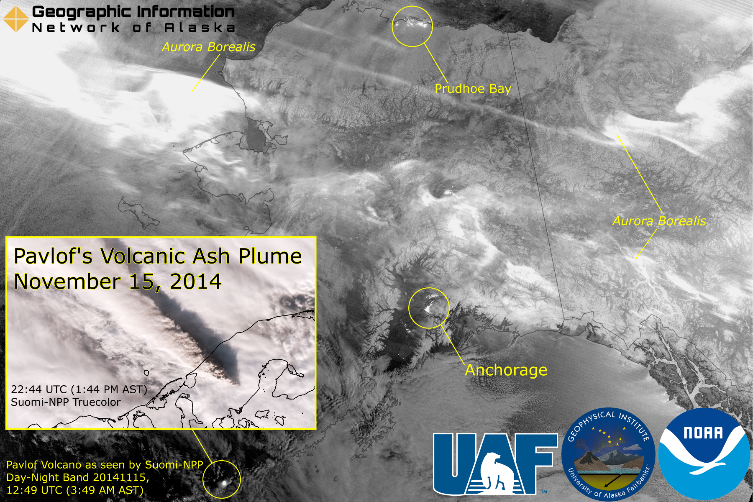
Day-Night Band

Slide 26
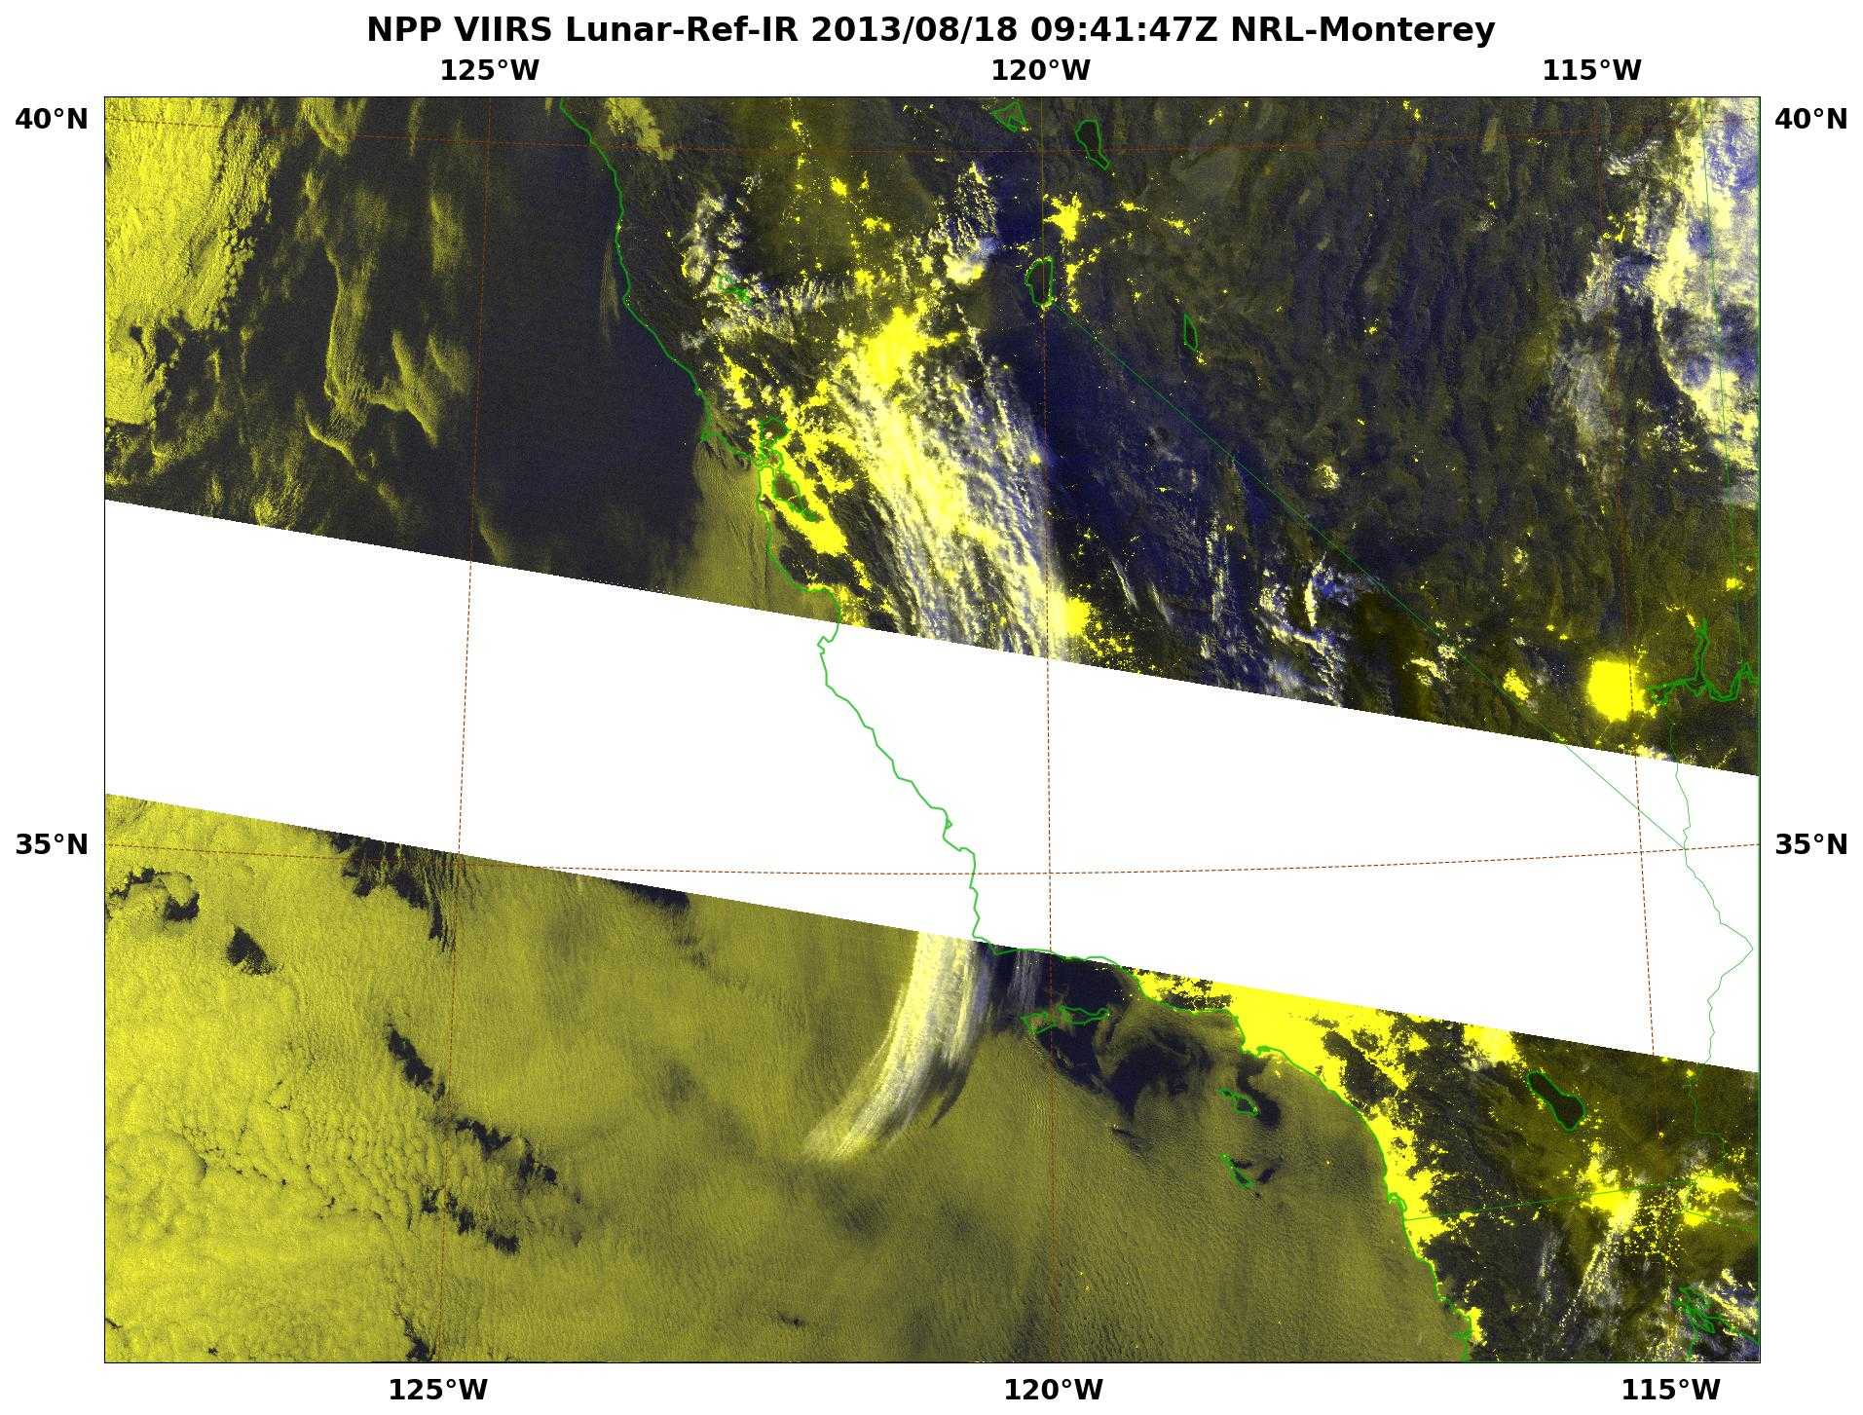
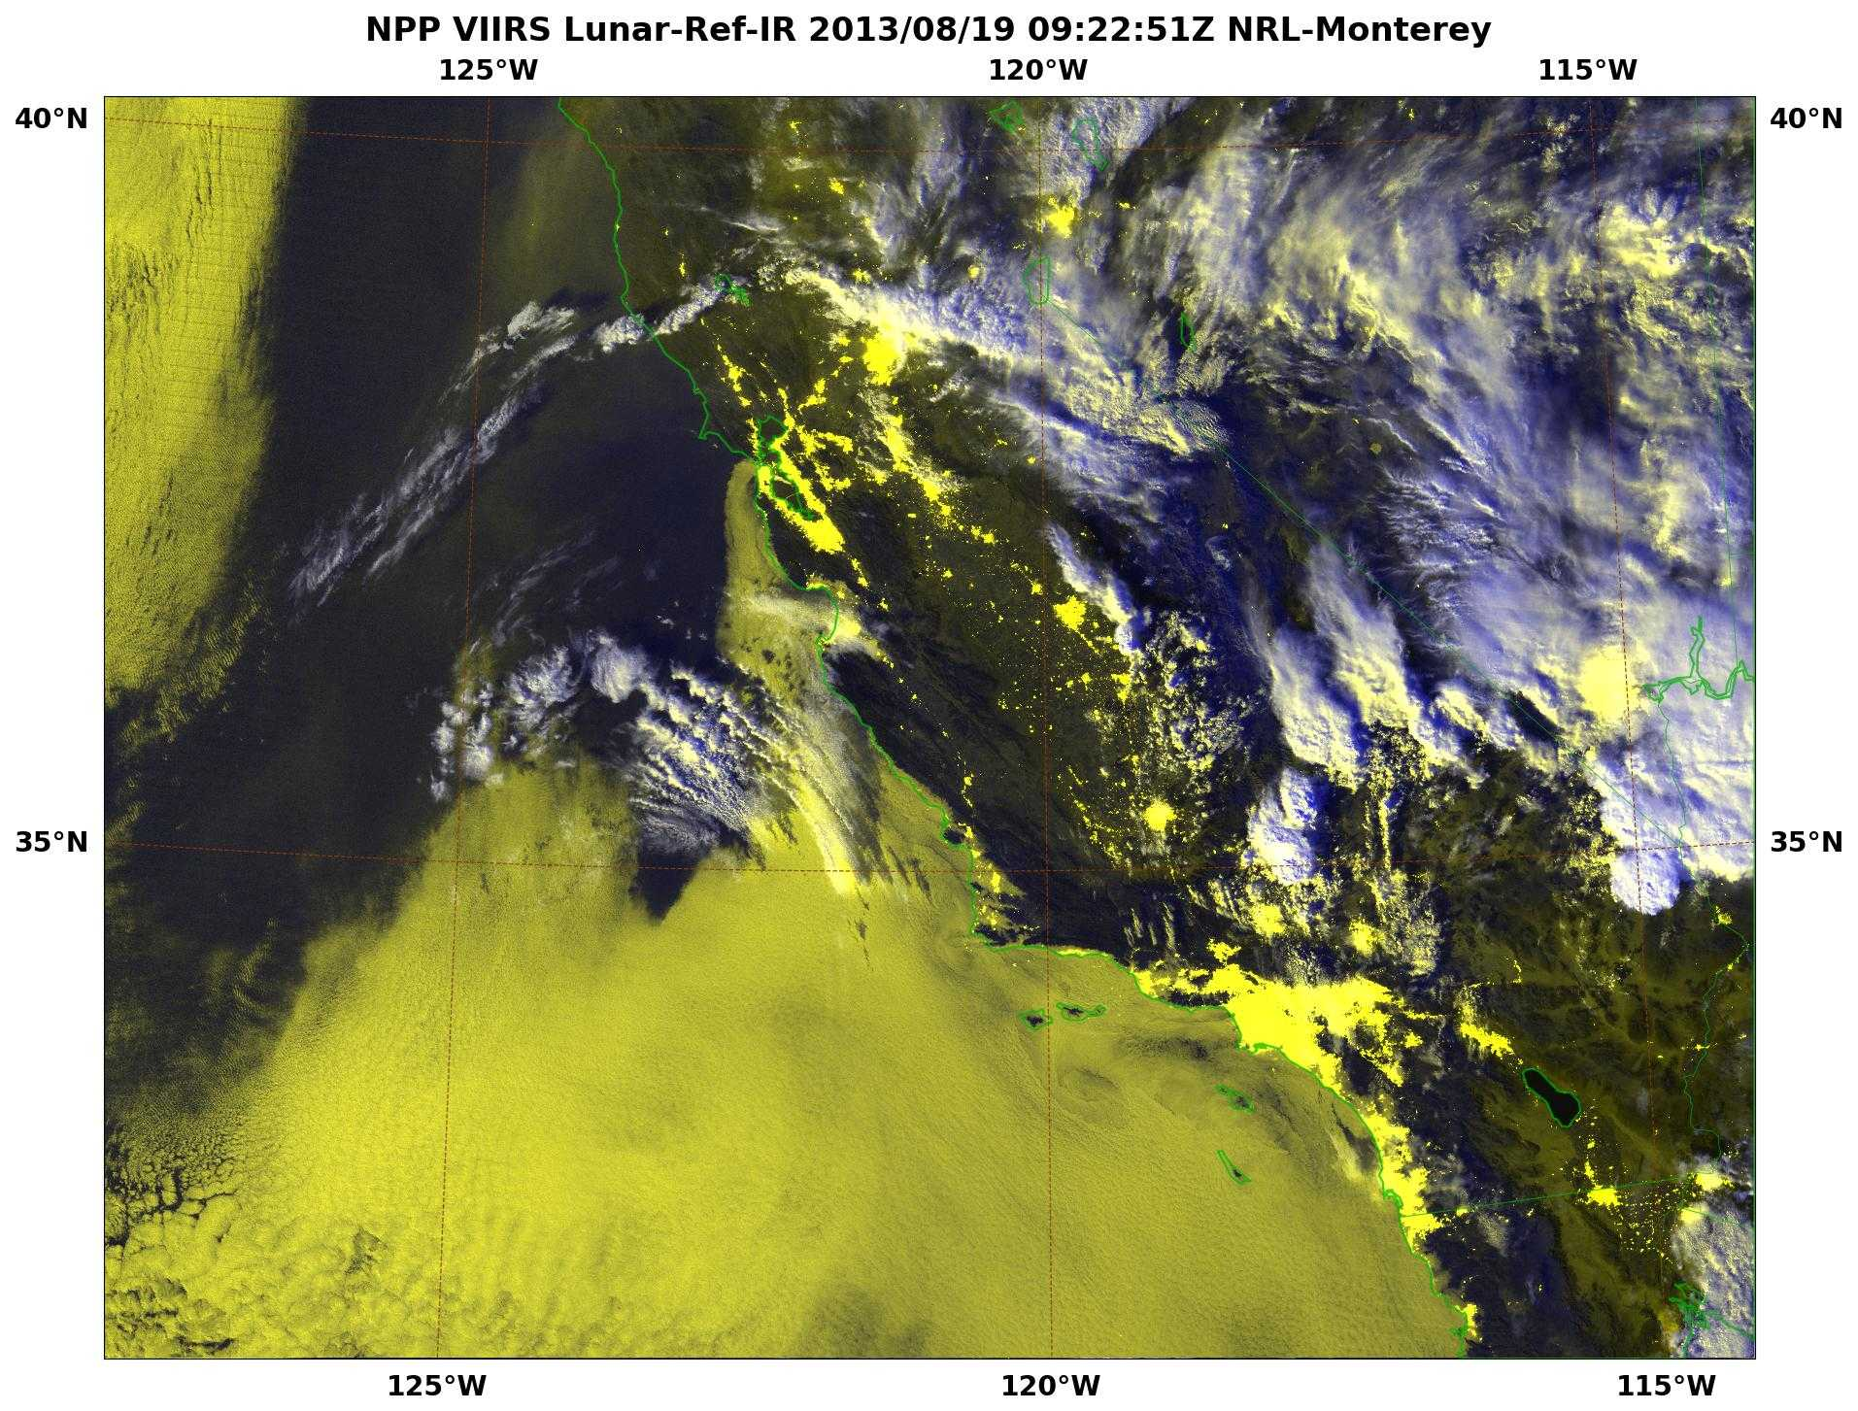
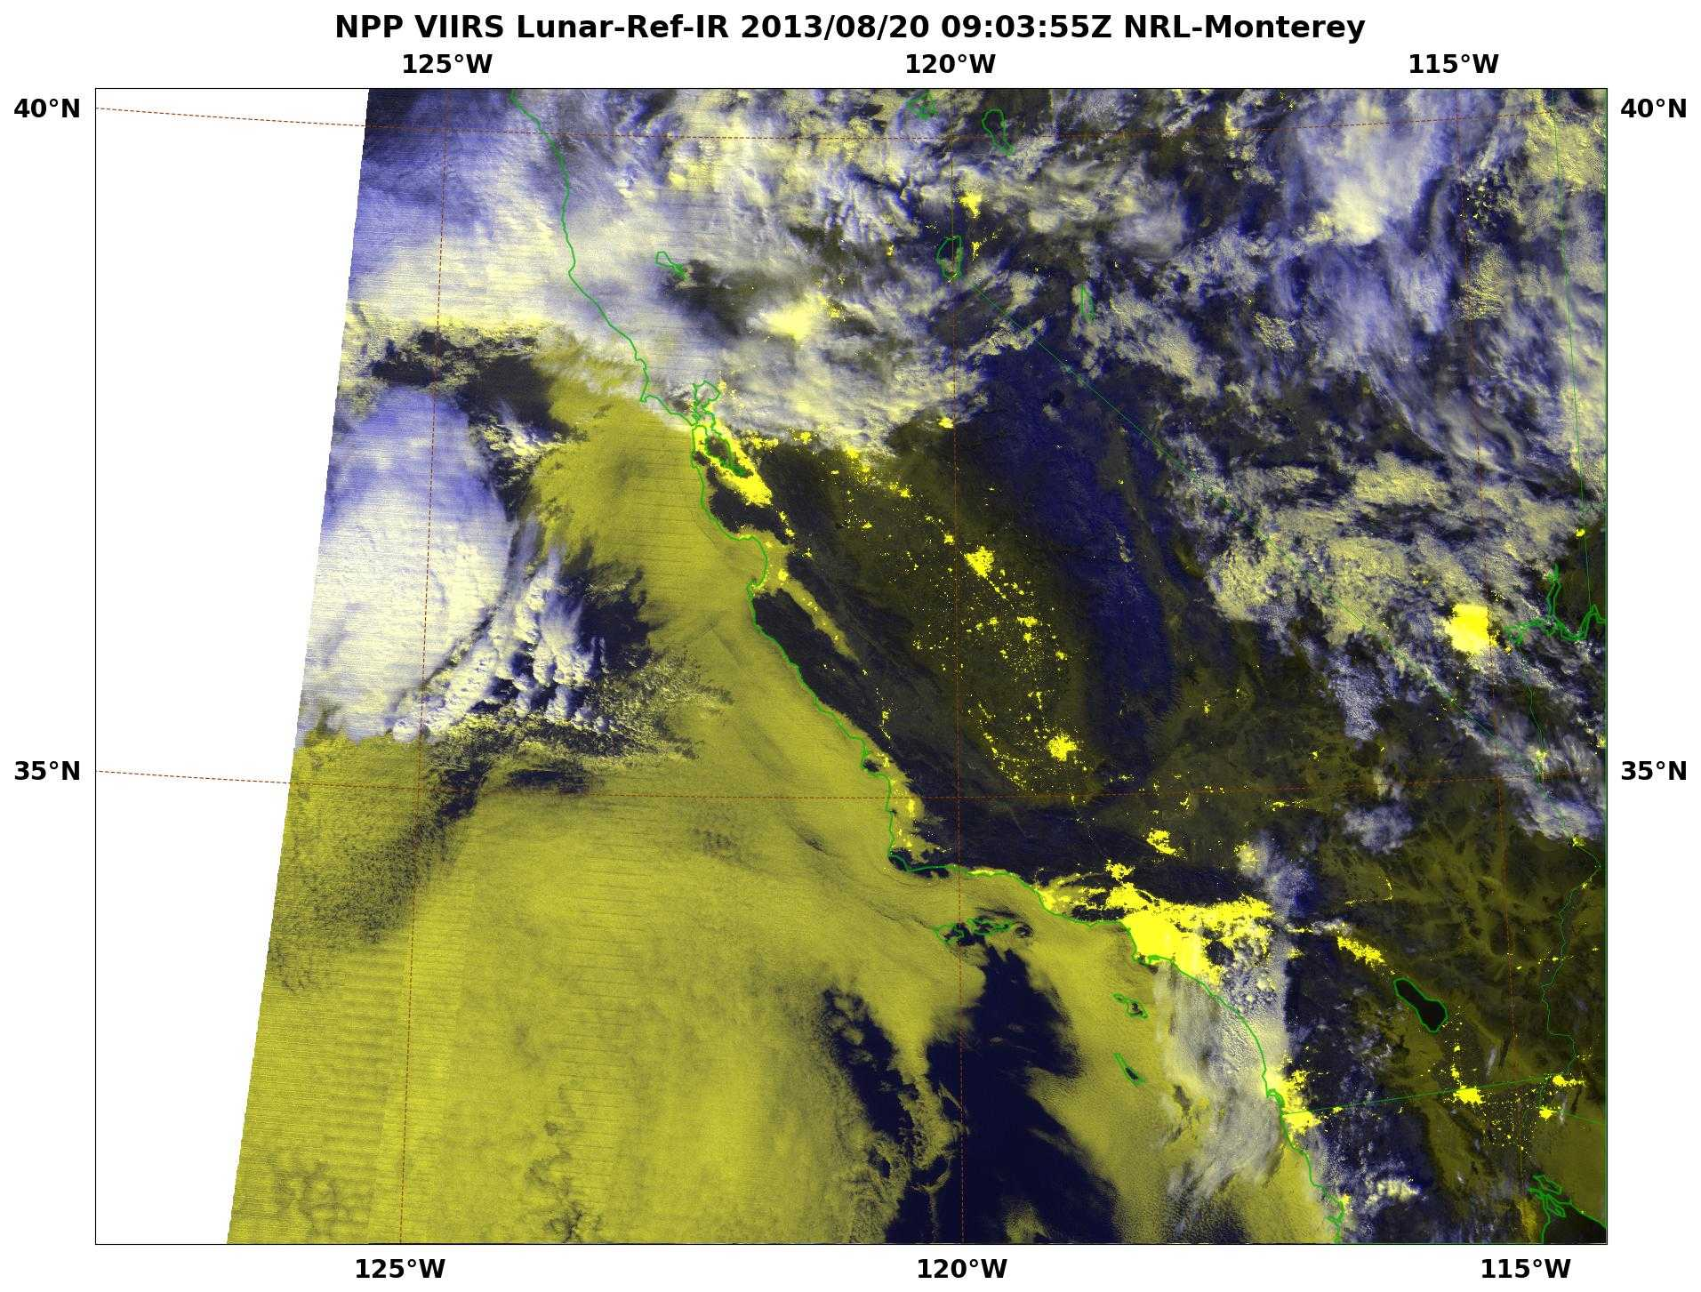
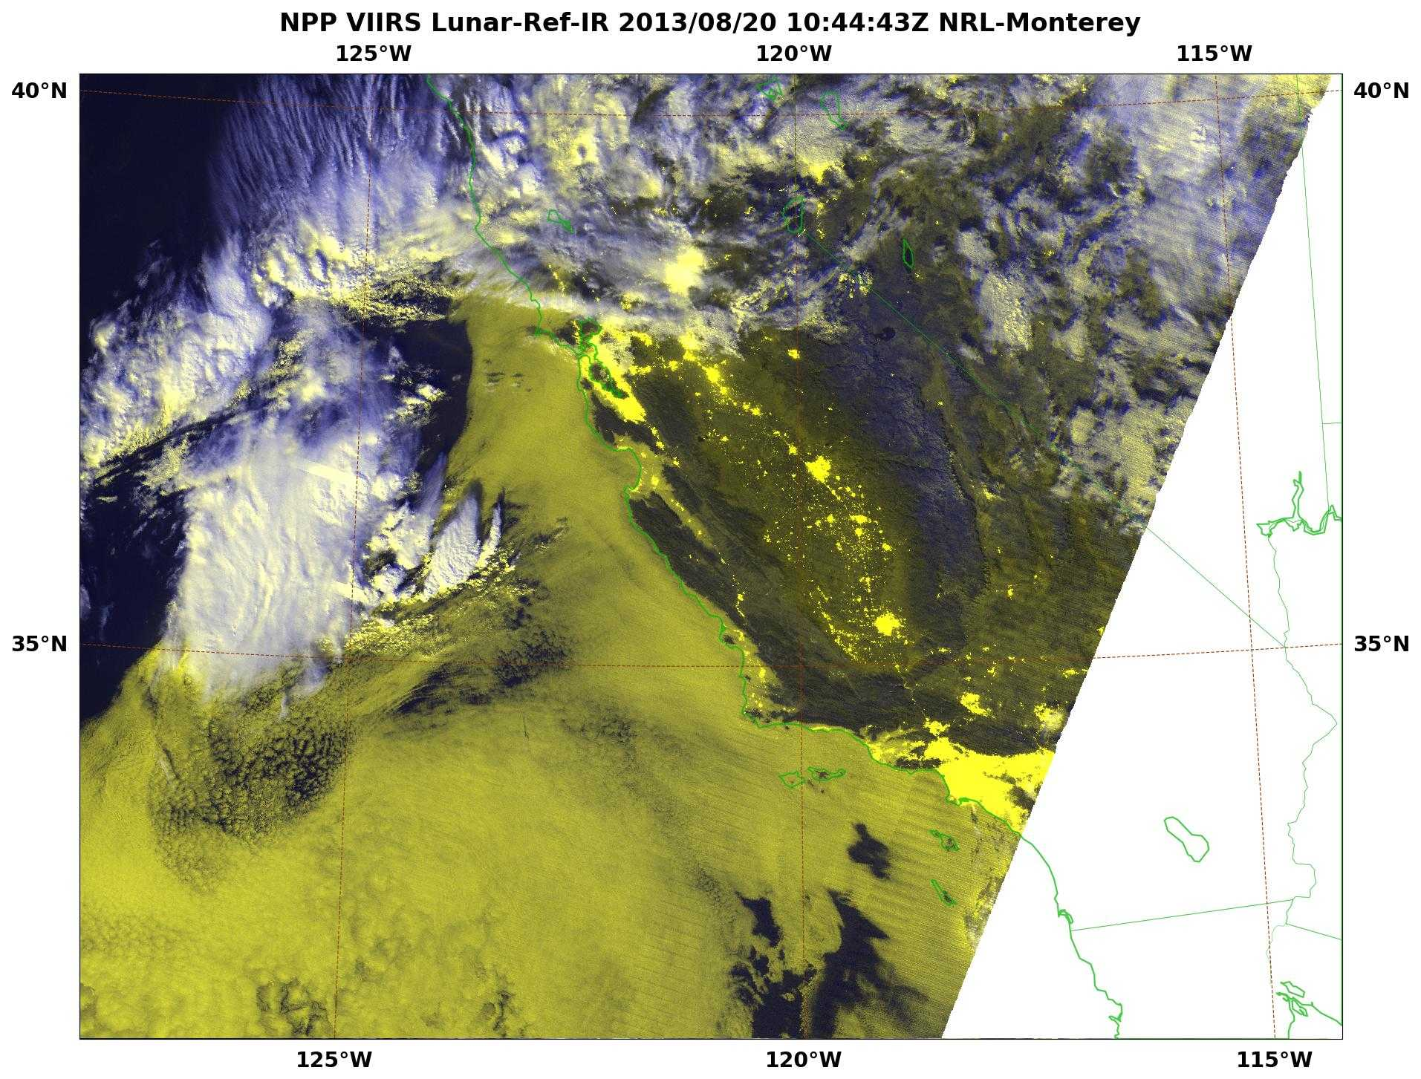
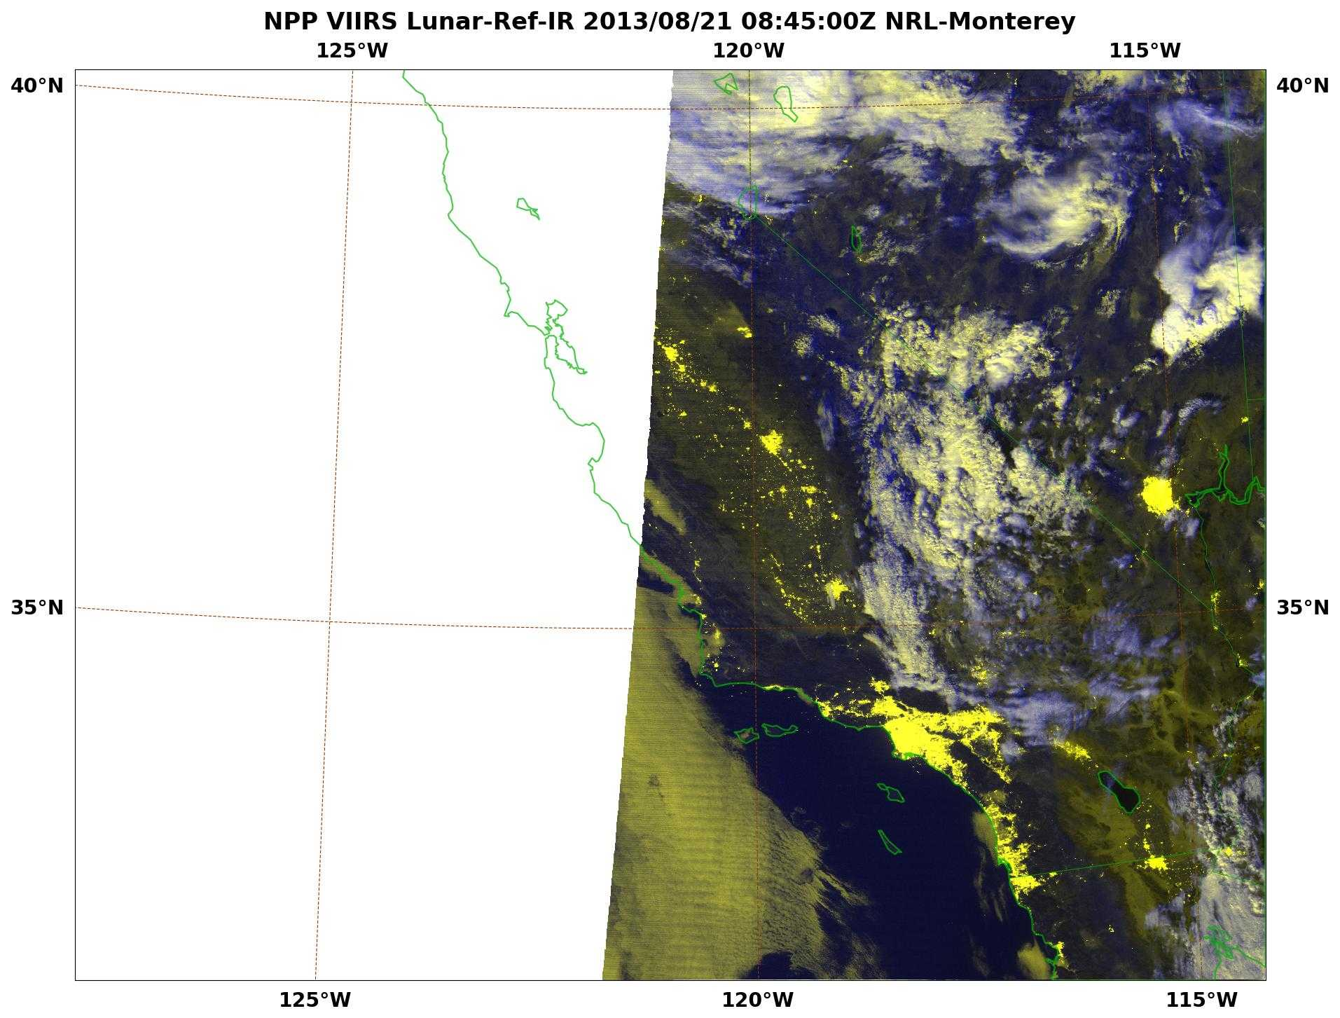
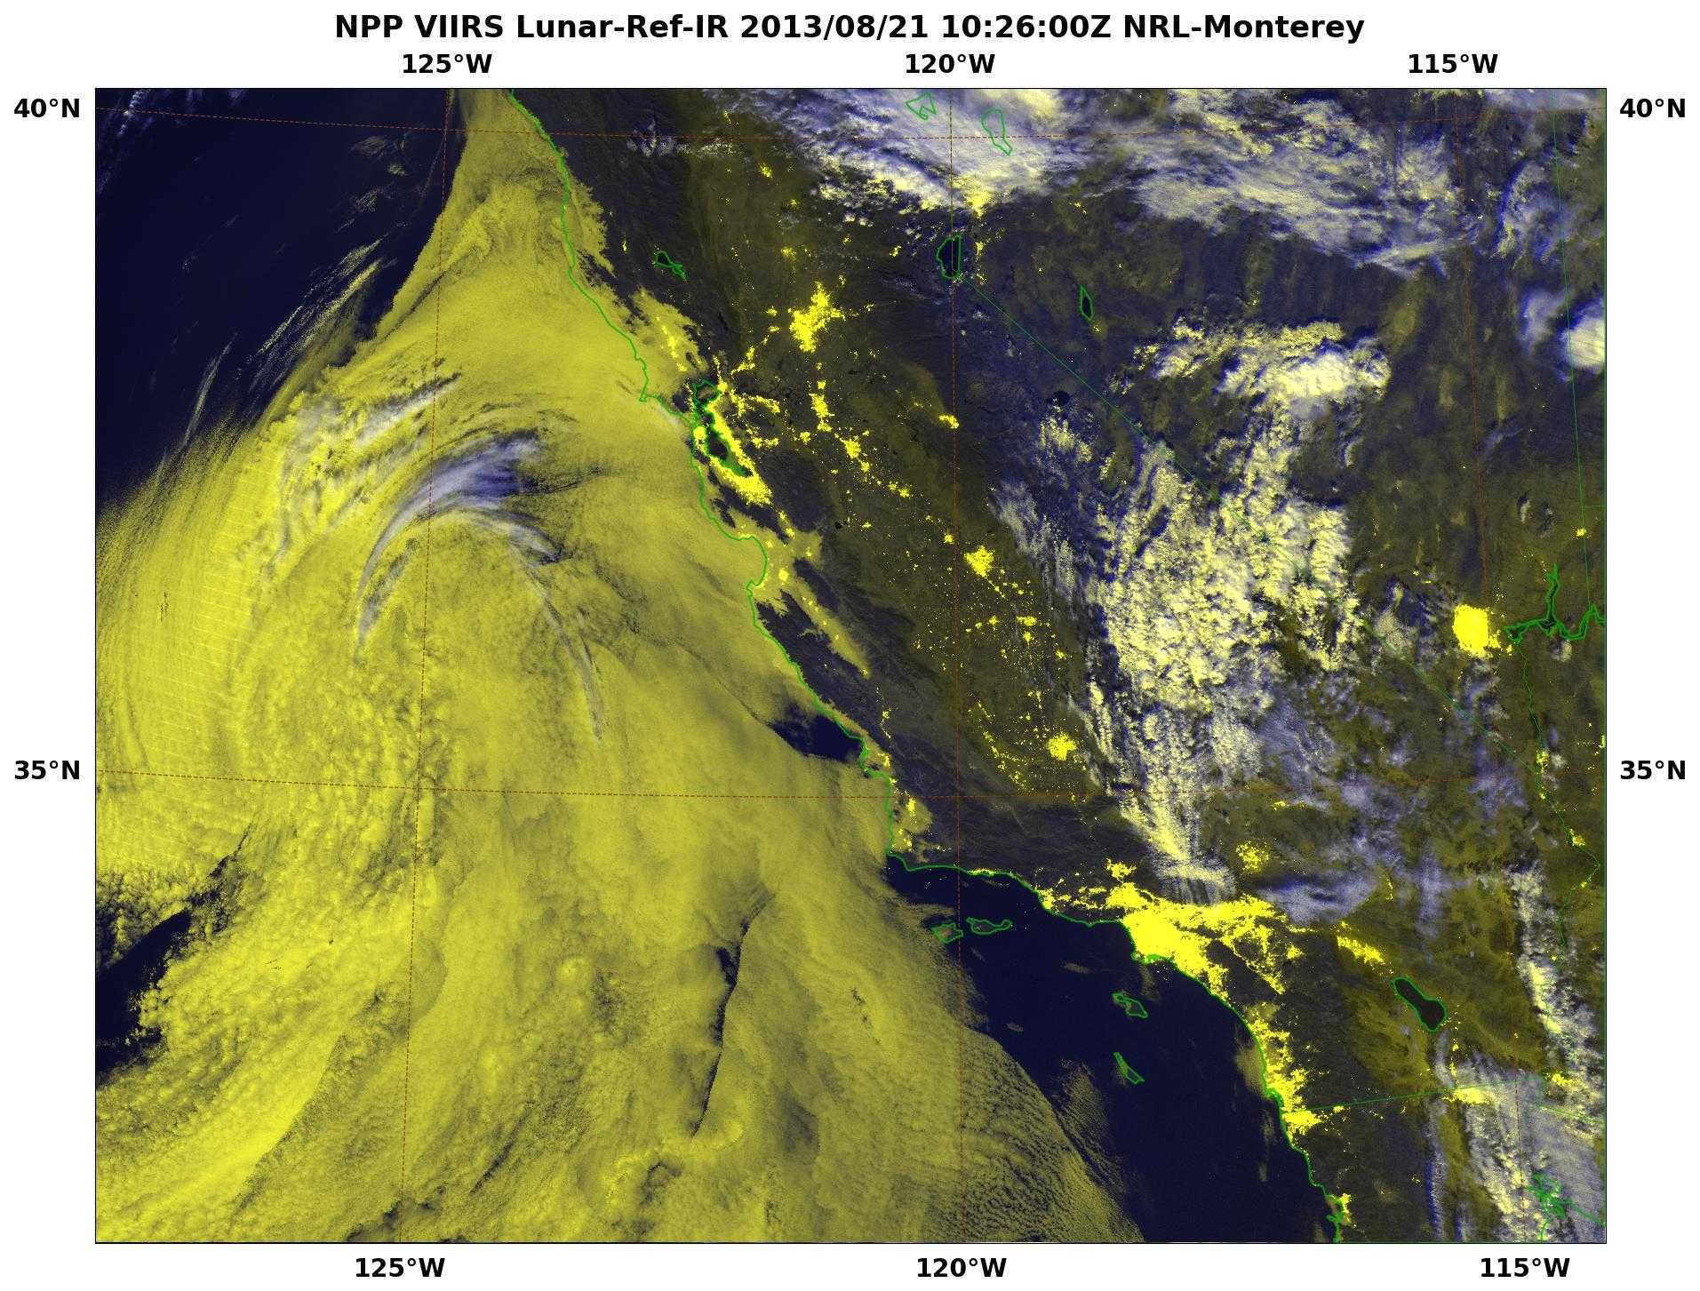
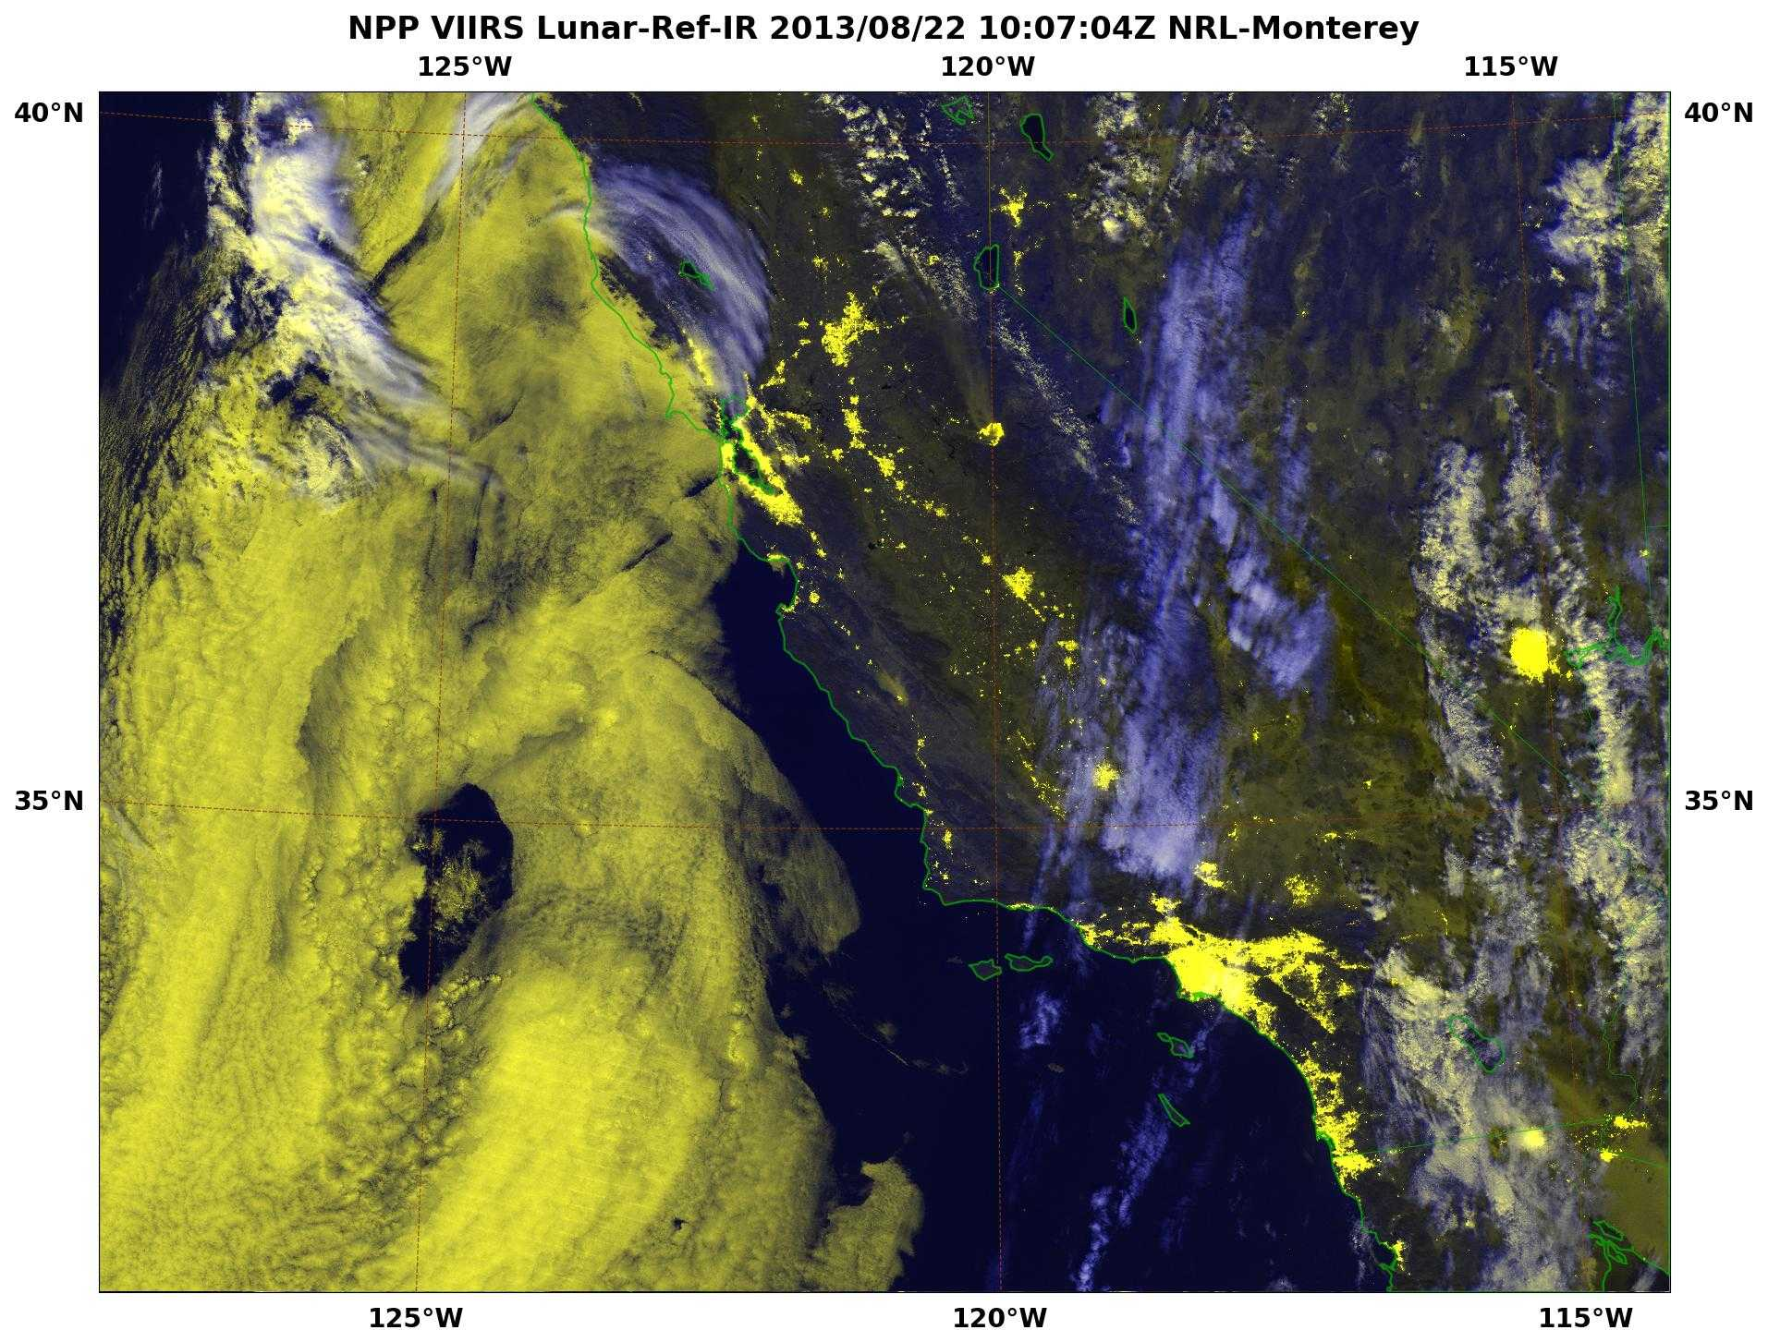
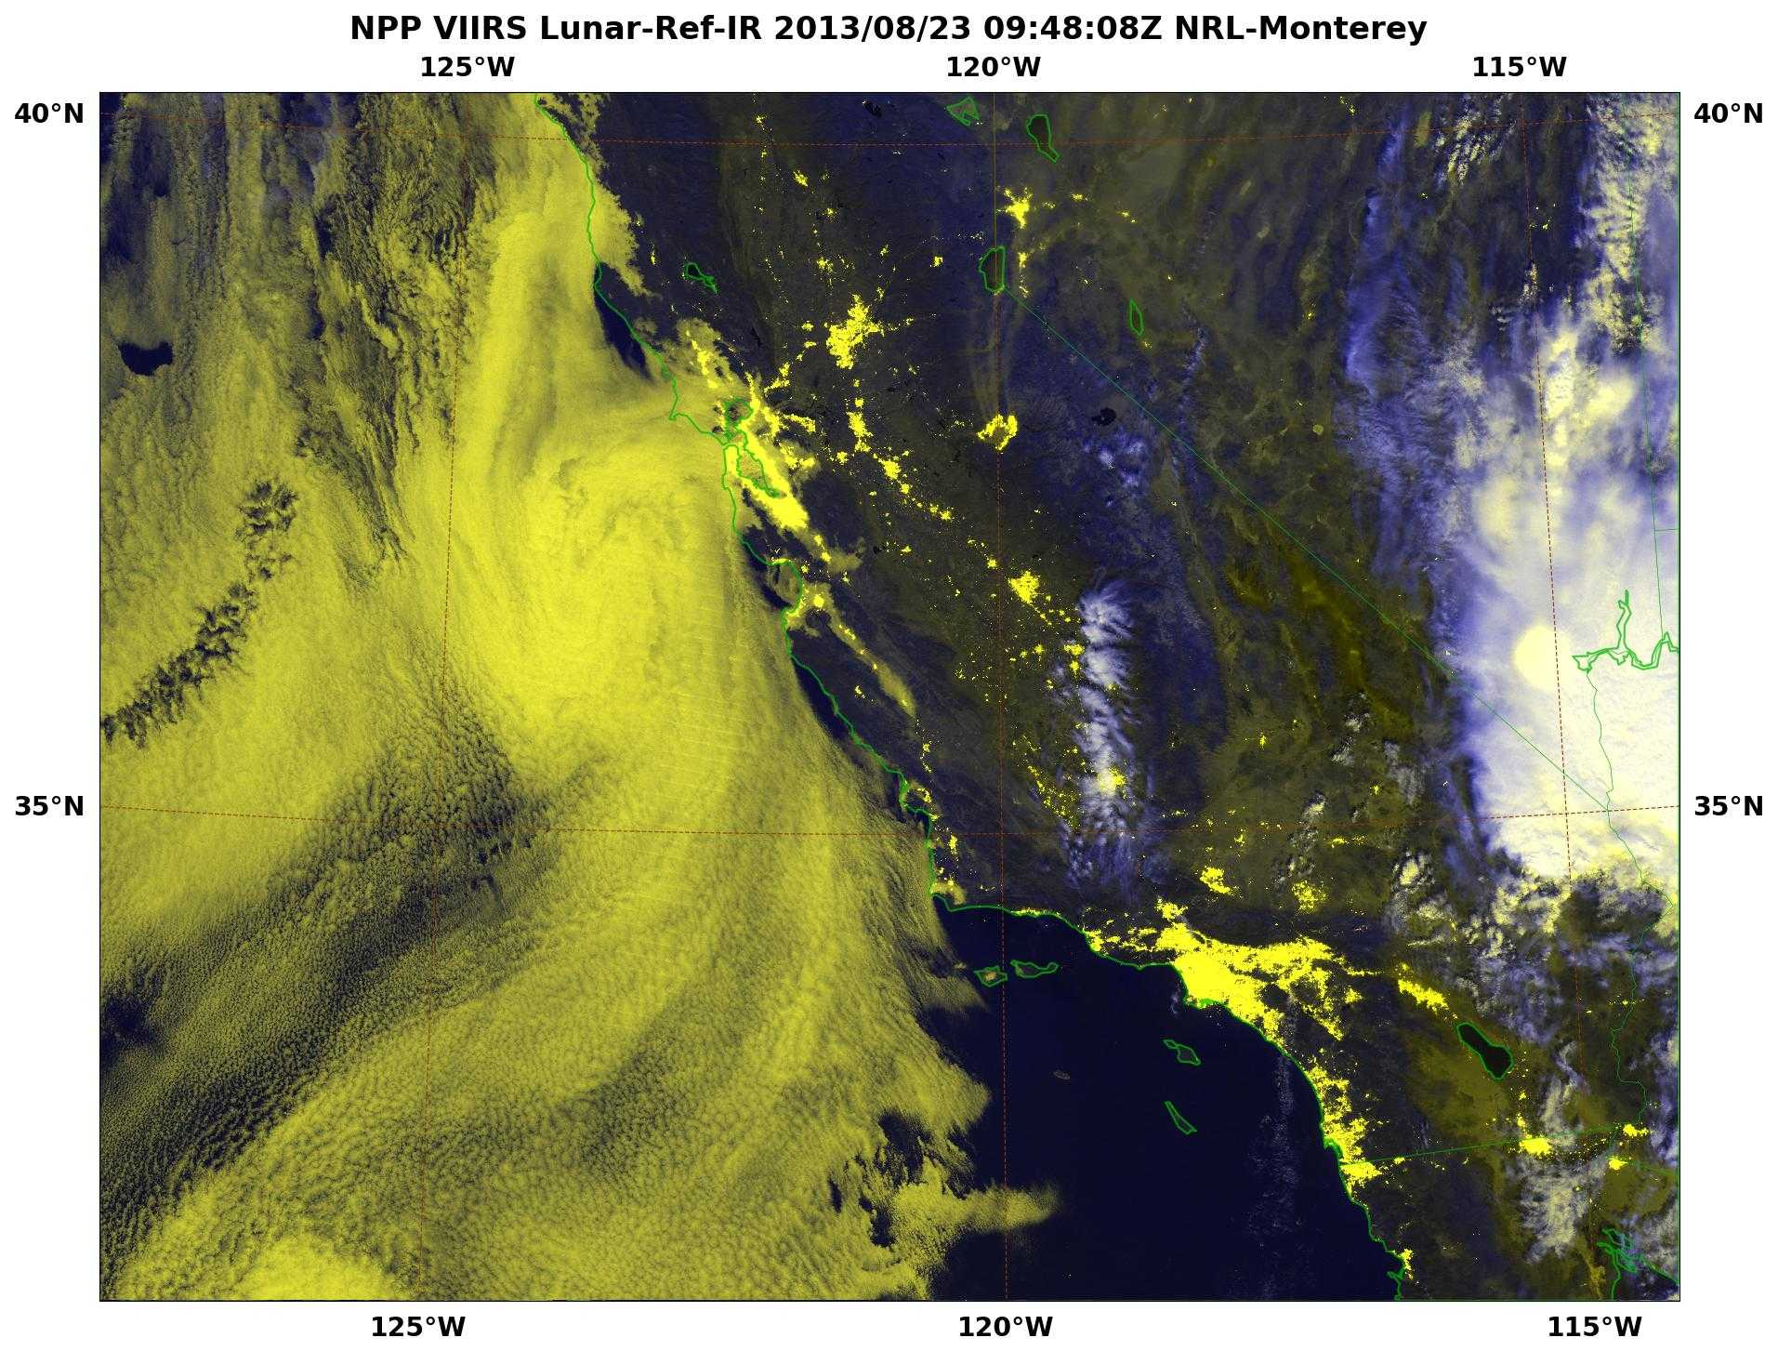




Tracking the Rim Fire at Night
VIIRS DNB + IR enhanced with Lunar Irradiance Model
18 – 27 August, 2013
Rim
Fire
Notes:
The S-NPP VIIRS DNB Imager allows for unprecedented views of hot spots illumination such as wildfires. This animation (denoted by the red arrow) shows the dramatic increase in areal coverage since its onset.
Additionally, with lunar availability, smoke can be seen drifting northward from the source.
The Naval Research Laboratory in Monterey, CA (NRL-MRY) has been monitoring the massive Rim Fire that has entered the Yosemite National Forest. The following images Using products hosted on the NexSat and NRL-VIIRS webpages, the NexSat hosts VIIRS products. Many of the scenes for this presentation are obtained from products hosted within our west coast imagery.
Acknowledgments: Naval Research Laboratory, Marine Meteorology Division
Tom Lee, Jeremy Solbrig, Kim Richardson, Mindy Surratt, Arunas Kuciauskas, Rich Bankert, Jeff Hawkins, Steve Miller (CIRA), and John Kent (SAIC)
VIIRS data is provided by FNMOC via AFWA and CIMSS Peate via NOAA CLASS.

Slide 27



VIIRS Smoke Detection-“Funny River” Fire
20 and 21, May 2014
JPSS Smoke Algorithm
.64 micron Channel

Slide 28

VIIRS Night-time visible routinely used for dense fog advisories
The National Weather Service Forecast Office in Monterey, California
Currently employs the VIIRS DNB to provide higher confidence for issuing marine dense fog advisories

Slide 29


Slide 30



VIIRS provides global vegetation monitoring and enables drought assessments
Green vegetation fraction
Vegetation Fraction
Drought Risk
(note: US has record corn yield in 2014)
Notes:
30

Slide 31


Real-time Monitoring and Short-term Forecasting of Fall Foliage from VIIRS

Slide 32
US SNPP to JPSS (1/2/3/4…)
Now to 2040’s
SNPP, JPSS 1/2 – well into 2030’s
JPSS 3/4 – 2030’s to 2040’s
Sounding sensors
  Improving NWP forecast accuracy
  Nowcasting/Nearcasting
Imaging sensors
  Various Atmospheric, Oceanic and Land applications
Direct Readout/Broadcast – lowest possible latency
DR/DB Processing Packages are to be continued to support CrIS, ATMS, VIIRS through out the period

