Slide 1
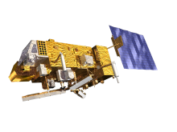
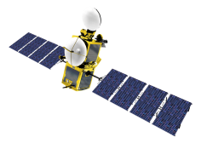
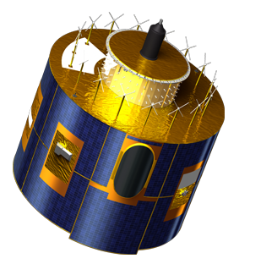
EUMETSAT satellites
METOP-B (98.7° incl.)
METOP-A (98.7° incl.)
JASON-2 (66° incl.)
JASON-3
EUMETSAT POLAR SYSTEM
EUMETSAT POLAR SYSTEM
OCEAN SURFACE TOPOGRAPHY
OCEAN SURFACE TOPOGRAPHY
In orbit at 817 km altitude, the primary operational satellite of the EUMETSAT Polar System (EPS).
In nominal mid-morning sun synchronous orbit at 817km altitude ,as part of the EUMETSAT Polar System (EPS) .
In nominal non-synchronous low Earth orbit at 1,336km altitude, in support of the Ocean Surface Topography Mission.
Same orbit as JASON-2. Flying 80 seconds behind JASON-2 during commissioning for cal purposes
METOP-B
METOP-A
JASON-2
SENTINEL-3A
METEOSAT-10 (0°)
METEOSAT-9 (9.5° E)
ALTIMETRY, SEA SURFACE AND OCEAN COLOR
METEOSAT FULL DISC IMAGERY
RAPID SCANNING SERVICE (RSS)
Positioned at 0° supporting the prime Meteosat full disc imagery service over the European continent, Africa and parts of the Atlantic and Indian oceans.
Provides the Rapid Scanning Service (RSS) delivering more frequent images every five minutes over parts of Europe, Africa and the adjacent seas.
In nominal mid-morning sun synchronous orbit at 814 km altitude, 98.6° inc
METEOSAT-8 (3.5° E)
METEOSAT-7 (57.5°E)
BACKUP SERVICE
INDIAN OCEAN DATA COVERAGE
Serves as a back-up to both the Meteosat-9 and -10 spacecraft for full disc imagery and rapid scanning.
Operated in support of the Indian Ocean Data Coverage (IODC) mission, bridging an observational gap in this region.
METEOSAT-10
METEOSAT-9
METEOSAT-8
Commissioning Phase

Slide 2
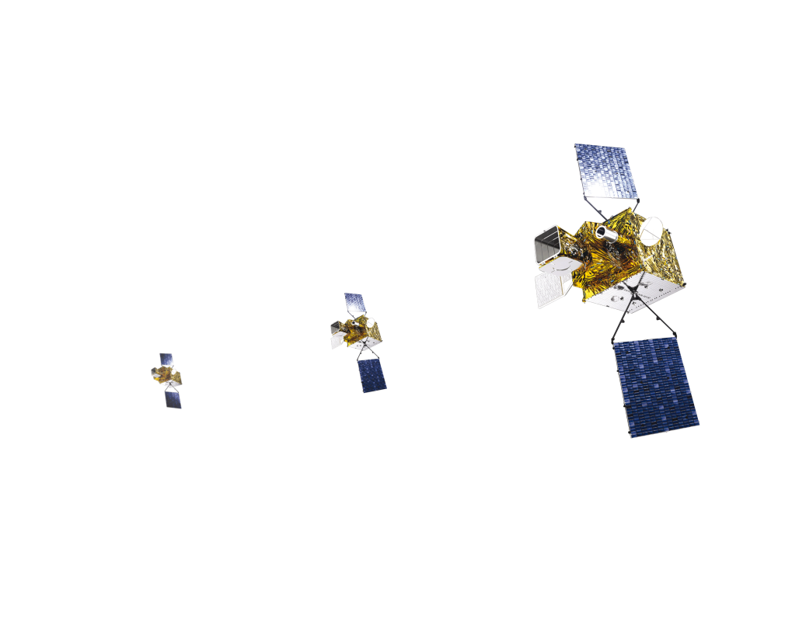
Meteosat Third Generation - MTG-I and MTG-S Geostationary Orbit
Imagery mission implemented by a two-satellite MTG-I system:
Full disc imagery every 10 minutes in 16 spectral bands
Fast imaging of European weather every 2.5 minutes
new Lightning Imager (LI)
Hyperspectral infrared (IRS) sounding mission implemented by MTG-S :
3D mapping of water vapour, temperature, O3 every 1 hour
Air quality monitoring and atmospheric chemistry in synergy with GMES Sentinel-4 Ultraviolet Visible
Launching from 2020

Slide 3
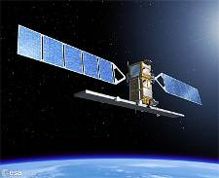
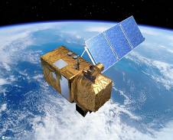
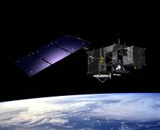
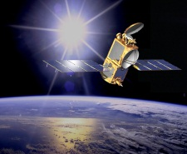
Copernicus Space Component Six Families of Sentinel Satellites/Instruments
Sentinel-1 Satellites EDRS
Radar imaging all weather, day/night applications
Sentinel-2 Satellites EDRS
Optical imaging land applications: urban, forest, agriculture
Sentinel-3 Satellites
Sentinel-6 Satellites (Jason CS)
Ocean and global land monitoring, high precision ocean altimetry
Sentinel-4 Instruments (onboard MTG - geostationary)
Sentinel-5 Instruments (onboard Metop SG - polar orbit) DB
Atmosphere composition monitoring
EDRS: ESA Data Relay Satellite, DB: Direct Broadcast
Notes:
A custom-built, comprehensive, cutting-edge Earth Observation system, that puts EU in class of its own
Satellites and types of images are mutually reinforcing, idem for space- and in-situ data.
A key difference between different Sentinels is their orbits, allowing for different types of observations and revisit times of an inidividual spot on the globe.

Slide 4
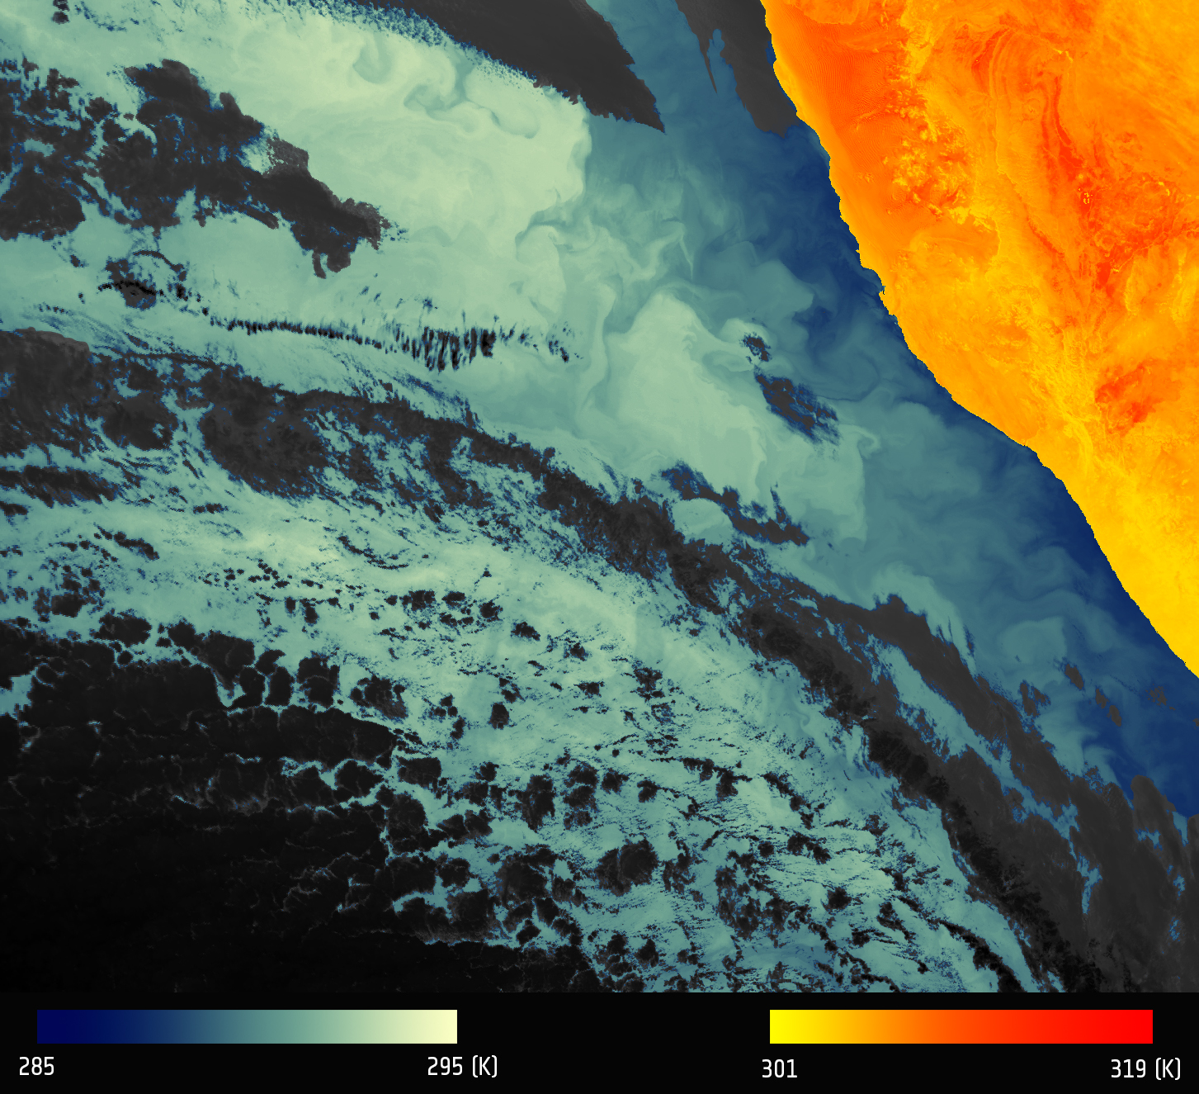
Sea Surface Temperature by Sentinel-3A (SLSTR)
First image
06 April 2016
SLSTR (Sea and Land Surface Temperature) measuring energy radiating from the Earth’s surface in nine spectral bands.
The first image came from its optical channel
The Namibian land surface is shown in red–orange colors, corresponding to a temperature range 301–319 K. The blue colors over the ocean correspond to a temperature range of 285–295 K. The black areas correspond to clouds, which are opaque to thermal-infrared radiation and so prevent a view of the ocean or land surface.
Sea surface temperature data is used as input for weather and ocean forecasting, to observe and monitor ocean current systems and ocean fronts, eddies, upwelling areas, marine ecosystems and the development of large scale El Niño/La Niña events.
Notes:
Sentinel-3A was launch on February 16 2016

Slide 5
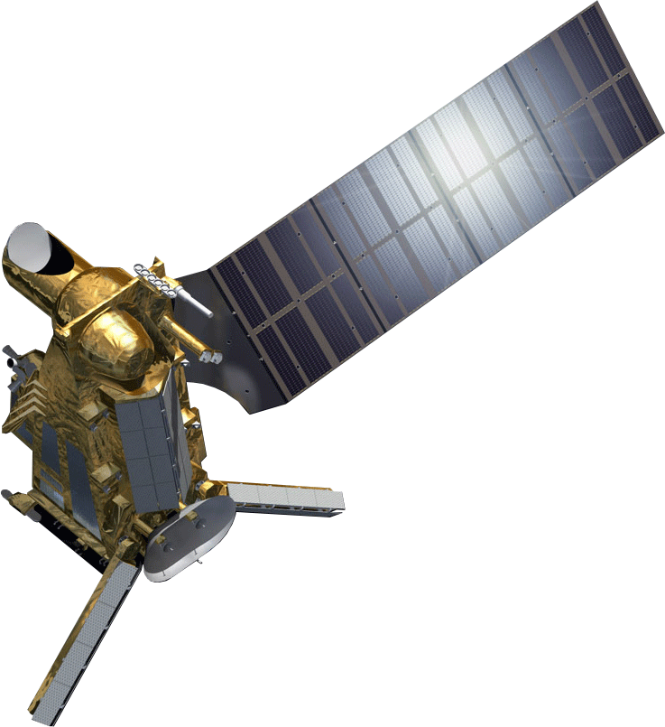
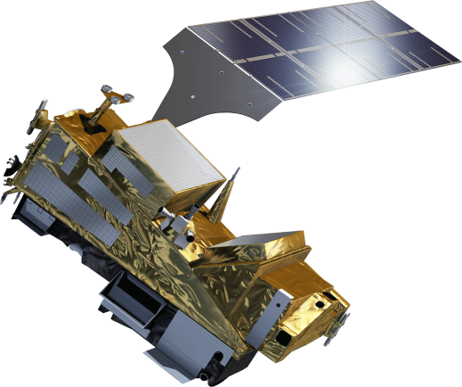
Metop Second Generation - the Missions
Primary mission: further improvement of observational inputs to Numerical Weather Prediction models
Significant improvements of other applications
Nowcasting at high latitudes
Marine meteorology and operational oceanography
Operational hydrology
Air quality monitoring
Climate monitoring

Slide 6
Metop Second Generation - the Satellites
Two-satellite system in polar orbit:
Metop-SG A: optical imagery and sounding mission
Metop-SG B: microwave imaging mission
Launching from 2021

Slide 7
EPS-SG Direct Broadcast Key Parameters
Characteristic | NPP/JPSS-1 | EPS-SG
Reception Station Performance Requirement, G/T | 22.7 dB/K | 22.7 dB/K
Typical Resulting Antenna Size | 2.4 m | 2.4 m
Data Rate (Instrument Data) | 16 Mb/s | 80 Mb/s
Radio Frequency | 7.8 GHz | 7.8 GHz
Modulation Scheme | QPSK | Offset QPSK
Polarisation | RHCP | RHCP
The parameter G/T is the main driver for the Reception Station Performance Requirements. For EPS-SG, the plan is to match the NPP requirement;
The G/T depends on the full chain of equipment including antenna dish quality and size, antenna tracking performance, feed, LNA, cabling, etc;
With good quality equipment, the required G/T can be achieved with a 2.4m antenna dish. To add additional margins for severe weather conditions and to mitigate potential local RF interference, a larger dish size may be chosen.

Slide 8
EPS-SG Products Processing Software
EUMETSAT and partners responsible for implementation of L1/L2 processing software used at EUMETSAT Headquarters in Darmstadt to generate EPS-SG mission products in NRT.
L1 software for selected EPS-SG instruments later on adapted by the EUMETSAT SAFs (including NWP SAF) for execution in local mission context / provision to local user.
To support future use in local mission context, design drivers for L1 software development:
Highly modular design
Clear separation between common libraries, COTS and algorithms
Portability to multiple computing platforms (HW/OS)
Testing on commonly available platform (x86/64bits Linux kernel)

Slide 9
Metop-SG Observation missions
Mission | Instrument | Predecessor on Metop
Hyper-spectral Infrared Sounding | IASI-NG | IASI
Visible/Infra-red Imaging | METimage | AVHRR
Microwave Sounding | MWS | AMSU-A, MHS
Radio Occultation Sounding | RO | GRAS
Scatterometry | SCA | ASCAT
Nadir viewing UV/VIS/NIR/SWIR Sounding | Sentinel-5 | GOME-2
Multi-viewing, -channel, -polarisation Imaging | 3MI | New
Microwave Imaging | MWI | New
Ice Cloud Imaging | ICI | New

Slide 10
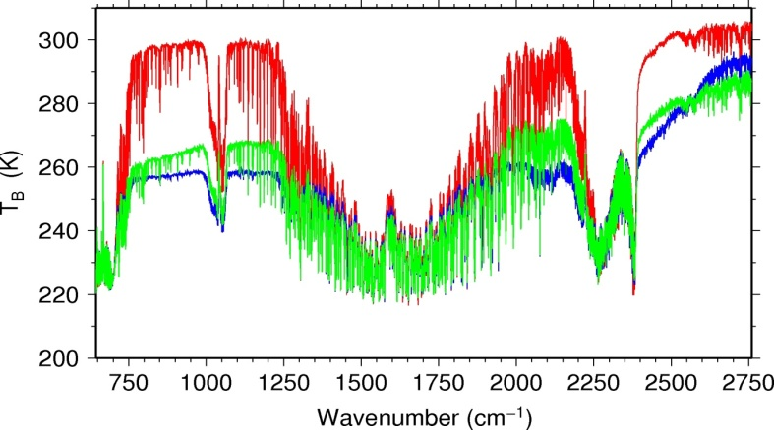
Hyper-spectral infrared sounding: IASI-NG
Objectives
Temperature/humidity profile at high vertical resolution
Clouds, trace gases (O₃, CO, CH₄, CO₂,...)
Sea/land/ice surface temperature
Aerosols, Volcanic Ash
Implementation
Development of Fourier Transform Spectrometer IASI-NG by CNES
Key performances
spectral range: 645 – 2760 cm⁻¹
spectral resolution: 0.25 cm⁻¹
radiometric calibration: 0.25 K
stability: 0.1 K
radiometric noise: 0.045 – 1.1 K
pixel size: 12 km
spatial sampling: 25 km
cross-track scan
Breakthrough
Doubling of radiometric and spectral resolution of IASI for the benefit of weather forecast and atmospheric composition
75% more information in temperature profiling, particularly PBL
30 % more information in water vapour profiling
Quantification of trace gases which are currently only detected
Vertical resolution of trace gases instead of columnar amounts only

Slide 11
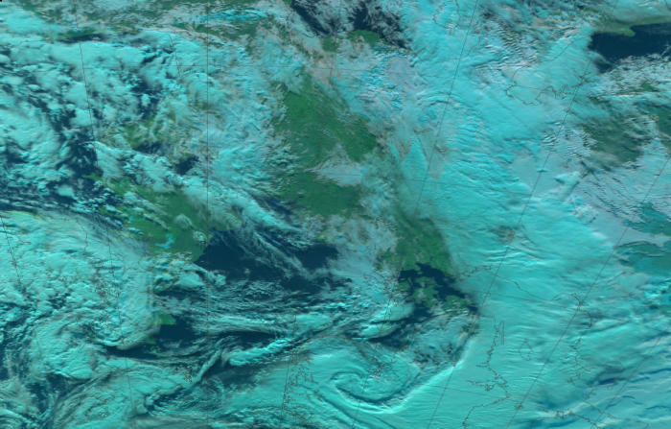
Optical imaging: METimage
Objectives
Hi-res cloud products, incl. microphysics
Aerosols
Polar AMVs
Vegetation, snow, fire
Sea/ice/land surface temperature
Support to sounding missions
Implementation
Development of METimage by DLR
Key performances
20 channels: 0.443 – 13.345 µm
absolute calibration:
5% (short-wave)
0.5 K (long-wave)
radiometric sensitivity:
SNR 60 – 500 (short-wave)
0.05 – 0.2 K (long-wave)
spatial sampling: 500 m
cross-track scan
Breakthrough
Far more spectral channels than AVHRR for the benefit of measuring more variables
Higher spatial sampling (500 m):
more complete coverage through greater likelihood to measure surface variables in partly cloud conditions
Better radiometric resolution for more accurate quantification of many variables

Slide 12
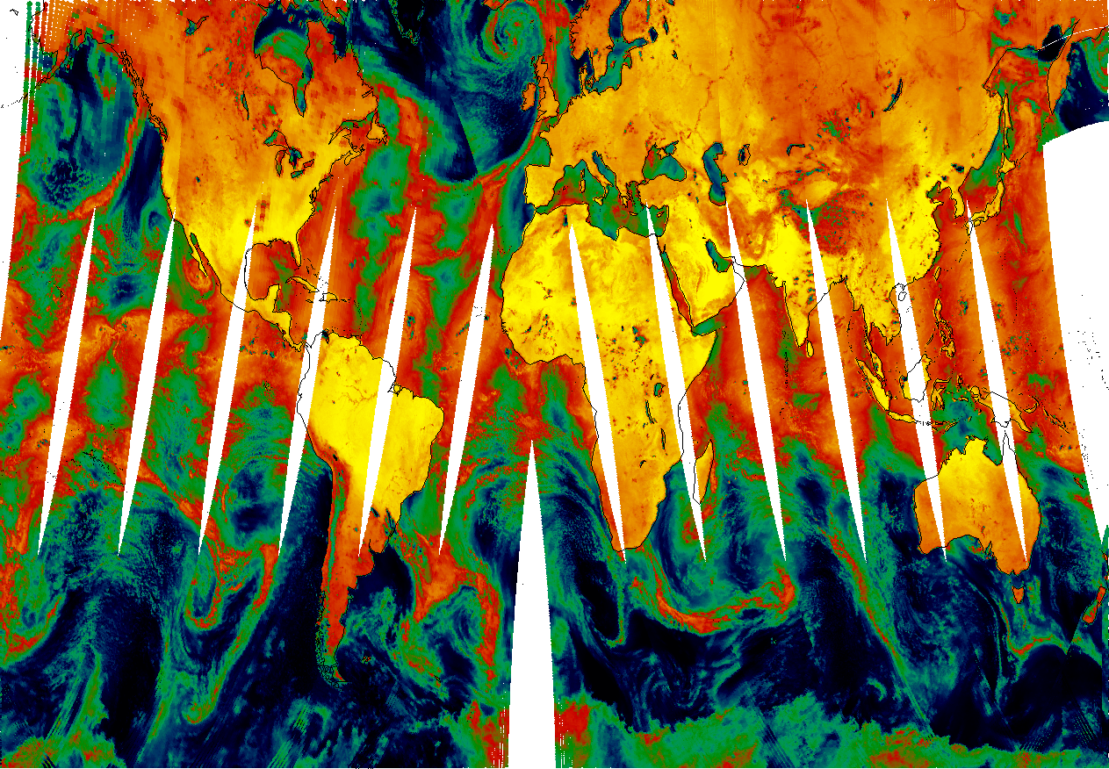
Microwave sounding: MWS
Objectives
Temperature/humidity profiles in clear and cloudy air
Cloud liquid water total column
Imagery: precipitation
Implementation
ESA development
Key performances
24 channels: 23.8 – 229 GHz
absolute calibration: 0.5 K
radiometric noise: 0.2 – 1.6 K
footprint size: 17 – 40 km
cross-track scan
Breakthrough
Addition of a quasi-window channel at 229 GHz (recommended by ITSC-11)
Cirrus cloud information giving a better humidity retrieval performance
Addition of sounding channels
+ 2 channels at 53-54 GHz
+ 2 channels at 183.31 GHz
More information on temperature and water vapour profiles

Slide 13
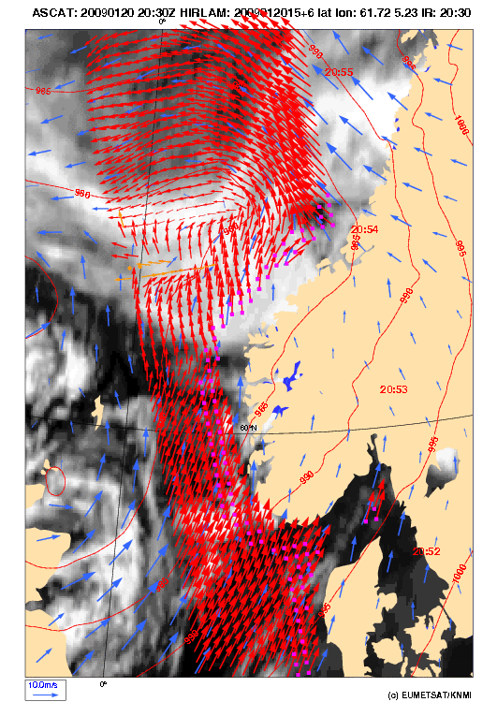
Scatterometry: SCA
Objectives
ocean surface wind vectors
soil moisture
snow equivalent water
sea-ice type
Implementation
ESA development
Key performances
C-band carrier frequency
VV + VH polarisation
measurement range: 4 – 40 m/s
Radiometric resolution: 3%
spatial resolution: 25 km
dual swath: 550 km each
Breakthrough
Increase of spatial resolution to 25 km
Better approach of coast lines
Increase of swath width to >1100 km
Enhanced coverage
Addition of VH polarisation
Covers higher wind speeds without saturation, will benefit observation of tropical and extra-tropical storms

Slide 14
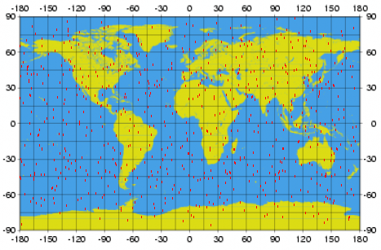
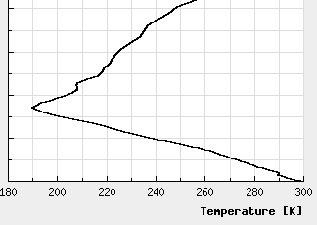
Radio occultation sounding: RO
Objectives
Refractivity profiles at high vert. resolution
Temperature / humidity profiles
PBL top and tropopause height
Ionospheric electron content
Implementation
ESA development
Key performances
tracking of GPS and Galileo satellites
optional: GLONASS and COMPASS
RO on two satellites: > 2600 occultations per day
bending angle accuracy: 0.5 µrad or 0.2%
Breakthrough
Tracking of GPS and Galileo satellites to double the number of occultation measurements, optionally also GLONASS and Beidou
Equipment of both Metop-SG satellites with RO

Slide 15
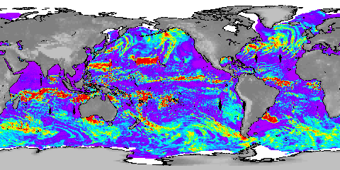
Microwave imaging: MWI
Objectives of a new mission
precipitation and cloud products
water vapour profiles and imagery
sea-ice, snow, sea surface wind
Implementation
ESA development
Key performances
18 channels: 18.7 – 183 GHz
dual polarisation (V, H) up to 89 GHz
V polarisation at higher frequencies
radiometric accuracy: 1 K
radiometric sensitivity: 0.6 – 1.2 K
Footprint size: 10 – 50 km
spatial sampling: 7 km
conical scan
RSS (2011)
Cloud Liquid Column
mm
Breakthrough: 18 channels
Continuity of key microwave imager channels for weather forecast
Inclusion of dedicated sounding channels (118.75 GHz)
Enhanced precipitation measurements through inclusion of dedicated sounding channels
Extended suite of 183.31 GHz channels
water-vapour and cloud profiling

Slide 16
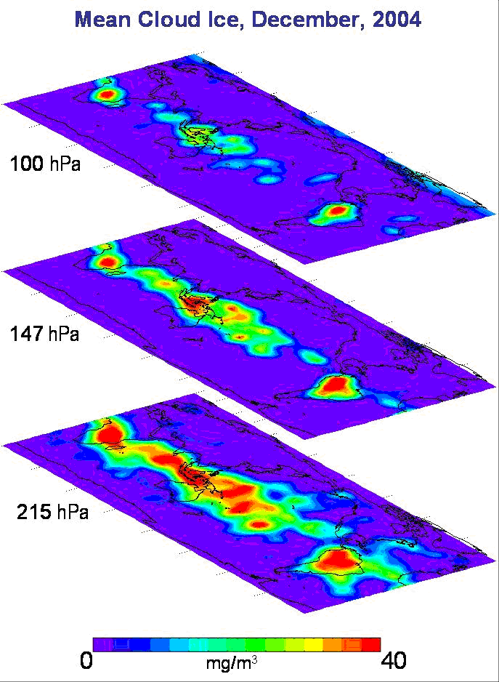
Ice cloud imaging: ICI
Objectives of a new mission
Cloud products, in particular ice clouds
Snowfall detection and quantification
Water-vapour profiles and imagery
Implementation
ESA development
Key performances
11 channels: 183 – 664 GHz
single polarisation (V) for all channels
dual polarisation (V, H) at 243 and 664 GHz
radiometric accuracy: 1 – 1.5 K
radiometric sensitivity: 0.6 – 1.9 K
Footprint size: 15-16 km
spatial sampling: 7.5 km
conical scan
NASA: Aura/MLS
Breakthrough: 11 channels
Establishes operational ice-cloud imaging mission
Support of weather forecast, hydrology, and climate monitoring

Slide 17
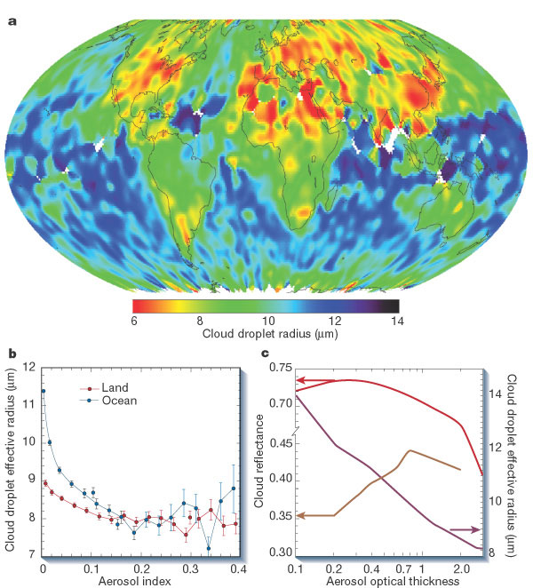
Multi-viewing Multi-channel
Multi-polarisation Imaging: 3MI
Objectives of a new mission
Aerosol – optical thickness, particle size, type, height, absorption
Volcanic Ash
Cloud phase, height, optical depth
Surface albedo
Implementation
ESA development
Key performances
12 channels: 0.41 – 2.13 µm
3 polarisations: 0°, 60°, -60°
up to 14 views
radiometric bias: 3%
SNR: 200
spatial sampling: 4 km
push-broom scan (2200 km swath)
Kaufman et al. (2002)
Breakthrough:
Enhanced spatial sampling (4 km)
Improves separation of cloudy areas
12 spectral channels (9 polarised), extending into the UV and SWIR
Better aerosol characterisation
Higher angular resolution (14 views)
Better phase function characterisation

Slide 18
Nadir-viewing UVNS sounding: Sentinel-5
Nadir viewing UV/VIS/NIR/SWIR sounding
Objectives
Ozone profile and column
Columns of CO₂,SO₂, NO₂, H₂O, CO, CH₄
Aerosol optical depth
Columns of BrO, HCHO, OCHCHO
Volcanic Plumes
Implementation
Copernicus Sentinel-5 to be embarked on Metop-SG
ESA development
Key performances
spectral range: 0.27 – 2.385 µm
spectral resolution: 0.25 – 1 nm
radiometric calibration: 1 – 2%
SNR: 120 - 1500
spatial sampling: 7 km
Cross-track scan
XXXX
X
Breakthrough
Drastically increased spatial sampling (7 km)
for the benefit of air quality monitoring
Extended spectral range into the near and shortwave infrared regions
to measure aerosols as well as methane and carbon monoxide in the PBL

Slide 19
Synergy of observation missions
Observation missions are
highly complementary
Co-registration of measurements will allow to optimise the information extraction
Synergy to be considered in payload distribution of a dual satellite configuration
Essential co-registrations
IASI-NG – METimage – Sentinel-5
MWI - ICI
Desired co-registrations
IASI-NG – MWS
METimage – 3MI
IASI-NG – Sentinel-5 – 3MI
MWI – SCA

Slide 20
EUMETSAT future satellites
YEAR...
03
04
05
06
07
08
09
10
11
12
13
14
15
16
17
18
19
20
21
22
23
24
25
26
27
28
29
30
31
32
33
34
35
36
37
38
39
40
METEOSAT FIRST GENERATION
METEOSAT-7
METEOSAT SECOND GENERATION
METEOSAT-8
METEOSAT-9
MSG-3/METEOSAT-10
MSG-4/METEOSAT-11*
METEOSAT THIRD GENERATION
MTG-I-1
MTG-S-1
MTG-I-2
MTG-I-3
MTG-S-2
MTG-I-4
EUMETSAT POLAR SYSTEM (EPS)
METOP-A
METOP-B
METOP-C
EPS-SECOND GENERATION (EPS-SG)
METOP-SG SOUNDING & IMAGERY SATELLITES
METOP-SG MICROWAVE SATELLITES
JASON
JASON-2
JASON-3
JASON CONTINUITY OF SERVICES (JASON-CS)
COPERNICUS
SENTINEL-3
SENTINEL-4 ON MTG-S
SENTINEL-5 ON EPS-SG

