Slide 1

Status and Future Atmosphere Near Real-Time Applications
Carlos Cabanas

Slide 2
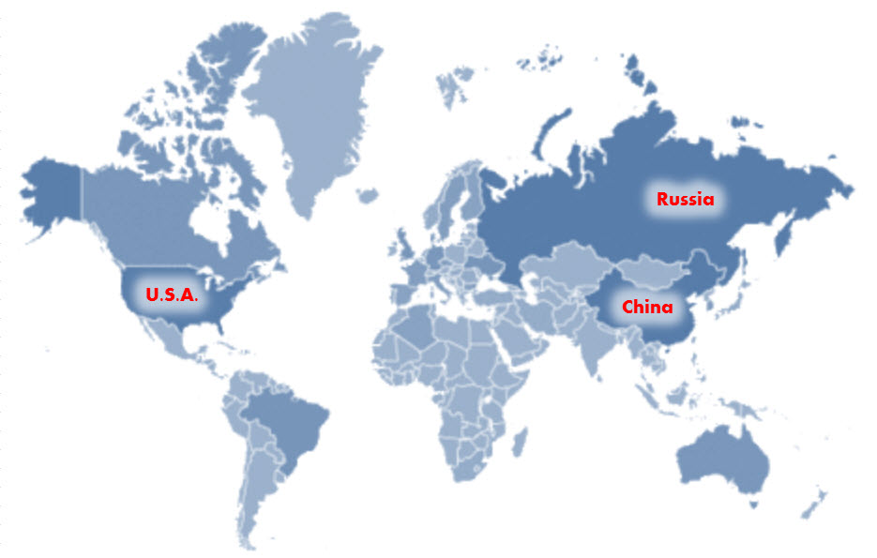



U.S.A + Europe + China + Russia
Europe

Slide 3
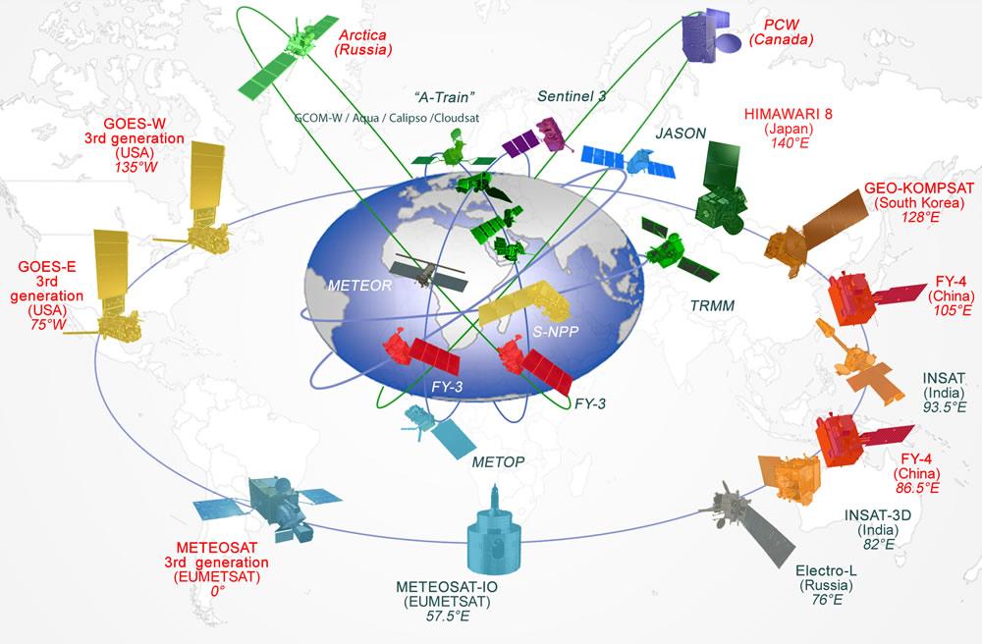
Schematic overview of the space-based WMO GOS

Slide 4
Future Polar Orbiting Meteorological Satellites
Satellite | Lifetime | ECT |  | 16 | 17 | 18 | 19 | 20 | 21 | 22 | 23 | 24 | 25 | 26 | 27 | 28 | 29 | 30 | 31 | 32 | 33 | 34 | 35 | 36
Metop-A | 2006-2016 | 09:30 desc
Metop-B | 2012-2018 | 09:30 desc
Metop-C | 2018-2024 | 09:30 desc
SG-1A | 2021-2028 | 09:30 desc
SG-1B | 2022 - 2029 | 09:30 desc
SG-2A | 2028-2035 | 09:30 desc
SG-2B | 2030 - 2037 | 09:30 desc
SG-3A | 2035-2042 | 09:30 desc
SG-3B | 2036 - 2043 | 09:30 desc
NOAA-15 | 1998-2016 | 17:38 asc
NOAA-18 | 2005-2016 | 17:30 asc
NOAA-19 | 2009-2016 | 14:20 asc
SNPP | 2011-2016 | 13:30 asc
JPSS-1 | 2017-2024 | 13:30 asc
JPSS-2 | 2021-2028 | 13:30 asc
JPSS-3 | 2026-2033 | 13:30 asc
JPSS-4 | 2031-2038 | 13:30 asc
FY-3C | 2013-2018 | 10:20 desc
FY-3D | 2016-2021 | 14:00 asc
FY-3E | 2018-2023 | 06:00 desc
FY-3F | 2019-2024 | 10:00 desc
FY-3G | 2021-2026 | 14:00 asc
Meteor-M N2-1 | 2016-2018 | 15:30 asc
Meteor-M N2-2 | 2016-2021 | 09:30 desc
Meteor-M N2-3 | 2019-2024 | 15:30 desc
Meteor-M N2-4 | 2020-2025 | 09:30 desc
Meteor-M N2-5 | 2021-2026 | 15:30 desc

Slide 5

Chinese Meteorological Satellite Program: FengYun

Slide 6
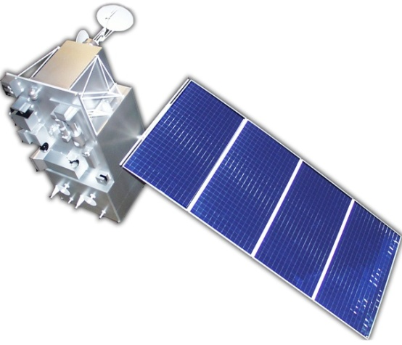
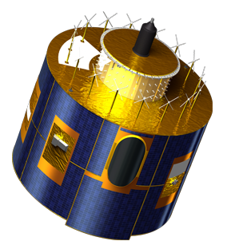
Chinese Meteorological Satellite Program: Feng-Yun
Polar Orbiting Meteorological Satellites
  FengYun 1 (FY-1) 1988- 2011
  FengYun 3 (FY-3) 2008- 2026
Geostationary Meteorological Satellites
  FengYun 2 (FY-2) 2006-2020
  FengYun 4 (FY-4) 2016-2028

Slide 7
Chinese Polar Orbiting Meteorological Satellites
88
89
90
91
92
93
94
95
96
97
98
99
00
01
02
03
04
05
06
07
08
09
10
11
12
13
14
15
16
17
18
19
20
21
22
23
24
25
26
27
28
FY-1
7 Sep1988
FY-1A
2 Sep1990
FY-1B
10 May 1999
FY-1C
15 May 2002
FY-1D
FY-3
27 May 2008
FY-3A
09.05 (D)
5 Nov 2010
FY-3B
13.38 (A)
23 Sep 2013
FY-3C
10.15 (D)
FY-3D
14.00 (A)
FY-3E
06.00 (D)
FY-3F
10.00 (D)
FY-3G
14.00 (A)
Notes:
FY-3C
Launched 2013/Sep/23, operational.
FY-3B
Launched 2010/Nov/5. It’s the same model as FY-3A, the design life-time is 3
years, 3 axis stabilized, sun-synchronous, taking the afternoon orbit. FY-2B carries
similar instruments on FY-3A.
FY-3A
Launched on 2008/May/27, designed life-time 3 years, 3-axis stabilized, sunsynchronous,
taking morning orbit. Service ends 5 Jan 2015.
FY-1D
Launched on 15 May 2002 with identical mission objective as the FY-1C; the last
satellite of FY-1 program. FY-1D had been working 9 years till 6 May 2011 when
power supply was becoming too weak to maintain the attitude stable. In Sept. 2011
FY-1D was de-missioned.
FY-1C
Launched 10 May 1999. Some improvement seen from its predecessors. The size
of solar panel was enlarged, the VIRR has ten channels. The attitude stability is
much improved. It had been operating for nearly 5 years. Data acquisition and
archive for FY-1C at NSMC ceased 6 April 2001 for good due to obvious degradation
of measurements. The satellite was de-missioned afterwards. On January 11, 2007 China destroyed one of these satellites (FY-1C) in a test of an anti-satellite missile
FY-1B
Launched on 2 September 1990. It’s a copy of FY-1A. A series tests was
performed on the spacecraft and to demonstrate the ground system. The satellite is
de-missioned in August 1991 due to attitude control failure.
FY-1A
Launched on 7 September 1988. As the first meteorological satellite ever made by
China, it was used to testd demonstrate the system. The VIRR instrument had five
channels (0.58-0.68μm, 0.725-1.1μm, 0.48-0.53μm, 0.53-0.58μm,10.5-12.5μm).
Satellite failure was announced not long after launch when the satellite attitude
control became impossible.
April 1, 1960 -- TIROS I is Launched

Slide 8
FY-3 Instruments

Slide 9
FY-3 Instrument Evolution

Slide 10
FY-3 Direct Broadcast capabilities
 | L-Band Downlink |  |  | X-Band Downlink
 | Data Rate | Polarisation | Data | Data Rate | Polarisation | Data
FY-3A | 4.2 Mb/s | RHCP | All instruments except MERSI-I | 18.7 Mb/s | RHCP | MERSI-I
FY-3B | 4.2 Mb/s | RHCP | All instruments except MERSI-I | 18.7 Mb/s | RHCP | MERSI-I
FY-3C | 3.9 Mb/s | RHCP | All instruments except MERSI-II | 18.7 Mb/s | LHCP | MERSI-I
FY-3D | No L-band broadcast |  |  | 60 Mb/s | RHCP | All instruments
FY-3E | No L-band broadcast |  |  | 60 Mb/s | LHCP | All instruments
Notes:
The project purpose is the establishment of two FY-3 Regional Services:
The EARS - Vertical Atmospheric Sounder Service
The EARS – MERSI which is an Imager Service.
In terms of satellites:
The project scope covers the establishment of this two services and their operational validation through the FY-3C and FY-3D satellites:
The FY-3A&B satellites are excluded due to the early failure of their instruments.
FY-3E, F and G are excluded since the FY-3E launch will not take place earlier than 2019, the space to ground interface is unknonw (polarization)
About the instruments:
HIRAS service: once more details of the sounder instrument and its performance characteristics are known

Slide 11
Chinese Geostationary Meteorological Satellites
YEAR...
03
04
05
06
07
08
09
10
11
12
13
14
15
16
17
18
19
20
21
22
23
24
25
26
27
28
29
30
31
32
33
34
35
36
37
38
39
40
FY-2
15 Nov 2006
FY-2D
123.5 E
23 Dec 2008
FY-2E
86.5 E
13 Jan 2013
FY-2F
114 E
31 Dec 2014
FY-2G
105 E
FY-2H
FY-4
FY-4A
FY-4B
FY-4C

Slide 12
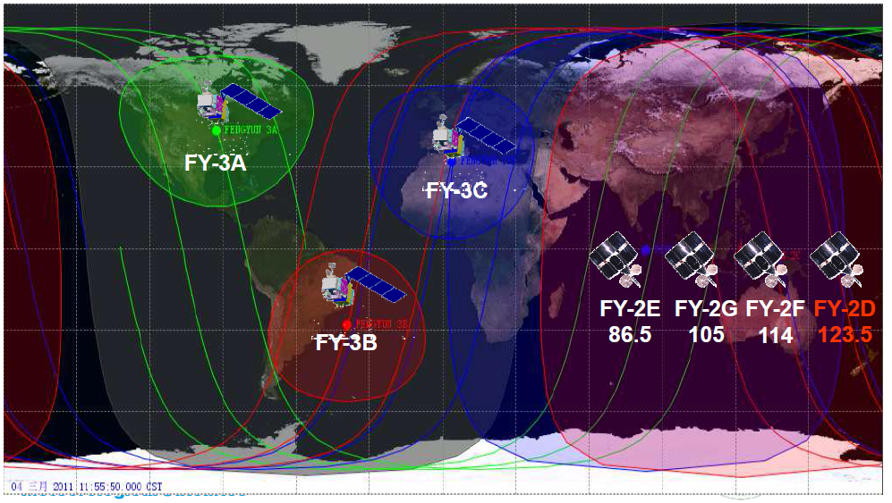
In-orbit Chinese Meteorological Satellites

Slide 13

Russian Meteorological Satellite Program

Slide 14
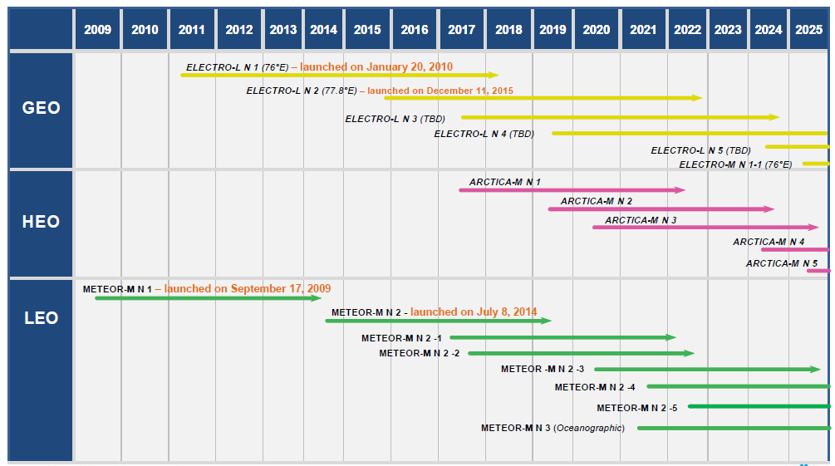
Russian Meteorological Satellite Program

Slide 15
Meteor-M N2 Instruments

Slide 16
Meteor M N2 Data Access: Direct Broadcast
Data is transmitted in direct broadcast mode (HRPT) via L-band at 1.7 GHz with 665.4 Kbps data transmission rate;
Signal contains information from the following instruments:
- MTVZA microwave sounder data;
- MSU-MR scanner data;
- information from data collection platforms (DCP)
- telemetry
DB data does not follow CCSDS standard;
DB Product Processing package still not available;
More info can be found at http://planet.iitp.ru/english/spacecraft/meteor_m_n2_structure_eng.htm

Slide 17
Backup

Slide 18
Best practices
DR community should keep open to the Chinese and Russian Direct Broadcast data;
Best Practices in support to Local and Regional Processing of LEO Direct Broadcast data (GGMS-44):
  To consolidate and detail the solution for making TLE orbit data accessible to Direct Broadcast reception station operators in a standardised manner.
  To consider if the installation of processing S/W packages can be standardised and made more user friendly, considering tools such as Docker (www.docker.com).
  To consider the advantages of using RHCP/LHCP as a means to minimise interference against the simplicity/affordability of the Direct Broadcast stations and to formulate a CGMS Agency Best Practice on use of Circular Polarisation for Direct Broadcast.
  To consider the advantages of orbital phasing between satellites as a measure for reducing pass scheduling conflicts and maximising the amount of instrument observation collected.

Slide 19
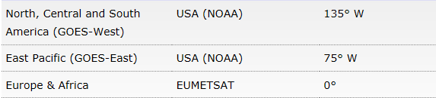
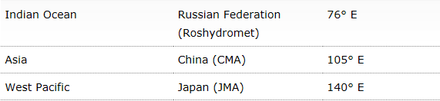
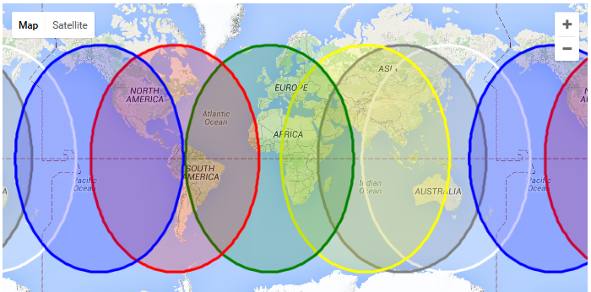
Geostationary meteorological satellites

Slide 20
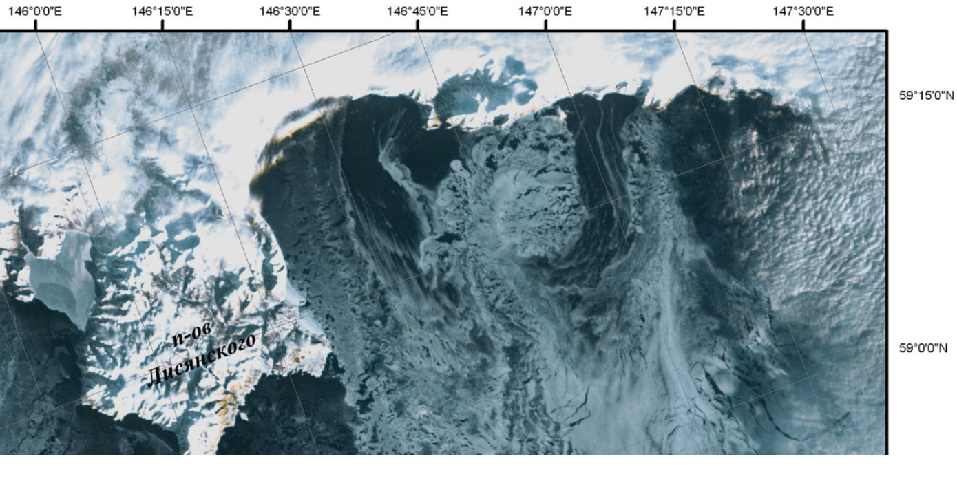
Sea of Okhotsk imaged by Meteor M2's KMSS instrument on
Jan. 13, 2015

Slide 21
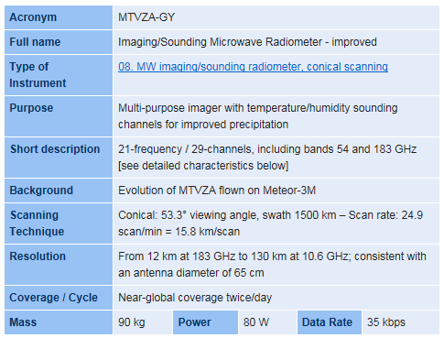
MTVZA-GY

Slide 22
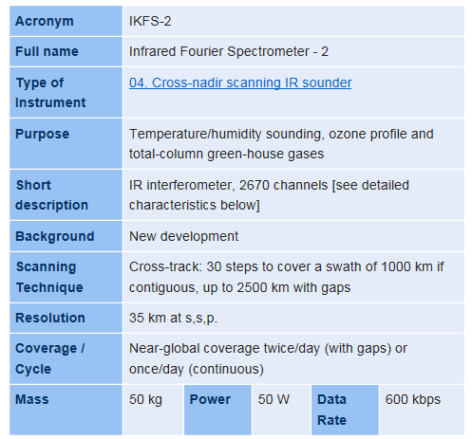
IKFS-2

Slide 23
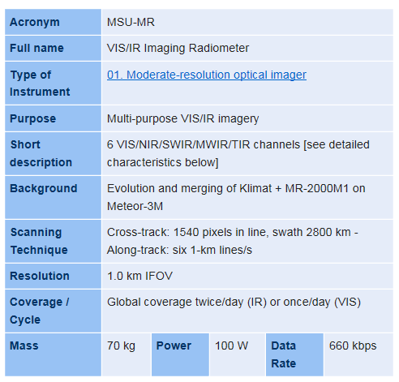
MSU-MR

Slide 24
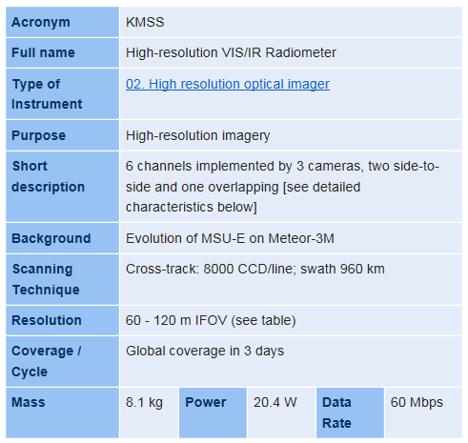
KMSS

Slide 25
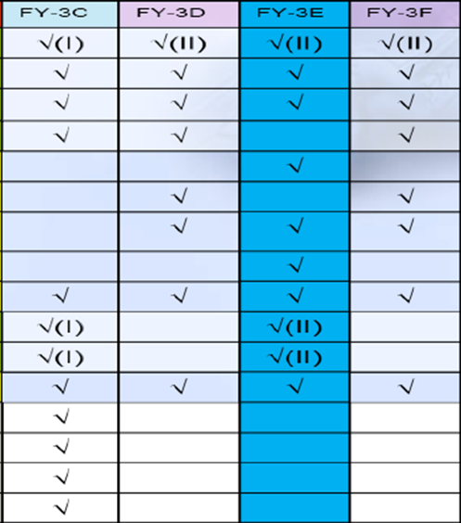
FY-3 Instrument Configuration

Slide 26
FY-3 Polar Orbiting Meteorological Satellites
 | Launch | Orbit
FY-3A | 2008 | 09:05 desc
FY-3B | 2010 | 14:25 asc
FY-3C | 2013 | 10:20 desc
FY-3D | 2016 | 14:00 asc
FY-3E | 2018 | 06:00 desc
FY-3F | 2019 | 10:00 desc
FY-3G | 2021 | 14:00 asc

Slide 27






EUMETSAT international cooperation
The US National Oceanic and Atmospheric Administration ( NOAA)
National Aeronautics and Space Administration
China Meteorological Administration (CMA)
The Russian Federal Service for Hydrometeorology and Environmental Monitoring (ROSHYDROMET)
Indian Space Research Organisation (ISRO)
Japanese Meteorological Agency (JMA)
Korea Meteorological Administration (KMA)
Environment Canada (EC) (...)
Notes:
We get data from meteorological satellites around the world

Slide 28
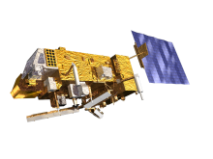

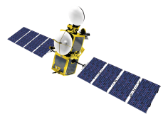
EUMETSAT satellites
METOP-B (98.7° incl.)
METOP-A (98.7° incl.)
JASON-2 (66° incl.)
JASON-3
SENTINEL-3A
EUMETSAT POLAR SYSTEM
EUMETSAT POLAR SYSTEM
OCEAN SURFACE TOPOGRAPHY
OCEAN SURFACE TOPOGRAPHY
ALTIMETRY, SEA SURFACE AND OCEAN COLOR
In orbit at 817 km altitude, the primary operational satellite of the EUMETSAT Polar System (EPS).
In nominal mid-morning sun synchronous orbit at 817km altitude ,as part of the EUMETSAT Polar System (EPS) .
In nominal non-synchronous low Earth orbit at 1,336km altitude, in support of the Ocean Surface Topography Mission.
Same orbit as JASON-2. Flying 80 seconds apart from JASON-2 during commissioning. 180 ° in nominal ops
In nominal mid-morning sun synchronous orbit at 814 km altitude, 98.6° inc
METOP-B
METOP-A
JASON-2
METEOSAT-10 (0°)
METEOSAT-9 (9.5° E)
METEOSAT FULL DISC IMAGERY
RAPID SCANNING SERVICE (RSS)
Positioned at 0° supporting the prime Meteosat full disc imagery service over the European continent, Africa and parts of the Atlantic and Indian oceans.
Provides the Rapid Scanning Service (RSS) delivering more frequent images every five minutes over parts of Europe, Africa and the adjacent seas.
METEOSAT-8 (3.5° E)
METEOSAT-7 (57.5°E)
BACKUP SERVICE
INDIAN OCEAN DATA COVERAGE
Serves as a back-up to both the Meteosat-9 and -10 spacecraft for full disc imagery and rapid scanning.
Operated in support of the Indian Ocean Data Coverage (IODC) mission, bridging an observational gap in this region.
METEOSAT-10
METEOSAT-9
METEOSAT-8
Commissioning Phase
Notes:
Jason 2 provides measurements of sea surface height, wind speed at the ocean surface and sea state.

