Slide 1
Monitoring Flood Events with NASA's Near Real-time Flood Mapping Products
NDRC-9
22-June-2016, Valladolid, Spain
Dan Slayback
Science Systems & Applications, Inc
Biospheric Sciences Laboratory
NASA Goddard Space Flight Center
dan.slayback@nasa.gov
PI: Fritz Policelli, NASA GSFC Hydrology Lab
Bob Brakenridge, Albert Kettner: Dartmouth Flood Observatory, University of Colorado
Hydrology Laboratory
Goddard Space Flight Center

Slide 2
SE Asia flooding – Oct 2011

Slide 3
Pakistan Flooding – Sept 2014

Slide 4
Mississippi river flooding – May 2013

Slide 5
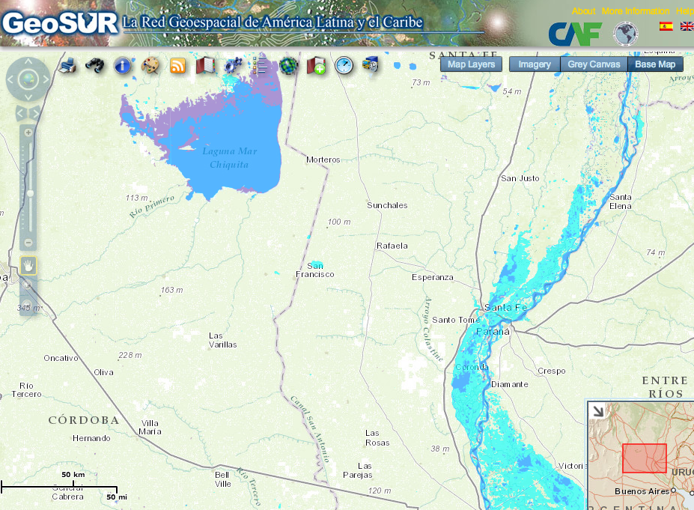
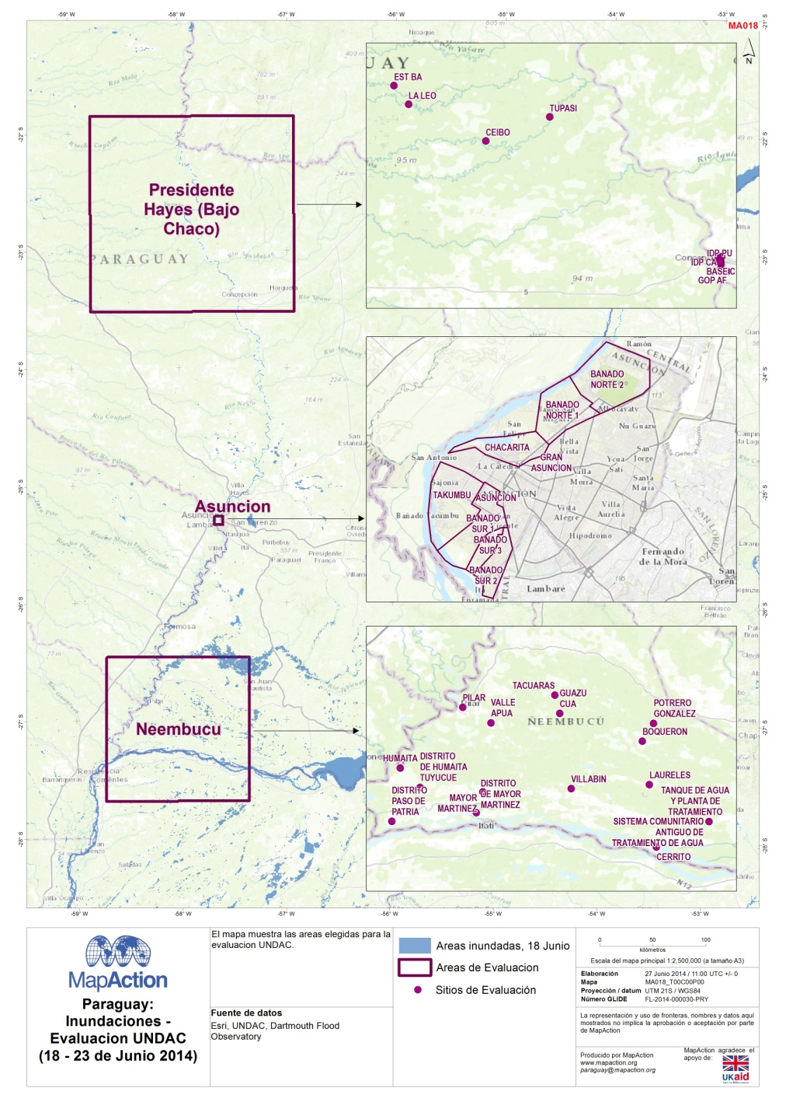
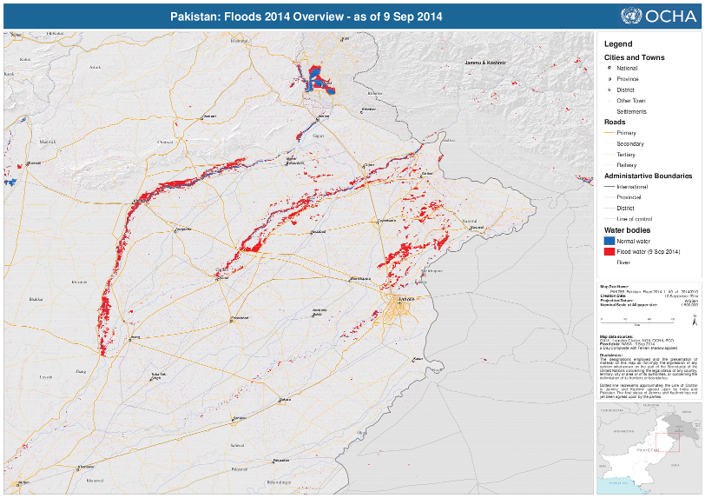
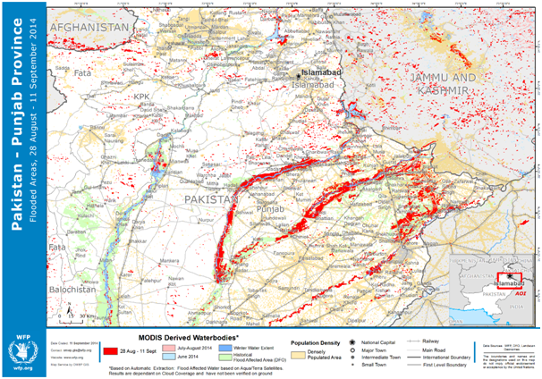
Selection of end users
GeoSUR
MapAction
UN Office for the Coordination of Humanitarian Affairs
World Food Program
NRCC – National Response Coordination Center

Slide 6
A brief history
Bob Brakenridge (Dartmouth Flood Observatory): manual generation of flood maps using MODIS rapid response imagery
Generally effective, but:
Not automated!
Using rapid response jpegs not meant for data analysis
Limited distribution formats
NASA GSFC Office of Applied Science automated the product using LANCE-MODIS NRT data stream
Automated global production began at end of 2011:
223 10x10° tiles x 3 products (2-day, 3-day, 14-day) = 669 daily product suites generated.
Product suites include: geotiffs, shapefiles, KML (Google Earth), and graphic maps (PNG).
Products typically available within 6 hours of Aqua overpass (~ 8:00 PM local time).
Currently pursuing LANCE adoption of production
Adding products from other sensors: Landsat, Sentinel-1, …

Slide 7
Approach: two steps
Water Detection:
Every Terra and
Aqua orbit
Multi-look compositing
(cloud removal)
Over 1, 2, or 3 days

Slide 8
Input data
Custom MODIS input imagery from the LANCE-MODIS system:
MOD09: Daily Terra and Aqua surface reflectances for band 1, 2, and 7 (band 7 pan-sharpened to 250 m)
MOD35: cloud mask product
Populates “insufficient data” to provide some information on when we cannot see the surface
MOD06: cloud product
Used with solar geometry to project and remove cloud shadows for 1-day product
Overlapping orbits mosaicked into single 10-degree tile per day per satellite

Slide 9
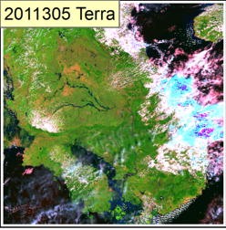
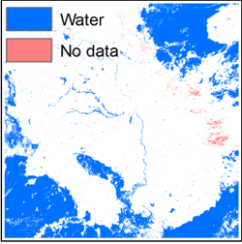
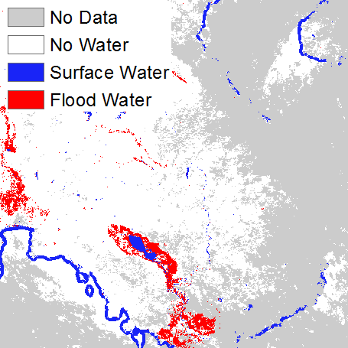
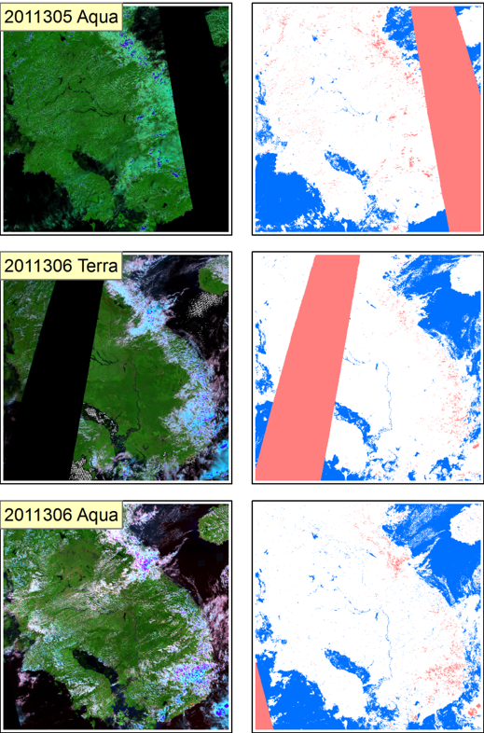
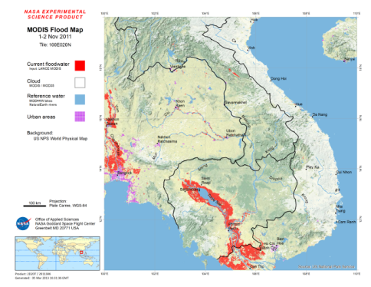
Example:
SE Asia Floods 2011
Tile: 100E020N
Dates: 1-2 Nov 2011
Composite: 2-day
Input MODIS 721
MWD products
MODIS Water Product
2-Day, 2-Observation
Additional outputs:
Shapefile/KML
ArcGIS Image Service
Map PNG

Slide 10
Key product parameter: compositing period Just how cloudy is it?
1-day composite: requires 1 water observation over current day’s imagery (potentially 2 observations with Terra and Aqua). Not normally generated.
2-day: requires 2 water observations over 2 days of imagery (potentially 4 observations).
3-day: requires 3 water observations over 3 days of imagery (potentially 6 observations).
14-day: second order composite, combining the 14 previous 3-day products. Provides a recent-historical view.
Which? It depends….basically on cloud conditions:
User tolerance for false positives (and false negatives)
User need for only the most up-to-date information
Clear conditions? Use 2-day or 1-day.
Very sensitive to false-positives? Use 3-day.
Very sensitive to false-negatives (cloud)? Use 14-day.
Need the latest info? Use 1-day.
Best approach? Look at them all and evaluate for given event and needs.

Slide 11
1-day product

Slide 12
2-day product

Slide 13
3-day product

Slide 14
Validation
Purpose:
Is water detection algorithm correctly detecting water that is visibly obvious? Are certain situations problematic?
Do we see differences between detection of flood vs normal water?
Method:
Manual qualitative assessment, using raw MODIS or Landsat imagery to inform.
Ground truth is difficult to find, expensive to collect, and generally biased towards accessible locations.
Flood events selected from DFO master list of recent floods
Global distribution.
Including areas with high and low cloud cover (humid tropics to arid regions).
Varying landcovers

Slide 15
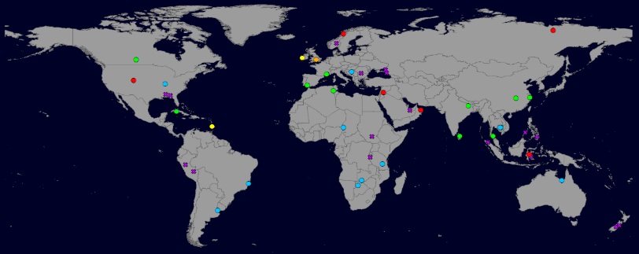
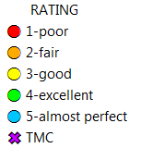
Flood
Detection
Rating
(53 sites)
Permanent
Water
Detection
Rating
(56 sites)

Slide 16
Flood Detection Ratings
RATING | Count | %
5-almost perfect | 11 | 21
4-excellent | 10 | 19
3-good | 2 | 4
2-fair | 1 | 2
1-poor | 11 | 21
TMC - too many clouds | 17 | 33
TOTAL | 53 | 100
66% of clear
Permanent Water Detection Ratings
RATING | Count | %
5-almost perfect | 15 | 28
4-excellent | 9 | 17
3-good | 7 | 13
2-fair | 2 | 4
1-poor | 4 | 8
TMC - too many clouds | 16 | 30
TOTAL | 54 | 100
84% of clear

Slide 17
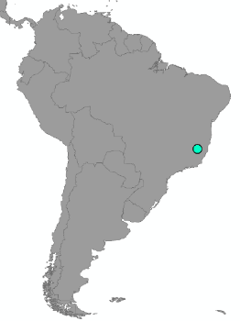
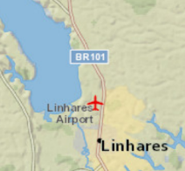
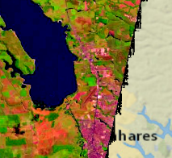
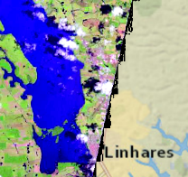
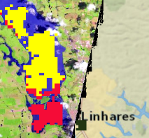
Correct flood and permanent water identification
Brazil: 02 January 2014
Flood water
Non-flood water
Insufficient Data
National Geographic
base map
Landsat 8 Pre-flood
Apr 21, 2013
Landsat 8 Flood
Jan 2, 2014
MODIS NRT product
Jan 3, 2014

Slide 18
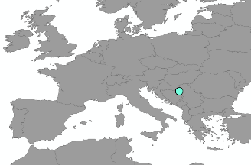
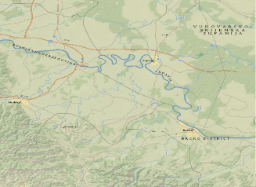
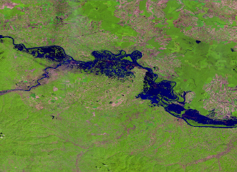
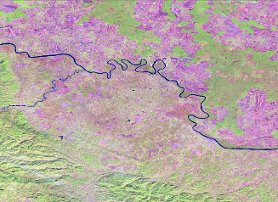
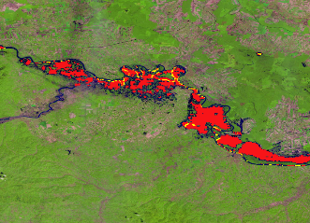
Correct flood identification
Bosnia and Herzegovina: 23 May 2014
National Geographic
base map
Landsat 8
May 22, 2014
Flood water
Non-flood water
Insufficient Data
Landsat 8
October 19, 2013
MODIS NRT product
May 22, 2014

Slide 19
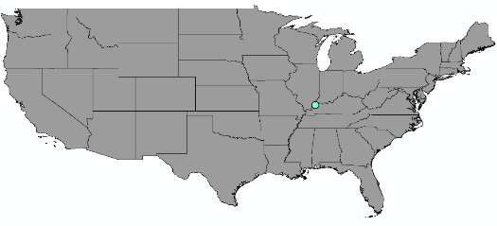
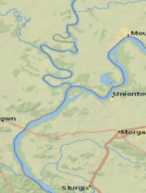
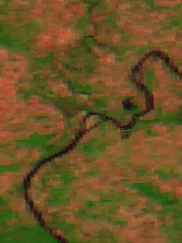
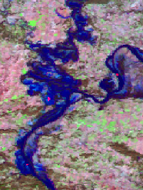
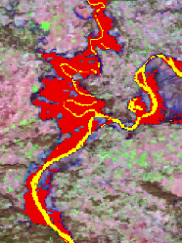
Correct flood identification
Kentucky: 04 Jan 2014
Flood water
Non-flood water
Insufficient Data
National Geographic
base map
MODIS (MOD09) Pre-Flood
Oct 12, 2013
MODIS (MOD09) Flood
Jan 4, 2014
MODIS NRT Product
Jan 4, 2013

Slide 20
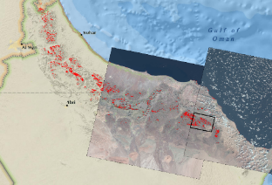
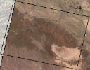
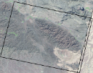
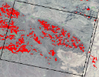
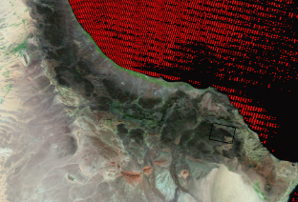
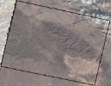
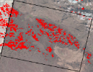
Terrain shadow false-positives
OMAN: mid November 2013 products
No
water
detected
Landsat 8
June 17, 2013
(2013178)
Landsat 8
Nov 9, 2013
(2013313)
= flood
3-day product
Landsat 8
Nov 18, 2013
(2013322)
MODIS (MOD09)
Nov 11, 2013
(2013315)
MODIS 2013315 REFLECTANCE

Slide 21
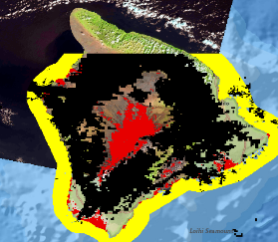
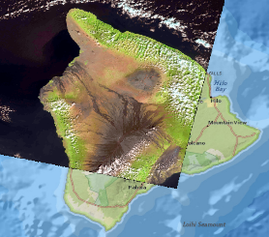
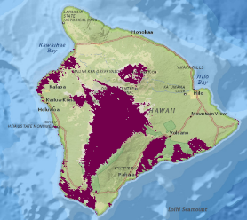
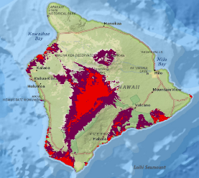
Barren rock / volcanic false positives
Mauna Loa, Hawaii: 17 Dec 2013
Flood water
Non-flood water
Insufficient Data
MODIS NRT Product
Landsat 8
Flood water
MODIS (MCD12Q1) IGBP Land Cover
MODIS IGBP Land Cover with flood water

Slide 22
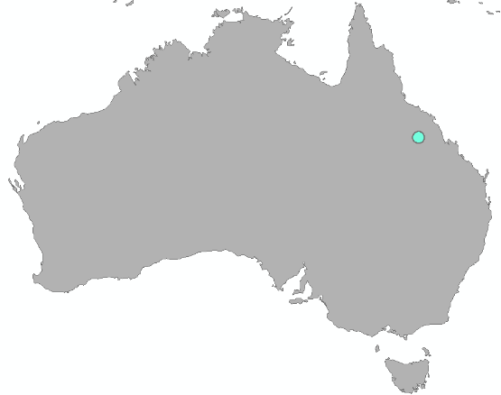
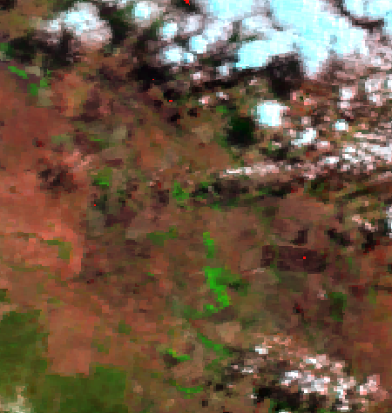
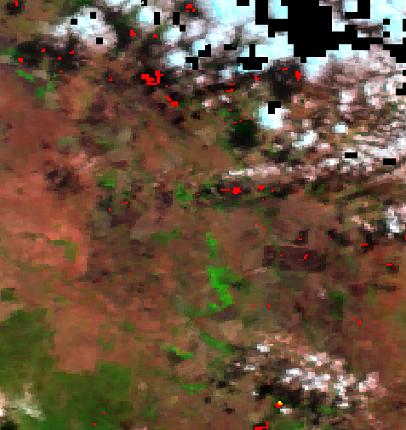
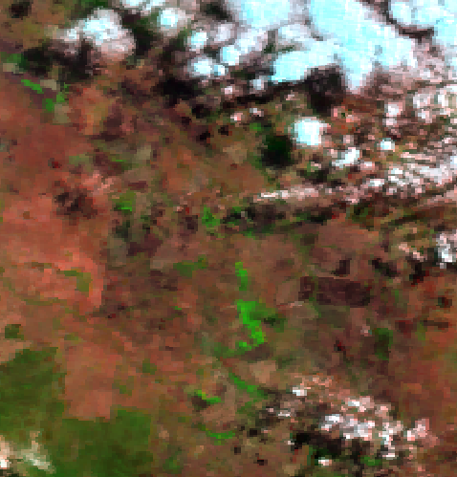
Cloud shadow false-positives
Australia: 04 July 2014
Flood water
Non-flood water
Insufficient Data
Input data: MOD09, 04 Jul 2014
2-day Product
3-day product removes most cloud shadow false positives
3-day Product

Slide 23
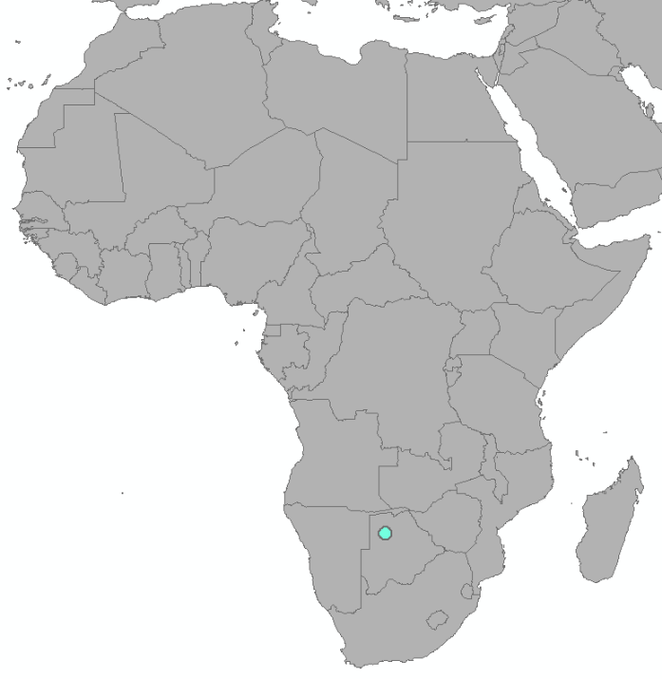
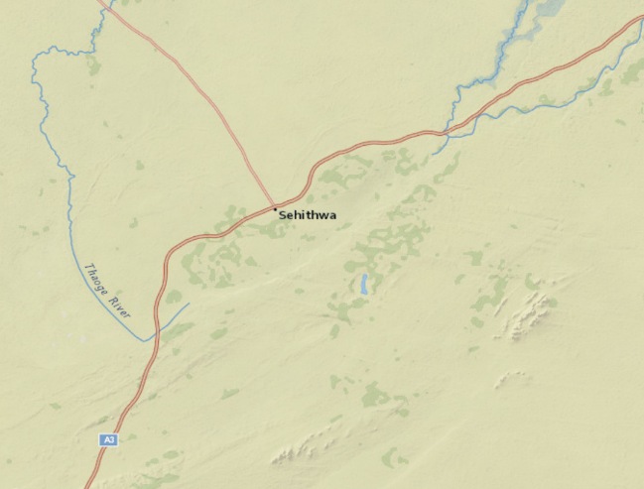
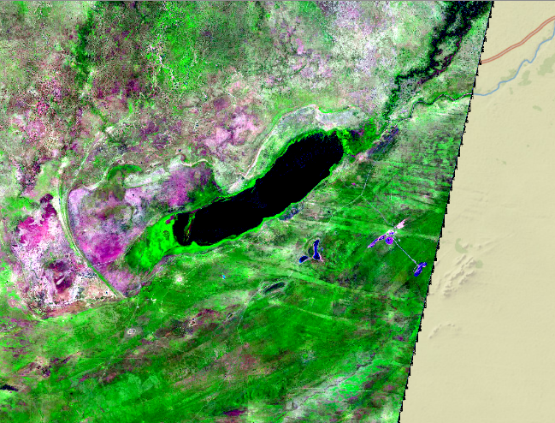
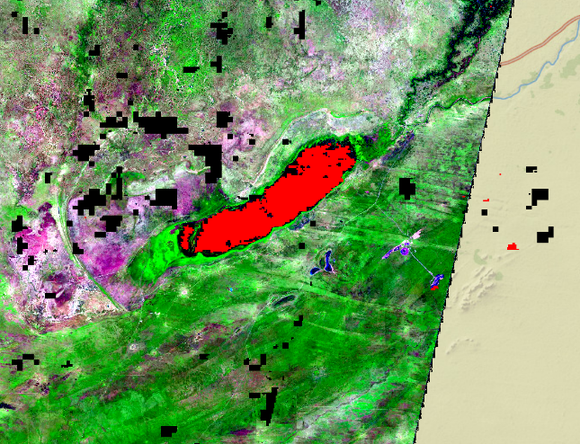
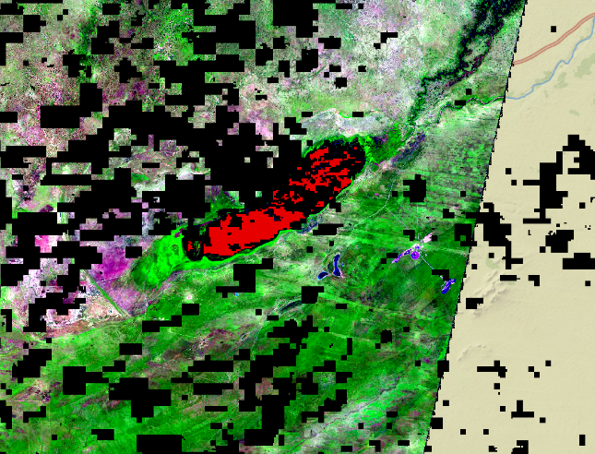
2-day vs 3-day product comparison
Botswana: 24 Mar 2014
National Geographic base map
MODIS (MOD09) Mar 24, 2014
Flood water
Non-flood water
Insufficient Data
2-day product
3-day product

Slide 24
Product / Format Examples

Slide 25
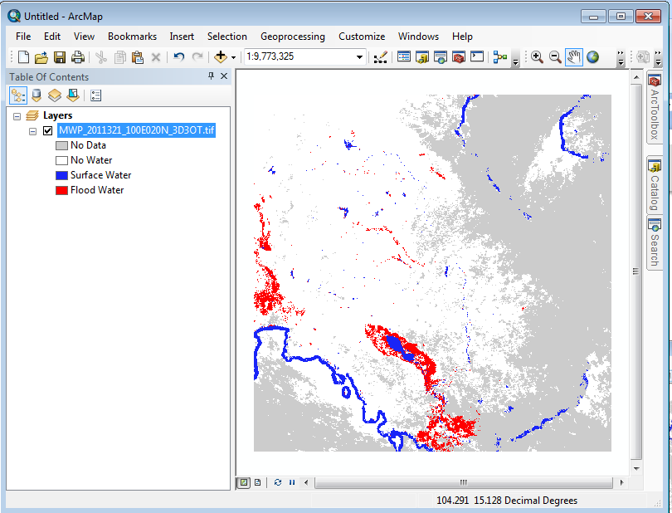
Products: MODIS Water Product (MWP)
Values:
0: Insufficient data (for composite period)
1: No water detected
2: Surface water (corresponding to Reference water pixels).
3: Flood water (water outside Reference water pixels).
Core product
Geotiff format and ArcGIS Image Service
Coastal strip visible; ocean water removed beyond 10 km
MOD35 Cloud used only to populate “Insufficient data”; water detected through cloud IS reported

Slide 26
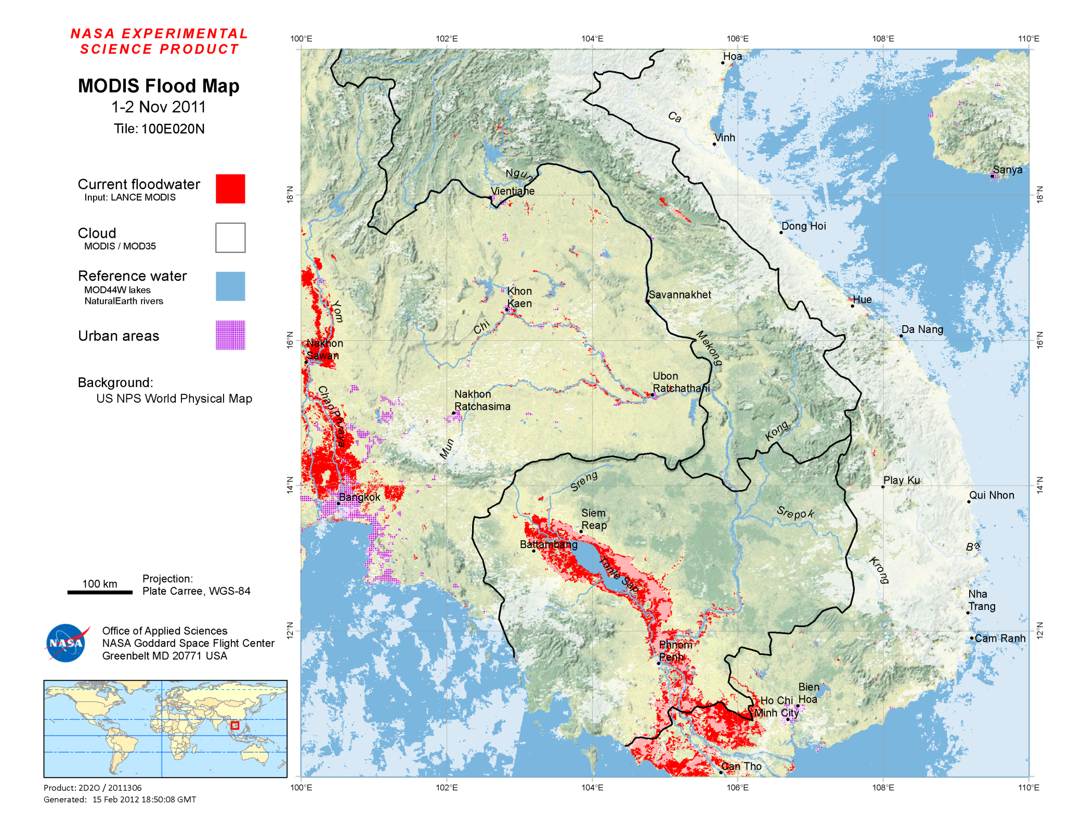
Products: MODIS Flood Map (MFM) 10° tile graphic map (PNG)

Slide 27
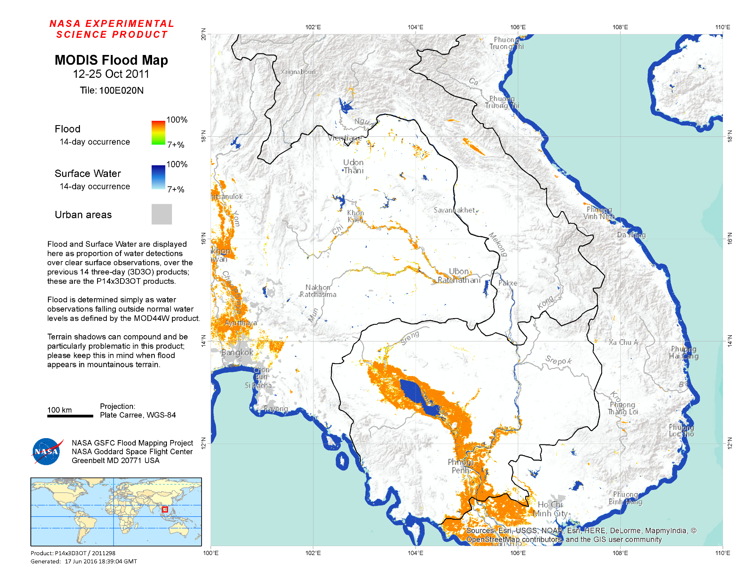
Products: MODIS Flood Map (MFM) 10° tile graphic map (PNG)
14-day product

Slide 28
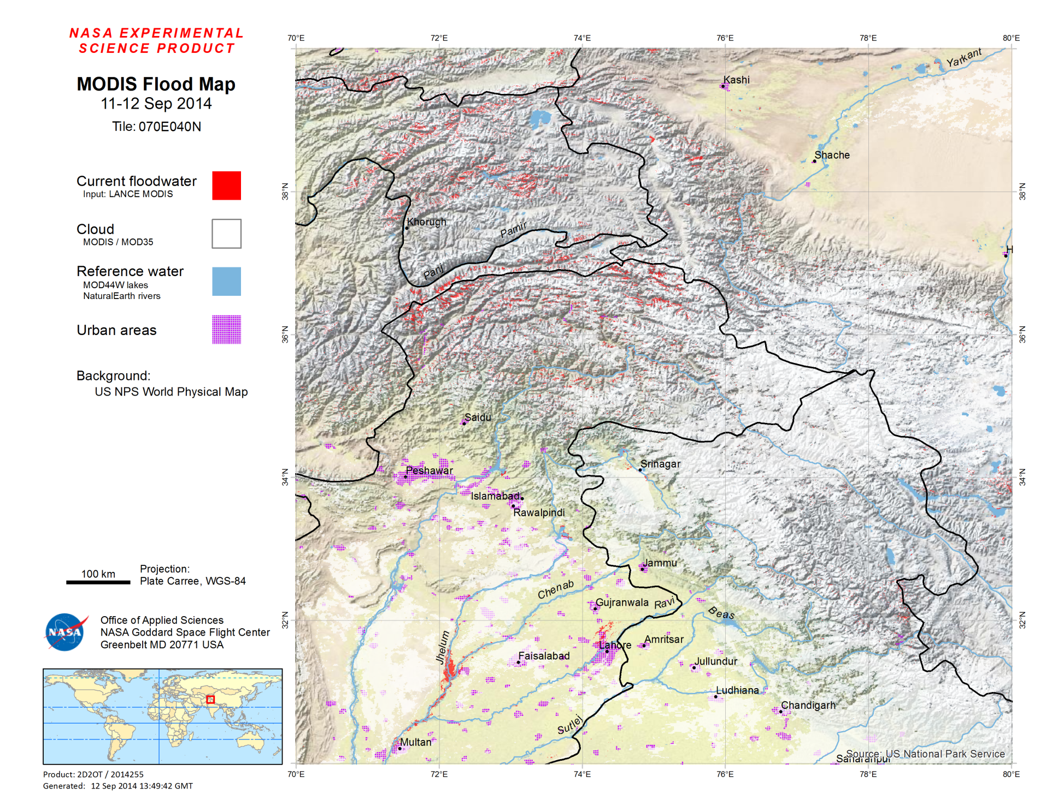
Products: MODIS Flood Map (MFM) 10° tile graphic map (PNG)
Pakistan flooding
Sept 2014:
Massive river flooding, but not obvious at this scale.

Slide 29
Products: MODIS Surface & Flood Water (MSW, MFW) shapefiles
Vectorized from MWP (raster) product
Does not indicate where insufficient data to determine (value 0 of MWP product)
Provides area and centroid per polygon
Production can fail if too many polygons
KML production skipped if #polygons > 15000

Slide 30
Products: MODIS Surface & Flood Water KML files (Google Earth)
KML files in Google Earth:

Slide 31
Products: MODIS Surface & Flood Water KML files (Google Earth)
Google Earth zoomed in -- Bangkok’s Don Muang Airport runways under water:

Slide 32
Product utility – key factors
Cloudiness
Flood spatial extent
250m pixels
Flood temporal extent
Flash floods / short duration on ground?
Landcover
Water under tree cover vs in usual places

Slide 33
Distribution

Slide 34
Distribution via NASA website: http://oas.gsfc.nasa.gov/floodmap
Global Regions / Homepage
Continental tile index for Asia

Slide 35
Distribution via NASA website: http://oas.gsfc.nasa.gov/floodmap
Product downloads table
070E040N (NE Pakistan)
date selector
product/format downloads

Slide 36
Distribution via ArcGIS Image services: http://oas.gsfc.nasa.gov/arcgis/rest/services/FloodMaps
Pros:
+ Product tiles combined into seamless mosaic (bypass limitations of 10-degree tiles)
+ Easier to work with than downloading, storing, importing, and symbolizing individual files
Cons:
- Requires ArcMap, ArcGIS Online, Portal, or other interface capable of querying Image Services
ArcMap interface:
Global overview
Zoom (Pakistan): seamless across tile boundaries

Slide 37
Distribution via ArcGIS Web Maps: http://oas.gsfc.nasa.gov/arcgis/home
ArcGIS Portal Interface
Collection of ArcGIS “web maps”
Generic maps, and some focused on specific events
Provides front end to the ArcGIS Image Services for each product
Notes:
Show web map

Slide 38
Distribution via ArcGIS Web Maps example: Caprivi strip flooding, Namibia
Default basemap
Features
Display other products
Change basemap background
Retrieve pixel values
Display legend

Slide 39
Distribution via ArcGIS Web Maps example: Caprivi strip flooding, Namibia
Zoomed and basemap layer changed to “Imagery”

Slide 40
Product Limitations & Improvements in progress
Shadow false-positives
Terrain:
Limited shadow-modeling fix in place, 80% effective.
Soon deploying HAND filter.
Cloud:
Initial geometric projection approach implemented, but needs improvement.
Static reference water
Ephemeral water layer in development
End-user product selection / evaluation
2-day? 3-day? 14-day? 1-day? Can be confusing…
Custom web front-end to ArcGIS REST services being built
Easier browse/view, comparison to previous events.
Tools to export AOI to geotiff, convert to vector, etc.
Historical comparisons
Latency: ~ 8 PM local time

Slide 41
Ephemeral water layer for SE Asia

Slide 42
Updated product incorporating ephemeral water layer
Currently, we would report all orange and red as flood.
With this improvement, we can differentiate.
(11-Oct-2013, 2-day product)

Slide 43
Historical Comparisons

Slide 44
Lake Chad: Water observations 2003 - 2015
Monthly / yearly composites
Provides context for current events
Requires having processed archive (selected tiles only)

Slide 45
Indus: Water observations 2003 - 2015

Slide 46
Tonle Sap, Cambodia:
Monthly composites 2003 - 2015

Slide 47
Complementary Products
MODIS 2x/daily/global provides an excellent base, but:
Higher resolution can be necessary for urban areas or heterogeneous environments.
Clouds are a constant problem: false-negatives and false-positives.
Adding complementary products from other sensors when possible:
Trigger automated production based on MODIS flood detections, or other alerts.
Reference water is more problematic with higher-resolution products
Distribution system – ArcGIS Image services / web interface
Examples:
Landsat – operational (Surface water only at present)
Sentinel-1 – in development.
Radarsat, DigitalGlobe high-resolution
Feasible and useful, but requires NRT data stream.
Targeting required.
VIIRS/JPSS: should work, but PM only.

Slide 48
Potential Direct Readout Opportunities
Use our products, customize for local case
Customized seasonal water layers
Staff available (?) to evaluate best product per event, and incorporate local maps and knowledge
Generate products directly
LATENCY
Our system generates products ~8pm local time
We can move up a few hours with improvements
DR could move up several more hours, to just after data reception
Customized water detection algorithms
Optimize for local conditions / landcover

Slide 49
Thank you!
For more information:
NASA GSFC website: http://oas.gsfc.nasa.gov/floodmap
DFO website: http://floodobservatory.colorado.edu
dan.slayback@nasa.gov
Hydrology Laboratory
Goddard Space Flight Center

Slide 50
Backup slides

Slide 51
Processing Overview:
Water Detector Module
Terra
Aqua
LANCE
10:30 AM 1:30 PM
MOD09:
Reflectance bands 1,2,7
MOD35:
Cloud
MOD06:
Solar geom, cloud height
Water Detector
Output: MWD
Cloud Shadow
1-day products only
Terrain Shadow
Elevation:
ASTER GDEM2
Static
MWD Terra
MWD Aqua
MODIS Water Detection: 2 x daily, internal product

Slide 52
MWD Terra
MWD Aqua
MWD Terra
MWD Aqua
Processing Overview:
Water Compositor Module
Day 1
Day 1
Day 2
Day 2
Water Compositor
1-day, 2-day, 3-day
Reference Water
(lakes, rivers, ocean)
In Development
MWP: MODIS Water Product
Custom Reference Water Generator
(Offline process)

Slide 53
Product Suite Generation
MWP core product (raster)
Annotate overview map (10º x 10º)
MODIS Flood Map (MFM)
Shapefile products
Vector conversion
MSW, MFW
KML products
(Google Earth)
Ingest to global raster mosaic dataset
ArcGIS Image Services

Slide 54
Water detection algorithm
Water if: $\frac{\left(Band2+A\right)}{(Band1+B)}<C$
AND $Band1<D$
AND $Band7<E$
A | 13.5
B | 1081
C | 0.7
D | 2027
E | 676
Bands are MOD09 surface reflectance product
Thresholds in units of scaled reflectance (0-10000)
Developed by Bob Brakenridge, Dartmouth Flood Observatory

Slide 55
NASA Goddard NRT System
Custom MODIS input imagery from the LANCE-MODIS system
Daily Terra and Aqua surface reflectances for band 1, 2, and 7 (pan-sharpened to 250 m).
Overlapping orbits mosaicked into single 10-degree tile per day per satellite.
Corresponding cloud products (MOD06 and MOD35) for cloud and cloud shadow masking.
Flood algorithm: Bob Brakenridge / Dartmouth Flood Observatory
Water detection: empirical band ratio threshold: (Band1+A)/(Band2+B).
Multi-look compositing: require multiple positive water detections to label a pixel as water. Minimizes shadow false-positives.
Products available for different compositing periods: 1-day, 2-day, 3-day, 14-day.
Flood = water beyond “expected” surface water, as defined by MOD44W product (at present).
Fully automated system (since late 2011)
223 10x10° tiles x 3 products (2-day, 3-day, 14-day) = 669 daily product suites generated.
Product suites include: geotiffs, shapefiles, KML (Google Earth), and graphic maps (PNG).
Products typically available within 6 hours of Aqua overpass (~ 8:00 PM local time).
Delivery via web download, and ArcGIS Image services.

Slide 56
Products: 3 elements
Composite period (balance between currency and spatial completeness):
Standard products: 2-day, 3-day
Short-term: 1-day
Extended: 14-day
“Product” name:
MWP: MODIS Water Product (core product)
MFW: MODIS Flood Water (derived)
MSW: MODIS Surface Water (derived)
MFM: MODIS Flood Map (derived)
Formats:
Raster / geotiff (some products)
Vector / shapefile & KML (some products)
ArcGIS Image Services (MWP product)

Slide 57
Distribution via ArcGIS Web Maps: http://oas.gsfc.nasa.gov/arcgis/home
Initial display for Texas flooding event (May-June 2016)
Time-slider defaults to full range of data in mosaic dataset (2001-present), and starting at beginning.
➔ Must be configured
Notes:
Show web map

Slide 58
Distribution via ArcGIS Web Maps: http://oas.gsfc.nasa.gov/arcgis/home
Initial display for Texas flooding event (May-June 2016)
Click on tool icon (lower-right)
Click on “Show advanced options”
Notes:
Show web map

Slide 59
Distribution via ArcGIS Web Maps: http://oas.gsfc.nasa.gov/arcgis/home
Initial display for Texas flooding event (May-June 2016)
Update Start end End time
Update display window to 1 day
Notes:
Show web map

Slide 60
Adding Image Service to ArcMap:
1. Add ArcGIS Server
Open ArcMap
In ArcCatalog window, open “GIS Servers”
Click on “Add ArcGIS Server”
Select “Use GIS Services”

Slide 61
Adding Image Service to ArcMap:
2. Set Server URL: http://oas.gsfc.nasa.gov:6080/arcgis
Input server URL
Keep Authentication blank; no account is required.

Slide 62
Adding Image Service to ArcMap:
3. Navigate available services
Flood map services are in FloodMaps folder
Drag wanted service to map.
In example →:
LandsatFootprints is shown as green boxes

Slide 63
Using Image Services:
Example: Convert Image Service raster to shapefile
Open “Raster to Polygon” tool in ArcToolbox (Conversion tools → From Raster)
Set “output polygon features” to wanted shapefile name (name.shp), or set to a geodatabase.
You do NOT want to convert the entire Image service – this will be too large!
Click on “Environments…” to set processing extent.

Slide 64
Using Image Services:
Example: Convert Image Service raster to shapefile
In Environment Settings, open “Processing Extent” section.
Select wanted extent. Here, we’re using whats shown in the display.
Click OK and OK to run.

Slide 65
Using Image Services:
Example: Display shapefile on top of Image Service
Zoomed out to show extent of converted data.
Note colors for both image service and the resulting shapefile are randomly generated initially.

Slide 66
Using Image Services:
Example: Export display to raster
Right click on displayed Image Service → Data → Export Data

Slide 67
Using Image Services:
Example: Export display to raster
Set export parameters
Extent: data frame
Reference, pixel size, format: as you prefer

Slide 68
Distribution via DFO: http://floodobservatory.colorado.edu
Customized products for specific events
Current global flood index
Homepage with current flood event map

