Slide 1
SeaDAS 7 for Ocean Data Users
Fred Patt
Sean Bailey
and the OBPG SeaDAS Team
June 23, 2016

Slide 2
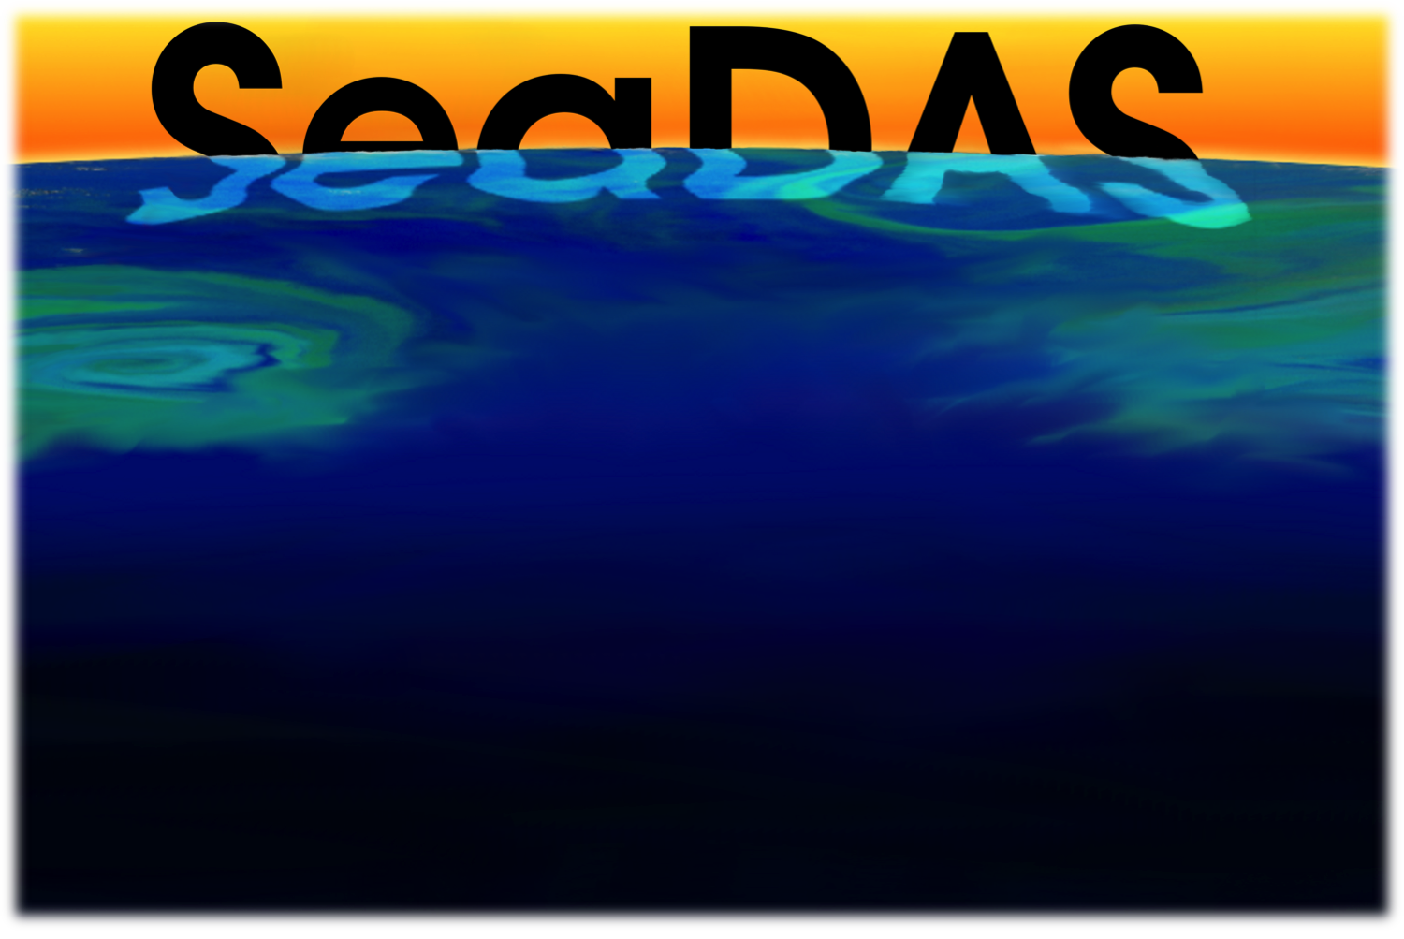
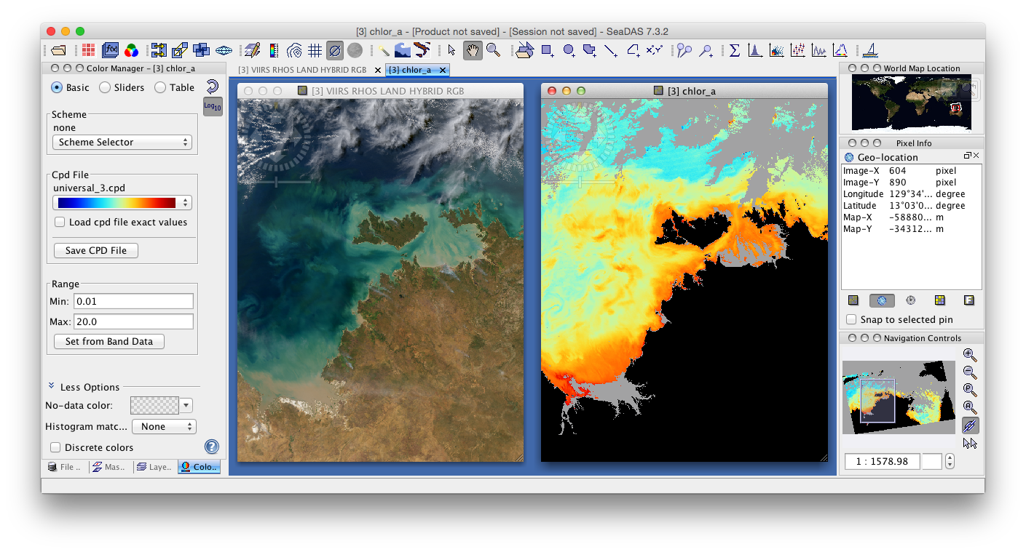
Enabling the Study of our Planet from Space
Free and publicly available software developed by NASA which enables users from their standard desktop and laptop computers to process, visualize, and analyze remote-sensing data.
“Standardizing Satellite Data”

Slide 3
SeaDAS Overview
SeaDAS is a comprehensive open-source toolbox and development platform for viewing, analyzing and processing of remote sensing data.
nearly 20 years as a tool for the ocean color community
it has two primary components, visualization and science data processing that can exist independently
original GUI package development used IDL
evolved from “PC-SEAPAK” developed for CZCS data in the late 1980s
GUI redesign began in 2009 based on the BEAM, with extensions that provide the functionality provided by previous versions of SeaDAS
first official release of SeaDAS version 7 was April 2013
SeaDAS
OCSSW
Tool
Integration
User Interface
Look & Feel
OCSSW
Ocean Color Science SoftWare package
BEAM
core
Tool Modification
Modules

Slide 4
Description & Significance
Vision and Strategic Goals
NASA:
“Advance understanding of Earth and develop technologies to improve the quality of life on our home planet.” (2014)
SeaDAS
Provide the user community with the tools to work with supported satellite mission data
Identically reproduce all standard products, including levels 1, 2 and 3
Continually evolve to keep up with technology
Accessibility
Software (open-source)
Runs on standard inexpensive desktop and laptop computers
Data (freely available)
User Community
Research Scientists
Anyone
Standardizes Satellite Data
Supports over 16 remote-sensing satellite missions

Slide 5
Description & Significance
Supported Satellite Missions
Aquarius
AVHRR
CZCS
GOCI
HICO
LANDSAT-8 OLI
MERIS
MODIS Aqua
MODIS Terra
MOS
OCM1
OCM2
OCTS
OSMI
SeaWiFS
VIIRSN
... coming soon Sentinel-3 (OLCI)

Slide 6
Components
Visualization and Analysis
mapping and reprojection*
cropping and subsetting
bathymetry and topography
masking and overlays
band combinations (rgb imagery)
mosaic and file merging
band smoothing
custom algorithms (band math)
statistics
scatterplots
color palettes
Satellite Data Processing
processors installer
processors (l2gen, l3bin, l3mapgen, …)
multilevel processor
SeaBASS field measurement integration

Slide 7
Supported Data Formats
SeaDAS supports a growing number of raster data formats:
GeoTIFF
NetCDF
HDF (HDF4, HDF5, HDF-EOS)
ENVI (BIL/BIP)
Additional targeted support for specific data formats of other EO sensors such as MODIS, AVHRR, AVNIR, PRISM and CHRIS/Proba.
BEAM-DIMAP (Digital Image Format)
Originally developed to support the SPOT mission
Data are stored as a single product header file with the suffix .dim in XML format containing the product meta-data

Slide 8
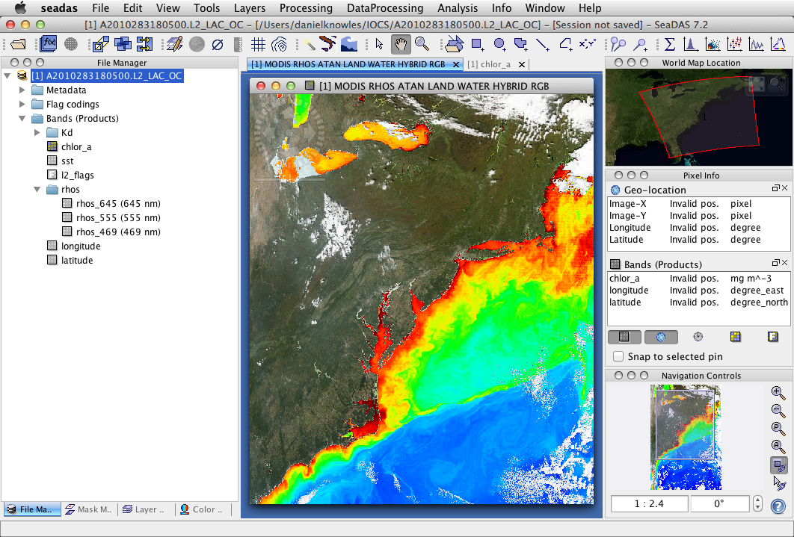
Layout & Toolbars

Slide 9
File Manager
Displays loaded files in a tree view
Metadata
Flag codings
Vector data
Bands (products)
Enables selection of a band
Convenient right-click options
Band properties and renaming
Vector export

Slide 10
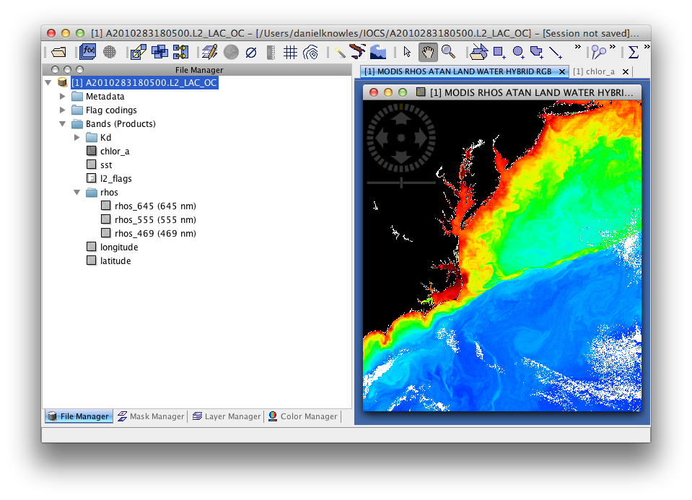
File Manager

Slide 11
Image View
Screen interactive modes
Pan & zoom (default)
Selection
Rectangle zooming tool
Auto-zoom options
Match screen resolution
Fill window
Multiple image views
Window tiling
Synchronized boundaries/zoom
Show synchronized cursor
Windows are not floatable
Stores/contains layers
Stores/contains mask visibility
Image rotation
Image export

Slide 12
Image View

Slide 13
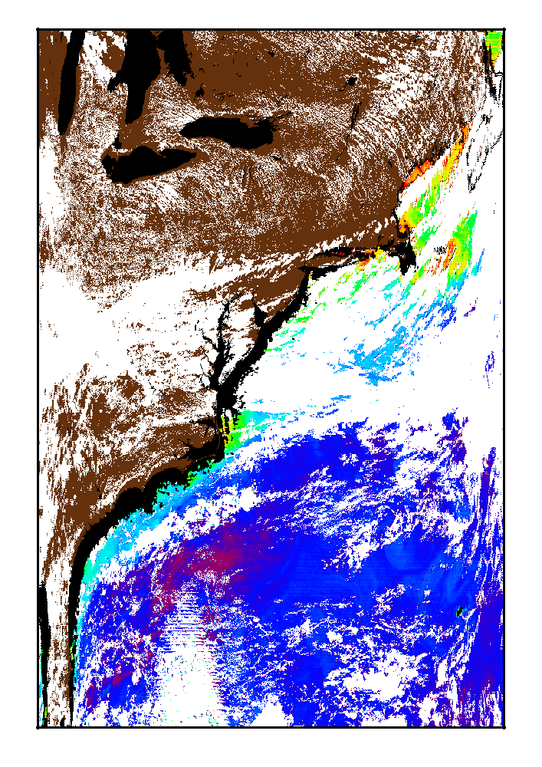
Mask View
Masks
l2flags
Geometries
Logical math expression
Coastline
Land
Bathymetry
Region of Interest (ROI) Mask
Mask Manager Tool
add/modify/delete
show/hide
color, transparency
Stored in file
shared by all bands
Chlorophyll level-2 image, masks displayed:
COASTZ (black), CLDICE (white), LAND (brown)

Slide 14
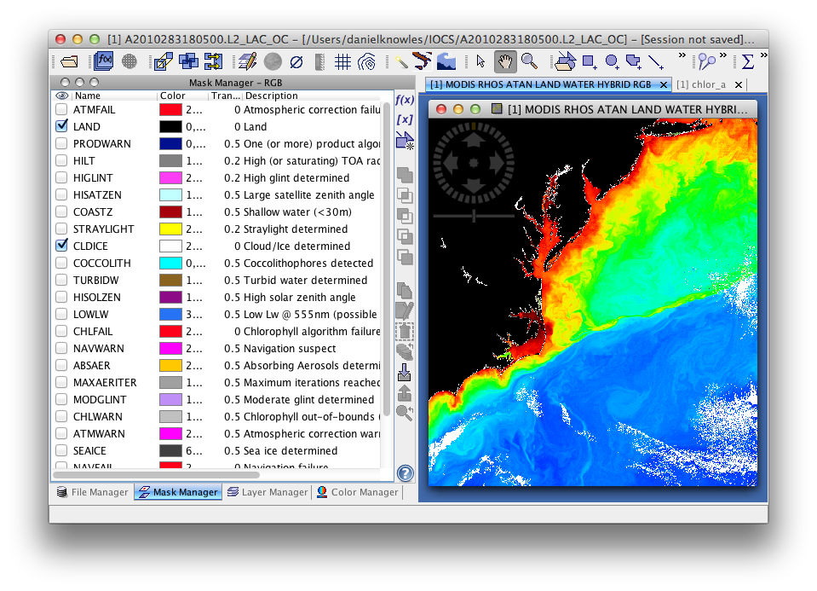
Mask Manager

Slide 15
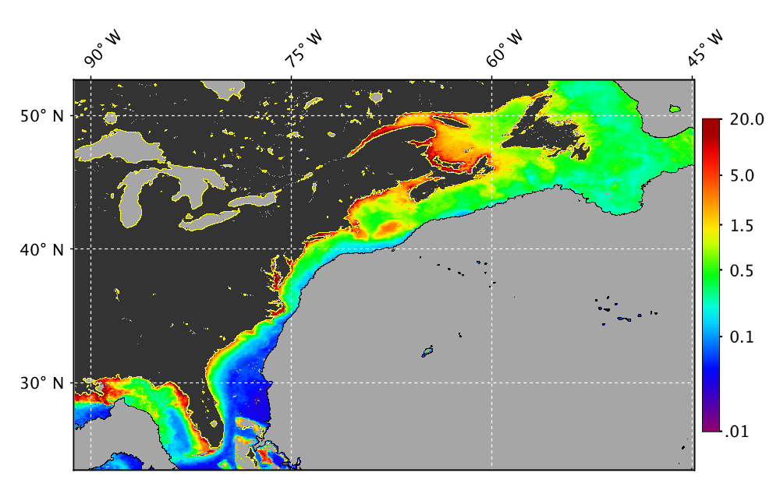
Layers
Layers
band image
color bar
contours
GCP
geometries
masks
map gridlines
no-data
pins
world map
Layer Manager Tool
add/remove
show/hide
stack order
transparency
edit (Layer Editor Tool)
Stored independently in each image view
Can only be saved in a session
Chlorophyll on US Eastern continental shelf, layers displayed:
land mask (black), no-data (grey), map gridlines, color bar,
2000m isobath contour, coastline contour

Slide 16
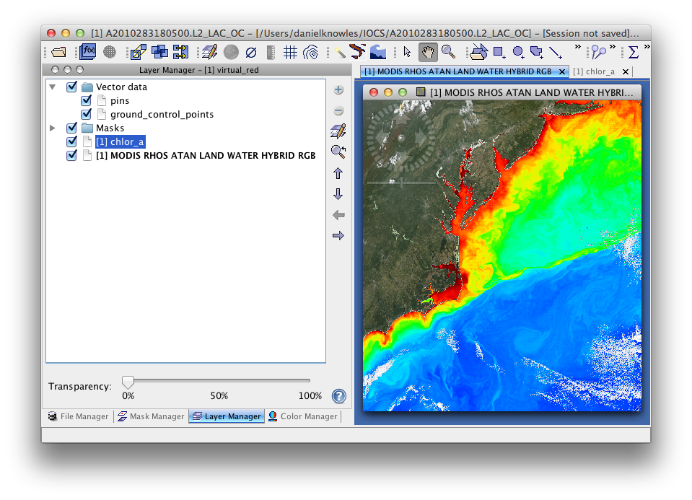
Layer Manager

Slide 17
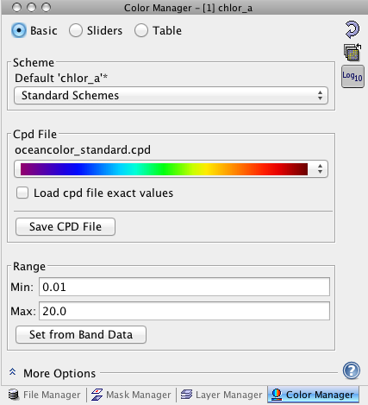
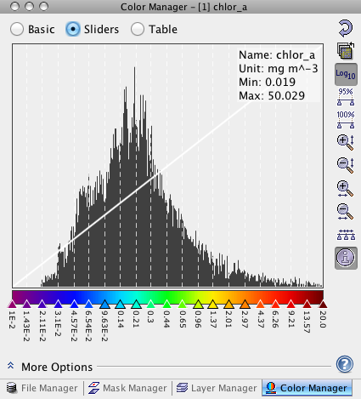
Color Manager

Slide 18
Tools

Slide 19
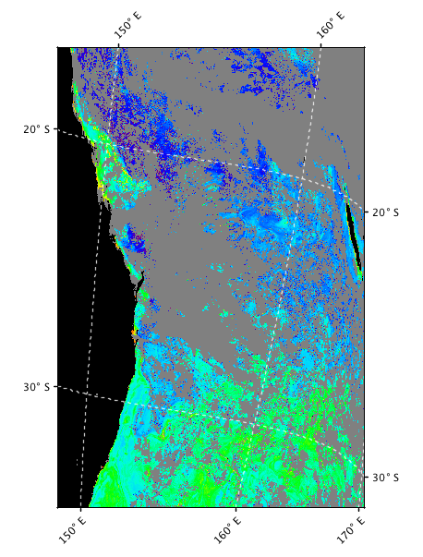
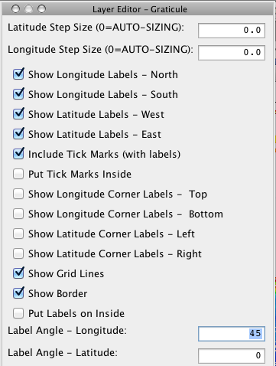
Map Gridlines

Slide 20
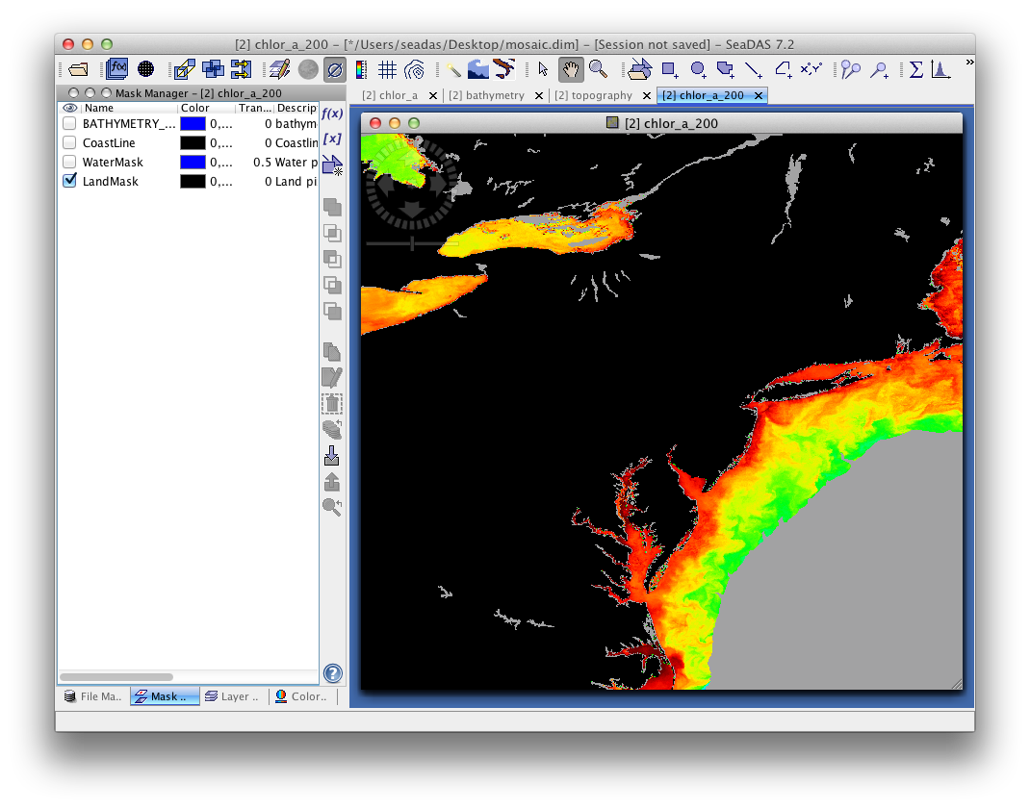
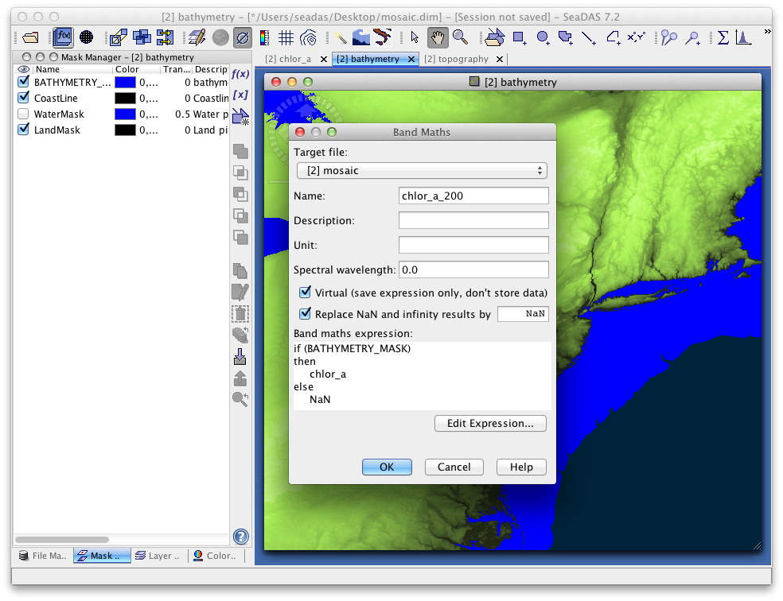
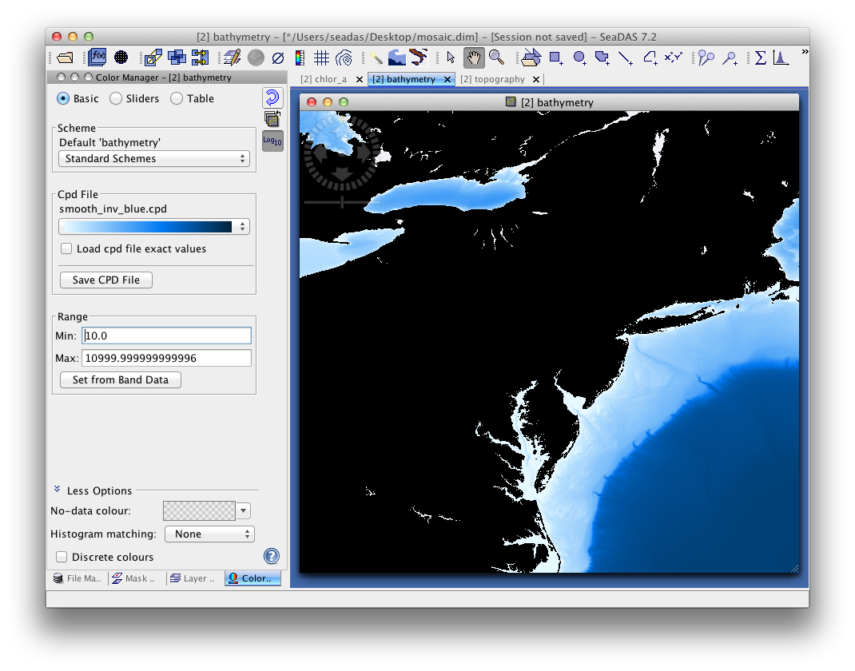
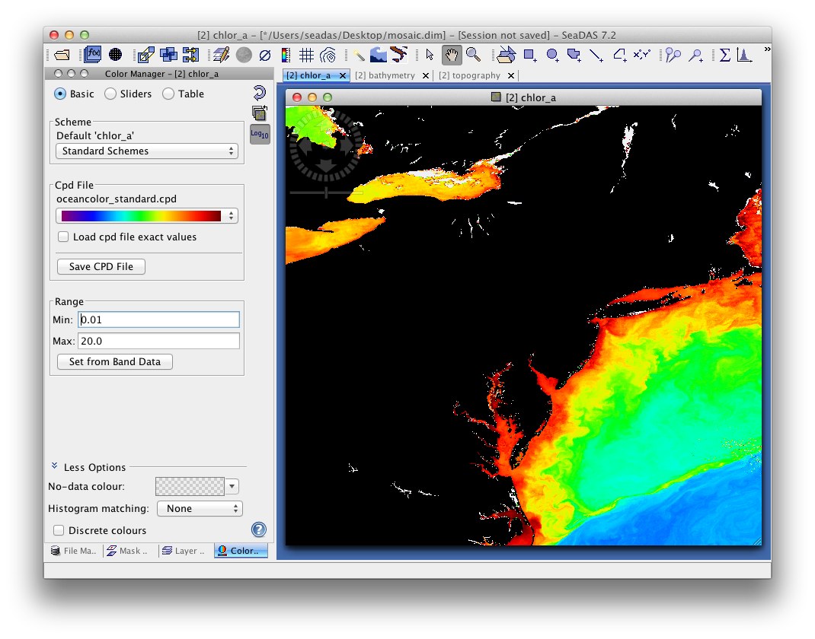
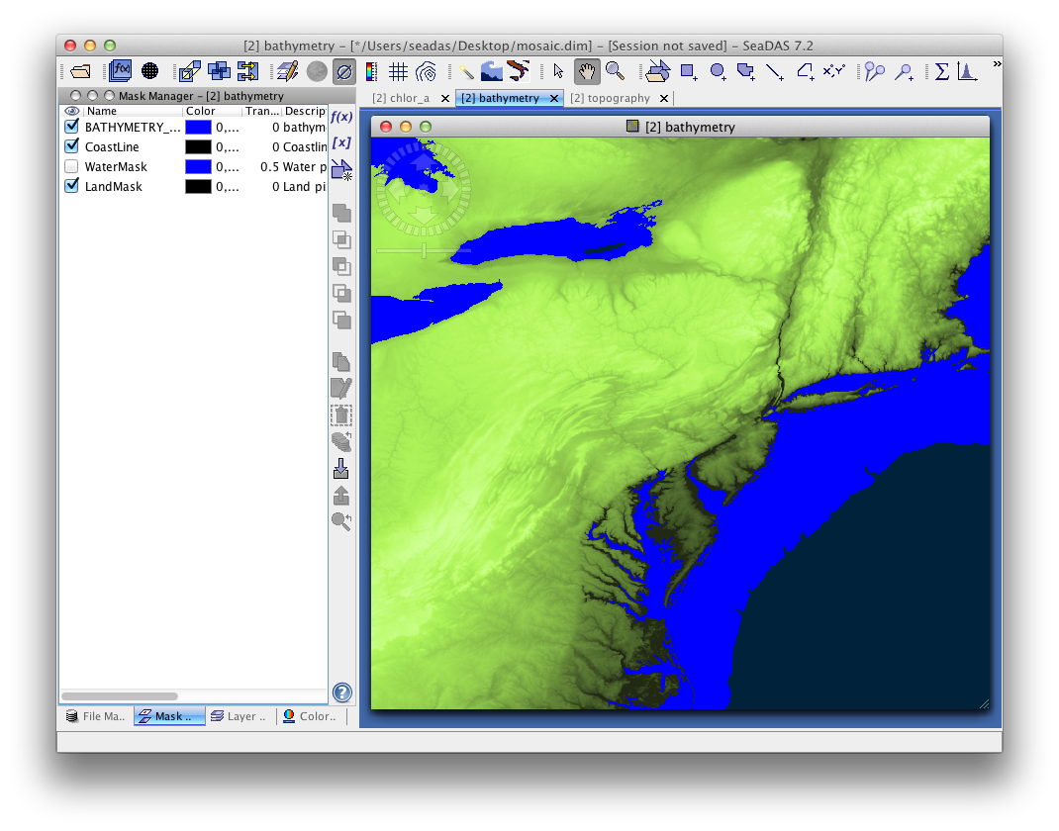
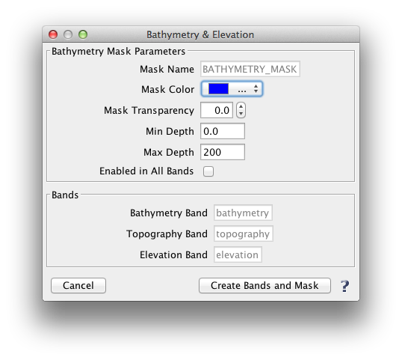
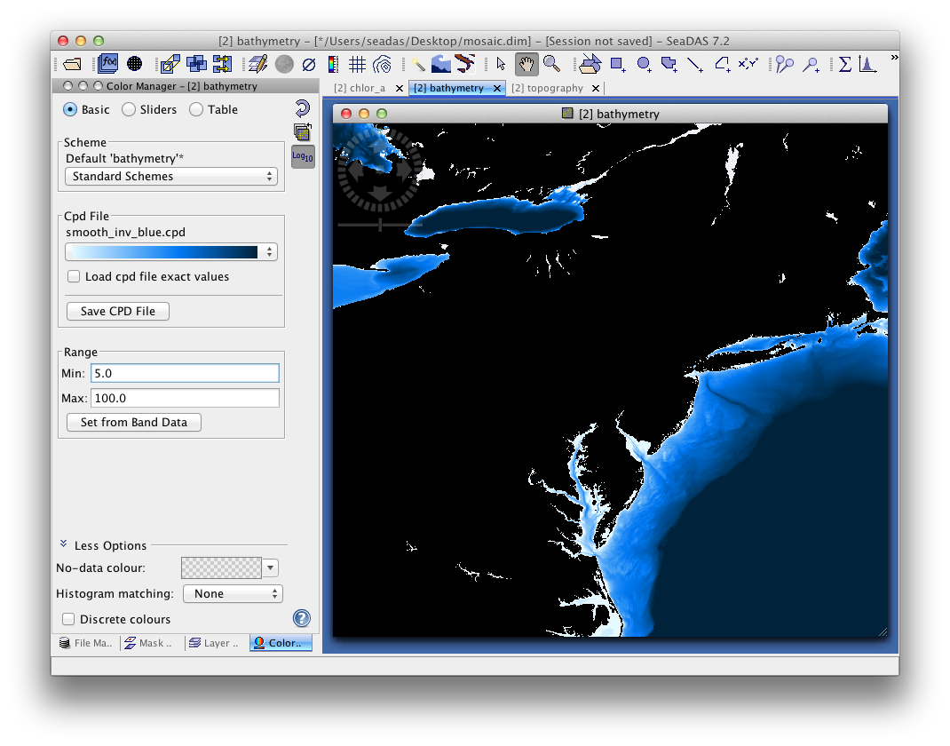
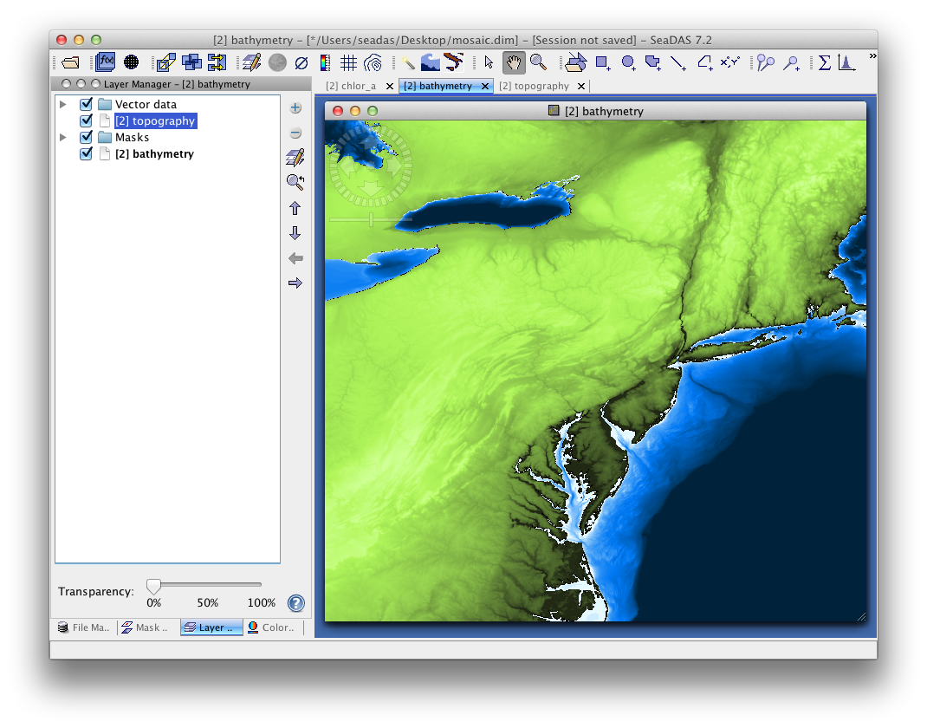
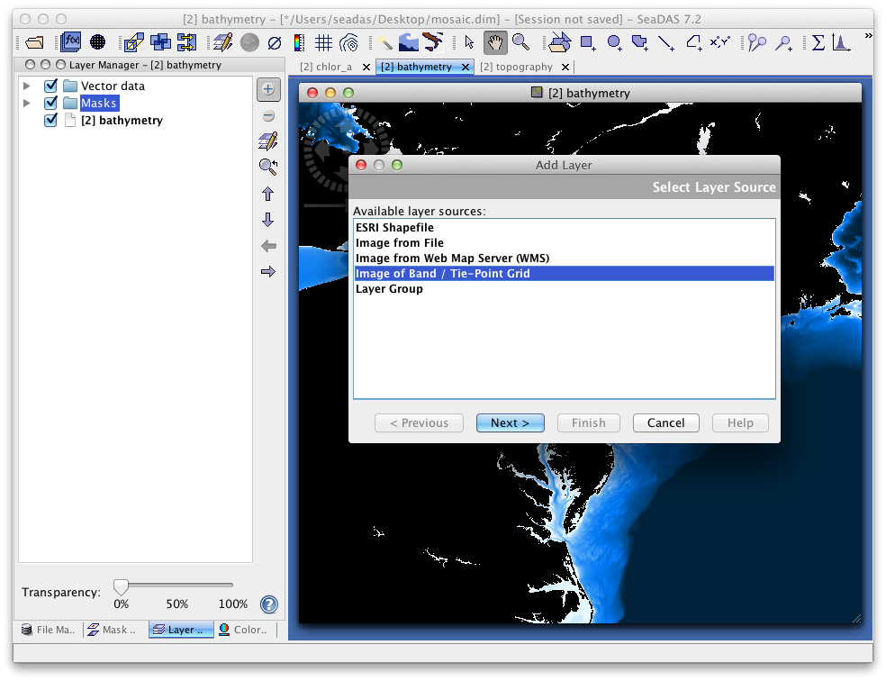
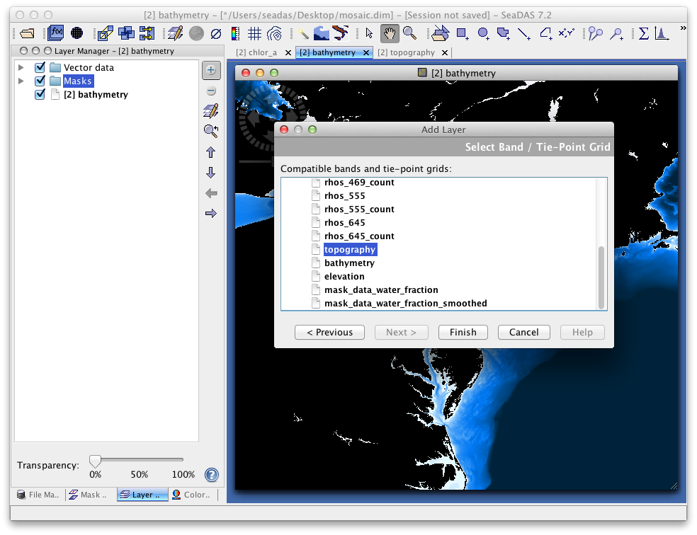
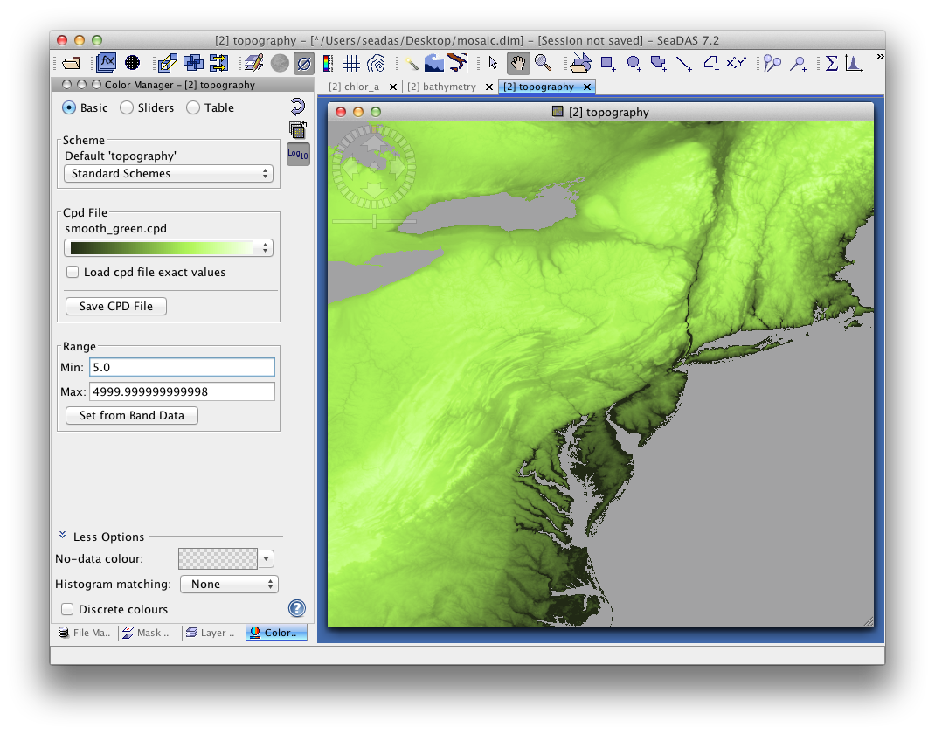
Bathymetry & Elevation Tool

Slide 21
Bathymetry & Elevation Tool

Slide 22
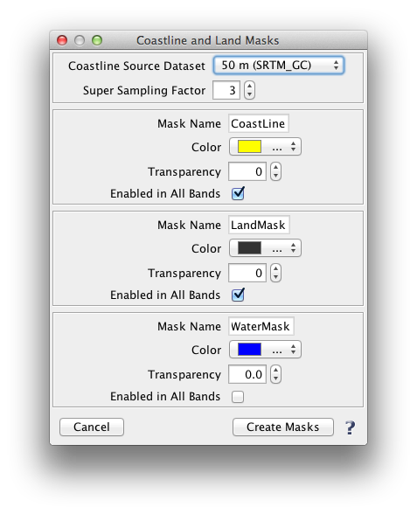
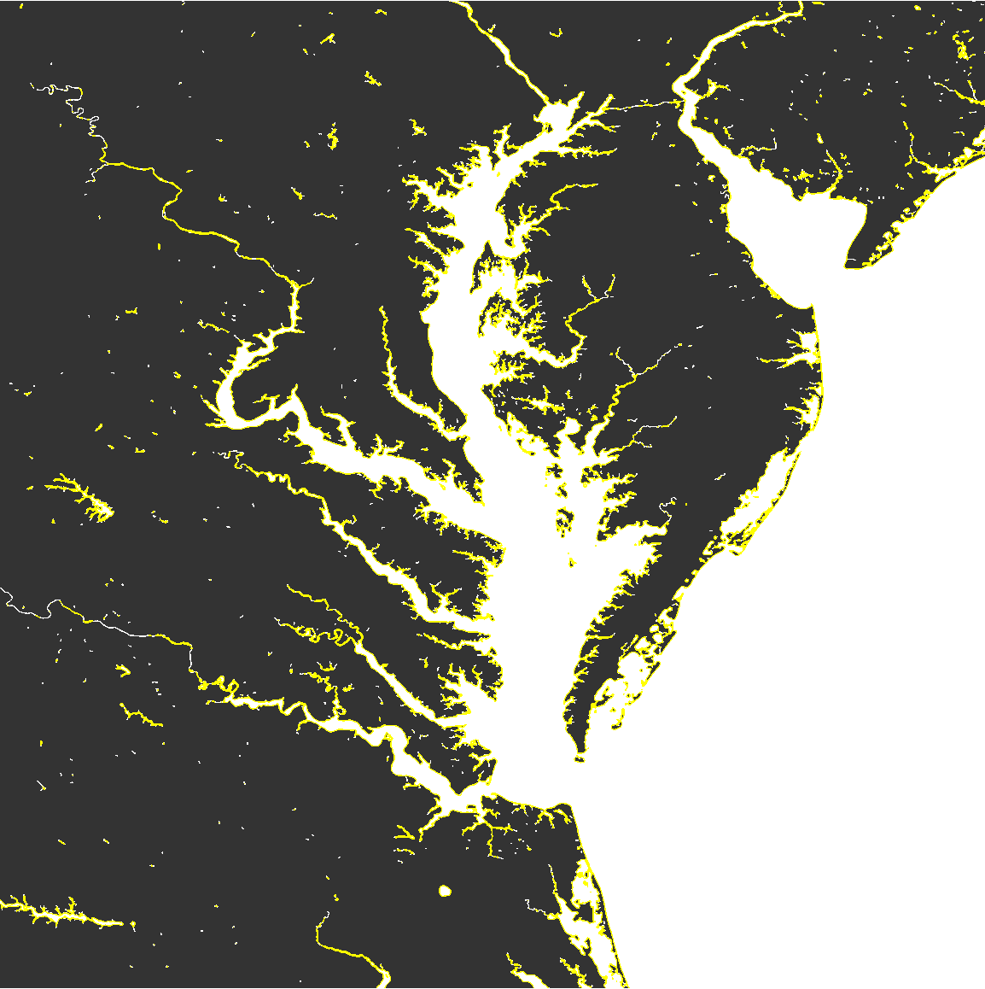
Coastline, Land & Water Mask Tool

Slide 23
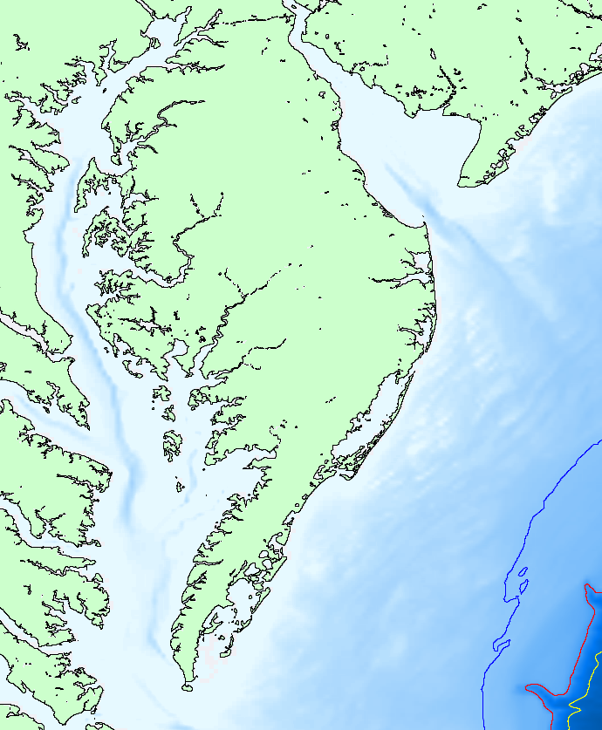
Contour Lines Tool
50m
200m
1000m

Slide 24
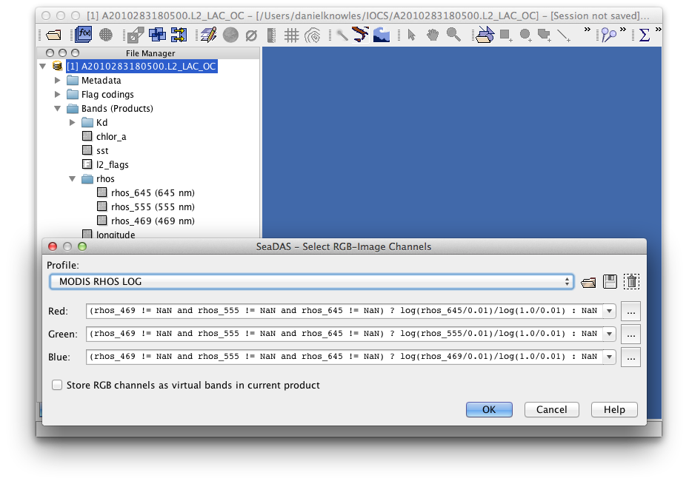
RGB Images

Slide 25
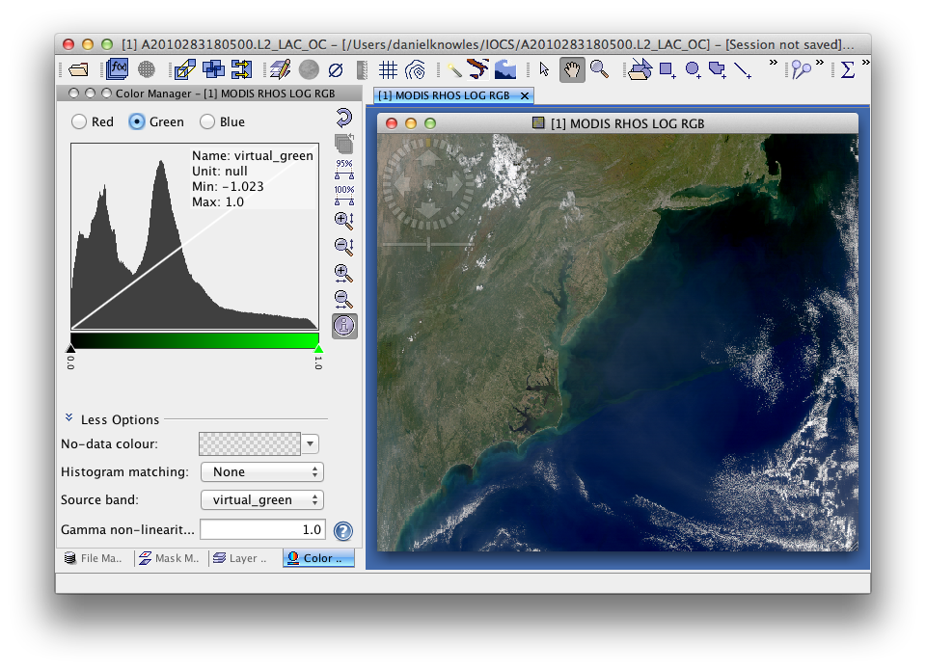
RGB Images

Slide 26
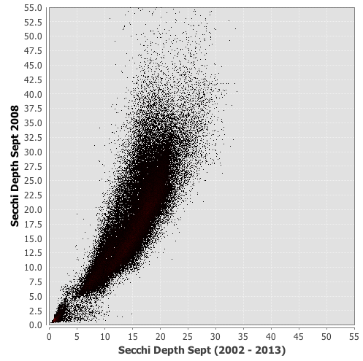
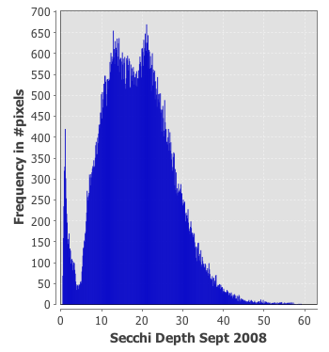
Analysis & Statistics
Statistics
Analysis Plots
Correlative Plot
Histogram Plot
Profile Plot
Scatter Plot
Spectrum Plot
Uses ROI (Region-Of-Interest) Masking
Analysis restrictions
All bands must be in same file (Collocate)
File Processing Analysis Tools
Cluster (EM and K-Means)
Principal Component
Spectral Unmixing

Slide 27
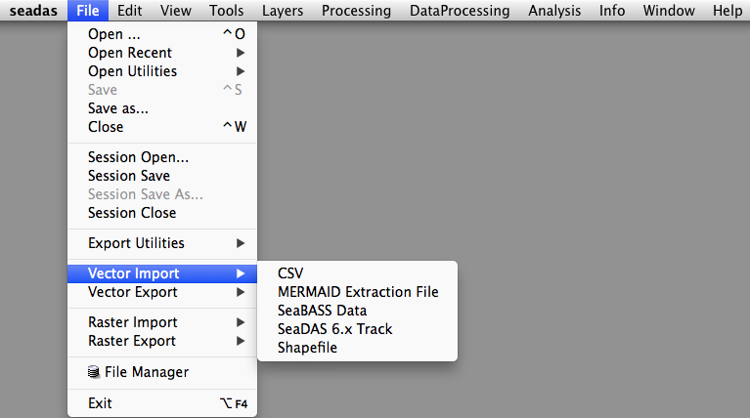
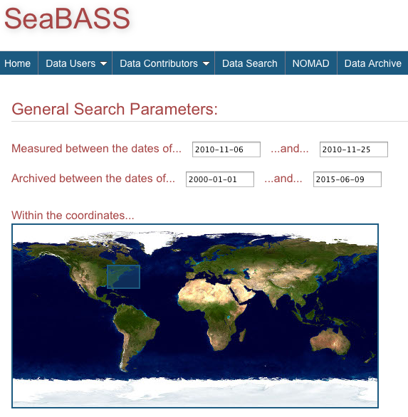
Shiptrack & SeaBASS

Slide 28
Shiptrack & SeaBASS

Slide 29
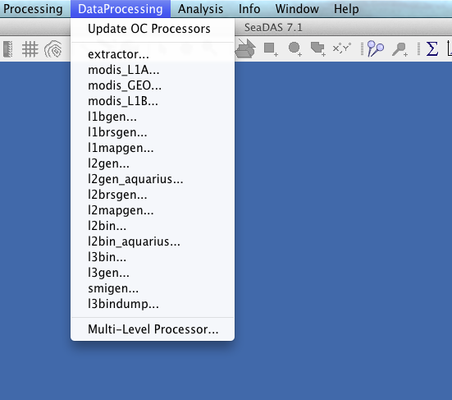
OCSSW Processors GUI
All Ocean Color Science Software processors have dedicated user interfaces in SeaDAS

Slide 30
OCSSW Processing

Slide 31
OCSSW Processing: l2gen

Slide 32
OCSSW Processing: l2gen

Slide 33
OCSSW Processors – l2bin
Generate a L3 bin file from one or more L2 files
Command line usage
l2bin parfile=parfile or
infile=infile ofile=ofile [sday=sday] [eday=eday]
resolve=resolve [flaguse=flaguse] [l3bprod=l3bprod]
[prodtype=prodtype] [noext=noext] [verbose=verbose
[rowgroup=rowgroup] [night=night]
parfile = parameter filename
infile = input filename/filelist
ofile = output bin filename
sday = start datadate (YYYYDDD) [ignored for "regional”]
eday = end datadate (YYYYDDD) [ignored for "regional”]
resolve = bin
flaguse = flags masked [see /SENSOR/l2bin_defaults.par]
l3bprod = bin products [default=all products]
prodtype = product type (Set to "regional" to bin all scans.) pversion = production version [default=Unspecified]
noext = set to 1 to suppress generation of external files
[default=0, (1 for "regional" prodtype)]
rowgroup = # of bin rows to process at once.
night = set to 1 for SST night processing [default=0]
qual_prod = quality product field name
qual_max = maximum acceptable quality [default=2]
verbose = Allow more verbose screen messages [default=0]

Slide 34
OCSSW Processing: l3mapgen

Slide 35
Multilevel Processor (MLP)
Allows for sequential end-to-end processing via a single script
Accessible via command line and the SeaDAS GUI
Programs that can be accessed:
modis_L1A.py
modis_GEO.py
modis_L1B.py
l1aextract_modis.py
l1aextract_seawifs.py
l1mapgen
l1brsgen
l2gen
l2brsgen
l2mapgen
l2extract
l2bin
l3bin
l3mapgen

Slide 36
OCSSW Processing: Multi-level Processor

Slide 37
How To Download
http://seadas.gsfc.nasa.gov/

Slide 38
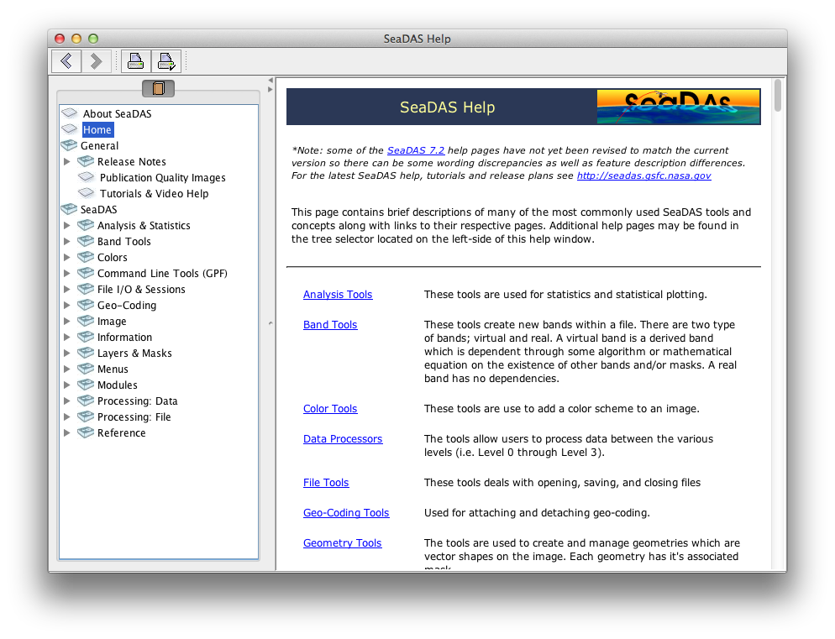
Help

Slide 39
Help
SeaDAS Internal Help
Located in Help menu
Ocean Color Web Page
http://oceancolor.gsfc.nasa.gov
SeaDAS
http://seadas.gsfc.nasa.gov
Web Version of SeaDAS Internal Help
Tutorials
Latest downloads
Forum
http://oceancolor.gsfc.nasa.gov/forum/oceancolor/forum_show.pl
YouTube Channel
http://www.youtube.com/user/nasaoceancolor

Slide 40
Questions?

Slide 41
Backup

Slide 42
Remote-Sensing Satellite Data Levels
Level 0 data
unprocessed instrument/payload data
Level 1A data
time-referenced and annotated with ancillary information including radiometric and geometric calibration coefficients and georeferencing parameters
Level 1B data
instrument/radiometric calibrations applied
Level 2 data
derived geophysical variables
Level 3 data
derived geophysical variables that have been aggregated/projected onto a well-defined spatial grid over a well-defined time period
Binned
Each Level 3 binned data product consists of the accumulated data for all L2 products in a product suite, for the specified instrument and resolution, corresponding to a period of time (e.g. daily, 8 days, monthly, etc.) and stored in a global, nearly equal-area, integerized sinusoidal grid (ISIN)
Mapped
Created from the corresponding Level 3 binned products – Each Standard Mapped Image (SMI) file contains a Plate Carrée, pixel-registered grid of floating-point values (or scaled integer representations of the values) for a single geophysical parameter

