Slide 1
SNPP Overall Status
Harry Solomon
Suomi NPP & GCOM-W1 Mission Manager

Slide 2
SNPP Flight Summary
Phase: E Launch Date: Oct 28, 2011
Status as of: 5/31/2016
 | Mar | Apr | May | Comments
Schedule |  |  |  | All routine operations and intensive calibration and validation on schedule
Spacecraft |  |  |  | Systems operating nominally;
Instruments |  |  |  | VIIRS SBC Lockups; Mirror degradation; CrIS Autonomous Resets; ATMS Scan Drive
VIIRS |  |  |  | Mirror degradation due to Tungsten Oxide; Single Board Computer Lock-ups; HAM-RTA Scan Synch Losses - recurring error
CrIS |  |  |  | CREECBIT-recurring error; LWIR FOV1 intermittent errors; CrIS Autonomous Reset; CrIS SSM Reset-recurring error, CrIS SSM Over-Speed Safehold Anomaly
ATMS |  |  |  | Scan Drive Main Motor current; instrument is providing nominal data; Successful Scan Drive Daily Reversals Continue; ATMS Safehold anomaly on 4/14
OMPS |  |  |  | Operating as expected—continued calibration/validation; OMPS misconfiguration during propulsive maneuver on 2/24
CERES |  |  |  | Nominal operations
C³S |  |  |  | SVL (SG4) antenna issues resolved; GEM Issues at Svalbard; FCDAS, Svalbard & NSOF Ops errors (VIIRS Lunar Cal) & TLE Error, Svalbard SG4 ACU Fault
IDPS |  |  |  | Nominal operations with known workarounds
Algor & Cal/Val |  |  |  | KPPs and SDRs performing well
Mission |  |  |  | Ground system robustness and VIIRS sensor anomalies
Overall |  |  |  | Continuing to exceed science data availability and latency thresholds
G
G
G
G
G
G
G
Y
G
G
Y
G
G
G
G
G
G
G
G
G
G
G
G
G
G
G
G
G
G
G
G
G
G
G
G
G
G
G
G
G
G
G
Good Shape
Y
Minor Problem
R
Major Problem

Slide 3
SNPP Overall Status
Nominal Operations Continue
Closely watching expected Star Tracker performance
  Some errors visible in VIIRS data during lunar intrusion periods
  Potential fixes being tested at this time
    Remove star trackers from Attitude solution (gyro only) during lunar periods
    Adjust star tracker background sensitivity
VIIRS Single Board Computer Lockups (AKA VIIRS Petulant Mode) not observed since Dec 2014; after Flight Software fix
VIIRS Half-Angle Mirror (HAM) Sync errors persist
  64 occurrences since launch
  Instrument recovers autonomously. Typical minor data degradation (~1.6 minutes max)
ATMS Scan Drive Main Motor performance being monitored closely. Increasing motor current observed
  Scan Drive Bearing degradation suspected. Analysis continues, and instrument protective measures in place
  Scan Drive reversed once/day above 75 deg N. Latitude to redistribute bearing lubricant
    Data degraded <I minute each reversal
CrIS Nominal
  Periodic CrIS Scene Selection Module (SSM) issues. Analysis continues on this
      Recovers autonomously. Some degradation in data
OMPS Nominal
CERES Nominal

Slide 4
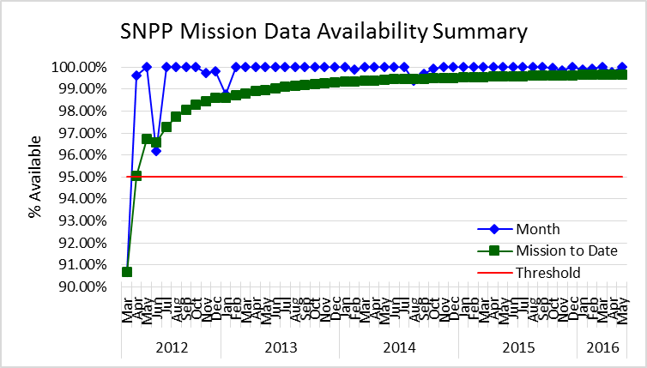
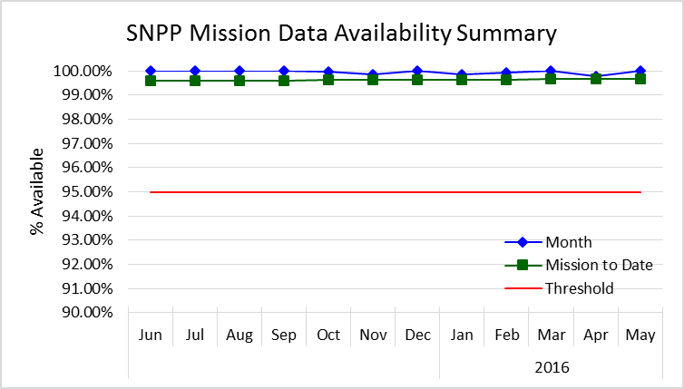
SNPP Mission Data Availability Summary
May 31, 2016
Mission-to-Date
CrIS SSM Anomalies
ATMS Safehold
CrIS Reset #3
Data Availability
May 2016 --- 100%
Mission to date --- 99.67%

Slide 5
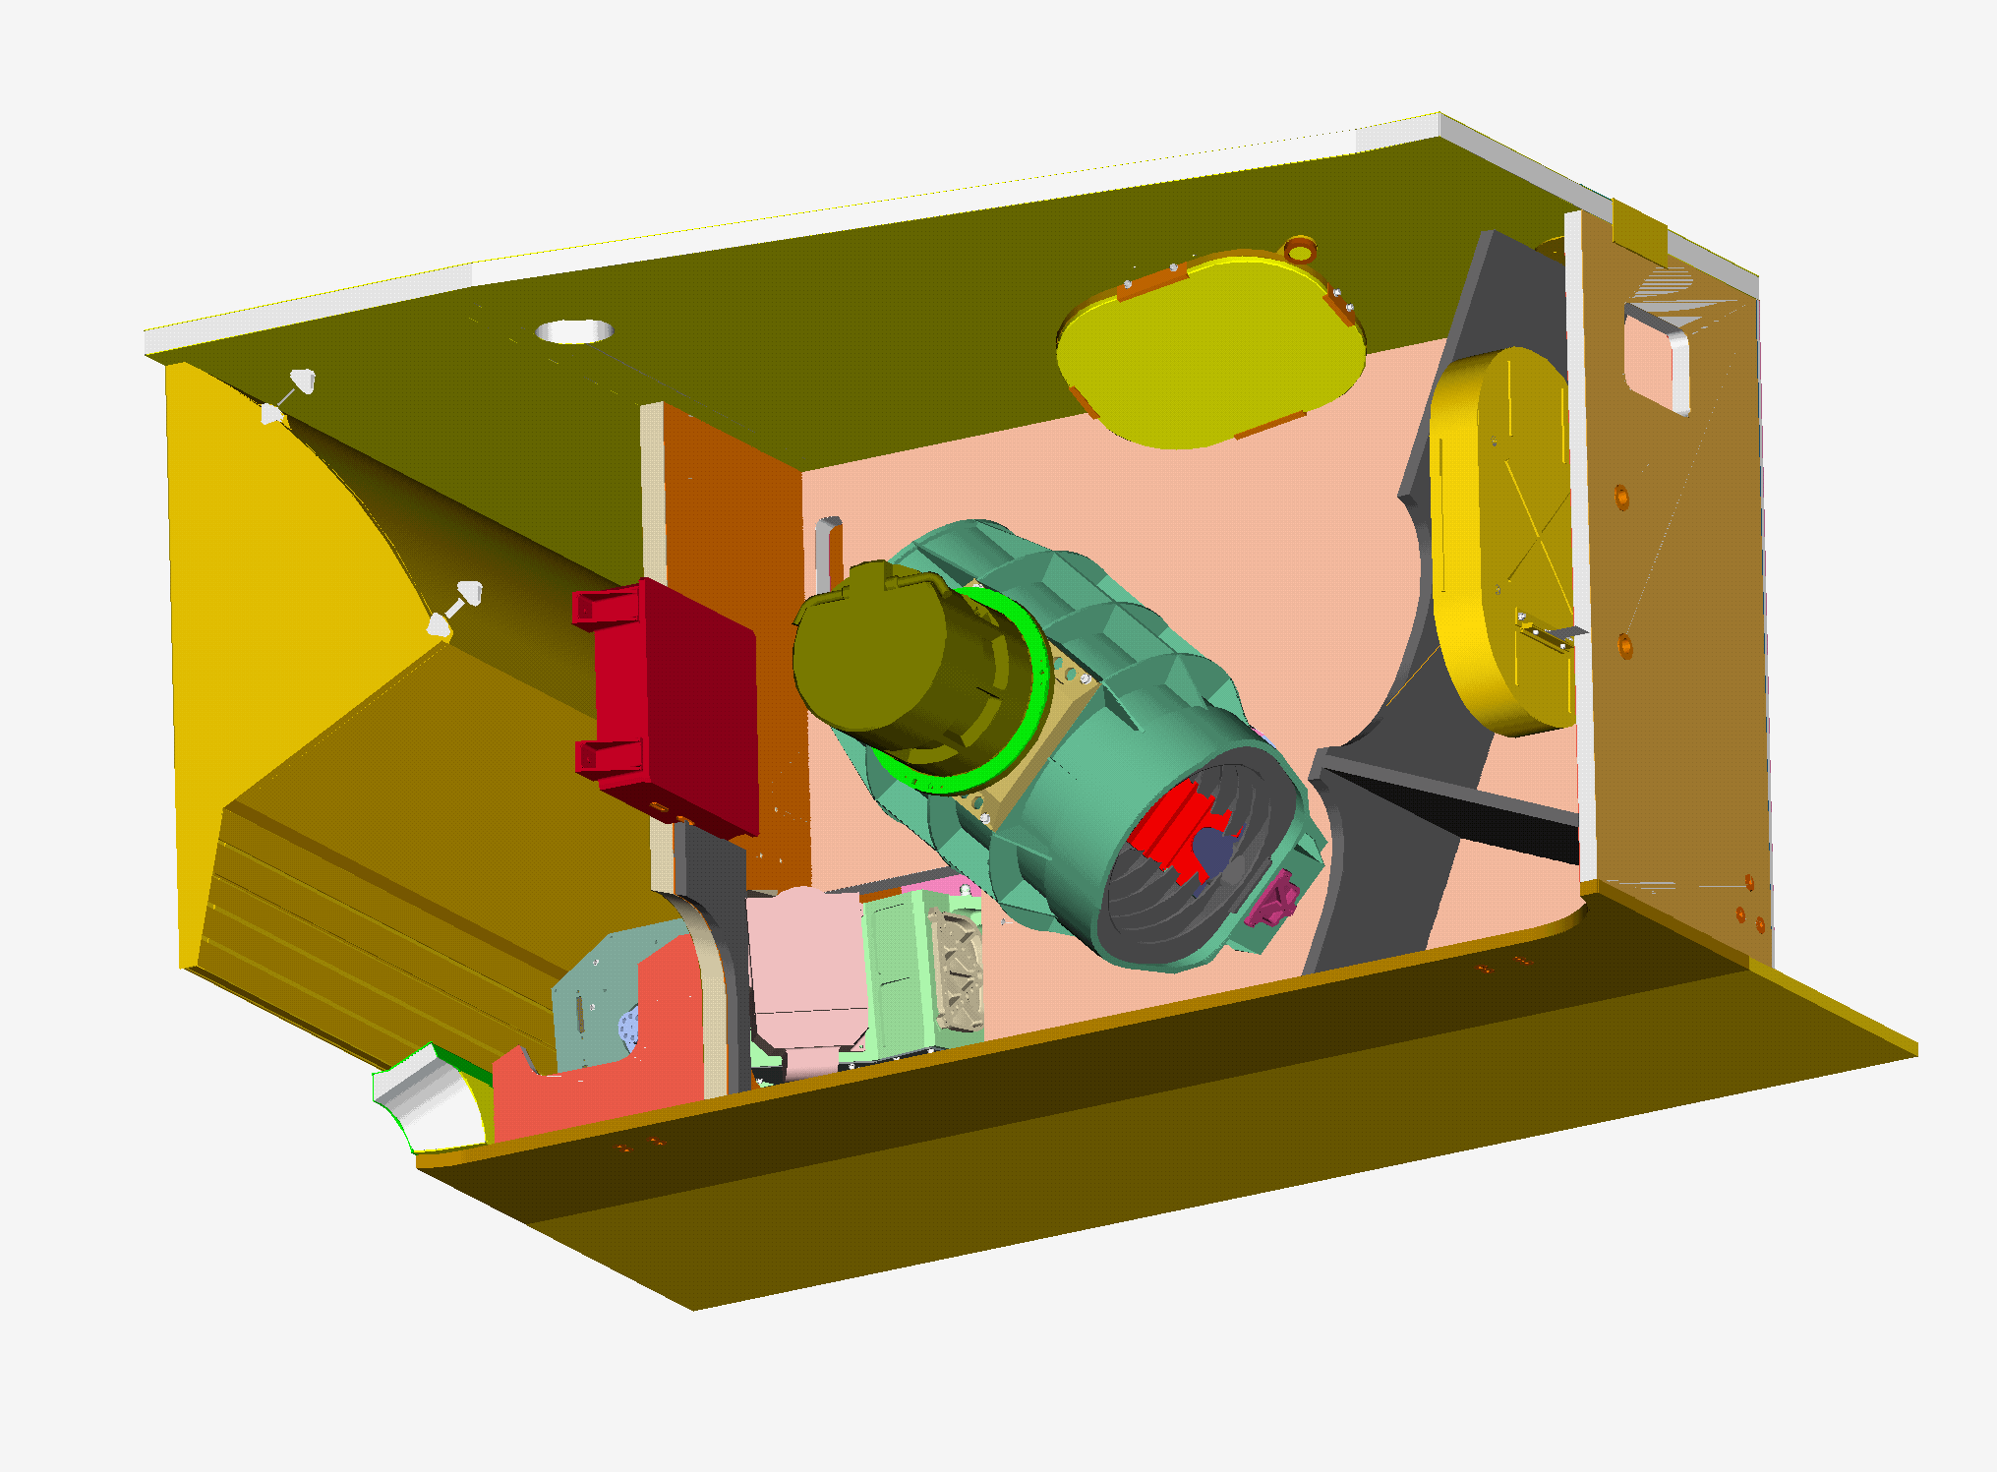
S-NPP VIIRS Highlights
Instrument Operations and OBC Functions – Normal
    Same operation configurations (B-side) since launch
    “Scan Sync Loss” between RTA and HAM: 64 since launch (2-3 min); poor geolocation accuracy
    “Petulant Mode” - the single board computer (SBC) lock-up not occurred since a FSW fix in Dec 2014 (FSW: 0x4016)
    Optical throughout degradation has nearly leveled off
On-orbit Calibration and SDR/L1B LUT Delivery
  SD calibration: each orbit; SDSM: 3 times/week
  BB WUCD: 17 since launch
  DNB: monthly VROP operation
  lunar observations: 41 since launch (not all need roll maneuvers)
  35 sets of LUTs for RSB (and DNB) delivered for Land SIPS SDR processing of C1.0 and C1.1 (Oct 2012 – present); 9 sets of LUTs delivered to Atmosphere SIPS (Nov 2014 – present)
5

Slide 6
S-NPP VIIRS Highlights
VIIRS Publications
  Total number of 264 (citation 8.4/article)
Technical Meetings and Workshops
  Regular Technical Meetings of VCST and OBPG
  VIIRS L1B Working Group Meetings
  VIIRS SDR Meetings (led by NOAA STAR)
Continues effort on L1B algorithm and LUT improvements
  POC: Fred Patt and Vincent Chiang
  Latest effort on L1 V2 SW (details in Calibration Workshop materials)
J1 and J2 VIIRS Instrument Status
  J1 VIIRS currently undergoing SC environment testing (sensor per-launch calibration performance summarized during last year’s STM and also at this year’s calibration workshop) – launch in early 2017
  J2 VIIRS recently started its ambient environment testing
6

Slide 7
S-NPP VIIRS On-orbit Performance
Instrument and On-board Calibrators (OBC)
  Instrument and FPA temperatures: stable
  SD degradation: relatively large (similar to Terra MODIS)
  BB stability: very stable (similar to Aqua MODIS)
Radiometric
  Spectral band responses (different from MODIS)
    Large changes in NIR and SWIR (due to mirror contamination)
    Small changes in VIS, MWIR, and LWIR
  Detector noise characterization (better performance than specification)
    Noticeable changes in NIR and SWIR are due optical throughput degradation
Spatial and Spectral
  Band-to-band registration (BBR): stable (tracked using lunar observations)
  Mirror contamination => wavelength dependent optics degradation
Geolocation
7

Slide 8
VIIRS and MODIS Spectral Bands
1 DNB
14 RSB
(0.4-2.3 μm)
16 Moderate (radiometric) bands, 5 Imaging bands, 1 DNB
Dual Gain Bands:
M1-M5, M7, M13
7 TEB
8

Slide 9
Summary
Both Terra MODIS (16 years) and Aqua MODIS (14 years) and their on-board calibrators continue to operate and function normally
Dedicated effort by MCST (and SDST) and support from science algorithm developers remain critical to MODIS instrument calibration/data product quality
Challenging issues identified for both MODIS instrument calibration will be investigated and addressed for future improvements of data processing/reprocessing
SNPP VIIRS on-orbit performance (4.5 years) has become very stable
Effort from VCST is vital in support of SIPS for producing the improved and consistent VIIRS data products
Multiple and major instrument calibration activities in the coming year will be more challenging for both MCST and VCST
9

