Slide 1
Real Time Land Science Applications Day
Welcome & Logistics
Wednesday, June 22, 2016
Brad Quayle
U.S. Department of Agriculture - Forest Service
Remote Sensing Applications Center (RSAC)
NASA Direct Readout Conference
Valladolid, Spain
June 21-24, 2016

Slide 2
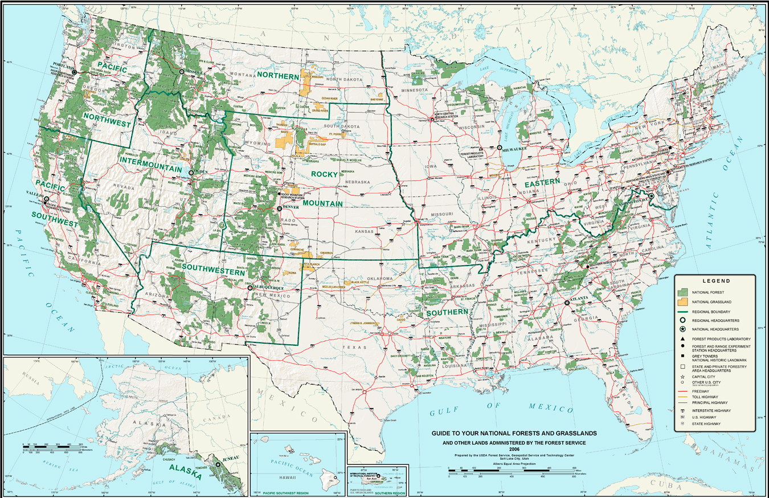
US Department of Agriculture-Forest Service
Mission: “Sustain the health, diversity and productivity of the nation’s forests and grasslands to meet the needs of present and future generations”
National Forest System
155 National Forests and 20 National Grasslands
78 million hectares in CONUS, AK and PR
Research & Development
Stations & Field Offices
State and Private Forestry
Fire & Aviation
Forest Health Protection
International Programs Office

Slide 3
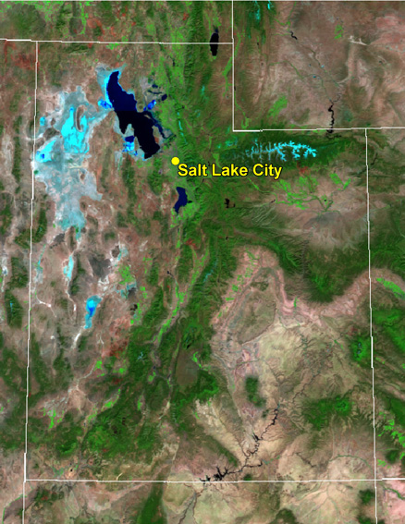
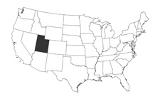
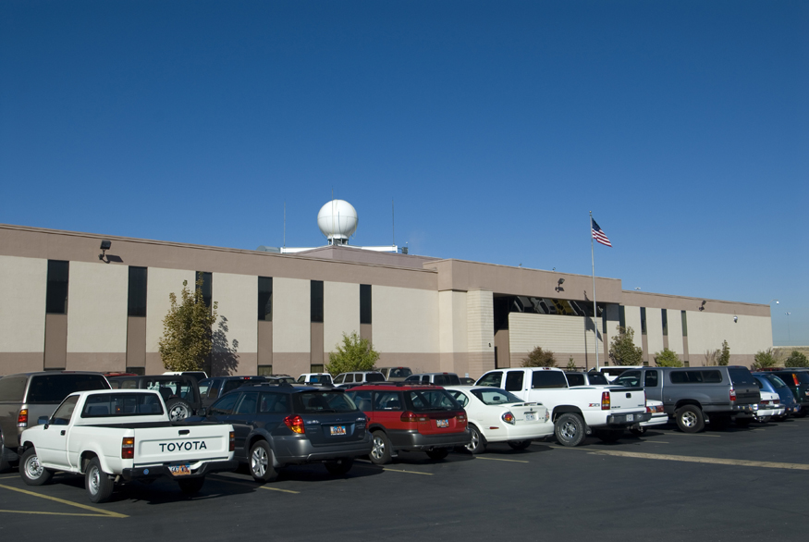
Near Real-Time Data in the USDA Forest Service
NRT remote sensing data/products support critical applications
Wildfire detection, monitoring and characterization (U.S. and Canada)
Forest health monitoring (U.S.)
Operational collection/processing of EOS MODIS and S-NPP VIIRS
DR data sharing network with partner ground stations
LANCE provides backup/gap-filler for DR
Support provided by NASA, mission science teams and academia

Slide 4
Land Science Applications Day Schedule
9:00 AM Welcome and Logistics Brad Quayle (USDA Forest Service)
9:10 AM WORKSHOP: Multi-Angle Implementation of Atmospheric Correction
(MAIAC) Alexei Lyapustin (NASA GSFC)
10:00 AM WORKSHOP: Soil Moisture Active/Passive (SMAP) Mission
Vanessa Escobar (NASA GSFC)
10:45 AM Posters/Exhibits
11:30 AM WORKSHOP: Applications of Real-time Satellite Precipitation
Estimates Francisco Tapiador (UCLM)
12:00 PM Lunch
1:00 PM WORKSHOP: Active Fire Algorithms Louis Giglio & Wilfrid Schroeder
(NASA GSFC)
2:15 PM WORKSHOP: Burned Area Algorithms Louis Giglio & Wilfrid Schroeder
(NASA GSFC)
3:00 PM Break
3:15 PM WORKSHOP: Advanced Fire Information System (AFIS) Philip Frost (CSIR)
3:45 PM WORKSHOP: Monitoring Flood Estimates Using NASA’s Near Real- Time Flood
Mapping Products Dan Slayback (NASA GSFC)
4:30 PM WORKSHOP: USDA World Agricultural/Food Security Monitoring
Dath Mita (USDA FAS) 5:15 PM Wrap-up

Slide 5
Workshop Objectives & Formats
Descriptive/Instructional Workshops
- examples include algorithm, product and software
workshops
- longer presentation
- provides details of implementation and use
- questions and discussion are welcome throughout
B. Discussion Workshops
- examples include workshops on application topics
- short (10-15 min) presentation by the workshop lead
- discussion period
The audience is encouraged to ask and answer questions, bring up topics, and generally contribute to the discussion.
Microphones available for audience use.
Please state your name and affiliation before speaking.

Slide 6
Workshops - Possible Avenues of Discussion
What kinds of applications are you interested in seeing developed?
What types of data/algorithms are needed for your potential and/or existing application and information needs?
Provide information on the actual or potential use of the presented algorithms/product/application in the context of your organization’s needs.
Are there particular challenges/shortcomings/unmet needs? Where can things be made better?
Are there opportunities for collaboration with other attendees and workshop leads? (regional applications, data sharing, etc.)
Discuss scenarios with the broader group to identify innovative ideas, potential improvements, etc.
Notes:
Workshop discussion topics/questions

Slide 7
Questions/Comments???

Slide 8
Oceans Schedule for Thursday, June 23
9:00 AM Welcome and Logistics Jasmine Nahorniak (OSU)
9:10 AM PRESENTATION: Possibility of Day-Night-Band of VIIRS to Detect Fishing Activities Ichio Asanuma (TUIS)
9:40 AM WORKSHOP: Suomi-NPP VIIRS Nighttime Environmental Products for Land Science and Disaster Response Applications Miguel Roman (NASA) 10:30 AM Posters/Exhibits
11:15 AM PRESENTATION: Sentinel-3 Mission Overview Susanne Mecklenburg (ESA)
11:45 AM Lunch
1:00 PM WORKSHOP: SeaDAS 7 for Ocean Data Users
Fred Patt (NASA) 2:00 PM WORKSHOP: Fisheries Cara Wilson (NOAA) 3:00 PM Posters/Exhibits
3:30 PM PRESENTATION: VIIRS Ocean Color Products from Global Open Oceans and Coastal/Inland Turbid Waters
Menghua Wang (NOAA)
4:00 PM WORKSHOP: Monitoring for Ecosystem and Human Health Erin Urquhart (EPA) 5:00 PM Wrap-up

