Slide 1
Atmospheric Composition
NDRC-9
Valladolid, June 24, 2016
C. Retscher, R. Munro, R. Lang,
R. Lindstrot, R. Huckle, G. Poli,
A. Kokhanovsky, A. Holdak,
M. Grzegorski, A. Cacciari

Slide 2
Contents
Main application areas related to atmospheric composition (AC)
The role of satellite-based remote sensing in monitoring and forecasting atmospheric composition
Measurement techniques
EUMETSAT missions relevant to AC and potential data use for direct readout

Slide 3
Main application areas - Introduction
Satellite-based remote sensing supports a number of applications related to atmospheric composition
  Stratospheric ozone monitoring; continues to be important as the anticipated recovery of the ozone layer is monitored
  For tracking long-range pollution transport satellites potentially provide global coverage on a daily basis
  Air quality monitoring both at global and regional scales
  Monitoring biomass burning, fire emissions, and volcanic eruptions.
  Monitoring greenhouse gases to help estimate surface fluxes
  Improved knowledge about the role of aerosols with new instruments and products

Slide 4
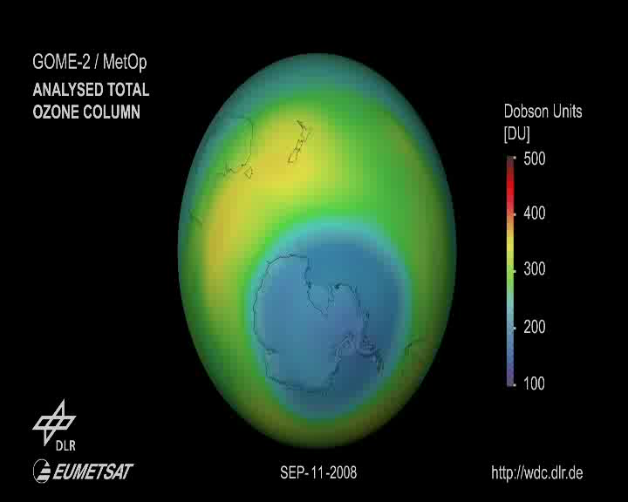
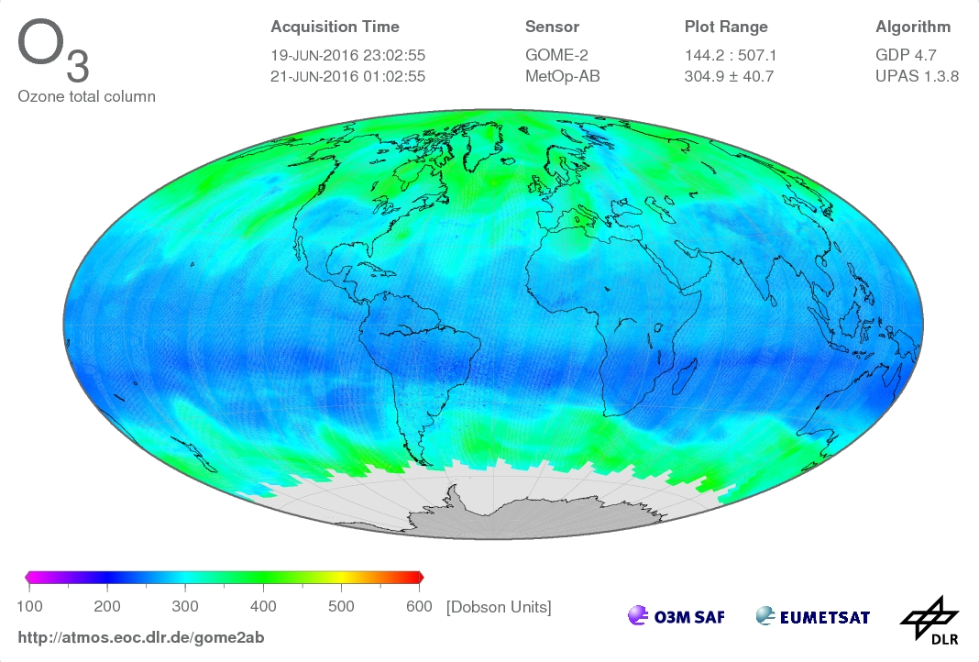
Stratospheric Ozone Monitoring & Ozone Depletion
Stratospheric ozone has been monitored from space since the 1970's when the ozone hole over the South Pole was first observed by ground-based systems.
Stratospheric ozone depletion is driven by ozone-depleting substances (ODS's)

Slide 5
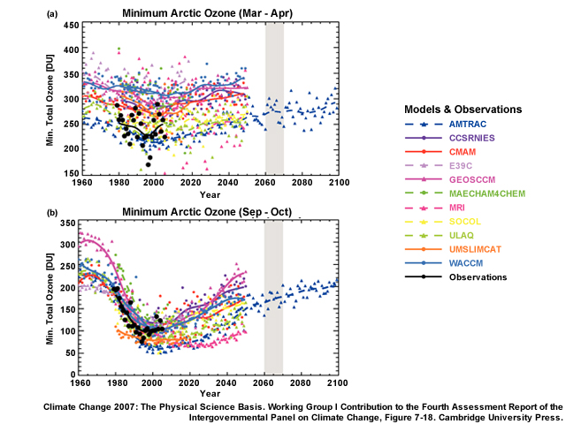
Stratospheric Ozone Monitoring & Ozone Depletion
Climate change could alter atmospheric circulation and temperature, which could affect stratospheric ozone recovery
Model predictions of future ozone including climate change effects do not yet give a fully consistent picture
Continued monitoring of the stratospheric ozone layer remains essential

Slide 6
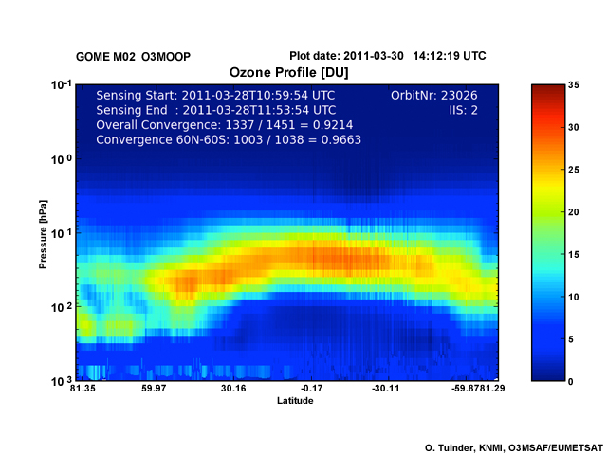
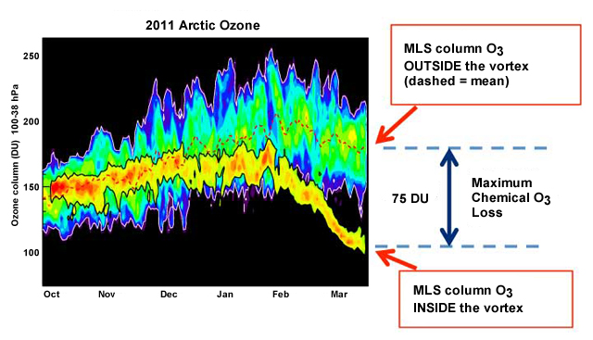
Stratospheric Ozone Monitoring & Ozone Depletion
Measurements of ozone have historically been made in the UV/Visible spectral range but can also be measured in the infrared and microwave/millimeter wave spectral regions
Many measurements have been made in nadir viewing geometry, but limb and occultation measurements provide an important contribution

Slide 7
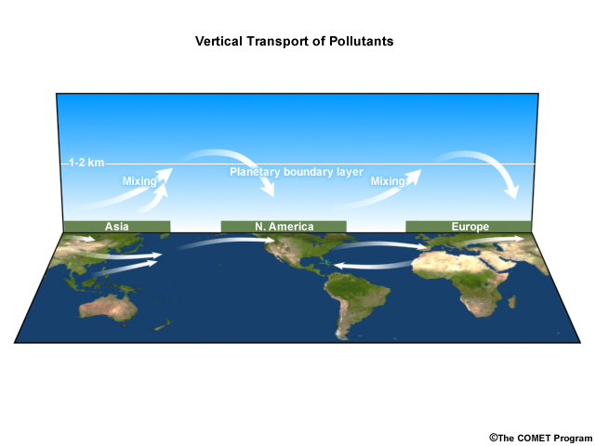
Long-Range Transport of Pollution
Long-range pollution transport occurs when pollutants are lifted from source regions near the surface into the free troposphere where they can be carried large distances
When dynamical processes return the pollutants to the boundary layer, they impact the local air quality
Satellite data have shown that trans-oceanic transport of pollutants can also occur
Pollutants:
  particulate matter from diesel engines, deserts, and agricultural dust
  nitrogen oxides from petrol engines, and
  volatile organic compounds

Slide 8
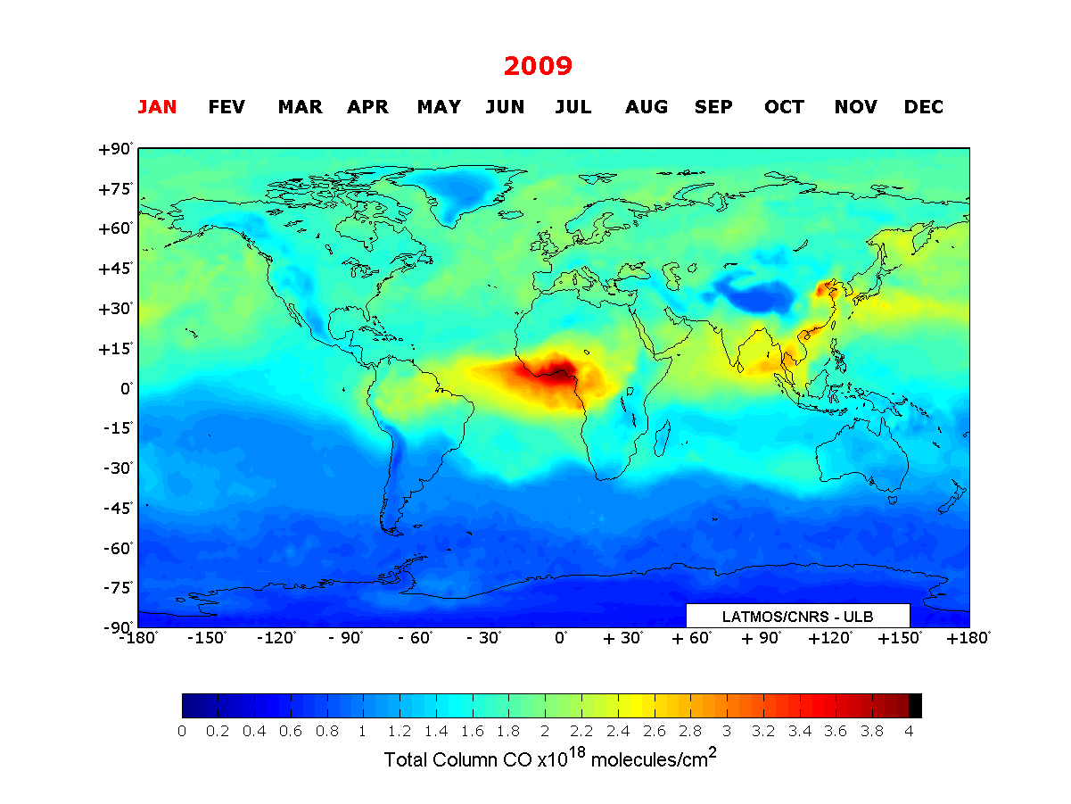
Long-Range Transport of Pollution
Nadir observations with global coverage at a relatively high horizontal resolution, daily repeat coverage or better, and sensitivity to the planetary boundary layer
Limb observations with high vertical resolution
Combining measurements and models as well important

Slide 9
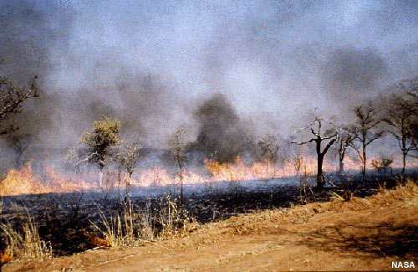
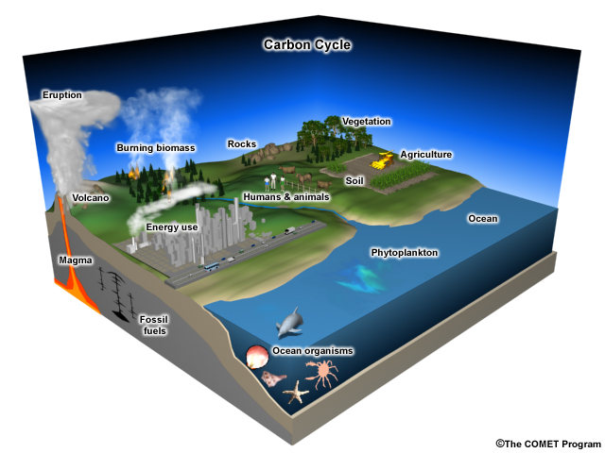
Biomass Burning
~90% of biomass burning may be attributed to human activity
Biomass burning releases a complex mixture of particles and gases into the atmosphere depending on the material being burnt -> including carbon dioxide, water vapour, carbon monoxide, hydrocarbons, nitrogen oxides, and many other compounds
Biomass burning plays an important role in the global carbon cycle by releasing significant amounts of greenhouse gases and aerosols into the atmosphere
Pollutants generated from biomass burning can be transported long distances, these events can affect not only the local air quality, but also regions far from the fire

Slide 10
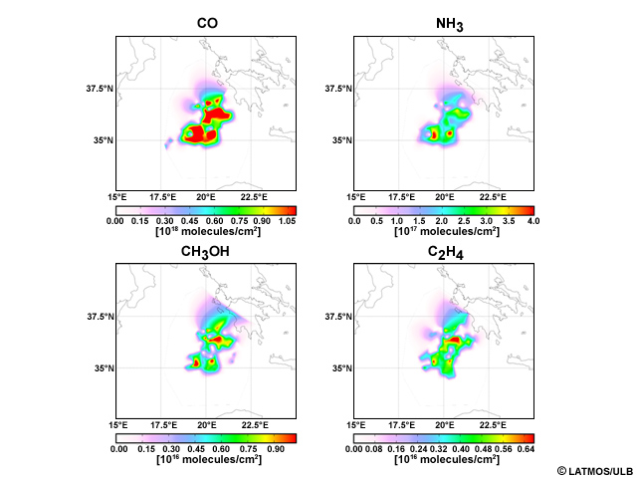
Biomass Burning
Measurements of the chemical composition of biomass burning plumes are made by hyperspectral instruments currently flying in LEO.
Data from GEO platforms can measure the diurnal cycle
Fires in Greece Trace Gas Emissions measured by IASI
Notes:
Ch3oh methanol
C2h4 ethylene
Hcooh formic acid
Hno3 nitric acid

Slide 11
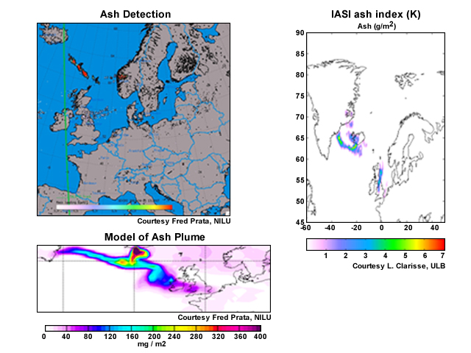
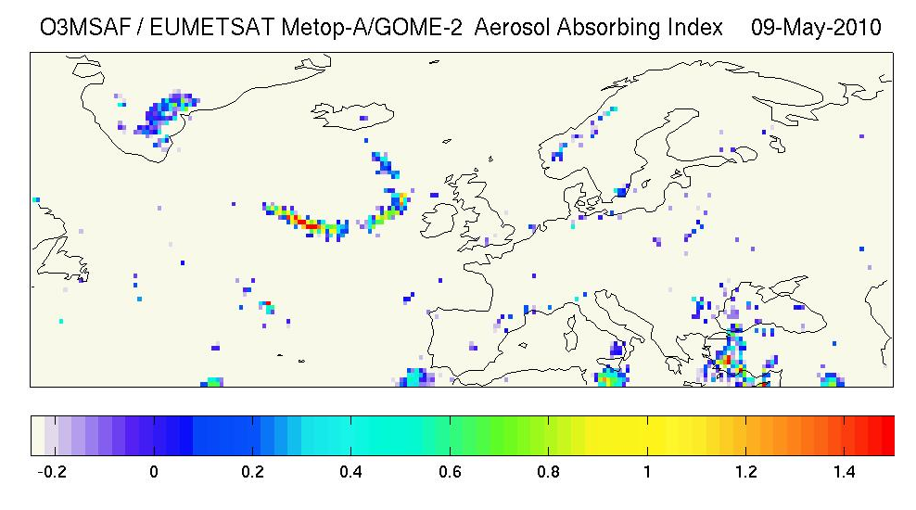
Volcanic Emissions
Volcanic eruptions can potentially cause significant damage and impact public health
Regional and long-range transport of volcanic plumes can disrupt air traffic
Traditionally, aviation control during volcanic events has been based on estimates of local emissions at the volcano and knowledge of injection height, coupled with the use of dispersion models
Satellite imagery has primarily been used to verify the information provided by models
During the Eyjafjallajökul eruption in 2010, the aviation industry in Europe set a maximum volcanic ash loading of 2000 μg /m³ (later raised to 4000 μg /m³) through which it is deemed safe to fly.
Establishing methods for determining both presence of ash and ash mass loading in the atmosphere, in addition to providing information on the plume height is important

Slide 12
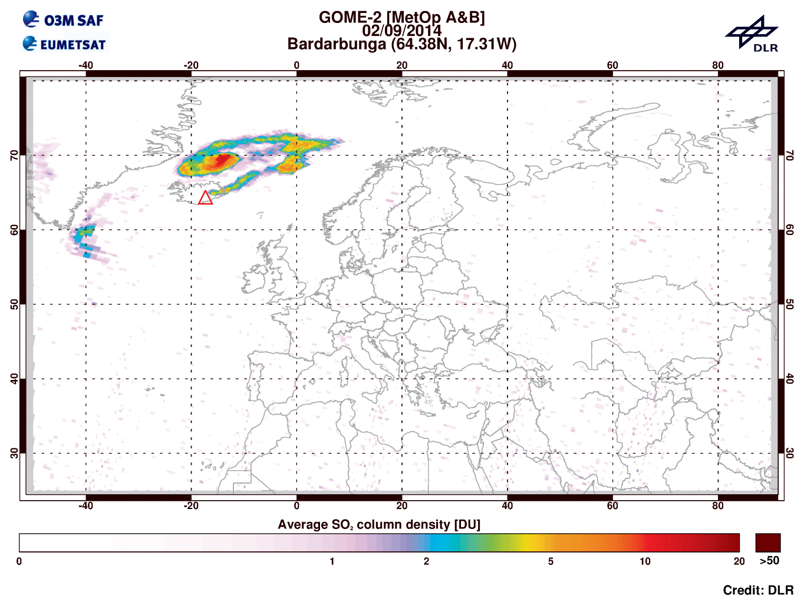
Volcanic Emissions
SO₂ concentrations in volcanic plumes is also of interest because it reacts with water vapour in the atmosphere to form sulphuric acid, which is corrosive and can also damage aircraft
Because of the regional and highly time-varying nature of a volcanic ash plume, data from GEO are preferred
Data from LEO complements the picture

Slide 13
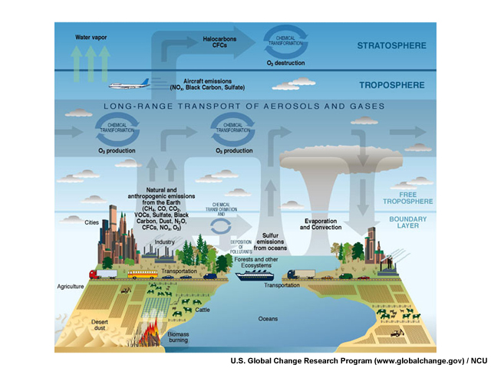
Air Quality Monitoring & Forecasting
Regional and local air quality monitoring and forecasting are primarily associated with processes occurring in the planetary boundary layer, although uplift and long-range transport also play a role.
Space-based air quality measurements should discriminate the lowest levels from the atmosphere above and have a ground footprint small enough to resolve cities and other pollution hot spots.

Slide 14
Air Quality Monitoring & Forecasting
To sense the lowest layers of the atmosphere, it is necessary to look through the complete atmosphere to “see” the surface. -> information on the vertical structure in the troposphere is typically limited to one or at most two pieces of information.
Reducing the ground pixel size decreases the number of photons arriving at the space craft and makes it more challenging to design instruments with the required signal to noise and performance needed to extract the small signals from atmospheric trace gases.
The troposphere is often obscured by clouds which blocks the view of the troposphere and surface from space. Smaller ground pixels can provide an increased number of cloud-free pixels and improve the information content.
The surface characteristics must generally be well-known as it also provides the background to the atmospheric measurements.

Slide 15
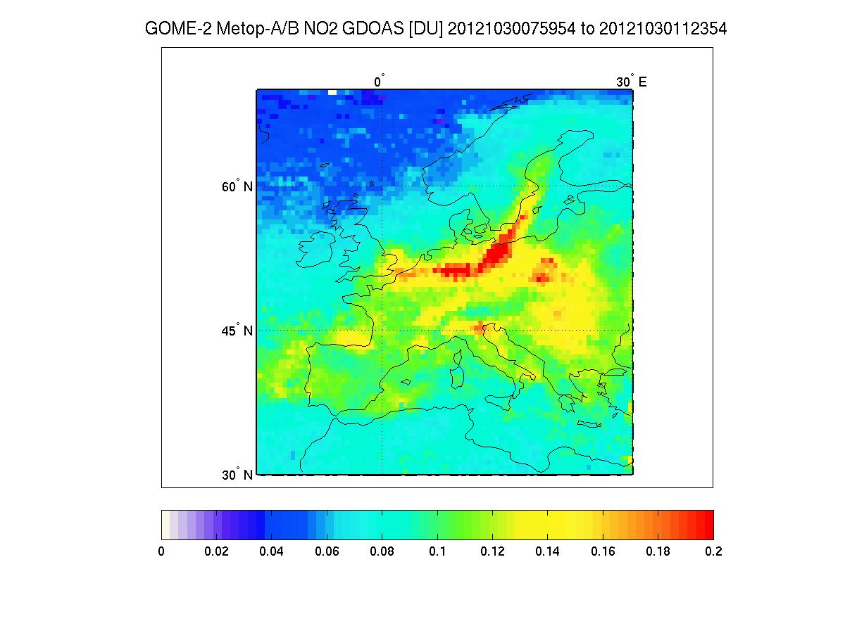
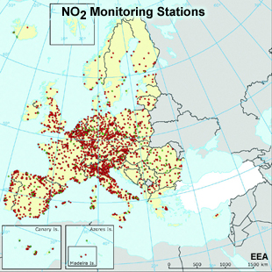
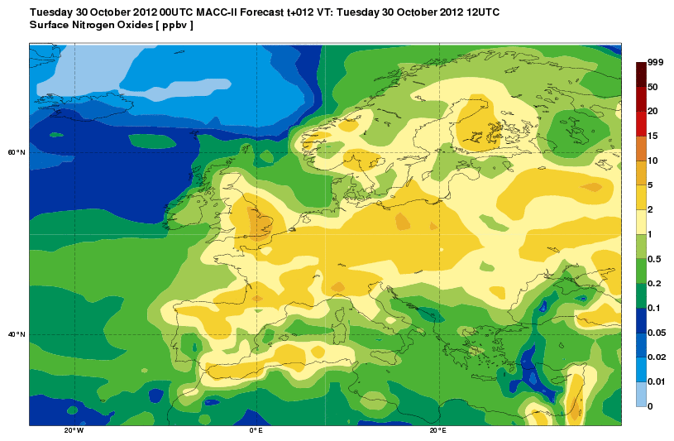
Air Quality Monitoring & Forecasting
Even most sophisticated satellite data products have limitations when addressing regional and local air quality issues.
It is essential to combine satellite data with in-situ and model data.
Assimilation of satellite-based trace gas measurements into global models is now being done
Improvements in our understanding of the processes governing these species and advances in data assimilation techniques both play a role.

Slide 16
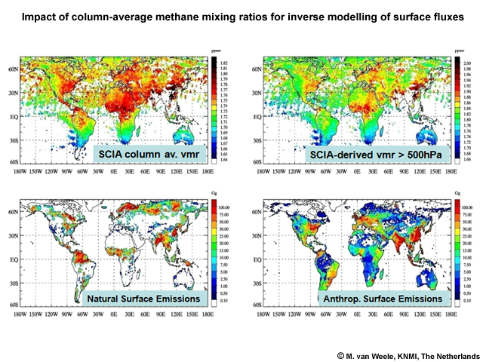
Composition-Climate Interaction
Satellite-based greenhouse gas measurements require very high accuracy.
To monitor changes in surface fluxes the measurements must be sensitive to the PBL.
Estimates of the CO₂ and CH₄ column derived from the thermal infrared alone are sensitive primarily to the mid-upper troposphere -> not sufficient.
Measurements made in the shortwave infrared which are sensitive to the surface, are required.

Slide 17
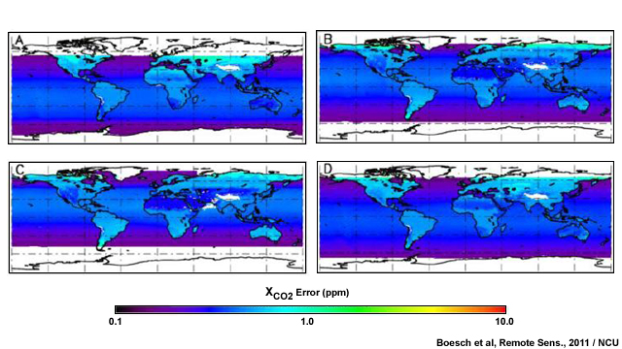
Composition-Climate Interaction
Anthropogenic greenhouse gases are typically very long-lived in the Earth’s atmosphere
The signal from local and regional variations in the surface fluxes is a very small contribution to the total signal measured at the satellite.
Satellite data must have very low biases (in particular, spatially varying biases) and very high precision for estimating surface fluxes.
Distribution of the XCO₂ retrieval errors for single soundings in glint mode for
January (A), April (B), July (C) and October (D)
Screening for residual aerosol and cloud effects in the measurements and very accurate calibration.

Slide 18
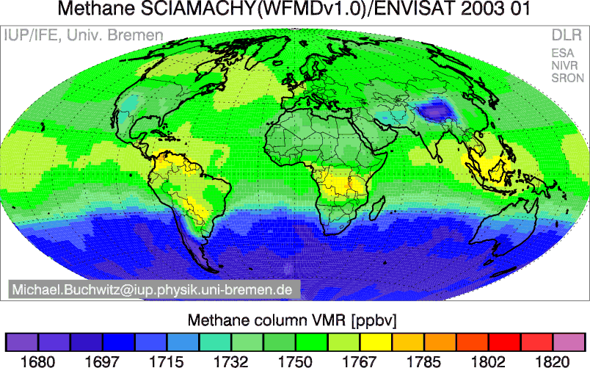
Composition-Climate Interaction
Monitoring greenhouse gases from space is still considered a research application
SCIAMACHY on ESA's ENVISAT satellite was not designed specifically for monitoring greenhouse gases.
It has none the less provided estimates of XCO₂ and XCH₄, which have been tested in flux inversion systems.
Current satellite missions dedicated to monitor greenhouse gases: GOSAT, OCO-2

Slide 19
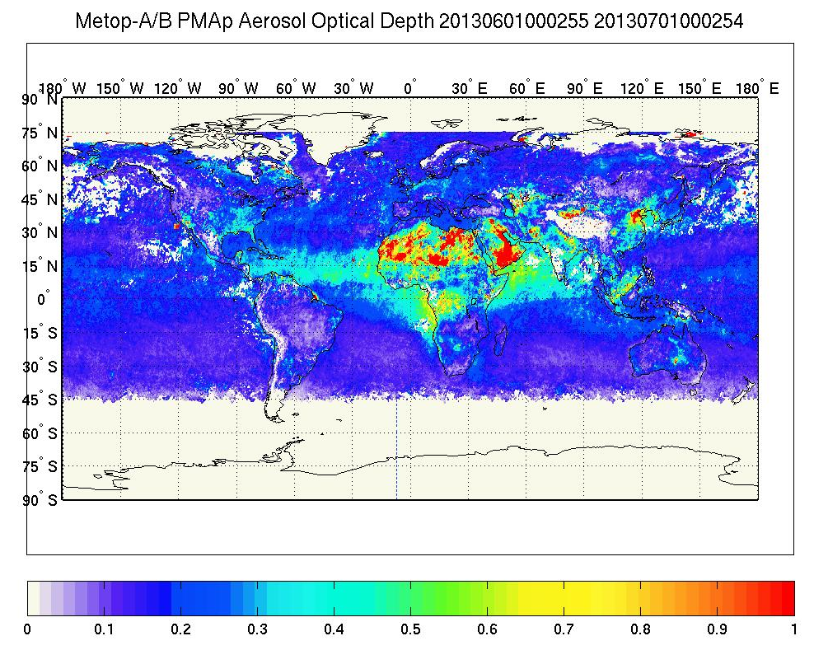
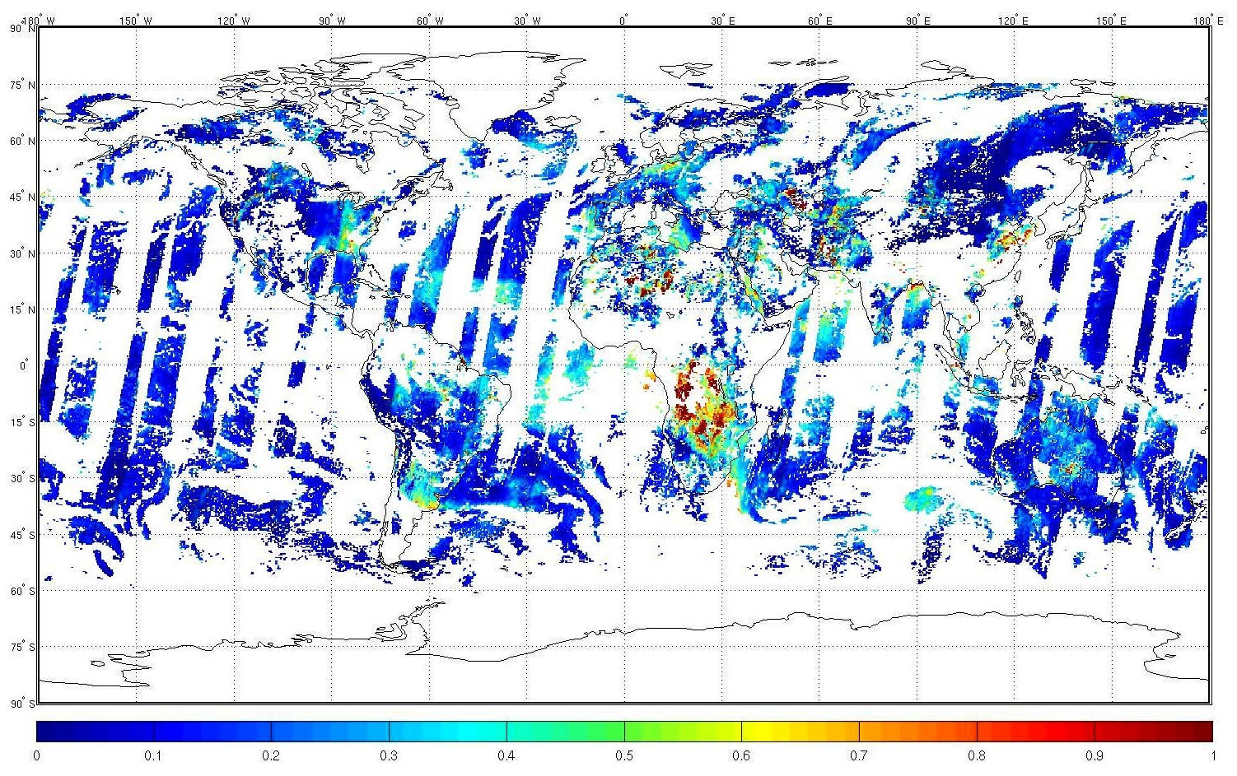
Composition-Climate Interaction
PMAp: Polar Multi-sensor Aerosol product: AOD Metop A & Metop B
Aug 30, 2013 (bottom)
June 2013 (top)

Slide 20
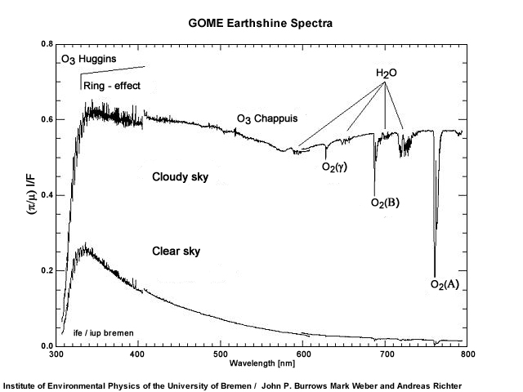
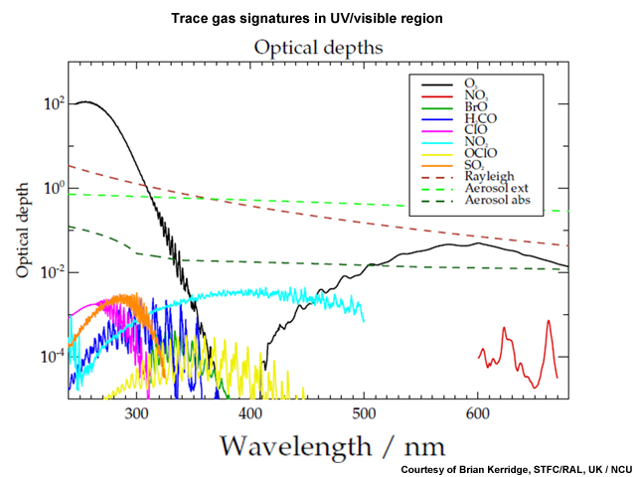
Measurement Techniques:
UV/Visible/SWIR Solar Backscatter
Many trace gases are measured in the UV/Visible spectral range
In UVVIS, satellite instruments measure light from the Sun scattered back to the satellite from molecules and particles in the atmosphere, and from the surface for wavelengths longer than ~300 nm.

Slide 21
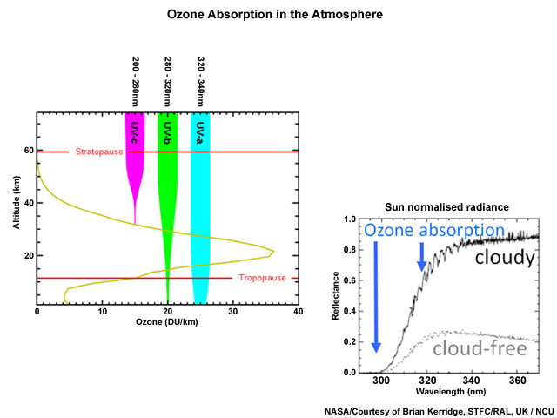
Measurement Techniques:
UV/Visible/SWIR Solar Backscatter
The Hartley-Huggins bands from 270-340 nm are typically used to obtain information on the ozone profile.
Light absorbed by ozone in this spectral region is strongly wavelength dependent & the penetration depth in the atmosphere depends on wavelength thus providing profile information.
Nadir measurements have the advantage of good spatial coverage, potentially at relatively high spatial resolution, but information on the vertical profile is difficult to obtain (with the exception of ozone for which coarse profile information is available).

Slide 22
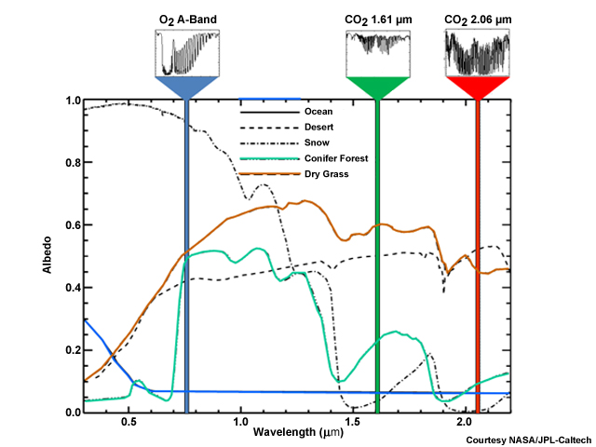
Measurement Techniques:
UV/Visible/SWIR Solar Backscatter
Measurements made in the shortwave infrared can be used to measure CO, CH₄, and CO₂ with sensitivity to the surface in the 1.6, 2.0, and 2.3 micron CO₂, CH₄ and CO bands.
In the SWIR there is still a contribution to the signal measured from solar radiation back-scattered at the surface.
Signal levels (particularly over the ocean) are very low, and over the land an accurate knowledge of the land cover type and wavelength-dependent surface albedo is required.

Slide 23
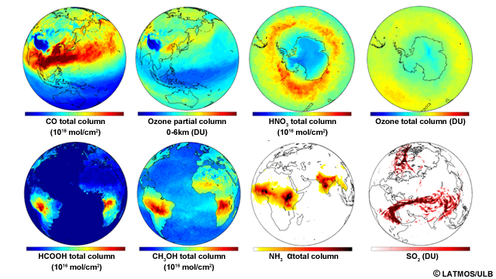
Measurement Techniques:
UV/Visible/SWIR Solar Backscatter
Notes:
With the advent of nadir-viewing, hyperspectral sounders, a wide range of atmospheric species can be detected, even against the warm background of the land surface.
This capability relies on high spectral resolution and good noise performance of the instrument and is enhanced in situations when the thermal contrast between the surface and the levels of the atmosphere of interest is greatest.

Slide 24
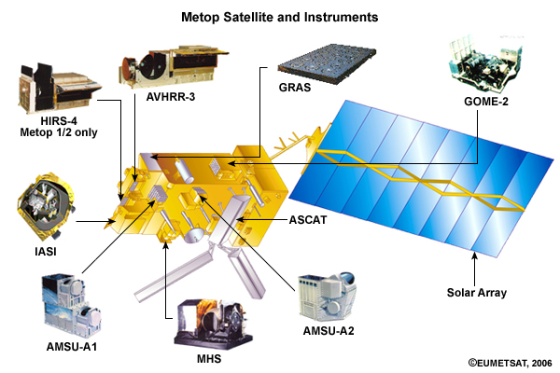
EUMETSAT Current and Future Missions
The EUMETSAT Polar System (EPS) mission series provides continuous, long-term data sets to support operational meteorological and environmental forecasting and global climate monitoring.
The EPS system comprises three Metop satellites, the first of which was launched on 19 October 2006, with the second launched on 17 September 2012, and the third planned for launch in 2018.

Slide 25
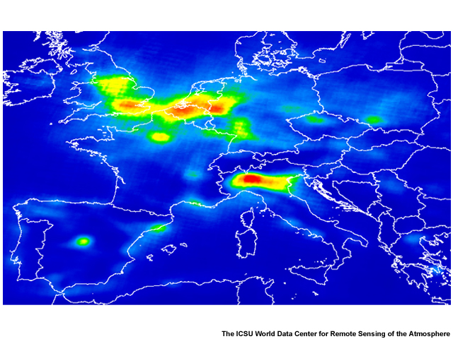
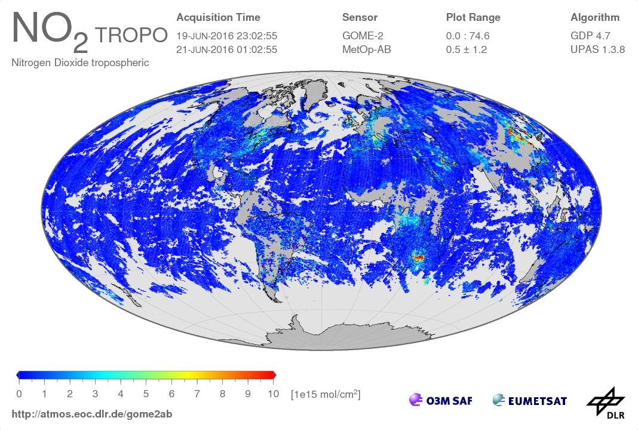
EUMETSAT Current and Future Missions
GOME-2 measures ozone, trace gases, and aerosol
in the UV/Visible part of the spectrum.
In comparison to its predecessor, GOME-2 has significantly improved spatial resolution (from 40 x 320 km to 40 x 40 km)
High spatial resolution is a benefit for measuring trace gas information in the troposphere, particularly for tropospheric ozone and NO₂.
Total amount of nitrogen dioxide (NO₂) in the atmosphere above Europe derived from one year of data from the GOME-2 instrument on Metop-A (March 2007 - February 2008)

Slide 26
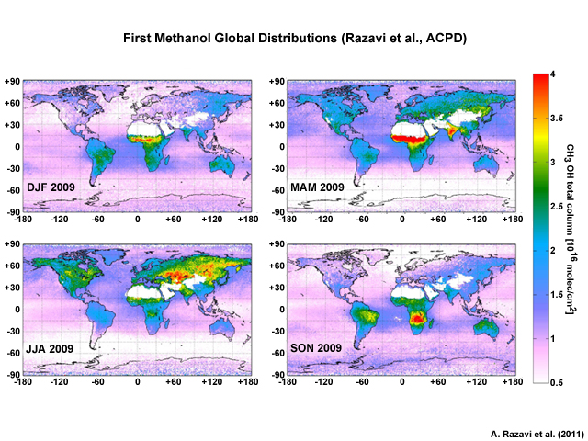
EUMETSAT Current and Future Missions
IASI provides information on atmospheric trace gases although it is primarily dedicated to monitoring temperature and humidity
It provides operational information on ozone, carbon monoxide, and SO₂ and has been used to detect a number of minor trace gases, in particular in biomass burning and fire events.
IASI has detected volcanic ash and provided the first global measurements of ammonia sources, methanol, and formic acid from space.

Slide 27
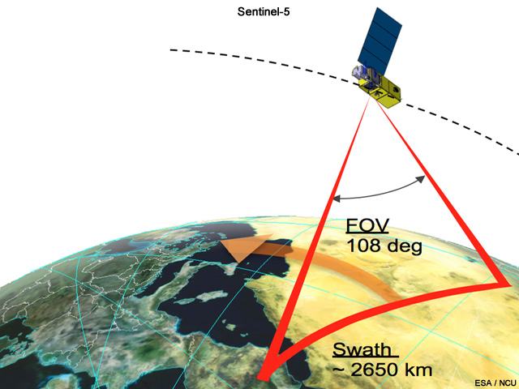
EUMETSAT Current and Future Missions
EPS-SG UVNS Sentinel-5
UV-NIR-SWIR hyper spectral instrument from low-earth polar orbit
Sentinel-5 will build on the heritage from the GOME/SCIAMACHY/GOME-2/OMI series of instruments and will provide continuity with these instruments
The spatial resolution will be significantly improved compared to previous missions (~ 7 x 7 km at SSP), which is important to support development of air quality applications
Sentinel-5 level 1 and 2 products will be produced operationally by EUMETSAT
Launch of EPS-SG 2021/22

Slide 28
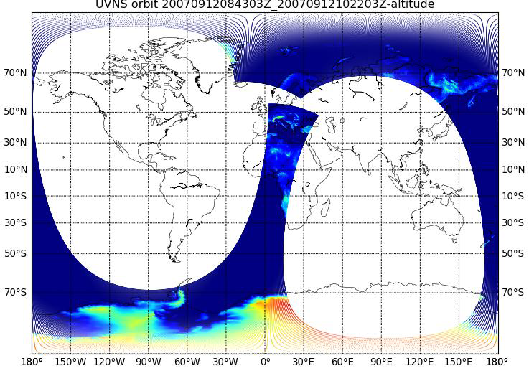
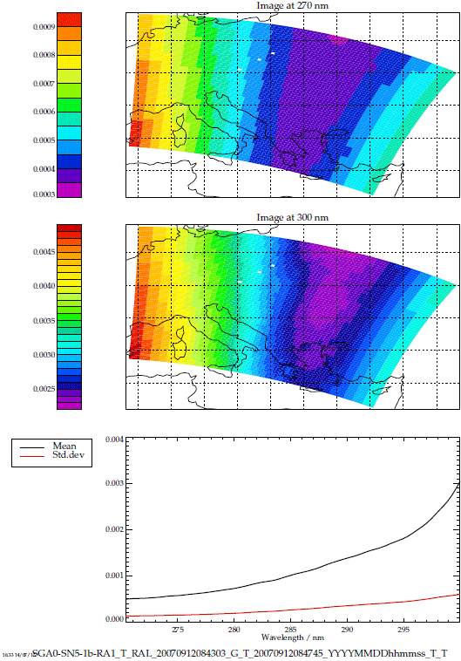
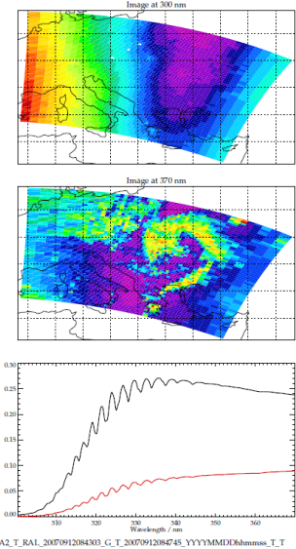
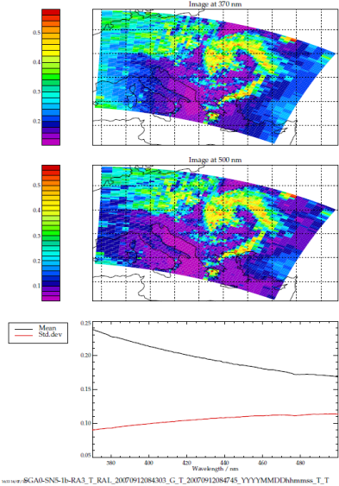
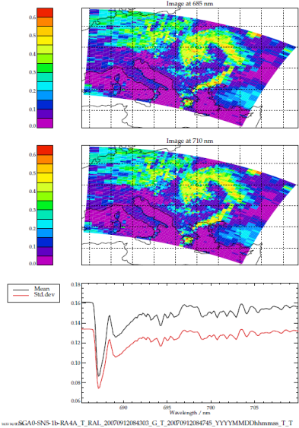
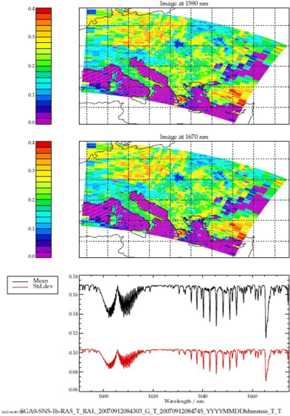
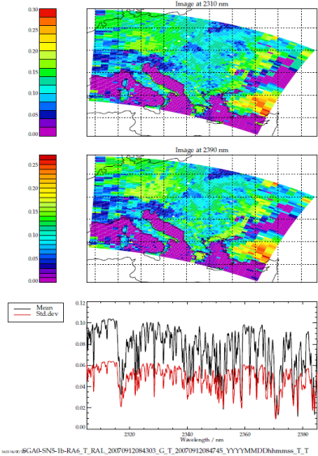



EUMETSAT Current and Future Missions
Sentinel-5 Parameter
Clouds | Effective Optical Depth (cirrus only)
 | Effective Height
 | Fraction/Mask from VII
Aerosol | UV Absorbing Index
 | Layer Height
Surface Albedo | Surface Albedo
Ozone O3 | Stratospheric Vertical Profile
 | Tropospheric Column
 | Total Column
Nitrogen dioxide NO2 | Total Column
 | Tropospheric Column
Sulfur dioxide SO2 | Total Column and Height
Formaldehyde HCHO | Total Column
Methane CH4 | Total Column
Carbon monoxide CO | Total Column
UV | Spectrally Resolved Irradiance at Surface and UV Index
Glyoxal CHOCHO | Total Column
Scene heterogeneity from VII | Scene heterogeneity from VII
Results from a test data study

Slide 29
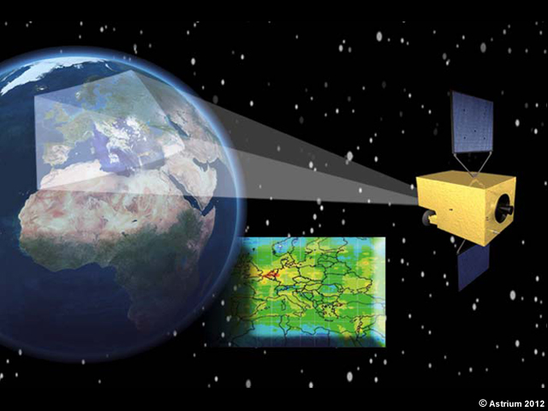
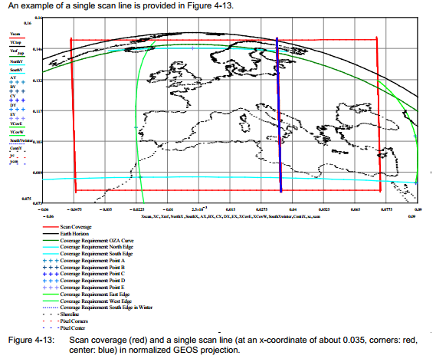
EUMETSAT Current and Future Missions
MTG-S UVN Sentinel-4 UV-NIR hyper spectral instrument from GEO
Sentinel-4 has heritage from the GOME/SCIAMACHY/GOME-2/OMI series of instruments
Primary focus is the monitoring of air quality in the European domain with high spatial and temporal resolution
The spatial resolution will be ~ 8 x 8 km with hourly temporal resolution
Sentinel-4 level 1 and 2 products will be produced operationally by EUMETSAT
It will fly alongside the MTG/Infrared sounder, the first hyperspectral sounder flown in geostationary orbit.
The MTG/IRS is not optimised for atmospheric composition applications, but it is hoped that under favourable conditions it will provide information on ozone and carbon monoxide.
Launch of MTG-S 2021/22

Slide 30
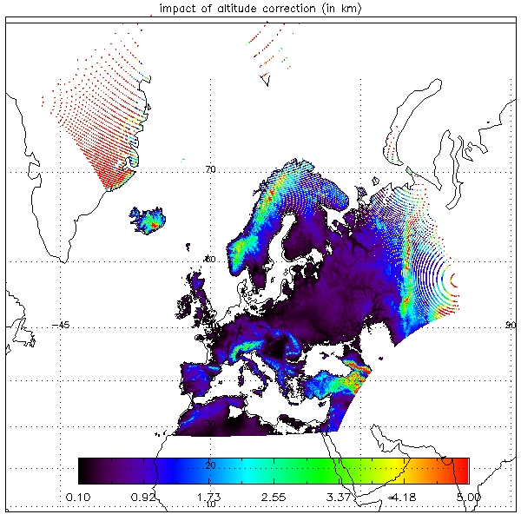
EUMETSAT Current and Future Missions
Centrally processed Sentinel-4 Level-2 Products and dependencies
Level-1b products of the Sentinel-4 UVN mission
Product | Parameter | Dependency |  |  | Distributed
 |  | S4/UVN | FCI | IRS
Core Total Ozone | Total O₃ column | L1b |  |  | to all users
Core Tropospheric Ozone | Tropospheric O₃ sub-column | L1b |  |  | to all users
Core Nitrogen Dioxide | NO­₂ total column, tropospheric sub-column | L1b |  |  | to all users
Core Sulfur Dioxide | SO₂ total column | L1b |  |  | to all users
Core Formaldehyde | CH₂O total column | L1b |  |  | to all users
Core Glyoxal ⁽¹⁾ | CHOCHO total column | L1b |  |  | to all users
Core Aerosol Index | Aerosol absorbing index | L1b |  |  | to all users
Core Aerosol Layer Height | Aerosol layer height | L1b |  |  | to all users
Core Cloud | Cloud optical thickness, fraction, altitude | L1b |  |  | to all users
Core Surface | Surface reflectance (Lambertian equivalent albedo and bi-directional reflectance factor), aerosol optical thickness | L1b |  |  | to all users
Core Cloud Support ⁽²⁾ | Cloud and scene characteristics from FCI re-sampled to S4 L1b spatial grid | L1b | L2 and L1c |  | to all users
Innovative Aerosol ⁽¹⁾ | Aerosol column optical thickness, type, layer height, absorbing index | L1b | L1c |  | to all users
Innovative Cloud ⁽¹⁾ | Cloud optical thickness, fraction, altitude | L1b | L1c |  | to all users
Innovative Ozone ⁽¹⁾ | O₃ with enhanced separation of the lower troposphere | L1b |  | L1b | to all users
Product | Parameter | Distributed
Earth radiance | Spectrally and radiometrically calibrated and geolocated Earth radiance | to all users
Solar irradiance | Spectrally and radiometrically calibrated Solar irradiance | to all users
DPPF | L1b data processing parameters | to all users
Star | Star calibration data | to Expert Users
Calibration | Calibration data | to Expert Users
Diagnostic | Instrument diagnostic data | to Expert Users
Preliminary results from a test data study, TOA radiance

Slide 31
EUMETSAT Current and Future Missions
3MI observation concept:
Multi Viewing Angle Acquisition, up to 14 views
c
c
c
c
c
c
c
c
c
c
c
c
View 1
View N
View 2N
Detectors
c
c
c
c
c
c
c
c
c
c
c
c
c
c
c
c
c
c
Wheel
Vsat
Filters
Optical heads
Target

Slide 32
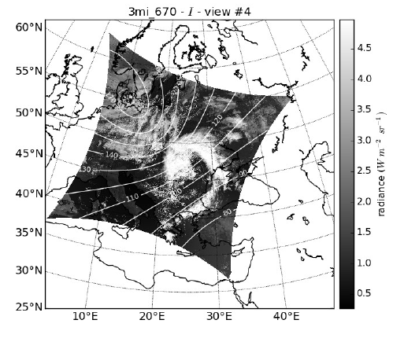
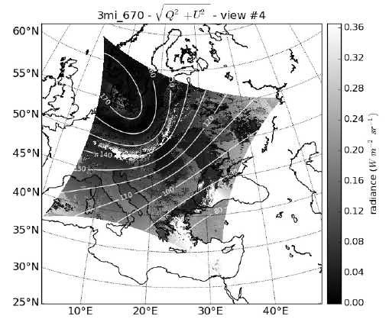


EUMETSAT Current and Future Missions
3MI observation concept: Multi Viewing Polarisation Measurements
EUMETSAT 3MI test-data study
Radiances
Degree of polarization

Slide 33
EUMETSAT Current and Future Missions
Sentinel-5 will build on the heritage from the GOME/SCIAMACHY/GOME-2/OMI series of instruments and will provide continuity with these instruments.
The spatial resolution will be significantly improved as compared to previous missions, which is important to support development of air quality applications.
Total amount of nitrogen dioxide (NO₂) in the atmosphere above Europe derived from one year of data from the GOME-2 instrument on Metop-A (March 2007 - February 2008)

Slide 34
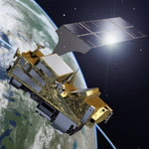
EUMETSAT Current and Future Missions
Towards an EPS-SG hyper-instrument 3MI/S5/IASI-NG/VII – MAP
Combining co-locations of VII/Sentinel5/IASI-NG observations with co-registered multi- viewing observations (3MI) at 3MI multi-viewing fixed grid.
Sentinel-5
UV-Vis-SWIR hyper spectral sounder
IASI-NG
IR hyper spectral sounder
Co-location and co-registration
EPS-SG
hyper-instrument
VII
Very high spatial resolution,
multi channel imager
0.29 – 15μm
0.5 – 7 km²
~ 19000 channels
3MI
Multi-viewing,
Multi-polarisation,
Multi-channel imager
EPS-SG Platform
Initial product: Multi-sensor Aerosol product (MAP)

Slide 35
Summary and Discussion
Main application areas related to atmospheric composition (AC)
The role of satellite-based remote sensing in monitoring and forecasting atmospheric composition
Measurement techniques
EUMETSAT missions relevant to AC and potential data use for direct readout
How to use these data?

Slide 36
Conclusion
Thank you
Total amount of nitrogen dioxide (NO₂) in the atmosphere above Europe derived from one year of data from the GOME-2 instrument on Metop-A (March 2007 - February 2008)

