Slide 1

Multi-Angle Implementation of Atmospheric Correction (MAIAC)
Alexei Lyapustin, GSFC, code 613
Y. Wang (UMBC), S. Korkin (USRA)
9th NASA Direct Readout Conference
Valladolid, Spain, June 22, 2016

Slide 2
MAIAC: General Information
Status:
  MAIAC is at MODAPS for C6+ re-processing of MODIS (MCD19)
  MAIAC to be ported on NASA Near Real Time Processing System
Products (gridded):
  Atmosphere: WV, CM, AOT, SSA, aerosol type (background/smoke/dust), FMF (over water) @1km resolution;
  Land Surface: spectral BRDF (RTLS model, naturally gap-filled), BRF (surface reflectance) @1km and 500m (250m in DR), albedo;
  Detected Snow: snow grain size, and sub-pixel snow fraction (1km);

Slide 3
Multi-Angle Implementation of Atmospheric Correction (MAIAC)
Features
Grid TOA L1B data to 1km fixed grid – work with polar-orbit data as “geostationary-like”;
Sliding window algorithm – store 4-16 last days of measurements in memory;
RT with fully coupled BRDF model;
Accumulate surface-related information for each grid cell (spectral BRDF, BT-contrasts etc.)
Main Results
Advanced cloud (snow) detection – particular improvements over tropics and at northern lat. (vegetation analysis);
AOD data globally over dark and bright land surface;
Aerosol at 1km resolution & low urban bias – strong interest from AQ community;

Slide 4
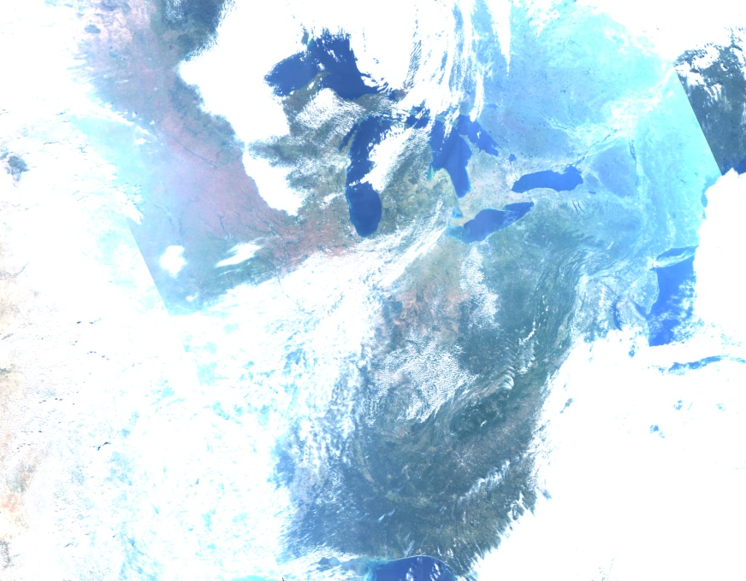
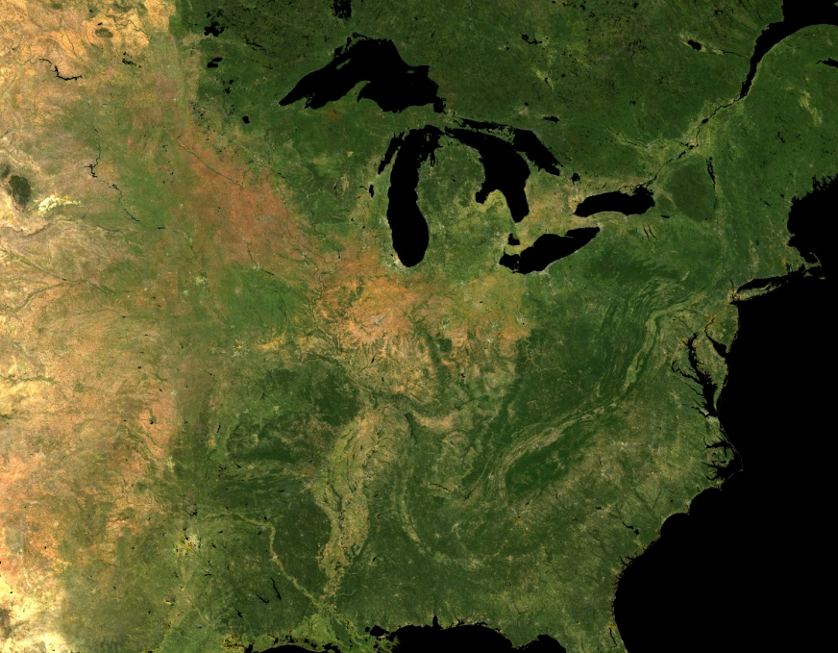
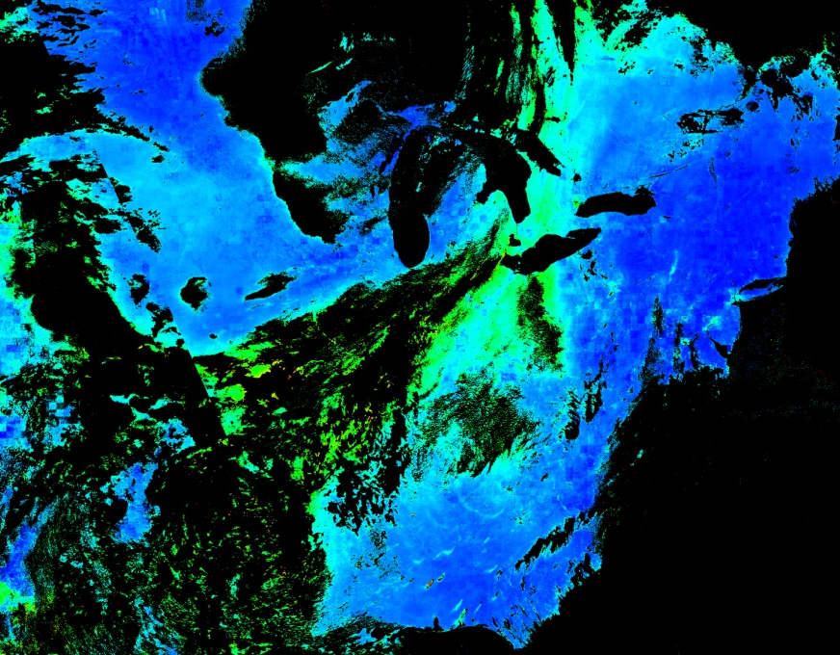
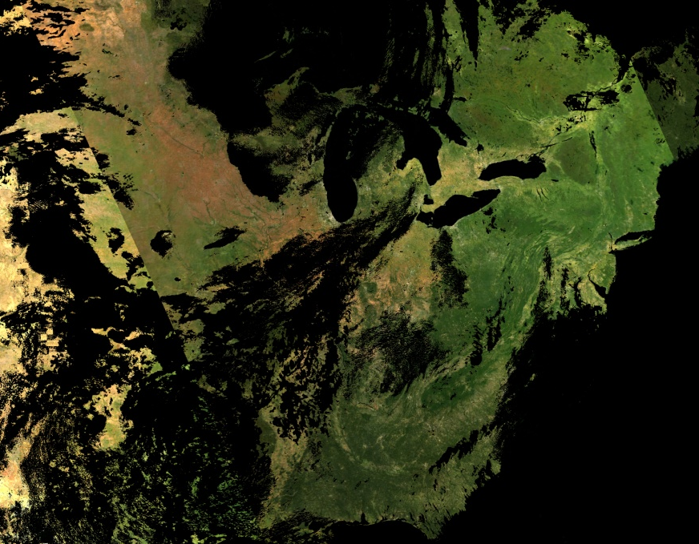
MAIAC = Time Series + Spatial Analysis
MODIS, TOA RGB
NBRF
AOT
BRF

Slide 5
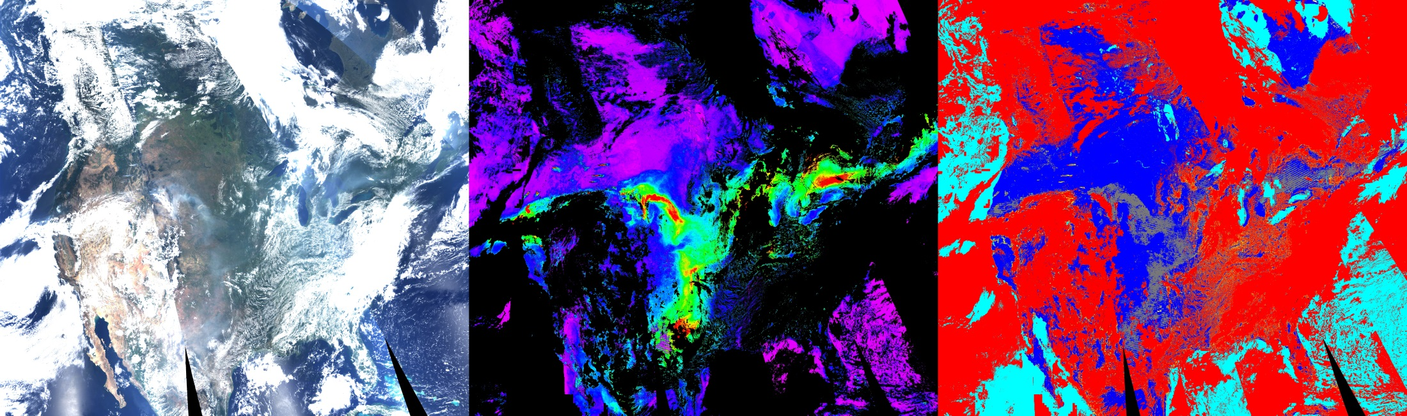
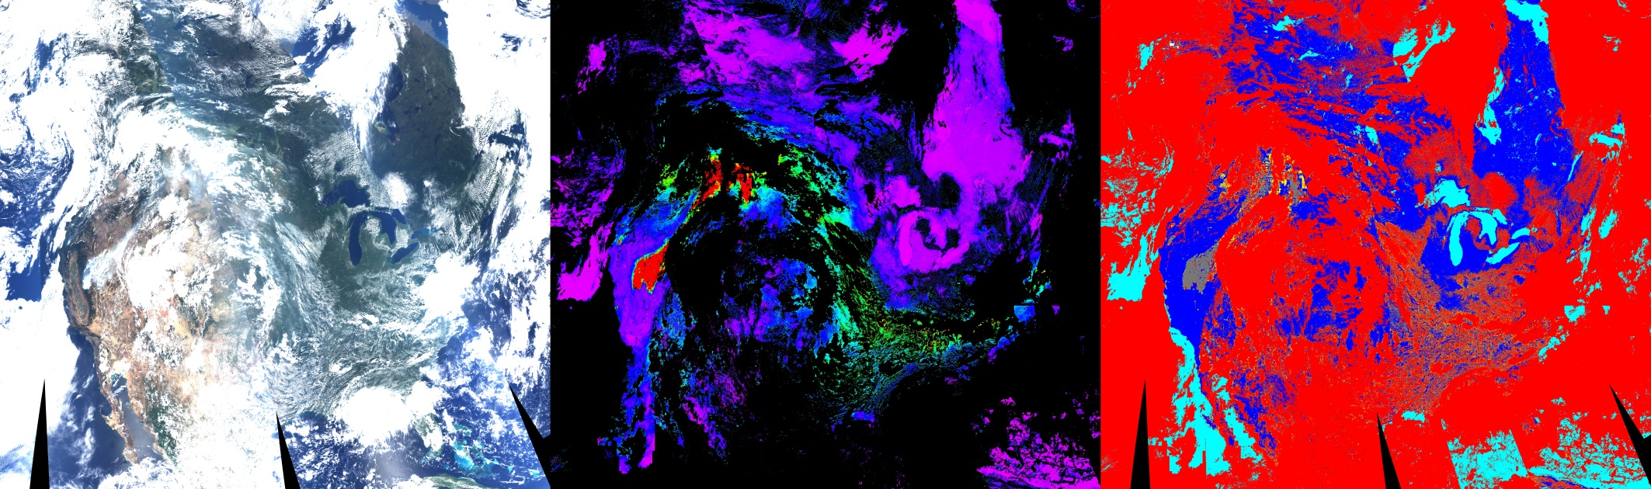
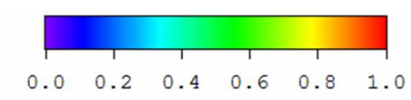
Idaho/Wyoming – Yosemite Fires (8/13)
TOA RGB
MAIAC AOT(0.47)
MAIAC CM:
Red – Clouds;
Grey – Smoke;
231
235
2
1
3

Slide 6
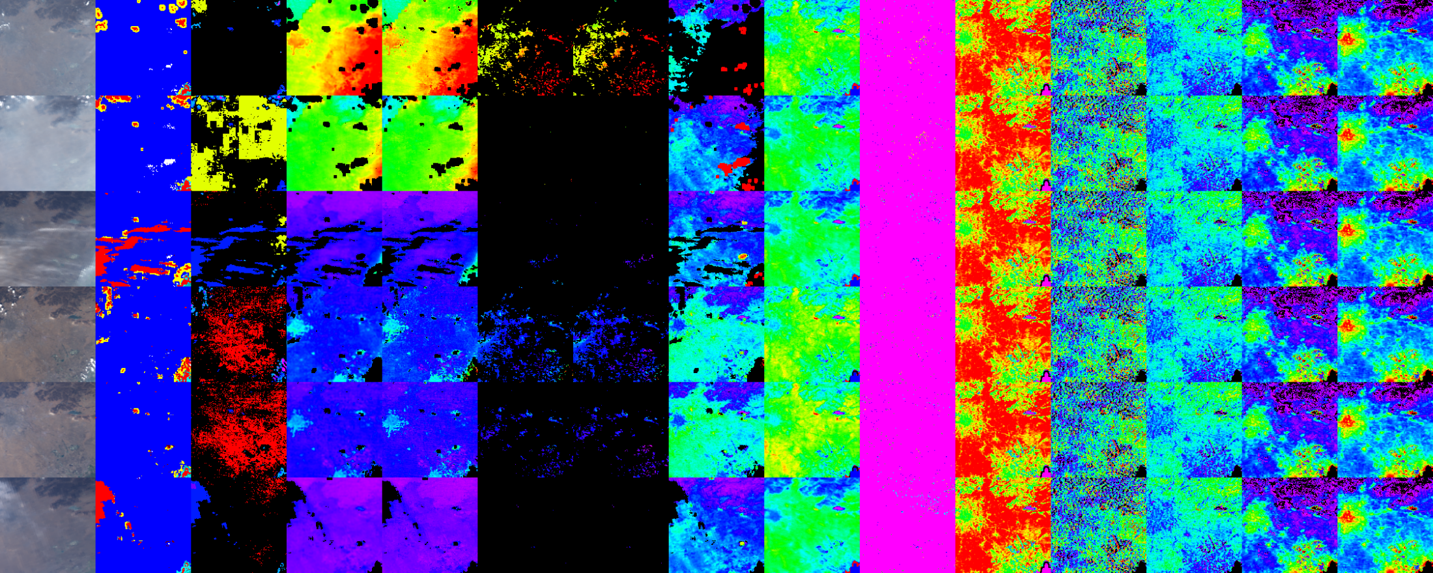
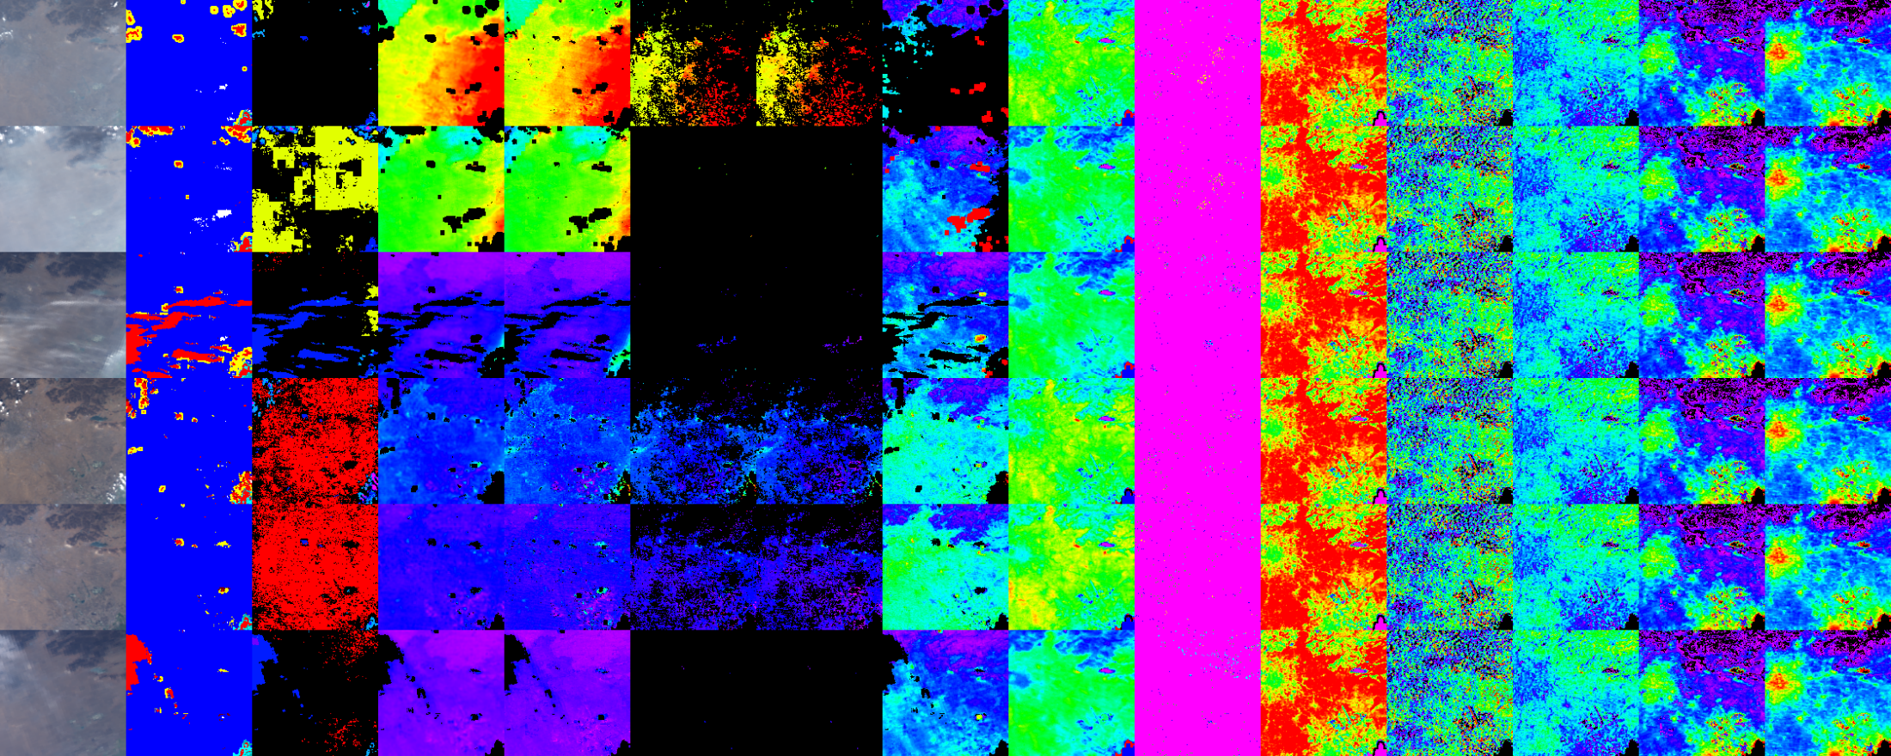
Urban Bias: Xianghe
TOA CM AOT AOT SRC
RGB DT C5 MAIAC FS BS
ρ_{0.47}= SRC×ρ _{2.1}
BRDF shape is not spectrally-invariant
AOT
0 0.5 1.0 1.5 2.0
DT bias over urban areas where C5 parameterization does not work

Slide 7
Current AQ Projects
Harvard School of Public Health (J. Schwartz)
Developed multi-variate statistical linear regression model to predict PM_{2.5} from MAIAC AOD (Kloog et al., Atm. Envir., 2014);
Cohort studies over USA (Kloog et al., Atm. Envir., 2015; Lee et al., J. Exposure Sci. Envir. Epidemiology, 2015).
Mt. Sinai Hospital, Dept. of Preventive Medicine (R. Write, A. Just et al.)
Cohort studies over Mexico City (Just et al., Environ. Sci. Technol, 2015).
3. Emory School of Public Health (Y. Liu - USA: Hu et al., RSE, 2014; ACP, 2014; JGR, 2014) – Pilot AQ Project in Lima, Peru
Dalhousie Univ. (R. Martin, A. van Donkelaar: ACP, 2015: Global Evaluation of PM_{2.5} using MISR, MODIS DT, MODIS DB and MAIAC)
Two groups in Israel (I. Kloog, Ben-Gurion Univ.; A. Chudnovsky, Tel Aviv Univ., – 6 publ. in last 3 years)

Slide 8
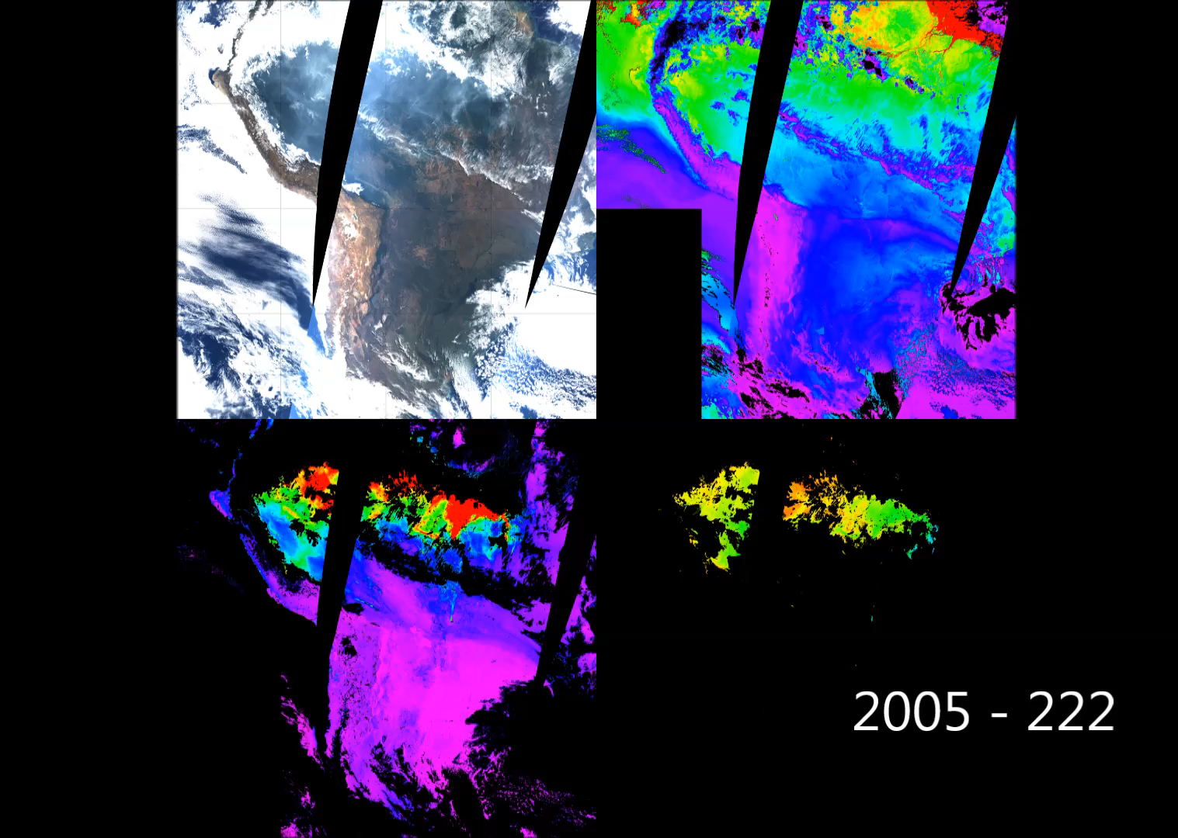

Biomass Burning in Amazonia - 2005
CWV
0. 2.0 4
SSA
AOT
0. 1.0 2
0.8 0.9 1

Slide 9
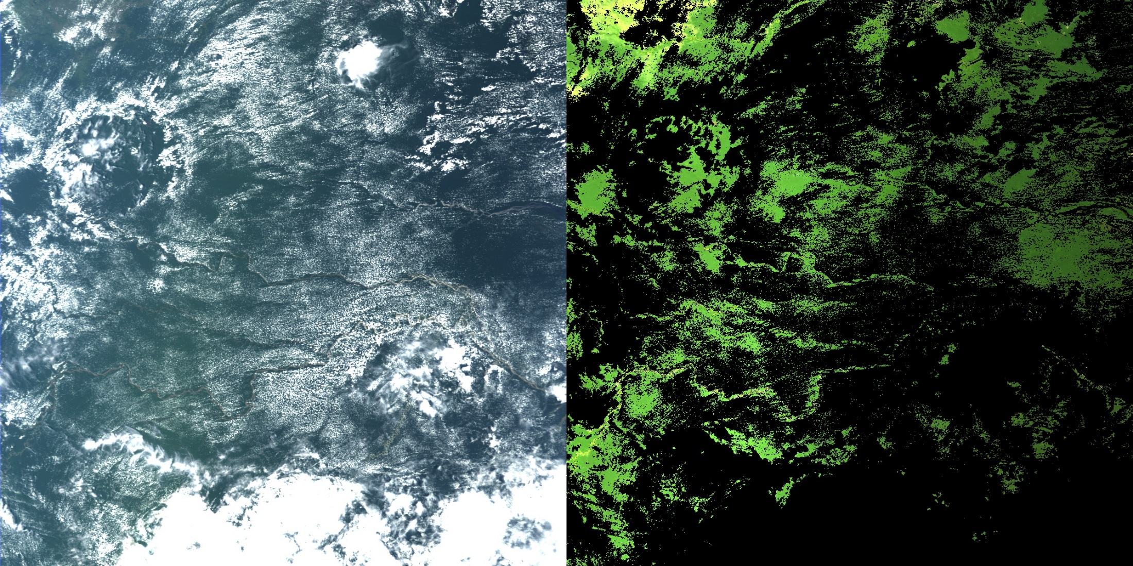
Quality of Atmospheric Correction …
TOA RGB
BRF RGB
1200 km
Decreasing brightness – moving from backscattering towards forward scattering

Slide 10
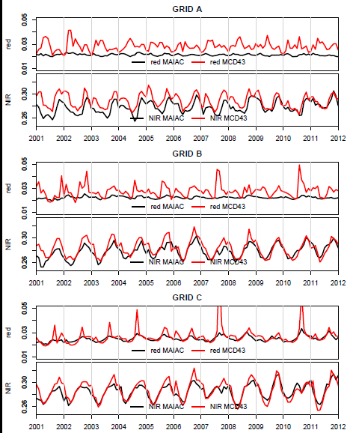
Quality of Atmospheric Correction
Maeda, E., Mendes Moura, Y., Wagner, F., Hilker, T., Lyapustin, A.I., Wang, Y., Mõttus,M., Aragão, L., Shimabukuro Y. Consistency of vegetation index seasonality across the Amazon rainforest (in press).

Slide 11
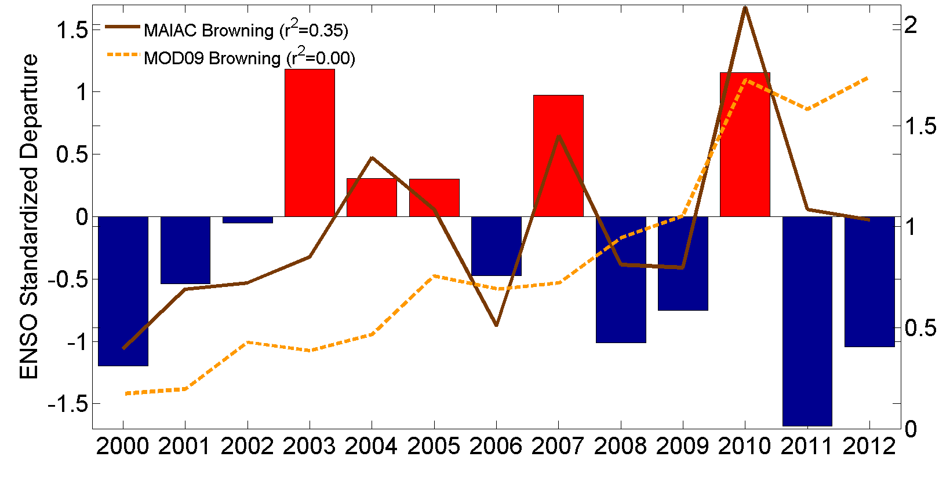
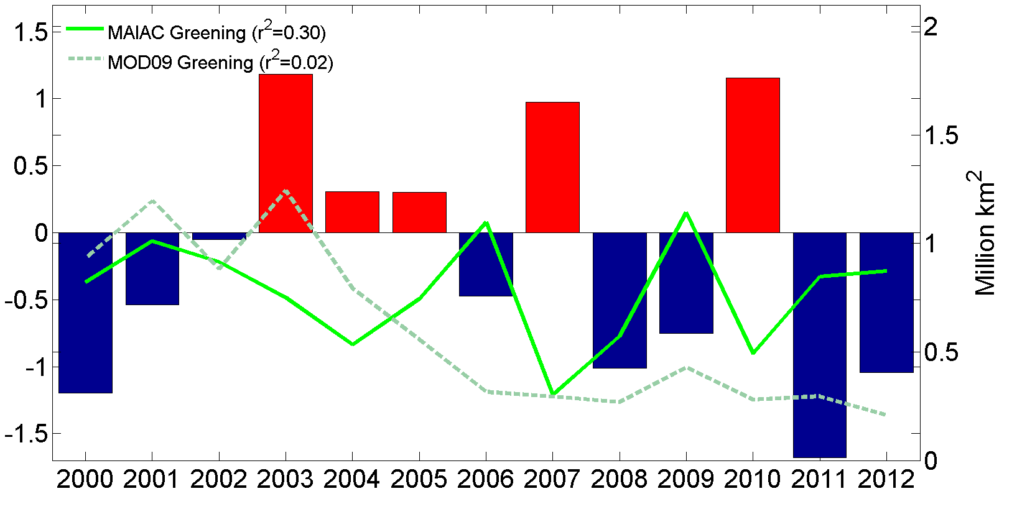
Interannual Variability
Hilker, T., A. I. Lyapustin, C. J. Tucker, F. G. Hall, R. B. Myneni, Y. Wang, J. Bi, Y. M. de Moura, P. J. Sellers (2014), Vegetation dynamics and rainfall sensitivity of the Amazon, PNAS, 111 (45), 16041-16046.
El Ninõ
Amazon Browning and Greening Anomalies from MOD09 C5 (dashed) and MAIAC C6 L1B data (solid).
Anomaly Analysis – Myneni & Jian (BU)
Correlation with MEI – Hilker & Lyapustin
La Ninã
Significant interannual variability in MAIAC B/G anomalies and expected physical correlation with the short-term climate variations.
Anomaly:

Slide 12
Interannual Variability
Bi, J., R. Myneni, A. Lyapustin, Y. Wang, T. Park, C. Chen, K. Yan, Y. Knyazikhin, Amazon forests’ response to droughts: a perspective from the MAIAC product, Remote Sens., 2016.
NDVI_{n}
EVI_{n}
Standardized anomalies for 2010 drought for MAIAC and MOD09 C5 and C6 NDVI, EVI
Amazon basin Greening and Browning area from MAIAC and MOD09 C5 and C6

Slide 13
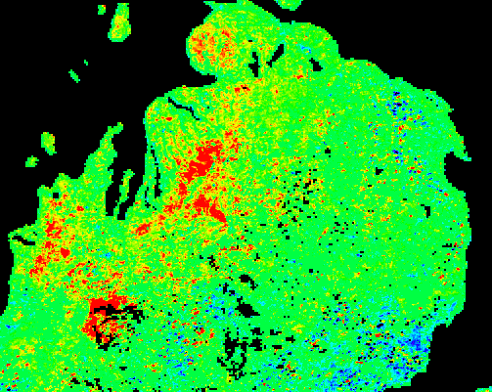
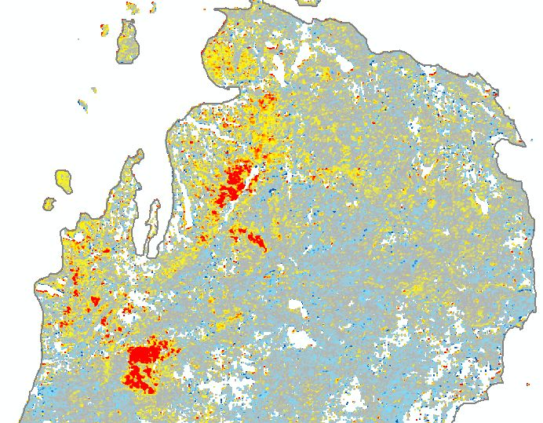
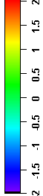
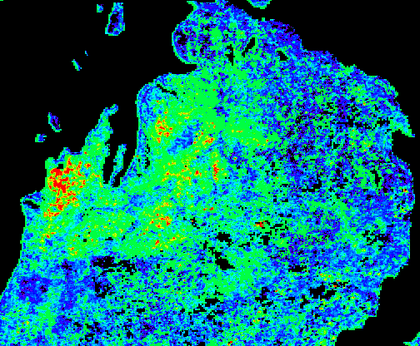
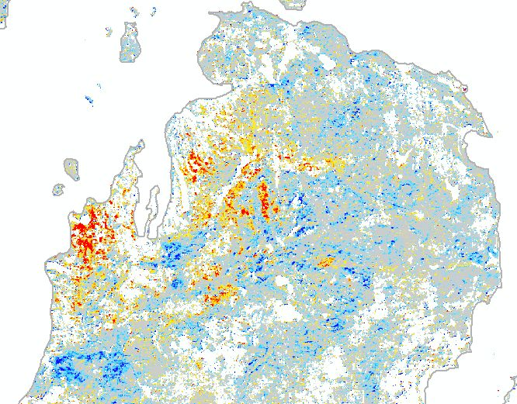
Insect Forest Damage, Michigan Area
MAIAC MODIS 500m NDVI
Standardized Anomaly
RSAC Change Index
from 30m Landsat Data
2009
2010

Slide 14
Satellite observed widespread decline in Mongolian grasslands largely due to overgrazing
Hilker, T., Natsagdorj, E., Waring, R.H., Lyapustin, A.I., Wang, Y. (2014), Global Change Biology, 20, 418-428.
Feature Article in “Le Monde”
Precipitation and Temperature Trends
Changes in Livestock since 1980

Slide 15
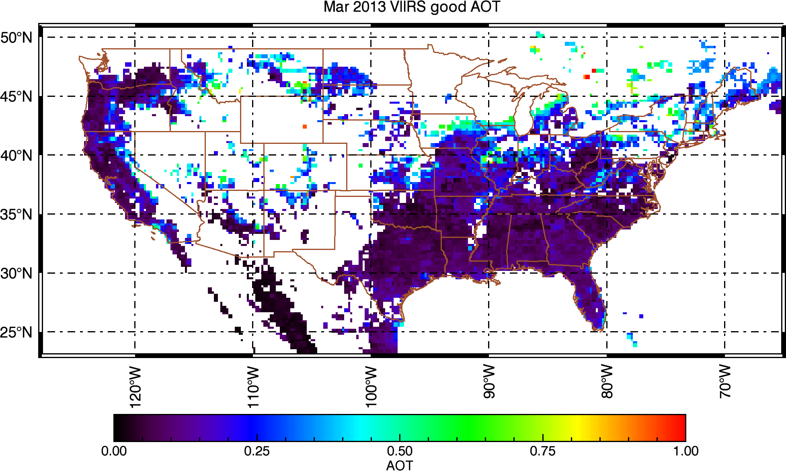
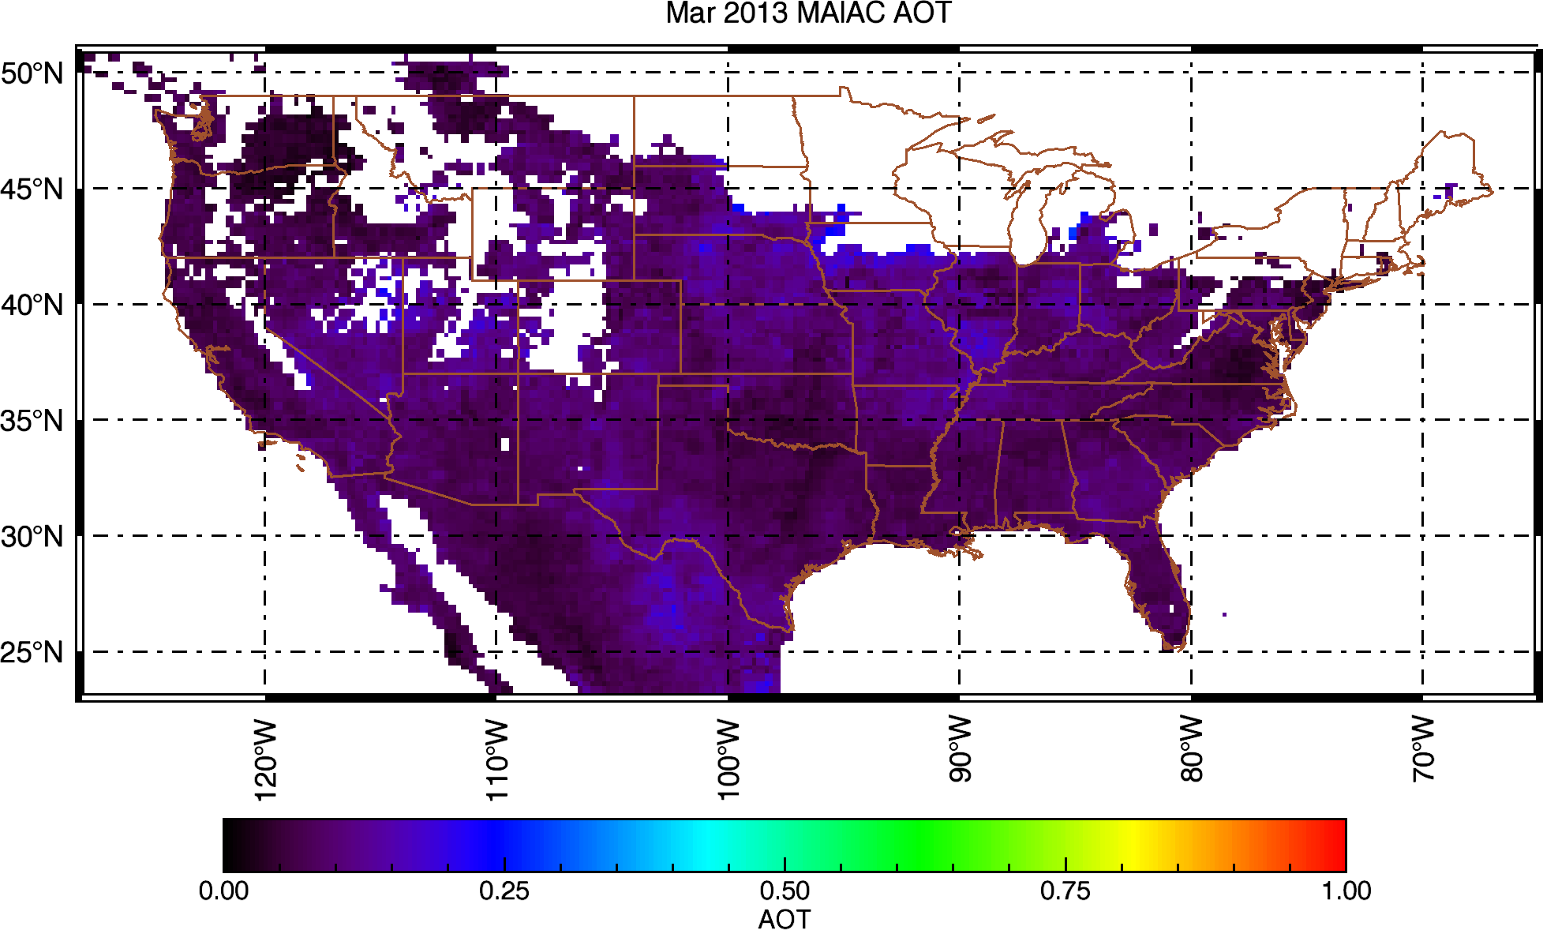
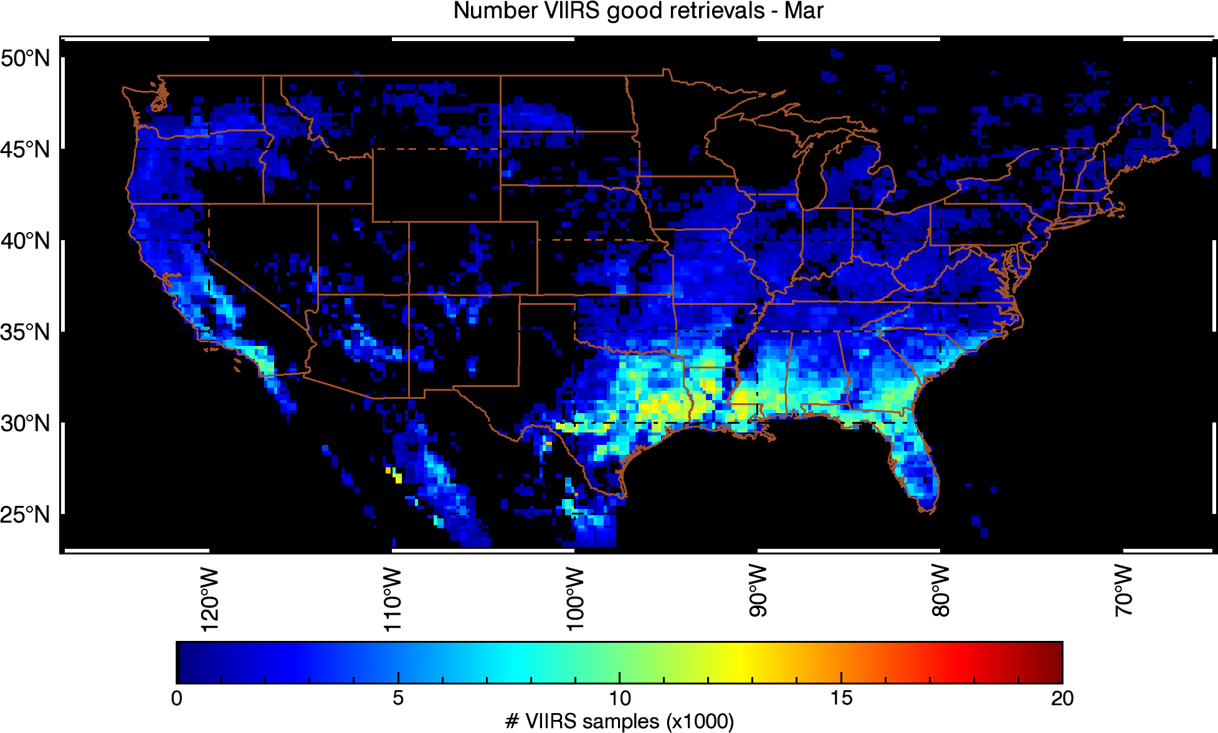
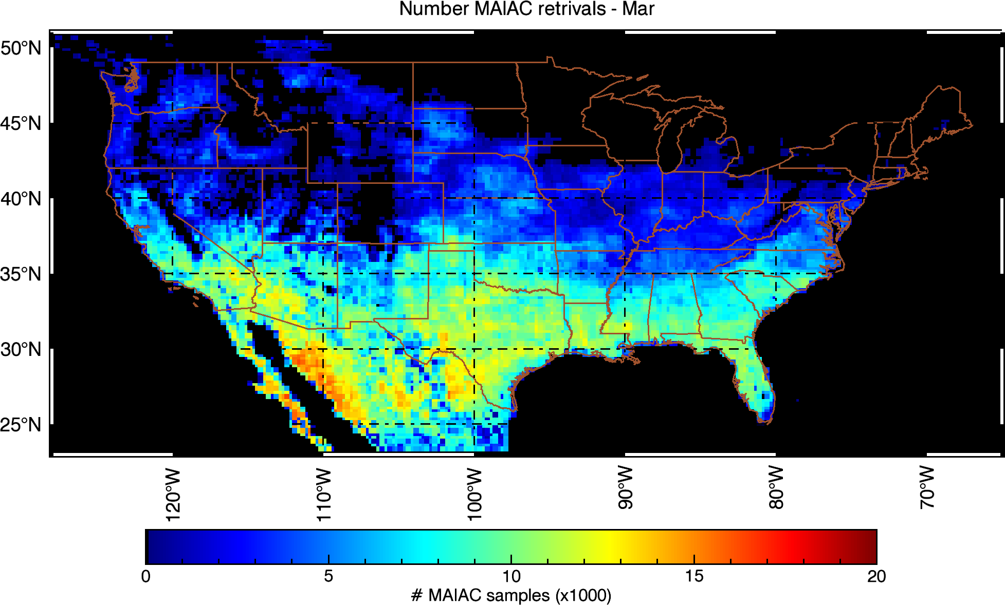
VIIRS AOT IP vs MODIS MAIAC (25km)
Superczynski, Kondragunta et al., to be subm., 2016)
NOAA VIIRS
MAIAC MODIS

Slide 16
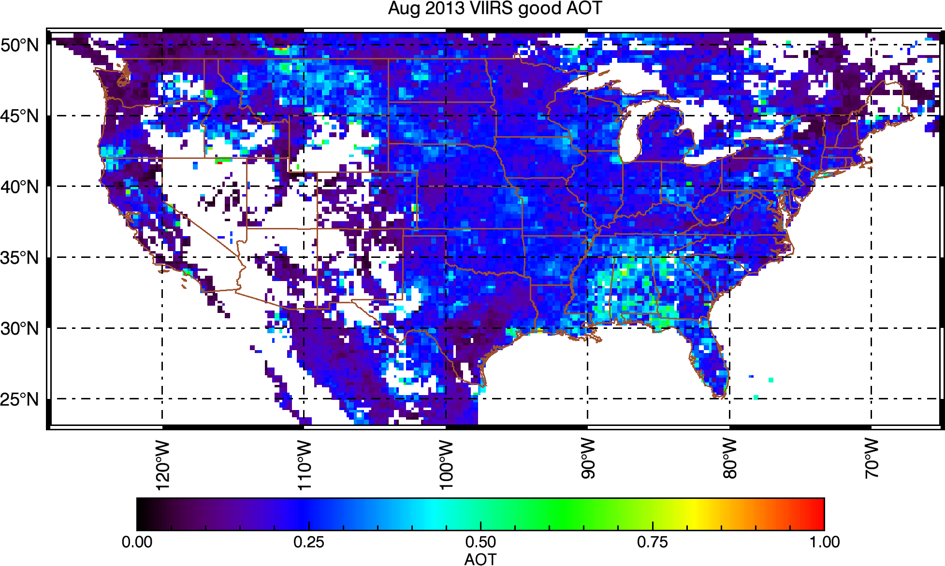
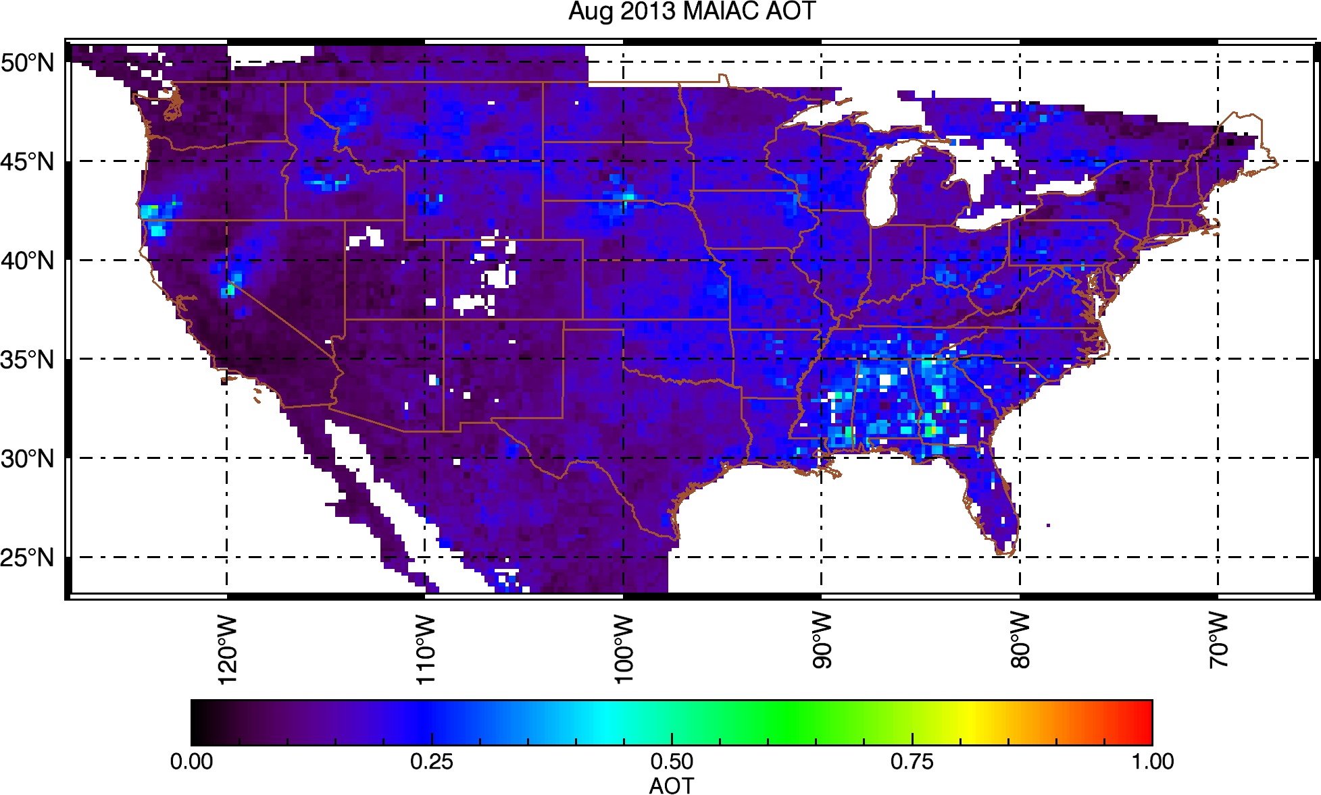
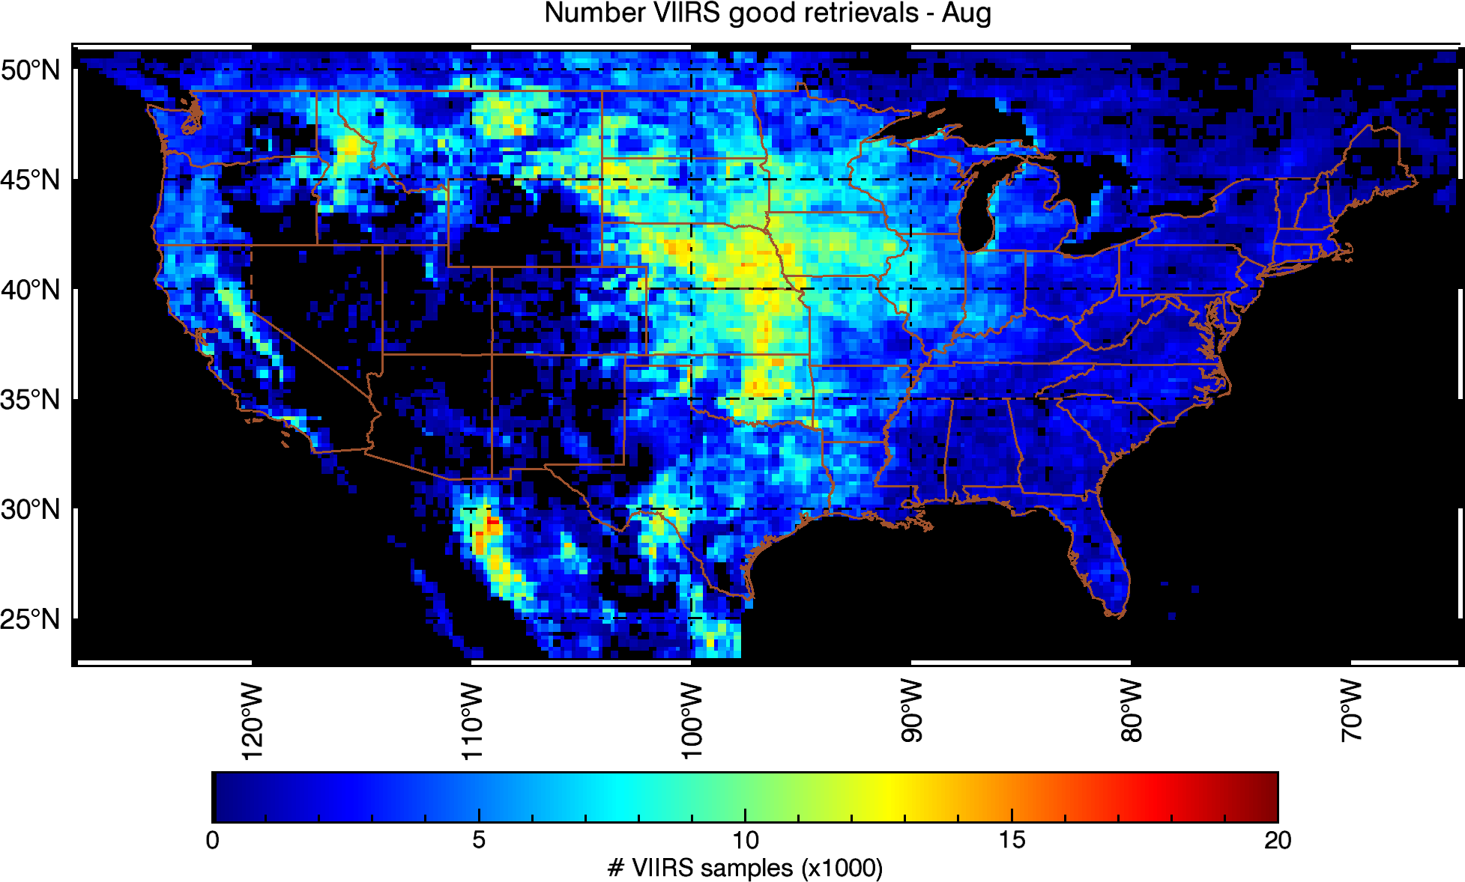
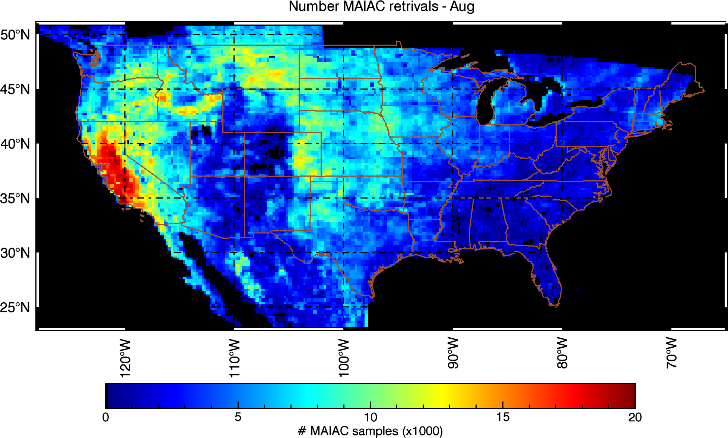
VIIRS AOT IP vs MODIS MAIAC (25km)
(S. Kondragunta, S. Superczynski (NOAA), study for NASA GeoCAPE project)

Slide 17
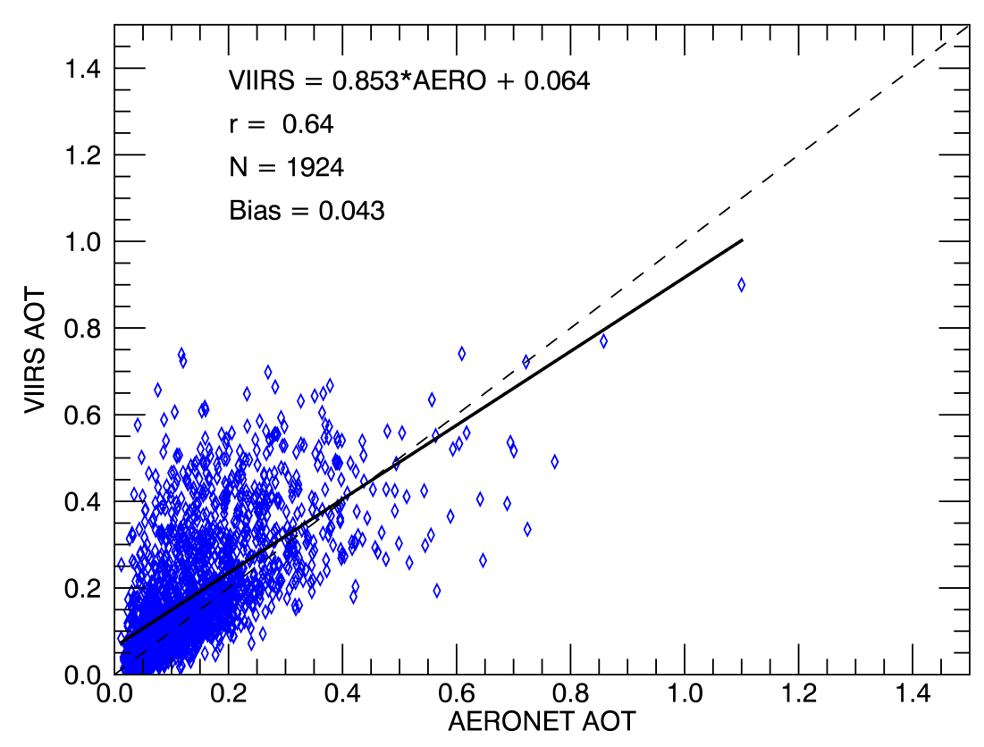
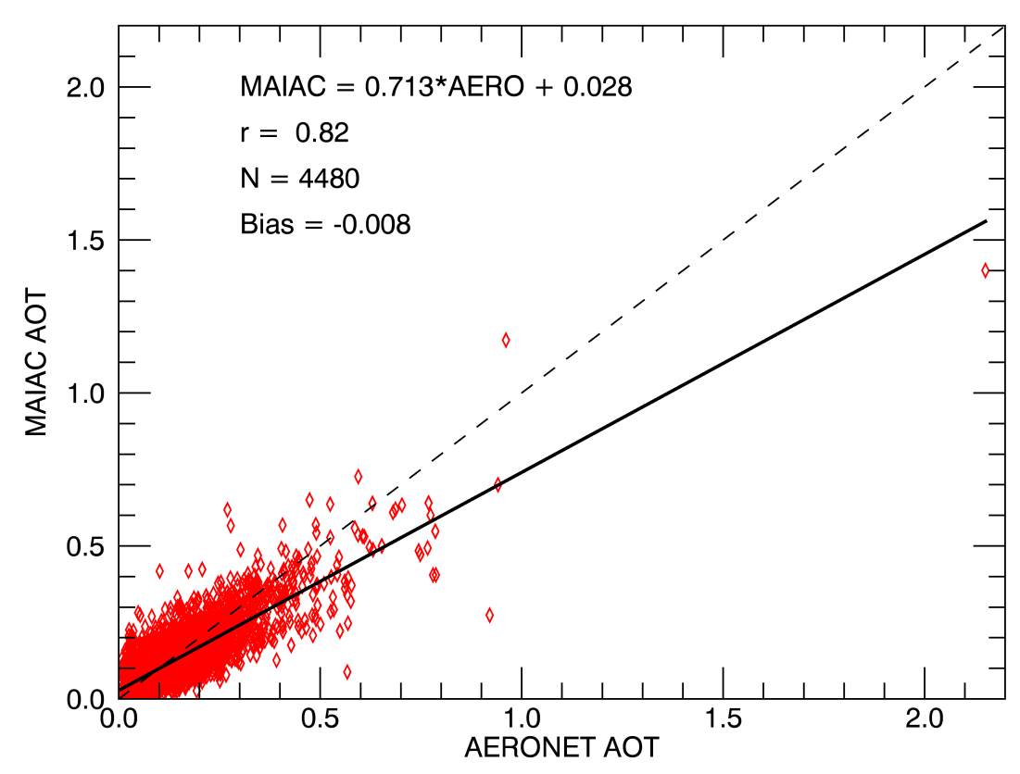
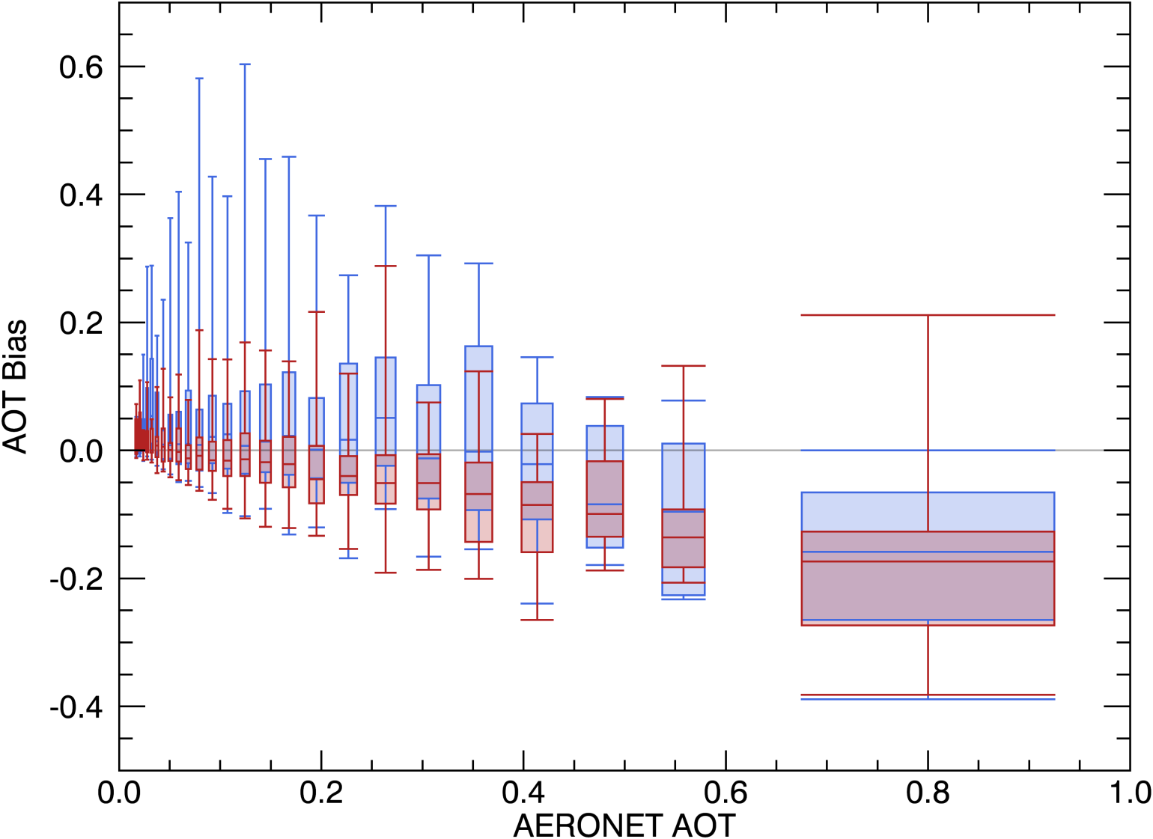
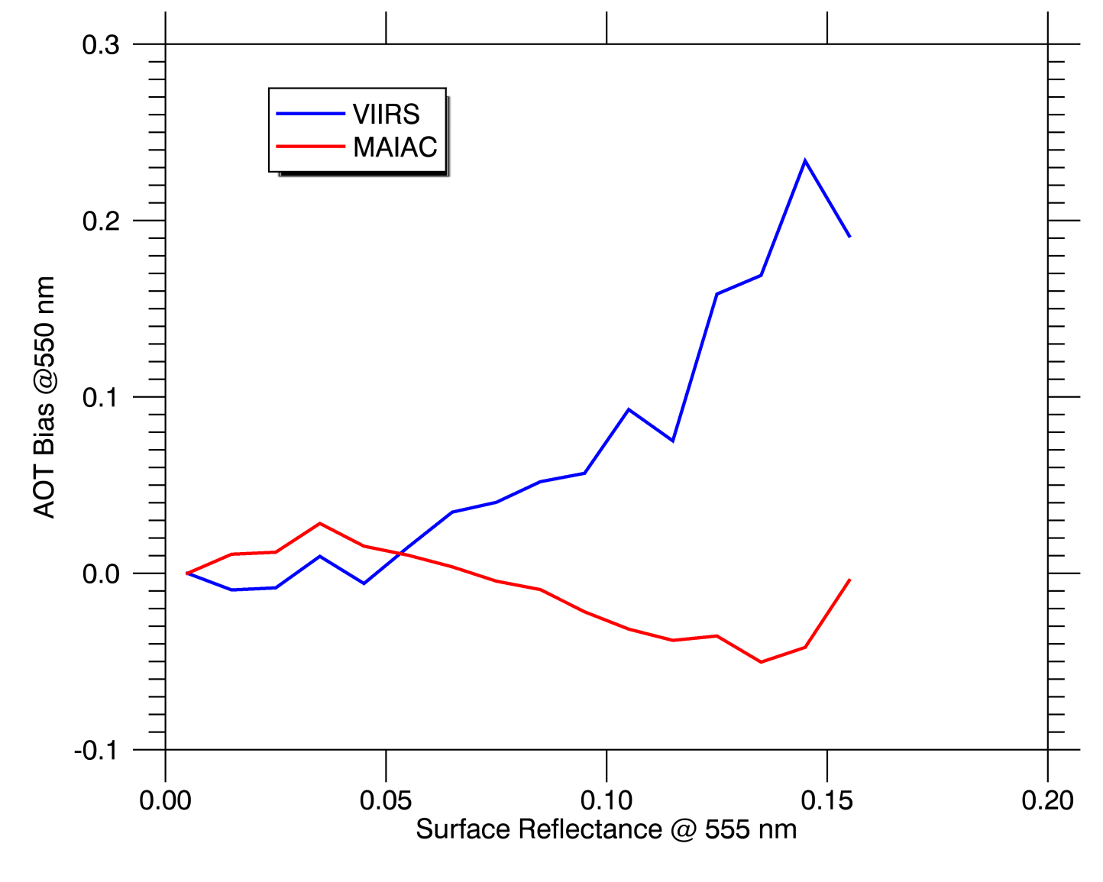
VIIRS AOT IP vs MODIS MAIAC (25km)
(S. Kondragunta, S. Superczynski (NOAA), study for NASA GeoCAPE project)
Bias vs AOT
Bias vs SR

Slide 18
MODIS De-Trending and X-Cal
New MCST RVS characterization for Aqua → new OBPG Terra Polarization Correction (PC) coefficients → MODAPS generated 50km L1B subsets for CEOS desert cal. sites;
Method: a) run MAIAC retrievals (AOT, BRDF etc.); 2) compute TOA reflectance (R_{n}) for fixed geometry (VZA=0°, SZA=45°) and evaluate trends in both Terra and Aqua; 3) Apply de-trending and compute T-A X-calibration factor (gain correction for T)
Lyapustin, A., Y. Wang, X. Xiong, G. Meister, S. Platnick, R. Levy et al, Science Impact of MODIS C5 Calibration Degradation and C6+ Improvements, AMT, 7, 7281-7319, 2014.
Average trend/year/unit_refl.
 | Δ_{Terra} | σ_{Terra} | Δ_{Aqua} | σ_{Aqua}
TOA_B01 | -1.6884E-03 | 2.6114E-04 | 1.5848E-06 | 3.9377E-04
TOA_B02 | 7.7780E-04 | 2.4303E-04 | -6.5120E-05 | 3.5583E-04
TOA_B03 | -8.8922E-04 | 4.5314E-04 | -3.1763E-04 | 2.8486E-04
TOA_B04 | -5.6629E-04 | 3.2829E-04 | -3.9831E-05 | 5.0202E-04
TOA_B05 | 1.9477E-04 | 3.3019E-04 | 4.5784E-06 | 3.3528E-04
TOA_B06 | -3.9516E-04 | 3.0211E-04 | -3.1194E-04 | 2.8191E-04
TOA_B07 | 2.0259E-04 | 2.4491E-04 | -5.8419E-04 | 3.2705E-04
TOA_B08 | -1.2627E-03 | 1.0018E-03 | -5.5178E-04 | 1.0915E-04
TOA_B09 | -3.9874E-04 | 5.2176E-04 | 1.3724E-04 | 2.1120E-04
TOA_B10 | -7.2800E-04 | 8.2601E-04 | -3.0632E-04 | 7.1498E-04

Slide 19
Terra-Aqua X-Calibration
After MCST RVS de-trending for Aqua, we see trend reduction (a factor of 12 in B1 and a factor of 2 in B3) compared to our previous analysis.
Average X-gain for Terra
 | Average | Stdev
TOA_B01 | 1.018776 | 0.000949
TOA_B02 | 1.000523 | 0.001054
TOA_B03 | 0.989436 | 0.001268
TOA_B04 | 1.00109 | 0.001448
TOA_B05 | 0.98862 | 0.001855
TOA_B06 | 0.997128 | 0.000898
TOA_B07 | 0.999368 | 0.000373
TOA_B08 | 1.003774 | 0.000948
TOA_B09 | 1.0014 | 0.001488
TOA_B10 | 1.014141 | 0.002077

Slide 20
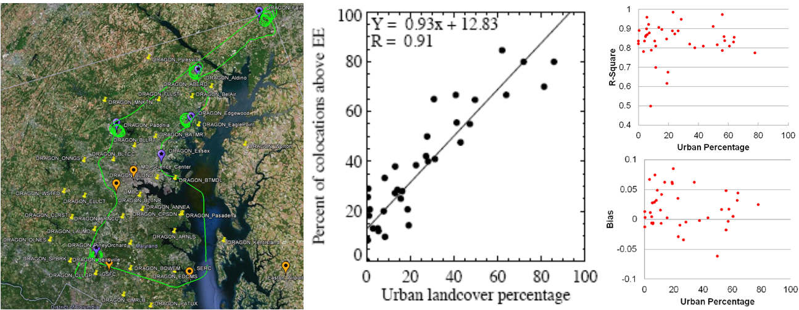
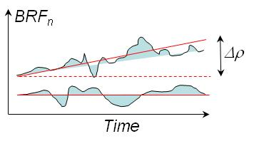
MAIAC: Building a Complete Physical Model of Atmosphere-Surface (RT)
(Dark Target Algorithm is biased over urban surfaces; MAIAC is not)
DT MAIAC
- Anisotropic surface;
- SRC Retrieval
- Detection of seasonal and rapid change:
- Dynamic LWS classification;
- Adaptive and learning system:
Aerosol Type Discrimination;
Synergy among WV, CM, aerosol and AC;
(global aerosol retrievals; low urban bias)
BRF
BRF_{n}
NIR
RGB
(store and dynamically update clear-sky TOA reflectance; spectral BRDF; spatial variability metrics; brightness temperature and contrasts @1km)

