Slide 2
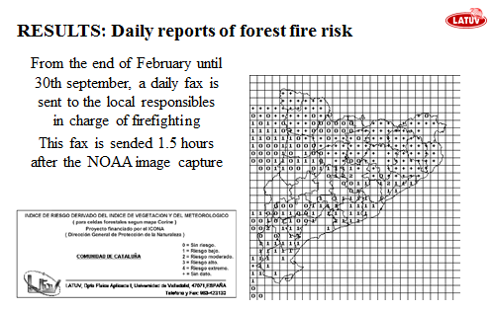
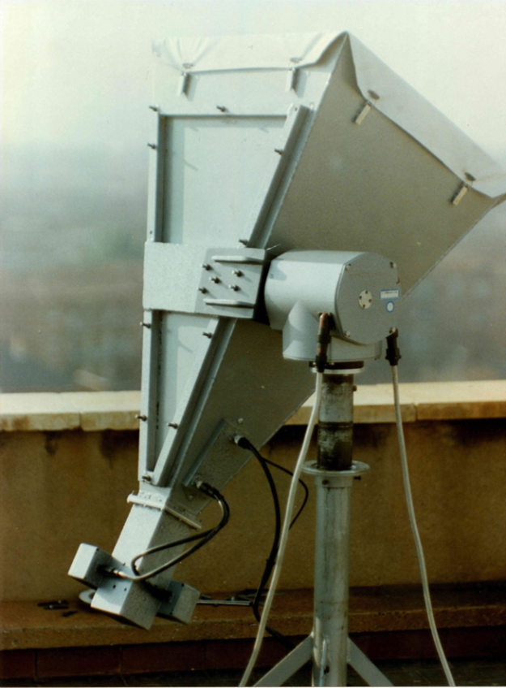
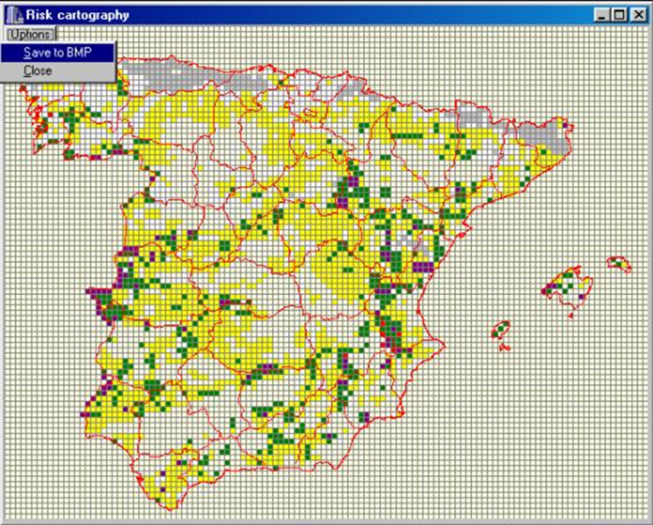
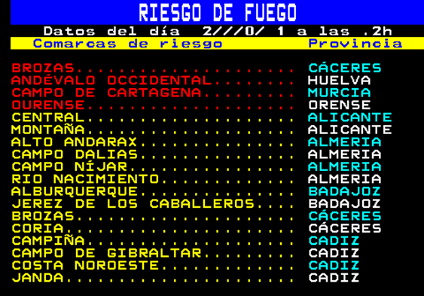
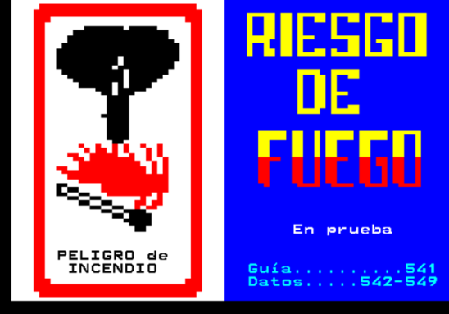
THE BEGINNING
1ST NOAA receiver, 1991
Univ. of Bradford, UK

Slide 3
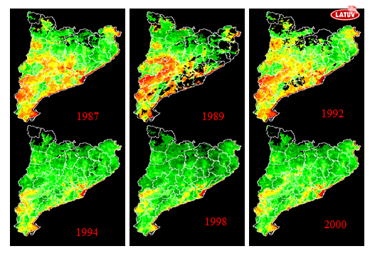
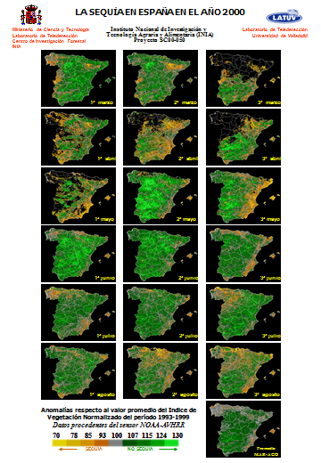
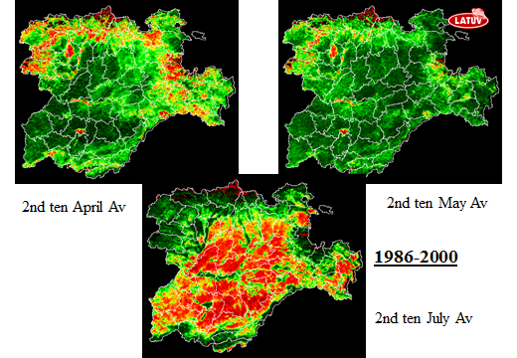
NDVI

Slide 4
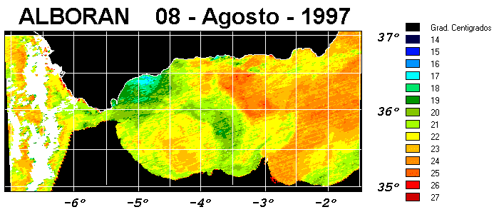
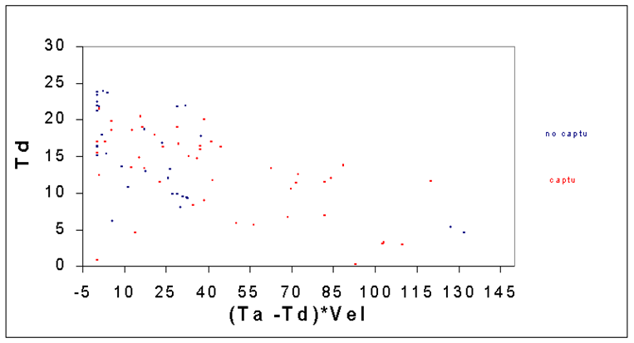
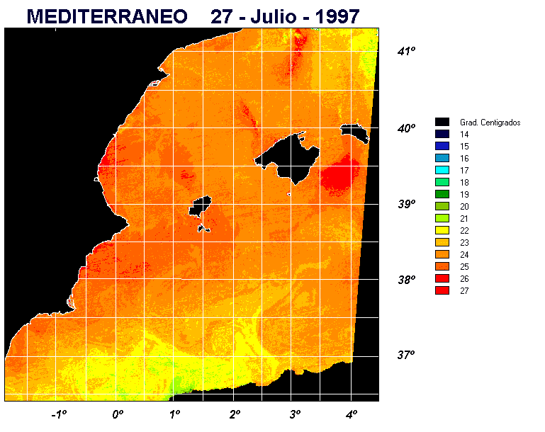
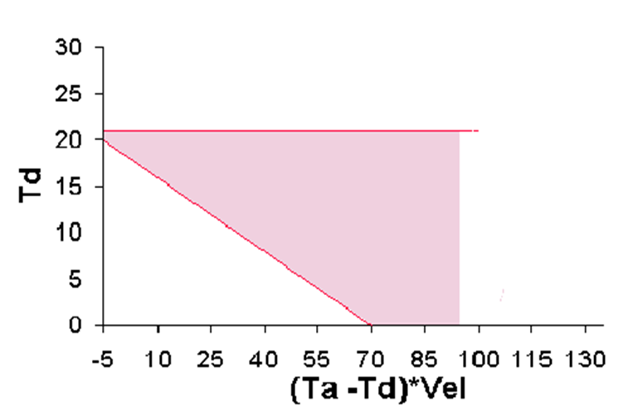
FISHERING
84 % in 16% out
25 % in 75% out
Blue: Fishing (60%)
Red: No Fishing (40%)

Slide 5
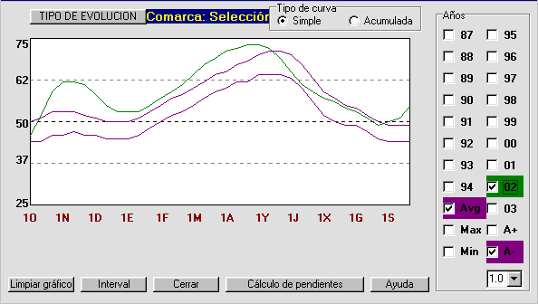
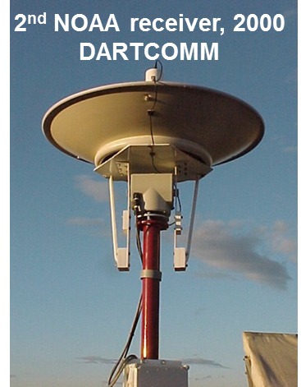
INSURANCES
EVOLUTION OF PASTURE NDVI AT “LA SIERRA (SALAMANCA)”
Green: Current NDVI
1st Purple. Averaged NDVI
2nd Purple: Av. NDVI – 1x SD

Slide 6
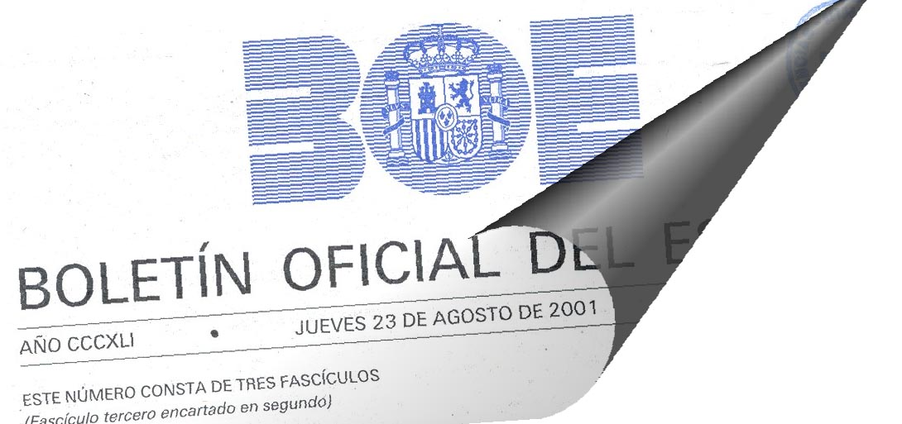
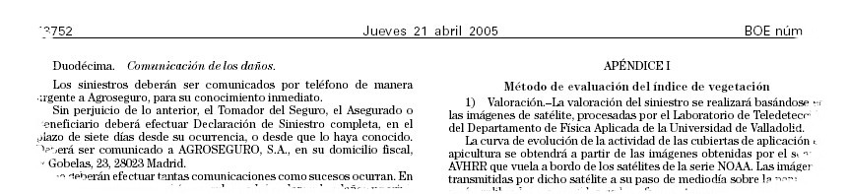
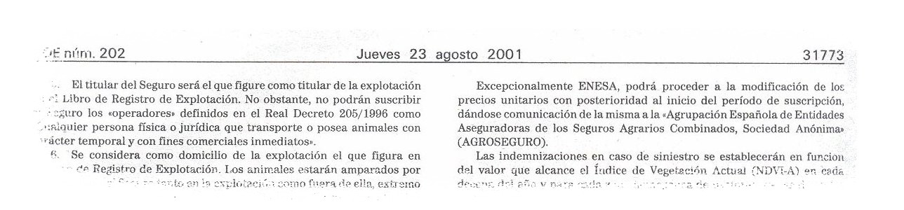

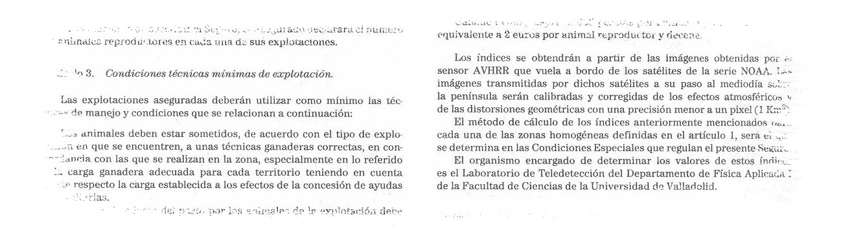

INSURANCES

Slide 7
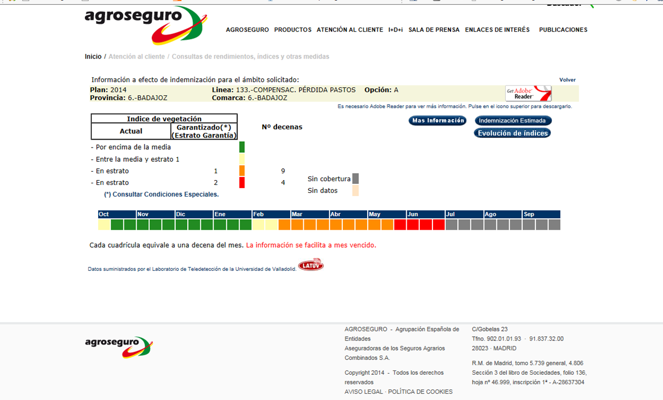
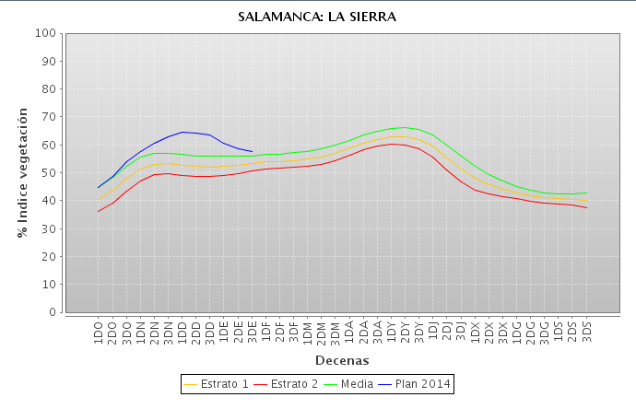
INSURANCES

Slide 8
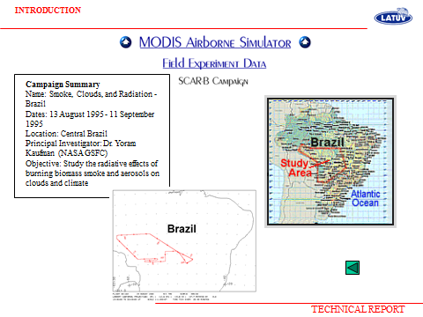
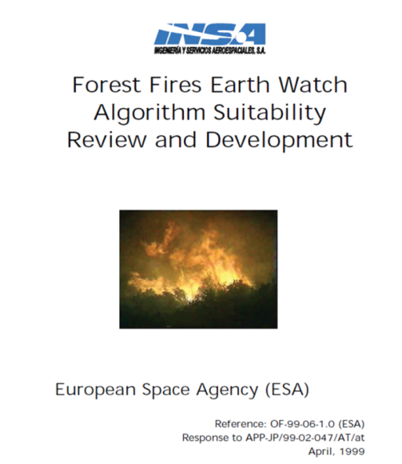
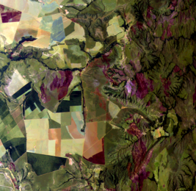
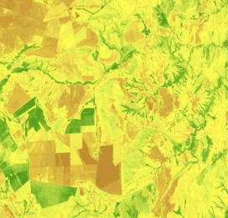
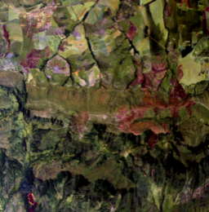
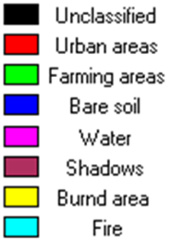
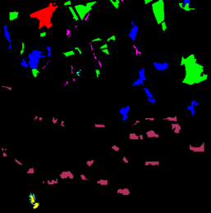

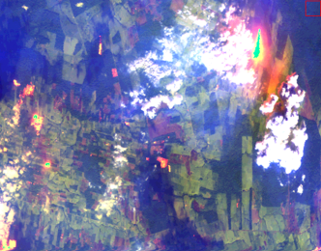
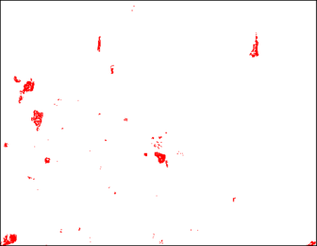
FOREST FIRES
2000-2001: FFEWALS
Atmospheric correction
Geo-referentiation
Fine Geo-location
Sunglint
Classification
Forest fire detection
……
NDVI
Uns. Clas.
Forest Fires

Slide 9
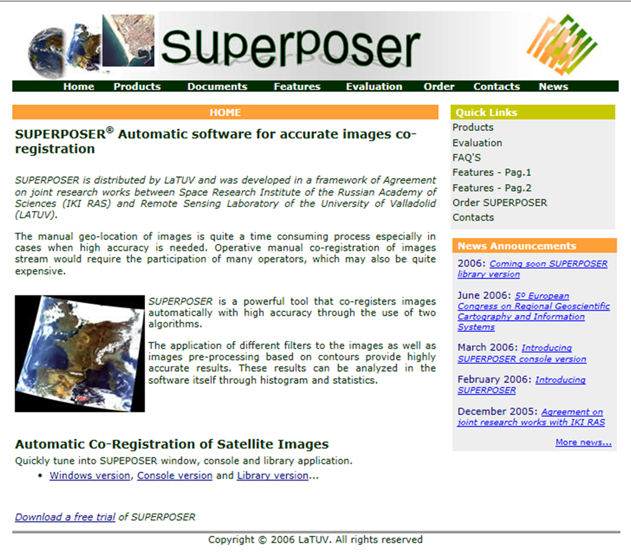

FOREST FIRES
http://www.superposer.eu/

Slide 10
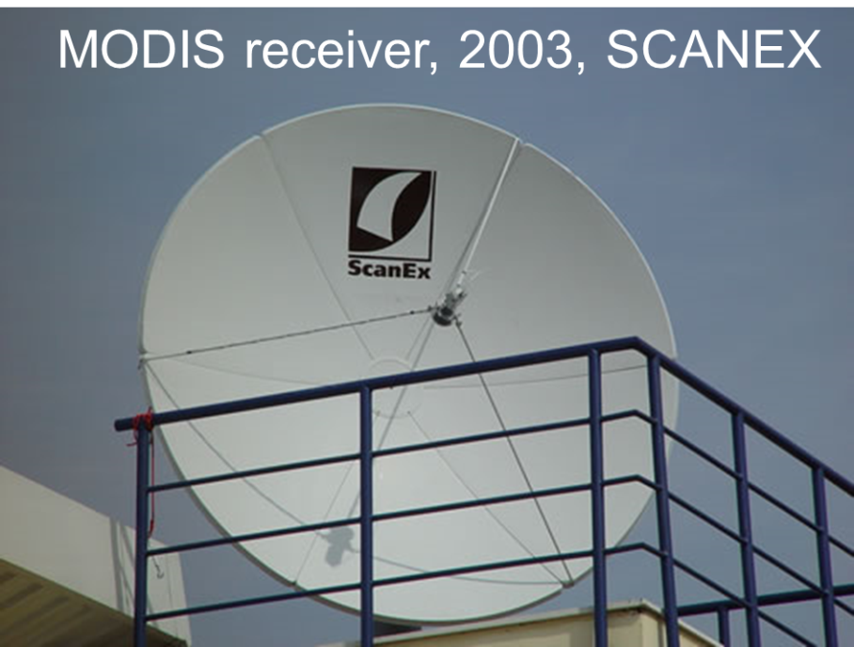
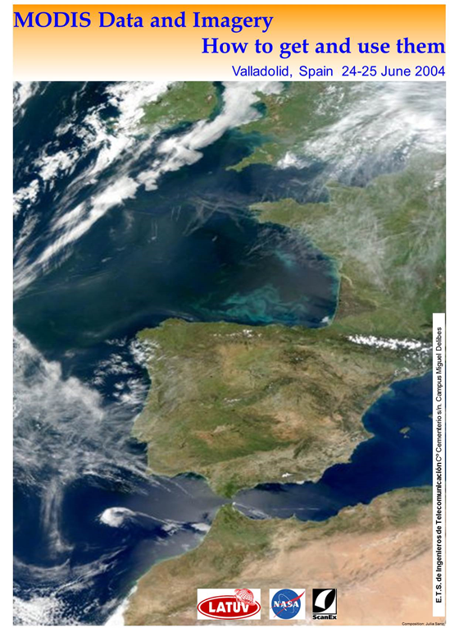
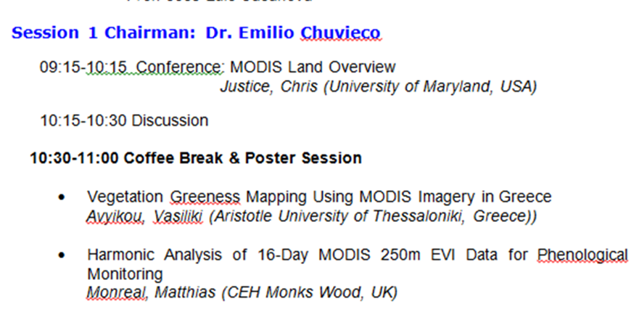
MODIS FINALLY!

Slide 11
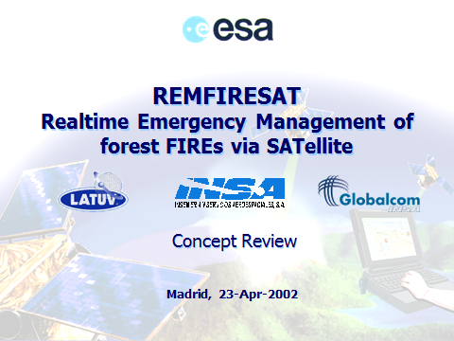
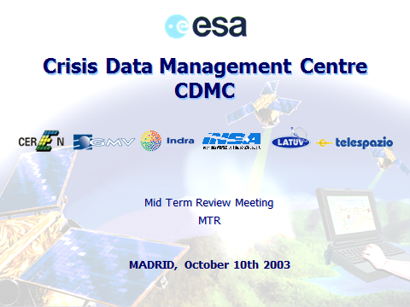
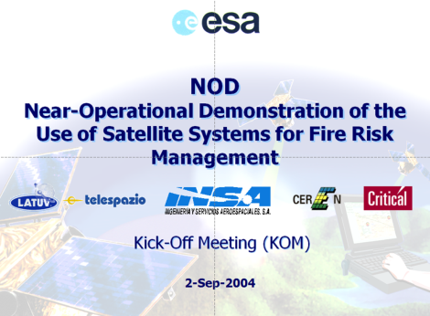
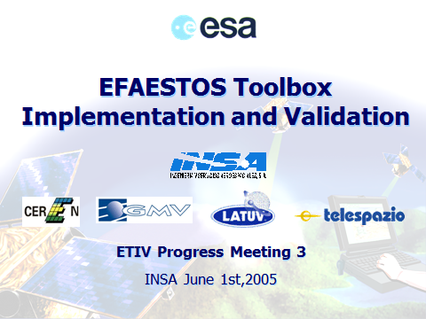
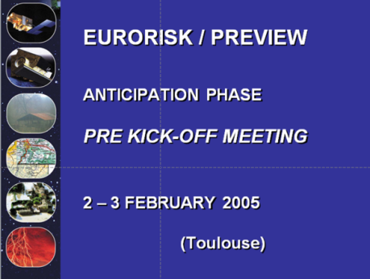
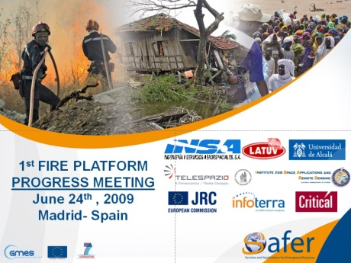
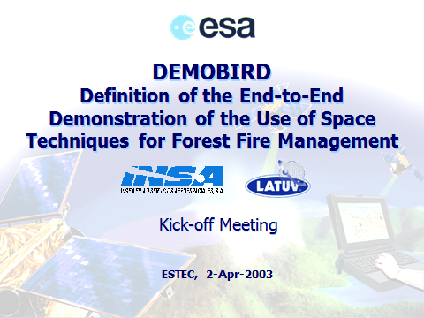
FOREST FIRES
2001-2003
REMFIRESAT
2003-2004
CDMC
2004-2005
NOD
2005-2006
ETIV
2005-2009
PREVIEW
2008-2011
SAFER-GMES
(Copernicus)
2003
DEMOBIRD

Slide 12
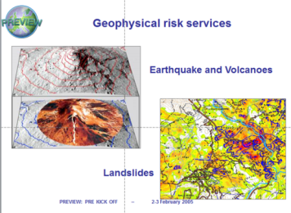

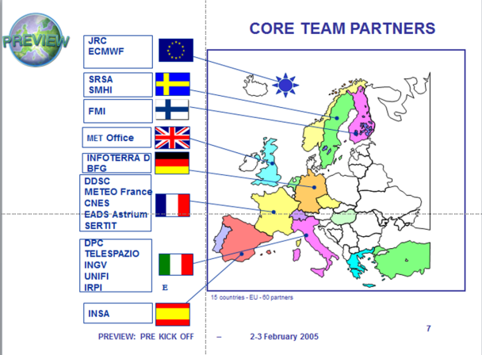
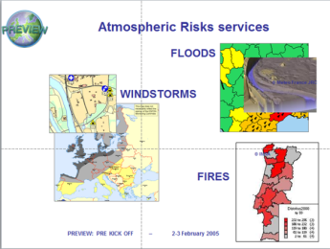
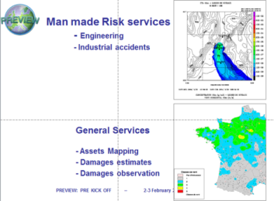
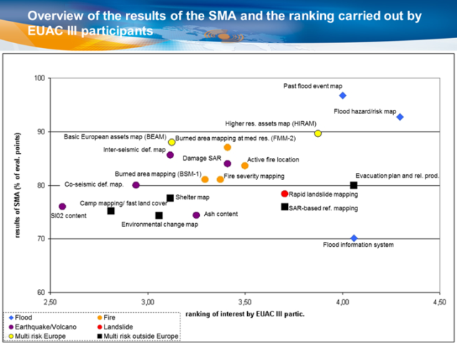
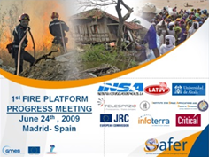
FOREST FIRES
2005-2009
PREVIEW
EURORISK PREVIEW: PREVention, Information & Early Warning
58 partners
23 M€, FP6
2008-2011
SAFER-GMES
SAFER and GMES Emergency Response Core Service:
One step closer to full-scale operational deployment
55 partners
39 M€, FP7

Slide 13
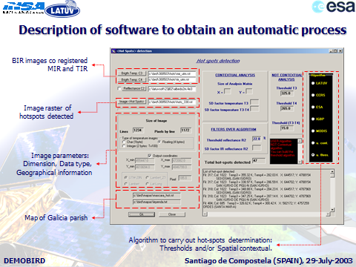

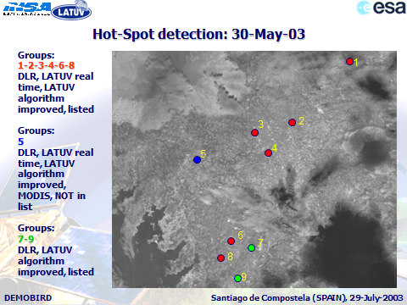
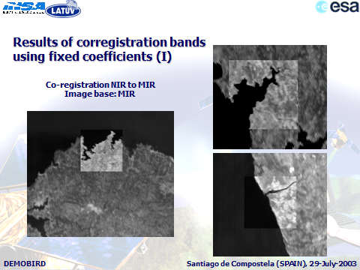
FOREST FIRES
2003
DEMOBIRD
Bi-Spectral Infrared Detection
DLR HSRS sensor
MIR&TIR
Swath: 190 km
Pixel: 372 m
14 bit
Sat. Temp: Very high

Slide 14
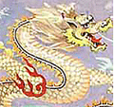



DRAGON PROGRAMME
ESA-NRSCC
Cooperation

Slide 15






DRAGON PROGRAMME
Fire temp, burning area, FRP
FRE: power law
Burnt Biomass
Number of fires detected
Fire severity
Fire recovery
CO emissions
Sentinel-2

Slide 16






DEIMOS IMAGING
Deimos-Imaging: 2006
Swath: 600/460 km
R,G,NIR (8/10 bit)
22 m
Deimos-1: 2009

Slide 17


NATIONAL PROJECTS
2009-2012
CENIT TEcoAgua: Development of Sustainable Technologies for the Integral Water Cycle
10 commercial companies
21 research centers
18 M€

Slide 18



NATIONAL PROJECTS
2010-2013
CENIT PROMETEO: Integral technologies for fighting forest fires and forest conservation
14 commercial companies
15 research centers
24 M€

Slide 19




WILD LIFE
Probability of presence of Milano Real
in the Iberian Peninsula

Slide 20




WILD LIFE
We used breeding success data of the Great Bustard (Otis tarda) to create yearly series (1988-2010) on the basis that NDVI from NOAA-AVHRR is a proxy of food availability and we demonstrated that NDVI is a successful predictor of chick survival during rearing periods.

Slide 21




HEALTH
www.solysalud.org, 1997

Slide 22



HEALTH
www.malariawarning.eu

Slide 23




SUOMI NPP
CrIS

Slide 24
Our greatest achievement in these years is to have trained a large number of young students, who are currently working in companies, in academic or have created their own company.
All this has been possible thanks to the images, data and information we have received freely.
I encourage everyone to take advantage of this data, especially now that it is possible to receive them not only through antennas but also by internet.
THANK YOU

