Slide 1
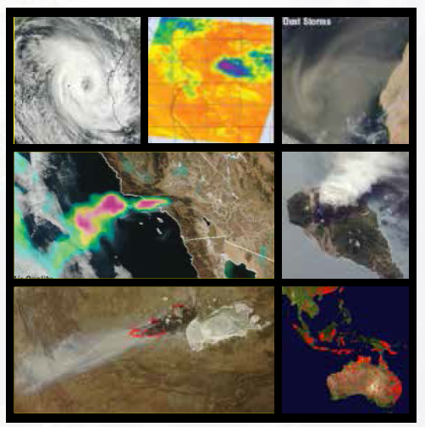
LANCE: Land, Atmosphere Near Real-Time Capability for EOS
Global Near Real-time Products
Prepared for the NASA Direct Readout Conference (NDRC-9), June 21st 2016, Valladolid, Spain
Diane Davies, LANCE Operations Manager and Karen Michael, LANCE Manager

Slide 2
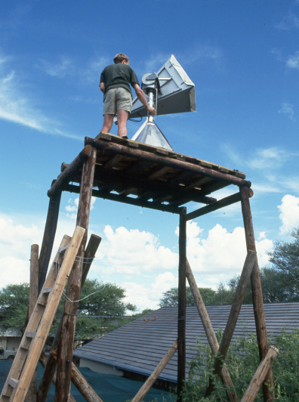
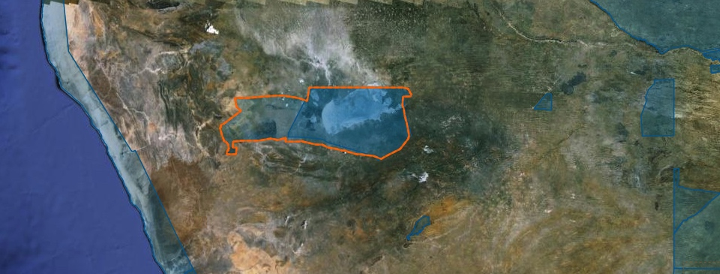
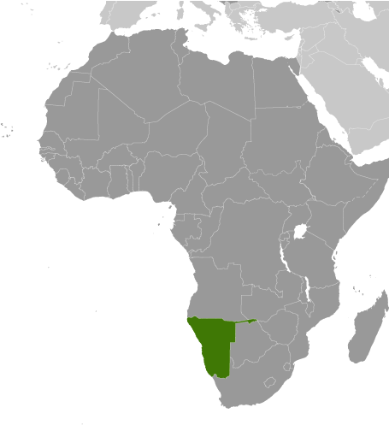
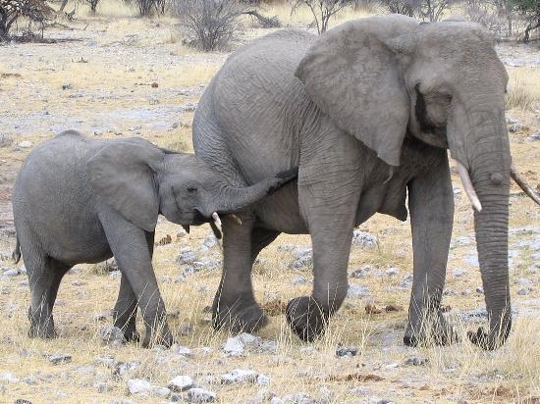
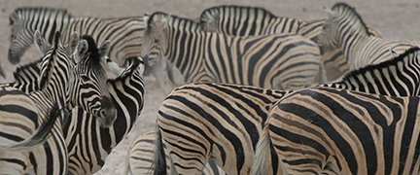
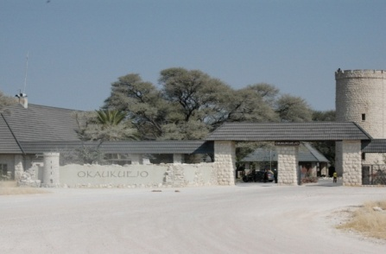
Direct broadcast of NOAA AVHRR HRPT
Direct reception provided real-time monitoring capability
System provided by LARST - Local applications of Remote Sensing Technology with funds from the UK Department for International Development (DfID).
Notes:
Added this slide as an intro for me – I used to work with a DR station
HRPT = High Resolution Picture Transmission

Slide 3
Land, Atmosphere Near Real-time Capability for EOS (LANCE)
The goal of LANCE is to provide global near real-time (NRT) data products within 3 hours of observation to meet the timely needs of applications users.
LANCE provides NRT data and imagery from the AIRS, AMSR2, MISR, MLS, MODIS, OMI and VIIRS instruments much quicker than routine processing allows.
LANCE is a virtual system that leverages existing EOSDIS Components and consists of an umbrella set of requirements to ensure consistency for end users
Air Quality - Dust storms – Fires – Vegetation for agricultural monitoring – Floods – Ash Plumes – Drought – Smoke Plumes – Sea Ice for shipping – Severe Storms

Slide 4
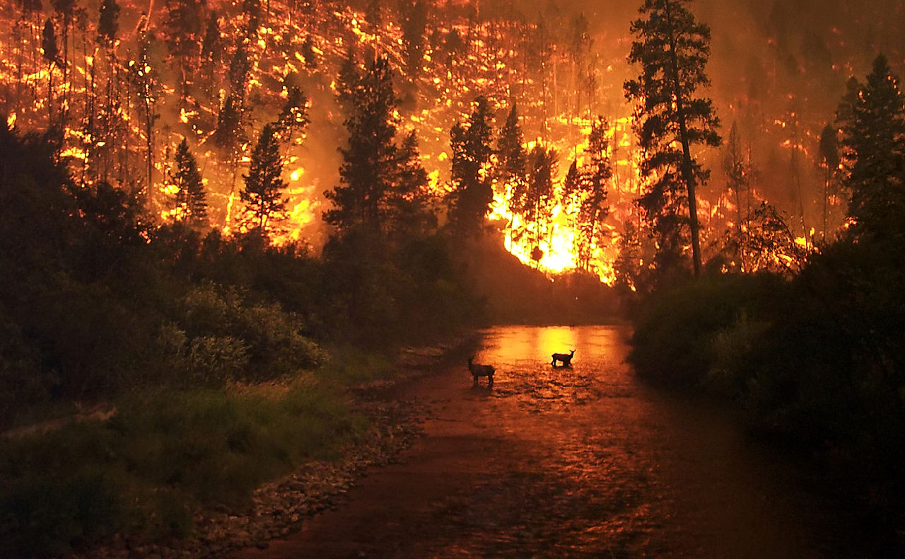
The first request for Near Real-Time MODIS data was from US Forest Service in 2000
Deer and wildfire, Montana Taken 6 August 2000 by John McColgan, USFS, via Wikimedia Commons.
Notes:
Origins of LANCE
The first request for NRT products from MODIS was back in 2000 not long after MODIS was launched on the Terra satellite. The US Forest Service (USFS) requested MODIS fire detections within hours of acquisition, to help manage the wild land fires on the Idaho-Montana border. A team of scientists from University of Maryland, NASA Goddard Space Flight Center and the USFS, assembled a series of customized images that demonstrated the significant contribution that NRT MODIS products could make to wildfire suppression and emergency rehabilitation.

Slide 5
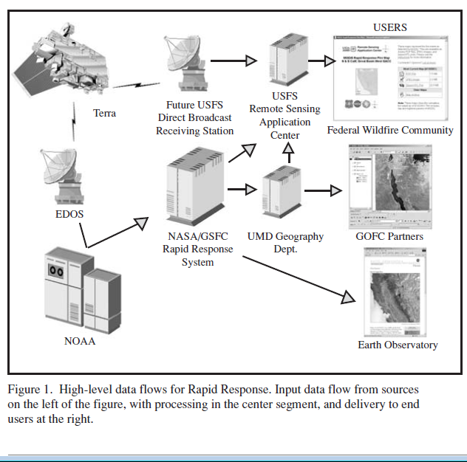
MODIS Rapid Response
Source:
Sohlberg, R., J. Descloitres, et al. (2001). "MODIS Land Rapid Response: operational use of Terra data for USFS wildfire management." The Earth Observer 13(5): 8-10,14.
Notes:
Sohlberg, R., J. Descloitres, et al. (2001). "MODIS Land Rapid Response: operational use of Terra data for USFS wildfire management." The Earth Observer 13(5): 8-10,14.
The following April, the same team initiated the Rapid Response System.
Initially, Rapid Response System produced data and imagery just for North America. But by 2007, the Rapid Response System was producing global imagery and data from the MODIS instruments on both the Terra and Aqua satellites

Slide 6
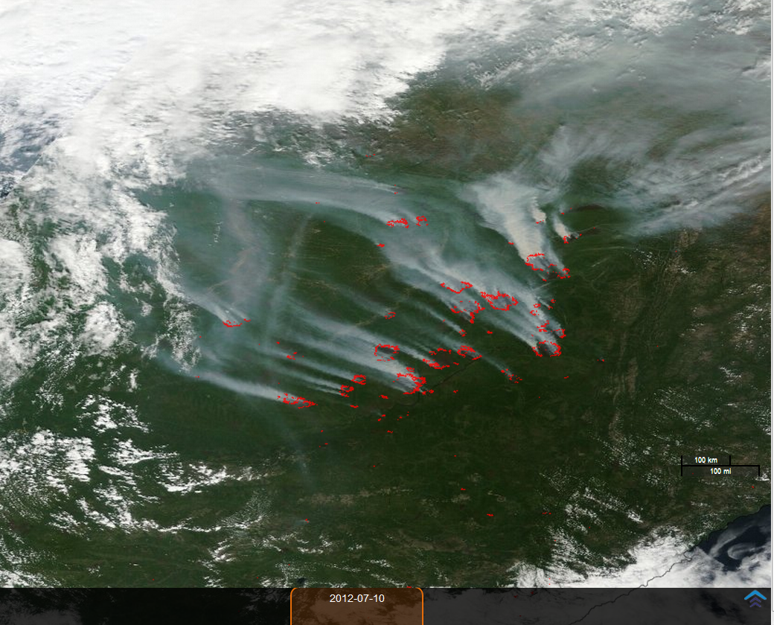
Wildfires in Siberia: 10th July 2012. Corrected Reflectance (True Color) Terra / MODIS with active fires overlaid in red.

Slide 7
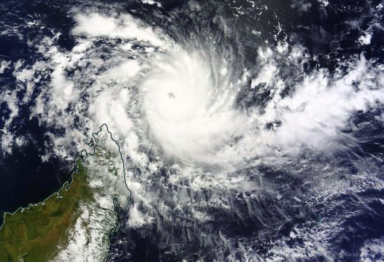
Example of a MODIS True Color ‘natural-looking’ image showing Cyclone Fantala, off the coast of Madagascar.
Acquired from MODIS on NASA’s Terra satellite April 18, 2016.
Notes:
Some of the most valuable products created by RR included imagery based on the MODIS Corrected Reflectance algorithm, which provides ‘true color’ (i.e. natural-looking) images. This example is of Cylcone Fantala.
As the Rapid Response capability became more visible, news organizations, such as CNN, BBC, Washington Post and the New York Times, began requesting custom geo-referenced images for large newsworthy events. Users quickly realized that the imagery and data products produced by Rapid Response could be used for other tasks, including monitoring air quality, dust storms, snow cover and agriculture, as well as for public education and outreach.

Slide 8
LANCE
LANCE - implemented in 2009 by NASA’s Earth Science Division
Levies a set of requirements that ensure a consistent service to a wide user base
Promotes software re-use across and within the elements in order to reduce development and sustaining engineering costs
LANCE is governed by a User Working Group
Members reflect the various user communities served by LANCE as well as representatives of the Science Teams for the LANCE instruments
Meets at least once a year to review status of LANCE operations and provide guidance on upgrades suggested by the user communities and the LANCE elements

Slide 9
Notes:
More up to date slide?

Slide 10
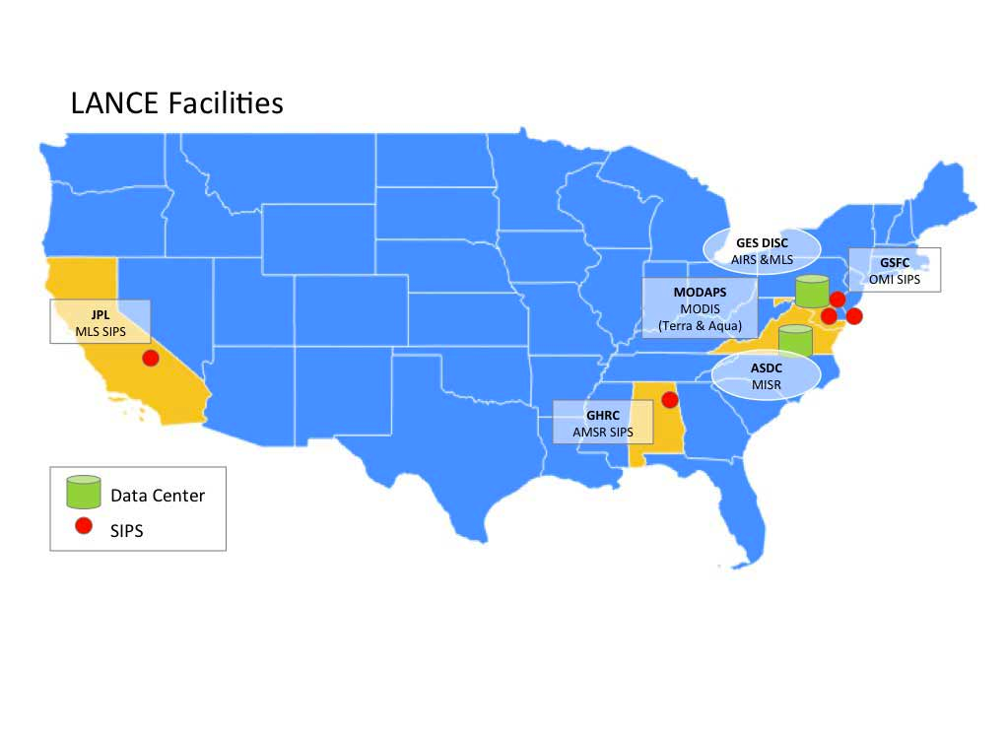
LANCE FACILITIES
The LANCE elements are located at the following facilities
AMSR Science Investigator-led Processing System (SIPS) providing AMSR2 data
Atmospheric Science Data Center (ASDC) providing MISR data with support from the MISR Science Computing Facility at JPL
GSFC Earth Sciences Data and Information Services Center (GES DISC) providing AIRS, and MLS data via the MLS SIPS at JPL
MODIS Adaptive Processing System (MODAPS) providing MODIS and VIIRS data
OMI Science Investigator-led Processing System (SIPS) providing OMI and OMPS data

Slide 11
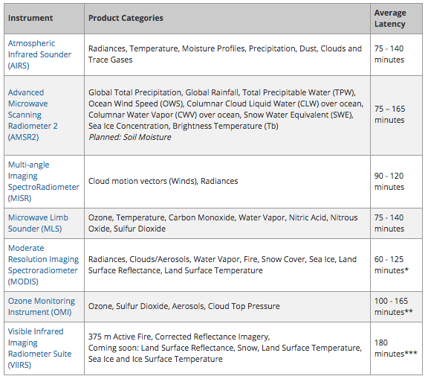
LANCE NRT Products with Average Latency
* Latency excludes daily Land Surface Reflectance
** Latency excludes Level 3 products
*** It is anticipated that this initial latency will be reduced
Notes:
LANCE provides over 90 products from 6 instruments. It distributes lower level products such as calibrated geo-located radiances and higher-level products such as active fire locations and snow cover.

Slide 12
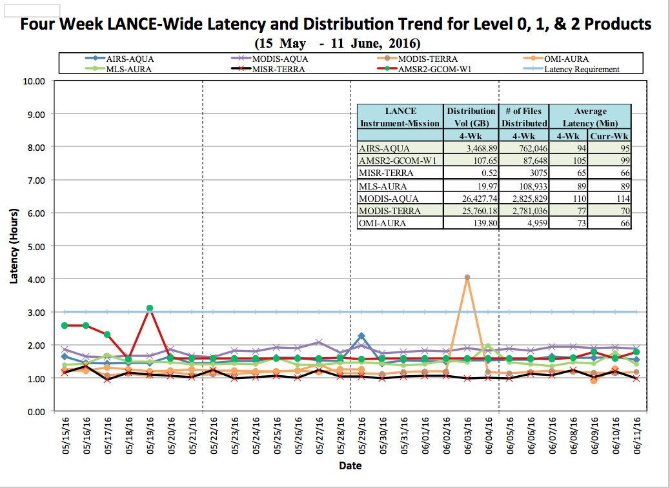
Notes:
Generally latencies are under 2 - 2.5 hours.

Slide 13
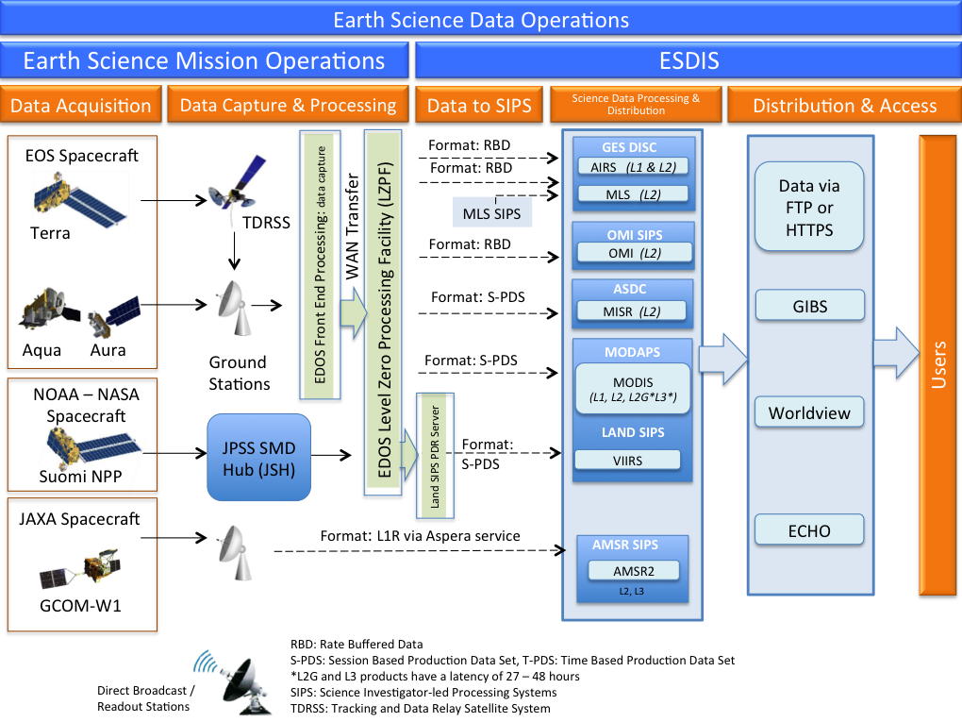
Notes:
To achieve the 3 – hour latency requirement LANCE data are expedited at every step of the way from data capture to processing and distribution. LANCE elements are supplied with datasets from the EDOS (EOS Data and Operations System) as soon as they are downlinked from satellites or transmitted from ground stations, generally within 30 minutes to two hours after observation. The exception to this is AMSR2 …Originally, LANCE provided data from Advanced Microwave Scanning Radiometer-EOS (AMSR-E), but in 2011, the AMSR-E instrument on the Aqua satellite malfunctioned and data provision was discontinued. LANCE ingest and processes ASMR2 data from the Japanese GCOM-W1 satellite.

Slide 14
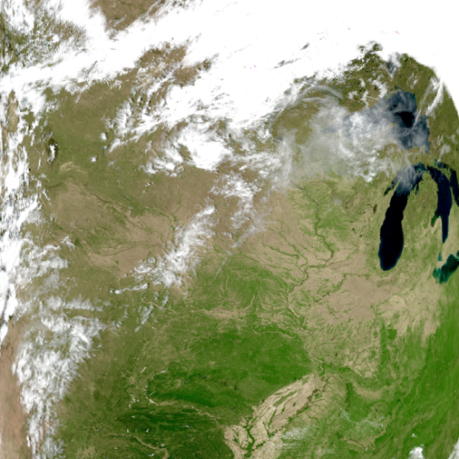
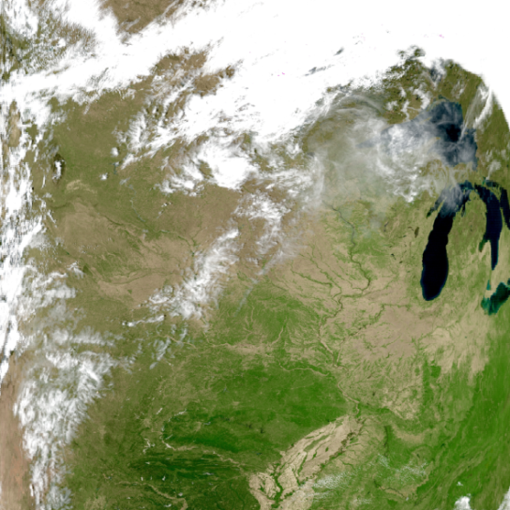
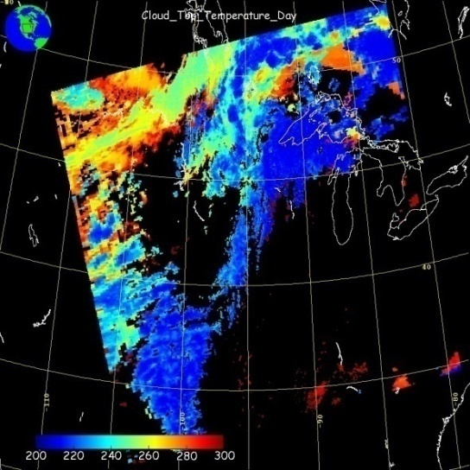
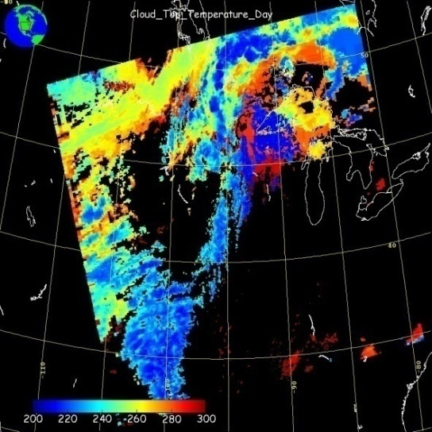
Comparison of NRT and Standard Products
LANCE latency requirements necessitate predicted geo-location and relaxed ancillary data – in some cases there are significant differences between the NRT and standard data products, but overall the agreement is high.
Science Product
Near Real-Time Product
Land Surface Reflectance
Cloud Top Temperature
Notes:
All expedited algorithms and any subsequent product modifications are overseen by science team members and they are considered appropriate for NRT applications. Comparisons of NRT and Science undertaken by the relevant science instrument team members - they provide validation and documentation to NRT as well as to the standard products, and ensure that user feedback and evolving user needs will translate into appropriate product modifications and new products.

Slide 15
Services available to access LANCE Products
NASA supports an open data policy
Data can be downloaded following self registration through the Earthdata login https://urs.earthdata.nasa.gov/users/new
Data products
Subscription – set up with an individual LANCE elements
Near Real-Time webpages: https://earthdata.nasa.gov/lance
Earthdata search client: https://search.earthdata.nasa.gov/
MODIS & VIIRS Hotspot/Active Fire data
FIRMS (Fire Information for Resource Management): Web Fire Mapper, data downloads and customized email alerts
Imagery
Global Imagery Browse Services
Worldview
Rapid Response
Notes:
Earthdata login: Once registered you can use this ID and password to access all EOSDIS data centers and EOSDIS system components

Slide 16
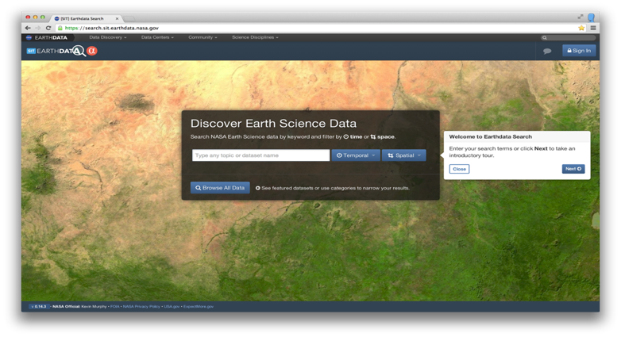
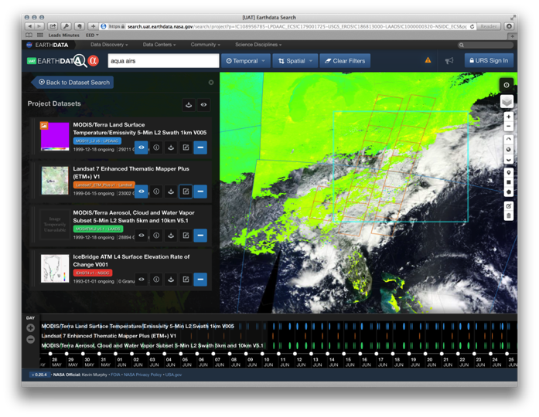
EOSDIS Earthdata Search Client
Provides search, discovery and access for all EOSDIS data
Provides granule visualization
Allows for cross dataset comparisons.
Provides services for format conversion and subsetting.
Supports saving and sharing of data projects.
Has Streamlined data access workflows
The Earthdata Search Client provides users with cross-DAAC search, discovery, and access for all EOSDIS data.
It showcases the advanced features of the Common Metadata Repository, the Global Imagery Browse Service, OPeNDAP and more.

Slide 17
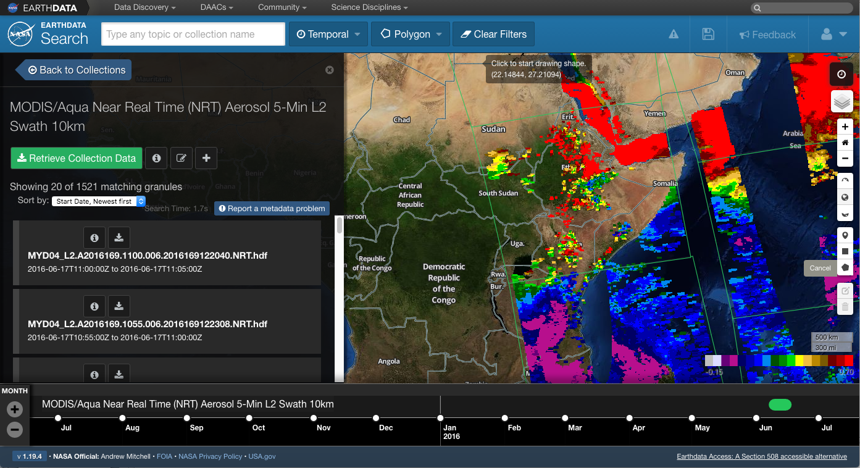

Slide 18
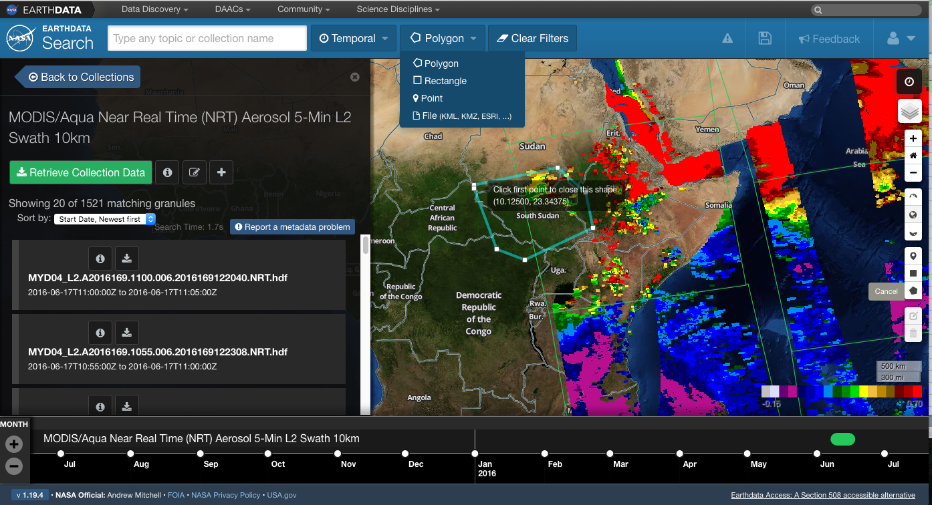

Slide 19
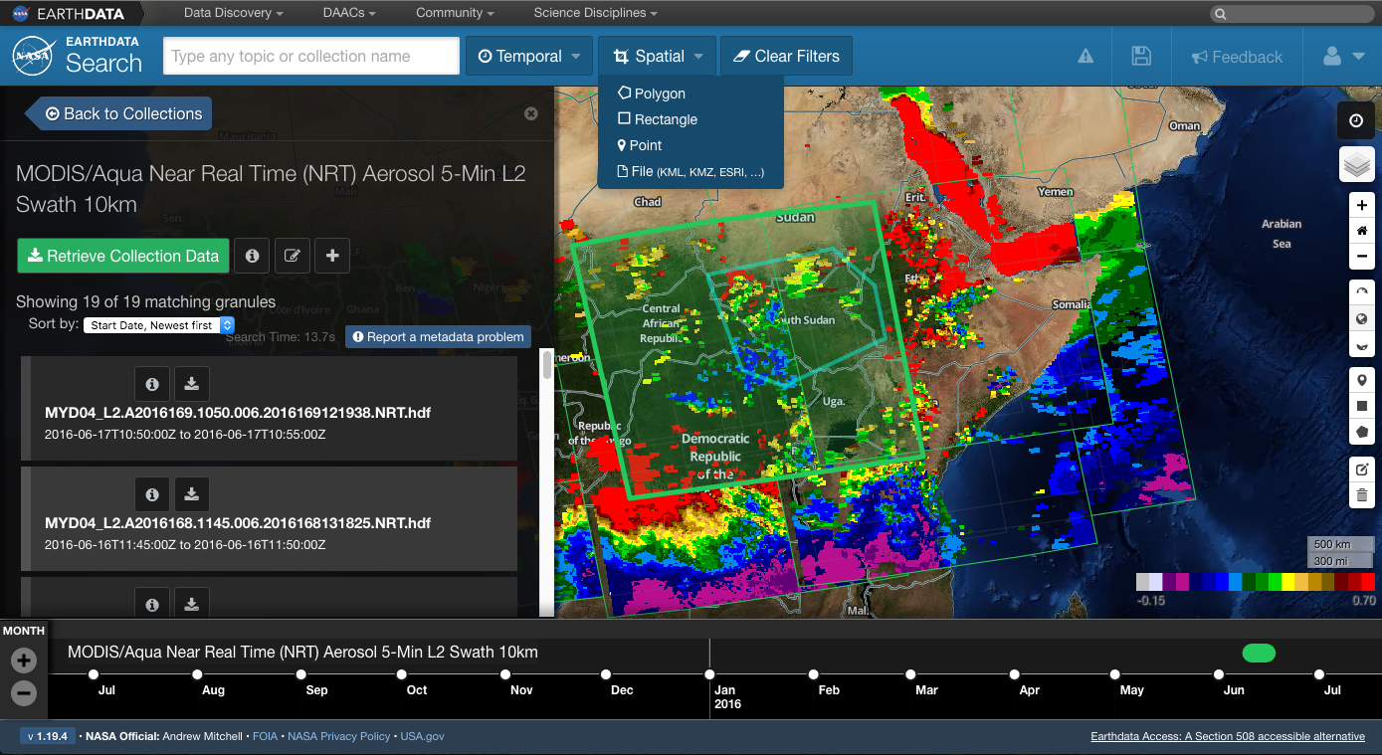

Slide 20
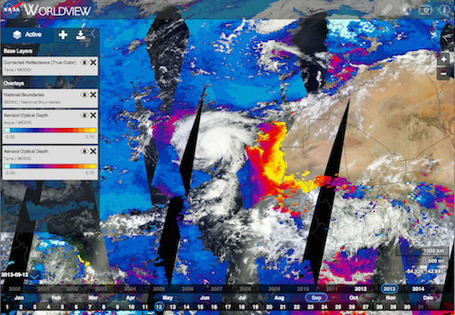
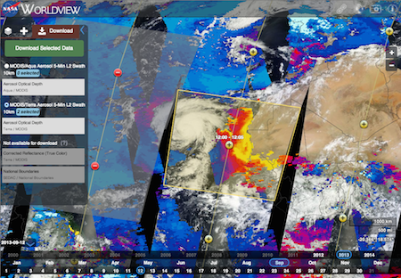
EOSDIS Global Imagery Browse Service (GIBS)
What is GIBS?
GIBS supports high performance, full resolution imagery browse services for EOSDIS.
GIBS’ vision is to transform how end users interact and discover EOSDIS data; make it visual.
GIBS provides open access to its imagery; easily connect through mapping clients, GDAL-based scripts, and some GIS clients.
Worldview is the EOSDIS (reference) client for GIBS (https://earthdata.nasa.gov/labs/worldview/).
Visually discover “interesting” imagery as served by GIBS
Benefits of GIBS:
Improves “approachability” of data – a picture is worth a thousand words.
Leverages science expertise to generate authoritative, science based visualization products (quality, image generation, etc.).
Facilitates full-resolution, “no boundaries” interaction patterns (as opposed to granule-based, reduced-resolution browse).
Widens usage of NASA Earth Science data to new communities – non-experts.
When found, query EOSDIS/ECHO for underlying files and
download data from DAACs

Slide 21
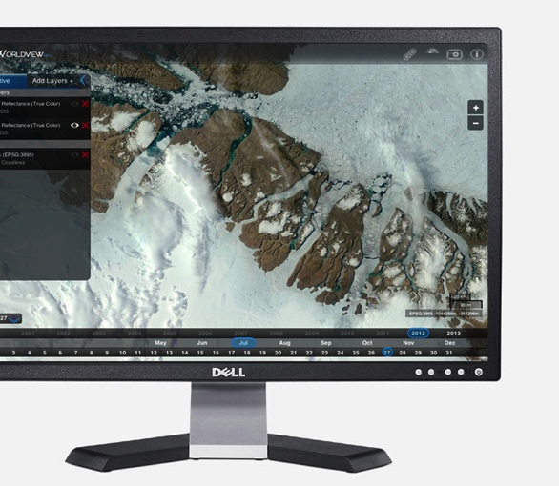
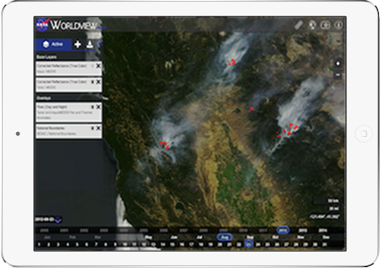
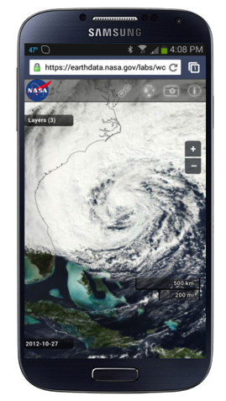
Worldview
EOSDIS Data Visualization, Discovery, and Download Tool for GIBS
Key Features:
Global satellite imagery products available from GIBS, many available within 4 hours of observation
Google Maps-like ability to interactively pan and zoom, then share “permalinks” with others
Unlike Google Maps, Worldview can
interactively change the currently-displayed time
view imagery in Arctic and Antarctic polar stereographic projections
download imagery in JPEG, PNG, GeoTIFF, and KML
download the underlying data used to generate the imagery
Web browser-based, developed using open standards (JavaScript, CSS, HTML) for cross-device compatibility; all code is available as open source
https://earthdata.nasa.gov/worldview

Slide 22
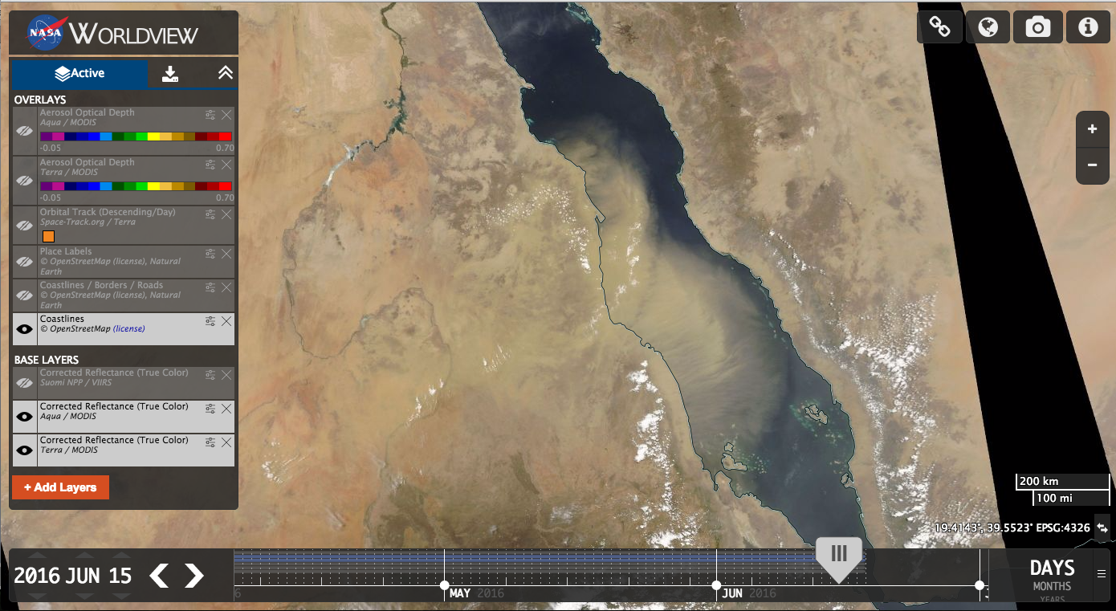
Notes:
Time slider

Slide 23
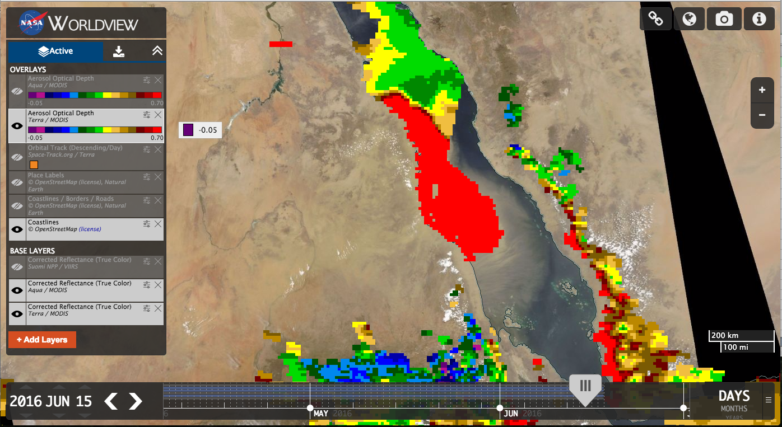

Slide 24
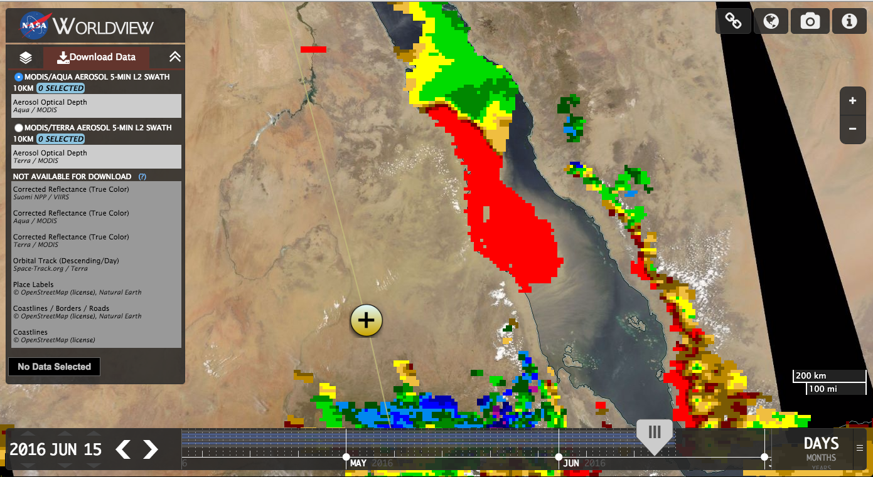

Slide 25
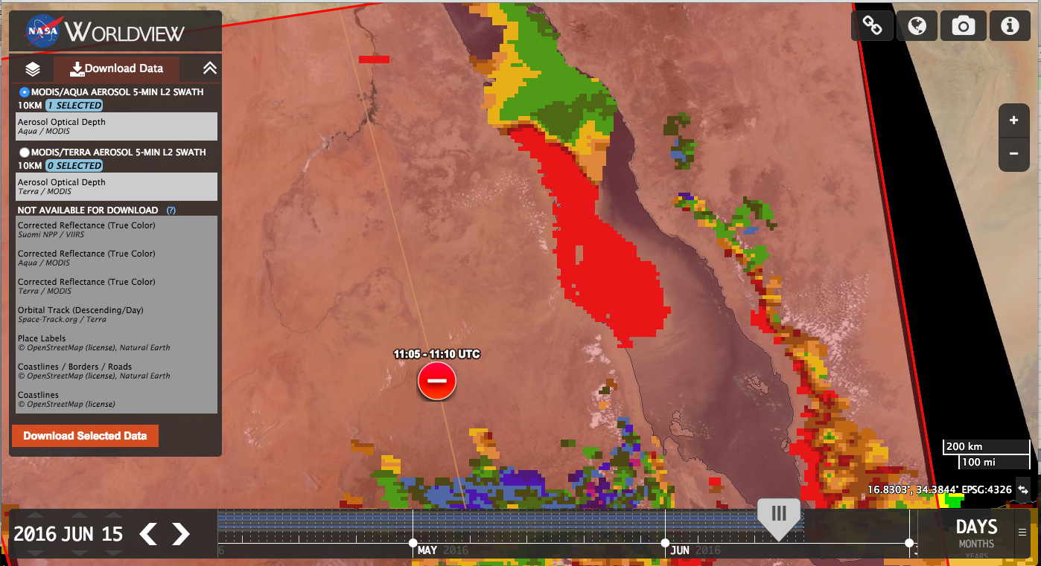

Slide 26
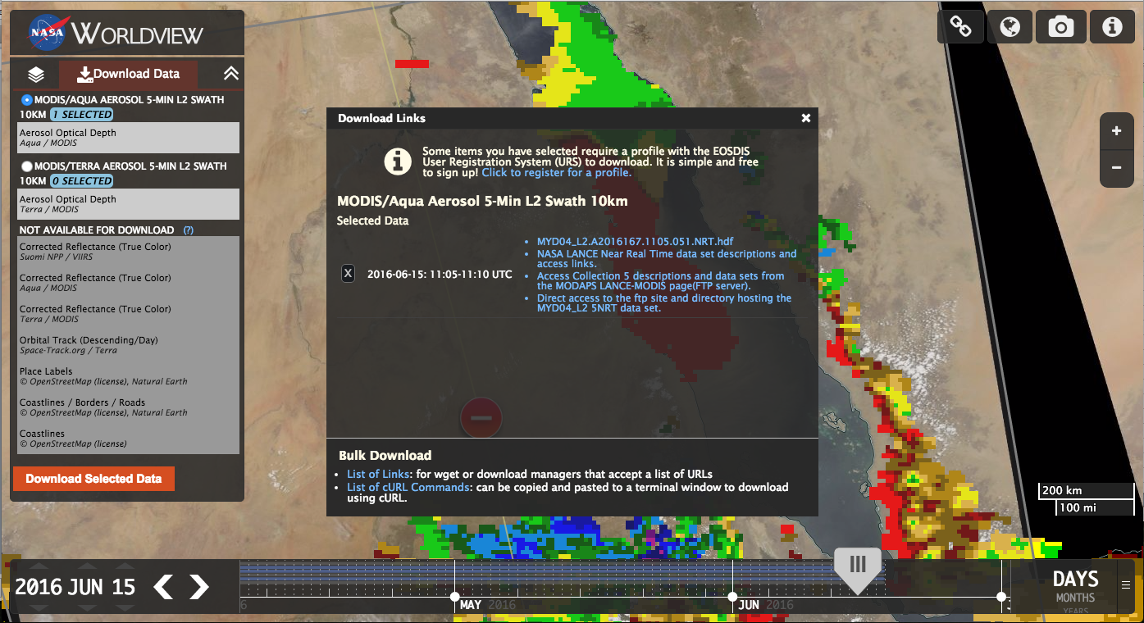

Slide 27
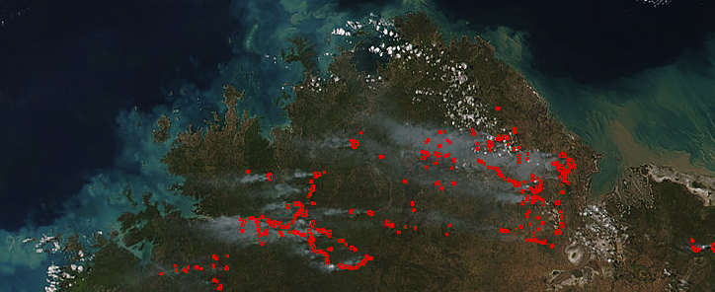
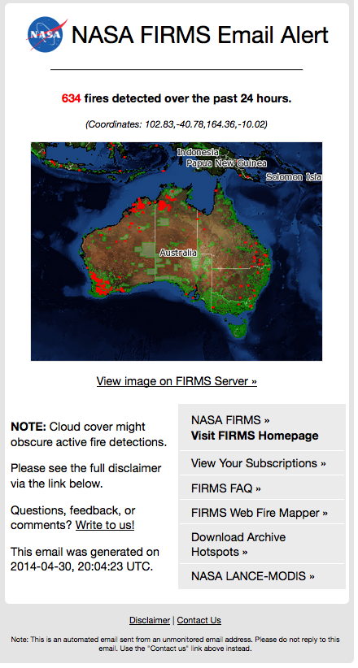
FIRMS Fire Information for Resource Management System: Getting VIIRS and MODIS active fire data in to the hands of users
Users can interactively view and query the fire hotspot data in Web Fire Mapper, download data (text, shape or KML files) or subscribe to fire email alerts for their area of interest.
FIRMS primarily distributes NRT data but also pulls standard (MCD14ML) data and makes it available through its download tool.
There are over 6000 fire email alert subscriptions. Approximately 2000 fire email alerts are sent daily to users in over 120 countries.
https://earthdata.nasa.gov/firms

Slide 28
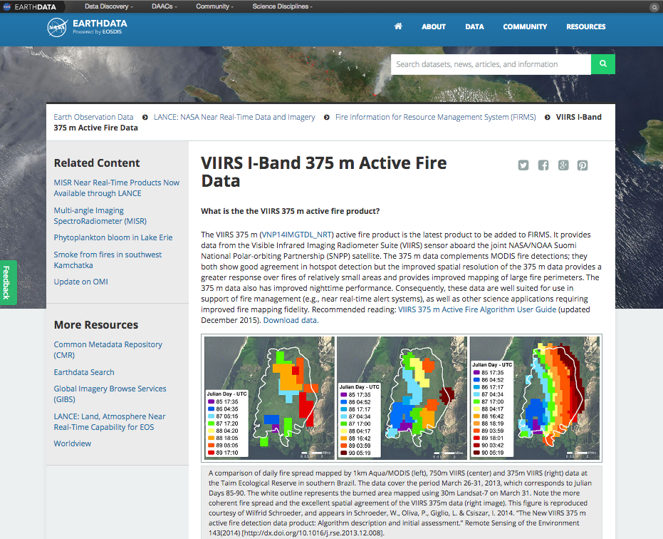

Slide 29
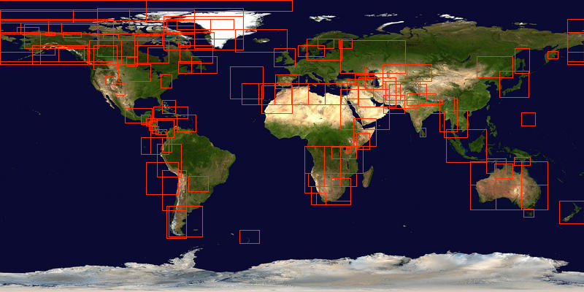
Rapid Response
https://earthdata.nasa.gov/lance/rapid-response
View and download MODIS images for a large number of areas in
GIS-compatible format.

Slide 30
Users and Metrics
LANCE products are routinely used by direct users, who access data for their own purposes, and by brokers who add value to the data by combining it with other specialist knowledge and serve it to targeted end users.
The beneficiaries include natural resource managers, those working with hazards and disasters and scientists and researchers monitoring and analyzing natural and man-made phenomena.
In excess of 2TB of data products are distributed each day and approximately 50,000 images are downloaded daily

Slide 31
Acknowledgements
The slides presented here draw on the work of the LANCE Elements and ESDIS including: Jeff Schmaltz, Ryan Boller, Matt Cechini, Min Wong, Katie Baynes, Dan Pilone and many more.
For more information
LANCE Near Real-Time webpages:
Rapid Response: https://earthdata.nasa.gov/lance/rapid-response
Worldview https://earthdata.nasa.gov/worldview
Global Imagery Browse Services https://earthdata.nasa.gov/gibs
GIBS wiki: https://wiki.earthdata.nasa.gov/display/GIBS/
FIRMS: https://earthdata.nasa.gov/worldview
Earthdata Search: https://search.earthdata.nasa.gov/
EOSDIS User Registration System: https://urs.earthdata.nasa.gov/users/new
Questions? support@earthdata.nasa.gov

