Slide 1
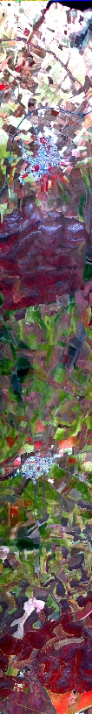

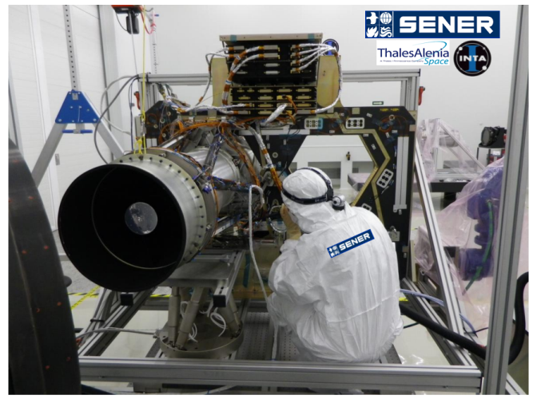
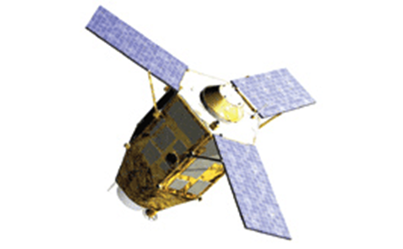
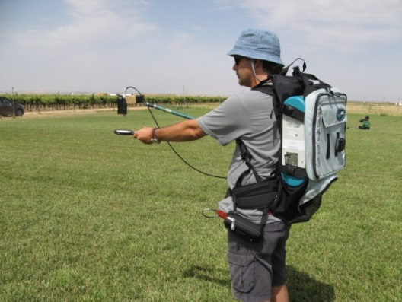
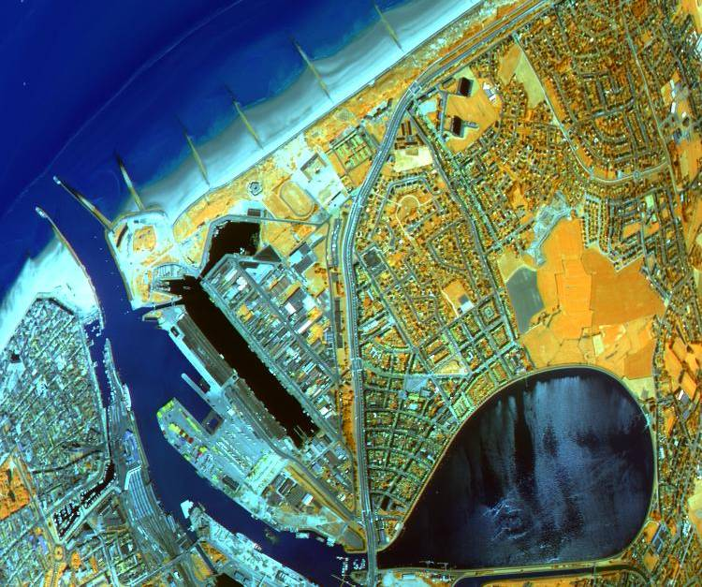
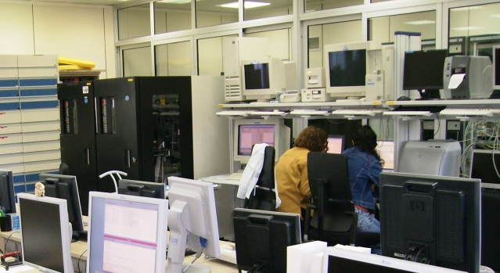
EARTH OBSERVATION AT INTA
Eduardo de Miguel
Remote Sensing Lab / EO Department

Slide 2
INTA
Public Research Institution focused on aerospace research and technology; part of the Spanish Ministry of Defense.
Functions / goals
  a) The acquisiton, maintenance and development of technology in its field, by research and innovation or by collaboration and partnerships with similar institutions at national or international level.
  b) The definition of goals, programmes and large projects in its field.
  ...
  f) Management of specific programmes as required by the Spanish MoD or any public institution belonging to the Spanish science-technology-innovation system
  ...
  h) Technical support and technological services to the MoD and to any other institution (including universities, research centres and private sector companies) which may require it.
  ...

Slide 3
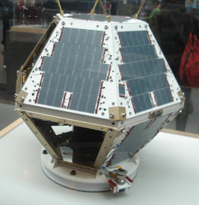
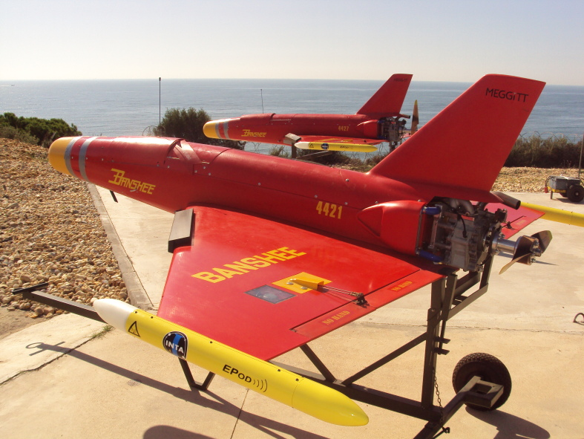
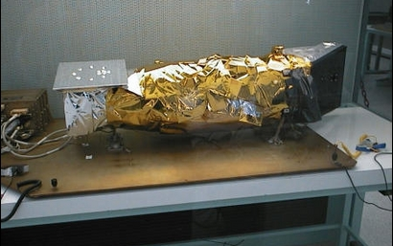
INTA
INTA activities might be classified into different categories:
  Operation of large facilities
  Test laboratories
  Programme management
  Services to research/industrial sectors
  High technology programs
  Applied research
More information: www.inta.es

Slide 4

INTA
CIAR Rozas (Lugo)
Robledo de Chavela (Madrid)
INTA Torrejón de Ardoz (Madrid)
Villafranca (Madrid)
“El Arenosillo” (Huelva)
Granada
Maspalomas (Canary Islands)

Slide 5
INTA & NASA
Long term collaboration.
Some historical milestones:
  1965: start of operations for MDSCC (Madrid Deep Space Communications Complex), part of DSN (still active!)
  1967 start of operations for the Manned Space Flight Network station in Fresnedillas (closed in 1985)
  1975: Maspalomas station transferred from NASA to INTA
  ...
  1999: CAB (associated to NASA Astrobiology Institute)
  2010 REMS for Mars Science Lab / Curiosity
  2015 Twin Instrument for InSight
  201X REMS for Mars2020
Not much Earth Observation!

Slide 6
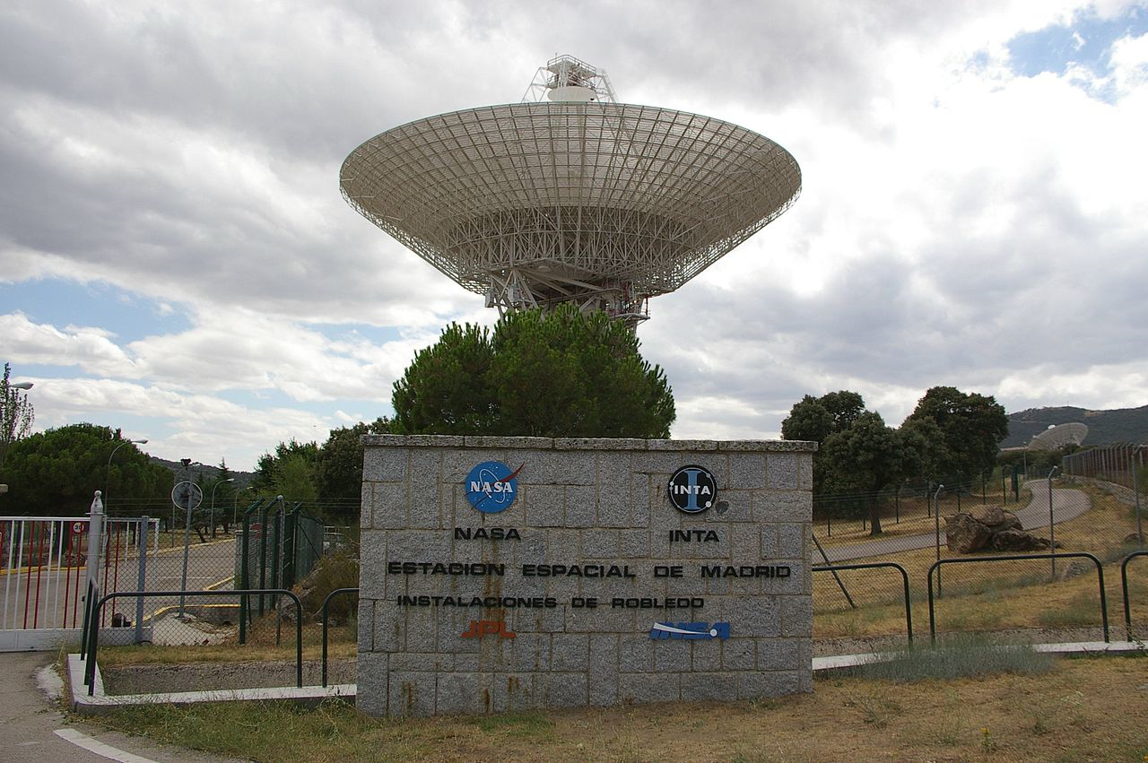

Slide 7
EARTH OBSERVATION @ INTA
MAIN ACTIVITIES IN EARTH OBSERVATION
Airborne remote sensing
CTEIE and related defense programmes
Atmospheric research (with ground-based, airborne, balloon or satellite instrumentation)
C.E.C - Maspalomas (CREPAD, E-PAC, SPOT DRS, EARS...)
Ground segment for Paz and Ingenio (PNOTS)
Development of an airborne SAR
EO payloads: Ingenio AIV, Apis ...
Developing SW for image processing, mission simulators and ground segment prototypes
...
These activities are scattered through different departments and units
Notes:
7

Slide 8
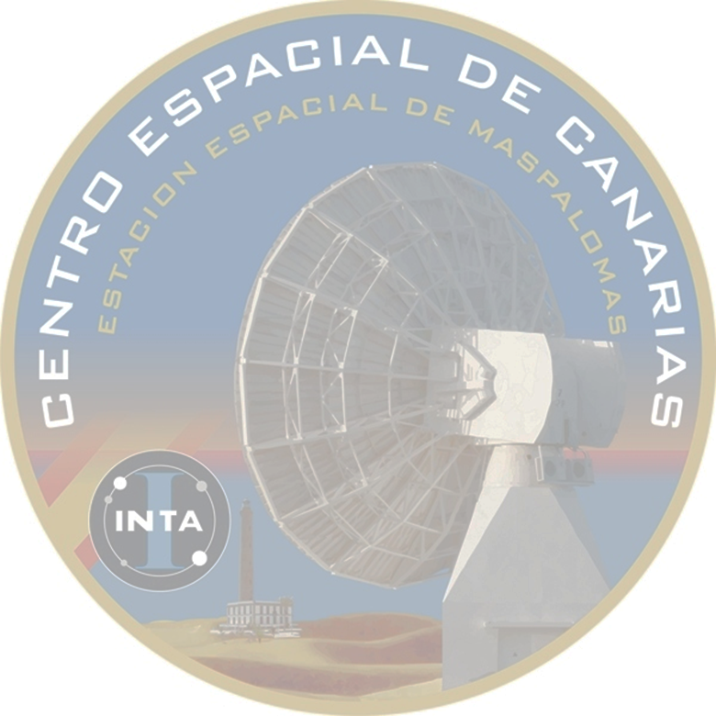
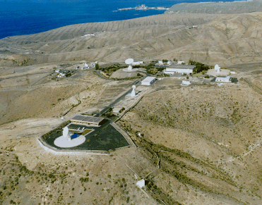
Centro Espacial Canarias - Maspalomas
The Canaries Space Center at Maspalomas provides an operational, centralized infrastructure for acquisition, processing, archiving and dissemination of EO data to Spanish and international institutions and end-users.
8
Notes:
8
CREPAD Main goals:
To provide an operational centralized infrastructure for acquisition, processing, archiving and dissemination of EO data to the Spanish users
To drive and ease the access to EO technologies, promoting their use for technical and scientific purposes
To guarantee technological and scientific community the free access to updated EO data through a centralized service in charge of elaborating added value products
To keep an archive of historical EO data enabling temporal analysis

Slide 9
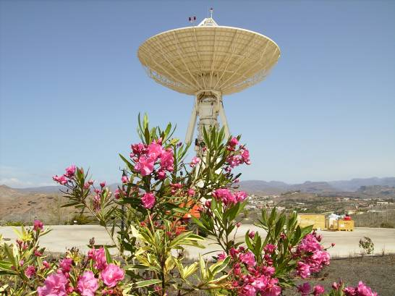
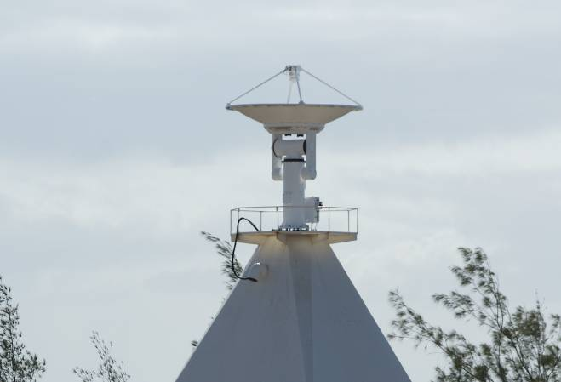
CEC Maspalomas: Main Users
ESA / ESRIN: several projects including DR and E-PAC
EUMETSAT: BRGS (Backup and Ranging) for MSG satellites, EARS
ESA/ESOC: ESTRACK network
HISDESAT / SPAINSAT / HISPAMAR
INTELSAT
JAXA
COSPAS-SARSAT (Nodal Centre of the world salvage and rescue network)
...
and INTA itself!
Direct Receiving Station for SPOT/CBERS
L/X – Band 2.4 m antenna for NOAA/METOP/
NPP/FY-3
9
Notes:
9
CREPAD Main goals:
To provide an operational centralized infrastructure for acquisition, processing, archiving and dissemination of EO data to the Spanish users
To drive and ease the access to EO technologies, promoting their use for technical and scientific purposes
To guarantee technological and scientific community the free access to updated EO data through a centralized service in charge of elaborating added value products
To keep an archive of historical EO data enabling temporal analysis

Slide 10

CREPAD & related programmes
  Centre for Reception, Processing, Archiving and Dissemination of Earth Observation Data
  Project founded by the National Institute of Aerospace Technology on 1997 with the collaboration of the Government of the Canary Islands, the National Plan of R+D and the European Space Agency
Main goals:
To provide an operational centralized infrastructure for acquisition, processing, archiving and dissemination of EO data to the Spanish users
To drive and ease the access to EO technologies, promoting their use for technical and scientific purposes
To guarantee technological and scientific community the free access to updated EO data through a centralized service in charge of elaborating added value products
To keep an archive of historical EO data enabling temporal analysis
Maria de los Angeles Domínguez Durán
Head of Earth Observation Services
dominguezda@inta.es
http://crepadweb.cec.inta.es

Slide 11
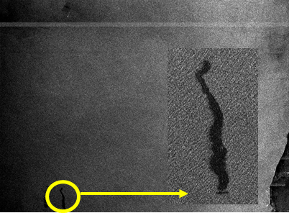
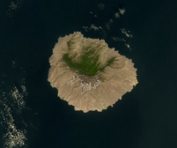
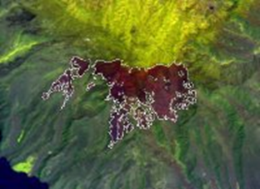
CREPAD support to NRT programmes
Oil spill detection in NRT with ERS-1 / ERS-2
(2002)
REMFIRESAT (2002/2003):
Collaboration with ESA, INSA and LATUV
MODIS data reception, processing and delivery of products to the user for NRT fire detection.
.
.
.
Suomi-NPP VIIRS Active Fire algorithm evaluation (2013/2014)
USDA Forest Service Remote Sensing Applications Center (RSAC) and the NASA Direct Readout Laboratory (DRL) planned to coordinate an evaluation effort with several direct readout facilities (INTA-CREPAD among others), in order to capture the efficacy of the algorithm performance throughout the world.

Slide 12
CREPAD support to NRT programmes
EARS: EUMETSAT Advanced Retransmission Service
Goals:
  Provide information from EUMETSAT and NOAA polar-orbiting satellites with a timeliness suited to the needs of European operational short-range regional weather prediction models (<15 min).
  Contribute to the detection and monitoring of climatic changes.
Steps:
  First transmissions October 2002, ATOVS NOAA sounder only
  In 2005 this service started to include AVHRR data from NOAA satellites
  In 2006, after the launch of the first METOP, the service was extended to ATOVS, AVHRR and ASCAT from METOP
  In 2012 started Suomi-NPP and FY3A and FY3B satellites acquisitions to support new regional services like EARS-VIIRS.

Slide 13
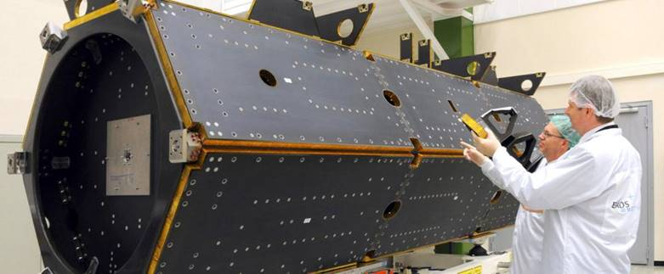
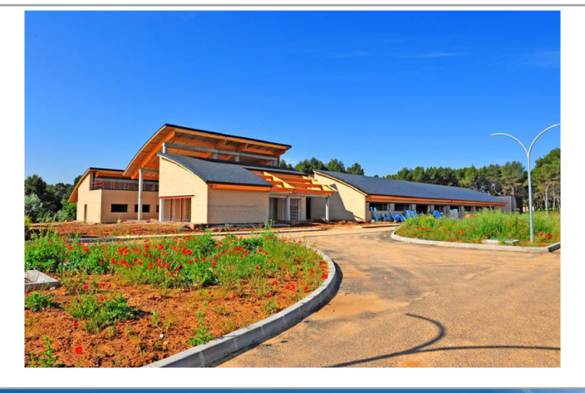
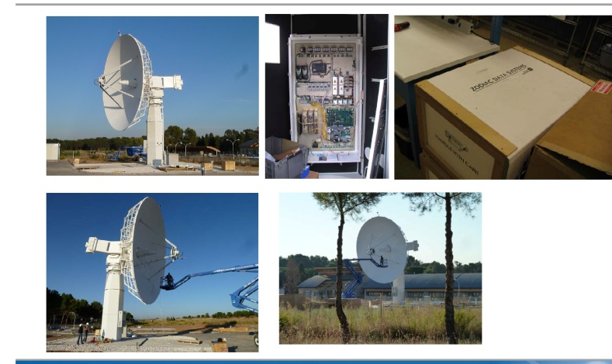

PAZ GROUND SEGMENT
Paz is the Spanish mission for a dual use (civil / defense) space SAR.
Main contractor: AD&S - Spain
Based on TerraSAR-X (http://terrasar.net/terrasar-x-satellite), similar specifications
INTA is responsible for Ground Segment implementation.
Operations will be made in partnership with Hisdesat.
Satellite and ground segment ready, launch in stand-by due to Dnepr problems

Slide 14
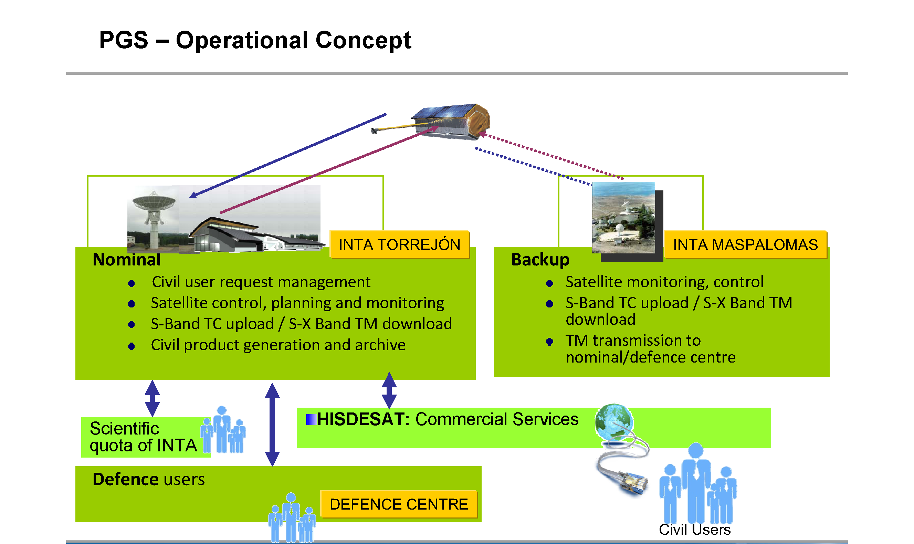
PAZ GS
Science NRT activities should fit in this concept: feasible but not easy

Slide 15
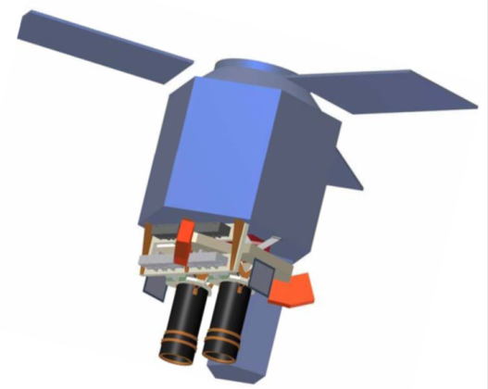
SEOSAT/INGENIO
Ingenio is the “sister” mission to PAZ.
Objective: VNIR imagery with 2.5 m (PAN) and 10 m (MS) spatial resolution / large swath / dedicated coverage of relevant land areas.
Specs:
LEO sun-synchronous orbit, 678 km, repetition 49 days.
Two cameras, FOV ≈2.5º /camera; full swath 55 km.
Cross track agility
4 bands VNIR, 10 m GSD; 1 Pan band (0.6 - 0.8 um), 2.5 m GSD. Pan band uses 7 TDI stages.
Spectral separation in-field, with filters on the detectors.
Science TM with lossy compression.
Receiving station INTA-Torrejón; backup in Maspalomas.
PDGS in INTA-Torrejón.

Slide 16
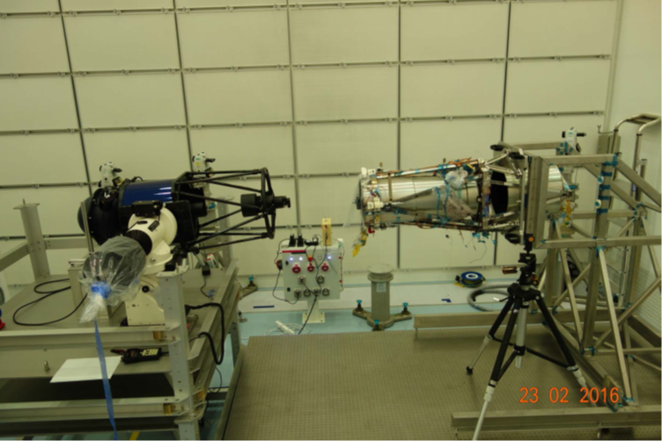
SEOSAT/INGENIO
S/C ready, primary payload in AIV
Ground segment frozen (waiting for PP)
Launch planned for 2018
INTA is responsible for Ground Segment implementation
Operations will be made by INTA in partnership with Hisdesat
Data policy TBD, including NRT capabilities
=> there is still a chance to push in that direction!
Picture courtesy of AD&S and SENER

Slide 17
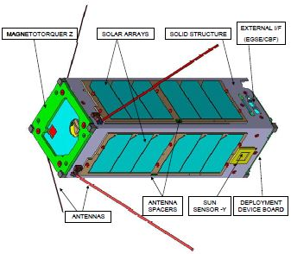
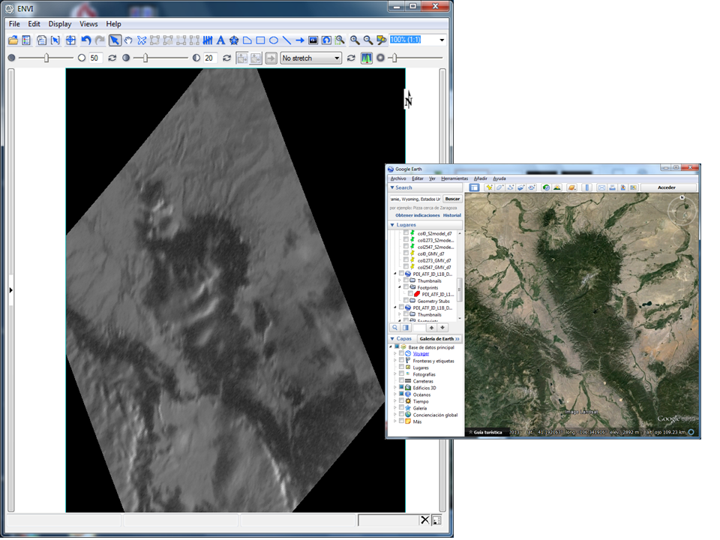
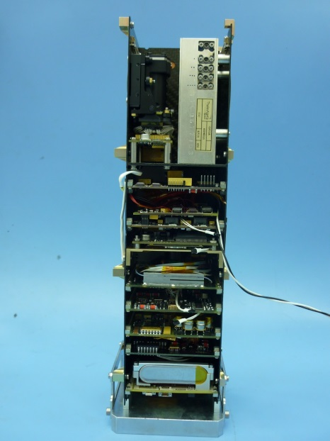
APIS/OPTOS
OPTOS: INTA cubesat demonstrator
APIS: panchromatic frame camera, used as reference payload
Medicine Bow National Forest, WY (USA)

Slide 18
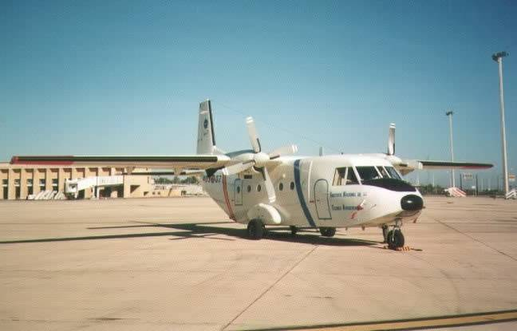
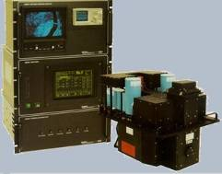
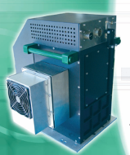
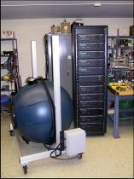
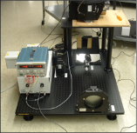
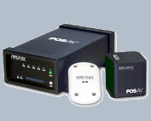
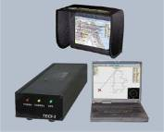

INTA – Airborne remote sensing
INTA maintains and operates a complete facility for airborne remote sensing
It is based on the AHS and CASI sensors.
This facility is intended as a technological service for any remote sensing user (R+D, management, commercial)
Part of the EUFAR2 fleet (www.eufar.net)

Slide 19
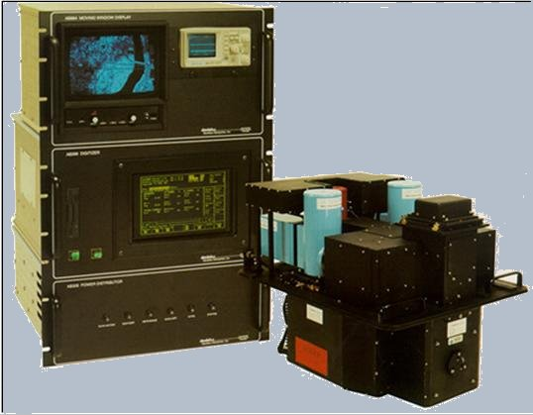
INTA – AHS Sensor
INTA AHS sensor:
  linescanner, similar to MODIS (design by SensyTech / ArgonST)
  Cassegrain-type telescope + complex spectrometer based on gratings and dichroics.
  FOV / IFOV: 90º / 2.5 mrad
  spatial resolution from 2.5 m to 7 m
  spectral coverage VNIR / SWIR / MIR / TIR
  80 bands, medium/high spectral resolution
AHS (Airborne Hyperspectral Sensor)
Port 1 VIS+NIR 430 - 1030 nm / 20 bands / Δλ = 30 nm
Port 2A SWIR 1550 - 1650 nm / 1 band / Δλ = 90 nm
Port 2 SWIR 1900 - 2550 nm / 42 bands / Δλ = 18 nm
Port 3 MIR 3300 - 5400 nm / 7 bands / Δλ = 300 nm
Port 4 LWIR 8200-12700 nm / 10 bands / Δλ = 400 nm

Slide 20
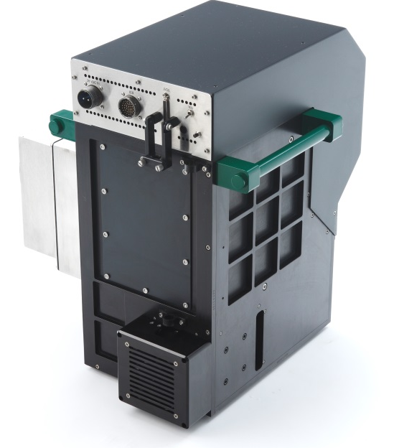


INTA – CASI Sensor
INTA CASI sensor:
  pushbroom, similar to Hyperion
  1548 x 292 elements CCD
  FOV / IFOV: 40º / 0.05 mrad (1/5 AHS)
  spatial resolution from 0.4 m to 1.5 m
  spectral coverage VNIR
  <288 bands, >2.4 nm band-to-band, >3 nm FWHM
www.itres.com

Slide 21
Users of the airborne remote sensing facility
Use of the system depends on the user´s requests
NRT is feasible but rare

Slide 22
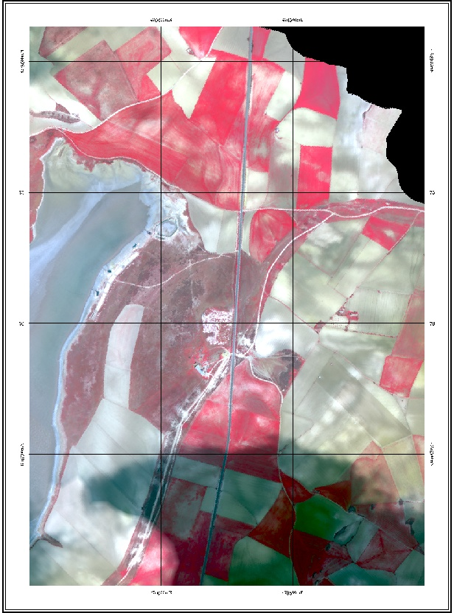
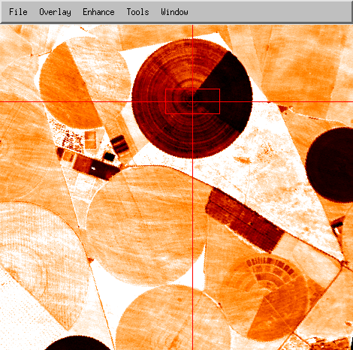
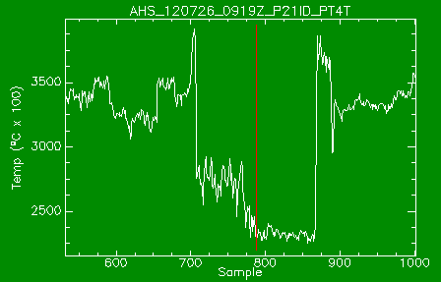
AIRBORNE IMAGES PROCESSING
Images are processed to level 2 (geolocated physical magnitudes) at the INTA PAF in Torrejón.
The processing chain is a collection of commercial applications (Itres; ReSe PARGE & ATCOR4; Applanix PosPac; ... ) and in-house tools, controlled by IDL and Linux shell scripts

Slide 23
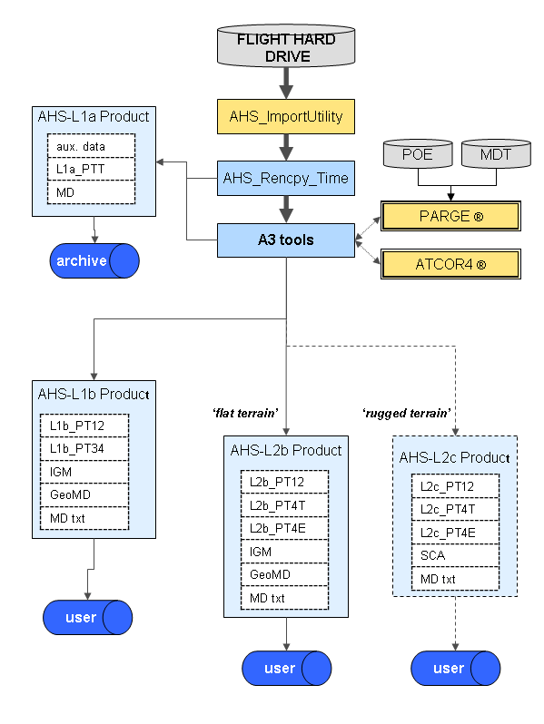
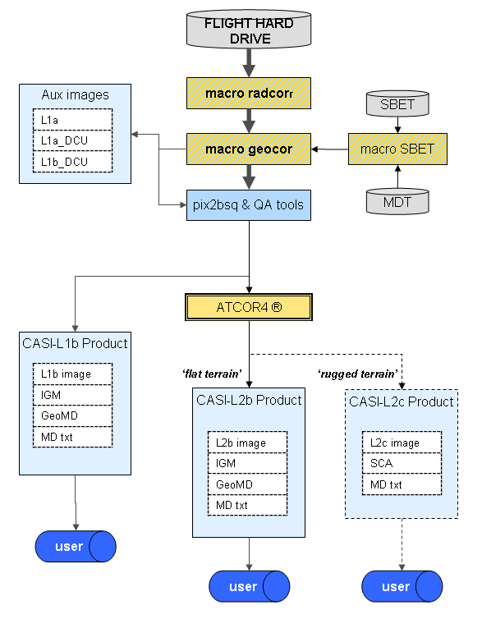
AIRBORNE IMAGES PROCESSING

Slide 24
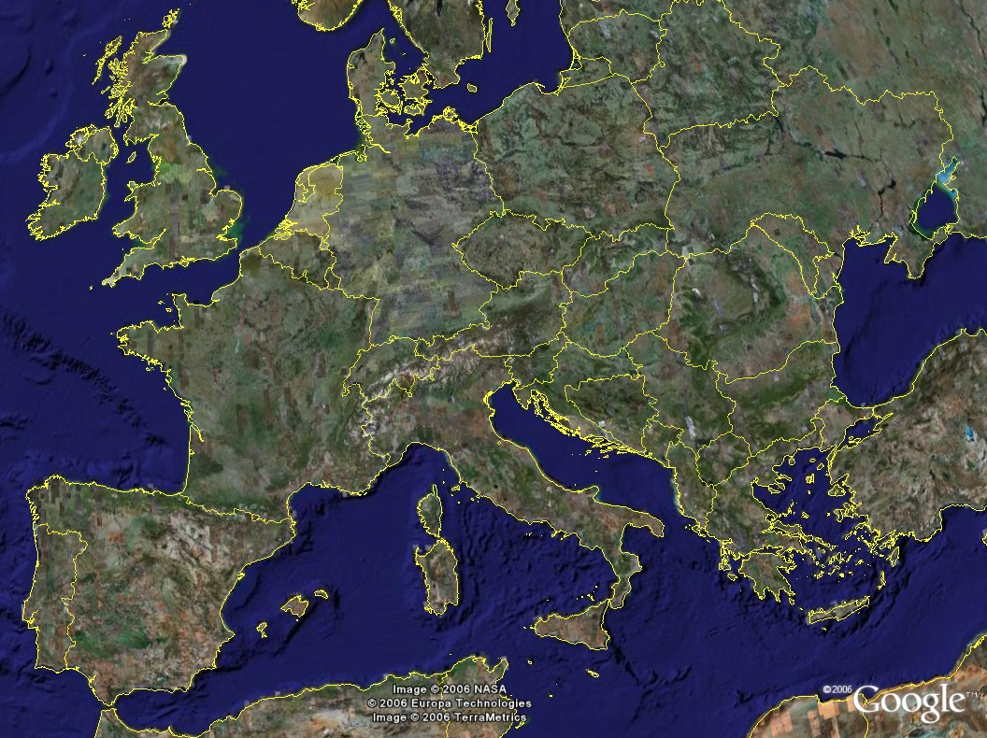

> 10 years flying all around Europe!
PROJECT | APPLICANT | PLACE
SEN2FLEX2005 | Univ.Valencia | Barrax-E
GUADALAJARA 2005-09 | INIA | Guadalajara-E
AgriSAR 2006 M1-M2 | ESA | Demmin-D
EAGLE 2006 | ITC-ESA | Several Forests-NL
MAESTRAZGO 2006 | IGME | Castellón-E
ALBUFERA 2006 | CEDEX | La Albufera-E
CEFLES2 2007 M1-M3 | ESA | Les Landes-F
BROWNFIELDS 2007 | INDRA | Madrid - E
MAJADAS | CSIC | La Poveda - E
STEREO II 2007 | VITO | B, L, NL
GREASEMH | Tartu Obs.-EUFAR | Estonian sites-EE
CALABRIA 2007 | VITO-EUFAR | Calabria-I
HUELVA 2008 | EGMASA | Almonte-E
HYDRA 2008-2011 | EBD-CSIC | P.N.Doñana-E
DESIREX 2008 | ESA | Madrid-E
SEN3EXP 2009 | ESA | Italy,France & Spain
THERMOPOLIS 2009 | ESA | Atenas-G
LITORAL VALENCIA 2010 | ICV | Valencia Coast - E
EUFAR T-MAPP-FP7 2010 | University of Siena | Tiber Valley, Tuscany, I
EUFAR EDOCROS 2010 | Univ. degli Studi di Milano-Bicocca | Piacenza, I
EUFAR HYMOWEB 2010 | Vrije Universiteit of Brussel | Woluwe Valley, Brussels, B
EUFAR BIOHYPE 2010-11 | Univ. of Antwerp. | Ghent, B
EUFAR HyperForest 2010 | Univ. of Ghent | Several forest, Belgium
EUFAR ValCalHyp 2010 | Univ. of Tel Aviv | Marseille, F
EUFAR REFLEX 2012 | Univ. of Twente | Barrax, E
CEOS-SPAIN 2012 | Univ. Valencia | Barrax, Majadas, E

Slide 25
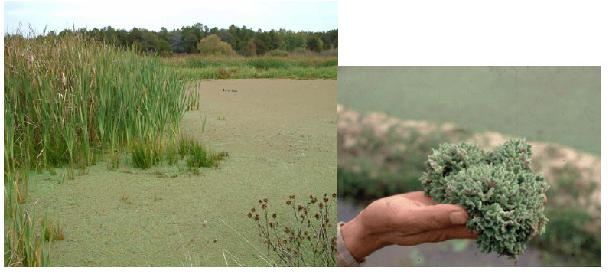
Use cases: HYDRA (EBD – CSIC)

Slide 26
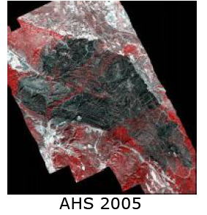
Use cases: Guadalajara forest fire (INIA)
González-Alonso et al. Seguimiento de la regeneración del incendio del rodenal de Guadalajara utilizando imágenes hiperespectrales AHS-INTA. 5º Congreso Forestal Español. 21-25 septiembre 2009
Curso de Teledetección Aplicada a la Observación del Territorio (AECYD-IGN-UPM) INTA, 29 de septiembre de 2011
Notes:
26
26

Slide 27
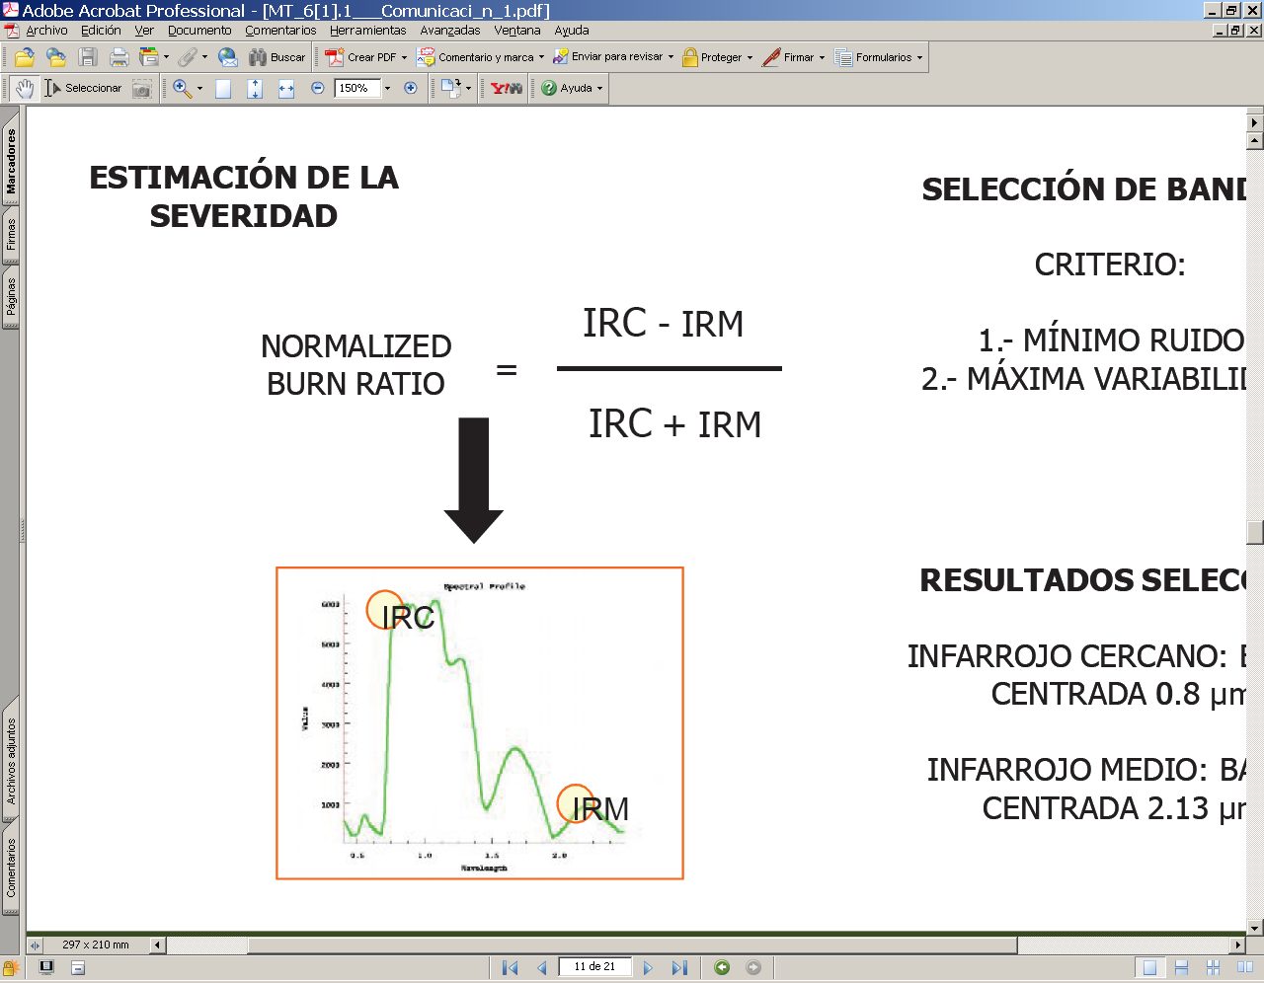
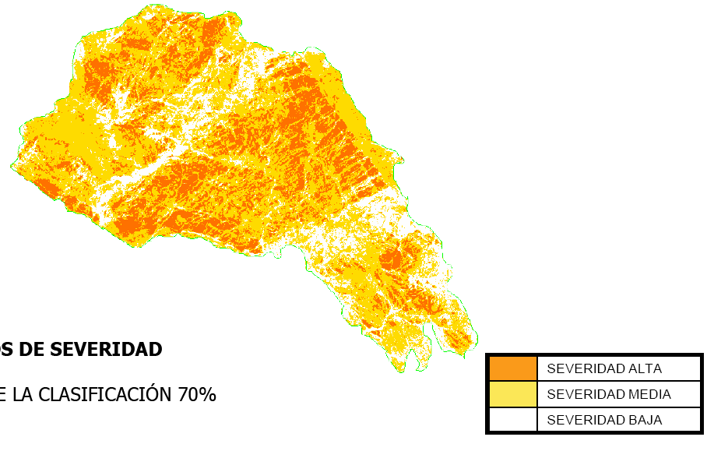
Use cases: Guadalajara forest fire (INIA)
González-Alonso et al. Seguimiento de la regeneración del incendio del rodenal de Guadalajara utilizando imágenes hiperespectrales AHS-INTA. 5º Congreso Forestal Español. 21-25 septiembre 2009
Curso de Teledetección Aplicada a la Observación del Territorio (AECYD-IGN-UPM) INTA, 29 de septiembre de 2011
Notes:
27
27

Slide 28
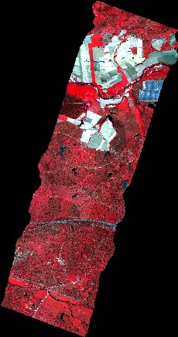

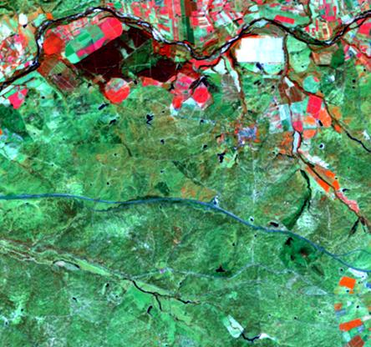
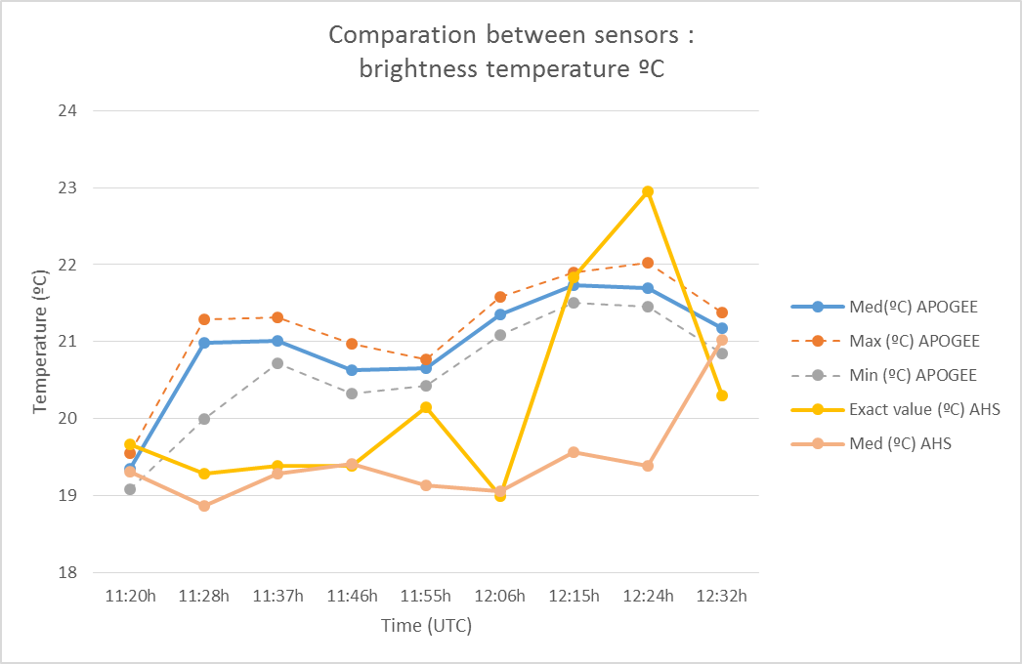
Use cases: FLUXPEC (IEGD - CSIC)
Vuelo AHS & CASI1500i sobre Torre BIOSPEC
(Majadas de Tiétar, Cáceres)
Esquema de pasadas sobre imagen Google Earth
Notes:
Pasadas adaptadas al sensor AHS a unos 1600m sobre el terreno

Slide 29
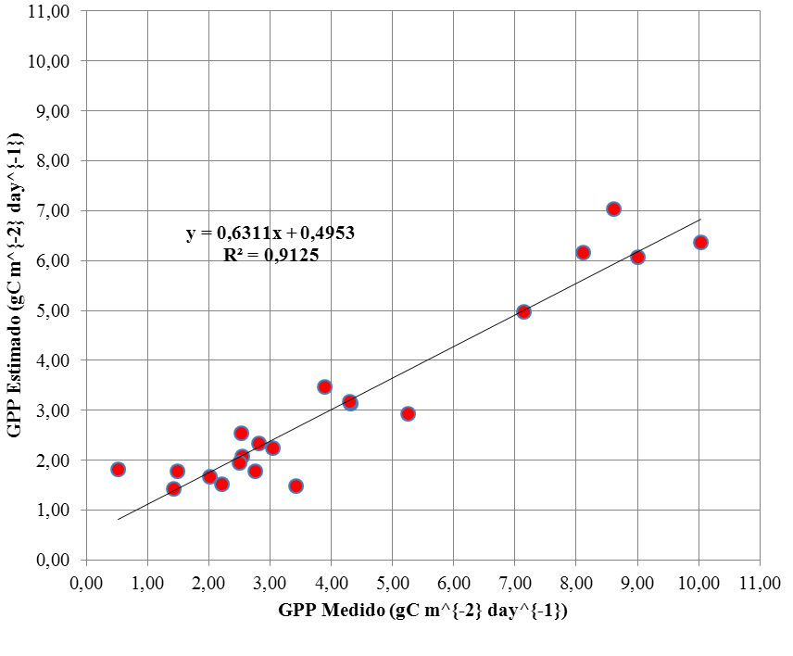




Use cases: FLUXPEC (IEGD - CSIC)
  $$GPP=\left(a·NDVI+b\right)·PAR$$
http://www.proyectos.cchs.csic.es/fluxpec/
Model from Up-scale approach (field to MODIS-Landsat fusion product)
  R²= 0,91
  RMSE = 1,54
  EMR = 36,81%
Infraestimation
  Static footprint?
  Worse estimation of reflectance in spring and autum, when GPP is large
Javier Pacheco-Labrador, Pilar Martín
Notes:
Pasadas adaptadas al sensor AHS a unos 1600m sobre el terreno

Slide 30
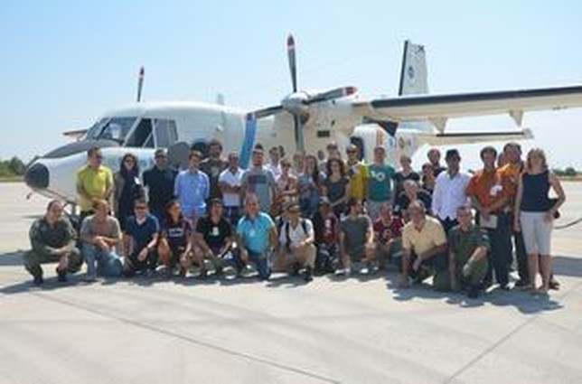


Use cases: NRT processing @ REFLEX
Training course to teach early-stage researchers how to plan and conduct a campaign with hyperspectral imaging sensors supporting research in multi-scale (“leaf to ecosystem”) land-atmosphere exchanges.
Funded by EUFAR and the COST action EUROSPEC
An airborne campaign with the INTA C-212-200 RS aircraft in Barrax was the core of the training course.
Participants helped in campaign planning and performed ground measurements.
Image Level 2 processing was performed by INTA in NRT with a specific hardware and software setup deployed at the REFLEX course headquarters. Level 2 images were delivered to the participants for analysis.

Slide 31





Use cases: NRT processing @ REFLEX

Slide 32


SW for EO image processing
ESA Earth Observation Mission CFI SW (EO-CFI): set of C libraries with functions for solving orbital and satellite pointing problems
http://eop-cfi.esa.int/
INTA EO-CFI tool: direct georeferencing from orbital data and sensor model
Optional: use of GCPs to refine orbital data (not for reprojecting the image)
Supporting tools for orbit propagation, attitude computations, TM processing and others.

Slide 33

EO-CFI based georeferencing tools
Intended for:
mission performance analysis
alternative processing methods at user side (example: alternative atm. correction in the sensor - not reprojected - geometry)
Could run standalone at the user side, provided that:
orbital info (position and orientation at well-defined times) is available
sensor model is known or can be defined from standard parameters (focal length, pixel size or IFOV)

Slide 34
EARTH OBSERVATION AT INTA
Thank yu for your attention!
www.inta.es

