Slide 1
Burned Area Mapping and Monitoring Algorithms
Louis Giglio
Department of Geographical Sciences
University of Maryland
9th International EOS/S-NPP Direct Readout Conference
21-24 June 2016

Slide 2
Co-Is and Collaborators
Luigi Boschetti, University of Idaho
David Roy, South Dakota Sate University
Chris Justice, UMD
Wilfrid Schroeder, UMD
Joanne Hall, UMD
Krishna Vadrevu, UMD

Slide 3
Focus
Focus will be on status of moderate/low resolution burned area mapping using MODIS and VIIRS.
NASA sponsored
MCD45A1
MCD64A1

Slide 4
Landsat-8/Sentinel-2 Clarification
Landsat-8 (early 2013)
OLI (15, 30 m)
TIRS (100 m); failed Dec. 2014
Sentinel-2A (mid-2015)
MSI (10, 20, 60 m)
Sentinel-2B (mid-2016?)
MSI (10, 20, 60 m)
Likely topic for NDRC-10.

Slide 5
Overview
Current C5.1 MODIS burned area products
2008 IPOPP DR implementation
Forthcoming C6 MODIS burned area product
Forthcoming VIIRS burned area product
Vision for a true NRT DB implementation

Slide 6
MODIS C5.1 Burned Area Products
MCD45A1 | 500-m Monthly L3
MCD45A1-based GIS Products (SCF) | Shapefiles + 500-m GeoTIFF
MCD64A1 (SCF) | 500-m Monthly L3
For all products burning is mapped to the nearest day.

Slide 7
MODIS C6 Burned Area Products
MCD64A1 | 500-m Monthly L3
MCD64A1-based GIS Products (SCF) | Shapefiles + 500-m GeoTIFF
Should be released late this year.
Waiting primarily on validation.

Slide 8
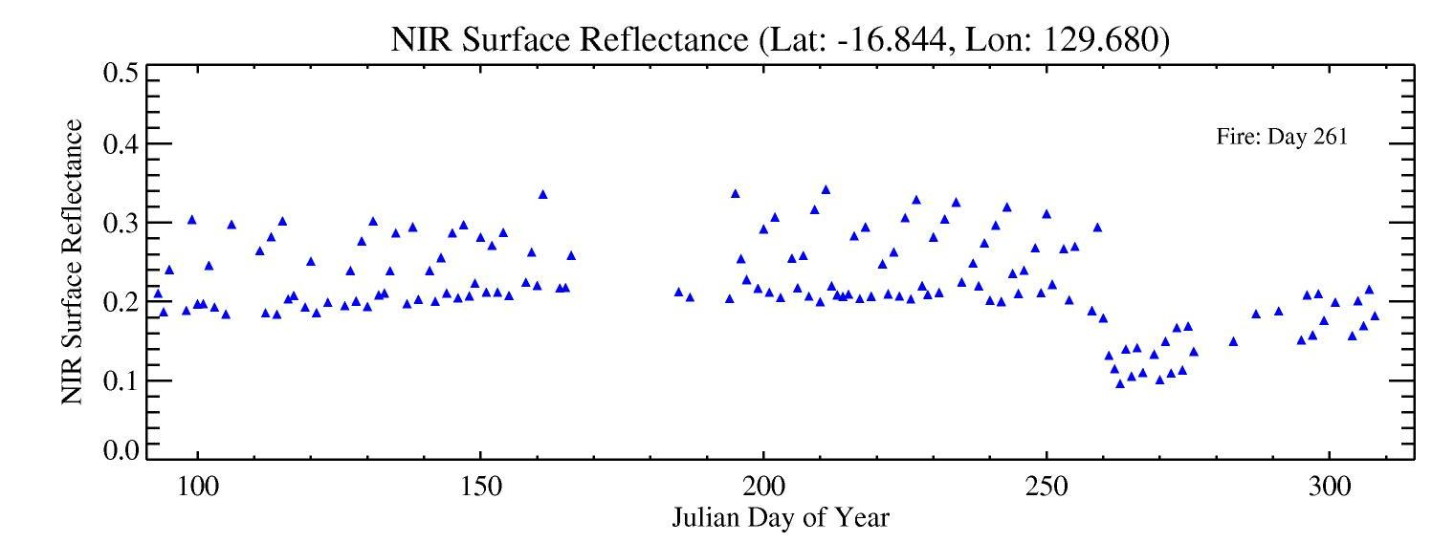
The challenge: change detection of Burned Areas
Persistence of the signal
BRDF Effects
gaps
Day of burning
D. Roy

Slide 9
Algorithm/Product Characteristics
MCD45A1
MCD64A1
Predictive BRDF model
500-m, daily
Uses no active fire data
Less noise-tolerant
Poorer mapping under cloudy conditions
Better mapping of cropland burning
Supervised classifier
500-m, daily
Exploits active fire data
More noise-tolerant
Better mapping under cloudy conditions
Poorer mapping of cropland burning

Slide 10
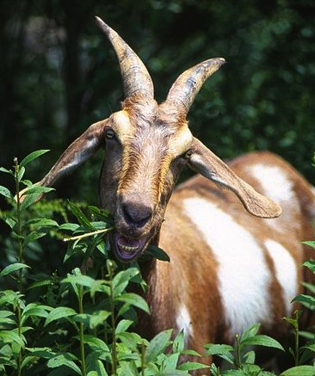
MCD45
MCD64
Wikimedia Commons
Notes:
Photo credits: Wikimedia Commons

Slide 11
Original plan for C6 was to merge features of the two different approaches to produce a better C6 product, i.e., a “Koala Goat”.
MCD45
MCD64
Wikimedia Commons
Notes:
Photo credits: Wikimedia Commons

Slide 12
MCD45
MCD64
Wikimedia Commons
Notes:
Photo credits: Wikimedia Commons

Slide 13
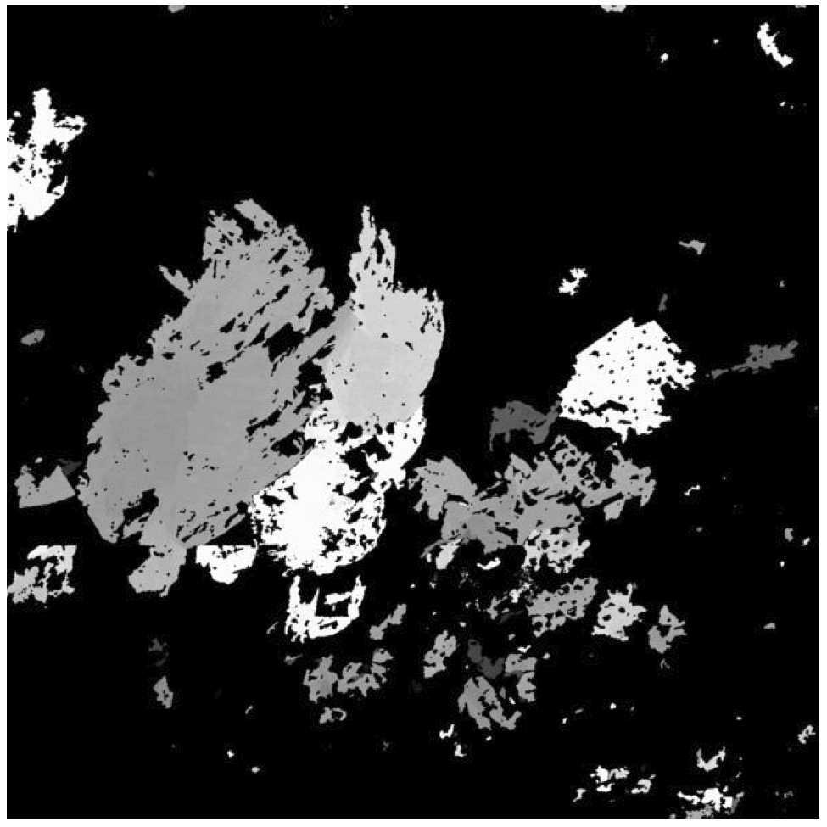
Large burn in Botswana, Aug.-Sep. 2008
~ 100 km
C5.1 MCD45
C5.1 MCD64

Slide 14
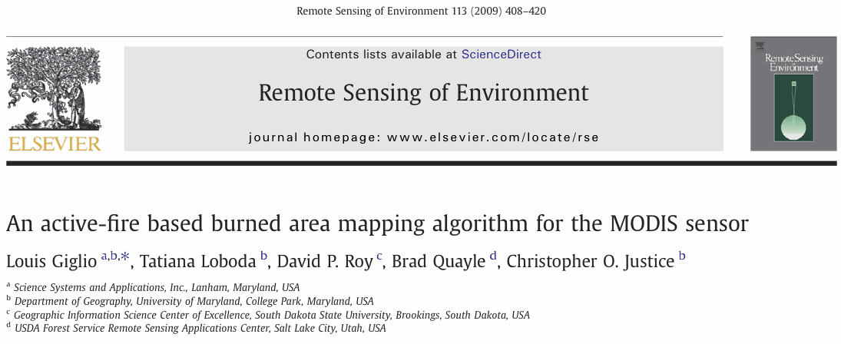
Algorithm published in 2009. Product known by various names (“Direct Broadcast Burned Area Product”), but ultimately “MCD64”.

Slide 15
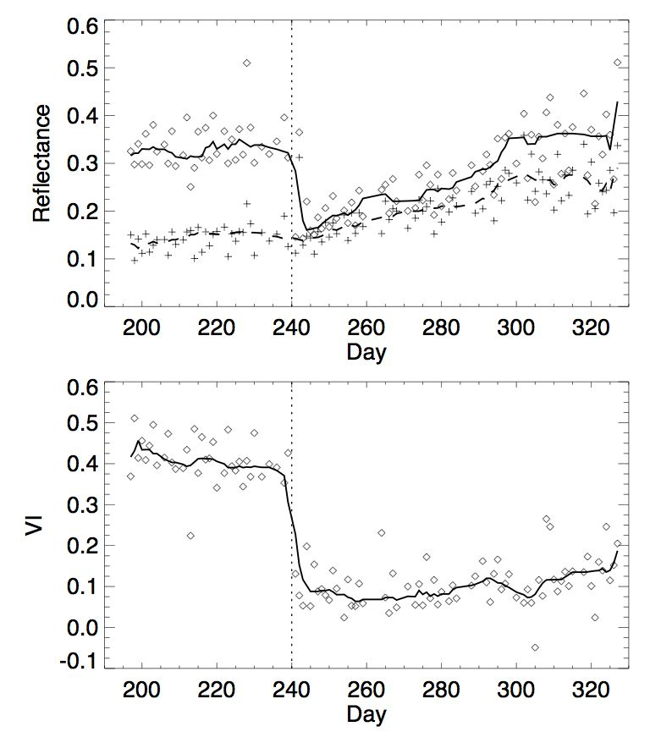
burn
band 5 (1.2 μm)
band 7 (2.1 μm)
VI57

Slide 16
burn
band 5 (1.2 μm)
band 7 (2.1 μm)
Both magnitude of drop and post-burn level depend on many variables -- fixed thresholds inappropriate.
VI57

Slide 17
MCD64 Approach
Use “cleaned” active fire maps to select burned and unburned training samples from temporal composites
Extract conditional PDFs for burned and unburned pixels
Assign prior burned probability to each pixel
Bayesian classifier + supplementary relative threshold tests
Final contextual relabeling phase

Slide 18
DAILY SURFACE REFLECTANCE
DAILY ACTIVE FIRE MASKS
C6 MCD64
Algorithm
ΔVI*, VI*_{post}
S*, t*, t_{f}
IQR*_{pre}, IQR*_{post}
change summaries
TEMPORAL COMPOSITES
primary role of active fire map
TEMPORAL TEXTURE
TRAINING MASK
CONDITIONAL PDFs
SPATIAL PRIORS
p(n_{b} ≤ N|B)
INITIAL CLASSIFICATION
CONTEXTUAL FILTER
BURN MAP
LAND COVER

Slide 19
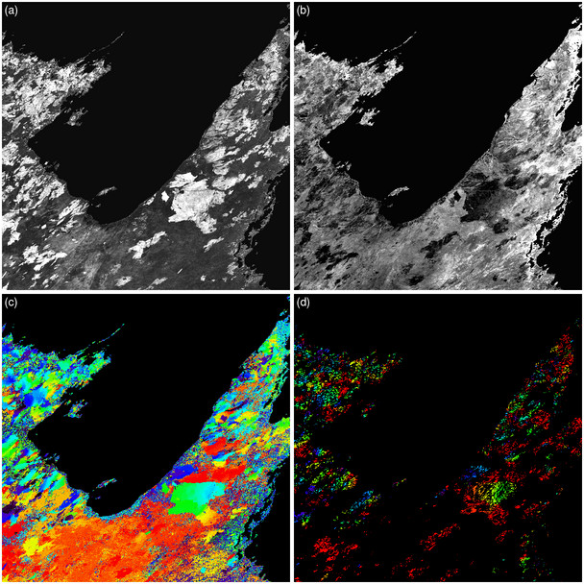
Change-summary examples:
Maximum decrease in VI
Post-decrease VI
Day of maximum decrease
Active-fire date
Northern Australia, approx. August-October 2001

Slide 20
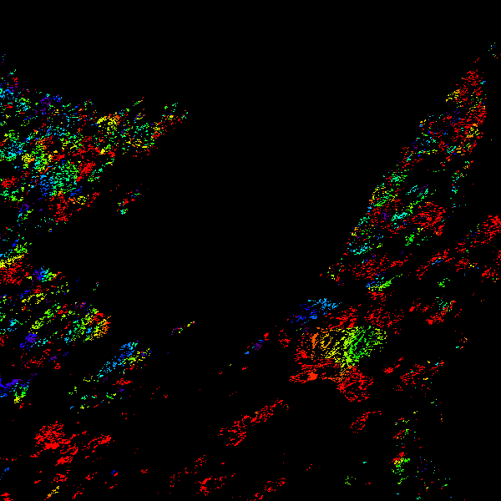
Region growing seeded with “cleaned” active fire map to identify burned and unburned training pixels…

Slide 21
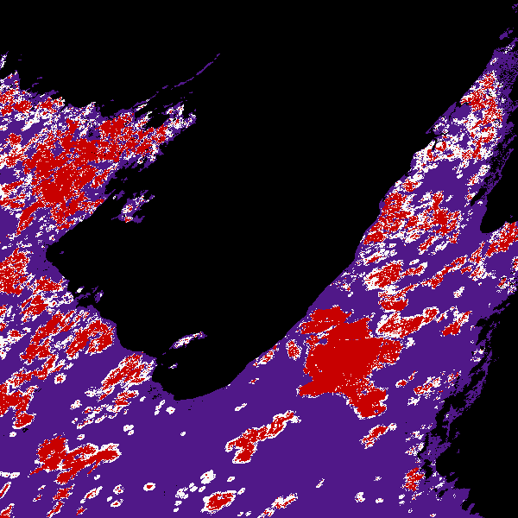
burned training pixel
unburned training pixel

Slide 22
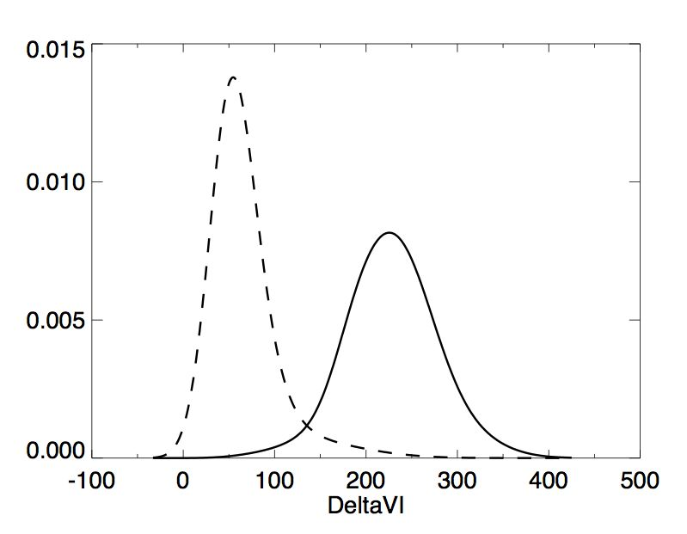
Conditional PDFs
unburned
burned

Slide 23
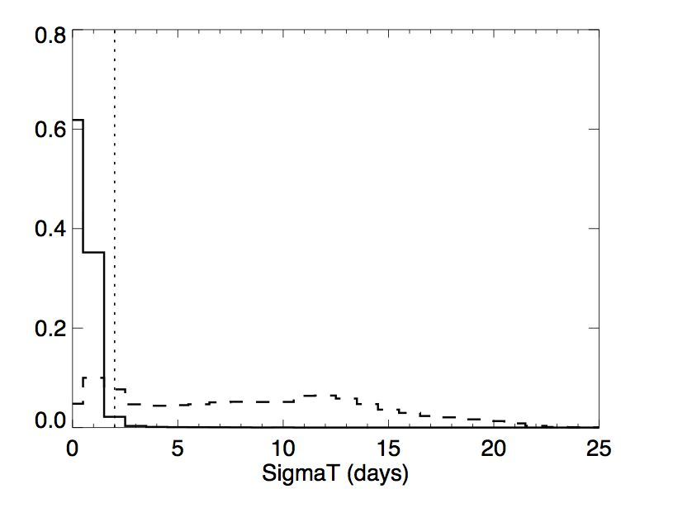
Conditional PDFs
dynamic threshold
burned
unburned

Slide 24
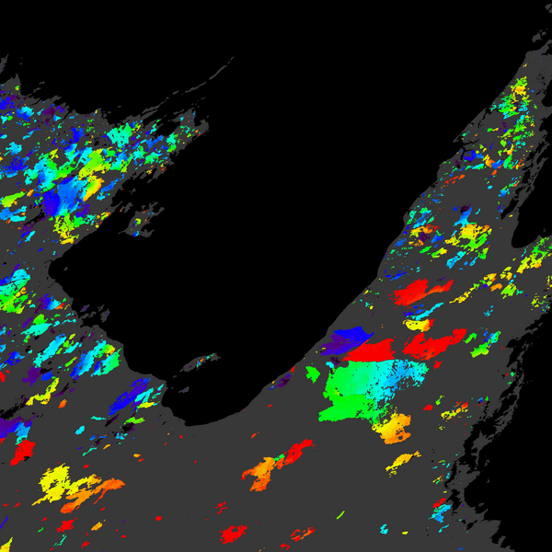
Final result: Date of burn for each 500-m grid cell

Slide 25
MODIS C6 Burned Area Early Results
Overall increase in burned area relative to C5
9% to 22% globally pending final tuning
Modest loss of burned area in boreal tiles
Huge number of new small lakes in C5.1 MCD12Q1
Sporadic “dark” grid cells in surface reflectance input
Improved (i.e., smaller) temporal uncertainty
Final contextual relabeling phase now guided by neighbor statistics derived from training data
True small burns much less likely to be discarded
Mapping of cropland burning somewhat cosmetically improved
Timing can still be off due to confusion with harvest

Slide 26
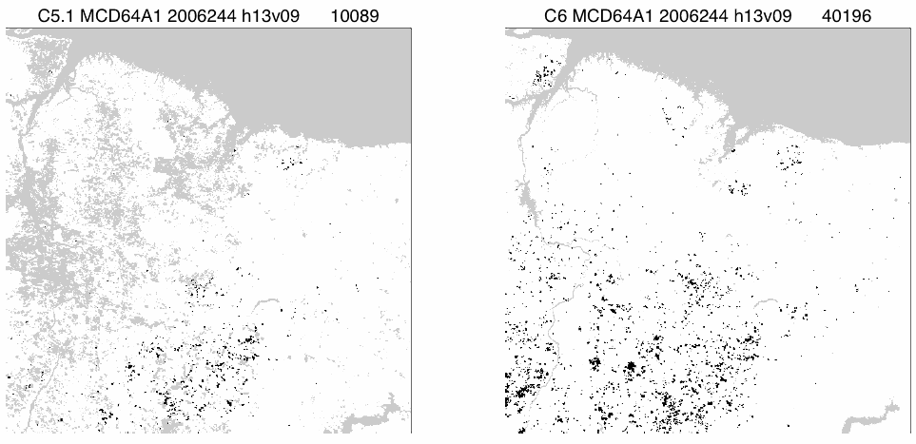
September 2006, MODIS tile h13v09 (eastern Brazil)
C5.1 MCD64A1
C6 MCD64A1

Slide 27
Preliminary!
Regional 2006 Burned Area Totals (× 10⁴ km² = Mha)
Region C5.1 C6
Global 341.8 374.6 9.6%
Boreal North America 1.9 1.8 -5.8%
Temperate North America 2.7 3.3 23.9%
Central America 1.5 2.2 47.2%
NH South America 2.2 4.2 89.7%
SH South America 11.5 20.5 78.7%
Europe 0.6 0.7 18.7%
Middle East 0.7 1.2 67.2%
NH Africa 114.5 113.8 -0.6%
SH Africa 121.9 129.0 5.8%
Boreal Asia 4.5 6.1 34.7%
Central Asia 18.0 23.4 30.0%
Southeast Asia 5.9 9.4 59.3%
Equatorial Asia 2.8 3.1 11.8%
Australia and NZ 53.2 55.7 4.8%

Slide 28
Collection 6 Validation
Landsat-8 imagery
CEOS burned area validation protocol
Image-pair interpretation
Cloud free + within a set time period (~2 months)
Widely tested and used in peer reviewed literature
CEOS “Stage 3”
“Product accuracy has been assessed, and the uncertainties in the product well established via independent measurements made in a systematic and statistically robust way that represents global conditions.”

Slide 29
C6 Validation: Design Based Sampling
Stratified random sampling
Statistically robust sampling essential for proper characterization of presence/absence of fire
Current validation datasets are biased and are not suitable for detecting false positives
Stratification
In space: sub-continental regions
In time: fire seasonality based on MODIS active fire detections
Validate temporal and spatial aspects separately

Slide 30
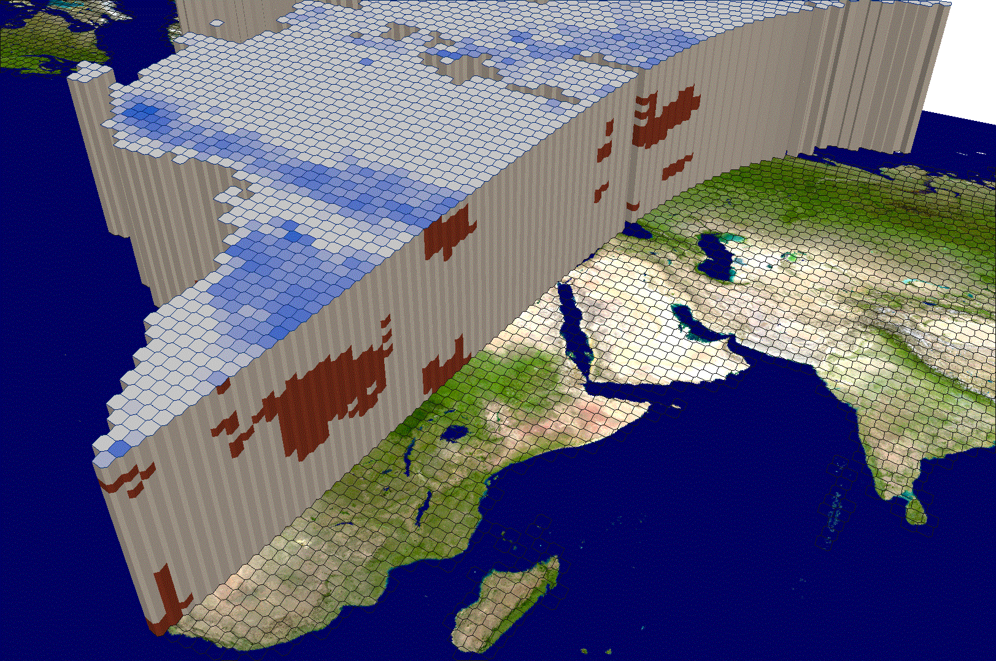
RED: ‘High Fire’ stratum
GRAY: ‘Low Fire’ stratum

Slide 31
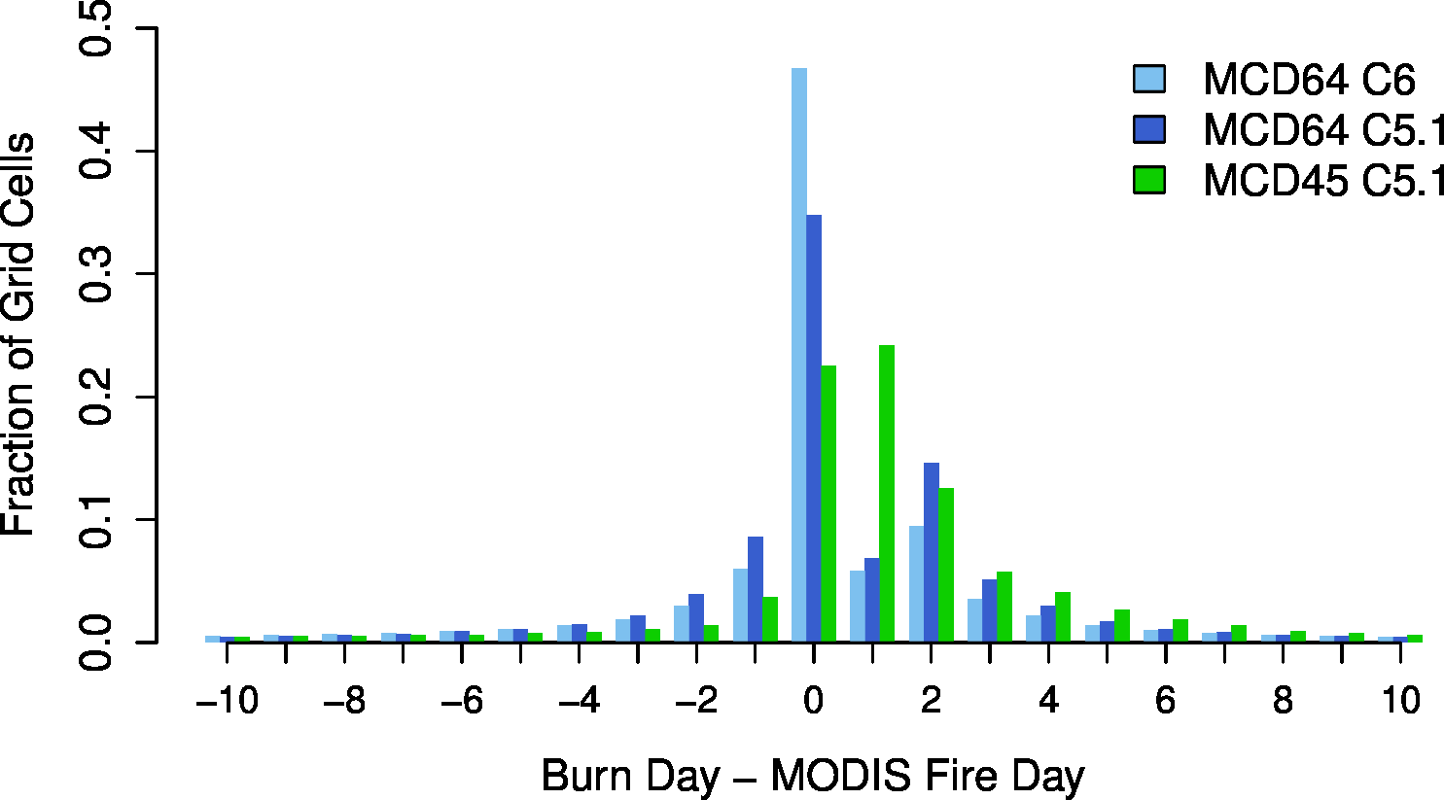
Temporal Uncertainty (Global, 2006)

Slide 32
VIIRS Burned Area Product
Adapt MCD64 code to use VIIRS data
500-m monthly product
Consistency with MODIS product
Compromise between M- and I-band spatial resolution
Burns mapped on daily basis
Same L3 10° × 10° MODIS sinusoidal tiles
HDF4 ➞ HDF5 format

Slide 33
VIIRS Burned Area Product
Shapefiles and GeoTIFF files produced at SCF
0.25° CMG
Validate with same Landsat-8-based reference data used for MODIS Collection 6

Slide 34
VIIRS Burned Area Product
Uses 750-m VIIRS bands M5, M7, M8, M11
VIIRS MCD64A1 (“VNP64A1”) prototyped with daily, 1-km VIIRS surface reflectance product as placeholder
March 2017 production code delivery to Land SIPS

Slide 35
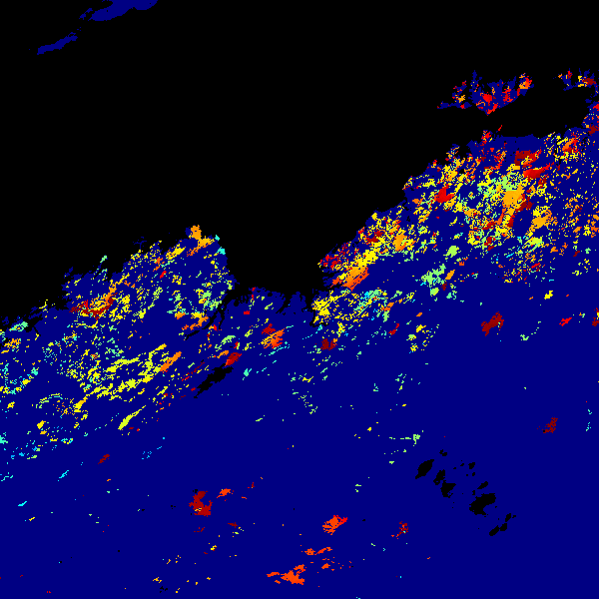
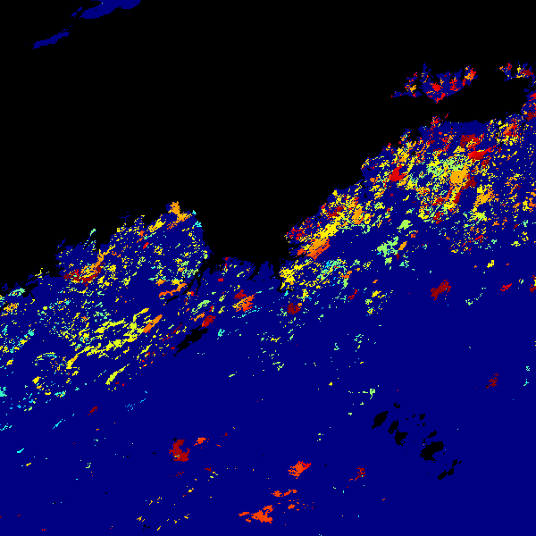
MCD64A1 Burn Date
Australia (h30v10), 1 March – 31 August 2014
MODIS
VIIRS

Slide 36
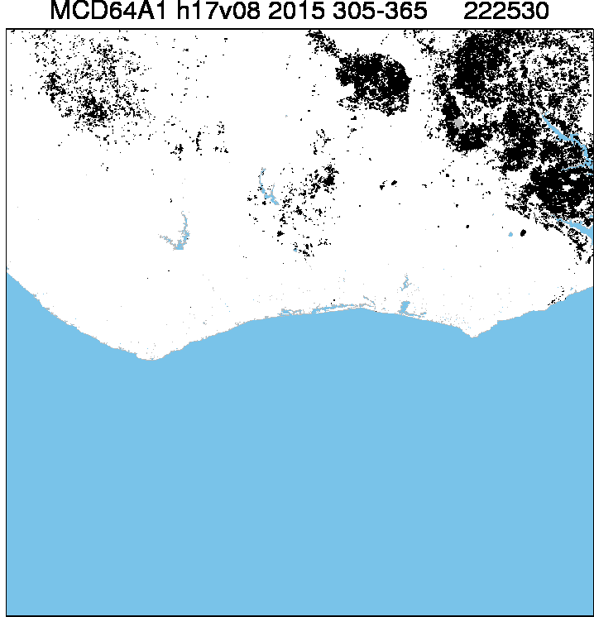
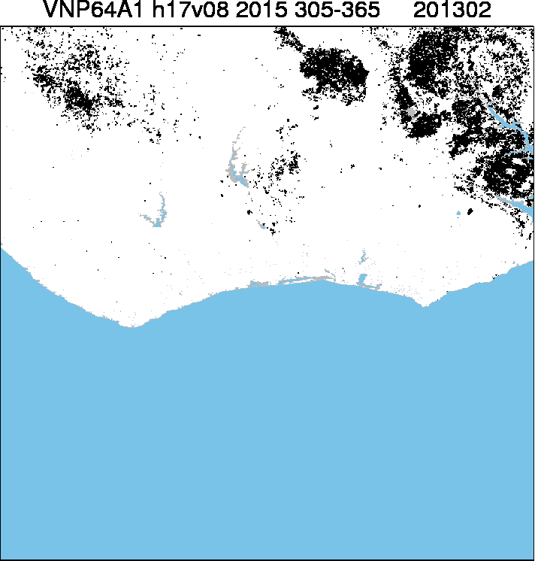
VIIRS VNP64A1 Prototype
MODIS
VIIRS*
*1-km interim VIIRS daily surface reflectance product used as stand-in for 500-m VIIRS daily surface reflectance.

Slide 37
C5 MCD64A1 DB Implementation
IPOPP burned area SPA released 2008
C5 (vs. C5.1) code
Ingests daily corrected reflectance + daily Terra/Aqua MODIS fire-mask composites
All input data coregistered in MODIS sinusoidal projection
Temporal window and look-ahead limited to reduce nominal one-month production lag
Processes one “tile-month” in ~1 hour

Slide 38
NRT Burned Area Mapping
Rapid production
Cumulative map through day N available on day N
Map is refined as additional days are acquired
Sacrifice mapping of smallest burns for NRT
Leverage active fire data more heavily
MCD64 prior probabilities

Slide 39
NRT Burned Area Mapping
Straightforward integration with MAIAC
Leverage consistent observation geometry, improved cloud masking, reduced noise, etc.
Focus on VIIRS
Seeking funding

