Slide 1
FY-3 Regional Services
Carlos Cabanas

Slide 2
The EARS System
Polar Satellite
EUMETCast
DB Reception Stations
EARS Communication Network
Product Processing Nodes
GTS
Users
15-30 Minutes

Slide 3
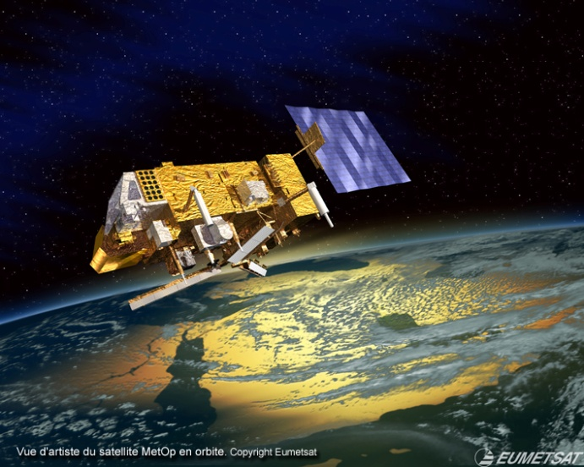
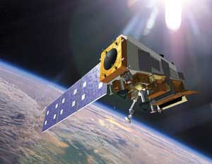
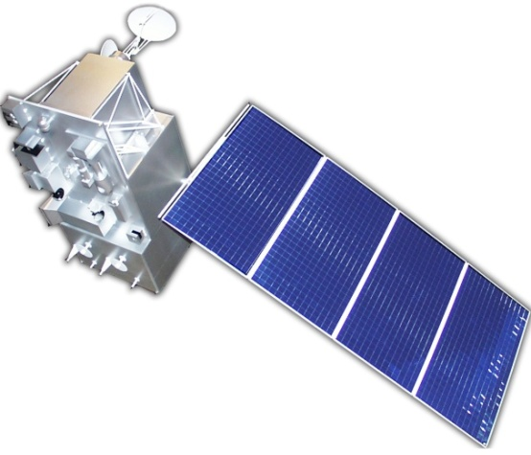
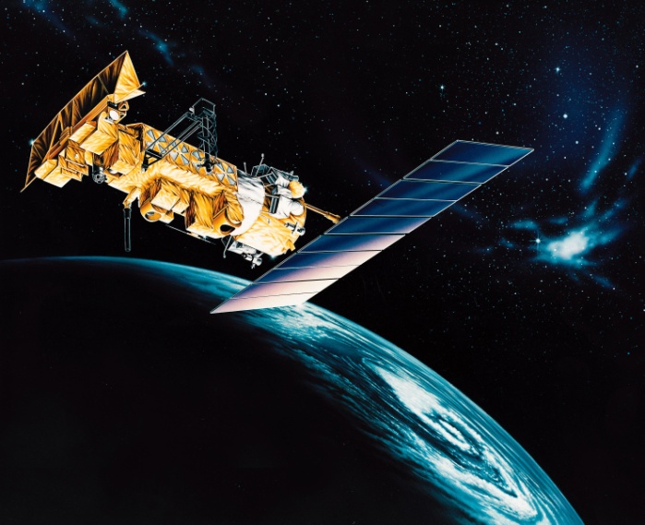
The EARS Satellite Network
METOP-A
METOP-B
S-NPP
NOAA-15
NOAA-18
NOAA-19
FY-3C

Slide 4
FY-3 Polar Orbiting Meteorological Satellites
 | Launch | Orbit
FY-3A | 2008 | 09:05 desc
FY-3B | 2010 | 14:25 asc
FY-3C | 2013 | 10:20 desc
FY-3D | 2016 | 14:00 asc
FY-3E | 2018 | 06:00 desc
FY-3F | 2019 | 10:00 desc
FY-3G | 2021 | 14:00 asc

Slide 5
FY-3 Regional Service
Approved by Council at its 82nd meeting on 28th October 2014
Regional
FY-3 Sounder Service EARS-VASS
Regional
FY-3 MERSI Service EARS-MERSI
FY-3C MWTS-II service was suspended since 17/02/2015 due to an instrument failure.

Slide 6
FY-3 Instruments

Slide 7
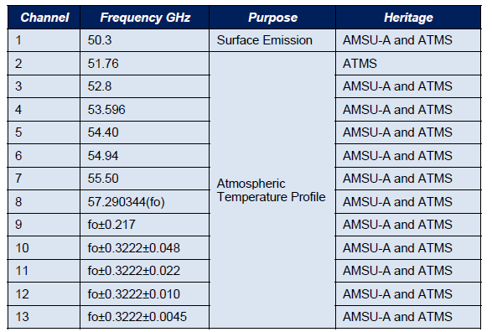
MWTS-II

Slide 8
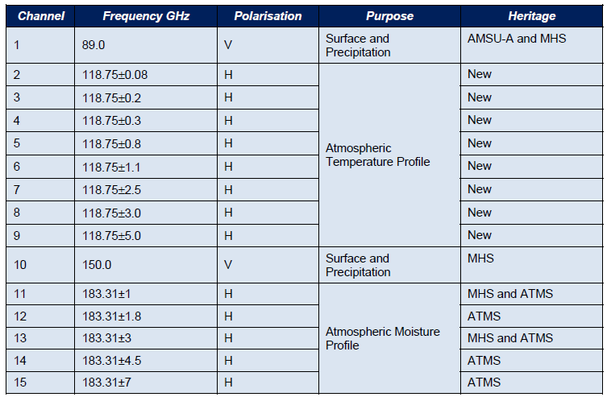
MWHS-II
Notes:
MWHS is the FY-3 Microwave Humidity Sounder. The MWHS-II is an evolution of the
MWHS-I flown on FY-3A and B, providing a total of 15 spectral channels compared to the 4
spectral channels of MWHS-I.
As can be seen from Table 3 the MWHS-II closely matches the channels of MHS and ATMS
and additionally introduces a new set of channels around the 118.75 GHz oxygen absorption
line. The weighting functions of the WMHS-II channels are shown in Figure 3 indicating the
layer of the atmosphere that each individual channel is sensing.

Slide 9
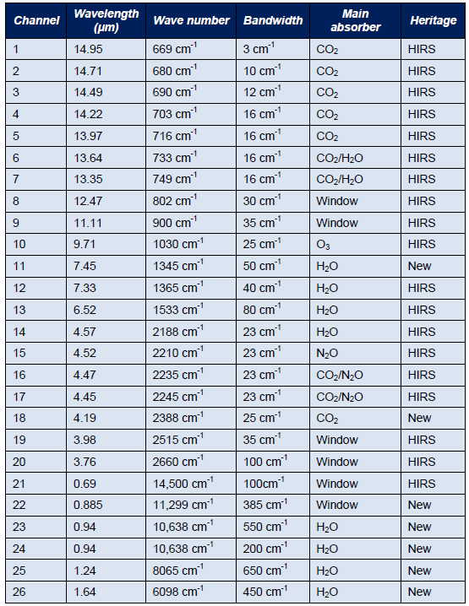
IRAS

Slide 10
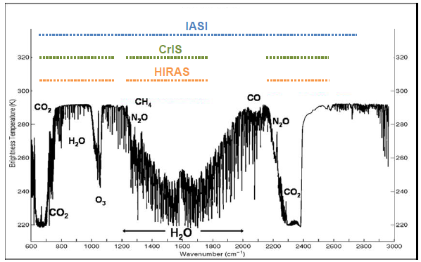
HIRAS
HIRAS provides 1370 channels compared to the 1305 CrIS channels and has the same spectral ranges as CrIS;
The spatial resolution of both HIRAS and CrIS is around 16 km.

Slide 11
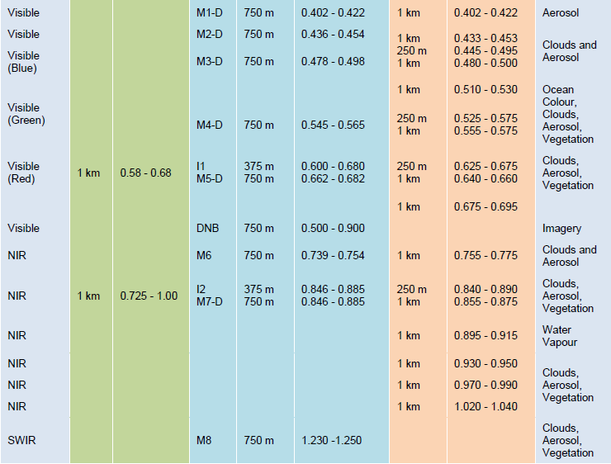
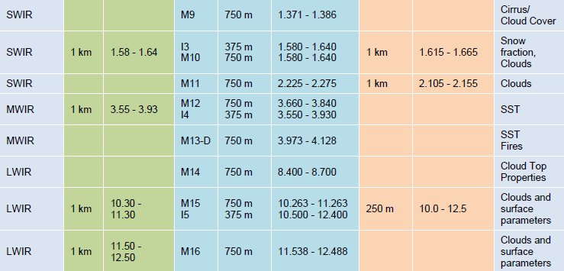
MERSI-II
MERSI-II provides 25 channels primarily support ocean colour, vegetation indexes and aerosol applications;
Six of the channels have a resolution of 250m and the remaining channels have a resolution of 1 km.

Slide 12
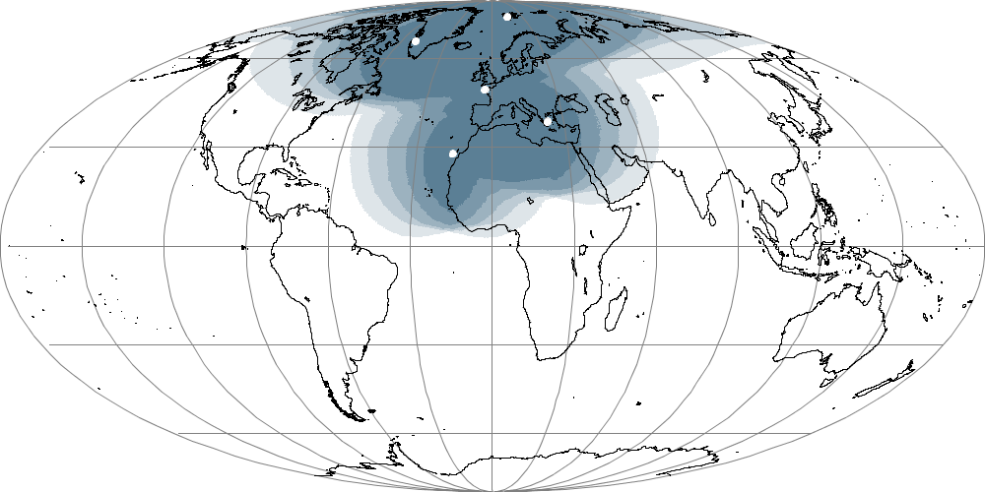
EARS-VASS and EARS-MERSI Coverage
Svalbard
Kangerlussuaq
Lannion
Athens
Maspalomas
Saint-Dennis
100 %
75-100 %
50-75 %
25-50 %
0-25 %

Slide 13
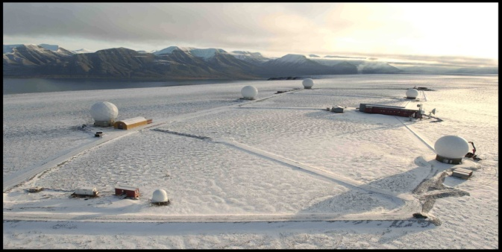
Svalbard
CDA2 10m Orbital
L/X-band antenna
SG7 3m Orbital
L/X-band antenna
CDA1 10m Orbital
L/X-band antenna

Slide 14
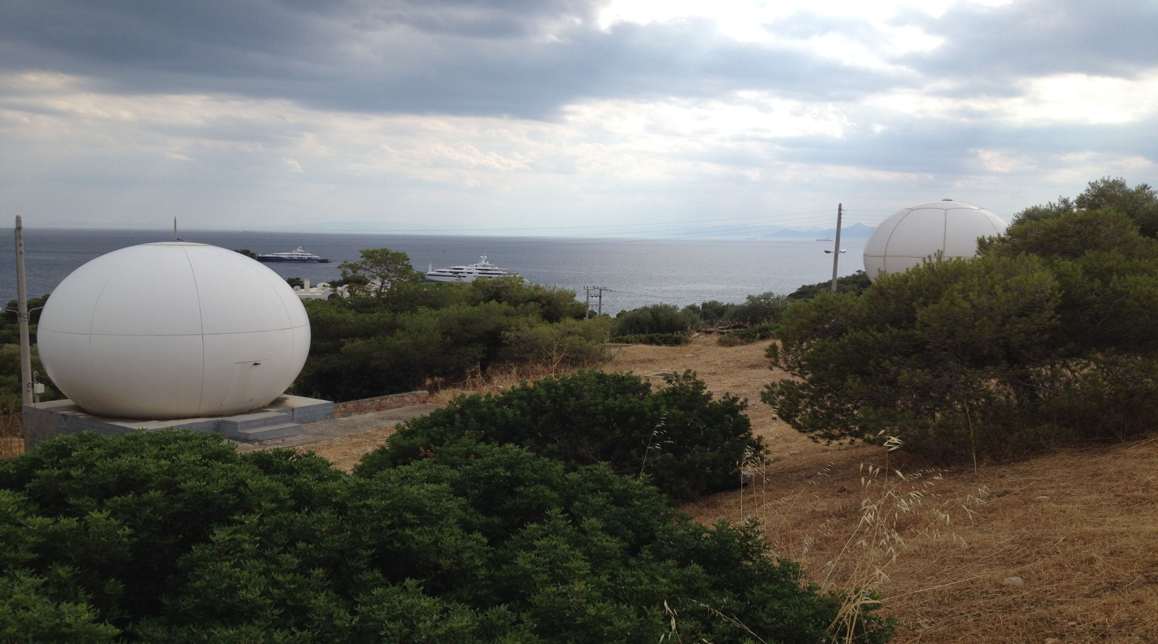
Athens
3.0 m Orbital
L/X-band antenna
2.4 m Yantai L-band antenna

Slide 15
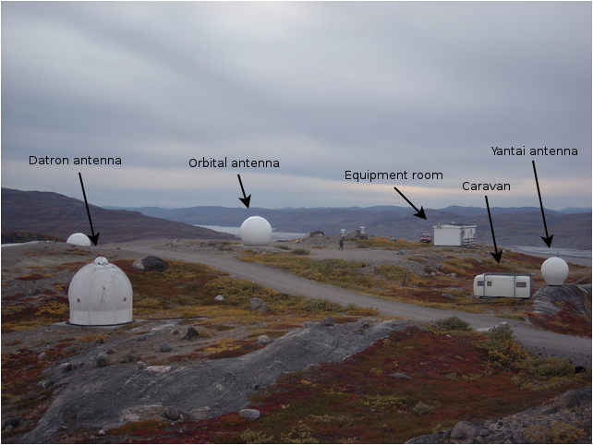
Greenland
2.4 L-band
2.4 m L/X-band
Orbital antenna

Slide 16
EARS-VASS Specifications
Satellites supported | FY-3C
Product Processing | FY3_IPP as provided by the CMA, configured and run by EUMETSAT AAPP as provided by NWP-SAF
Product Segmentation | One file per station and pass
Products via EUMETCast Europe | Level 1b MWHS-II and IRAS. All spectral channels, all Fields of View Calibrated and geolocated. BUFR format
Timeliness via EUMETCast | 30 minutes, target 15 minutes.
Products via RMDCN/GTS | As for EUMETCast.
Archived in EUMETSAT | None.

Slide 17
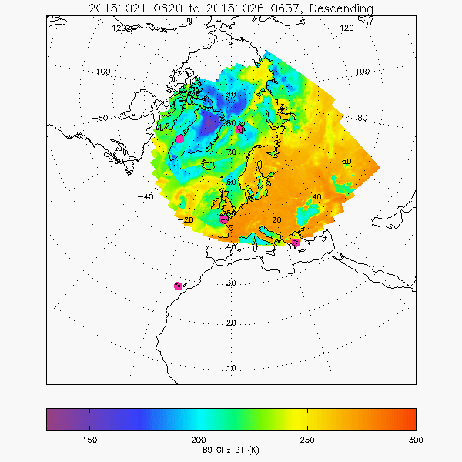
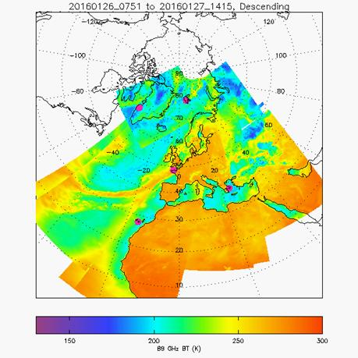
FY-3C Onboard Power Anomaly
Since July 2015 FY-3C L-Band HRPT enabled over Europe 4/5 times per day and with limited geographical coverage due to the onboard power anomaly
Geographical coverage after having been extended by CMA to cover EUROPE fully and permanently- Jan 2016
Figures courtesy of Nigel Atkinson – NWP-SAF (Met Office)

Slide 18
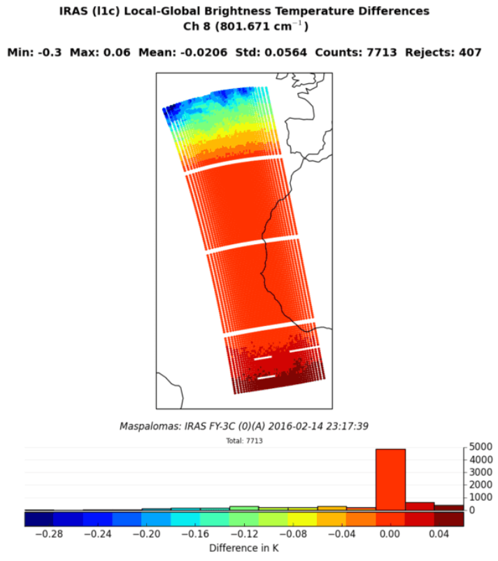
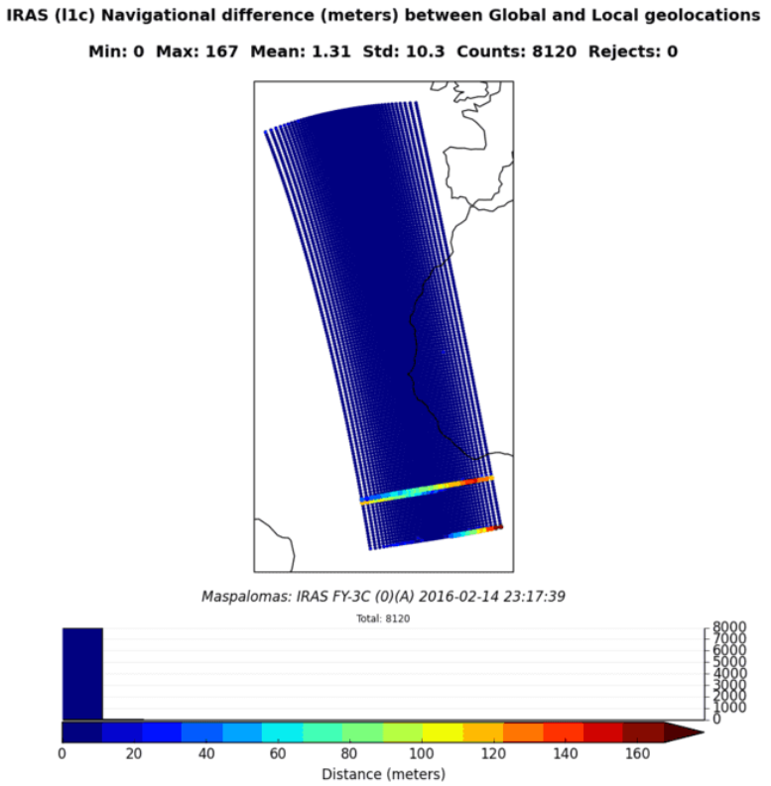
EARS-VASS Monitoring Concept
Regional and Global IRAS inter-comparison by the NWP SAF ( Met Office)

Slide 19
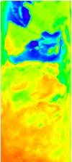
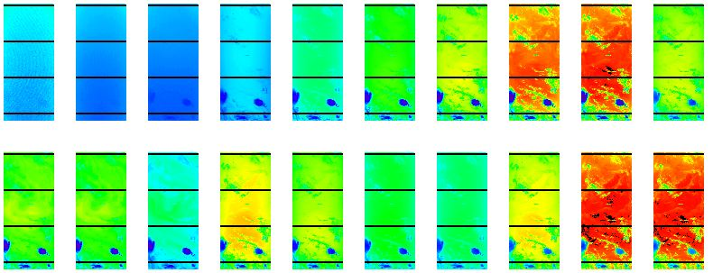
EARS-VASS Products
IRAS data from 2015/09/28, 20:11 UTC, received at Athens reception station. Brightness temperature in all 20 channels.
MWHS-II (Channel 1) data from 2015/10/15, 21:33 UTC, received at Maspalomas reception station.

Slide 20
FY-3 Polar Orbiting Meteorological Satellites
 | Launch | Orbit
FY-3A | 2008 | 09:05 desc
FY-3B | 2010 | 14:25 asc
FY-3C | 2013 | 10:20 desc
FY-3D | 2016 | 14:00 asc
FY-3E | 2018 | 06:00 desc
FY-3F | 2019 | 10:00 desc
FY-3G | 2021 | 14:00 asc

Slide 21
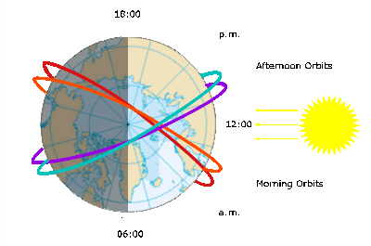
Early Orbit Morning Gap in the Polar Met Constellation
Space atmosphere observations suffer a temporal gap between dawn and dusk due to current orbit plane configuration.
OBJECTIVE: Regular sampling of the atmosphere, avoiding gaps, in order to satisfy the observing cycle requirements from NWP and climate monitoring as concerns atmospheric temperature and humidity profiles.

Slide 22
Visualization of the Early Orbit Morning Gap

Slide 23
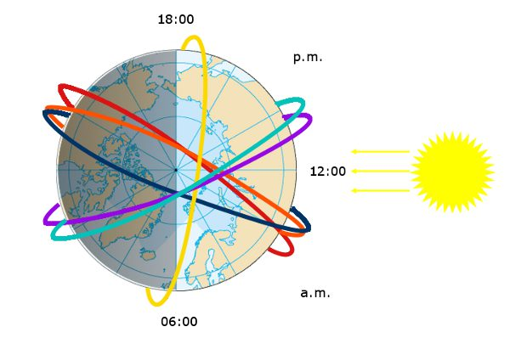
FY-3E @ Early Orbit Morning (06:00 AM)

Slide 24
FY-3E (early morning), METOP/SG (morning) & NPP/JPSS (afternoon)

Slide 25
Backup Slides

Slide 26
FY-3 Downlink Specifications
 | L-Band Downlink |  |  | X-Band Downlink
 | Data Rate | Polarisation | Data | Data Rate | Polarisation | Data
FY-3A | 4.2 Mb/s | RHCP | All instruments except MERSI-I | 18.7 Mb/s | RHCP | MERSI-I
FY-3B | 4.2 Mb/s | RHCP | All instruments except MERSI-I | 18.7 Mb/s | RHCP | MERSI-I
FY-3C | 3.9 Mb/s | RHCP | All instruments except MERSI-II | 18.7 Mb/s | LHCP | MERSI-I
FY-3D | 3.9 Mb/s | RHCP | All instruments except MERSI-II | 60 Mb/s | RHCP | All instruments
FY-3E | No L-band broadcast |  |  | 60 Mb/s | LHCP | All instruments
Notes:
The project purpose is the establishment of two FY-3 Regional Services:
The EARS - Vertical Atmospheric Sounder Service
The EARS – MERSI which is an Imager Service.
In terms of satellites:
The project scope covers the establishment of this two services and their operational validation through the FY-3C and FY-3D satellites:
The FY-3A&B satellites are excluded due to the early failure of their instruments.
FY-3E, F and G are excluded since the FY-3E launch will not take place earlier than 2019, the space to ground interface is unknonw (polarization)
About the instruments:
HIRAS service: once more details of the sounder instrument and its performance characteristics are known

Slide 27
FY-3 Data Dissemination – Data Rates

