Slide 1
EUMETSAT Regional Services
Carlos Cabanas

Slide 2
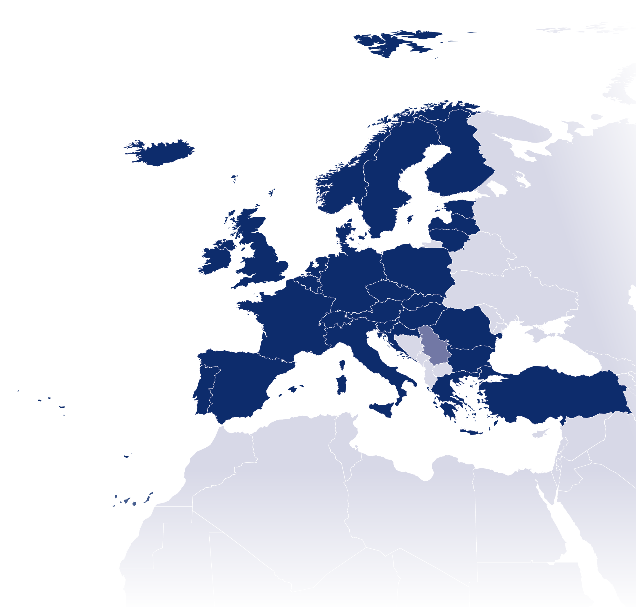

EUMETSAT is an intergovernmental organisation with
30 Member States and 1 Cooperating State
Member States
Cooperating States
AUSTRIA
BELGIUM
BULGARIA
CROATIA
SERBIA
CZECH REPUBLIC
DENMARK
ESTONIA
FINLAND
FRANCE
GERMANY
GREECE
HUNGARY
ICELAND
IRELAND
ITALY
LATVIA
LITHUANIA
LUXEMBOURG
THE NETHERLANDS
NORWAY
POLAND
PORTUGAL
ROMANIA
SLOVAK REPUBLIC
SLOVENIA
SPAIN
SWEDEN
SWITZERLAND
TURKEY
UNITED KINGDOM

Slide 3

EUMETSAT headquarters

Slide 4
EUMETSAT’s mission
The primary objective is to establish, maintain and exploit European systems of operational meteorological satellites, taking into account
as far as possible the recommendations of WMO;
A further objective is to contribute to the operational monitoring of the climate and the detection of global climatic changes;
Through fulfilling these objectives, contribute to environmental monitoring, where interactions with the ocean and the atmosphere are involved;
Deliver cost efficient operational satellite data and products that satisfy the meteorological and climate data requirements of its Member States
24 hours a day, 365 days a year, over decades
Encourage the maximum use of EUMETSAT data and products

Slide 5
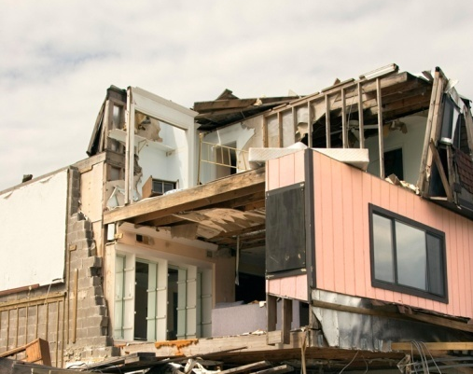


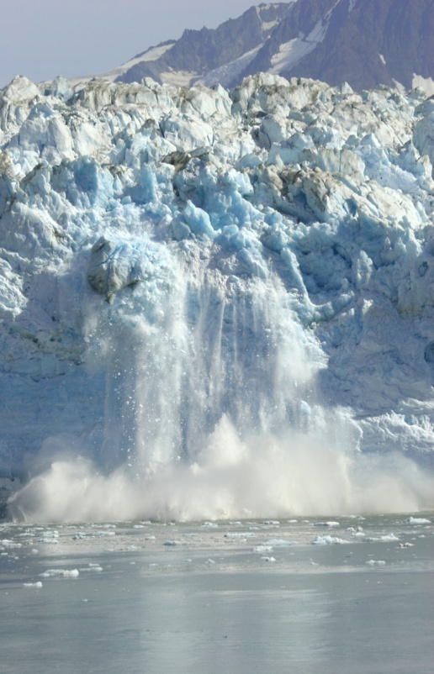
Benefit areas of weather forecasting
….... ......
Safety of life, property and infrastructure…
Transport …
....Energy, agriculture,
tourism....
...Climate policy and environment protection

Slide 6
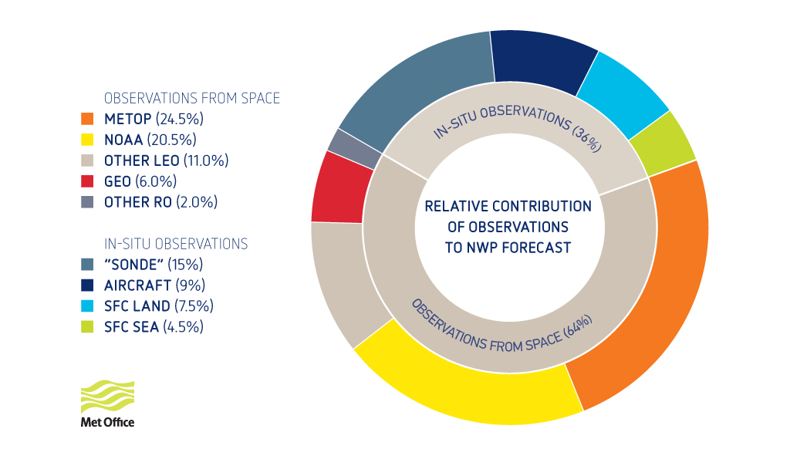
The vital contributions of satellites to forecast performance
Satellite observations account for 64% for Day 1

Slide 7
Estimated benefits of weather forecasting in the EU
BENEFIT AREA | MINIMUM | LIKELY
Protection of property and infrastructure | €1.3 billion/year | €5.5 billion/year
Added value to the European economy | €10 billion/year | €41 billion/year
Private use by European citizens | €4 billion/year | €15 billion/year
TOTAL | €15 billion/year | €61 billion/year
Not captured: the value of hundreds of lives saved, benefits to defense and security
Source: The case for EPS/Metop second generation cost/benefit analysis. 2013

Slide 8
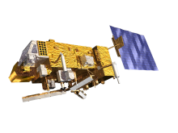

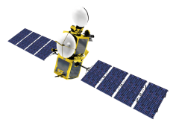

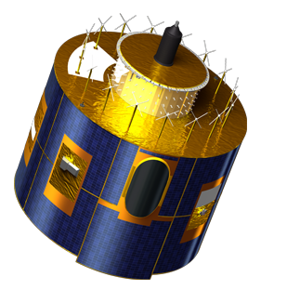
Current EUMETSAT satellites
METOP-A (98.7° incl.)
JASON-2 (66° incl.)
EUMETSAT POLAR SYSTEM
OCEAN SURFACE TOPOGRAPHY
In nominal mid-morning sun synchronous orbit at 817km altitude ,as part of the EUMETSAT Polar System (EPS) .
In nominal non-synchronous low Earth orbit at 1,336km altitude, in support of the Ocean Surface Topography Mission.
METOP-B
METOP-A
JASON-2
METOP-B (98.7° incl.)
EUMETSAT POLAR SYSTEM
In orbit at 817 km altitude, the primary operational satellite of the EUMETSAT Polar System (EPS).
METEOSAT-7 (57.5° EAST)
INDIAN OCEAN DATA COVERAGE
METEOSAT-7
Operated in support of the Indian Ocean Data Coverage (IODC) mission, bridging an observational gap in this region.
METEOSAT-10 (0°)
METEOSAT-9 (9.5° EAST)
METEOSAT-8 (3.5° EAST)
METEOSAT FULL DISC IMAGERY
RAPID SCANNING SERVICE (RSS)
BACKUP SERVICE
Positioned at 0° supporting the prime Meteosat full disc imagery service over the European continent, Africa and parts of the Atlantic and Indian oceans.
Provides the Rapid Scanning Service (RSS) delivering more frequent images every five minutes over parts of Europe, Africa and the adjacent seas.
Serves as a back-up to both the Meteosat-9 and -10 spacecraft for full disc imagery and rapid scanning.
METEOSAT-10
METEOSAT-9
METEOSAT-8

Slide 9
EUMETSAT mission planning...
YEAR...
03
04
05
06
07
08
09
10
11
12
13
14
15
16
17
18
19
20
21
22
23
24
25
26
27
28
29
30
31
32
33
34
35
36
37
38
39
40
METEOSAT FIRST GENERATION
METEOSAT-7
METEOSAT SECOND GENERATION
METEOSAT-8
METEOSAT-9
MSG-3/METEOSAT-10
MSG-4/METEOSAT-11*
METEOSAT THIRD GENERATION
MTG-I-1
MTG-S-1
MTG-I-2
MTG-I-3
MTG-S-2
MTG-I-4
EUMETSAT POLAR SYSTEM (EPS)
METOP-A
METOP-B
METOP-C
EPS-SECOND GENERATION (EPS-SG)
METOP-SG SOUNDING & IMAGERY SATELLITES
METOP-SG MICROWAVE SATELLITES
JASON
JASON-2
JASON-3
JASON CONTINUITY OF SERVICES (JASON-CS)
GMES
SENTINEL-3
SENTINEL-4 ON MTG-S
SENTINEL-5 ON EPS-SG

Slide 10
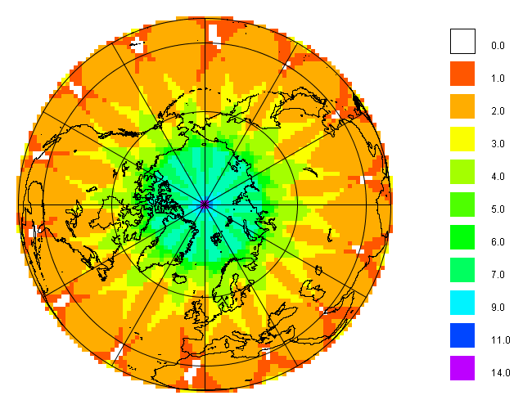
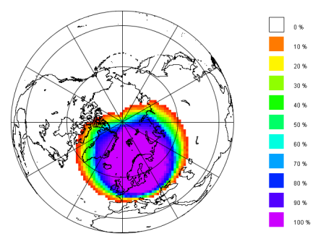
EUMETSAT’s challenge of timely access to LEO satellite data
Global Mission
Local Mission
Regional Mission
2-6 hours
Immediate
30 minutes

Slide 11
EUMETSAT Advanced Retransmission Service (EARS)
Objective
To provide Users with high timeliness regional data from Polar Orbiting Meteorological Satellites in support of Numerical Weather Prediction (NWP) and Nowcasting (NWC).
Principle
Achieved through a network of Direct Broadcast stations receiving, processing and distributing data to Users in near real time.

Slide 12
The EARS System
Polar Satellite
EUMETCast
DB Reception
Stations
EARS
Communication
Network
Product Processing Nodes
GTS
Users
15-30 Minutes

Slide 13
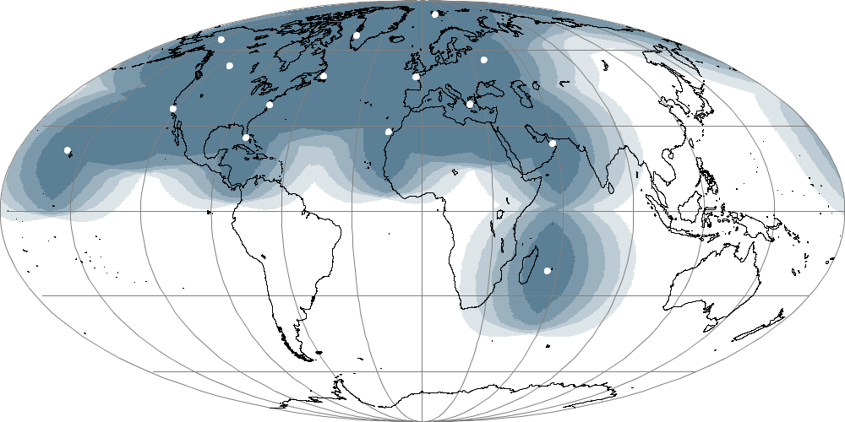
The EARS Ground Station Network
Svalbard
Gilmore Creek
Kangerlussuaq
Edmonton
Moscow
Gander
Lannion
Monterey
Wallops
Athens
Miami
Maspalomas
Muscat
Ewa Beach
Saint-Dennis
100 %
75-100 %
50-75 %
Five Core EARS European Stations
Additional EARS Stations
25-50 %
0-25 %

Slide 14
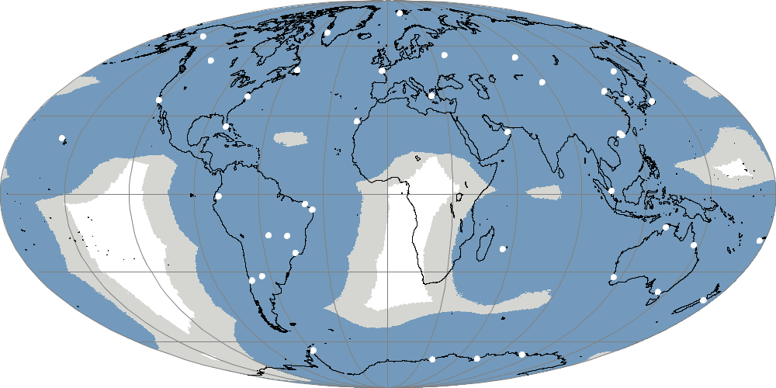
DBNet- ATOVS
Svalbard
Gilmore Creek
Kangerlussuaq
Edmonton
Moscow
Gander
Lannion
Monterey
Wallops
Athens
Miami
Maspalomas
Muscat
Ewa Beach
Saint-Dennis
EARS
Asian Pacific-RARS
South America-RARS

Slide 15
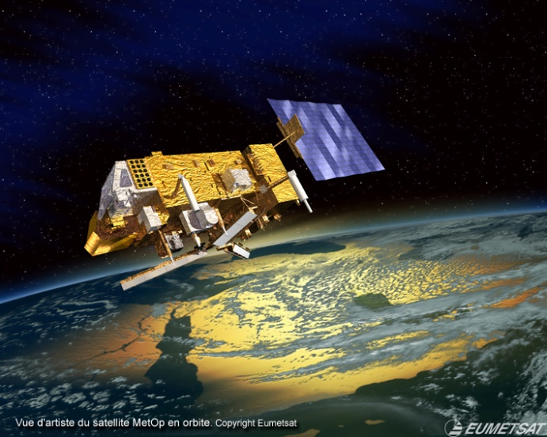
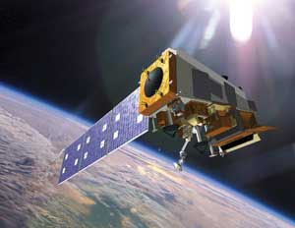
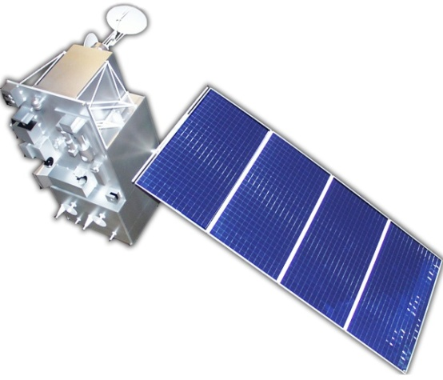
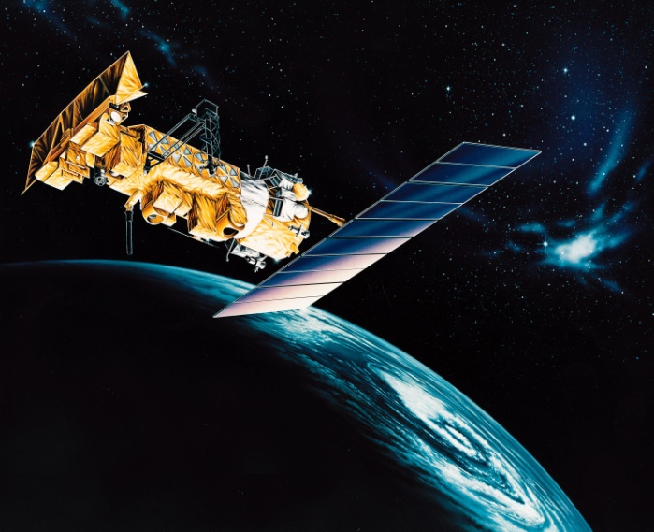
The EARS Satellite Network
METOP-A
METOP-B
S-NPP
NOAA-15
NOAA-18
NOAA-19
FY-3C

Slide 16
The EARS Instruments and Services
EARS-ATOVS
EARS-ATMS
EARS-VASS
EARS-IASI
EARS-CrIS
EARS-AVHRR
EARS-NWC
EARS-VIIRS
EARS-ASCAT
http://www.eumetsat.int/website/home/Data/RegionalDataServiceEARS/index.html

Slide 17
Satellites and Stations contributing to each Service

Slide 18
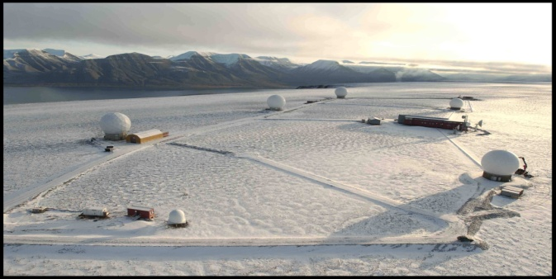

Svalbard
SG7 3m Orbital
L/X-band antenna
CDA2 10m Orbital
L/X-band antenna
CDA1 10m Orbital
L/X-band antenna

Slide 19
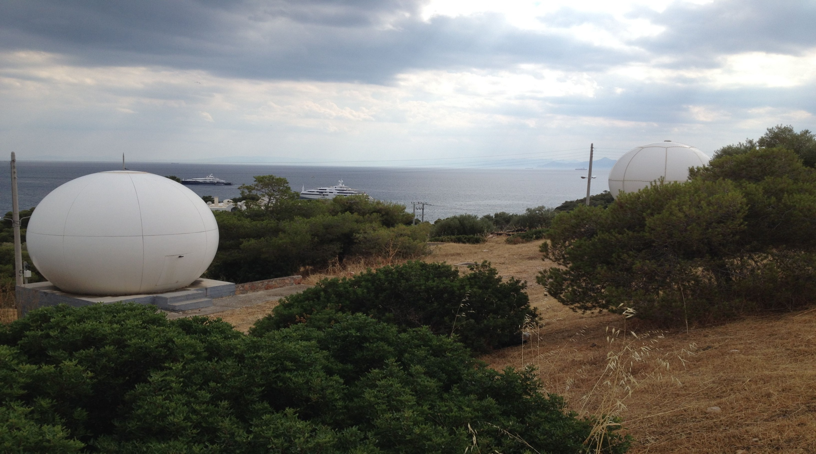
Athens
3.0 m Orbital L/X-band antenna
2.4 m Yantai L-band antenna

Slide 20
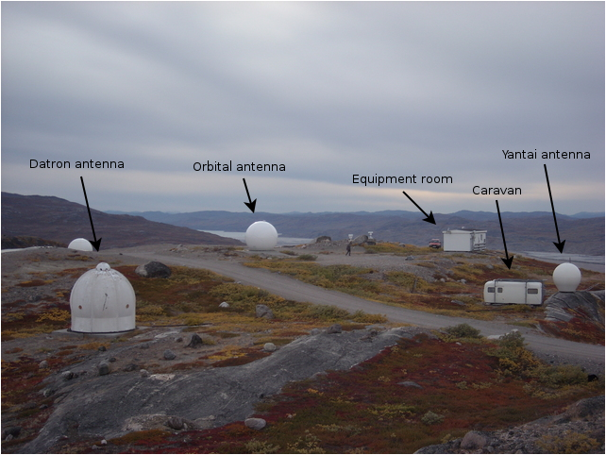
Greenland
2.4 L-band
2.4 m L/X-band

Slide 21
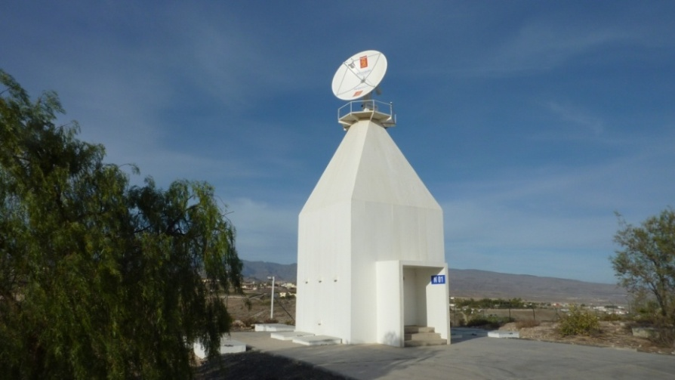
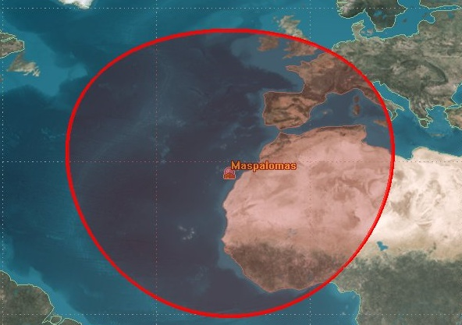
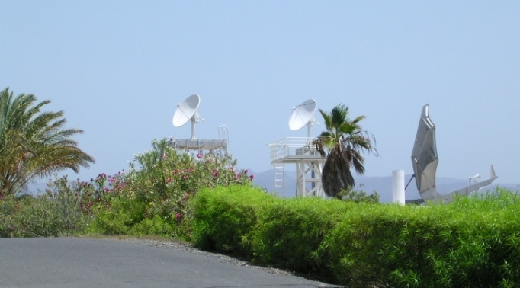
Maspalomas
2.4m KONGSBERG L/X-BAND ANTENNA
1.8m DSS & VCS L-BAND ANTENNAS

Slide 22
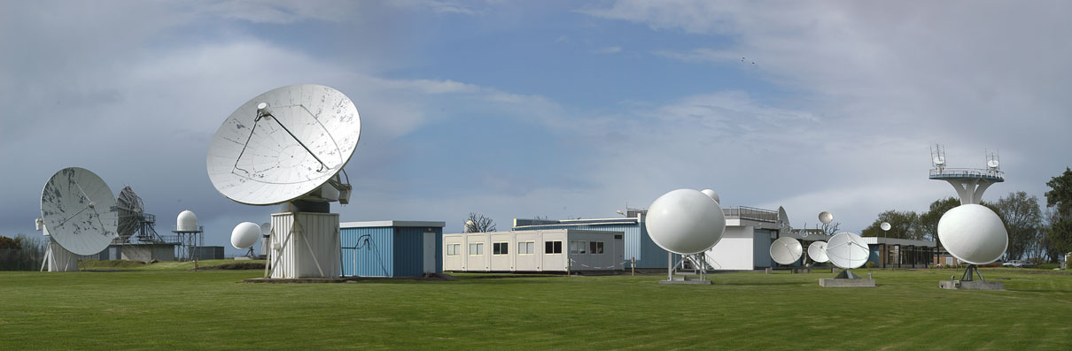
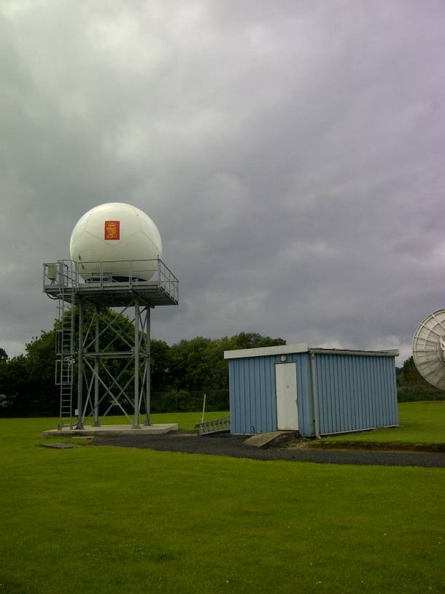
Lannion
Lannion: New 2.4 m L/X-band antenna
Orbital 2.4m
L/X-band antenna

Slide 23
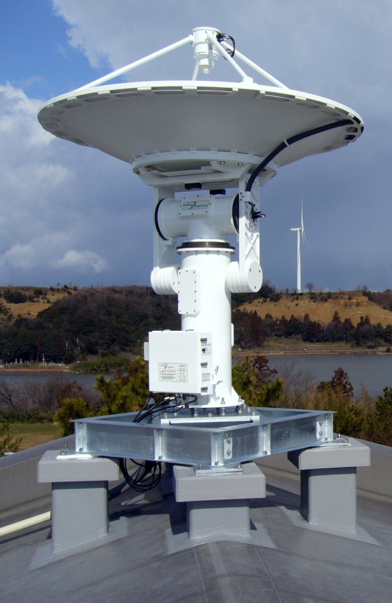
Antenna and X/L-Band Feed
High-quality, high-precision elevation-over-azimuth satellite tracking system suitable for operation at X-Band, and
below;
High Reliability;
Antenna positioner and feed are pressurized with dehydrated air to prevent corrosion of system components;
Full Antenna Control Unit integrated in Antenna;
X and L-Band Feed operates in fixed RHCP;
X and L-Band Feed allows simultaneous reception of X and L-Band signals;
System Performance:
Model | X-Band G/T | L-Band G/T
2.4 m | 24.5 dB/K | 8 dB/K
3.0 m | 26.2 dB/K | 9.5 dB/K
Orbital Systems Ltd.
Irving, Texas
http://www.orbitalsystems.com/

Slide 24
EARS Ground Station: from RF signal to L1 products
X/L Band Signal
Outdoor
Indoor
X-Band IF (720 MHz)
MEOS
PPN
L-Band IF
(140 MHz)
L-Band IF
(720 MHz)
Demodulation
Frame Synchronization
Data Acquisition
Monitoring/Control
Viterbi Decoding
Product Generation (L1)
LNA
Down Converter
IF Signal
CADU, VCDU, L0
L1 Products
Product Processing Packages Installed in the PPN
Package | Service | Level | Provider
AAPP | ATOVS, AVHRR | Level-1 | NWP SAF
OPS-LRS | IASI | Level-1 | NWP SAF
RT-STPS | ATMS, CrIS, VIIRS | Level-0 | NASA DRL
CSPP | ATMS, CrIS, VIIRS | Level-1 | SSEC, UW-Madison
ASCAT PPF | ASCAT | Level-1 and -2 | EUMETSAT, KNMI
PPS | NWC | Level-2 | NWC SAF
FY3L1PP | VASS, MERSI | Level-1 | CMA

Slide 25
The partnership between EUMETSAT and CMA is continuously developing
EUMETSAT and CMA signed extension of the existing Cooperation Agreement: Chinese FY3 Polar Orbiting Meteorological Satellites became part of the EARS network.
 | Launch | Orbit
FY-3A | 2008 | 09:05 desc
FY-3B | 2010 | 14:25 asc
FY-3C | 2013 | 10:20 desc
FY-3D | 2016 | 14:00 asc
FY-3E | 2018 | 06:00 desc
FY-3F | 2019 | 10:00 desc
FY-3G | 2021 | 14:00 asc

Slide 26
FY-3 Regional Service
Regional
FY-3 Sounder Service
EARS-VASS
Regional
FY-3 MERSI Service
EARS-MERSI
FY-3C MWTS-II service was suspended since 17/02/2015 due to an instrument failure.

Slide 27
EARS-VASS Specifications
Satellites supported | FY-3C
Product Processing | FY3_IPP as provided by the CMA, configured and run by EUMETSAT AAPP as provided by NWP-SAF
Product Segmentation | One file per station and pass
Products via EUMETCast Europe | Level 1b MWHS-II and IRAS. All spectral channels, all Fields of View Calibrated and geolocated. BUFR format
Timeliness via EUMETCast | 30 minutes, target 15 minutes.
Products via RMDCN/GTS | As for EUMETCast.
Archived in EUMETSAT | None.

Slide 28
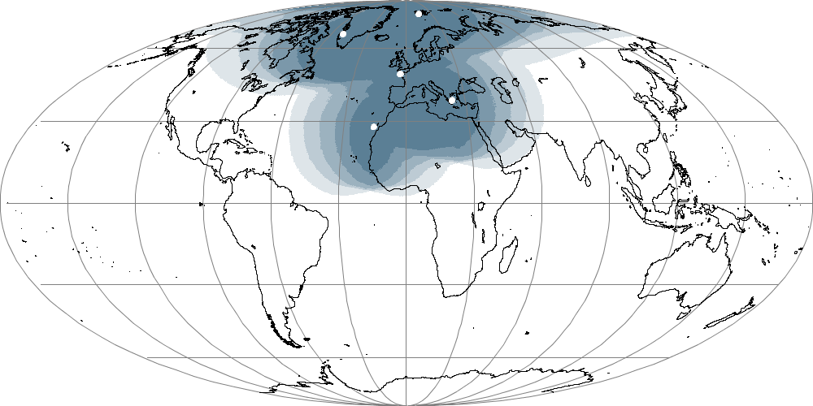
EARS-VASS Coverage
Svalbard
Kangerlussuaq
Lannion
Athens
Maspalomas
Saint-Dennis
100 %
75-100 %
50-75 %
25-50 %
0-25 %

Slide 29
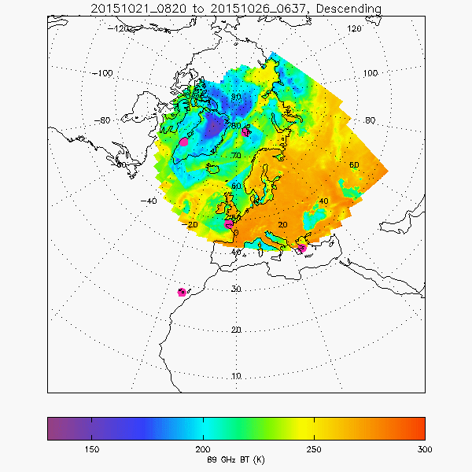
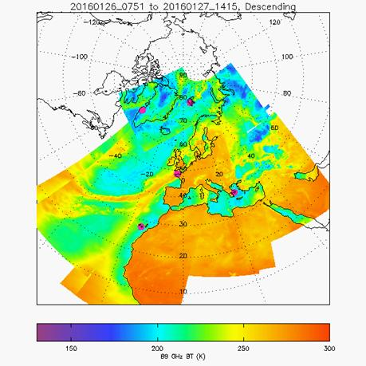
FY-3C geographical coverage extension over EUROPE
Since July 2015 FY-3C L-Band HRPT enabled over Europe 4/5 times per day and with limited geographical coverage due to the onboard power anomaly
Geographical coverage after having been extended by CMA to cover EUROPE fully and permanently- Jan 2016
Figures courtesy of Nigel Atkinson – NWP-SAF (Met Office)

Slide 30
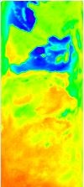
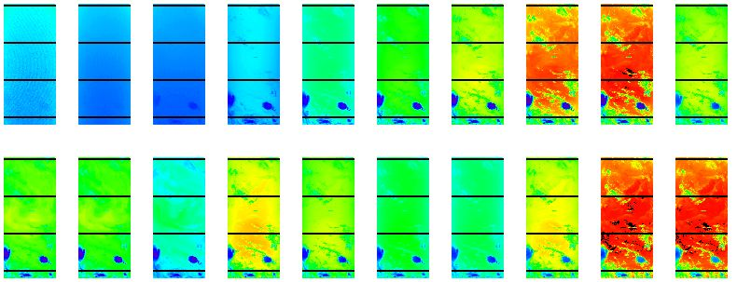
EARS-VASS Products
IRAS data from 2015/09/28, 20:11 UTC, received at Athens reception station. Brightness temperature in all 20 channels.
MWHS-II (Channel 1) data from 2015/10/15, 21:33 UTC, received at Maspalomas reception station.

Slide 31
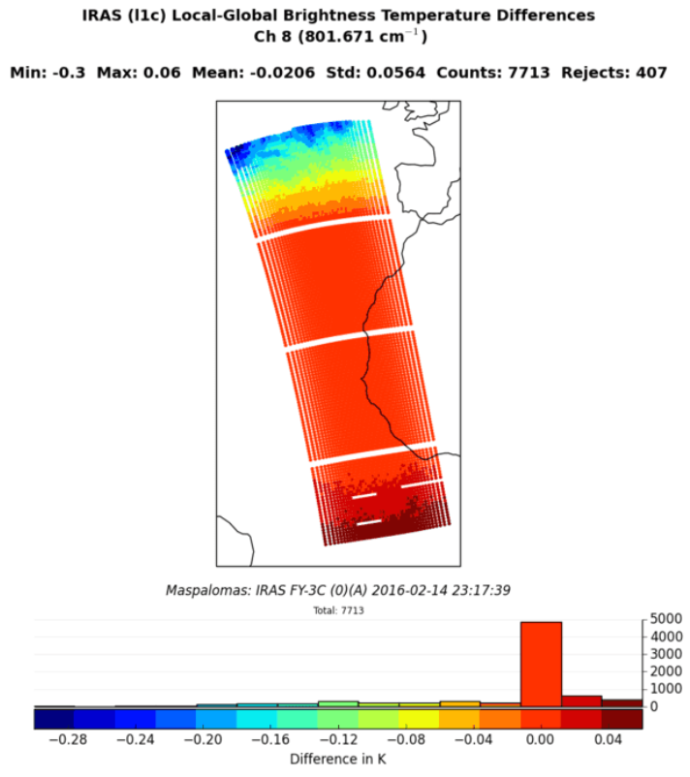
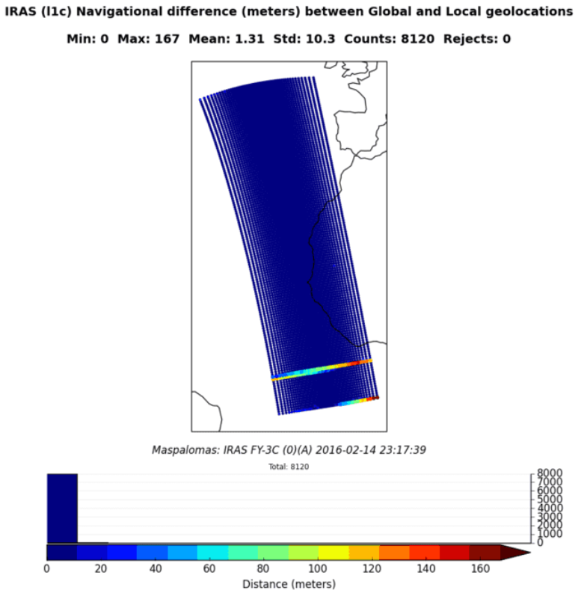
EARS-VASS Monitoring Concept
Regional and Global IRAS inter-comparison by the NWP SAF ( Met Office)

Slide 32
EARS-MERSI Specifications
Satellites supported | FY-3C
Product Processing | FY3_IPP as provided by the CMA, configured and run by EUMETSAT.
Product Segmentation | Segments each containing in the order of 1 minute of observations. Duplicate segments removed before dissemination.
Products via EUMETCast Europe | MERSI-II; All Channels with 250m Channels down-sampled to 1km; Calibrated and geolocated, Geolocation information on tie-point grid; HDF5 product format, EARS-VIIRS like.
Timeliness via EUMETCast | 30 minutes, target 15 minutes.
Products via RMDCN/GTS | None.
Archived in EUMETSAT | None.

Slide 33
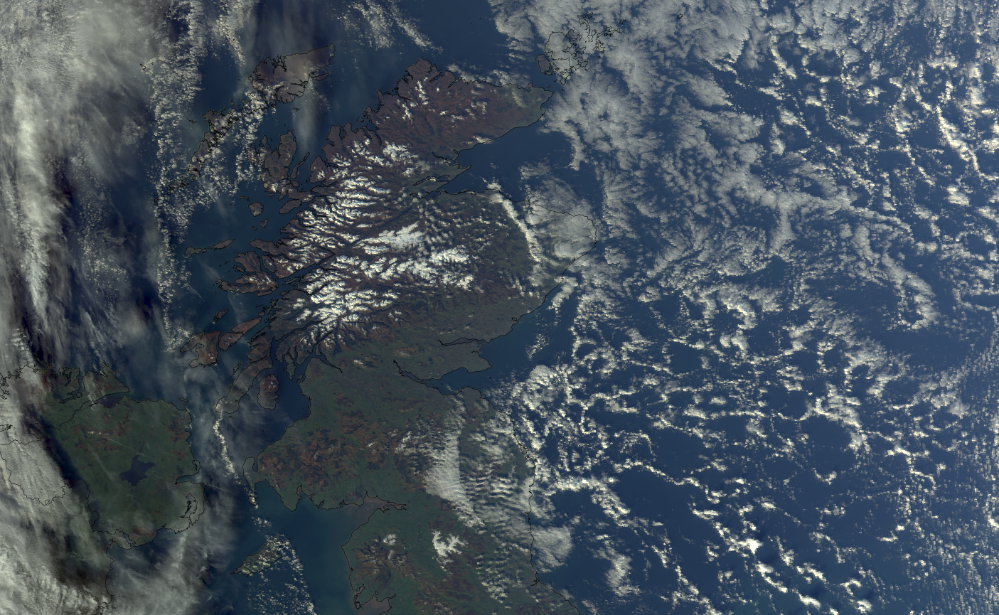
Fast EARS-VIIRS imaging data extremely useful for NWC applications
True Color Composite of VIIRS
M-band channels 3,4,5
EARS-VIIRS, Kangerlussuaq, 10 November 2013
EARS-VIIRS 10 November 2013

Slide 34
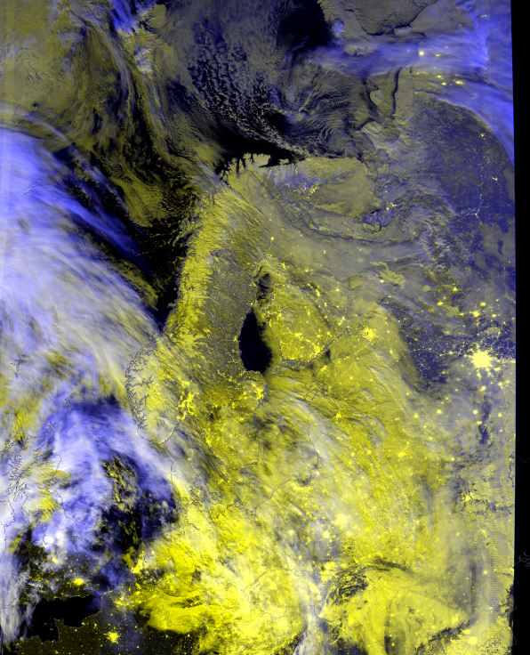
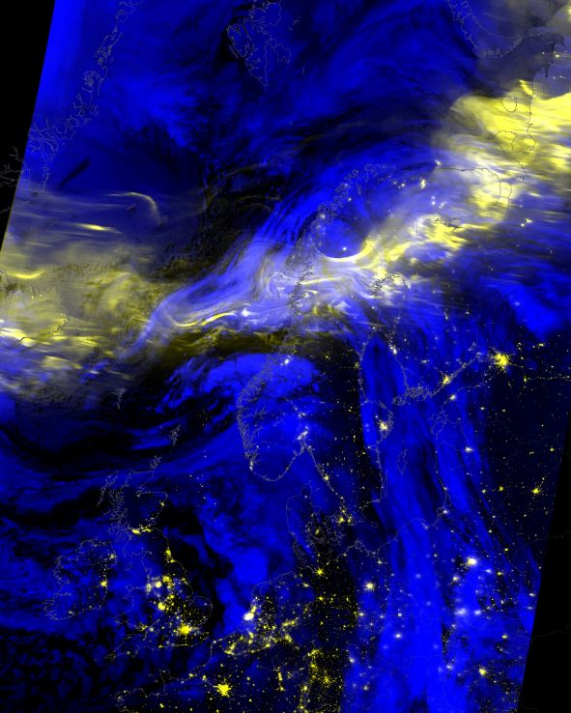
Fast EARS-VIIRS DNB data specially useful for European Northern countries
RGB
(DNB, DNB, -M15)
M15 = 10.8 μm
New Moon
Full Moon
RGB
(DNB, DNB, -M15)
M15 = 10.8 μm
25 January 2016
Norwegian Meteorological Institute
Northern Lights
24 January 2016 Swedish Meteorological and Hydrological Institute

