Slide 1
NASA Earth Science Division Update
Presented at
NDRC9 Conference
June 21, 2016
Tsengdar Lee – tsengdar.j.lee@nasa.gov, NASA Headquarters

Slide 2
  Big Thanks to
  Prof Jose Luis Casanova (LATUV)
  Juan Ramon Lopez (Univ. Valladolid)
  NDRC Steering Committee
    Patrick Coronado
    Jasmine Nahorniak
    Brad Quayle
    Allen Huang
    Anders Soerensen

Slide 3
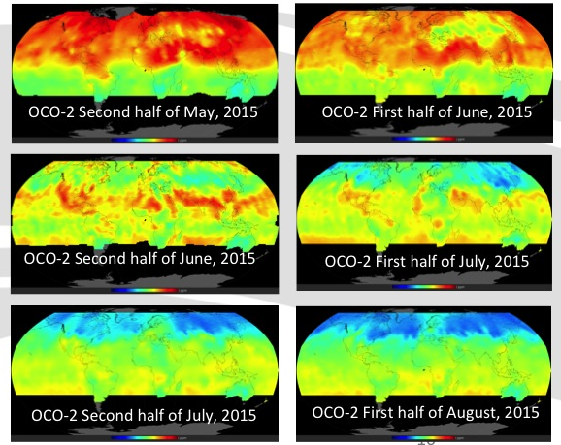
NASA Earth Science Division Update
21 June 2016

Slide 4
OUTLINE
  On-orbit constellation overview
  Upcoming launches – mission development
  Venture Class status/plans/schedule
  Sustained Land Imaging
  Questions/Discussion
Notes:
4

Slide 5
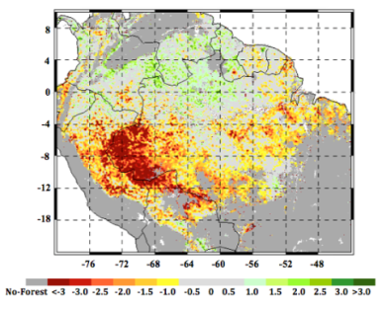
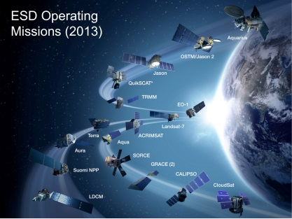
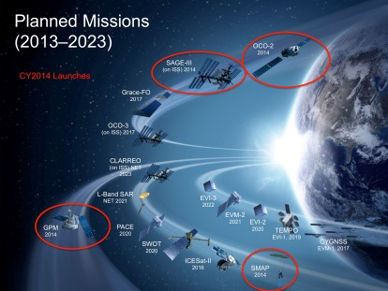
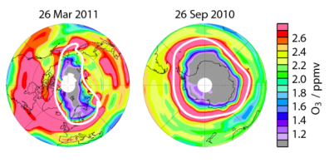
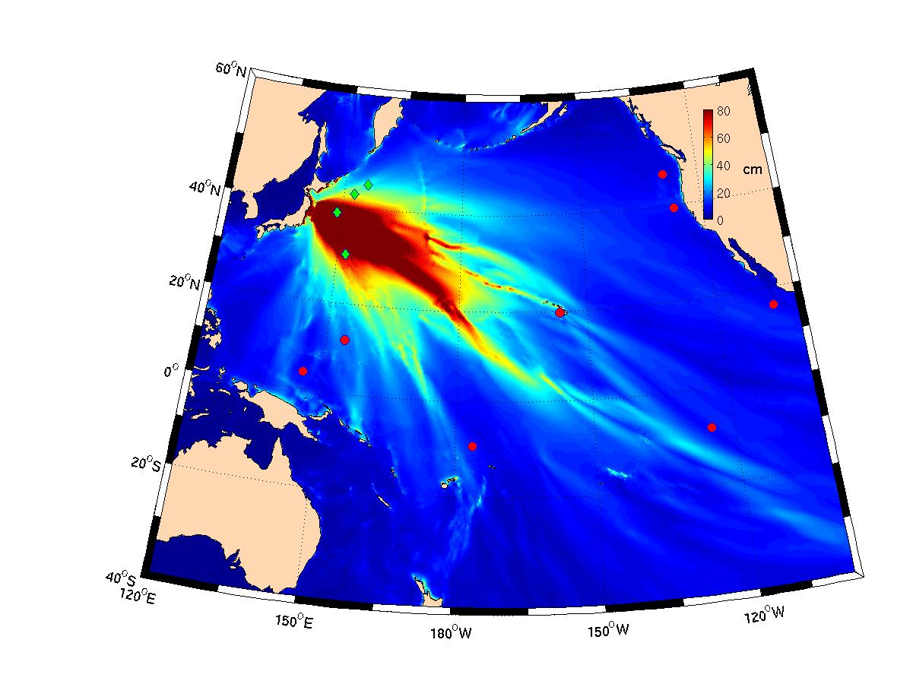
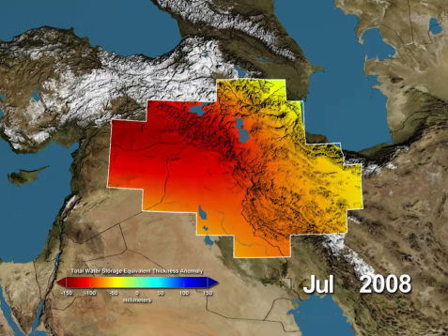
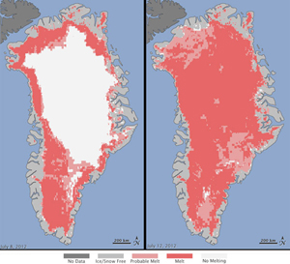
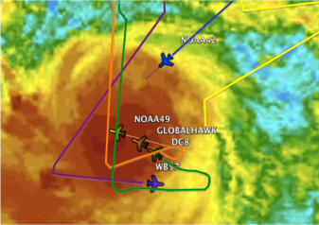
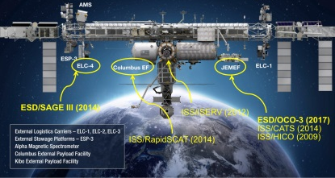

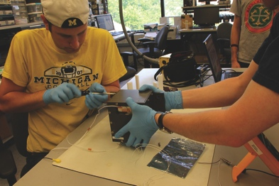
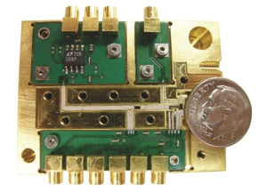
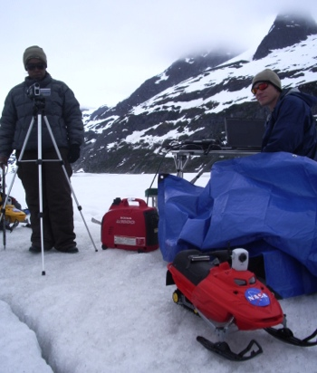

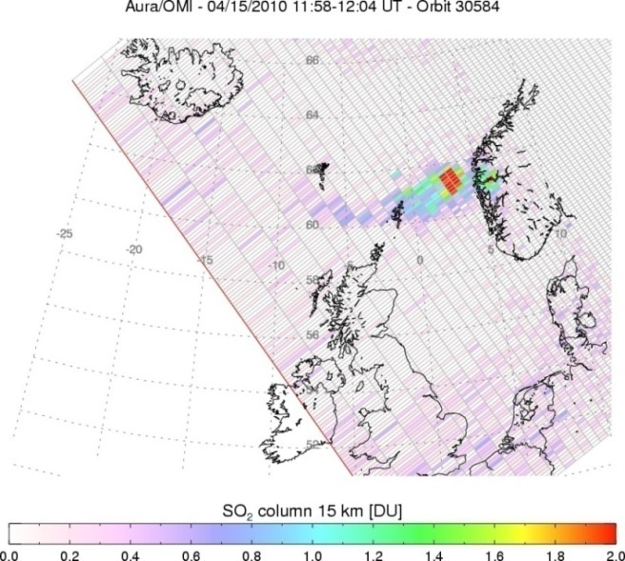
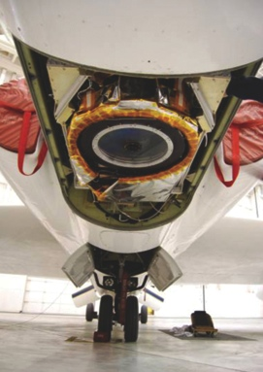
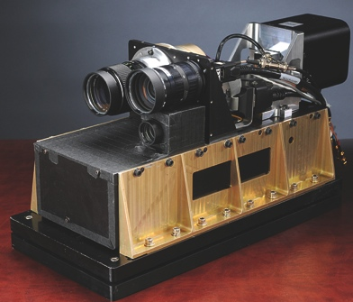



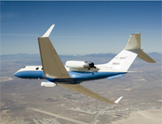
NASA’s Earth Science Division
Research
Flight
Applied Sciences
Technology
Notes:
5

Slide 6
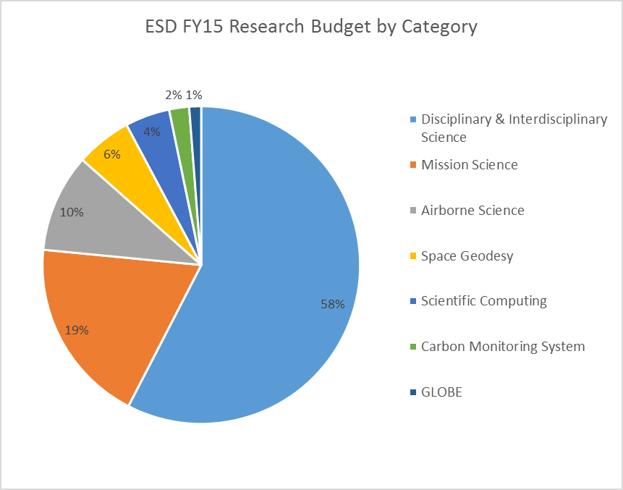
Earth Science Research
Focus Areas
Carbon cycle and Ecosystems
Climate Variability and Change
Atmospheric Composition
Global Water and Energy Cycle
Earth Surface and Interior
Weather

Slide 7
Mission | Location(s) | Date(s) | Platform(s) | Summary of Mission
Aviris NG India | Hyderabad India | Dec 15 – Spring 16 | B200 (ISRO aircraft) | Imaging spectroscopy science and application investigation over Indian territory
AfriSAR/G-TEC | Gabon Africa | Feb – Mar 16 | B200, C20A | NASA/ESA collaboration on algorithm development and future mission cal/val activities for above-ground biomass and ecosystem structure and dynamics usint radar and lidar.
Korus-AQ | Korea | Spring 16 | DC8, B200 | Study sources of pollution in atmosphere over Korea and Western Pacific region using a mix of in situ and remote sensing capability while enhancing understanding of future geostationary atmospheric composition observations
Atmospheric Carbon and Transport – America | Eastern and Midwestern US | Summer 16, Spring 17, Fall 17, Summer 18 | B200, C-130 | Quantify the sources of regional carbon dioxide, methane and other gases, and document how weather systems transport these gases in the atmosphere; improve identification and predictions of carbon dioxide and methane sources and sinks over the eastern US
North Atlantic Aerosols and Marine Ecosystems Study (NAAMES) | Atlantic Ocean, flown from Canada | Sep 17, Mar/Apr 18, | C-130, Ship ((UNOLS) research vessel) | Environmental and ecological controls on plankton communities in the North Atlantic Ocean
Coral Reef Airborne Laboratory (CORAL) | FL, HI, Mariana Is., Palau, Australia | Apr 16 – Jan 17 | Contracted GIV | Provide critical data and new models needed to analyze the status of coral reefs and to predict their future
ObseRvations of Aerosols Above Clouds and Their IntEractionS (ORACLES) | Namibia, Africa | Aug/Sep 16, Jul/Aug 17, Sep/Oct 18 | P-3, ER-2 | Investigate how smoke particles from massive biomass burning in Africa influences cloud cover over the Atlantic.
Oceans Melting Greenland (OMG) | Greenland | Sep/Oct 16 - + multiple till Sept/Oct 2019 | Contracted Twin Otter, GIII, Ship (MV Cape Race) | investigate the role of warmer saltier Atlantic subsurface waters in Greenland glacier melting. The study will help pave the way for improved estimates of future sea level rise.
Atmospheric Tomography Experiment (ATom) | Around the Globe | Aug 16, Jan/Feb 17, Sep/Oct 17, Apr/May 18 | DC-8 | Study the impact of human-produced air pollution on multiple greenhouse gases, addressing transformation of various air pollutants, especially methane and ozone.
O2/N2 Ratio and CO2 Airborne Southern Ocean (ORCAS) | Southern Ocean | Jan/Feb 16 | GV (NSF) | NASA brings remote sensing (PRISM) capability to NSF-led mission to Investigate the large-scale tropospheric distributions, gradients, and fluxes of O2 and CO2 over Southern Ocean.
HyspIRI | Hawaii | Summer 16 | ER-2 | Study the optical characteristics of coral reef and volcanic systems in and around Hawaii using MASTER and AVIRIS to assess value of HysPIRI-like observations
Operation IceBridge | Alaska, Greenland, Antarctica | Mar – May, Oct/Nov – FY16,17,18,19 | P-3, DC-8 | Study ice sheet thickness, sea ice distributions, and related parameters over Arctic and Antarctic to bridge gap between ICESat-1 and ICESat-2, complement lidar observations with those using related techniques (e.g., radar) and obtain coincident data with ESA CryoSat-2
UAVSAR | Various US and South America | Year round | C-20 | Radar data collected for multiple NASA focus areas (Earth Surface and Interior, Carbon Cycle and Ecosystems, Global Water and Energy Cycle, Climate Variability and Change) and for Applications Uses (e.g., levee monitoring)
SPURS II | Eastern Sub-Tropical Pacific Ocean | Starting spring 2016, multiple sailings covering 18 month period | Schooner Lady Amber plus in-water observations (e.g., gliders, drifters, buoys) | Study processes that control sea surface salinity in higher salinity region than that sampled in SPURS I (sub-tropical North Atlantic)
ABoVE | Alaska, NW Canada | Beginning 2016, continuing | Surface measurements; airborne to follow | Study vulnerability and resilience of Arctic ecosystems to environmental change in the Arctic and boreal region of western North America

Slide 8
Applied Sciences
Health & Air Quality Applications
Ecological Forecasting Applications
Water Resources Applications
Wildfires Applications (through FY17)
Disaster Applications
Disaster Response Teams
Capacity Building program
SERVIR (joint with USAID)
ARSET (Applied Remote Sensing Training)
DEVELOP
Early Adopters/Applications Support to Mission Planning
Socioeconomic Impact Analyses
Earth Science & Food Security Activity
Western States Water Availability Activity
Funds competitively selected, expanded SERVIR Applied Sciences Teams
Initiates Snow & Water Availability Focused Activity for Western States
Initiates Food Security Focused Activity
Improves disaster response approach (including Center coordinators and response teams)

Slide 9
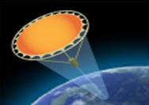
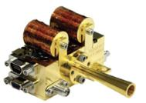
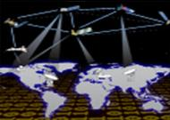
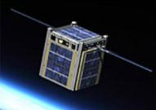
Technology Program Content
The Earth Science Technology Office is a targeted, science-driven, competed, and actively managed technology program. The investment elements include:
Instrument Incubator Program (IIP)
robust new instruments and measurement techniques
17 new projects added in FY14 (total funding approximately $71M over 3 years)
Observation
Advanced Component Technologies (ACT)
development of critical components and subsystems for instruments and platforms
11 new projects added in FY14 (total funding approximately $13M over 3 years)
Advanced Information Systems Technology (AIST)
innovative on-orbit and ground capabilities for communication, processing, and
management of remotely sensed data and the efficient generation of data products
24 new projects added in FY15 (total funding approximately $25M over 2 years)
Information
In-Space Validation of Earth Science Technologies (InVEST)
on-orbit technology validation and risk reduction for small instruments and instrument systems that could not otherwise be fully tested on the ground or airborne systems 4 new projects added in FY15 (total funding ~$20M over 3 years)
Validation
The current portfolio of active investments supports all of the 2007 NRC Decadal Survey mission concepts. 65% directly support Tier 1 and 2 missions, ~ 15% support Tier 3 missions, and the remainder are crosscutting.
Notes:
ESTO funds new competitively selected technologies driven by needs of the science community through four main programs. These programs include Advanced Technology Initiatives (ATI), Observations Technologies consisting of the Instrument Incubator Program (IIP) and Advanced Component Technologies (ACT), Advanced Information Systems Technology (AIST) and In-Space Validation of Earth Science Technologies (InVEST).
IIP funds remote sensing instrument development from concept through breadboard and demonstration while ACT manages projects focused on component and subsystem development to be used as part of advanced instruments and systems.
ATI leverages investments through partnerships with other Earth Science Division programs to further develop science-ready instruments deemed highly useful by the community.
AIST projects cover integral aspects of data acquisition and use including data handling, processing, access, sensor networks, high-performance computing and modeling applications.
ESTO’s newest program, InVEST, provides an avenue for emerging technologies to demonstrate and validate their performance through early space flight opportunities to increase readiness and lower the risk for future Earth observing missions

Slide 10

VIIRS Data from Earth Observatory Used on National Geographic’s Special Issue on Climate
An Earth Observatory VIIRS-based blue marble image appears as the cover of the November 2015 National Geographic, an issue focused on climate change.
http://earthobservatory.nasa.gov/IOTD/view.php?id=84214

Slide 11
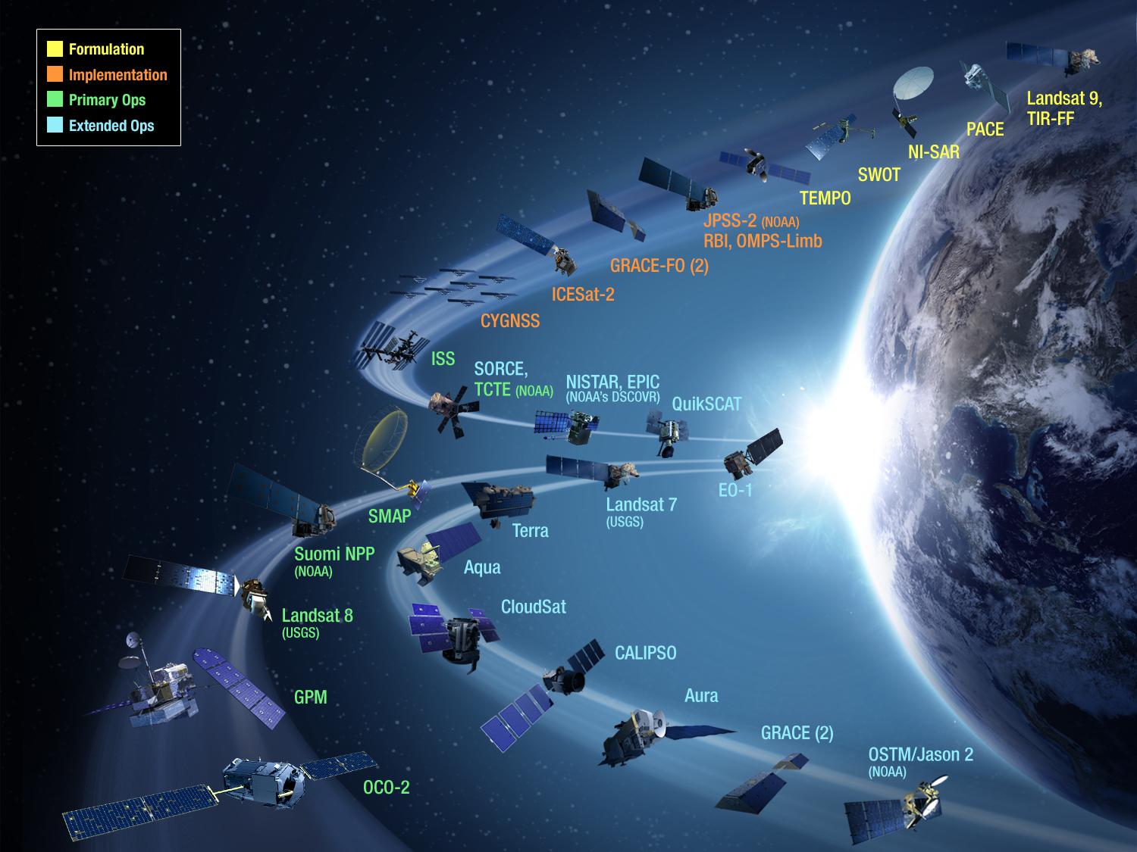

NASA Earth Science Missions and Instruments
= International
Collaboration
Altimetry-FO (Formulation in FY16; Sentinel-6/Jason-CS)
Earth Science Instruments on ISS:
RapidScat, CATS,
LIS, SAGE III (on ISS), TSIS-1, OCO-3, ECOSTRESS, GEDI,
CLARREO-PF

Slide 12
RECENT CHANGES TO ON-ORBIT CONSTELLATION
TRMM (Tropical Rainfall Measuring Mission) Re-enters (Tropical Precipitation)
  Launched 27 November 1997
  Joint with Japanese Space Agency (now JAXA)
  “Passivated” 15 April 2015
  Re-entered 16 June 2015 UTC (Indian Ocean)
Aquarius/SAC-D Satellite Bus Failure (Sea-surface Salinity)
  Launched 10 June 2011
  Joint with Argentine Space Agency (CONAE)
  Satellite bus failure 7 June 2015 (DC-DC converter, redundant unit failed
Soil Moisture Active/Passive (Soil Moisture and Freeze-Thaw state)
  Launched 31 January 2015
  First systematic Tier-1 Decadal Survey mission to be launched
  Active Radar failed 7 July 2015
  Satellite bus, rotating 6m antenna, and microwave radiometer are functioning well, science mode operations continue; global soil moisture and sea-surface salinity products at radiometer resolution being produced routinely

Slide 13

SMAP Soil Moisture and Salinity Animation
Operational processing
Research product (uncalibrated, ROSES)
SMAP Radiometer-Only and GPM IMERG

Slide 14
2015 Senior Review: Funded Mission Extensions
Mission Completed
Mission Completed
Mission Completed
Mission Completed

Slide 15
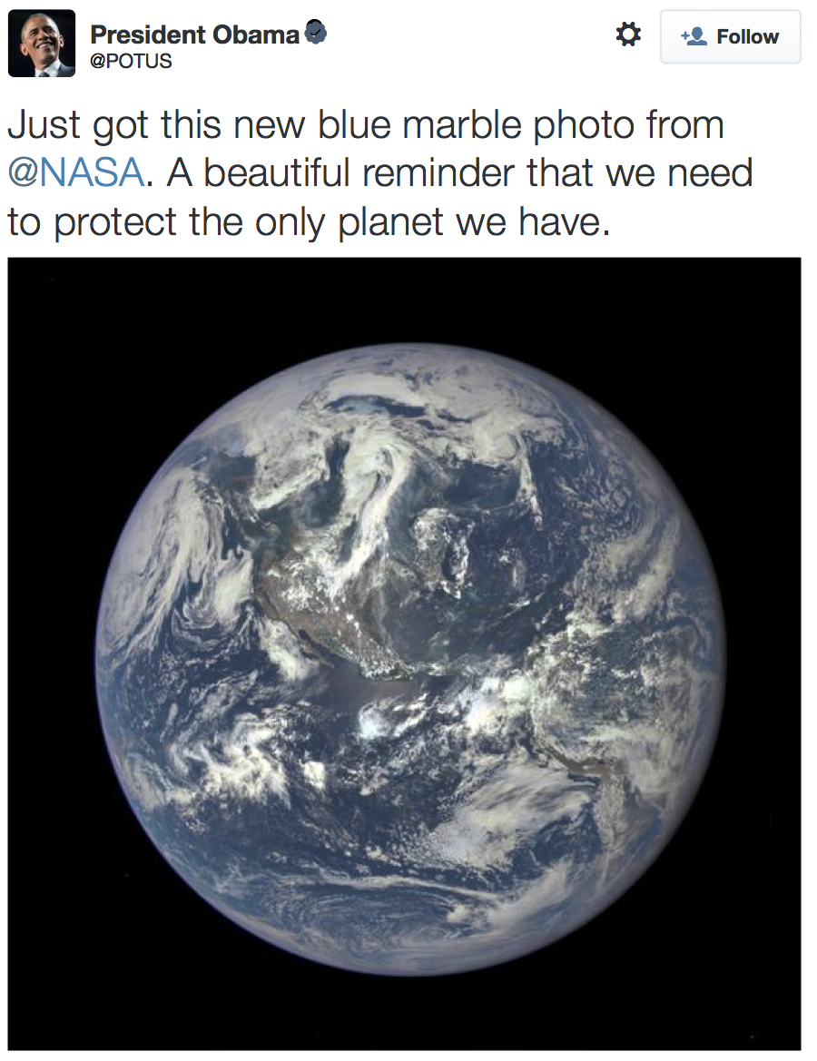
DSCOVR - EPIC
Release of Epic Images
  On July 22, President Obama tweeted the first publically released picture of Earth from the first Lagrange point.
  The image showed the western hemisphere centered in the image with clouds covering the Mississippi Valley and the North East, brilliant blue waters around the Bahamas and the snow pack covering Greenland.
  Lunar transit images tweeted by President Obama on Aug 5 (see next page).
  The images and related news stories were carried on social media and press articles around the world.

Slide 16
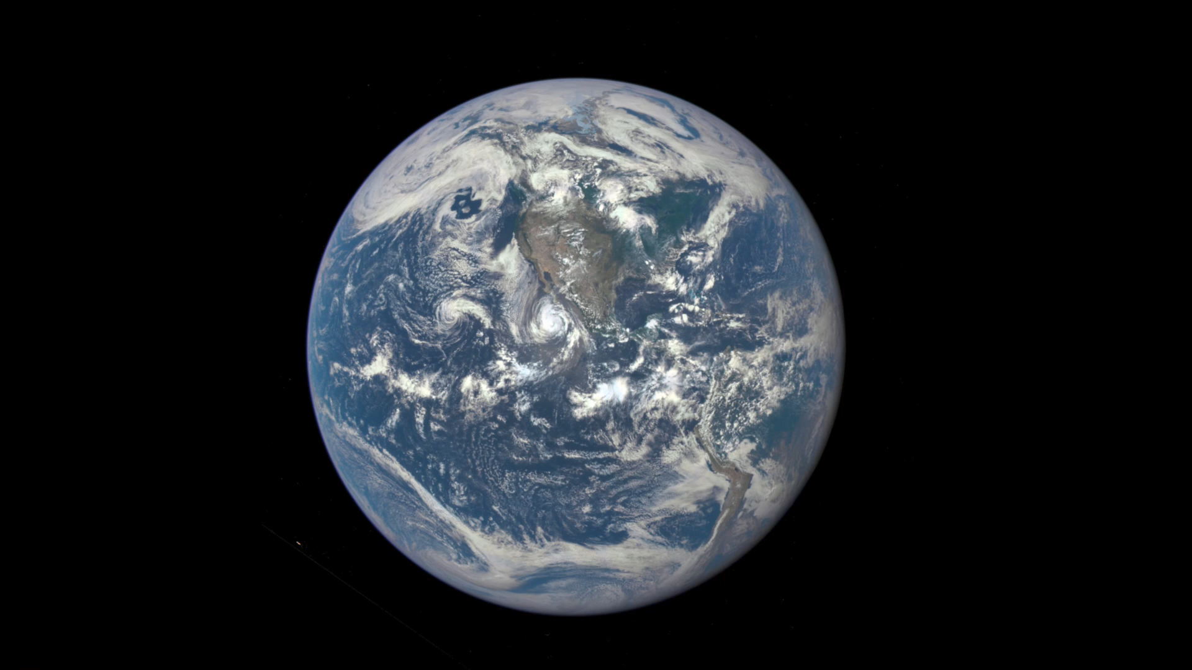
DSCOVR – EPIC (Lunar Transit movie)

Slide 17
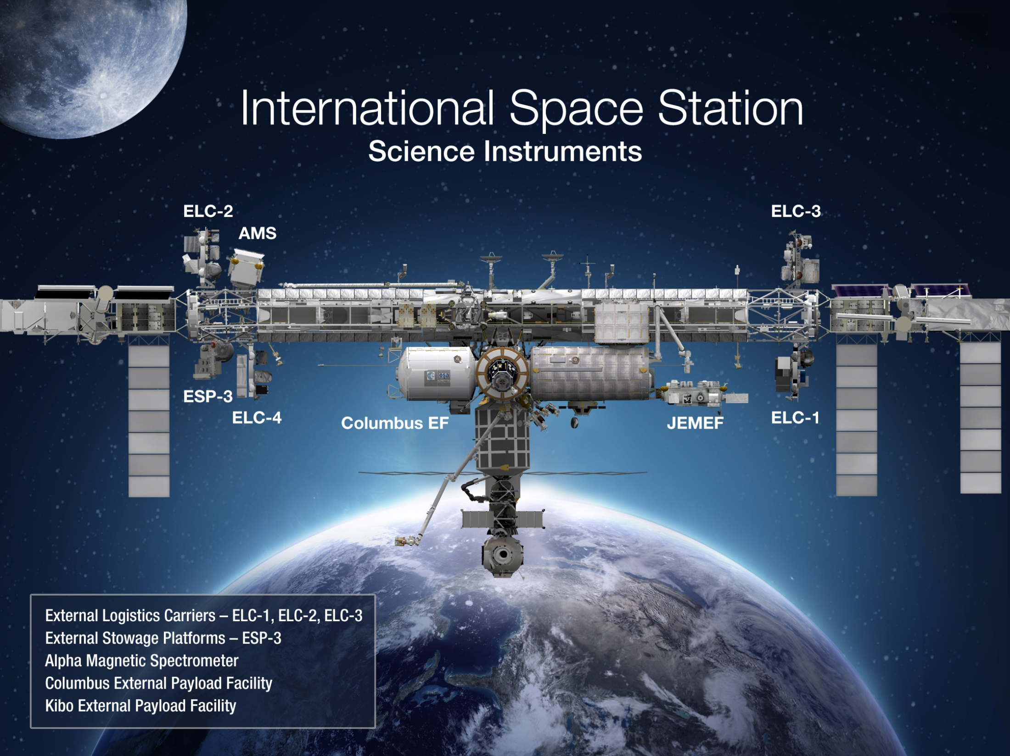
Earth
LIS (2016)
SAGE III (6/2016)
ISERV (2012-2015)
CATS (2015-)
HICO (2009-2014)
GEDI (2019)
ECOSTRESS (2017)
OCO-3 (2018)
RapidSCAT (2014-)
CLARREO Pathfinders (CY2019)

Slide 18
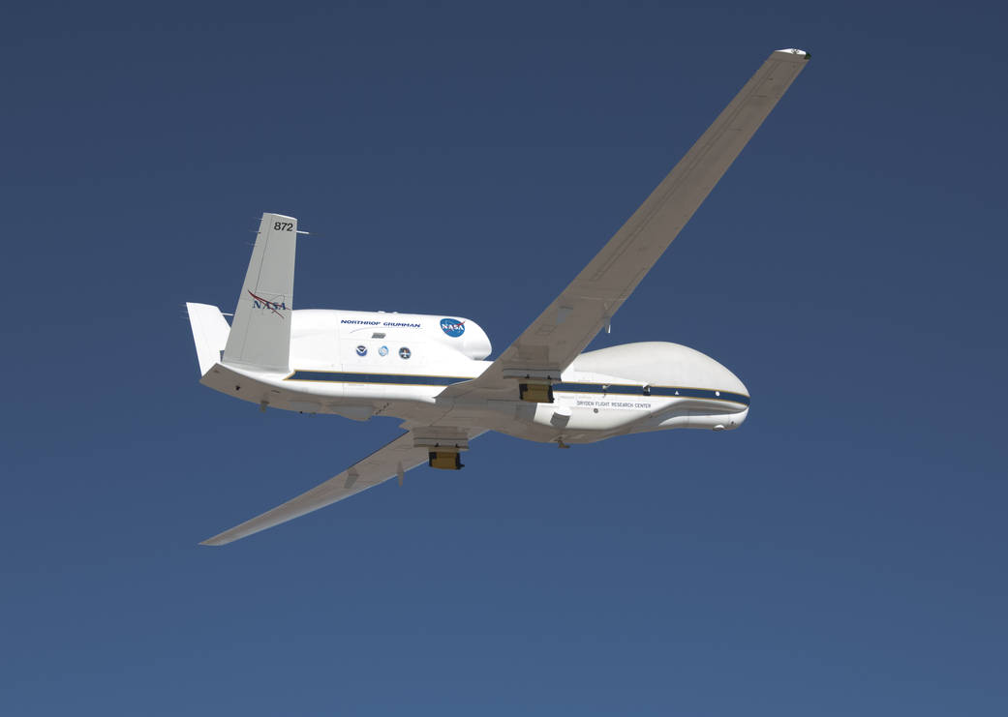
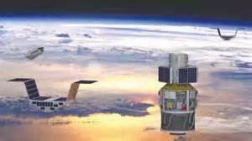
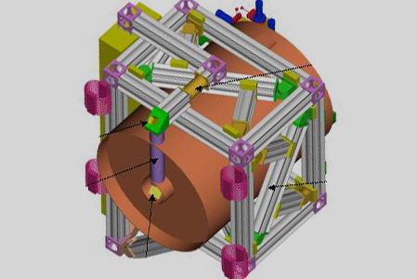
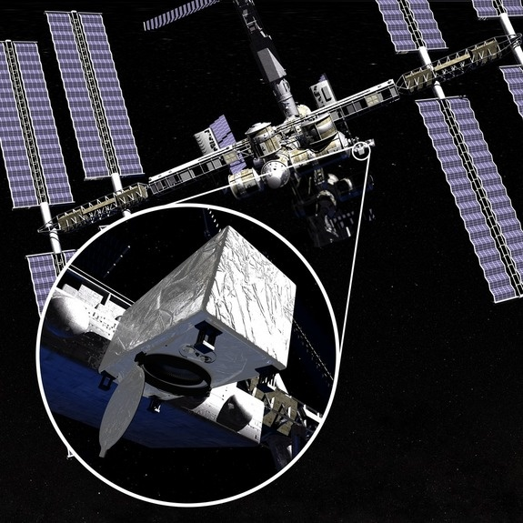
Venture-Class
  Science-driven, PI-led, competitively selected, cost- and schedule-constrained, regularly solicited – Venture-Class was a high-priority Decadal Survey Recommendation
  Complement the systematic missions, provide flexibility to accommodate scientific advances and new implementation approaches
  All ongoing and planned investigations, solicitations, and selections are on track and fully funded
  3 “Strands”
Suborbital Small-sat/Missions Instruments
Notes:
18

Slide 19
Venture Class Selections/Solicitations
Most recent Selection
EVS-1: CARVE, ATTREX, DISCOVER-AQ, AirMOSS, HS-3
EVM-1: CYGNSS (2016 LRD)
EVI-1: TEMPO (2017 Instrument Delivery)
EVI-2: GEDI (2019, 2018 del.); ECOSTRESS (10/2017, 5/2017 del.)
EVS-2: AtoM, NAAMS, OMG, ORACLES, ACT-America, CORAL
Notes:
TJF 3/27/15: removed second page number.

Slide 20
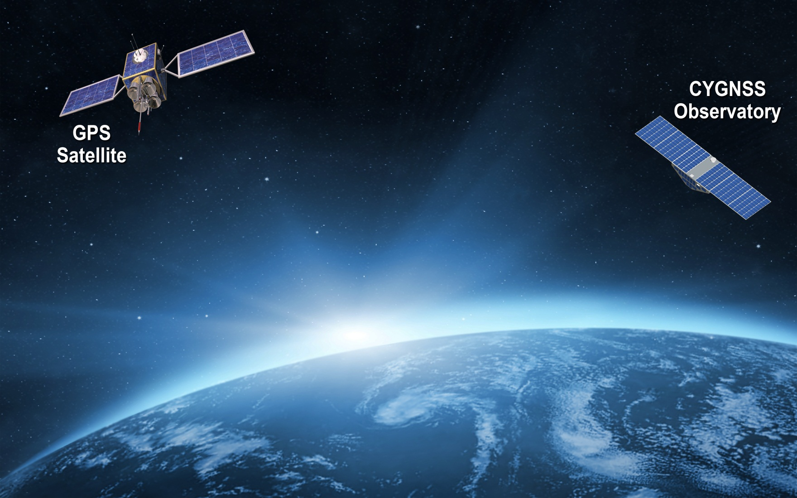




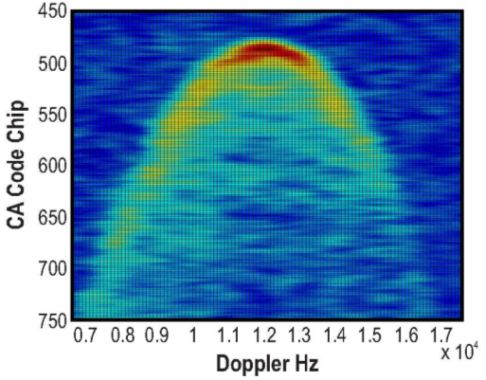
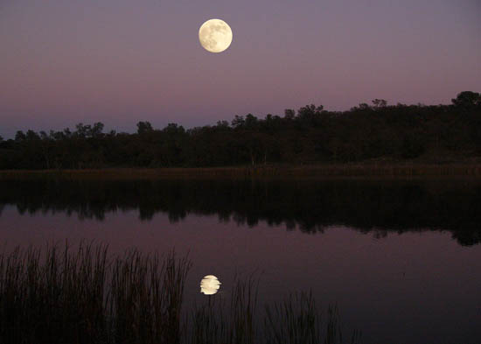

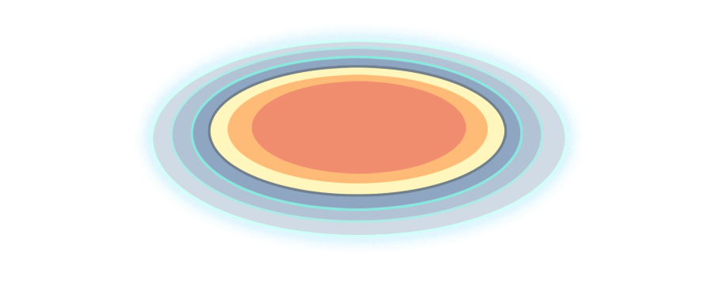
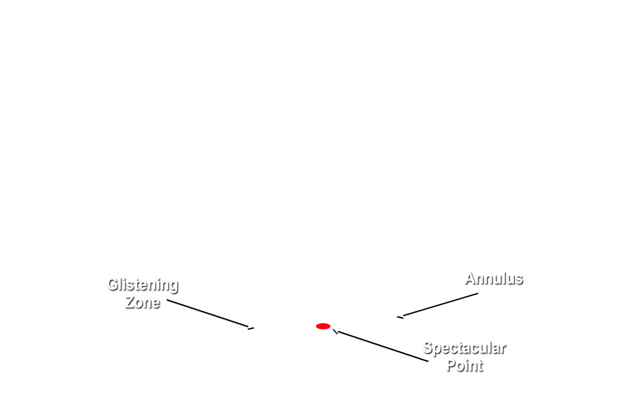

CYGNSS Mission Concept
Notes:
Bi-static scattering geometry with GPS direct signal proving reference and quasi-specular forward scattered signal containing ocean surface roughness information
Animation illustrates – propagation and scattering geometries – GNSS bi-static scatterometry
quasi-specular forward scattered signal from the ocean surface -- received by nadir ant array
Ideal reflected signal (perfect ocean surface) -- mirror image of direct
scattered signal contains detailed information about surface roughness statistics
Glistening zone broadens from perfect surface to broad area given increase in surface wind speed.
Use example of Sun reflection while flying on airplane overwater to conference
direct GPS signal -- coherent reference for the coded GPS transmit signal – received by zenith ant
Inset: Image produced from data by the UK-DMC-1 demonstration spaceborne mission shows scattering cross-section
Two coordinates of the image:
Variable lag correlation (signal delay)
Doppler shift
The DDM enable the spatial distribution of the GPS signal surface scattering cross section to be resolved
Measurement of the ocean surface roughness and near-surface wind speed is possible from two properties of the DDM
The scattering cross-section can be related to surface roughness which corresponds to near surface wind speed
Wind speed can also be estimated from the shape of the scattering arc (the red and yellow regions)
The arc represents the departure of the actual bi-static scattering from the purely specular case that would correspond to a perfectly flat ocean surface

Slide 21
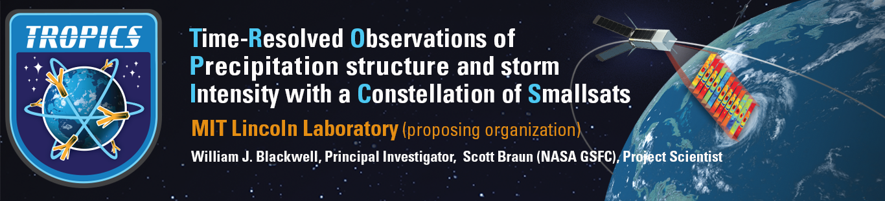
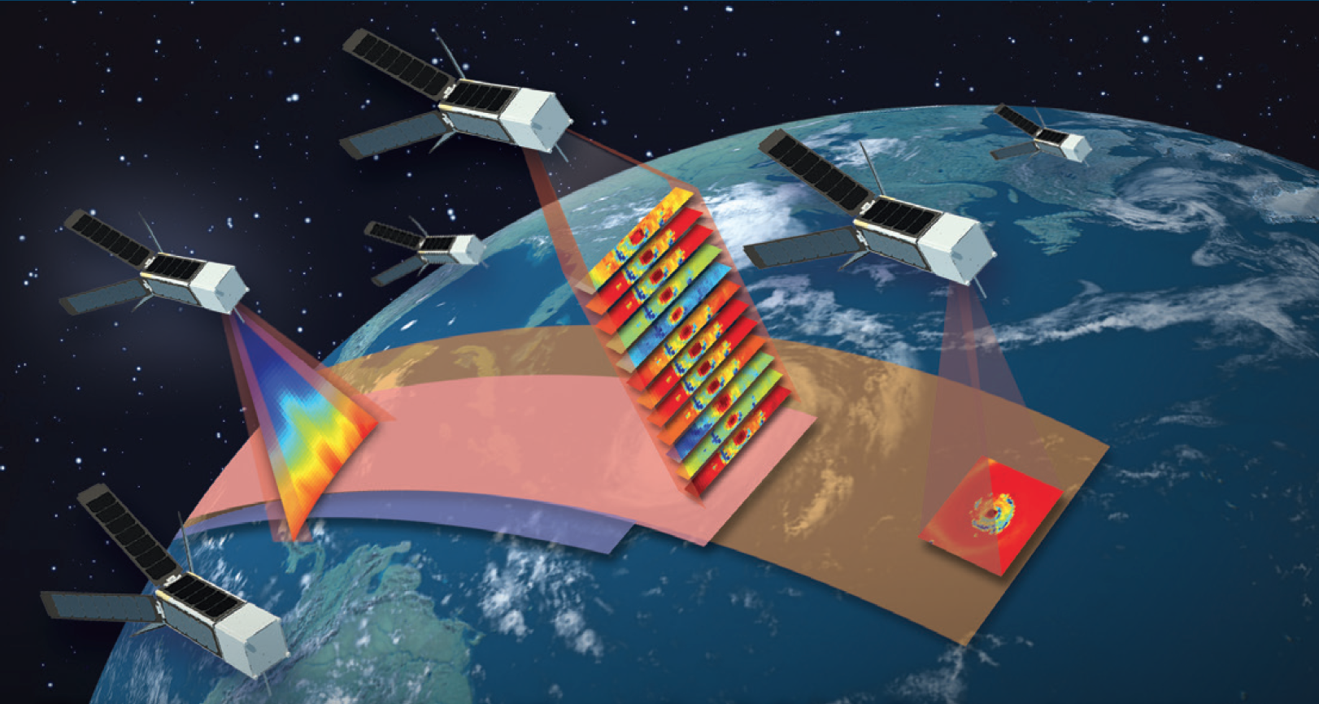
https://tropics.ll.mit.edu

Slide 22

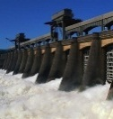

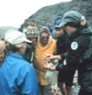

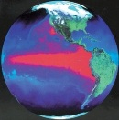
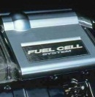

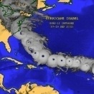
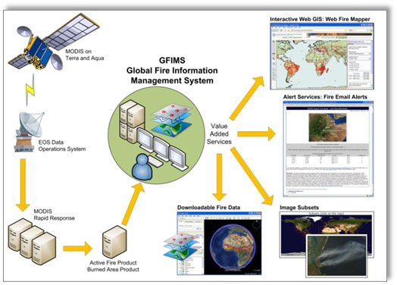
SMD/ESD Applied Sciences Program
Applications Themes
Health
Water
Disasters
Ecosystems
Agriculture
Climate
Energy
Oceans
Weather
United Nation’s system now using data from NASA’s Terra and Aqua satellites to identify fires and send alerts to remote areas via SMS and text messages.
NASA Ground Water Storage
NASA Surface Soil Moisture
USDA/NOAA managed weekly U.S. Drought Monitor now using NASA GRACE data as part of analysis in creation of national and state-level maps..

Slide 23
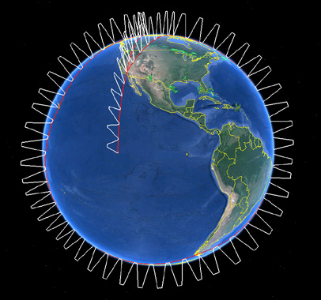
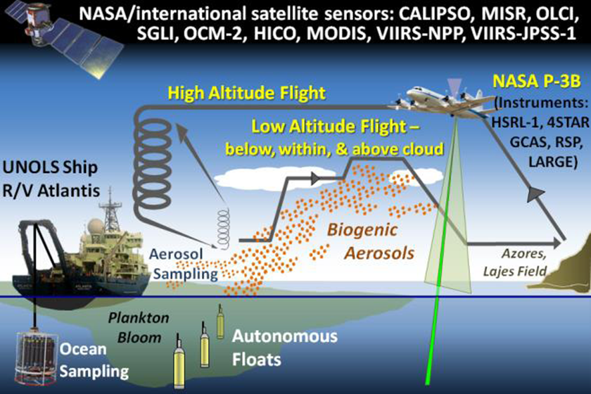
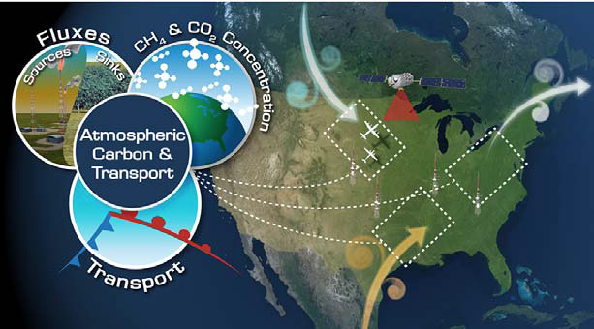
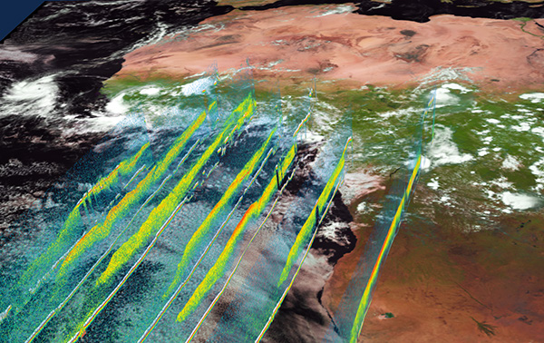
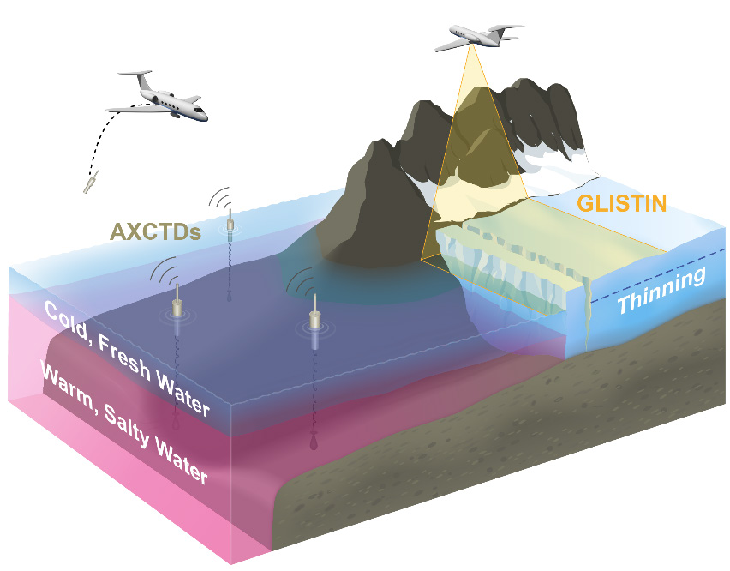
Earth Venture Suborbital-2 (EV-2) Investigations
Atmospheric Tomography Experiment (ATom) – Harvard University (Steve Wofsy)
  This investigation will study the impact of human-produced air pollution on certain greenhouse gases. Airborne instruments will look at how atmospheric chemistry is transformed by various air pollutants and at the impact on methane and ozone which affect climate. Flights aboard NASA’s DC-8 will originate from the Armstrong Flight Research Center in Palmdale, California, fly north to the western Arctic, south to the South Pacific, east to the Atlantic, north to Greenland, and return to California across central North America.
North Atlantic Aerosols and Marine Ecosystems Study (NAAMES) – Oregon State U. (Mike Behrenfeld)
This investigation will improve predictions of how ocean ecosystems would change with ocean warming. The mission will study the annual life cycle of phytoplankton and the impact small airborne particles derived from marine organisms have on climate in the North Atlantic. The large annual phytoplankton bloom in this region may influence the Earth’s energy budget. Research flights by NASA’s C-130 aircraft from Wallops Flight Facility, Virginia, will be coordinated with a University-National Oceanographic Laboratory System (UNOLS) research vessel.
Atmospheric Carbon and Transport – America – Penn State University (Kenneth Davis)
This investigation will quantify the sources of regional carbon dioxide, methane and other gases, and document how weather systems transport these gases in the atmosphere. The research goal is to improve identification and predictions of carbon dioxide and methane sources and sinks using spaceborne, airborne and ground-based data over the eastern United States. Research flights will use NASA’s C-130 from Wallops and the UC-12 from Langley Research Center in Hampton, Virginia.
ObseRvations of Aerosols Above Clouds and Their IntEractionS (ORACLES) – ARC (Jens Redemann)
  ORACLES will probe how smoke particles from massive biomass burning in Africa influences cloud cover over the Atlantic. Particles from this seasonal burning that are lofted into the mid-troposphere and transported westward over the southeast Atlantic interact with permanent stratocumulus “climate radiators,” which are critical to the regional and global climate system. NASA aircraft, including a Wallops P-3 and an Armstrong ER-2, will be used to conduct the investigation flying out of Walvis Bay, Namibia.
Oceans Melting Greenland (OMG) – JPL (Josh Willis)
The objective of OMG is to investigate the role of warmer saltier Atlantic subsurface waters in Greenland glacier melting. The study will help pave the way for improved estimates of future sea level rise by observing changes in glacier melting where ice contacts seawater. Measurements of the ocean bottom as well as seawater properties around Greenland will be taken from ships and the air using several aircraft including a NASA S-3 from Glenn Research Center in Cleveland, Ohio, and Gulfstream III from Armstrong.

Slide 24
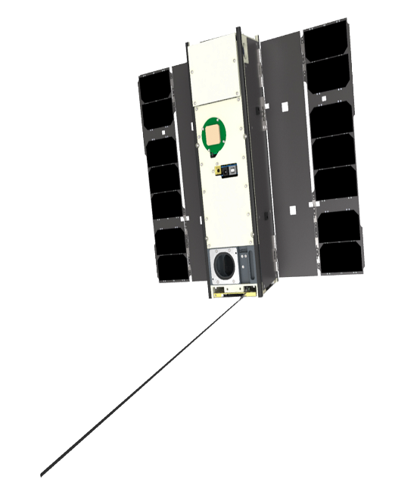
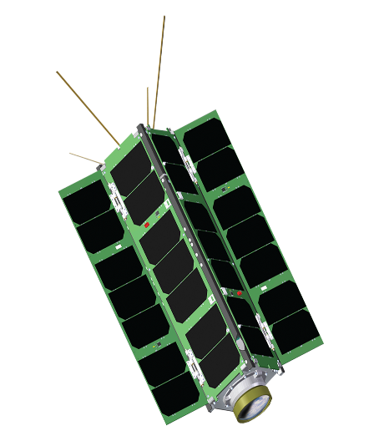



In-Space Validation of Earth Science Technology (InVEST)-2012
U-Class satellites advancing TRLs for Earth science measurements – all 3U
MiRaTA
MIT / MIT-LL
RAVAN
APL/JHU
ICECube
GSFC
HARP
UMBC
LMPC
The Aerospace Corporation
3 Frequency Radiometer and GPSRO
Validation of new microwave radiometer and GPSRO technology for all-weather sounding
Vertically Aligned Carbon Nanotubes (VACNTs)
Validate VACNTs as radiometer absorbing material and calibration standard for total outgoing radiation
883 GHz submm-Wave radiometer
Validation of submm radiometer for spaceborne cloud ice remote sensing
Wide FOV Rainbow Polarimeter
Validation of 2-4 km wide FOV hyperangular polarimeter for cloud & aerosol characterization
Photon Counting InfraRed Detector
Validation of linear mode single photon detector at 1, 1.5, and 2 microns in space environment
Targeting launch dates (for all) in 2016-17 timeframe primarily utilizing the CubeSat Launch Initiative
Notes:
The Linear Mode Photon Counting (LMPC) CubeSat will provide a new capability, a space qualified photon level detector greater than 1 micron. LMPC could be infused into lidar mapping, trace gas detection and large array passive sensing missions from 0.7 to 4.0 microns and would be useful for any of the ASCENDS concepts currently in preformulation

Slide 25




InVEST 2015 Program
U-Class satellites advancing TRLs for Earth science measurements - all 6U; selected Sept. 17, 2015
CIRAS
JPL
RainCube
JPL
CubeRRT
The Ohio State University
CIRIS
Ball Aerospace
Infrared Atmospheric Sounder
Demonstrate ability to measure spectrum of upwelling infrared radiation in 4-5 micron spectral region
Precipitation Profiling Radar
Validate Ka-band (35.75 GHz) radar payload using new deployable antenna and processing technologies
Radiometer Radio Frequency Interference
Demonstrate wideband RFI mitigation technologies vital for future space-based microwave radiometers
Infrared Radiometer
Validation of an uncooled imaging infrared (7.5-13 um) radiometer for high radiometric performance in LEO
Notes:
The InVEST CubeSats show promise of supporting NASA’s Earth science measurement objectives. The Compact IR Radiometer in Space, or CIRiS, was selected by ESTO to validate an uncooled imaging IR radiometer for high radiometric performance in LEO. CIRiS’s measurements are directly related to the radiometric measurements of Landsat. As such, the measurements collected by flying 5 CIRiS satellites are comparable to the measurements of Landsat 8 and could be used as a calibrator for Landsat 9.
RainCube (Radar in a CubeSat) will be the first orbiting active radar instrument on a CubeSat platform. It was funded to validate a precipitation Ka-Band radar payload using new deployable antenna and processing technologies.
Another newly selected InVEST award, CIRAS (CubeSat IR Atmospheric Sounder) – funded to demonstrate the ability to measure upwelling IR radiation – has potential to be used as a gap-filler for the Cross-track Infrared Sounder (CrIS) instrument that produces high-resolution, three-dimensional temperature, pressure, and moisture profiles.

Slide 26
Venture Class Launch Services (VCLS)
Joint ESD/NASA Launch Services Program initiative
RFP released 12 June 2015; Selections announced 14 Oct 2015
Funded with $10M from ESD
  Selected launches will:
    Accommodate 132 pounds (60 kilograms) of CubeSats on 1 or 2 launches
    Launch(es) must occur by April 15, 2018
Selectees:
  Firefly Space Systems, Inc.
  Virgin Galactic LLC
  Rocket Lab USA, Inc.
Tangible and substantial ESD investment in small launch vehicles

Slide 27

Sustainable Land Imaging 2016 - 2035
FY14, FY15 President’s NASA budgets called for design and initiation of an affordable, sustained, Land Imaging Satellite System (with USGS) to extend the Landsat data record for decades – not just the “next mission”
|‌ 27
Notes:
NASA/USGS Sustainable Land Imaging System Steering Committee
Sustainability
The SLI program should provide the data products for the long haul, without extraordinary infusions of funds, within the budget guidance provided.
It should also ensure the technology required for the program is available and appropriate for the long haul
Continuity
The SLI program should continue the long term Landsat data record. This does not necessarily mean the imagery per se, but the usable products that define the utility of the data record.
Understanding how the data are used is essential when considering potential architectures.
Reliability
The SLI program should exhibit a form of functional redundancy. The data sets should be able to draw on equivalent or near equivalent deliverables from different sources to provide the data for the highest priority land imaging data products.
With these “near equivalent” data sources identified in advance, the loss of a single satellite or instrument on orbit should not cripple the program or significantly impact users, and the program will exhibit graceful degradation.
35 RFI responses
Explore the Trade space via several design cycles
Identify candidate architectures by assessing the ability of available approaches to satisfy desired performance
Look for “sweet spots” in the trade space in the attempt to maximize requirements compliance within program cost
Develop satellite technical parameters, orbit constraints, communications parameters, launch replenishment philosophy, and business models for each candidate architecture

Slide 28
SLI in FY16 President’s Budget Submit
A 3+1 part program to ensure a world class, sustainable, and responsible land imaging program through 2035:
  Class D Thermal Infrared Free Flyer (TIR-FF) to launch ASAP (NLT 2019) and to fly in constellation with a reflective band imager
    Low cost mitigation against an early loss of the Landsat 8 Class C TIRS, while demonstrating feasibility of constellation flying
    House and Senate marks not encouraging
  Landsat 9 (fully Class-B rebuild of Landsat 8) to launch NLT 2023
    Low programmatic risk implementation of a proven system with upgrades to bring the whole system to Class B
  Land Imaging Technology and Systems Innovation
    Hardware, operations, and data management/processing investments to reduce risk in next generation missions
  Landsat 10, Class B full spectrum, to launch ~2030
    Mission architecture to be informed by the technology investments (2015-), leading to definition ~2020

Slide 29




Existing Sub-Saharan Arid and Semi-arid Sub-meter Commercial Imagery
Area Of Interest (AOI) for Sub-Saharan Arid and Semi-arid Africa
~1600 strips (~20TB) at GSFC
9600 Strips (~80TB) to be delivered to GSFC

Slide 30
SLI: NASA Present Status
Landsat-9 Project has been initiated with FY15 funds
  Directed to NASA’s Goddard Space Flight Center (GSFC)
  Project Office established and substantially staffed
  OLI Instrument and L-9 spacecraft procurement actions in work
  TIRS-2 development in progress
  Earliest possible launch date is 2021 – there is sufficient near-term funding
Technology studies underway
  Detector component development
  Overall instrument size reduction using advanced technologies
  Expect focused ROSES SLI Technology call soon
NASA has solicited, selected, and initiated science investigations focused on construction of multi-system fusion data sets (“Multi-Source Land Imaging Science”)
  “…[W]e solicit for efficient use and seamless combination with Landsat, of satellite sensor data from international Landsat-type moderate resolution (~30 m ground resolution), multispectral sources on continental to global scales. A primary focus is on developing algorithms and prototyping products for combined use of data from Landsat and Sentinel-2 toward global land monitoring. However, we also welcome proposals combining Landsat with other sources of moderate resolution data, such as IRS and/or CBERS…”
  7 investigations selected, $1.3M/year total, 3-year studies
Copernicus data access agreements with EU signed (including all Sentinel-2 data)

Slide 31
Questions and Discussion

Slide 32
Long-term Measurement Mandate Missions
  Precision Altimetry following the launch of Jason-3
    FY16-20 budget supports NASA contributions to Sentinel-6/Jason-CS
      LV, radiometer, laser retroreflector; etc. NASA funding for mission ops and data analysis; 2020 launch
      US-EC agreement on exchange of all Copernicus/Sentinel data signed 16 October 2015 – Sentinel-1 (SAR) mirror has begun
    Continued development of SWOT (2020 launch)
  Solar Irradiance
    TSIS-2 and follow-on missions transferred to NASA in FY14
    FY16-20 budget supports completion of TSIS-1 and flight on ISS, LRD August 2017
      Transferred seamlessly to NASA for FY16- (no impact from CR)
  Earth Radiation Balance (RBI instrument)
    RBI being developed by NASA for flight on JPSS-2 (~April 2019 instrument delivery date)
Notes:
TJF 3/27/15: Changed TSIS-2 to FY14 (consistent with discussion with Peg Luce and the Babin QFR [QFR-Babin-Transfer of Missions to NASA-SMD-Cleared-150313-CLEAN] cleared by SMD on 3/13/15

Slide 33
ESD Orbital Flight Portfolio – 2012-2022
(Slide original from 11/2012 ESS Presentation)
✔
  LDCM (2/2013) – “Landsat-8” including thermal IR, w/USGS
  GPM (2/2014) – Global Precipitation mapping, w/JAXA
  OCO-2 (7/2014) – Atmospheric CO2 monitoring, recovery mission (2 July 14 LRD)
  SAGE-III/ISS (8/2014) – O3, Temp, Hum. prof. w/ HEOMD/ESA (Delivered - mid-2016 LRD)
  SMAP (1/2015) – Soil Moisture and Freeze/Thaw cycling, w/CSA (minor) (31 Jan 15 LRD)
  ICESat-2 (late-2016) – Precision Ice Topography, Ecosys. mon. (Phase C 10/17–6/18 LRD)
  CYGNSS [EV-Mission/1] (late 2016) (In Phase D, Oct 2016 LRD)
  GRACE-FO (8/2017) – Gravity/Ice Mass/Ground Water, w/GFZ & DLR (In Phase D)
  OCO-3/ISS (Fall 2018) – CO2 continuity, OCO-2 spares (Restored in FY16 budget)
  TEMPO [EV-Instrument/1] (2017) (Phase C, May 2017 delivery, ~2019 LRD on comm sat)
  SWOT (2020) – Wide-swath ocean altimetry, land water, w/CNES (Phase B, B-F IA signed)
  PACE (2020) – Ocean Color, Aerosols (Pre-Phase A - 2022 LRD likely)
  EV-Instrument-2 (NLT 2020) (GEDI/ISS (B; 2019 LRD), ECOSTRESS/ISS (C; 8/2017 LRD))
  L-band SAR (2021) – Solid Earth, Cryo, Ecosys., w/ISRO (In Phase B, FY2021 LRD)
  CLARREO (2022?) – Precise global radiation balance, poss. w/partner (PF in FY16 budget)
  EV-Mission/2 (NLT 2022) (On-schedule in FY16 budget)
  EV-Instrument/3 (NLT 2022) (On-schedule in FY16 budget)
  RapidScat (20 Sep 14), CATS (6 Jan 15) to ISS (HEOMD funding)
  Sustained/Sustainable Land Imaging
  ROAM in JPSS-2 timeframe (2021) (Solar Irrad., Ozone Profiles, Radiation Budget)
✔
✔
✔
✔
✔
Notes:
33

Slide 34


Sentinel-2 – European Multi-Spectral Land Imaging
Sentinel-2A launched successfully 23 June 2015
  13 spectral bands (Landsat-8 bands plus…) – NO THERMAL INFRARED
  10 m resolution, 280 km swath – 10-day, single-satellite repeat
  First imagery and processed products received 27 June 2015
  Sentinel-2B on schedule for mid-2016 launch – 5-day system repeat
  Northwest Sardinia
NASA has solicited and selected research investigations for multi-system data fusion products
So. France, No. Italy

