Slide 1
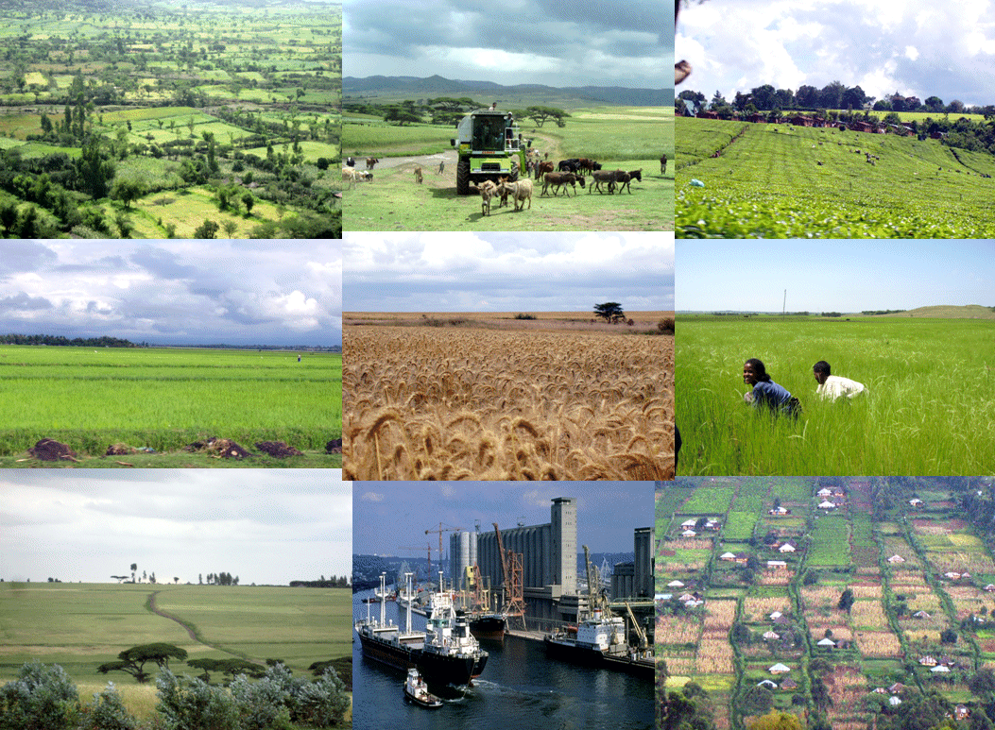
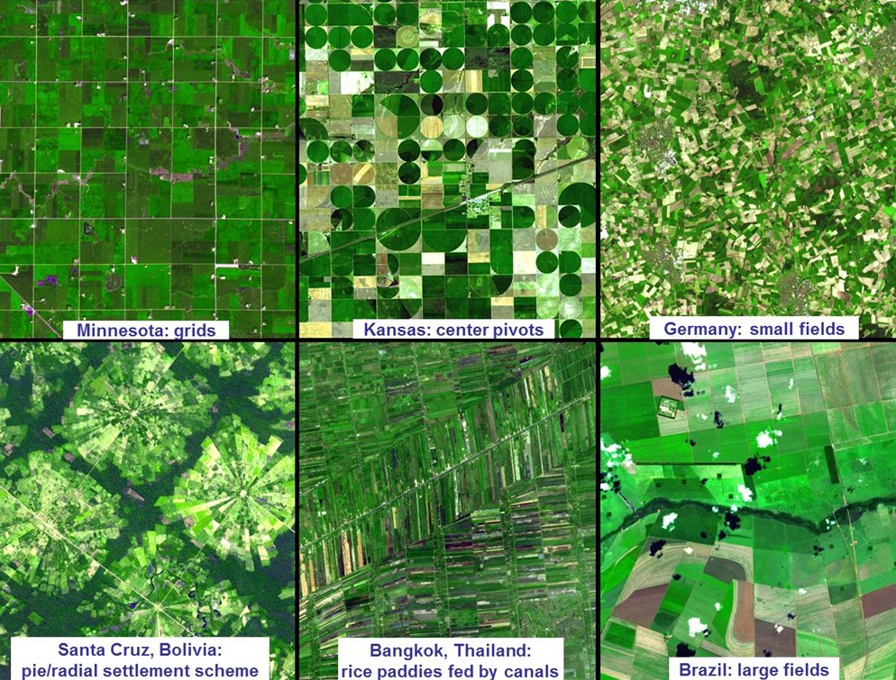

USDA Office of Global Analysis
International Production Assessment Division
Integration of Satellite Remotely Sensed Data
In Operational Crop Assessment Decision Support Systems
*Dath K. Mita, PhD
Senior Global Analyst/Technical Lead
*Pingping Jiang, PhD
Sr. Crop Analyst & Soil Scientist

Slide 2
Introduction: OGA Mission, General Approach

Slide 3
FAS OGA-IPAD Mission Statement
The primary mission of the USDA’s IPAD (International Production Assessment Division) is to target, collect, analyze, and disseminate timely, objective, useful, and cost-effective global crop production information.
The information includes country specific monthly crop conditions, harvested area, yield, and production forecasts of major grains, oilseeds, and cotton, which is delivered to the USDA’s World Agricultural Outlook Board (WAOB)
The World Agricultural Supply and Demand Estimates are published at http://www.usda.gov/oce/commodity/wasde and the USDA’s Supply and Demand Database at http://www.fas.usda.gov/psd/online

Slide 4
USDA Situation and Outlook Organizational Structure
Secretary/Deputy Secretary
Chief Economist
WAOB Chairperson
Chief Meteorologist/
Joint Agricultural Weather Facility
Interagency Agricultural Projections Coordinator
Interagency Commodity Estimates Committees
Chaired by WAOB Senior Analysts
Grains
Livestock
Fibers
Oilseeds
Specialty Crops

Slide 5
USDA’s Economic Information System
The WAOB chairs the Interagency Commodity Estimates Committees ICEC which is composed of the following agencies and their mandates:
FAS:
Foreign Agricultural Service
NASS:
National Agricultural Statistics Service
FSA:
Farm Service Agency
JAWF:
Joint Agricultural Weather Facility
NOAA-USDA
ERS:
Economic Research Service
OGA
Foreign Agricultural
Commodity Developments
Domestic Policy and
market information
Domestic and Foreign
Regional Assessments
Domestic Production
Estimates
Weekly Weather and
Crop Bulletin
World Agricultural Outlook Board
WAOB
Cotton, Oilseeds, Rice, Grains
Long-term
Baseline Projections
FAS Commodity
Circulars
WAP
ERS Situation
and Outlook Reports
NASS
Crop Production Report
World Agricultural Supply
and Demand Estimates
WASDE
Notes:
The organization at the center of the commodity forecasts is the World Agricultural Outlook Board, as they make the final determination and approval of all commodity and crop supply and demand estimates. The central starting place for supply side of the equation is knowing the anticipated production, and from that the other attributes will be influenced.
My division of the International Production Assessment is located within the Foreign Agricultural Service. Though the FAS has several missions the vast majority that focus on promoting the sales of US agricultural products overseas, my division is unique in it’s role of crop forecasting.
The World Agricultural Outlook Board (WAOB), reviews, and approves the Department's commodity and farm sector forecasts. Three goals: Objectivity, Reliability, and Timeliness. USDA agencies are in yellow and output (reports) are in green.
The World Agricultural Outlook Board (WAOB) was created in 1977 to serve as the focal point for economic intelligence on the outlook for U.S. and world agriculture. Prior to 1977, responsibility for USDA's food and fiber outlook information was fragmented among several agencies. While these agencies' missions did not change, the Board was created to coordinate USDA's outlook analysis and assure its accuracy, timeliness and objectivity. The Board also makes sure that this essential information quickly reaches farmers, policymakers and the public. The Board is a unit of the Office of the Chief Economist of USDA.
The red line indicates that NASS US crop numbers are taken directly by the World Agricultural Outlook Board.

Slide 6
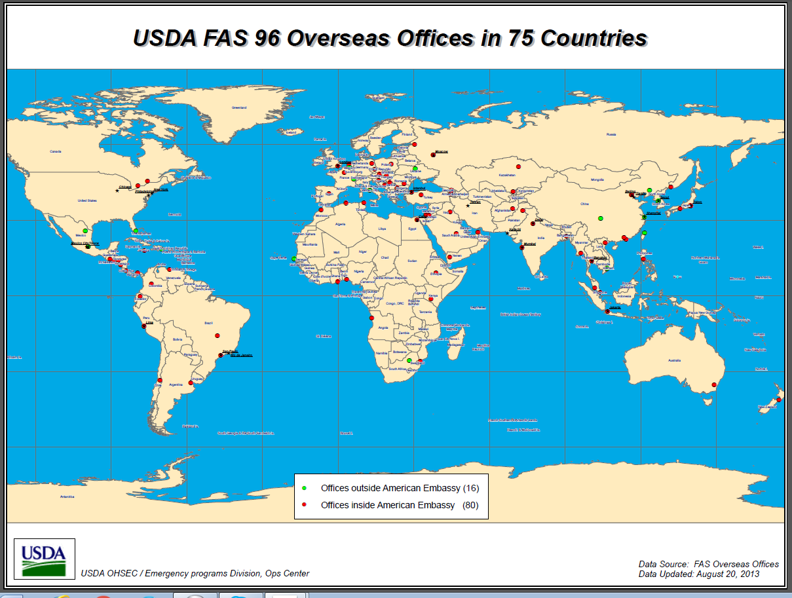

Slide 7
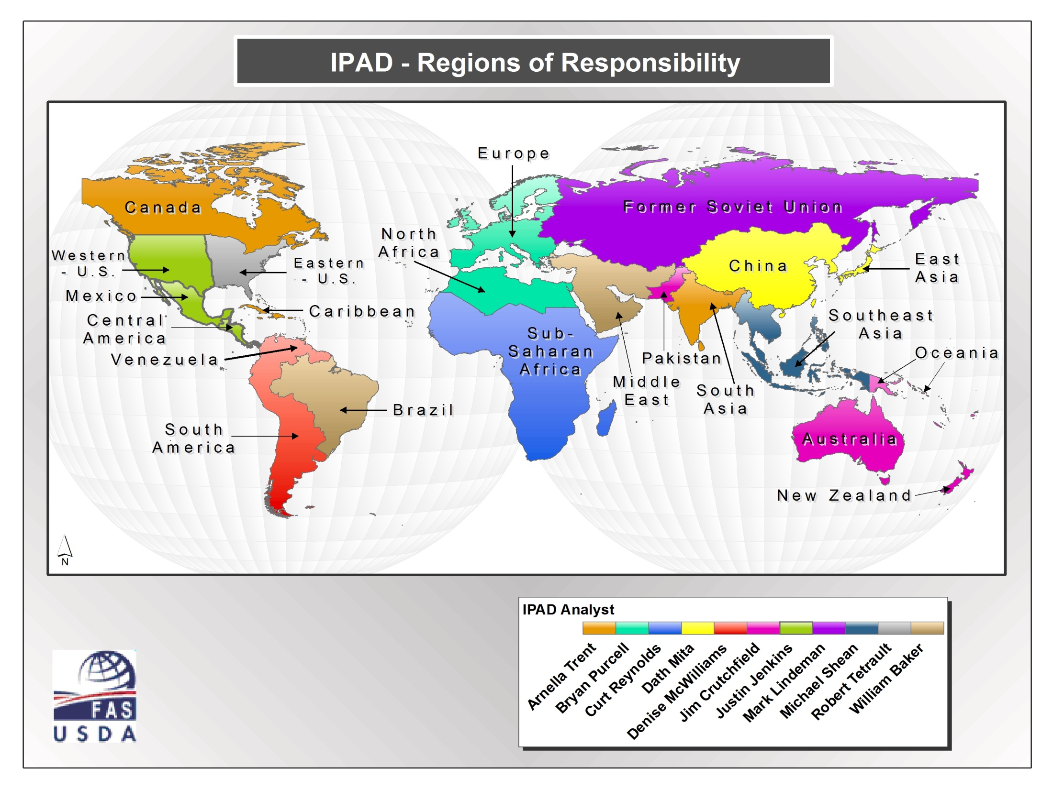

Slide 8

The Concept of Developing Actionable Situation/Outlook Report
Insight
Knowledge
Policy-Decision making
e.g. farmers, traders, politicians
Domain specific…:
meaning + understanding
e.g. agricultural industry
Practical significance
Information
Analysis, Interpretation, etc…:
visual or automated
serves the geospatial community
and agricultural experts
Data:
Soils, Crop, Weather
Acquisition---Analysis---Interpretation---Translation
Statistical significance
Increasing Certainty, Credibility, Legitimacy
e.g. satellite observations,
direct field measurements, farm surveys

Slide 9
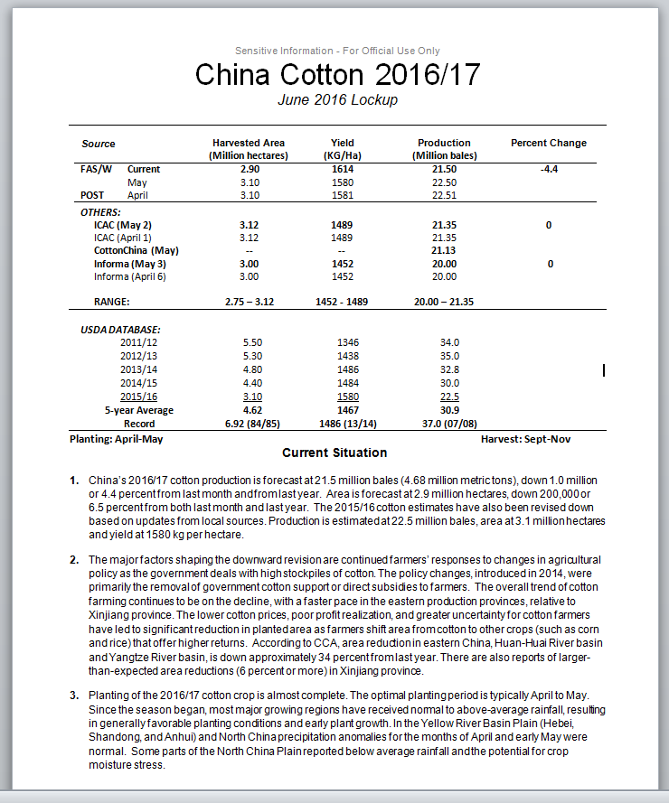
Developing Actionable Situation/Outlook Report
From:
    Data,
    Information,
    Knowledge,
    to
    Insight
Insight: decision making
Information-Knowledge

Slide 10
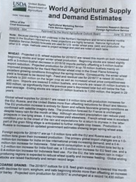
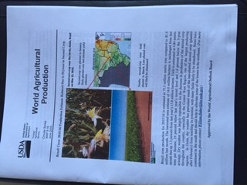
Publicly Available USDA Monthly Publication
http://www.usda.gov/oce/commodity/wasde

Slide 11
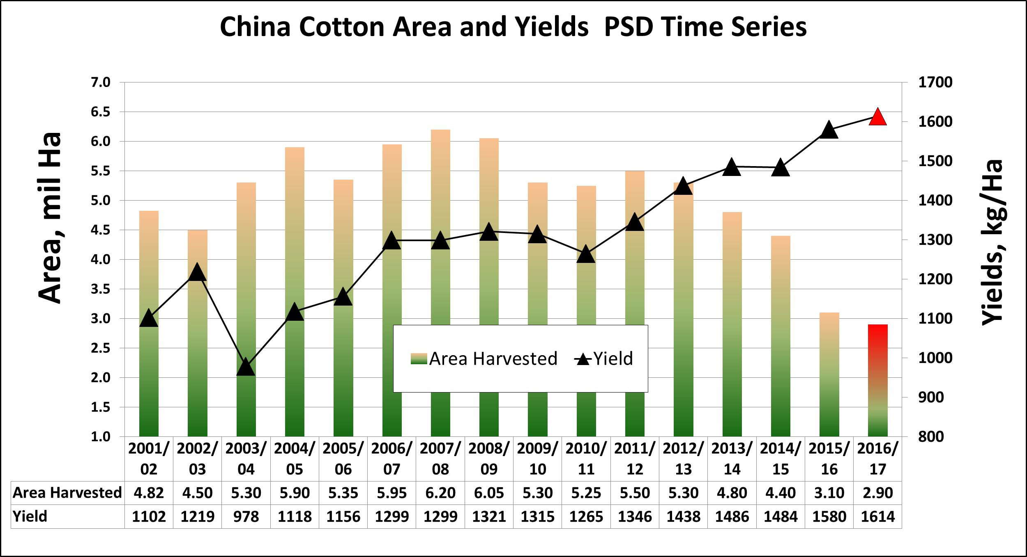
USDA World Agricultural Supply and Demand Database
http://www.fas.usda.gov/psd/online

Slide 12
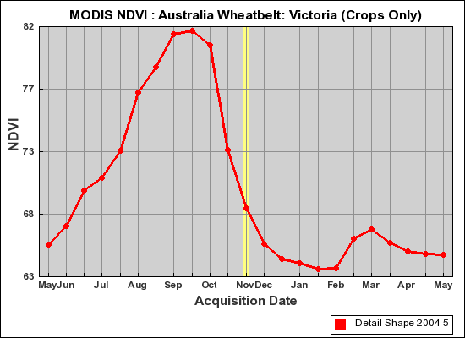
OGA/IPAD’s Major Crop Forecasting Parameters
What we monitored during the crop season……
Crop Growth (as a continuous function)
Crop Yields
Planted/Harvested Cropland
reproductive
senescence
vegetative
harvest
sowing

Slide 13
OGA IPAD CropExplorer and Other DSS

Slide 14
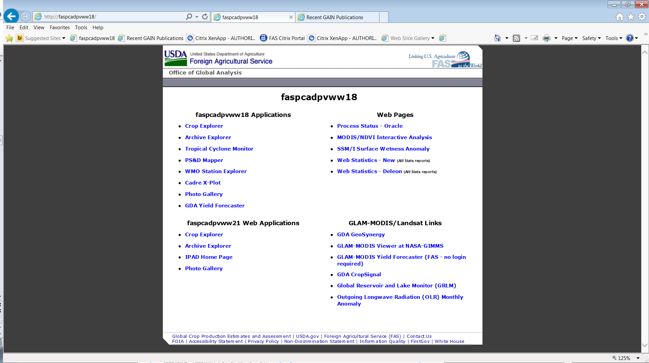
IPAD Decision Support Systems
DSS: Prediction Models and Direct Earth Observations
[SIA]
[GLAM: UMD 16D]
[Satellite Derivatives]
[SIA]
[GLAM: 8D]
[Crop Models]

Slide 15
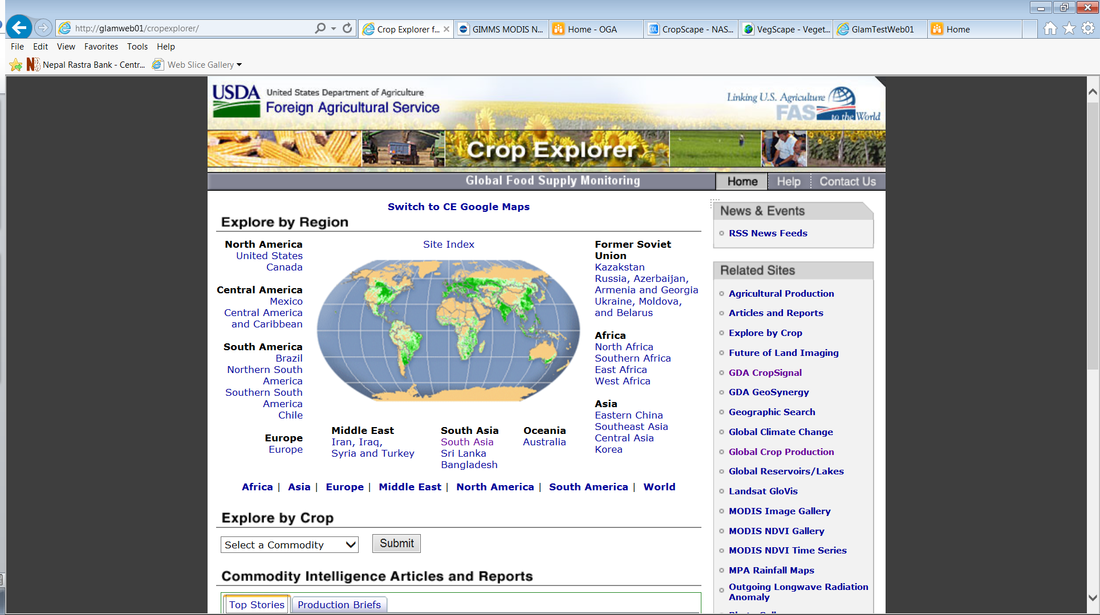
IPAD http://www.pecad.fas.usda.gov/cropexplorer Crop Explorer DSS
GIMMS

Slide 16
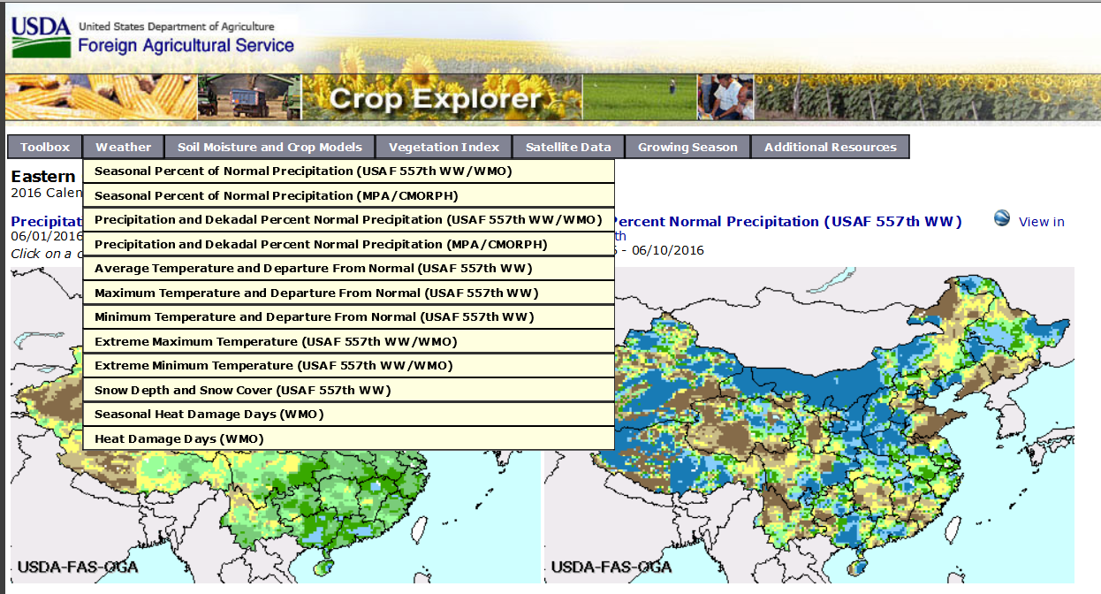
IPAD Crop Explorer DSS

Slide 17
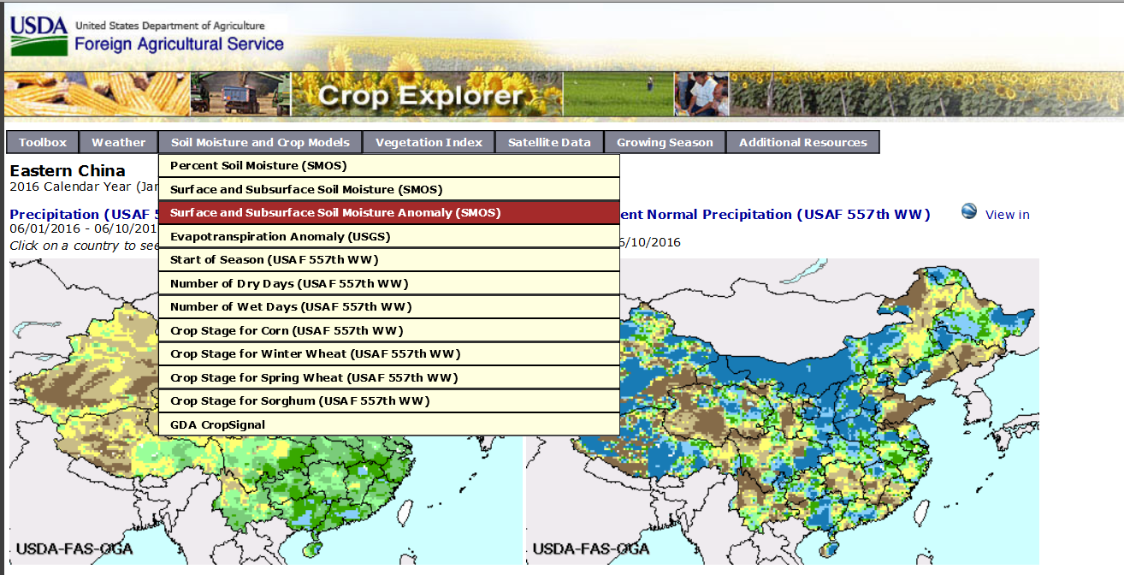
IPAD Crop Explorer DSS

Slide 18
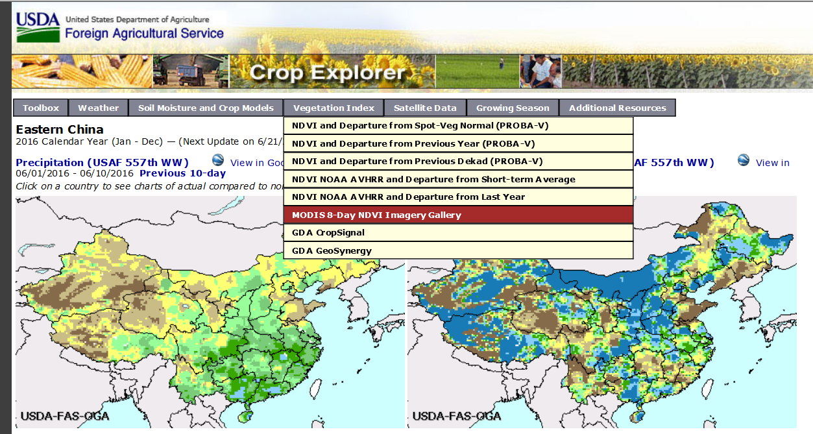
IPAD Crop Explorer DSS

Slide 19
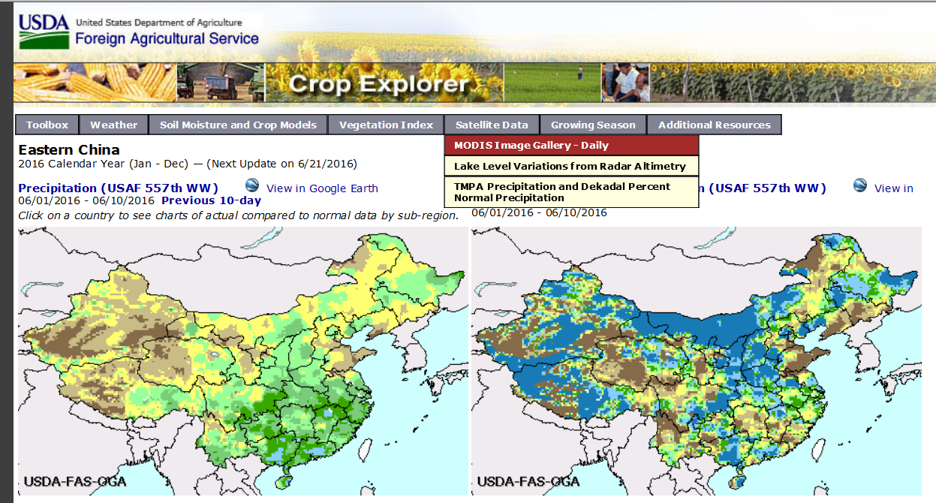
IPAD Crop Explorer DSS

Slide 20
Overview Of IPAD’s Operational Use Of GIMMS MODIS Global Agricultural Monitoring Production System and Other Decision Support Systems
The GIMMS MODIS Global Agricultural Monitoring system is developed and provided by the NASA/GSFC/GIMMS group for the USDA/FAS/IPAD Global Agricultural Monitoring project
Long-term data availability - from 2002 to up to date – consistently organized.
6 Crop mask layers to choose from
  GlobalCover 2009 crops
  MODIS-UMD 2009 crops
  Others
Data are easy to query, visualize, and extract
Multiple spatial scales available
  3-levels Admin boundaries (Country, State/Province, sub-state)
  Crop reporting districts (e.g., US, Australia)
  LIS grid @ 0.25-degree

Slide 21
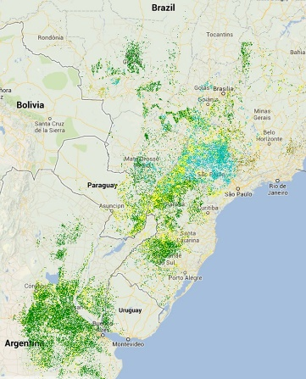
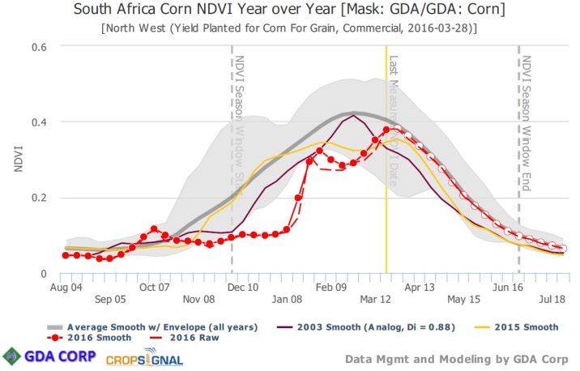
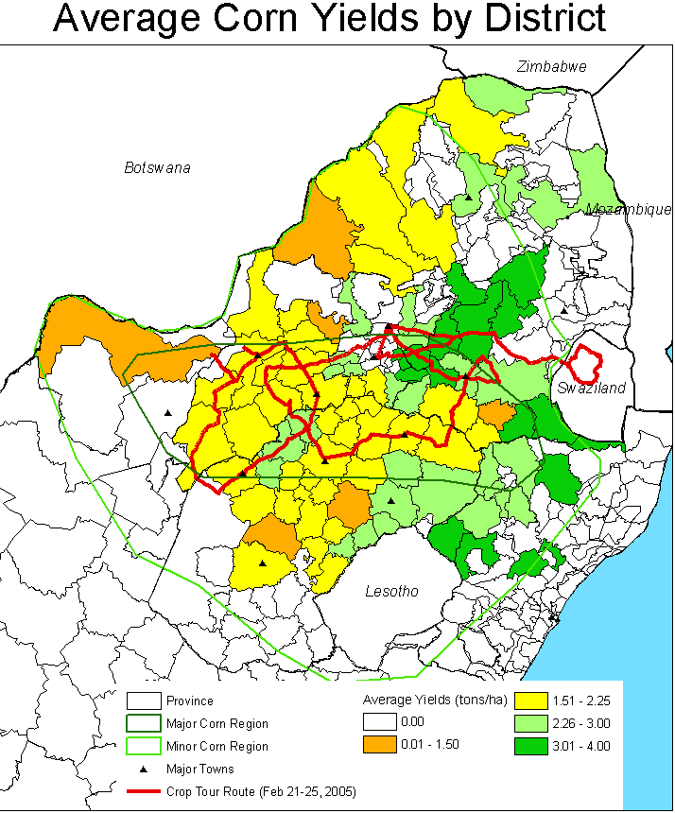
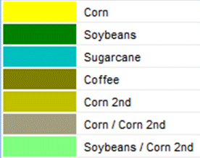
Global Agricultural Monitoring System (GLAM)
(Joint USDA/NASA project to produce quantitative
crop area & yield estimates from remote sensing data)
Production = Area * Yield
Crop Area
Crop Yield
Landsat-7/8 (30-m)
(8-day overpass)
MODIS-NDVI (250-m)
(daily AM/PM overpass)
(Landsat & MODIS imagery
= free & open to public)
Area Estimates & Specific Crop Masks
Yield Estimates & Yield Maps
2013 Crop Mask for Brazil, Argentina & Paraguay
Source: http://www.gdacorp.com/
Source http://glam1.gsfc.nasa.gov/
USDA/FAS/OGA/IPAD

Slide 22
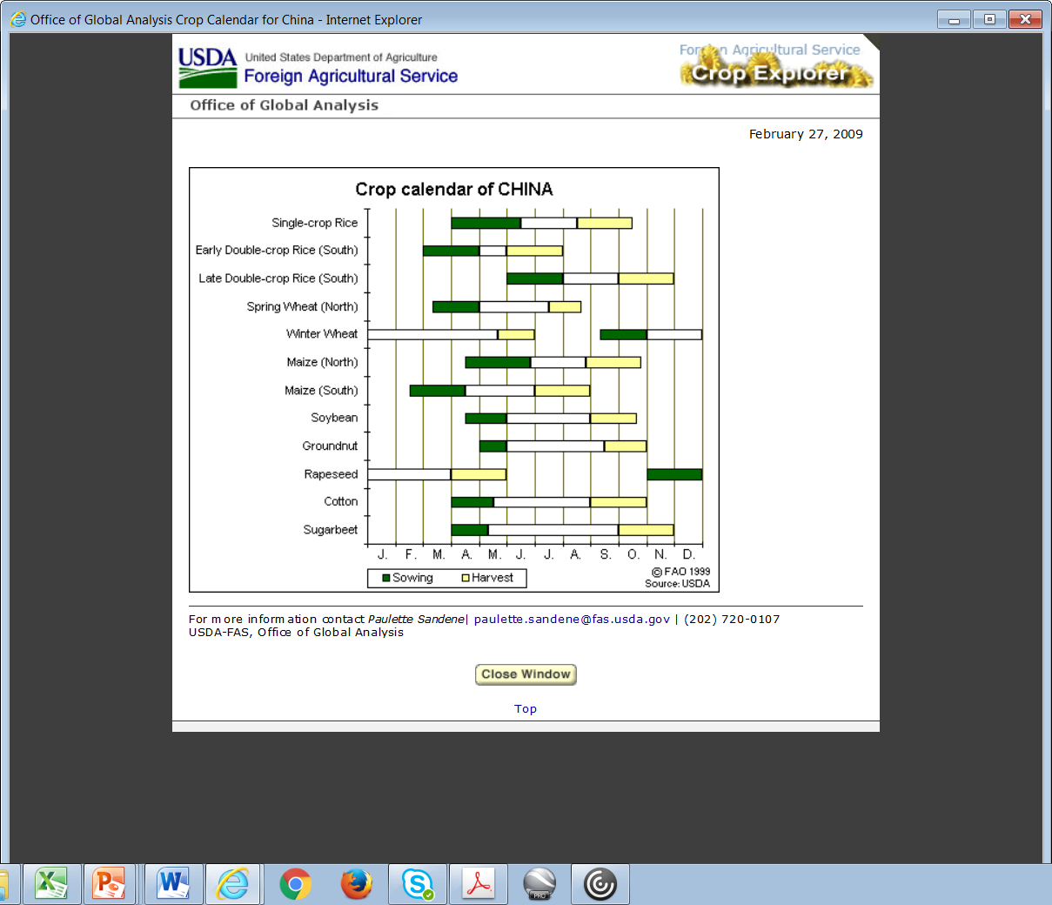
Cropping Calendars Are Used to Determine
Primary Data/Info Sources for Analysis/Evaluation of Crop Conditions
Cotton planting complete
Foreign Agricultural Service
Office of Global Analysis
IPA Division

Slide 23
Establishing Wheat Planting Dates using Satellite-based NDVI observations
Start-Of-Season
Scenario 1: Planted Nov
Northern Punjab
Scenario 2: Planted Dec
Southern Punjab; Central Haryana
Scenario 3: Late Planting, mid Jan
Uttar Pradesh
Distinguishing planting dates (start of the growing season)
is important to relate growth stage, impact of weather
events and productivity

Slide 24
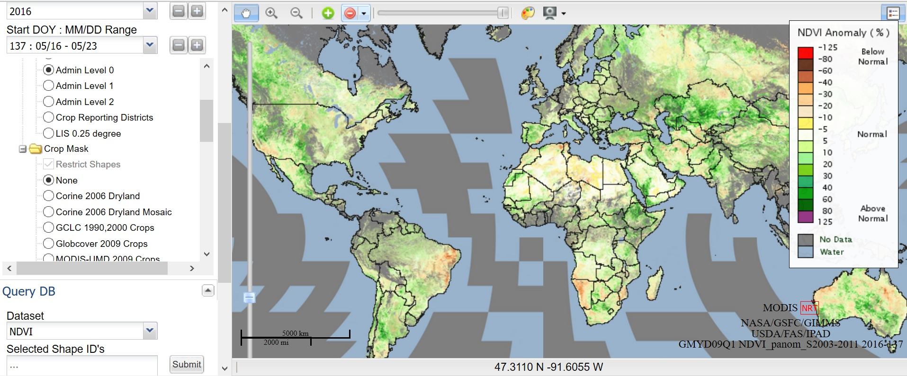
GLAM/MODIS-NDVI (250-meter) Time Series Database for Relative Yield Analysis via 250-m Cropland Data Drilling:
3. Select Admin Unit
1. Select Admin Unit
2. Select Baseline Cropland Data layer
4. Submit Time Series Graph
Source: NASA/USDA GLAM-MODIS/NDVI 250-m Cropland Data Drilling
http://glam1.gsfc.nasa.gov/
Notes:
24

Slide 25
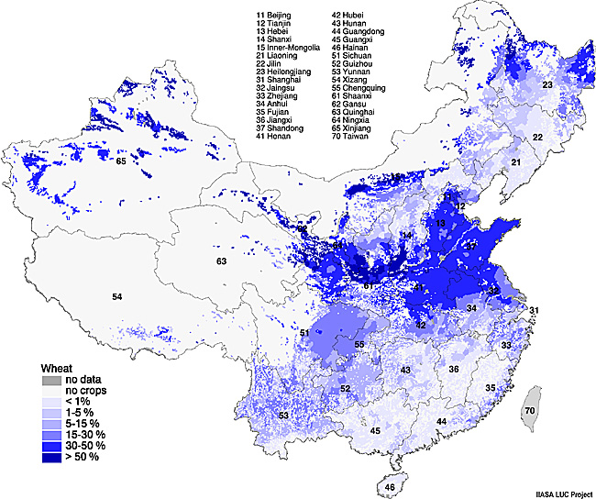
Wheat Cultivation Intensity
International Institute for Applied Systems Analysis (IIASA)
“cross-reference sampling frame”
China Wheat Production (2)
Winter wheat**95%
Growing Season: Sept– June
Sown: Sept – October
Harvest: May – June
Spring wheat**5%
Growing Season: Mar – Aug
Sown: March – April
Harvest: July – August
Wheat cultivation is concentrated in the East China plane (Hebei, Shandong, Henan) and in East-Central provinces of Shaanxi and Gansu
Notes:
Map developed by IIASA LUC-Project.
Primary Data Sources: (1) State Land Administration of the People's Republic of China / United Nations Development Program / State Science and Technology Commission of the People's Republic of China / Food and Agricultural Organization of the United Nations: Land Resources - Use and Productivity Assessment in China. Project CPR/87/029, Beijing, 1994. (2) Institute for Remote Sensing Applications: Land-cover map of China. Beijing, 1994
This map displays the cultivation intensity of wheat in China. It belongs to a set of maps, which should provide a more realistic geographical representation of cultivation patterns, than can be derived from either statistical or remote sensing data. These maps were developed at the LUC Project of the International Institute for Applied Systems Analysis (IIASA) by combining statistical data on crop cultivation at county level (from the "Land Resources" project of the Chinese State Land Administration) with cropping area information from a recent digital land-cover map of the Chinese Institute for Remote Sensing Applications.
Wheat cultivation is concentrated in the East China plane (Hebei, Shandong, Henan) and in East-Central provinces of Shaanxi and Gansu; but also in parts of Shanxi province. There are also - relatively small - areas of intense wheat cultivation in Western China (Xinjiang province).

Slide 26
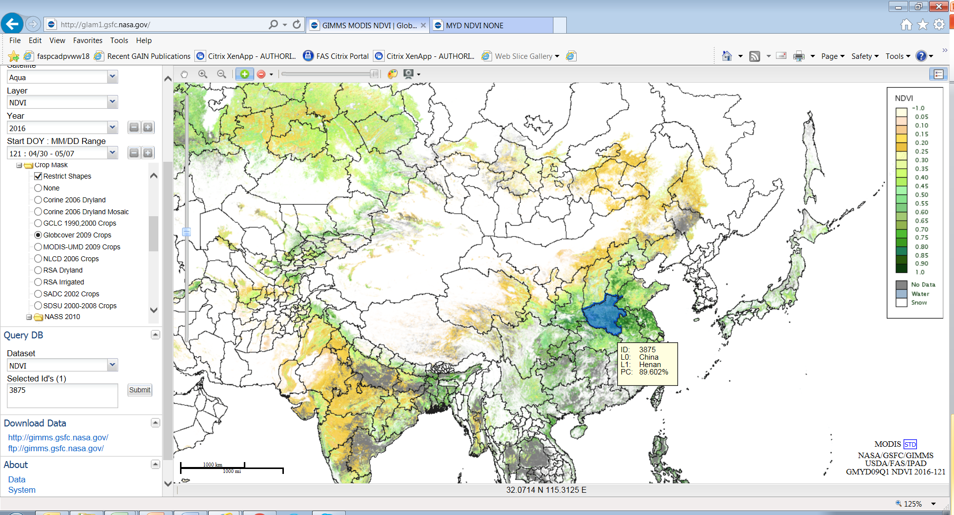
Extracting/Displaying NDVI with Specified Crop Mask
(stratified sampling of high crop intensity areas)
Selected Region (area) of interest: China, Henan Province
1
2
4
3

Slide 27
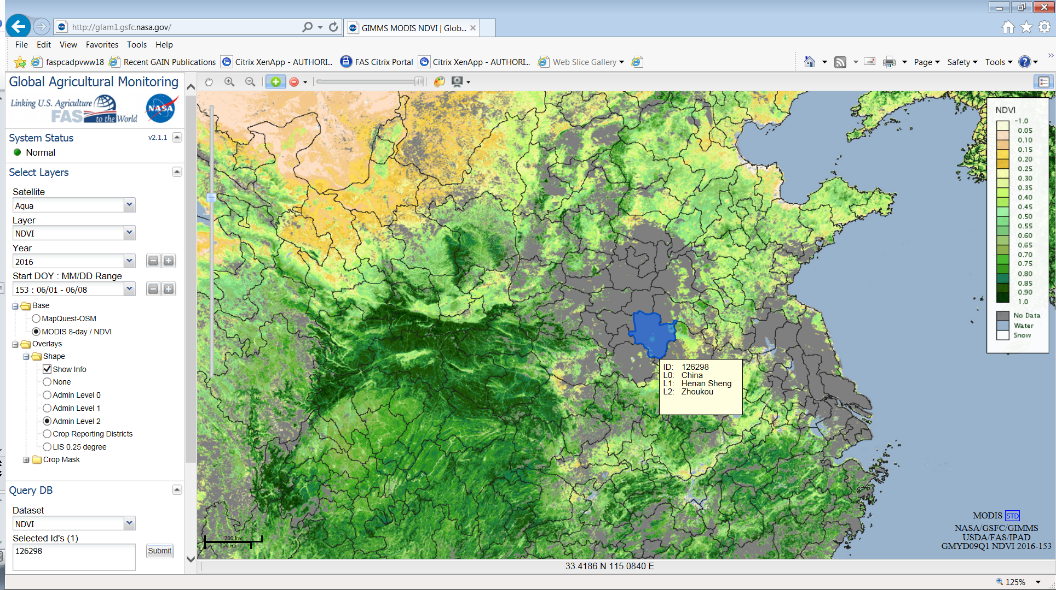
Visual Interpretation and Quantitative Analysis of NDVI + NDVI Anomalies

Slide 28
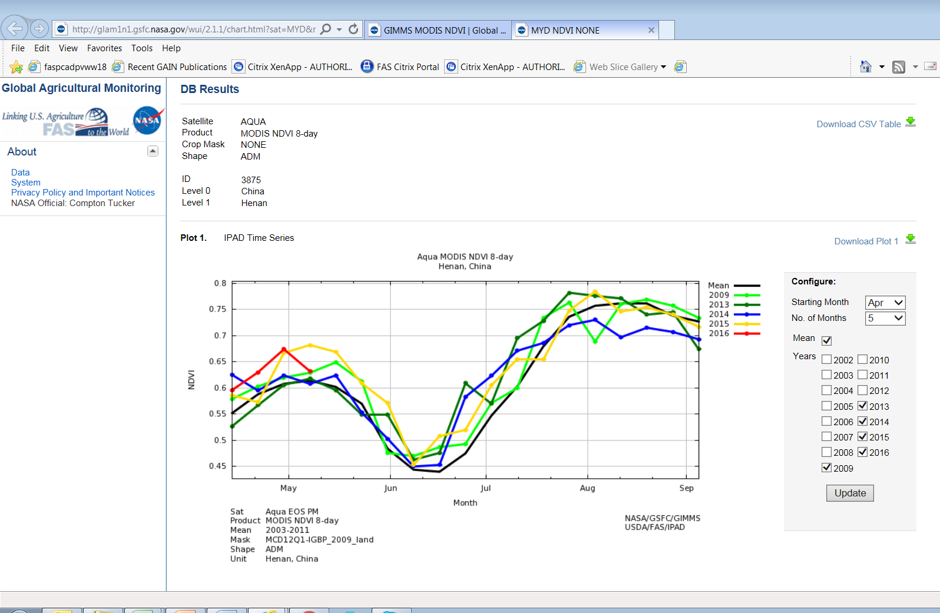
Extracting/Displaying Henan Province NDVI Curve + Downloading Actual Values
NDVI Values
NDVI Curves

Slide 29
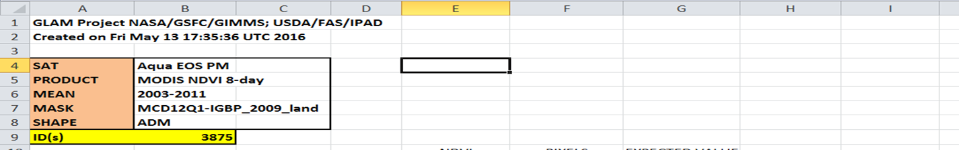
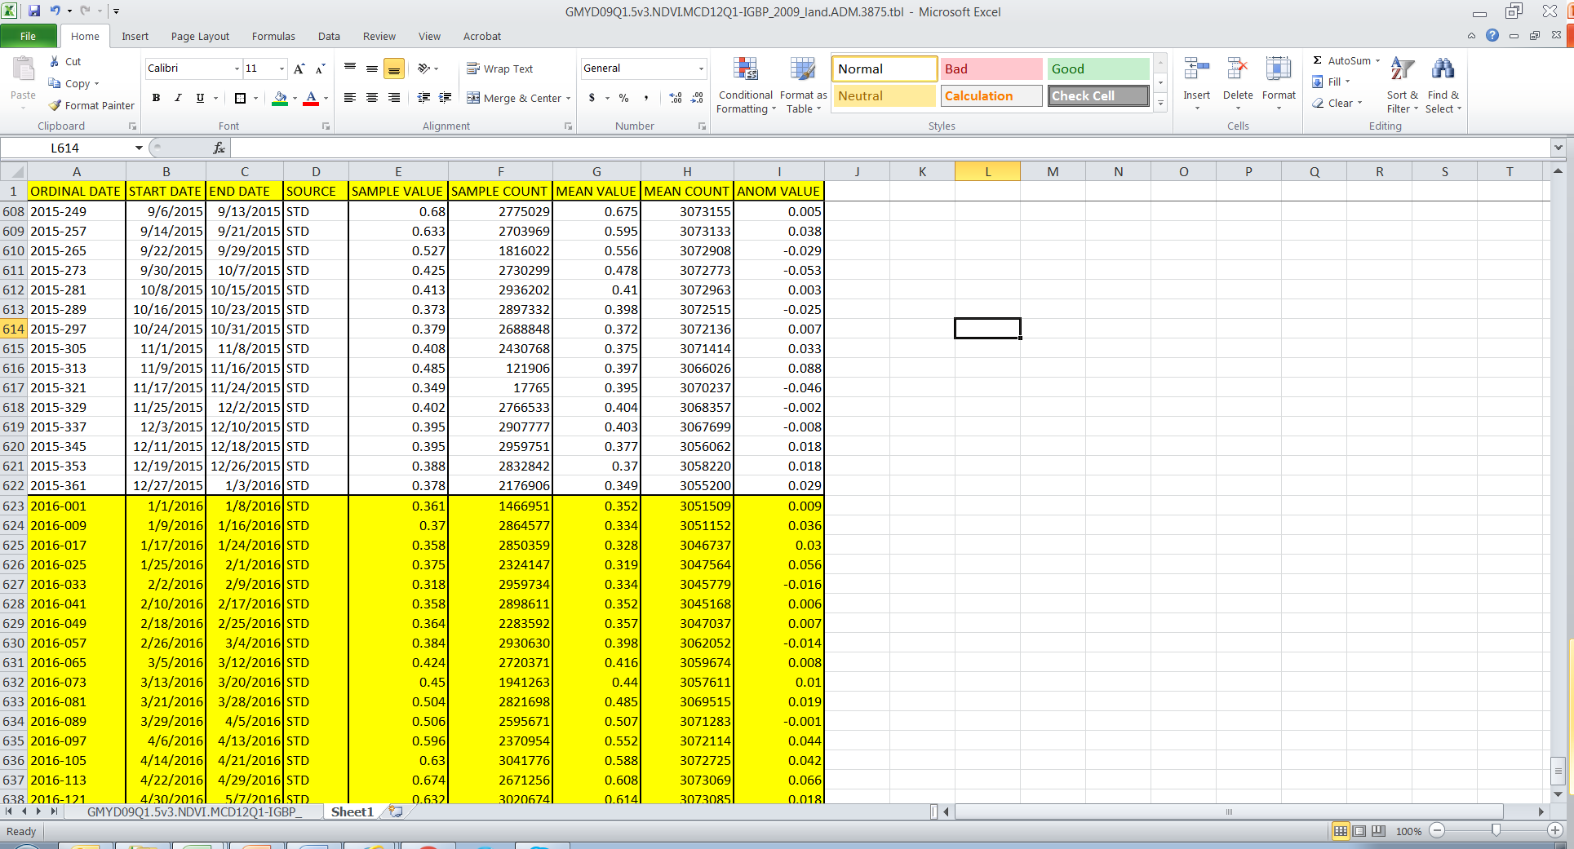
Extracting/Downloading Henan Province NDVI Actual Values
(selecting 2016 seasonal values)

Slide 30
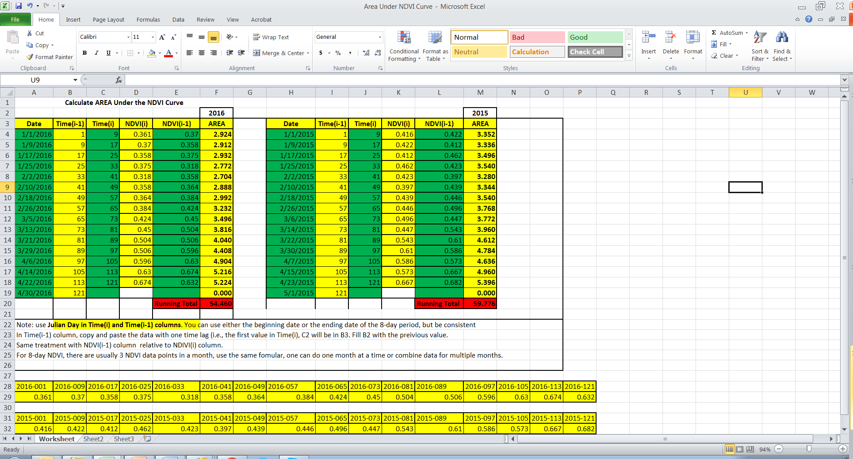
Calculating Henan Province NDVI Area Under The Curve
For Yield Inferences, Extrapolation, or Interpolations

Slide 31
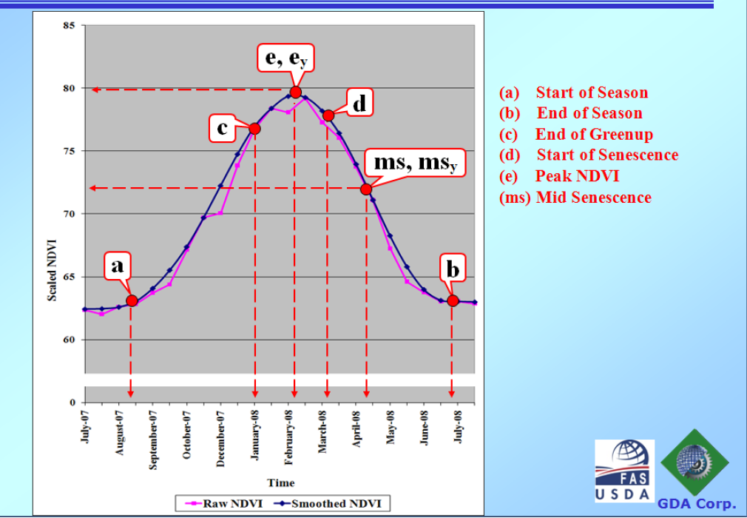
NDVI Curve and “Critical” Crop Stages for Cropped Areas
(temporal “zones” of inter-seasonal similarity/dissimilarity comparison)
Time
Notes:
Parameterize an NDVI curve

Slide 32
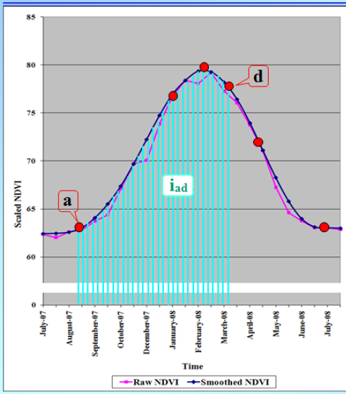
Cumulative NDVI (Area Under NDVI Curve)
High + Low Frequency Info

Slide 33
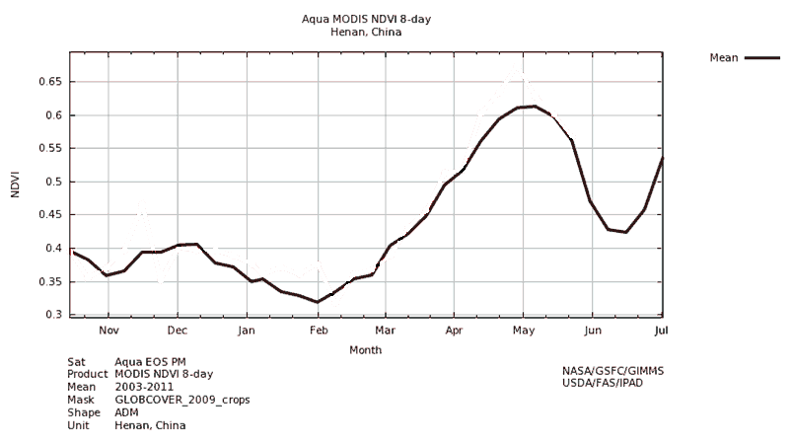
China, Henan Province NDVI time series for winter wheat
Senescing/physiological maturity
Spring Growth and Development/yield formation
Fall growth
Winter hardening/
Vernalization
A3
A4
A1
A2
To understand how each of the life-cycle periods relates to productivity; NDVI quantitatively used as a “guide” in determining in-season productivity trend and the critical time period(s) that determine the production
Calculated area under NDVI curve for the four life cycle periods; A1, A2, A3, A4

Slide 34
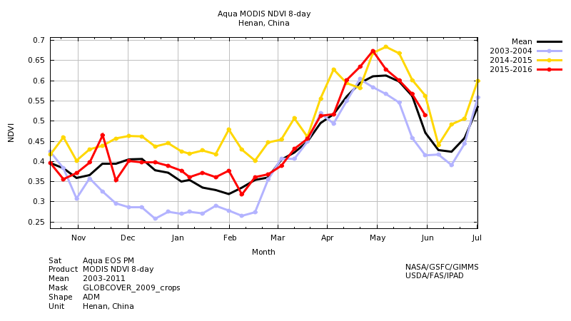
GIMMS 8-day NDVI Composites of China Henan Province Wheat Region

Slide 35
Some aspects of Model Development
GIMMS NDVI data availability dated back to 2002
  Winter Wheat production historical data: National Statistics Bureau of China, available to 2013/14 season.
  12 years of data (2002/03 – 2013/14) were used in the analysis
  Over the study time period, winter wheat planting acreage varied from year to year, but general trend was increasing
  NDVI data used to relate total greenness and total annual production or quantity.

Slide 36
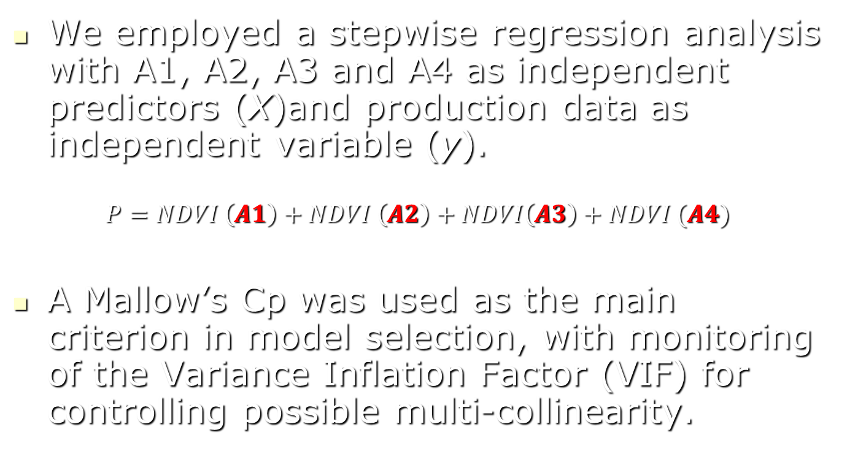
………model development
We employed a stepwise regression analysis with A1, A2, A3 and A4 as independent predictors (X)and production data as independent variable (y).
  $$P=NDVI \left(A1\right)+NDVI \left(A2\right)+NDVI\left(A3\right)+NDVI (A4)$$
A Mallow’s Cp was used as the main criterion in model selection, with monitoring of the Variance Inflation Factor (VIF) for controlling possible multi-collinearity.

Slide 37
Model Results
The final model contains three life cycle periods
(Adj. R-sq=0.8710)
  A2: Winter hardening and vernalization (P-value = 0.1100)
  A3: Spring growth and development, yield formation (P-value = 0.0172)
  A4: Senescing, yield formation and physiological maturity (P-value = 0.0039)
Notes:
(1)P-value: P-value can be thought of as a probability value at which the factor being tested is statistically significant. It also means how powerful the statistical evidence is based on data. The smaller the p-value is, the more significant the factor is or the stronger the statistical evidence.
The common levels of p-values used are, for example, 0.05, 0.10 and etc. That is equivalent to say a factor is significant at 5% level or 10% level, respectively. The choice of level of significance depends on the field of study. For example, in agronomy research we normally use p-value of 0.05, but my personal opinion is that we should easily be using 0.10 in many occasions as field research has a large amount of variability in trial conditions and data collected.
Back to our case study, we included factor A2 with a p-value of 0.1100, is because that in stepwise regression analysis, it is suggested to include factors that have good predictive power, instead of dwelling too much on having a very small p-value. So a higher R-squared value can be reached and model produces better prediction. Factor A2, even though has a not-very-small p-value, but by including it we had the best R-square value, without jeopardizing the model in any way.
(2) Variance Inflation: The Variance Inflation Factor (VIF) and tolerance are both widely used measures of the degree of multi-collinearity of the factors (i.e., independent variables) in a regression model. So, for example, the A1, A2, A3, and A4 in our model are supposed to be independent of each other. However, it is likely that these factors are somehow correlated, as they are data taken on the same subject over time. So it is important to monitor the VIF statistic in the model fitting. From our model result, the largest VIF was 5.74, which suggested by statistical literature is a small value and does not indicate a strong case of multi-collinearity. Some literature also indicates that even at VIF of 10, 20, 40 or even higher do not, by themselves, discount the validity of the fitted model and regression results.

Slide 38
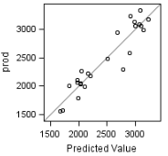
Model Results
Model Predicted Production vs. Observed Production
Predicted production = -1418.3+ 37.046*A2 + 39.24*A3 + 95.4386*A4
Observed winter wheat production (10^4 M Ton)
Predicted winter wheat production (10^4 M Ton)

Slide 39
Overview Of IPAD’s Operational Use Of Landsat Imagery for cropping area determination: exploring various band combinations, image enhancement technics, targeted image classification
In-Season Cropping Area Assessment

Slide 40
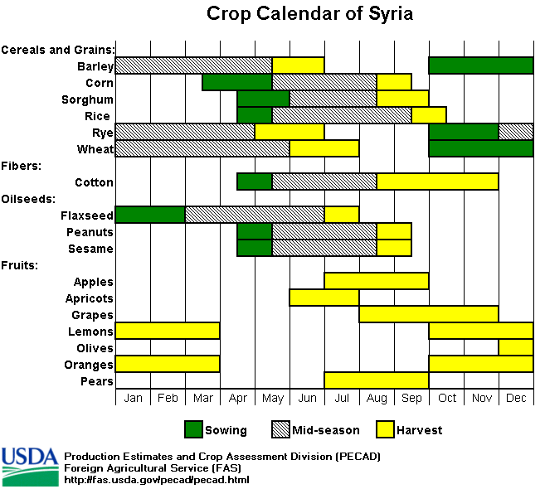
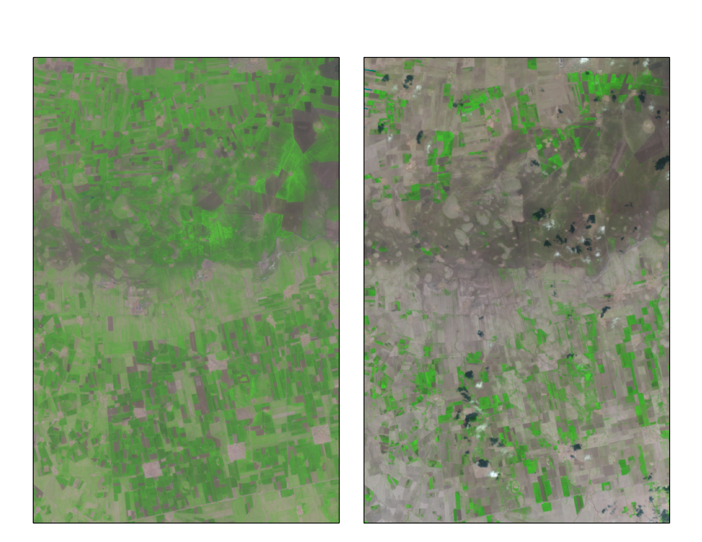
In-season monitoring of Planted Area
(optimum planting period) using Landsat Data
Reference location + year (analogue)
current year
April 7, 2003
April 7, 2009
Quick synopsis of
crop-of-interest classification
…for regional extrapolation
Change detection on the basis of: visual evidence or numerical difference between 2 images collected on different dates by same sensor. Late planting or significant weather-related area shortfall

Slide 41
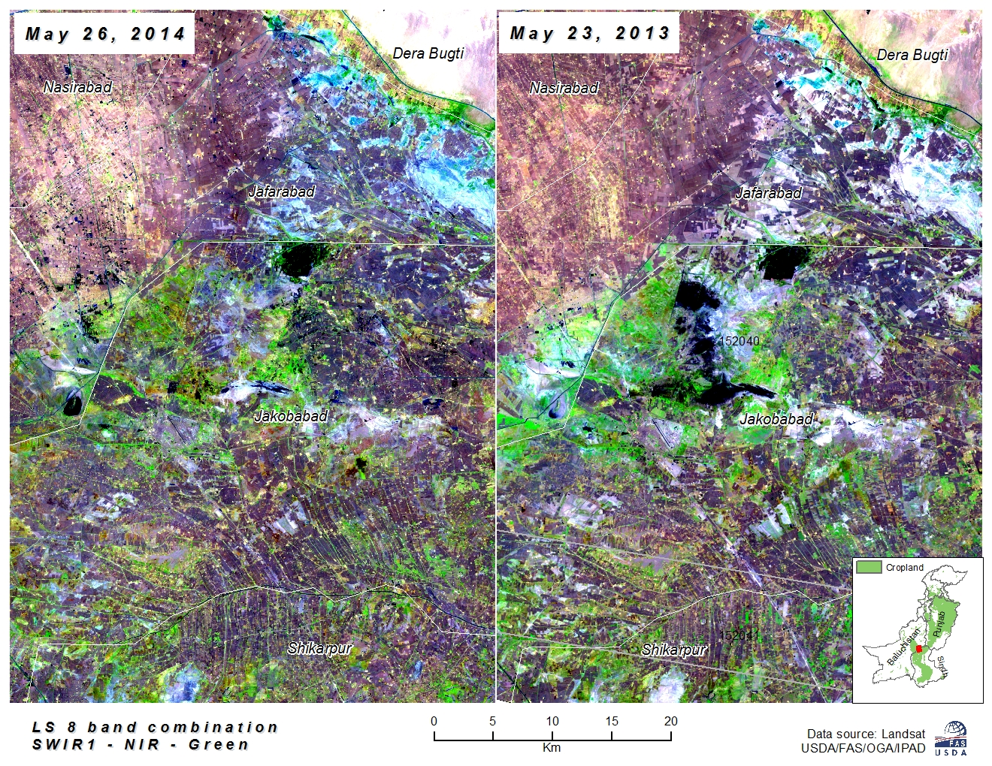
The SWIR-1, NIR and Green Landsat 8 band combination (false color) shows plants covered areas (crops) in bright green, water in black, and bare earth ranges from tan to pink, urban/built up areas in purple. The strongest vegetation spectral signature (NIR reflection) is assigned to green to easily distinguish cropping areas with active plant growth

Slide 42
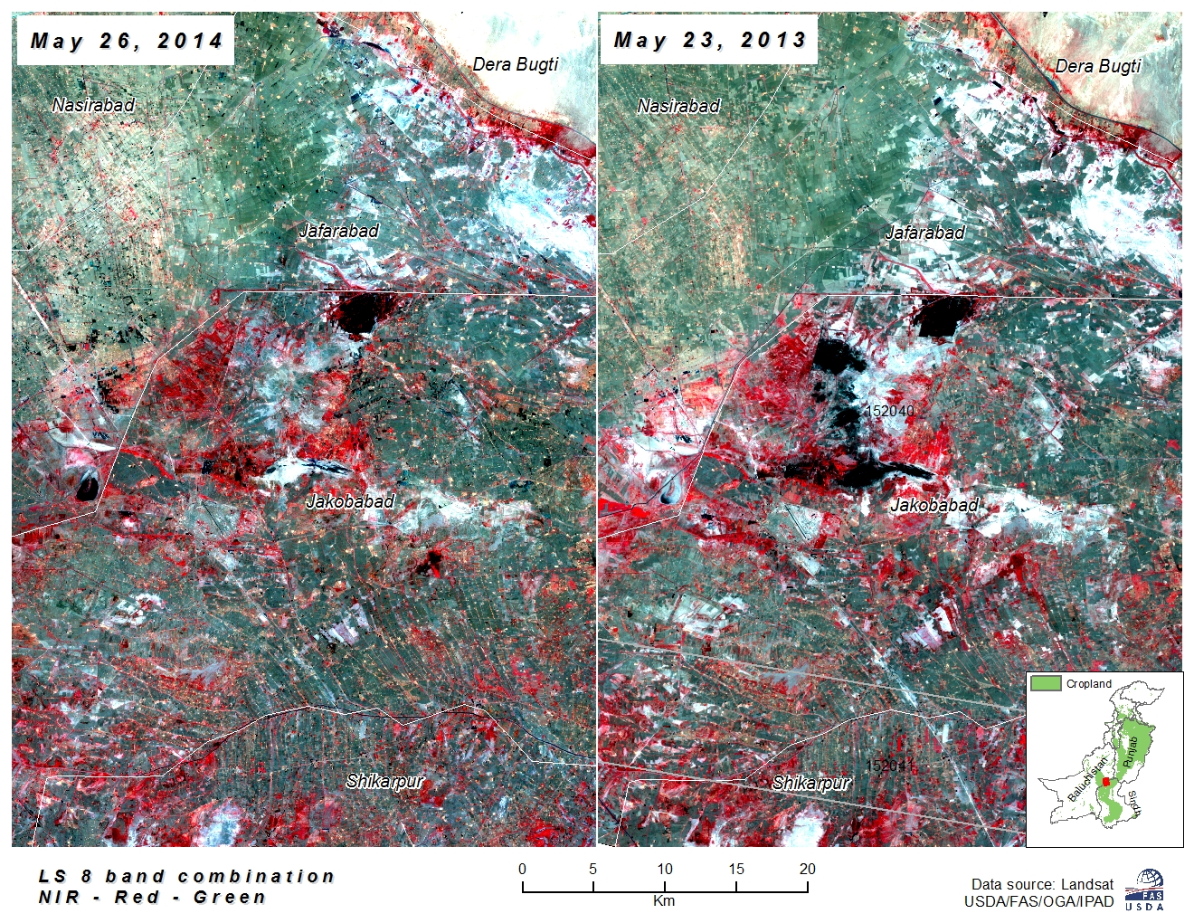
[R-G-B color display]
The NIR, Red and Green Landsat 8 band combination (false color) shows plants (crops) in dark red, quickly growing plants are bright red. The combination allows us to see how well plants (crops) are growing and how densely vegetated a specific area is

Slide 43
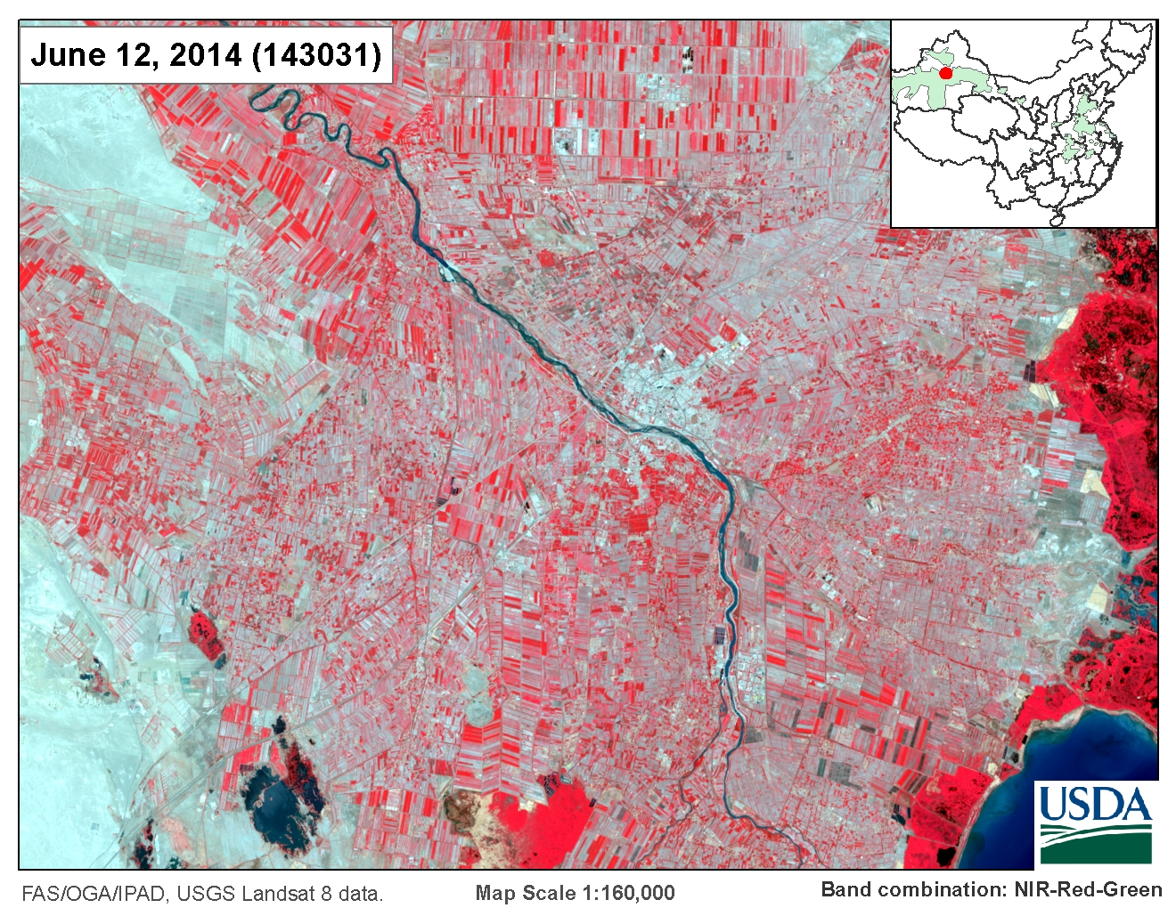
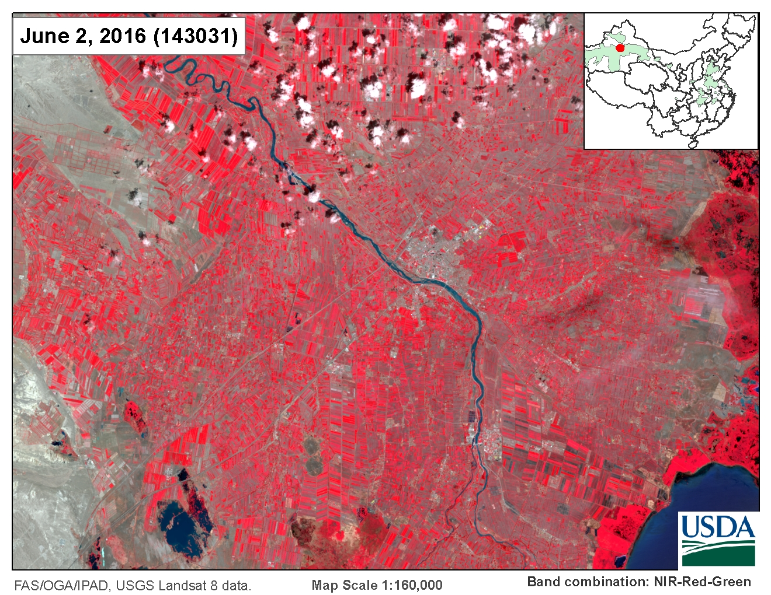
Xinjiang 2016 Cotton Planted Area Monitoring and Estimation
Reference/Benchmark
Current Year

Slide 44
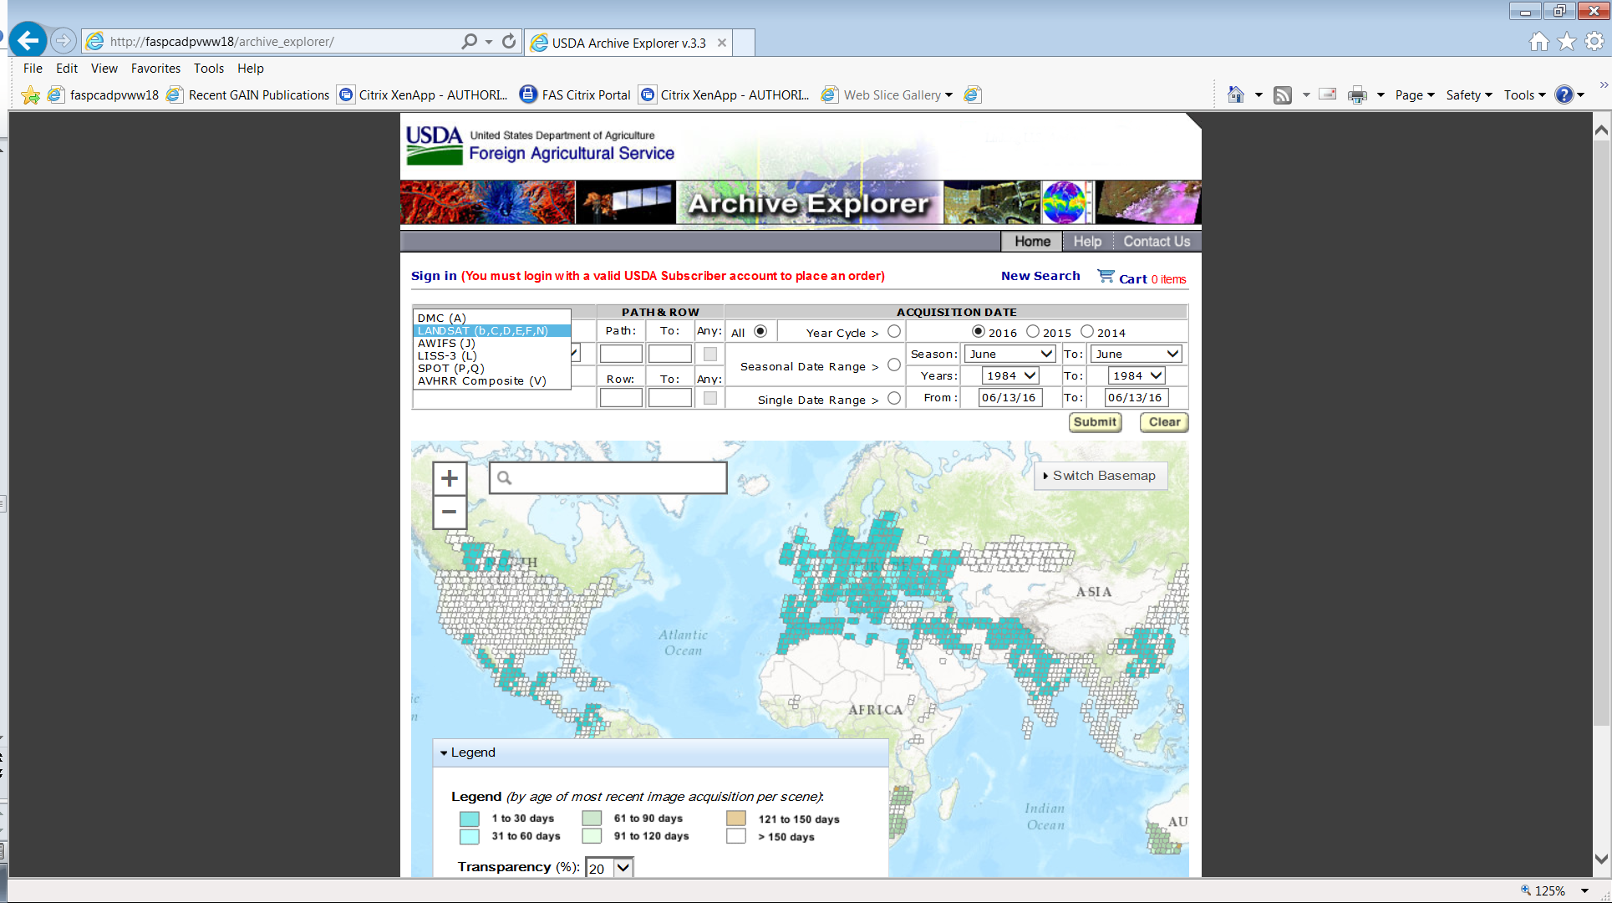
USDA Archive Explorer: Satellite Imagery Archive [SIA]
http://www.pecad.fas.usda.gov/archive_explorer/

Slide 45
Summary Satellites Used by FAS/IPAD
(time-series data sets important for crop monitoring)
Geo-stationary & radar satellites to monitor weather (rainfall & temperature)
    GOES (North & South America), METEOSAT (Europe & Africa), and
    GMS (Asia and Australia)
    TRMM-MPA and GPM
Polar-orbiting satellites to monitor:
  NDVI time-series analysis during growing season
    NOAA-AVHRR (8-km resolution), SPOT-VEG/Proba-V ( 1-km resolution),
    MODIS sensor on Terra/Aqua Satellites (250-meter resolution)
  Classify crop types and crop area
    Landsat-7/8 (30-m) and DMC (22-m)
  Soil moisture with passive microwave
    Special Sensor Microwave Imager (SSM/I, 25-km) to measure surface wetness (good results in cloudy regions)
    SMOS (50-km) to correct soil moisture water balance models
    SMAP (NASA and USDA merged product)
  Actual Evapotranspiration from thermal band on MODIS/Landsat
Radar satellite altimeters monitor lake water-level variations (10-day overpass)
    TOPEX/Poseidon (1992-2002), Jason-1 (2002-2009), OSTM/Jason-2 (Sept 2009-present), Jason-3 (2016-present)
    ERS (1991-2001), ENVISAT (2001-present)

Slide 46
Questions…..Comments……Thanks
Dath K. Mita, PhD
Senior Global Analyst/Technical Lead
dath.mita@fas.usda.gov
For more info:
http://www.pecad.fas.usda.gov/cropexplorer/
http://www.pecad.fas.usda.gov/archive_explorer/
http://glam1.gsfc.nasa.gov/
http://www.pecad.fas.usda.gov/cropexplorer/modis_ndvi/
http://gis.pecad.fas.usda.gov/WmoStationExplorer/
http://gis.pecad.fas.usda.gov/TropicalCycloneMonitor/
http://www.pecad.fas.usda.gov/cropexplorer/global_reservoir

