Slide 1
IMAPP Training Workshops – From Theory to Applications
Kathleen Strabala, Liam Gumley, Allen Huang, Rebecca Cintineo,
David Hoese, James Davies, Brad Pierce, Elisabeth Weisz, Jeff Key
Cooperative Institute for Meteorological Satellite Studies
Space Science and Engineering Center
University of Wisconsin-Madison
USA

Slide 2
Lots of Others
James Davies, Brad Pierce, Elisabeth Weisz, Eva Borbas, Robert Aune, William Straka, Scott Mindock, Ray Garcia, Graeme Martin, Nadia Smith, Rebecca Cintineo, Dave Hoese, Eva Schiffer, Katja Hungershöfer, Jeff Key, Jordan Gerth, Scott Bachmeieir, Mike Pavolonis, Crystal Schaaf, Yanmin Shuai, Peter Albert, Kris Bedka, Nigel Atkinson, Denis Denis Margetic, Tom Heinrichs, Dayne Broderson, Peter (Kung-Hwa) Wang, Aniko Kern, Christelle Ponsard, Philip Frost, Riris Adriyanto, Wei Gao, Jerrold Robaidek, Rosie Spangler, Paul Menzel, Tom Rink, Maria Vasys, Jerrold Robaidek, Rosie Spangler, Janean Hill, Douglas Ratcliff, Kevin Hallock, Nick Bearson, Richard Frey, Chris Moeller, Steve Ackerman, Dave Santek, Russ Dengel, William Smith, Scott Nolin, John LaLande, Bill Bellon
UW SSEC NOAA/STAR Boston University NASA Goddard Space Flight Center Instituted für Weltraumwissenschaften, Freie Universität, Berlin, Germany German Weather Service (DWD) NASA Langley NASA SPoRT Met Office NWS | Taiwan Central Weather Bureau, Taipei Australian Bureau of Meteorology Eötvös Loránd University, Budapest, Hungary East China Normal University, Shanghai, China GINA Alaska EUMETSAT BMKG, Indonesian Agency for Meteorology, Climatology and Geophysics CSIR South Africa INPE/CPTEC Jet Propulsion Lab (JPL)

Slide 3
What is IMAPP?
The International MODIS/AIRS Processing Package is a collection of software systems for processing data from NASA Aqua and Terra satellites. The primary goal of IMAPP is to facilitate and promote the use of Level 1 and Level 2 products for environmental applications. Funding is supplied by NASA.

Slide 4
History of Direct Broadcast Support
More than 30 years of experience
IAPP (International TOVS Processing Package) since 1985
ITPP (International ATOVS Processing Package) since 1998
Acquisition of TeraScan X Band 4.4 m Dish in 2000
NASA IMAPP (International MODIS/AIRS Processing Package) since 2000
Acquisition of Orbital Systems X/L Band 2.4 m Dish in September 2011
JPSS CSPP (Community Satellite Processing Package) 2011
The goal is to allow DB users the capability to create their own local products for local applications

Slide 5
IMAPP Software Philosophy
Released software must:
Create useful products for the DB community,
Include up-to-date algorithms,
Be pre-compiled for 32 and/or 64-bit Linux,
Include source code whenever possible,
Be easy to install and operate (simple bash script implementations),
Include test data for verification,
Have prompt user support,
Run efficiently on modest hardware.

Slide 6
IMAPP International MODIS/AIRS Processing Package
Funded by NASA since 2000
http://cimss.ssec.wisc.edu/imapp/
65 software packages released in 15+ years
More than 2300 registrants from 76 different countries
13 direct broadcast workshops held on 6 continents serving students from more than 60 countries
19 MODIS related software packages
6 AIRS related software packages
4 AMSR-E software packages

Slide 7
IMAPP Global Users
76 Different Countries (> 1/3 of the world total)
Italy Argentina Brazil Kazakhstan Ukraine Indonesia China Denmark South Africa Taiwan Japan Morocco Iran Singapore India Germany United Kingdom Iceland Slovenia Uganda | Australia Czech Republic Canada Spain Chile Pakistan Nepal Portugal Poland Saudi Arabia El Salvador Colômbia Serbia Kenya Oman Sweden Uzbekistan Switzerland Peru Ethiopia | Mexico Hungary Belgium Norway Venezuela Sri Lanka France Russia Vietnam Mongolia Turkey South Korea UAE Lithuania United States Thailand Philippines Ethiopia Suriname Netherlands | Romania Malaysia Algeria Reunion Austria Finland Czech Republic New Zealand Guatemala Uruguay Israel Azerbaijan Cuba Kuwait Syria Dominican Republic Belarus Laos

Slide 8
IMAPP Global Users
>2300 Individuals have registered AND downloaded software from the IMAPP suite since 2007

Slide 9
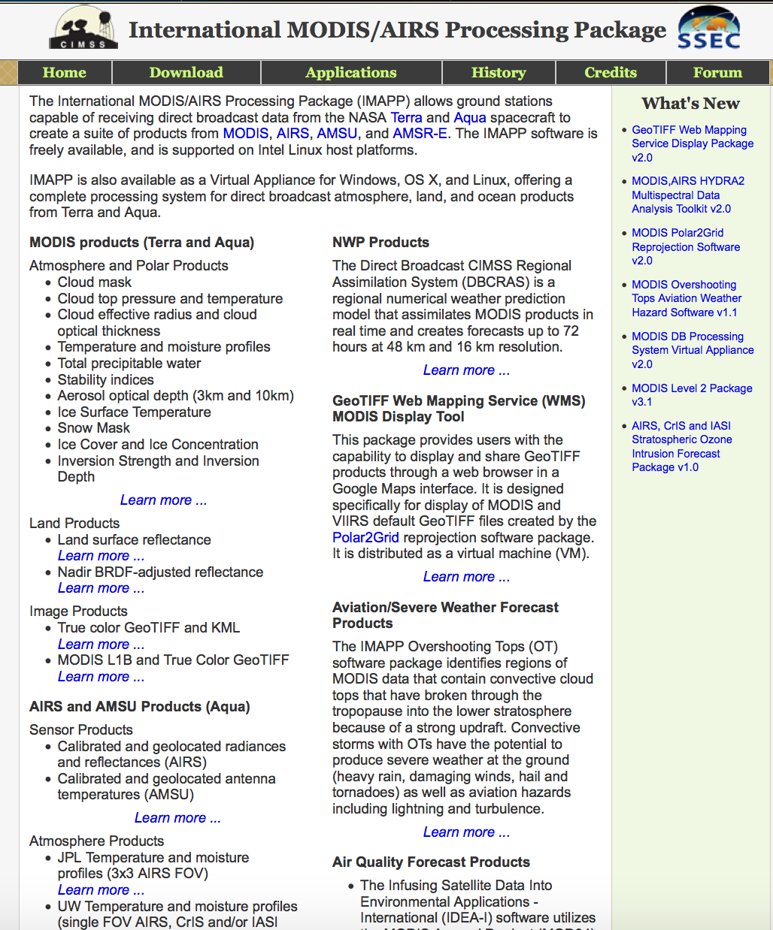
http://cimss.ssec.wisc.edu/imapp/

Slide 10
Suite of Products
MODIS Products (Terra and Aqua)
Atmosphere Group Collect 6 – MODIS Science Team Software
Cloud mask (MOD35)
Cloud top pressure and temperature (MOD06CT)
Cloud effective radius and cloud optical thickness (MOD06OD)
Temperature and moisture profiles (MOD07)
Total precipitable water (MOD07)
Stability indices (MOD07)
Aerosol optical depth (3km and 10km) (MOD04)
Bright Target Aerosol Optical Depth (Deep Blue) (MOD04)
Polar Products from Jeff Key (NOAA Cryosphere Scientist)
Ice Surface Temperature
Snow Mask
Ice Cover and Ice Concentration
Inversion Strength and Inversion Depth

Slide 11
Suite of Products
MODIS Land Products (Terra and Aqua)
MODIS Surface Reflectance (MOD09)
Nadir Bidirectional Reflectance Distribution Function (BRDF) MCD43 - Working with Crystal Schaaf
MODIS Image Products
Polar2Grid reprojection software
True Color Reprojection for Display in Google Earth (DB Google Earth) – Full Resolution
AIRS and AMSU Products (Aqua) from NASA Jet Propulsion Lab (JPL)
Calibrated and geolocated radiances (AIRS)
Calibrated and geolocated antenna temperatures (AMSU)

Slide 12
Suite of Products
AIRS and AMSU Products (Aqua)
3x3 AIRS FOV retrievals – JPL (Collect 5)
UW Dual Regression single FOV retrievals (AIRS, CrIS, IASI)
Collocated AIRS/MODIS FOVs
AIRS/AMSU HDF4 to BUFR Converter with UK Met Office (Meeting request from John Le Marshall at BOM)
AMSR-E Products
Calibrated and Geolocated Antenna Temperatures
Rain Rate
Soil Moisture
Snow Water Equivalent

Slide 13
Suite of Products
HYDRA2 Multispectral Data Analysis Toolkit - more later
Numerical Weather Prediction (NWP) Model DBCRAS
Direct Broadcast CIMSS Regional Assimilation system (DBCRAS).
Globally configurable NWP at 48 km resolution
Nested grid at 16 km.
72 hour forecast of gridded meteorological fields.
Assimilates MODIS Cloud (MOD06) and Moisture (MOD07) Retrievals to improve initial conditions in the model.
Output includes forecast IR and Water Vapor Satellite Imagery.
Used in several sites around the world including ISRO India.

Slide 14
Suite of Products
Web Mapping Service (WM) for display of local GeoTIFFs created by Polar2Grid
Overshooting Tops Aviation Hazard Software
Identifies potentially dangerous convection that protrudes into the stratosphere.
Using NASA Scientist Dr. Kris Bedka algorithm applied to IR bands.
Creates output product images that include areal coverage of danger of lightning and turbulence.
Infusing satellite Data into Environmental Applications – International (IDEA-I)
Globally configurable package for Air Quality Forecasters
MODIS Aerosol Pollution forecast trajectories, using MOD04 products with web interface and control of animations.
AIRS Stratospheric Ozone intrusions trajectories, using AIRS upper tropospheric ozone retrievals with webs inteface and control of animations.

Slide 15
Suite of Products
IMAPP Virtual Appliance
A complete free Aqua and Terra DB processing system (Level 0 to Level 2 products plus quicklooks) in the form of a Virtual Appliance which can be installed and run on:
Microsoft Windows (7, Vista, XP)
Linux
Apple OS X
Uses most of the freely available software that is available from IMAPP, SeaDAS and NASA DRL
Easy to install and run full-featured processing system Level 0 – Level 2 plus browse images

Slide 16
IMAPP Training Workshops

Slide 17
Global IMAPP Workshops Web site: http://cimss.ssec.wisc.edu/dbs/
2004 – Nanjing, China 2004 – Perth, Australia 2005 – Taipei, Taiwan 2005 – Beijing, China 2006 – Andenes, Norway 2006 – Pretoria, South Africa 2007 - Cachoeira Paulista, Brazil as part of GEOSS
2009 – Stellenbosch University, South Africa
IGARSS Short Course 4: MODIS direct broadcast data for enhanced forecasting and real-time environmental decision making
2011 June – Shanghai, China
2011 September – Jakarta, Indonesia
WMO Region V Training workshop on satellite applications for
meteorology and climatology
2013 September – Honolulu, Hawaii
Hawaii VIIRS / MODIS Direct Broadcast Applications Workshop
2015 February – Miami, Florida
AOML Miami VIIRS / MODIS Direct Broadcast Applications Workshop
2016 April – Mayaguez, Puerto Rico
Mayaguez Direct Broadcast Applications Workshop – NOAA CREST

Slide 18
Motivation
Promote the local use of satellite data
Lectures and hands-on labs determined by student interest/needs
Lectures, labs, data and software freely distributed
http://cimss.ssec.wisc.edu/dbs
How can the data inform decision making?
Remote sensing complemented by local knowledge
Encourages international collaborations both between NASA/global science community as well as and community to community
Teach the principles of remote sensing to foster the next generation of scientists

Slide 19
What is unique about this training?
Course tailored specifically on local usage of direct broadcast data and products for local applications
On site one-on-one student - instructor interaction
Partner with local organization
Gather local user community
Basic theory of Radiative Transfer and products so users can understand strength and weaknesses of products
Hands on labs using local data and tool designed specifically for remote sensing training - HYDRA
Last day is student presentations based upon an examination in area of their choosing

Slide 20
HYDRA2
Allows interactive display of Level 1B and Level 2 products from multispectral imagers (MODIS, AIRS, AVHRR), high spectral resolution sounders (AIRS, CrIS, IASI), and microwave sounders (AMSU, ATMS).
Different data sets can be collocated, compared, combined, and masked.
Data can be examined at the pixel level.
Designed to be easy to learn and use, especially for students.
Supported on Windows, Apple OS X, and Linux.

Slide 21
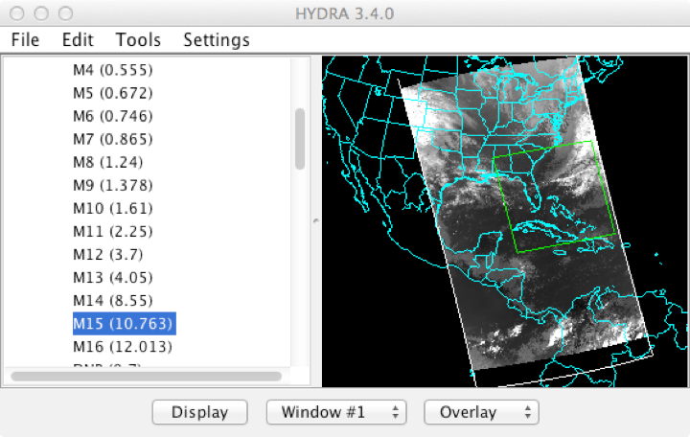
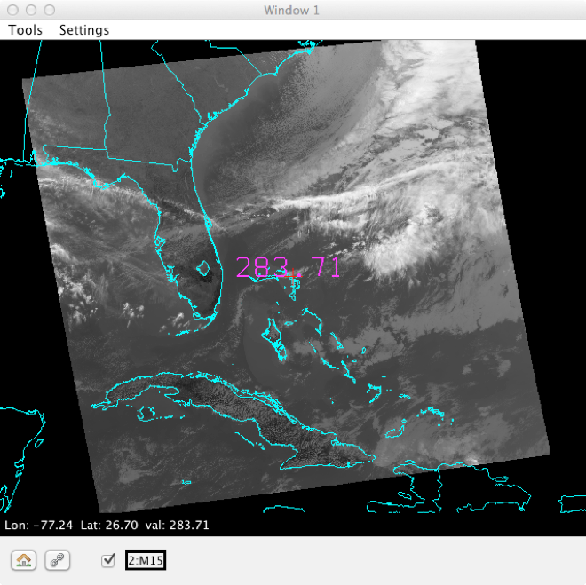
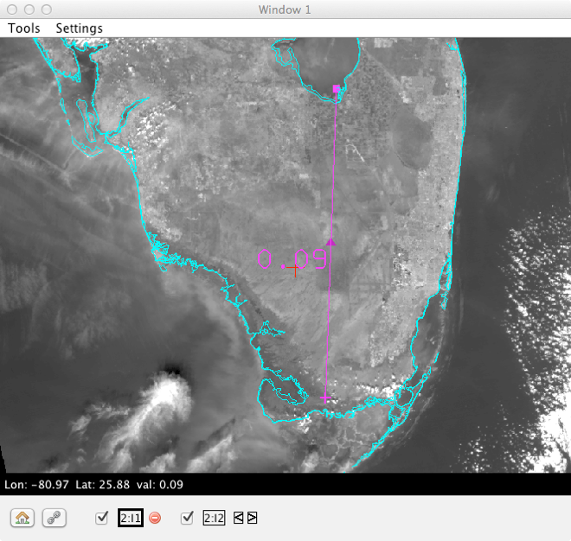
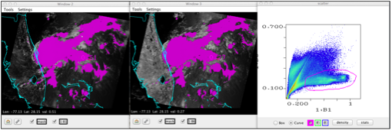
Hydra Examples
SNPP 2015/01/30 18:40 UTC
Terra 2014/06/19 06:05 UTC
VIIRS Data Selector
VIIRS M15 Image Window
VIIRS I1 Image Window
MODIS Band 6 vs. Band 1 Scatter Plot

Slide 22
Rink, Tom, et al. "HYDRA2 -
A Multispectral Data Analysis Toolkit for sensors on Suomi-NPP and other current satellite platforms." Bulletin of the American Meteorological Society, 2015.

Slide 23
Main workshop website http://cimss.ssec.wisc.edu/dbs/

Slide 27
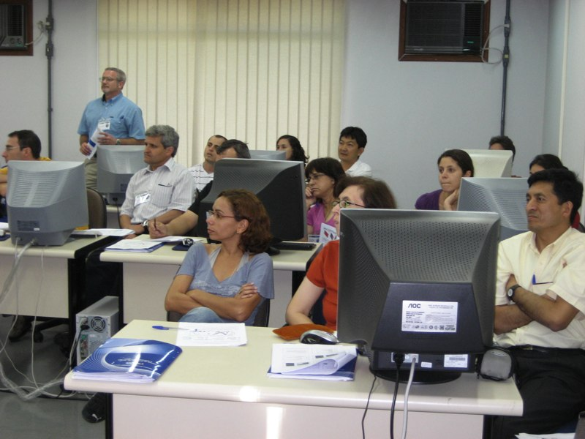
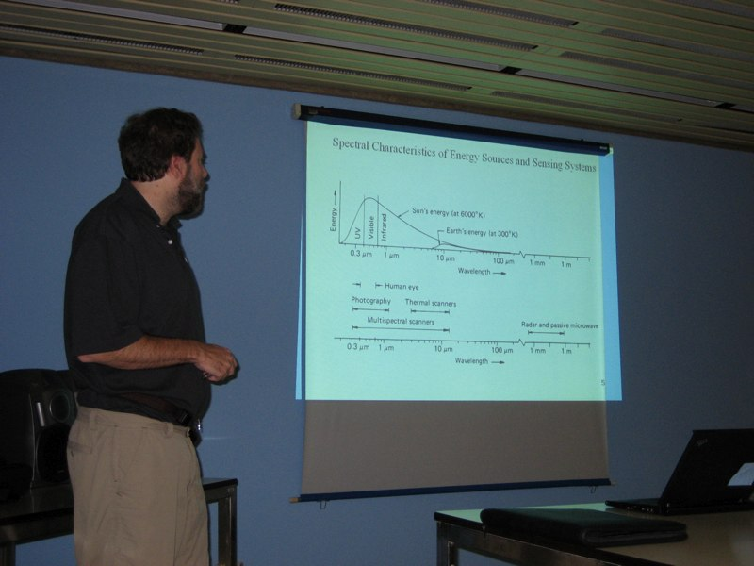
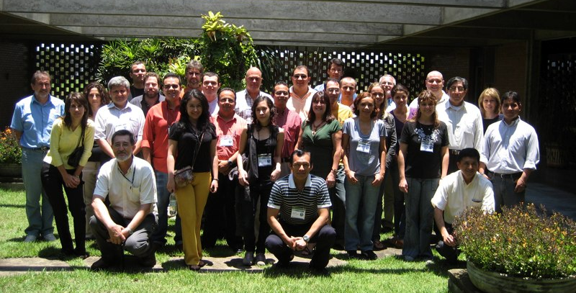
Sao Paulo, Brazil 2008

Slide 28
MODIS IR Cloud Phase Product Example

Slide 32
Student Presentations
Students
Present a
Briefing
Simulating
Real-time
Event or
Present Results
of their
Research Topic

Slide 33
Diana Rodriguez – Argentina Met Service

Slide 34
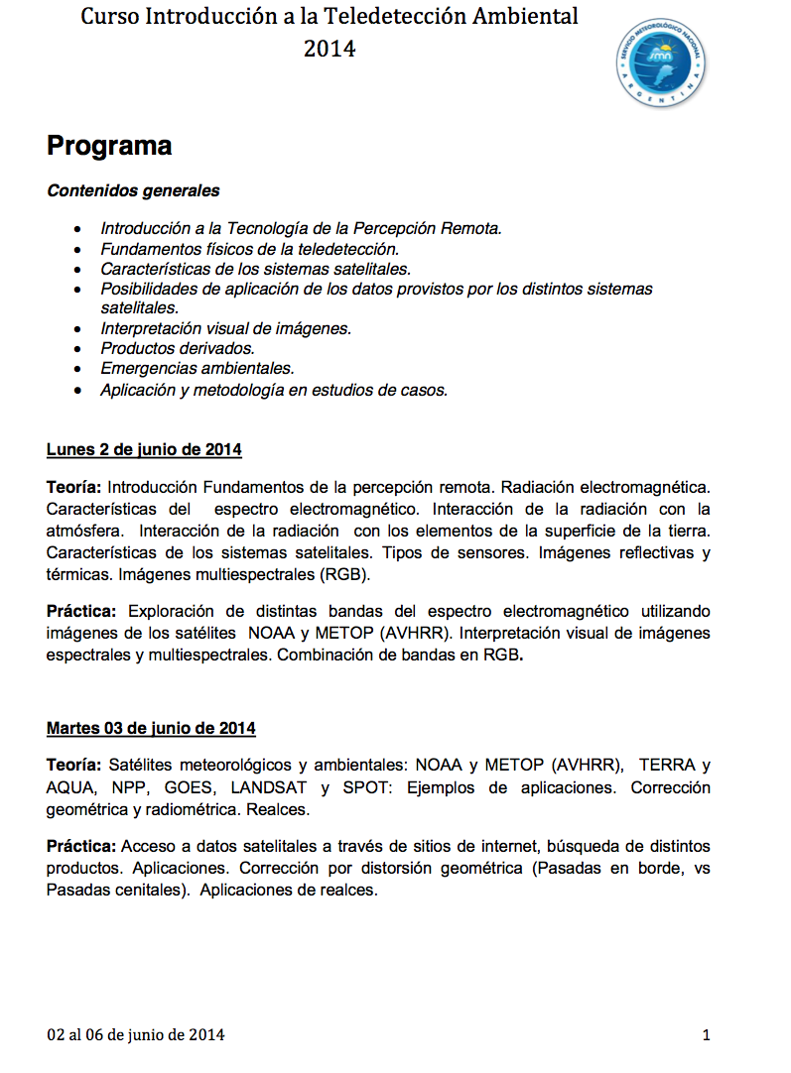

Slide 35
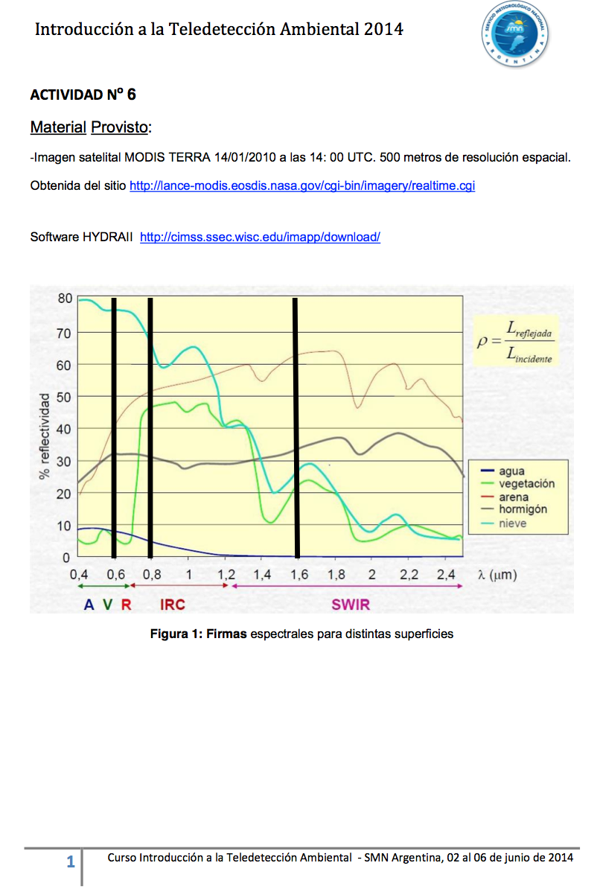

Slide 36
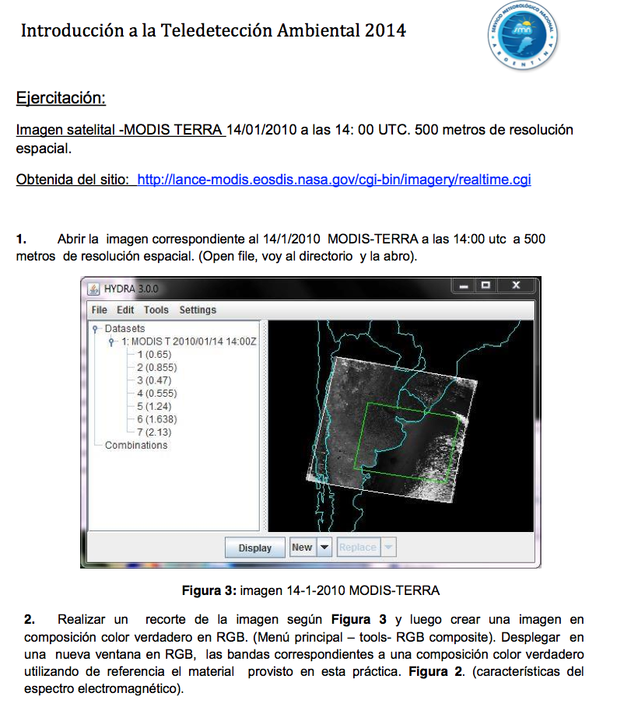

Slide 42
IDEA: NASA-EPA-NOAA partnership to improve air quality assessment, management, and prediction by infusing (NASA) satellite measurements into (EPA, NOAA) analyses for public benefit.
IDEA (Infusing satellite data into environmental air quality applications)
Part of NASA Earth Science Enterprise (ESE) Applications Program strategy to demonstrate practical uses of NASA sponsored observations from remote sensing systems and predictions from scientific research.

Slide 43
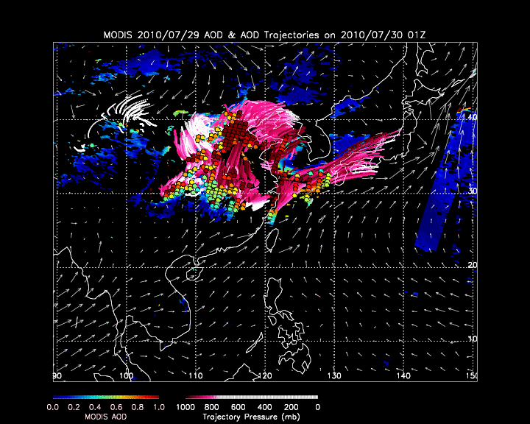
Trajectory Forecast
The trajectories are initialized at the high AOD values at 50mb, 100mb, 150mb, and 200mb above the surface
The air parcel trajectories are run using the 12Z NOAA/NCEP GFS forecast data providing a 48hr forecast via trajectories
The pressure levels of the trajectories are plotted in mb and colored to a magenta-white scale. White indicates that the air parcel no longer affects the surface

Slide 44
IDEA-I Trajectory 48 hour forecast

Slide 45
Academic Degrees Based Upon IMAPP Software at ECNU (2013)
Xiaoyun Zhuang : Localization of temperature profile retrieval (IMAPP Dual Regression).
Yunzhu Chen : Data fusion of aerosol optical depth. (IMAPP MOD04 products).
Cong Zhou : Research on CO2 (IMAPP Dual Regression Retrievals).
Yuanyuan Chen : PM 10 forecast (IMAPP IDEA-I products).

Slide 46
IMAPP Implementation of IDEA-I Ozone
Uses UW Dual Regression Retrievals from Hyperspectral Sounders (AIRS, CrIS and IASI) to identify regions of high ozone concentrations in the upper troposphere
Trajectory model is run using GFS forecast grids to predict movement of ozone in 3 dimensions
Trajectories color coded to help identify when the ozone may affect humans at the surface (Stratospheric Intrusions).
Especially important to Air Quality Forecasters in Western US Mountain States (exceptional events).

Slide 47
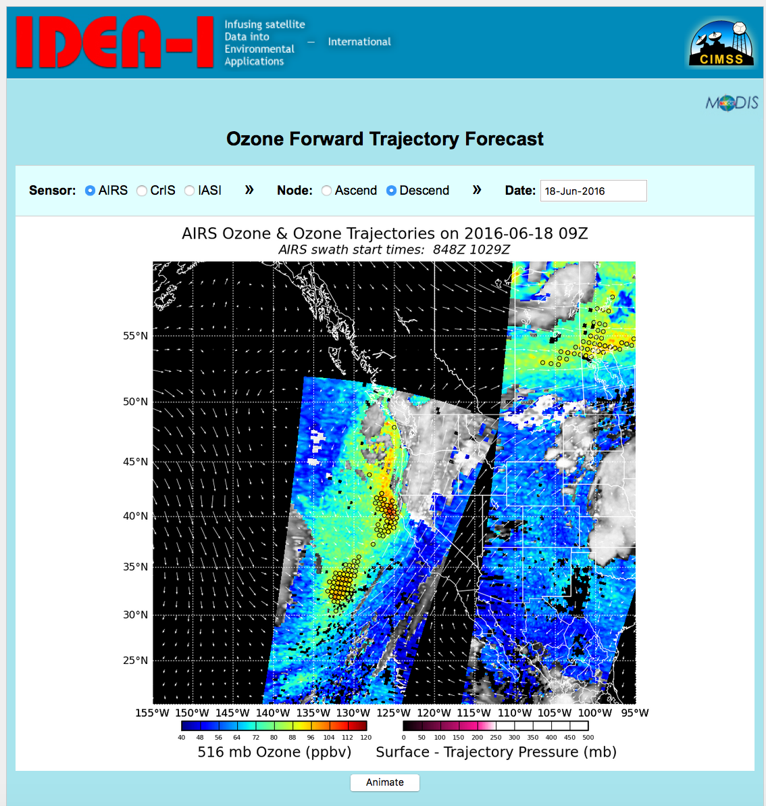
http://cimss.ssec.wisc.edu/idea-i/USozone/

Slide 49
Is it really useful?
Found to be especially useful for Western United States who have to be concerned with ozone concentrations exceeding EPA health standards.
EPA may designate areas as failing to meet the ozone levels standard, necessitating the development of plans for improvement in air quality ($$$$$).
However, heightened ozone levels caused by exceptional events (usually from natural sources) can be excluded if explained by appropriate documentation.
Air Quality forecasters can use IDEA-I to prepare for elevated ozone levels, and gather evidence that the event was due to a natural occurance.

Slide 50
Case Study 6 June 2012
Surface monitors in Wyoming showed that the concentration of ozone in the air reached nearly 100 parts per billion (ppb), with 8 hour averages registering above the 75 ppb public health standard established by the Environmental Protection Agency (EPA)
The State of Wyoming needed to prove that the elevated ozone readings for June 6th were caused by an intrusion of stratospheric air rather than pollution, otherwise they would be in violation of the Clean Air Act.
IDEA-I was a tool that the team started with to determine the possible source of the elevated ozone levels were due to stratospheric ozone intrusion (exception event).

Slide 52
Publications

Slide 55
Publications
Kaldunski, B., Pierce, B. and T. Holloway, 2016: When Stratospheric Ozone Hits Ground-level Regulation – Exceptional Events in Wyoming. Accepted for publication to the Bulletin of the American Meterological Society (BAMS).

Slide 56
Support for US NWS
US Domestic workshops include National Weather Service personnel
SSEC has been providing MODIS direct broadcast data to NWS since 2006.
Early, forecasters did not see how the products could be useful in operations.
Now we support 59 forecast offices in the US
Polar2Grid used for AWIPS reprojections
This software supporting Hawaii, Alaska and Puerto Rico regions too.

Slide 57
Supporting CONUS NWS since 2006

Slide 58
Support National Weather Service Forecasters

Slide 59
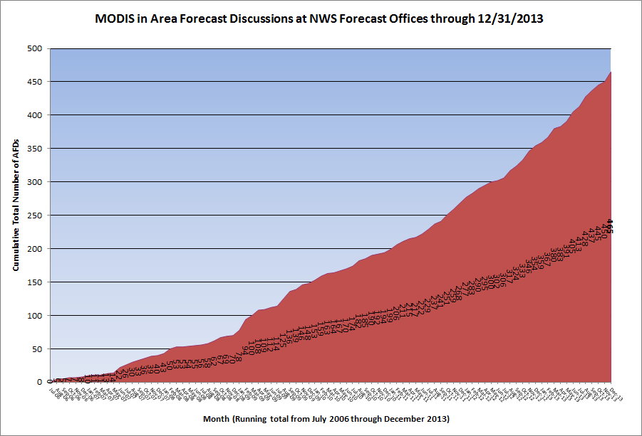

Slide 60
Support for Short Term Forecasts
AREA FORECAST DISCUSSION
NATIONAL WEATHER SERVICE STATE COLLEGE PA
442 AM EDT SUN MAR 27 2011
.SHORT TERM /6 PM THIS EVENING THROUGH 6 PM MONDAY/...ANOTHER VERY CHILLY NIGHT IN STORE FOR THE REGION WITH MINS ARND 15F BLW NORMAL. RIDGE OF HIGH PRESSURE WILL PROVIDE THE CLEARSKIES...LGT WINDS AND DRY AIR TO ALLOW FOR GOOD RADIATIONAL COOLING. LOWS SHOULD RANGE FROM THE SINGLE DIGITS ACROSS THE SNOW COVERED N MTNS /MODIS BAND 7 IMAGERY SHOWS EXTENT OF SNOW COVER BEAUTIFULLY/...TO ARND 20F IN THE SOUTH.

Slide 61
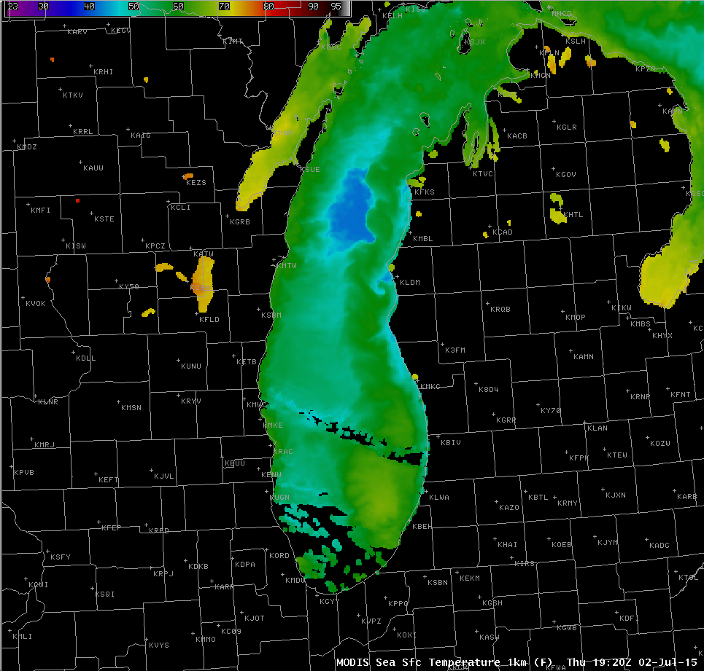
Fine Scale Water Features
AREA FORECAST DISCUSSION
NATIONAL WEATHER SERVICE GRAND RAPIDS MI
326 PM EDT THU JUL 2 2015
LATEST UPDATE...
SYNOPSIS/SHORT TERM/LONG TERM/MARINE
.MARINE...
ISSUED AT 326 PM EDT THU JUL 2 2015
….
ON ANOTHER NOTE...SOME UPWELLING HAS OCCURRED AT THE SHORELINE WITH THE NNE WINDS OVER THE LAST DAY. SOME WATER TEMPS HAVE DROPPED TO NEAR 40F ALONG THE SHORE PER LATEST WATER OBSERVATIONS FROM THE SITES ALONG THE COAST THIS MORNING AND MODIS SATELLITE IMAGERY.

Slide 62
AREA FORECAST DISCUSSION
NATIONAL WEATHER SERVICE GRAND RAPIDS MI
1156 AM EST MON FEB 24 2014
ON A SIDE NOTE IT WILL BE INTERESTING TO SEE THE MODIS SAT PIC
FROM TODAY AS THERE APPEARS TO BE SOME THIN ICE AGAIN IN PLACE
ACROSS THE FAR SOUTH PART OF THE LAKE AND UP THE WESTERN SHORE
TOWARDS MILWAUKEE. THIS WILL HAVE SOME AFFECT ON FETCH LENGTH IN A
SOUTHWEST FLOW. OBVIOUSLY THE LAKE IS MUCH MORE OPEN THAN IT WAS A
WEEK OR SO AGO. THE MODIS PASSES OVER LAKE MICHIGAN AT 1710Z TODAY
OR IN ABOUT 15 MINS.
So we have gone from “Can Research Satellite be Used in Operations?”
to forecasters knowing the MODIS orbit overpass times, and expecting
the data to be useful.

Slide 63
Area Forecast Discussion
National Weather Service Milwaukee/Sullivan WI
336 AM CDT SAT JUN 11 2016
….
.Marine …
Webcams not indicated any fog near the shore early this morning, however threat for dense fog will persist today into this evening as warm, humid air flows across cooler Lake MI. Recent buoys and MODIS imagery indicating Lake MI water temp in the low to mid 50s while surface dewpoints rise into the mid 60s to lower 70s today.
SW winds will likely back to the south to southeast over the near shore waters later this morning and afternoon. However the lake breeze should be held close to the shore by the expected WSW breezes over the land.

Slide 64
Future IMAPP Plans
Current funding through mid-2017
No funding beyond that as of now.
Coming Soon:
Aviation Hazard Products
Aerosol Visibility
Fog/Low Stratus (Identifies LIFR/IFR/MVFR probabilities) working with Mike Pavolonis/Corey Calvert
Update to BRDF Collect 6 package – with Crystal Schaaf
AIRS L1 and L2 Jet Propulsion Lab (JPL)
Collect 6 Software for Direct Broadcast
Training – Moscow in November?

Slide 65
Brunner, J., R. B. Pierce, and A. Lenzen, “Development and validation of satellite-based estimates of surface visibility”, Atmos. Meas. Tech., 9, 409–422, 2016.

Slide 66
MODIS Fog and Low Stratus Product

