Slide 1
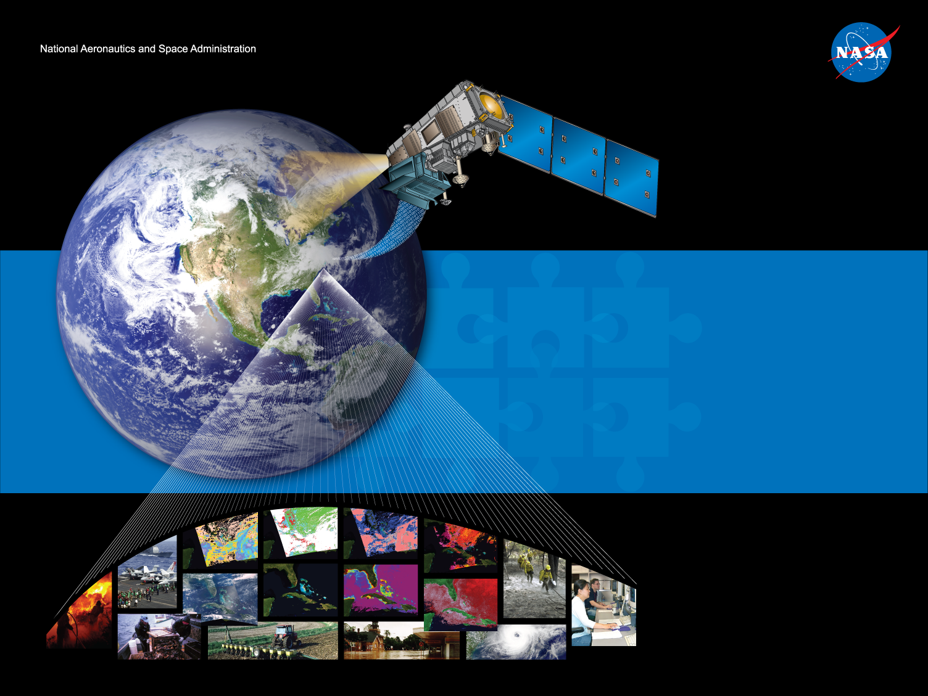
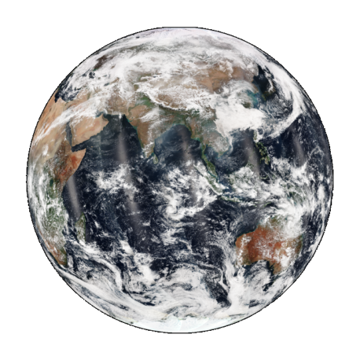
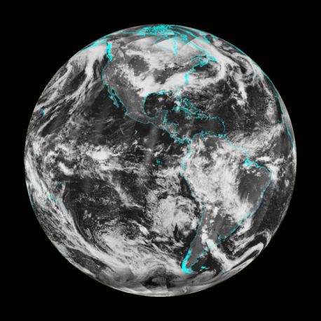
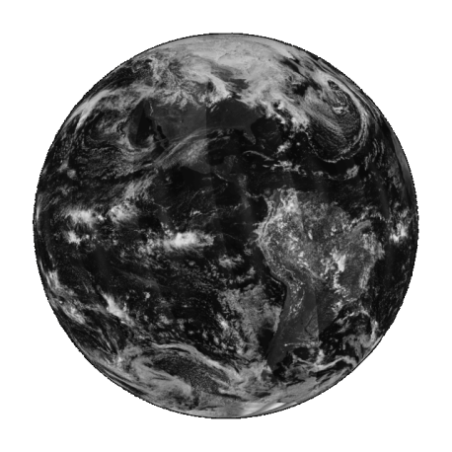
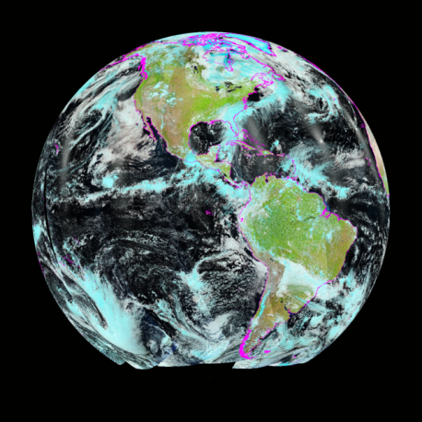
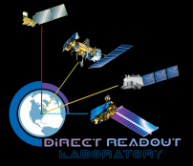
BLUEMARBLE
Bridging Science to Applications
Direct Readout Laboratory
directreadout.sci.gsfc.nasa.gov

Slide 2
Why BlueMarble?
motivation
Direct Broadcast
Fires
Science algorithms & enabling technologies
RT-STPS
Air Quality
Land Atmosphere Ocean
community feedback
Disaster Response
IPOPP
Cross Granule
Science Data
BlueMarble
Applications
Volcano
Parallel Processing
continuous improvement of algorithms and technologies
Storms
Weather Forecasting
Ancillaries
Multi Granule
Aviation
Science Processing Algorithms
Archive Reprocessing
Earthquakes
Floods

Slide 3
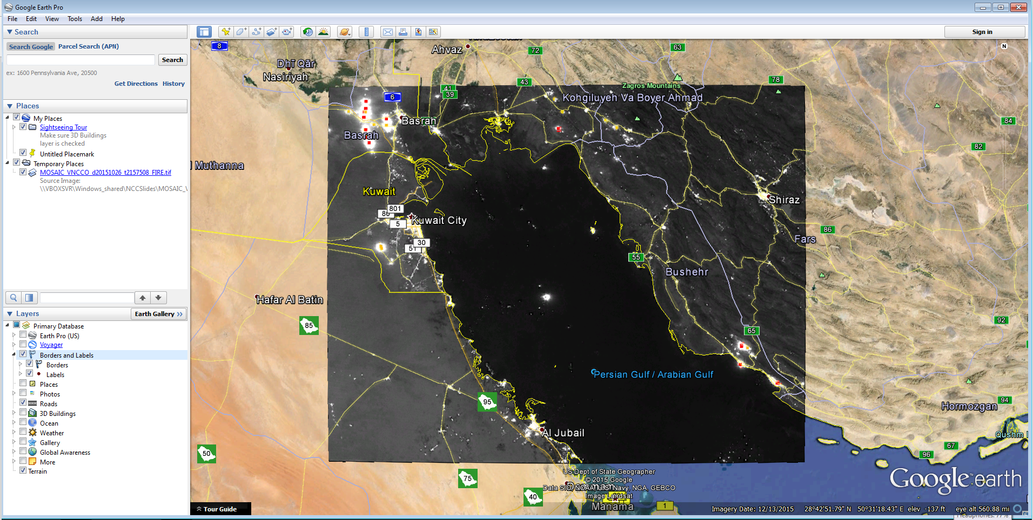
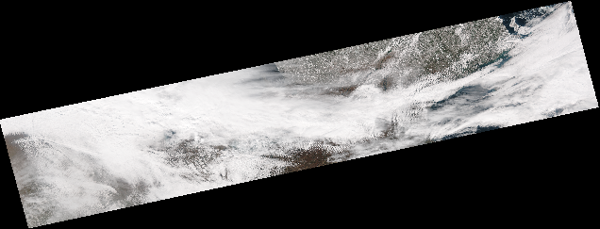
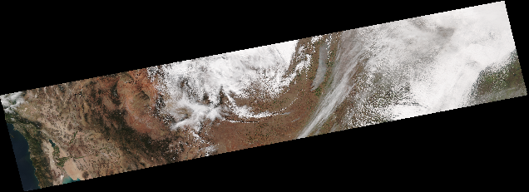
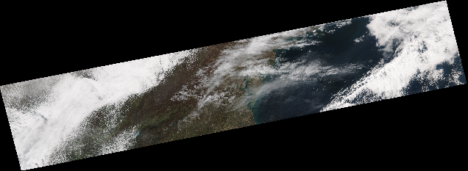
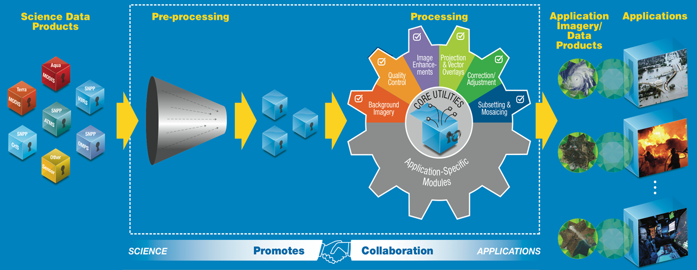
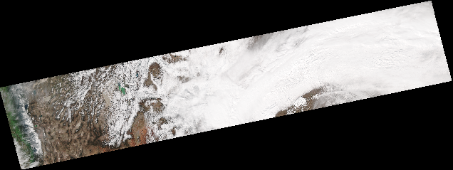
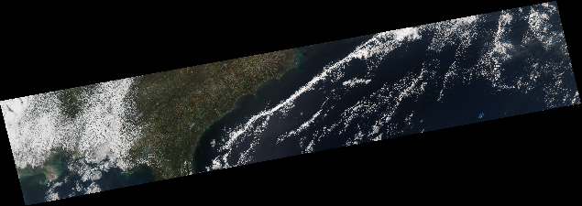
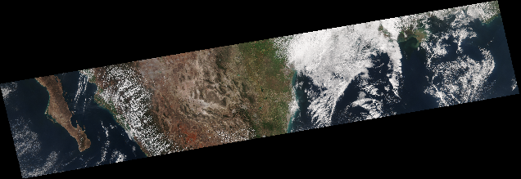
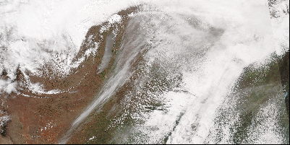
BlueMarble Overview
applications focus
multi-sensor image products & utilities
enhanced, high quality image products
projected GIS ingestible geotiffs
swath imagery
Region-Of-Interest imagery (automated input data search, subsetting & mosaicing)
Standalone or as IPOPP plug-in, easy interface, interoperable
Open source (Java/python/bash),
user collaboration/contributions encouraged
Region-of-interest imagery:
Automated search/subsetting/mosaicing

Slide 4
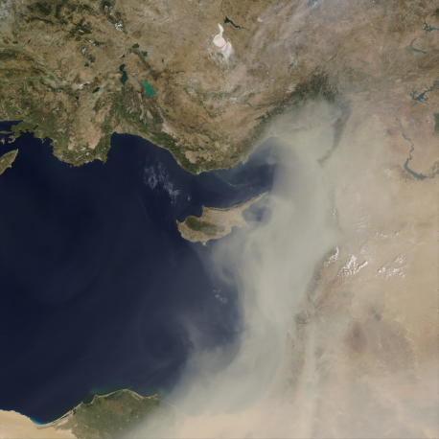
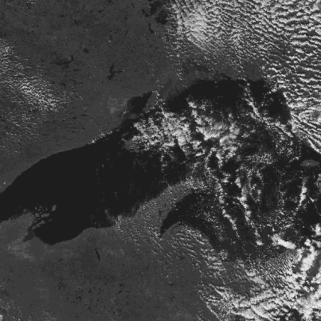
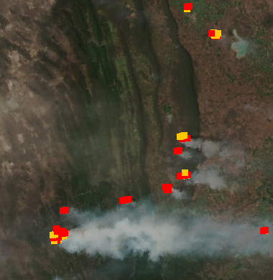
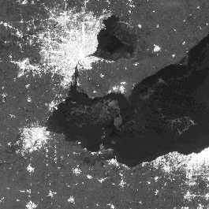
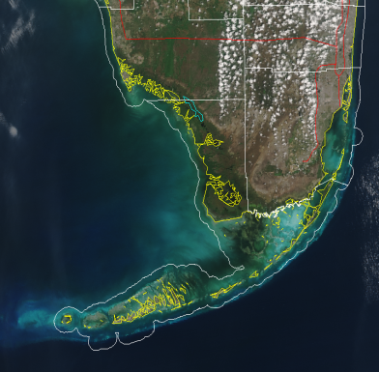
BlueMarble’s Products & Utilities
Current
VIIRS/MODIS
True Color
VIIRS-DNB
E-NCC Daytime
OMPS SO₂ on True Color
Fire Pixel Overlays
Fire Perimeter Overlays
VIIRS/MODIS
Natural Color
VIIRS-DNB
E-NCC Nighttime
OMPS Aerosol on True Color
Shapefile Overlays
Change Detection

Slide 5
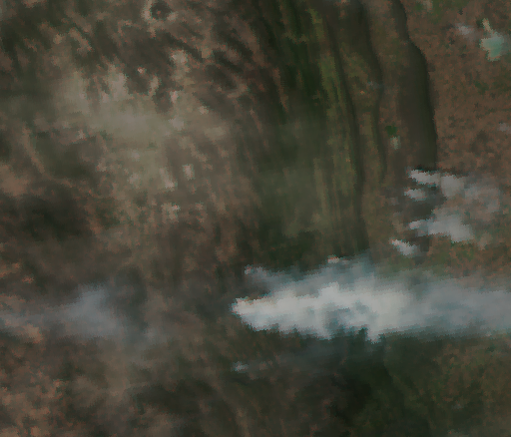
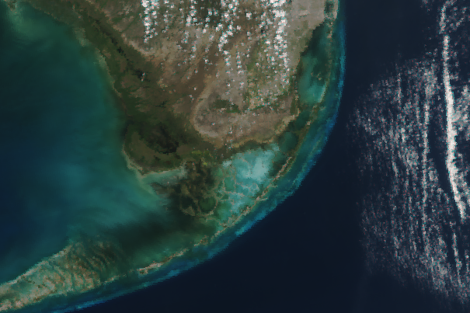
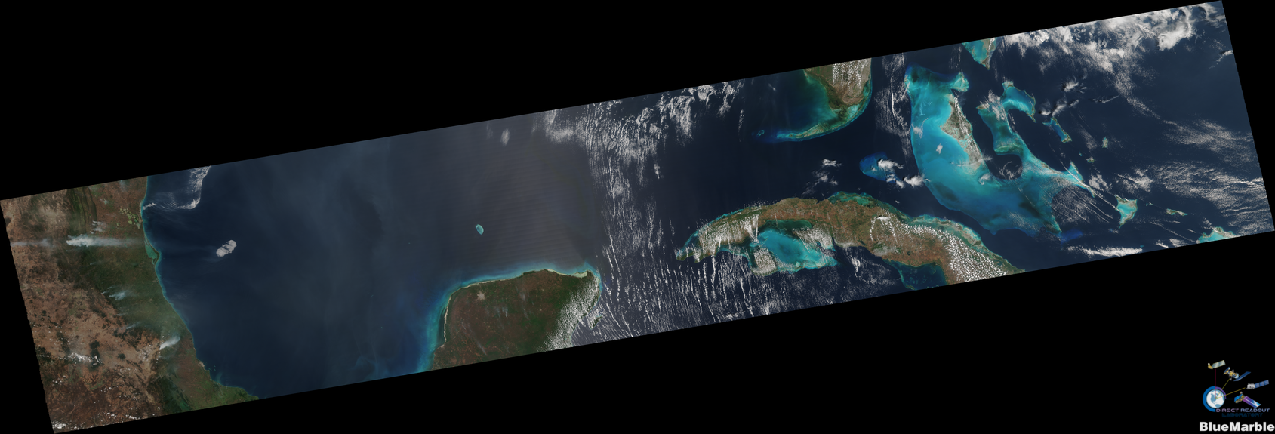
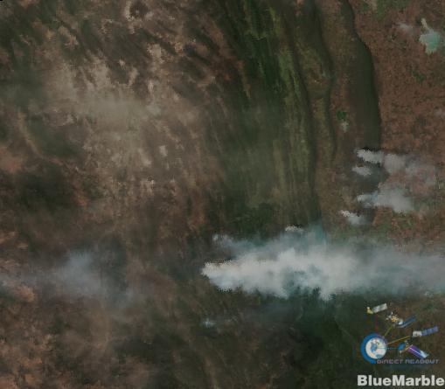
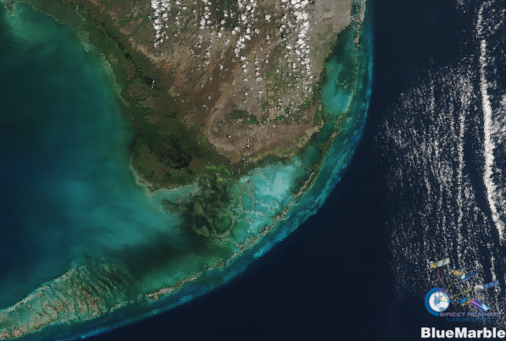
VIIRS Sharpened True Color
BEFORE
BEFORE
VIIRS Sharpened True Color
Red: I1 (0.64 µm); 375m
Green: M4 (0.555 µm); 750m
Blue: M3 (0.488 µm); 750m
AFTER
AFTER
Sharpening^{1,2}: resampling technique that captures sub-pixel variations
used to visualize features and phenomenon and as background images for other earth science data
¹Gumley, Descloitres & Schmaltz. “Creating Reprojected True Color MODIS Images”, https://earthdata.nasa.gov/files/MODIS_True_Color.pdf
²Direct Readout Lab, “Creating Reprojected True Color VIIRS Images”, http://directreadout.sci.gsfc.nasa.gov/?id=dspContent&cid=228
VIIRS Sharpened True Color: March 23 2013; 18:51 UTC; Gulf of Mexico

Slide 6
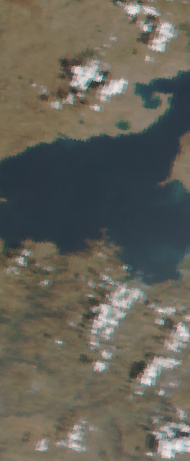
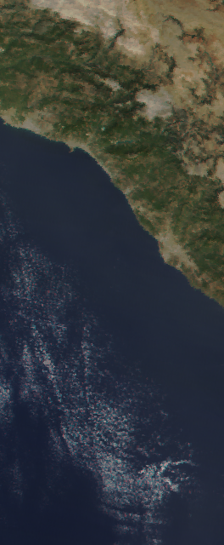
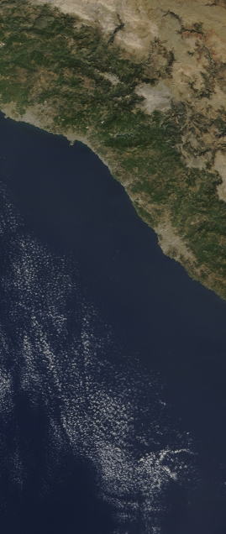
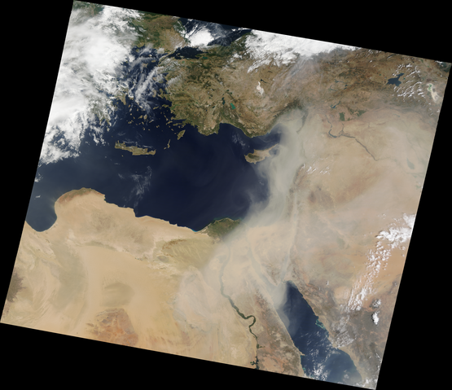
MODIS Sharpened True Color
BEFORE
BEFORE
AFTER
AFTER
MODIS Sharpened True Color: Sep 9th 2015; 08:45 UTC; Mediterranean

Slide 7
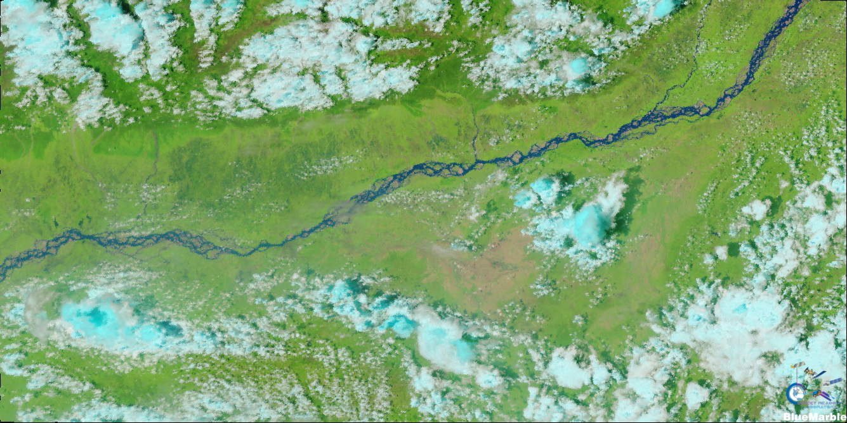
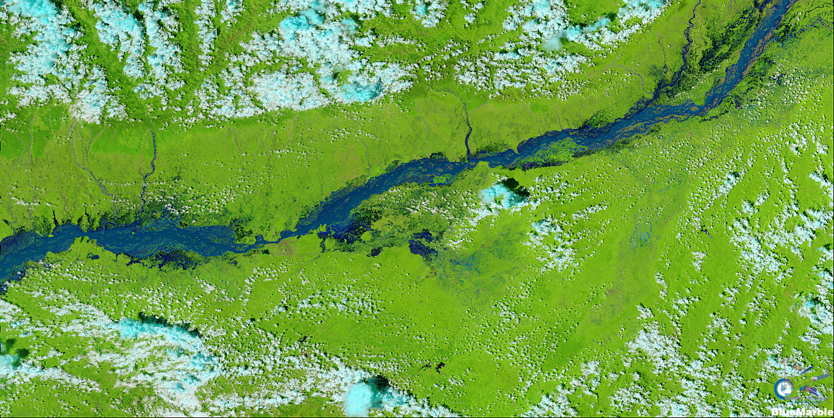
Natural Color
June 1st 2014
Aug 29th 2014
VIIRS Natural Color
Red: I3 (1.61 µm); 375m
Green: I2 (0.865 µm); 375m
Blue: I1 (0.64 µm); 375m
can be used for flood and snow mapping
VIIRS Natural Color: Aug; 2014; Floods in River Brahmaputra, India

Slide 8
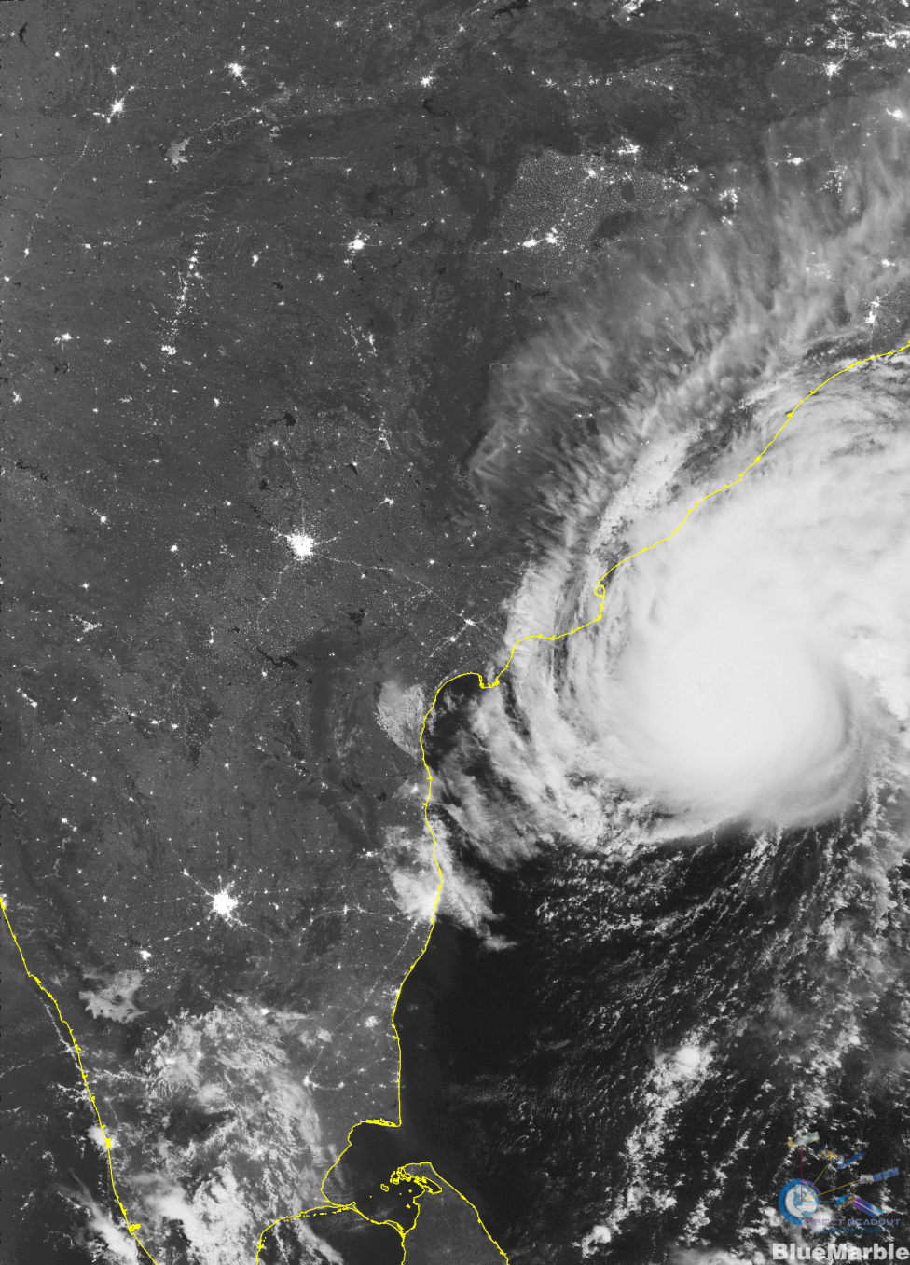
The VIIRS-DNB Enhanced NCC Product
Nov 20 2013; VIIRS-ENCC;
Cyclone Helen at Indian Coast
VIIRS Enhanced Near Constant Contrast
enhancements to the official NCC product, in collaboration with Dr. Miguel Román (NASA Science Team)
daytime and nighttime (all lunar phases) imagery
Can be used for nighttime operational analysis, weather, mapping infrastructure.

Slide 9
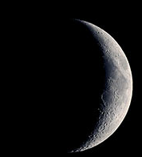
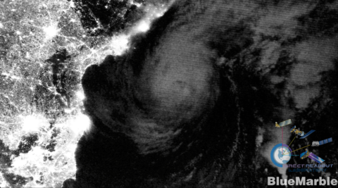
ENCC Night Imagery Enhancement
After
Before
Cyclone Madi; Indian coast, Bay of Bengal; Dec 9, 2013. 19:40 UTC

Slide 10
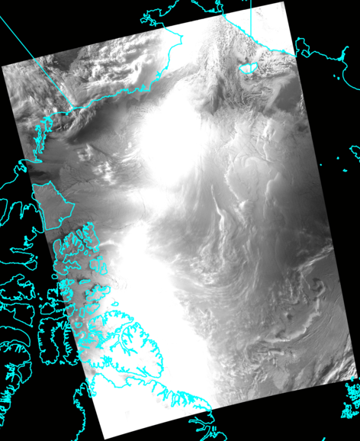
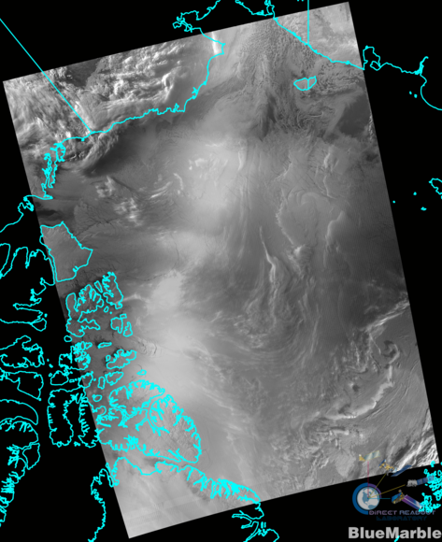
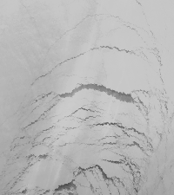
ENCC Twilight Enhancement
AFTER
BEFORE
October 25 2015; 18:33 UTC; VIIRS; Arctic Ocean Region

Slide 11
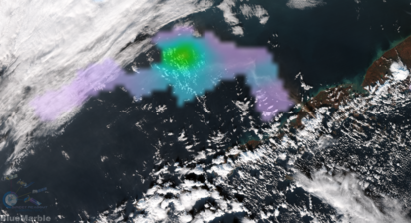
OMPS SO₂ Overlays
After: OMPS SO₂ overlay on VIIRS Sharpened True Color
Before: Standard Product
Volcano Pavlov Eruption; Alaska, 14 NOV 2014

Slide 12
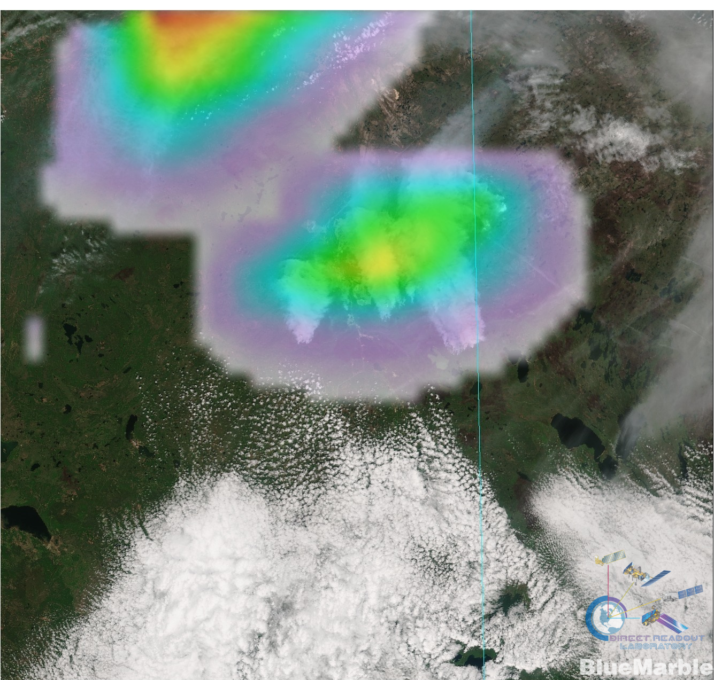
OMPS Aerosol Overlays
Fort McMurray Fire, Alberta, Canada, May 4, 2016

Slide 13
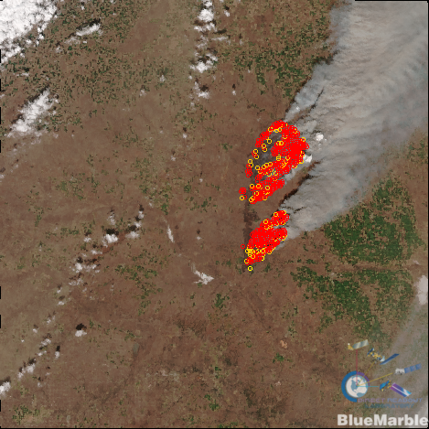
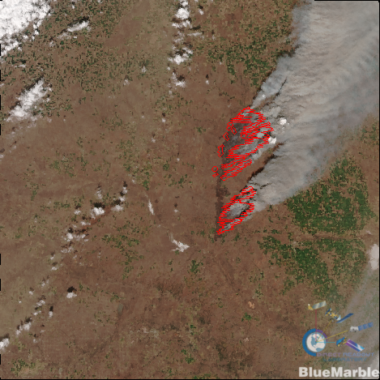
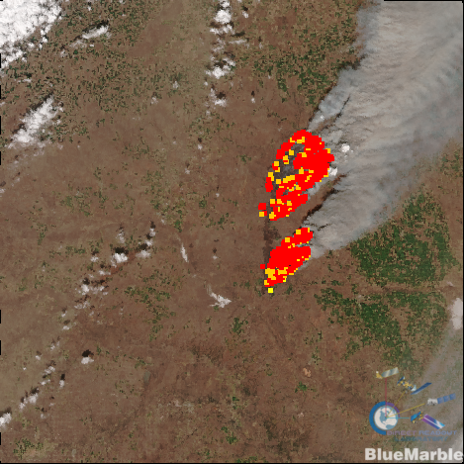
Fire Pixel & Perimeter Overlays
VIIRS True Color with Fire Overlays:
March 23 2016; 19:48 UTC; Oklahoma/Kansas, USA

Slide 14
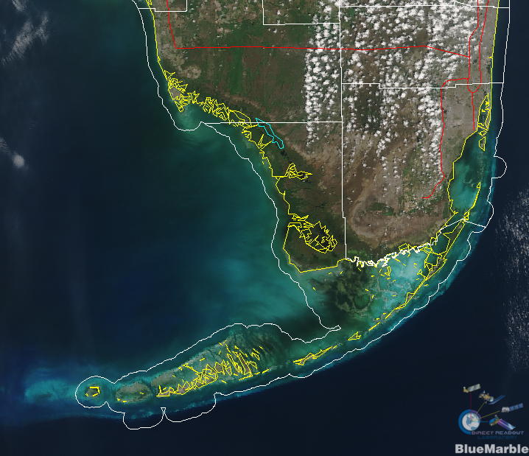
Shapefile Overlays
Choice of shapefiles
Choice of colors & linewidths

Slide 15
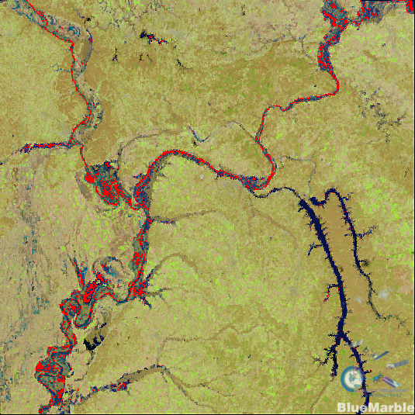
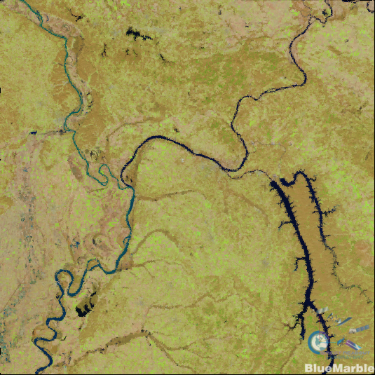
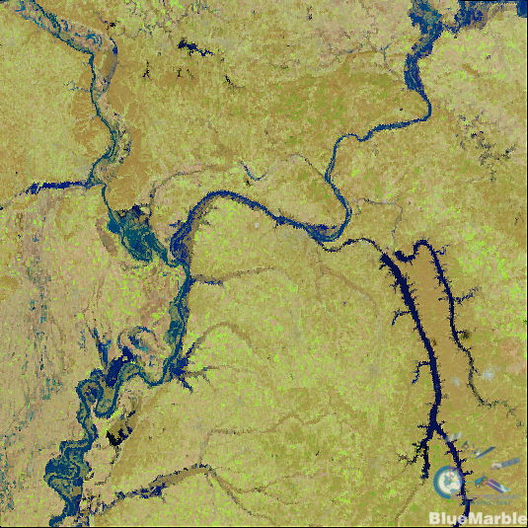
Change Detection
Dec 19th 2015
Jan 3rd 2016
Flood Locations in Red
Floods in River Mississippi, USA; VIIRS

Slide 16
BlueMarble Summary
user community feedback driven
http://directreadout.sci.gsfc.nasa.gov/?id=forum
Download BlueMarble http://directreadout.sci.gsfc.nasa.gov/?id=software
Empowers Users
Easy to Use
Applications focused products & utilities
Enhanced Imagery
Region-of-Interest & Swath Imagery

Slide 17
Extra slides

Slide 18
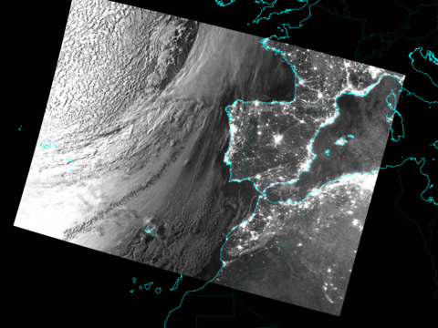
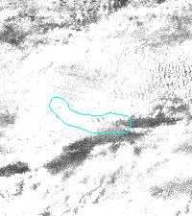
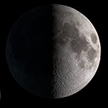
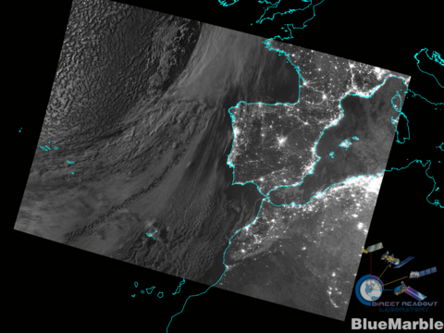
ENCC Night Imagery Enhancement
Before
After
Spain, Portugal, Morocco; Feb 17, 2016. 02:36 UTC

