Slide 1
EUMETSAT Operational
Hyperspectral Level 2 Products
from Global to Regional Services
T.August, A.Sorensen
T.Hultberg, M.Crapeau, D.Klaes,
E.Rojo, C.Cabanas, T.Heinemann

Slide 2
Outlook
IASI within EUMETSAT Polar System
IASI Sounding Products
Processor and performance overview
EARS-IASI Level 2
From global to regional (direct read-out) service, in support to regional applications

Slide 3
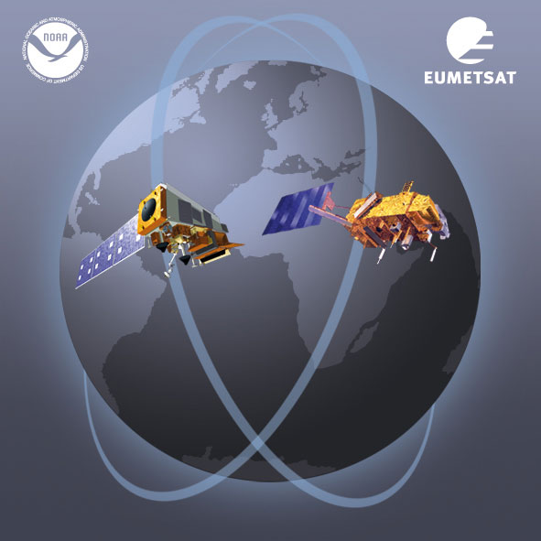
The EPS program
Metop is a series of three polar orbiting meteorological satellites which form the space segment component of the overall EUMETSAT Polar System (EPS).
Metop-A (launched on 19 October 2006) and Metop-B (launched on 17 September 2012) are in a lower polar orbit, at an altitude of 817 kilometres. Metop-C launch is planned in October 2018.
EPS is the European contribution to the Initial Joint Polar System Agreement (IJPS), an agreement between EUMETSAT and NOAA. Metop flies in a Low Earth orbit corresponding to local 'morning', while the US are responsible for the 'afternoon' coverage.

Slide 4
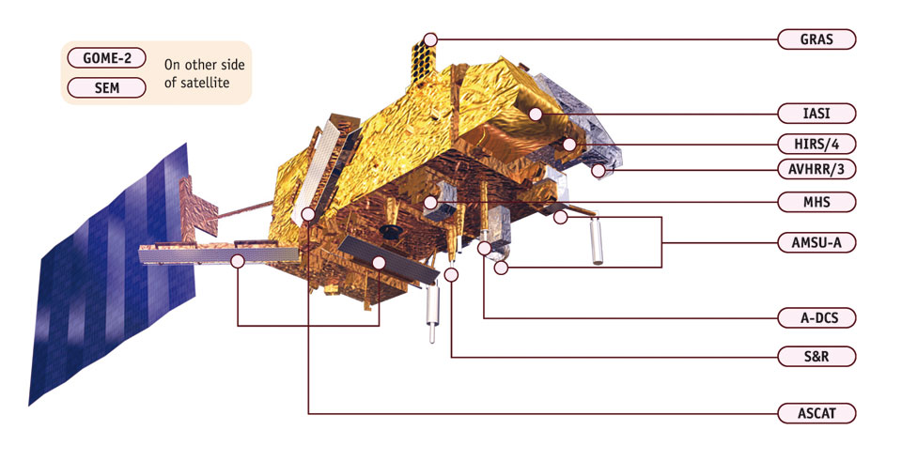
The Metop platform

Slide 5
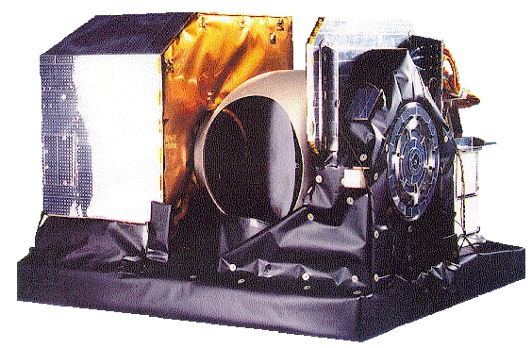
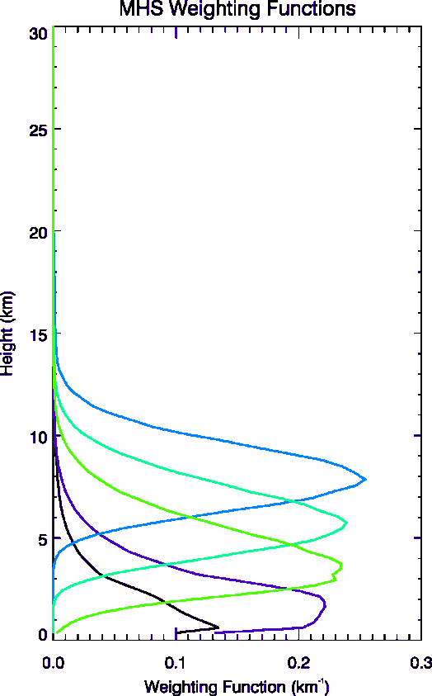
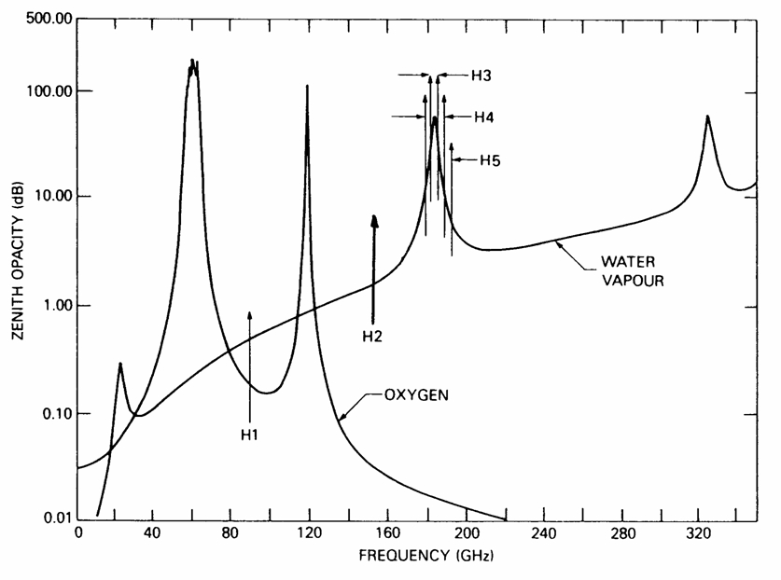
MHS: The Microwave Humidity Sounder

Slide 6
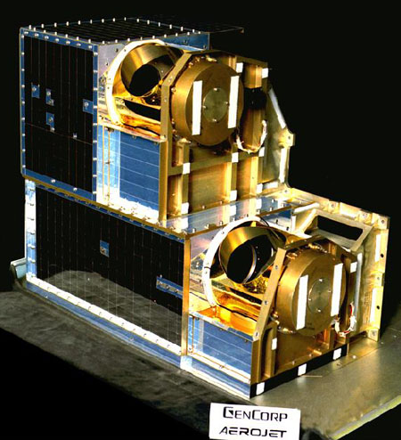
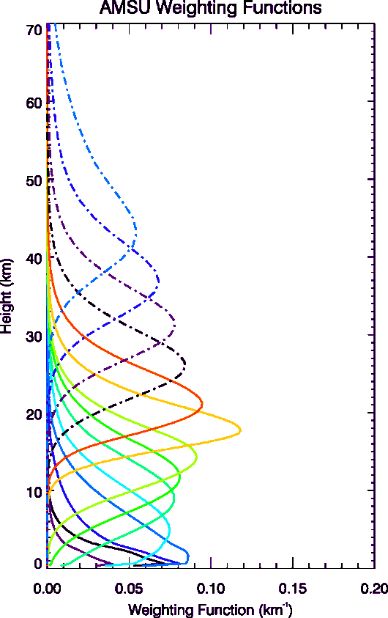
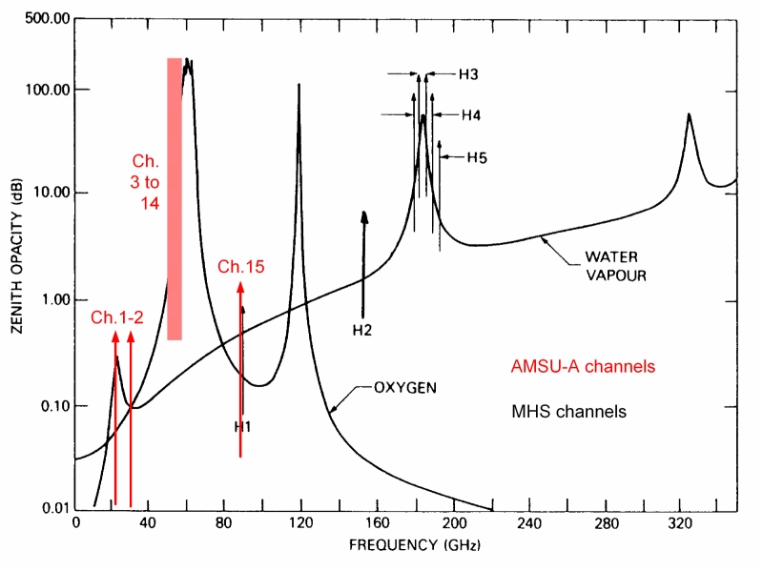
AMSU: The Advanced Microwave Sounding Unit

Slide 7
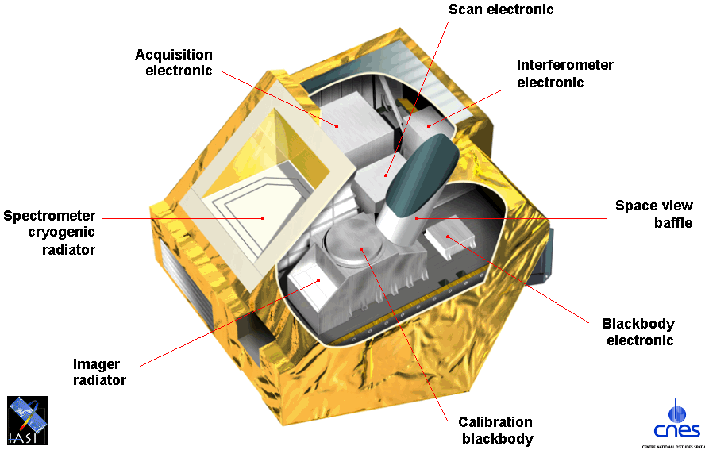
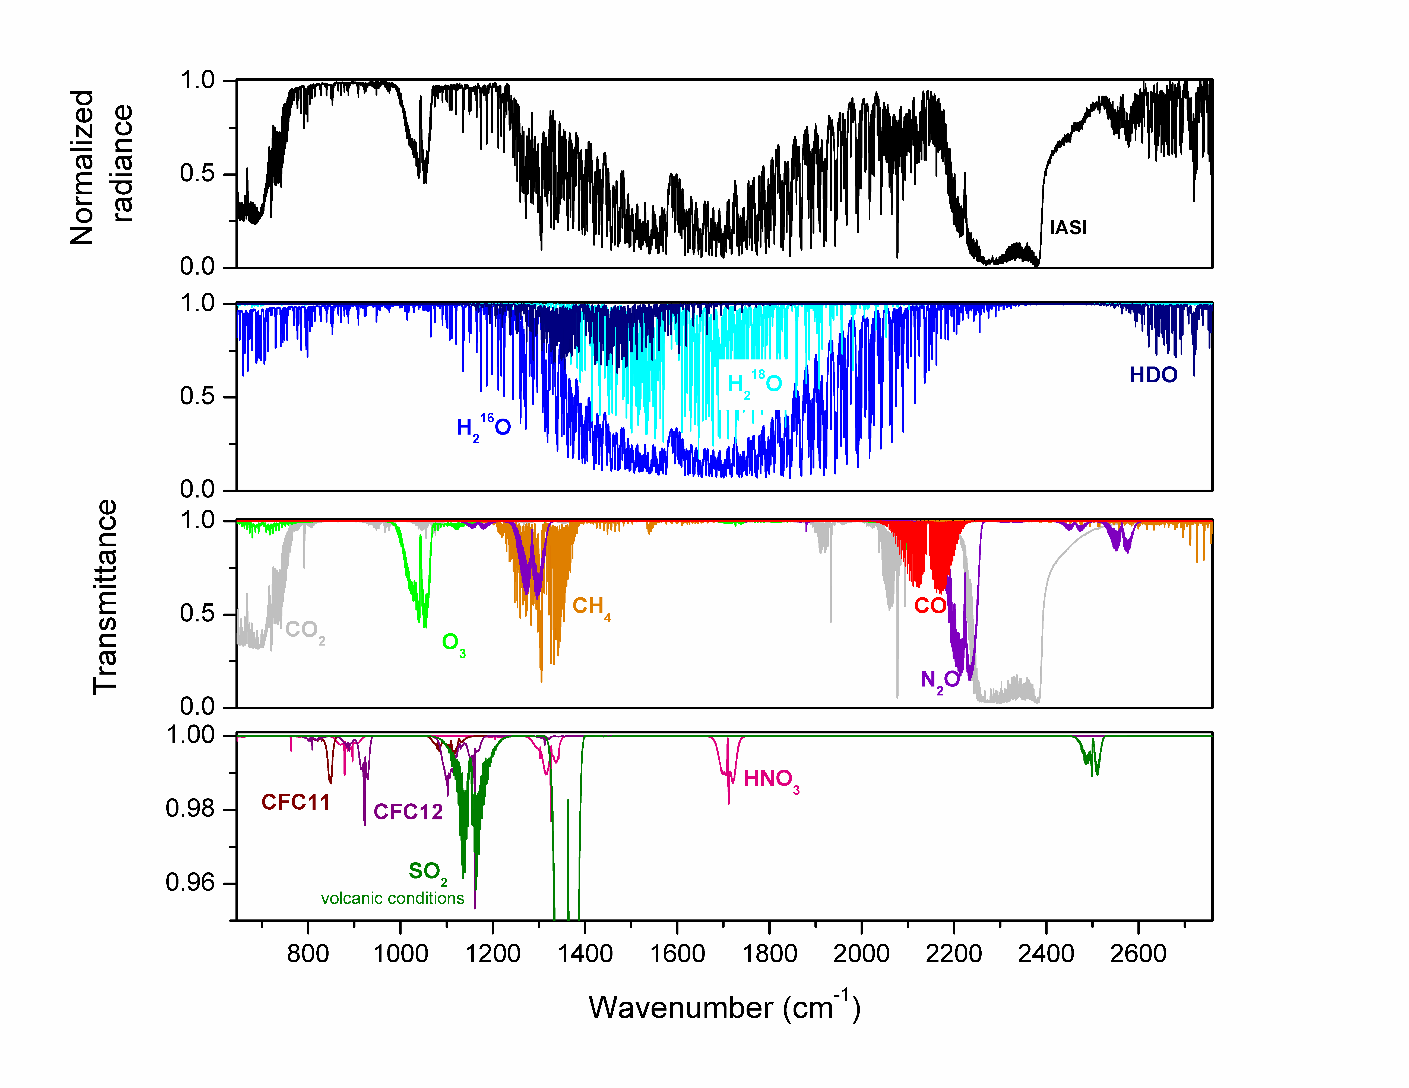
IASI: Infrared Atmospheric Sounding Interferometer
Infrared Fourier transform interferometer
Spectral range: 645 to 2760 cm⁻¹ (15.5-3.62 µm)
Spectral sampling: 0.25 cm⁻¹
Footprint: 12 km (Nadir)
Swath: ±1000km (± 48.3° scanning)
645 cm⁻¹
2760 cm⁻¹
Surface
Clouds
Aerosols
Surface
Clouds
Aerosols
Surface
Clouds
CO₂
O₃
CH₄
H₂O
CO
N₂O
CO₂
T profiles
+ SO₂, Volcanic ash, NH₃ and many more…
See talk by C: Retscher on Friday

Slide 8
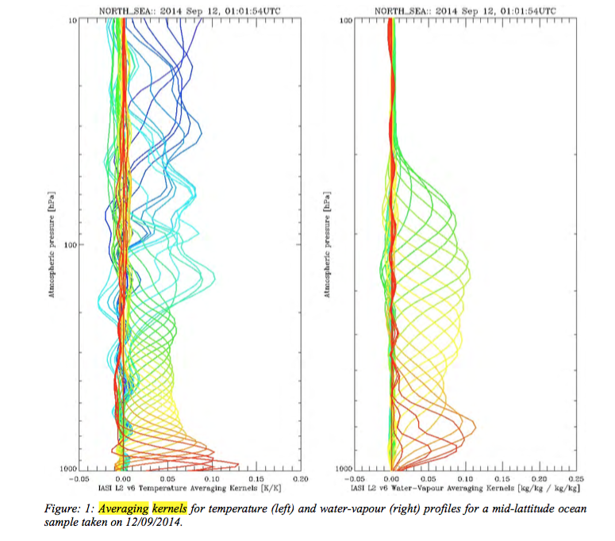
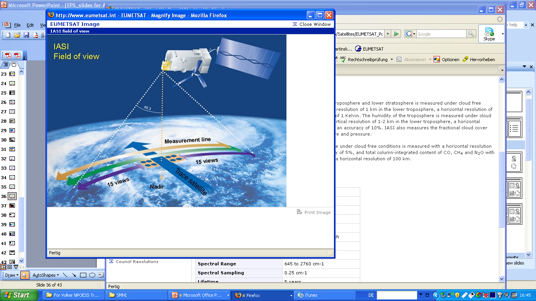
IASI: Infrared Atmospheric Sounding Interferometer
Sounding requirements:
Temperature 1K / 1km
Water-vapour 10% / 2km
Surface
Clouds

Slide 9
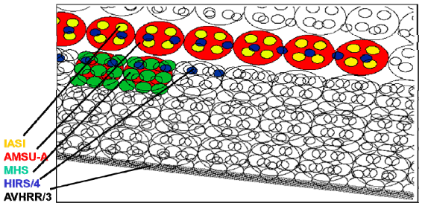
Collocation of IASI and companion instruments

Slide 10
Spatial and temporal coverage
Due to the nature of its low Earth Polar orbit, a Metop platform provides full Earth coverage twice a day, with more frequent overpasses over an area of interest at high latitudes.
The operation of two platforms provides two consective sets of information separated by ~50’ for a given area.

Slide 11
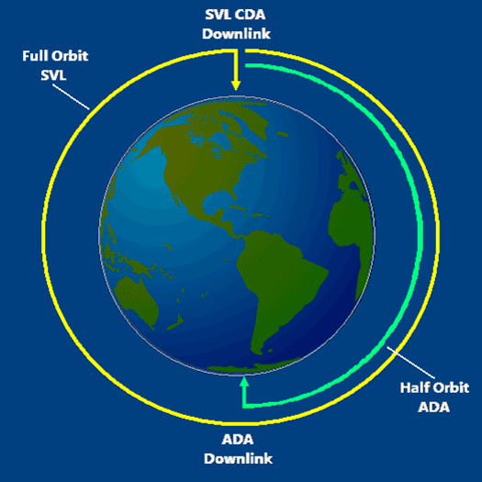
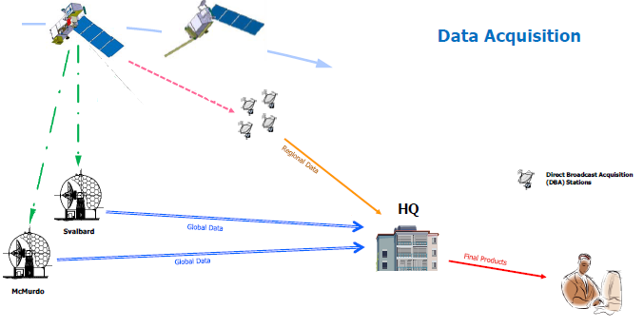
IASI data reception and dissemination
Regional
Under development for IASI Level 2
Global :: NRT < 2h

Slide 12
Outlook
IASI within EUMETSAT Polar System
IASI Sounding Products
Processor and performance overview
EARS-IASI Level 2
From global to regional (direct read-out) service, in support to regional applications

Slide 13
The IASI L2 products
Disseminated in near-real time (<2h Global)
+ Averaging
Kernels
Temperature (vertical profiles)
Humidity (vertical profiles)
Surface Temperature (Land & Sea)
TWT
EMS
Surface emissivity
CLD
Cloud detection, cloud fraction & top height
OZO
O₃ profiles (+ Averaging Kernels)
TRG
CO, N₂O, CH₄, CO₂ Total columns
CO profiles + Averaging Kernels, (SO₂, HNO₃)

Slide 14


2. IASI L2 v6 processor Very high-level overview
Extremely Fast
MW+IR (nominally)
IR-only (fall-back)
See talk by C. Retscher on Friday
Atmospheric Composition
All-sky
MW+IR
PWLR³ regression
IASI L2
OEM
TWT
TRG
IASI L1C
OZO
(x-x_{a})^{T}.S_{x}⁻¹.(x-x_{a})
+
(F(x)-y)^{T}.S_{y}⁻¹.(F(x)-y)
NWP
AMSU/MHS
AVHRR
EMS
CLD
Slow
IR-only (so far)
Conf. data
Static db

Slide 15
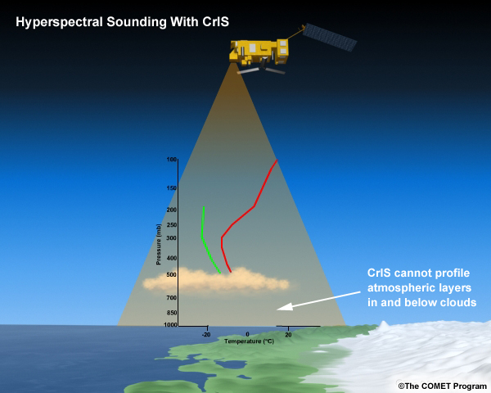
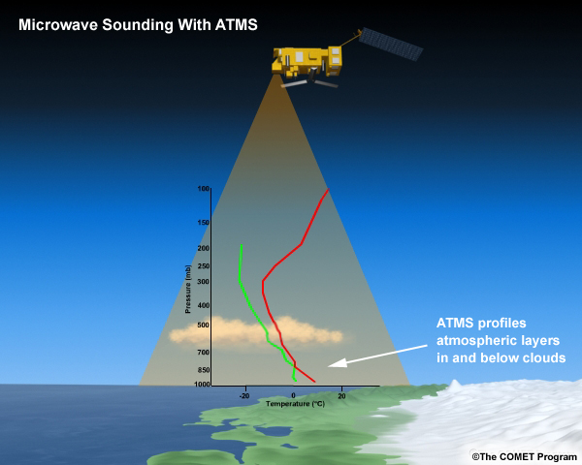
2. IASI L2 v6 processor Synergy MW + IR
IR Sounding with IASI
MW Sounding with AMSU/MHS
AMSU/MHS profile atmospheric layers in and below clouds
IASI can’t profile atmospheric layers in and below the clouds
Adapted from MetEd UCAR material
(University Corporation for Atmospheric Research, Boulder CO, US)

Slide 16
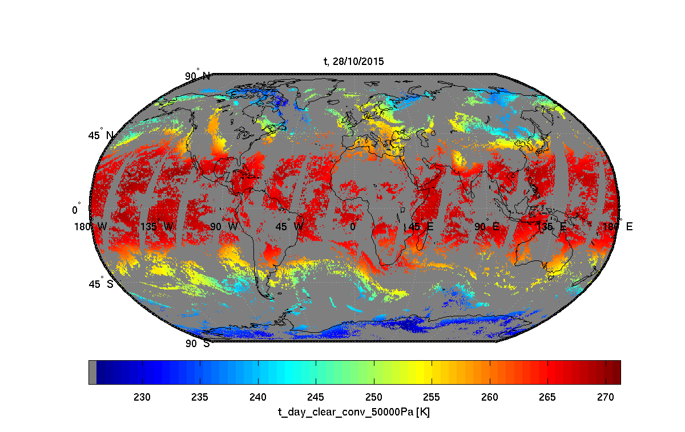
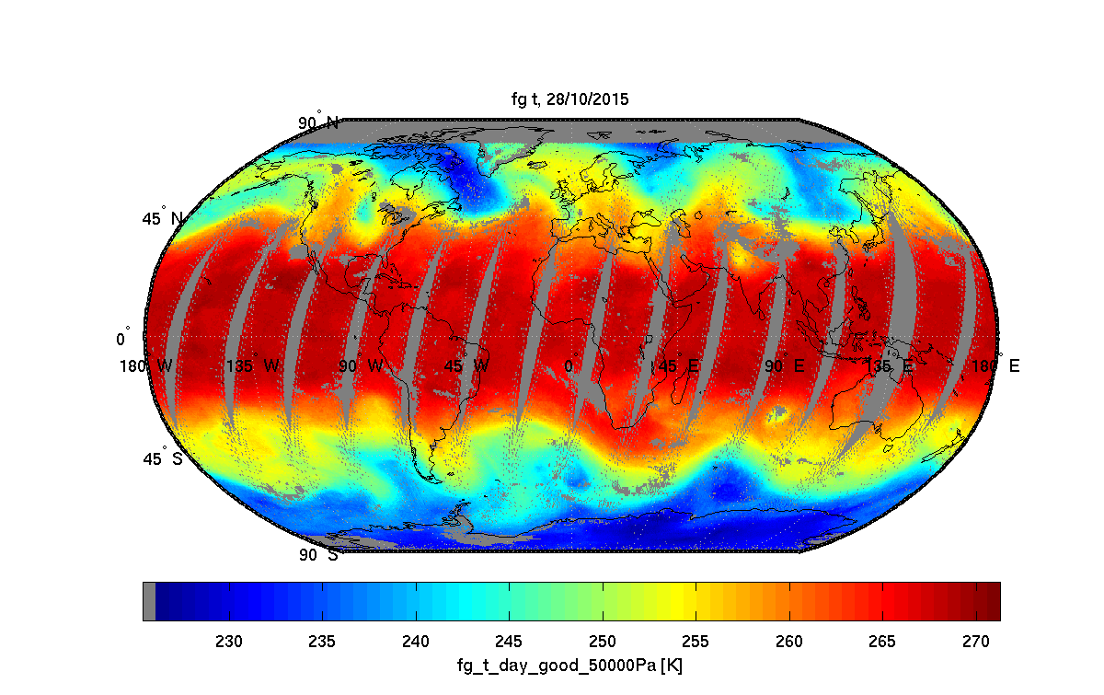
2. IASI L2 v6 processor Typical useful yield
Clear-sky OEM
All-sky PWLR³

Slide 17
2. IASI L2 v6 processor Exploiting horizontal correlation
A single input vector with all measurements
1
2
…
…
IASI₁
IASI₄
AMSU
MHS₁
MHS₉
4
3
PWLR³
3D Piece-Wise Linear Regression
K-mean clustering to define regression classes
Ensemble retrieval with different clustering
Simultaneous retrieval in adjacent pixels
T, q, Ts, O₃, surface emissivity, cloud
for every IASI pixel separately

Slide 18
1. IASI L2 v6 processor Performance assessment
The performances of IASI L2 v6 temperature and humidity products have been assessed in-house and also in various external Institutes through cooperations: SSEC/Univ. Wisconsin, NCAR, NOAA… with radiosonding, numerical models, ground-based measurements…
  full details in
  “IASI L2 v6 Validation Report” EUM/TSS/REP/14/776443, 290pp
  “IASI L2 v6.2 Validation Report” EUM/RSP/REP/16/857500, 73pp

Slide 19
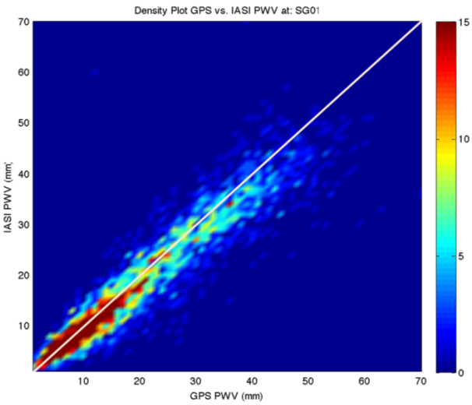
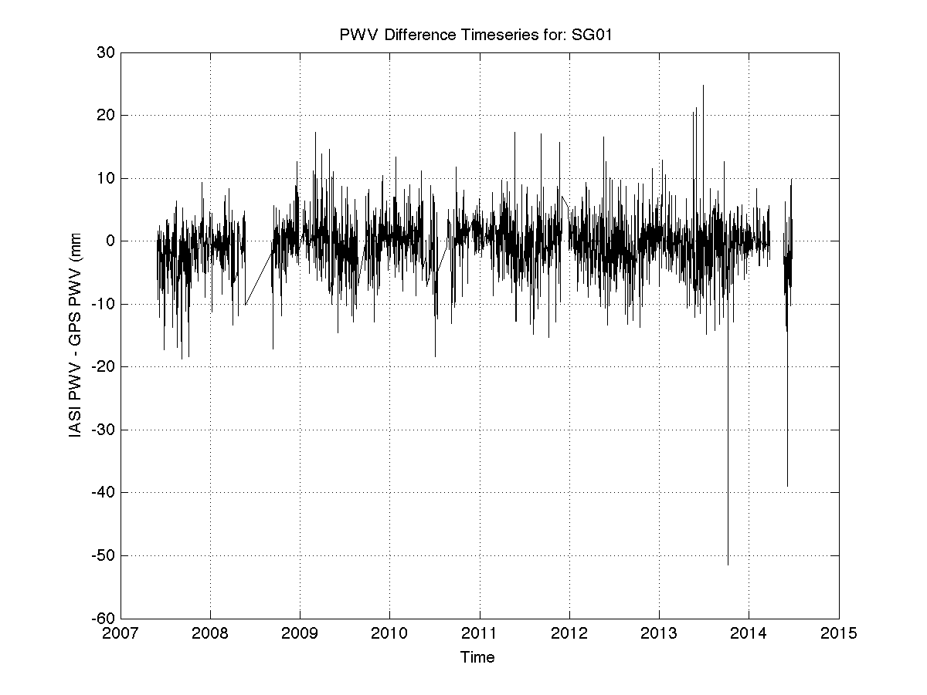
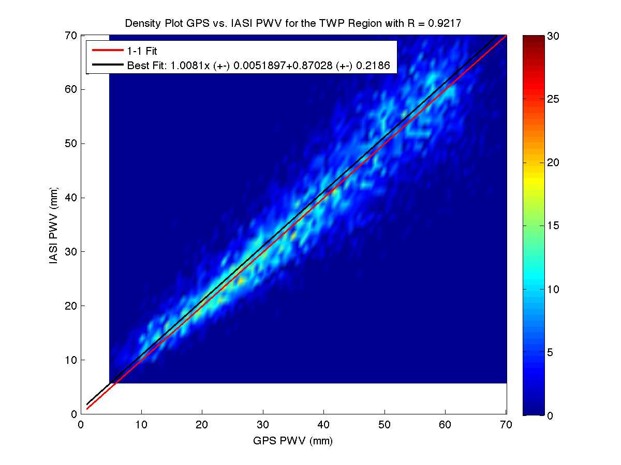
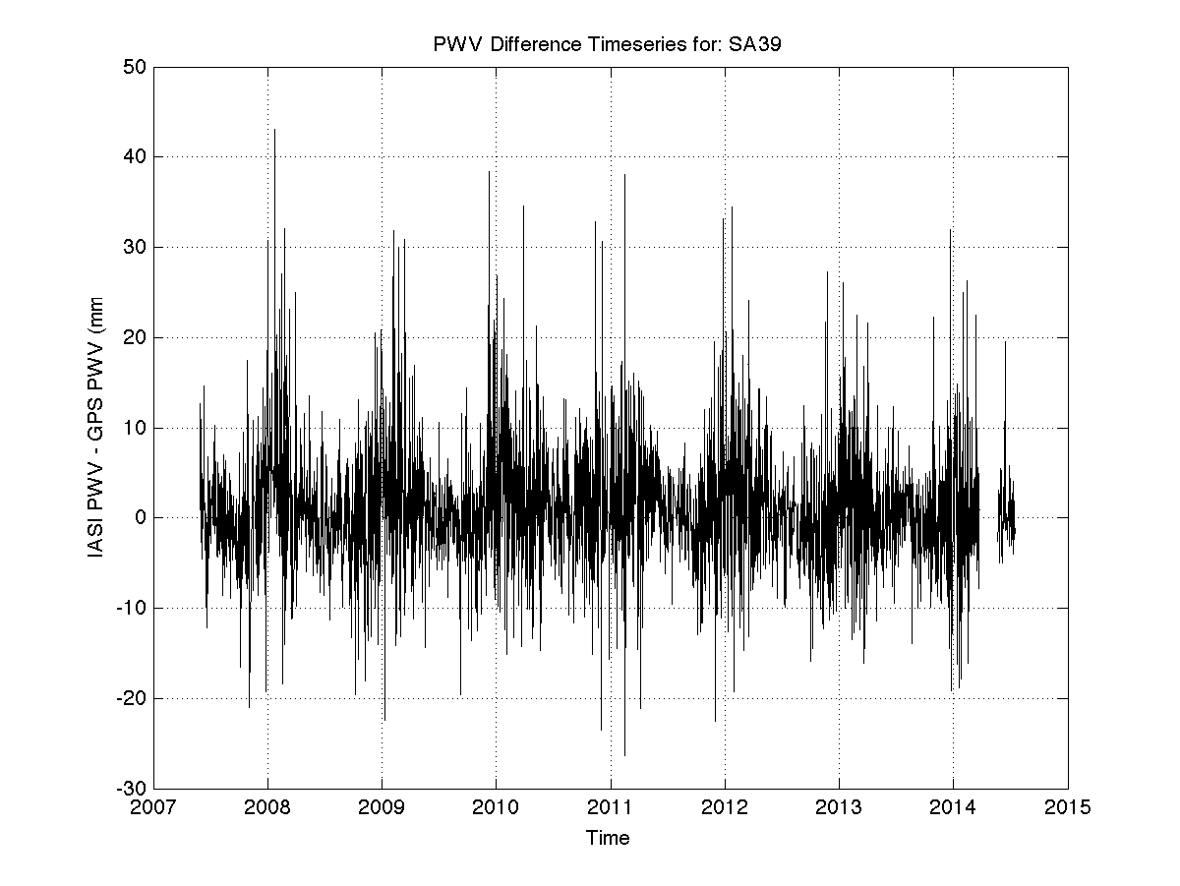
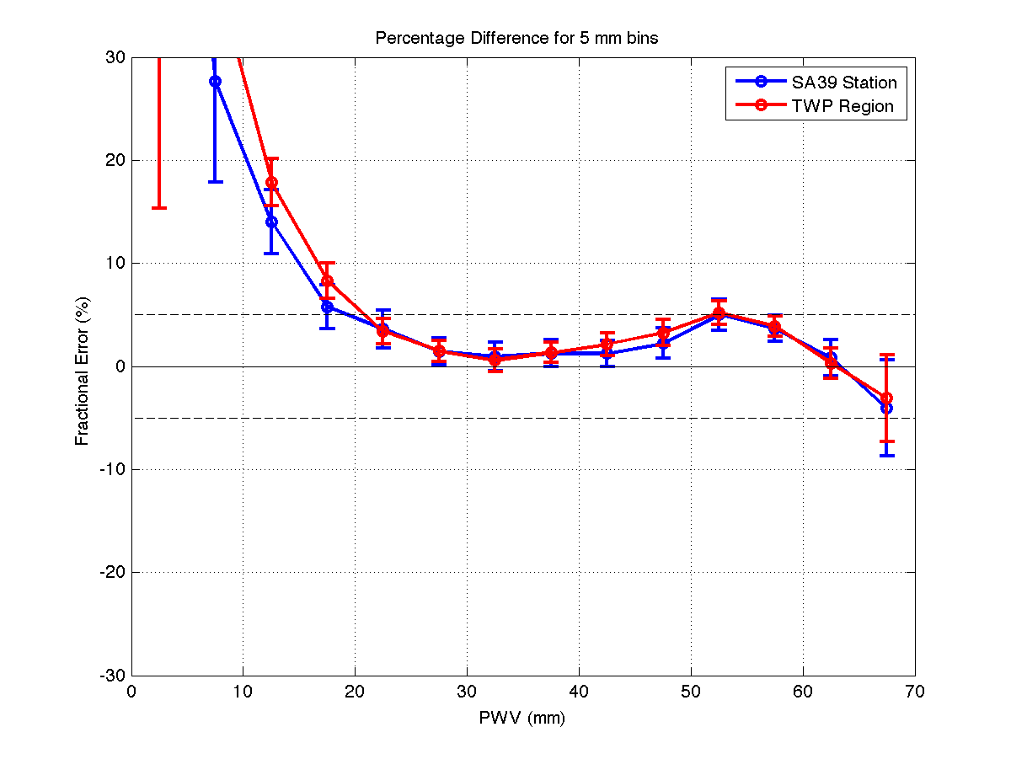
2. IASI L2 v6 performances TCWV vs ground-based RO
IASI-A v6
IASI-B v6
AIRS v6
Lamont
+5%
-5%
IASI - GPSRO
2007 → 2014
Darwin
+5%
-5%
Relative accuracy
After Bedka et al, JGR 2010
IASI vs GPS-RO
0
30
PWV [mm]
60
Results. Jacola Roman

Slide 20
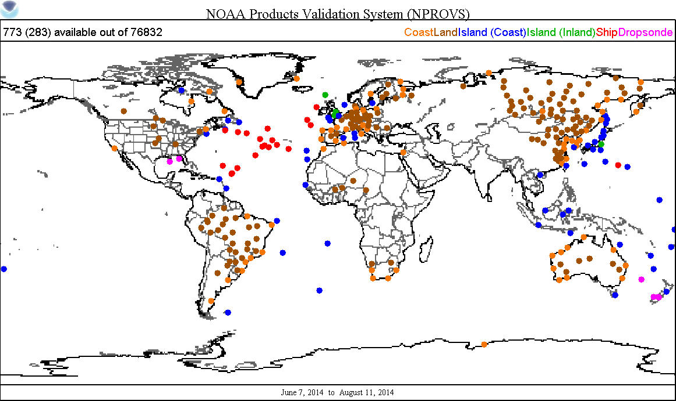
2. IASI L2 v6 performances Monitoring with in situ data
Credits: NOAA / NESDIS Center for Satellite Applications and Research.
http://www.star.nesdis.noaa.gov/smcd/opdb/poes/NPROVS.php

Slide 21
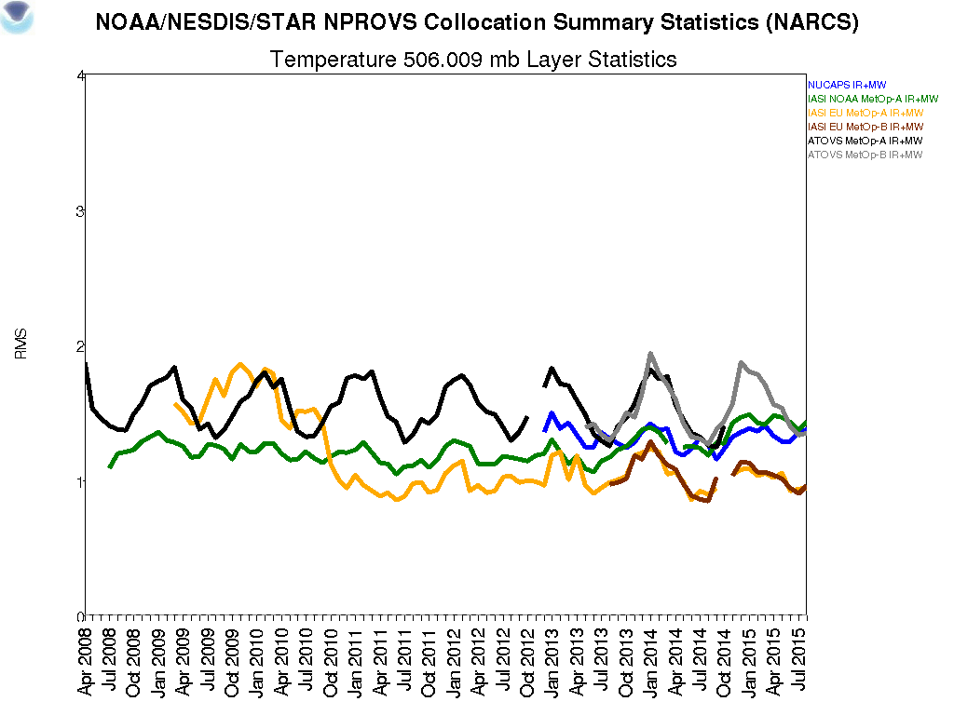
2. IASI L2 v6 performances Monitoring with in situ data
www.star.nesdis.noaa.gov/smcd/opdb/nprovs/NPROVS_trends.php#crumb
EUMETSAT L2
IASI+MW
Metop-A
Metop-B
T @ 500 hPa, Sea
1K rms
v4
v5
v6
2009
2010
2011
2012
2013
2014
2015
Credits: B. Sun, T. Reale (NOAA)

Slide 22
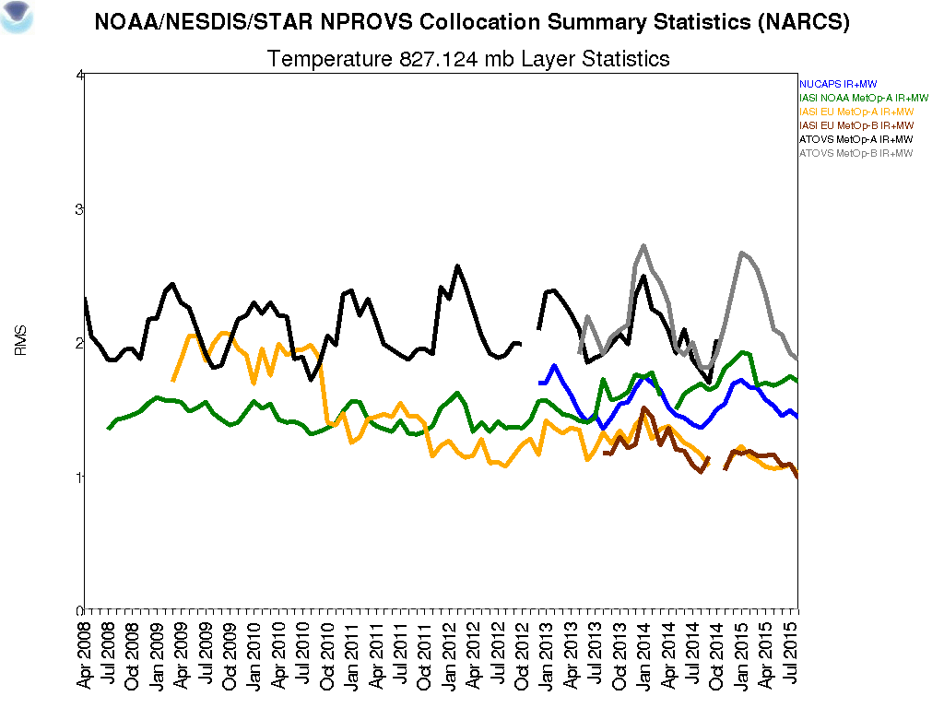
2. IASI L2 v6 performances Monitoring with in situ data
www.star.nesdis.noaa.gov/smcd/opdb/nprovs/NPROVS_trends.php#crumb
EUMETSAT L2
IASI+MW
Metop-A
Metop-B
T @ 827 hPa, Sea
1K rms
v4
v5
v6
2009
2010
2011
2012
2013
2014
2015
Credits: B. Sun, T. Reale (NOAA)

Slide 23
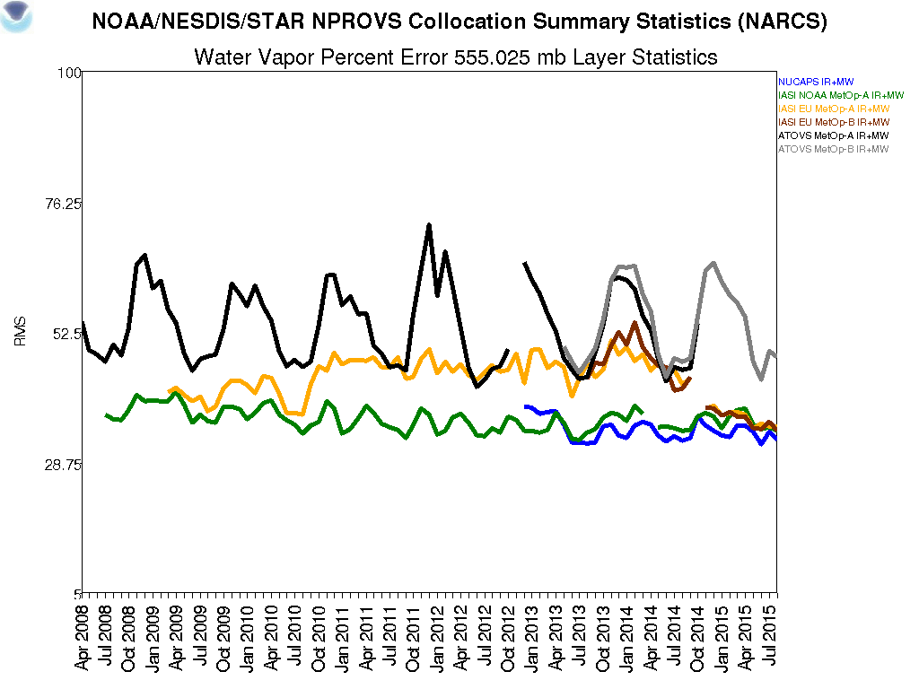
2. IASI L2 v6 performances Monitoring with in situ data
www.star.nesdis.noaa.gov/smcd/opdb/nprovs/NPROVS_trends.php#crumb
EUMETSAT L2
IASI+MW
Metop-A
Metop-B
WV @ 555 hPa, Land
v4
v5
v6
2009
2010
2011
2012
2013
2014
2015
Credits: B. Sun, T. Reale (NOAA)

Slide 24
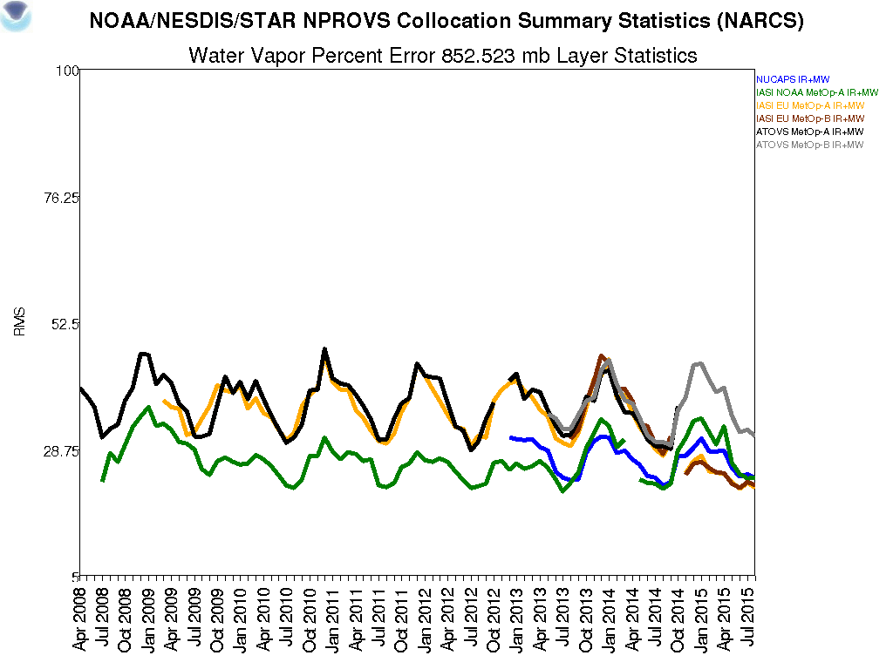
2. IASI L2 v6 performances Monitoring with in situ data
www.star.nesdis.noaa.gov/smcd/opdb/nprovs/NPROVS_trends.php#crumb
EUMETSAT L2
IASI+MW
Metop-A
Metop-B
WV @ 850 hPa, Land
v4
v5
v6
2009
2010
2011
2012
2013
2014
2015
Credits: B. Sun, T. Reale (NOAA)

Slide 25
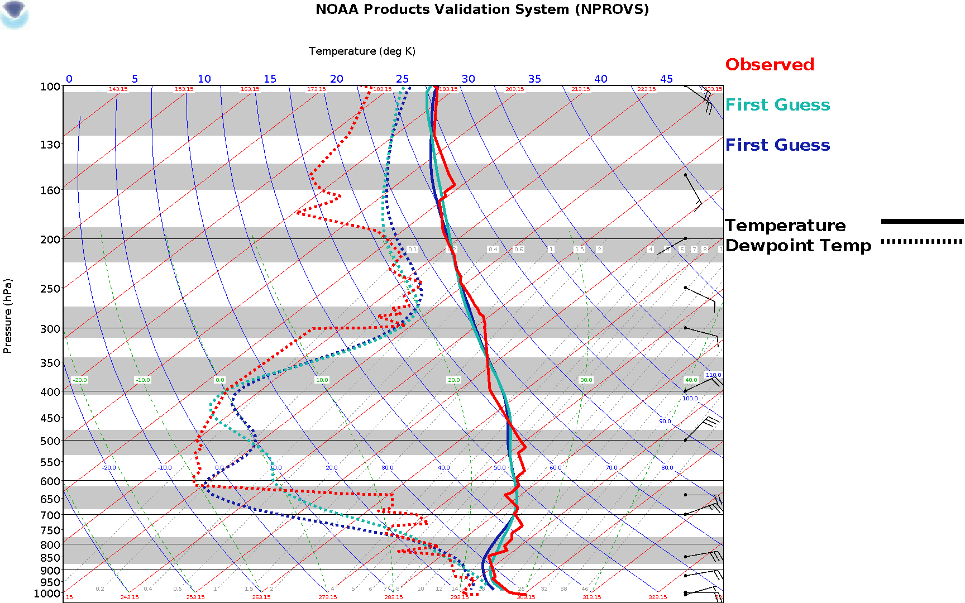
2. IASI L2 v6 performances Monitoring with in situ data
Metop-A
Metop-B
Credits: T. Reale (NOAA)

Slide 26
2. IASI L2 v6 performances v6.2: A fresh new release
The version 6.2 of the IASI L2 processor was released in operations on 2 June 2016.
It improves further the atmospheric sounding as compared to v6.0 (operational since September 2014), with the introduction of the PWLR³, and provides enhanced surface and CO products.

Slide 27
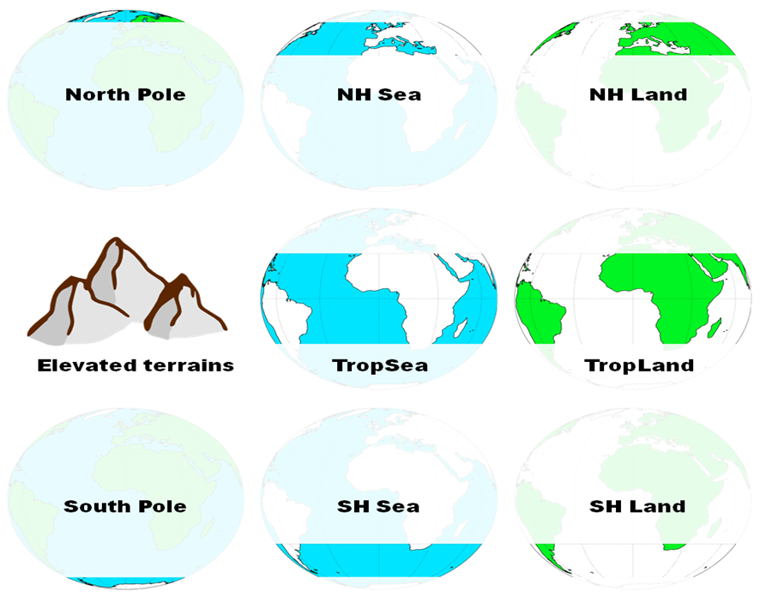
2. IASI L2 v6.2 performances Assessment with NWP
Arctic
Antarctic

Slide 28
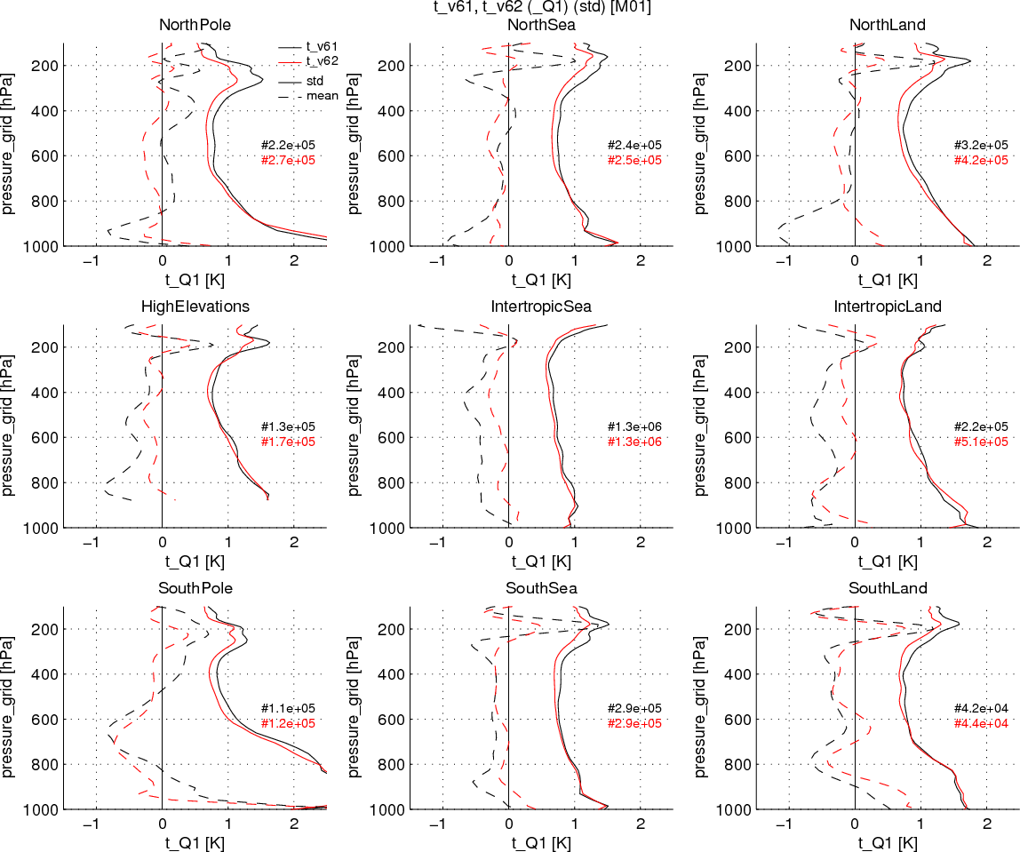
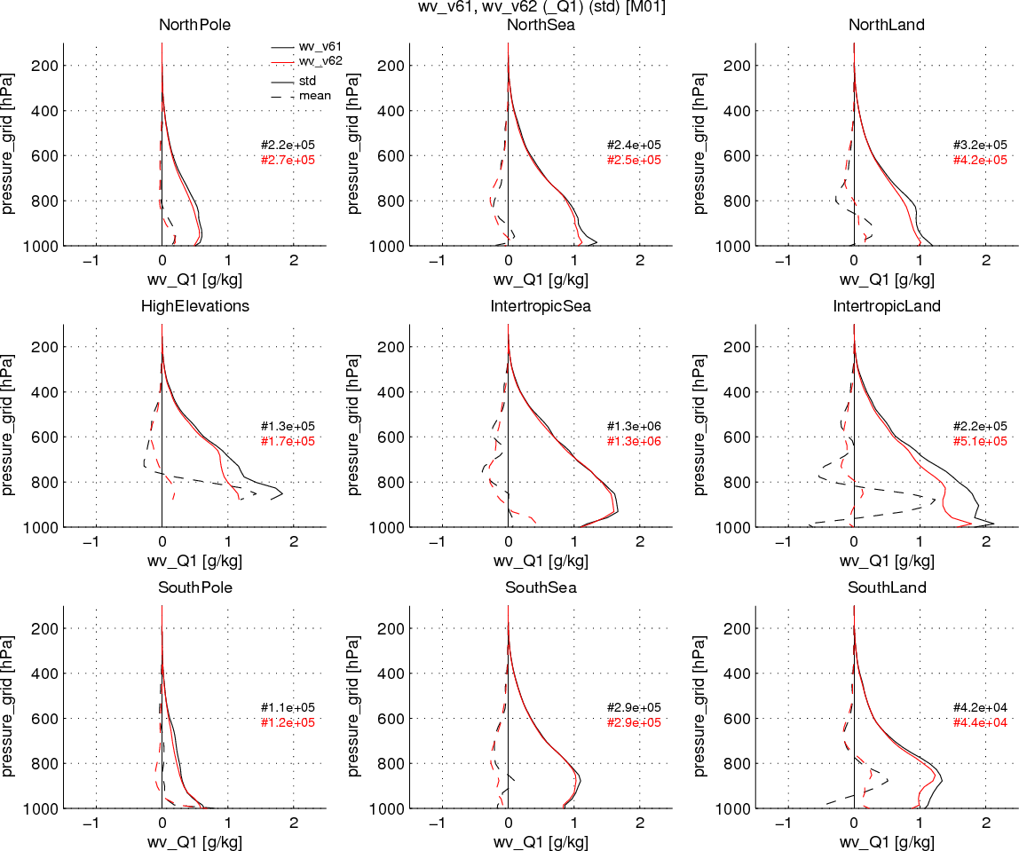
2. IASI L2 v6.2 performances Assessment with NWP
IASI L2 v6.2 reduces biases further and brings the retrievals over bare surfaces (especially of humidity) at a consistent quality level
Clear-sky OEM
L2 temperature vs ECMWF analyses
L2 humidity vs ECMWF analyses
V6.1
V6.2

Slide 29
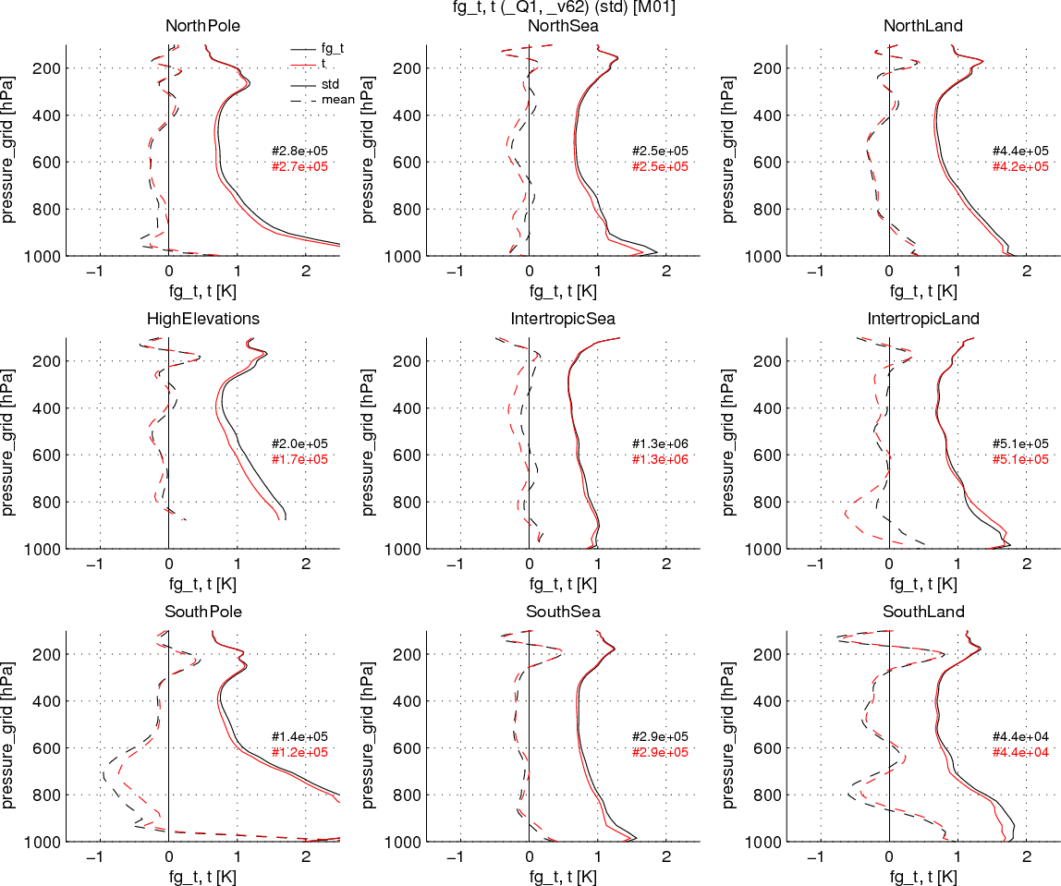
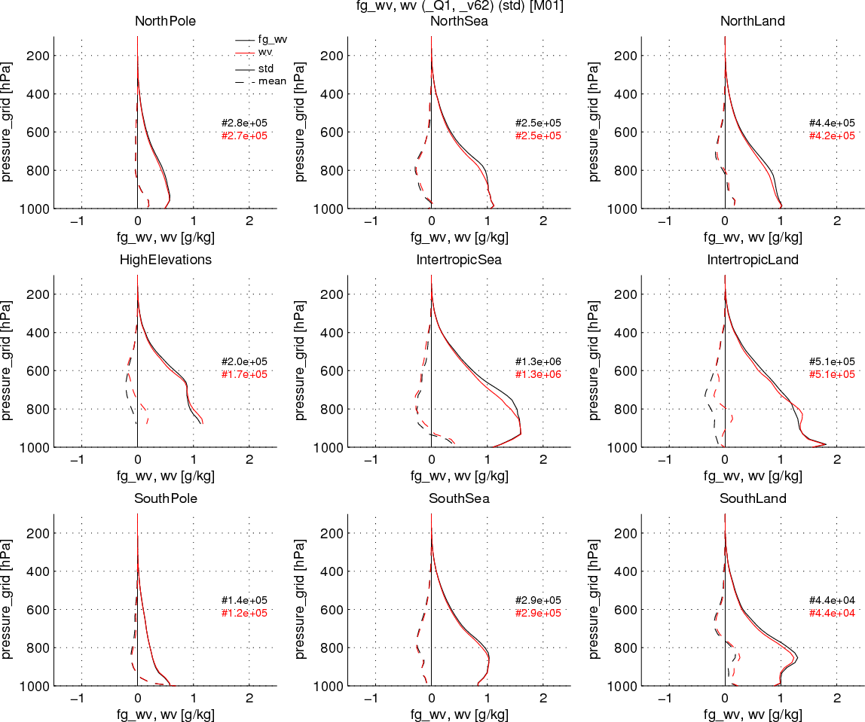
2. IASI L2 v6.2 performances Assessment with NWP
The nearly all-sky first-guess products PWLR³ are very much comparable in accuracy and precision to the performances reached with the optimal estimation method in clear-sky, with typical precision of 0.5 to 0.7 K in the mid-troposphere for temperature and 1 to 1.5 g/kg in the boundary layer for humidity.
L2 temperature
vs ECMWF analyses
L2 humidity
vs ECMWF analyses
PWLR³
OEM

Slide 30
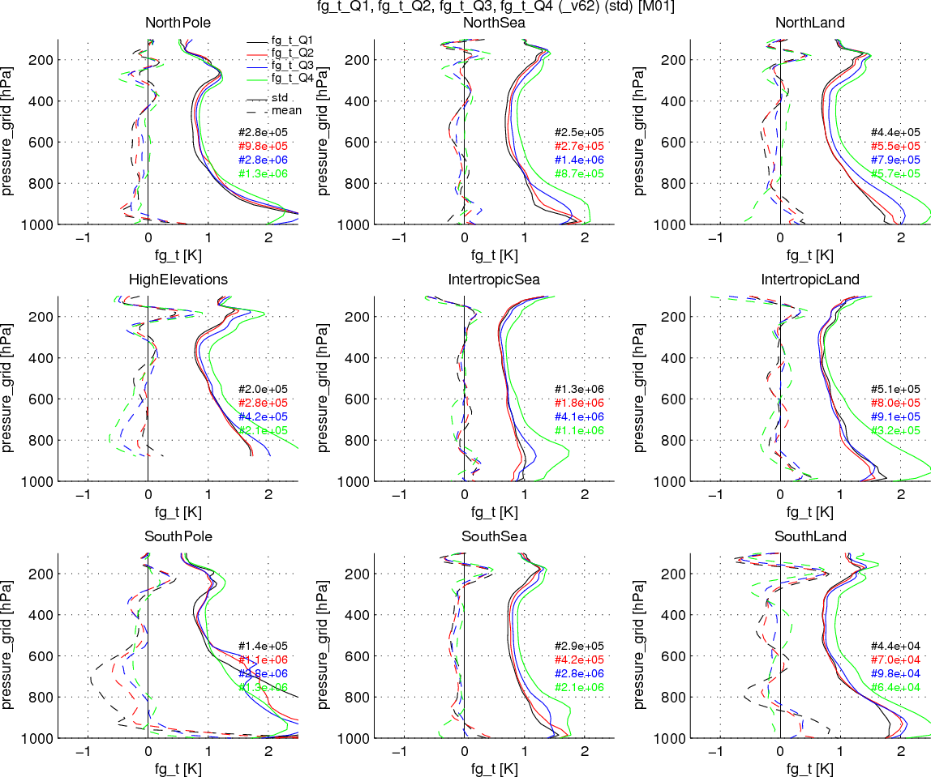
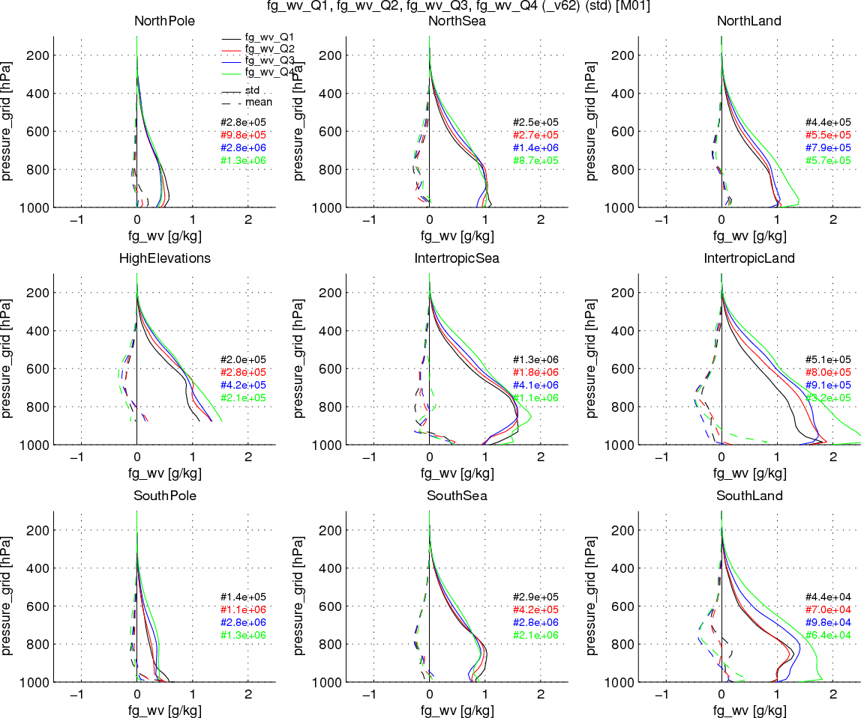
2. IASI L2 v6.2 performances Assessment with NWP
The nearly all-sky first-guess products PWLR³ are relatively robust against cloud contamination
L2 temperature
vs ECMWF analyses
L2 humidity
vs ECMWF analyses
Clear-sky
Likely clear
Partly cloudy
Fully cloudy

Slide 31
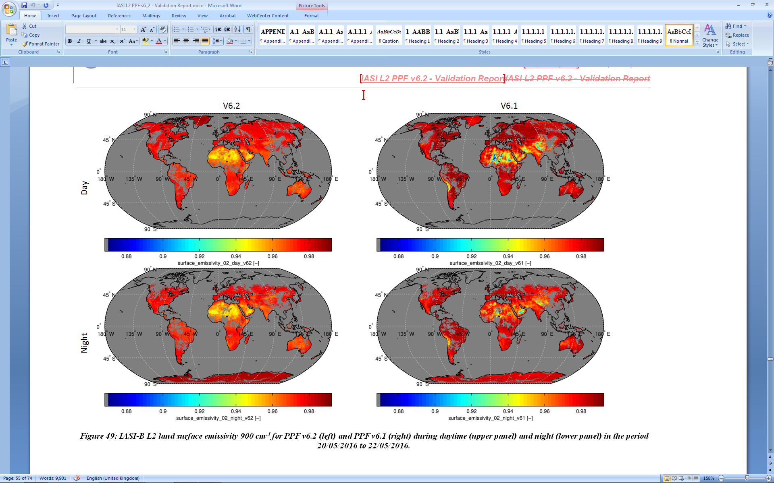
2. IASI L2 v6.2::PWLR³ A new surface emissivity product
The PWLR³ enables the retrieval of surface emissivity over continental surfaces, which exhibit more realistic diurnal variations and fits better IASI (radiance) observations.
Day
V6.2
V6.1
Night

Slide 32
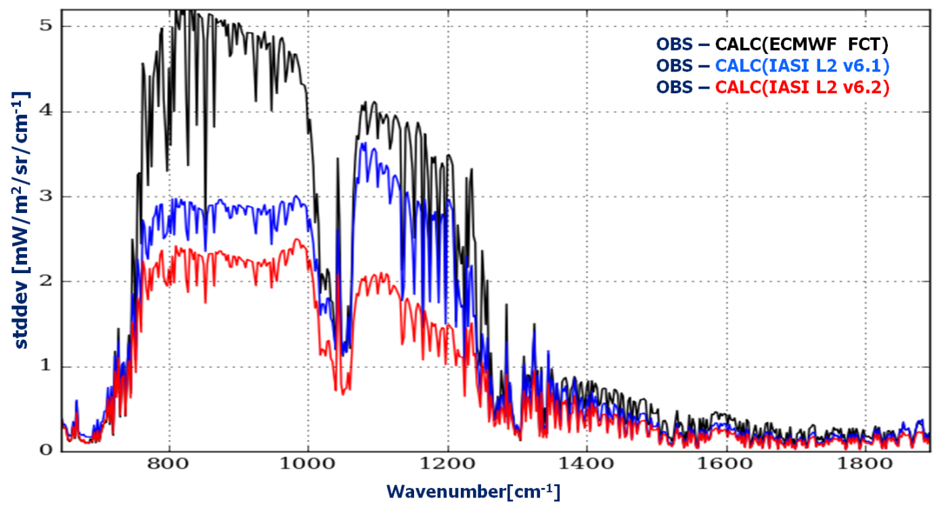
2. IASI L2 v6.2::PWLR³ A new surface emissivity product
16/05/2016 over land surfaces within [60°S;60°N] latitudes
OBS - CALC(ECMWF FCT + static ems atlas)
OBS - CALC(IASI L2 v6.1 T,q,O₃,Ts,ems)
OBS - CALC(IASI L2 v6.2 T,q,O₃,Ts,ems)

Slide 33
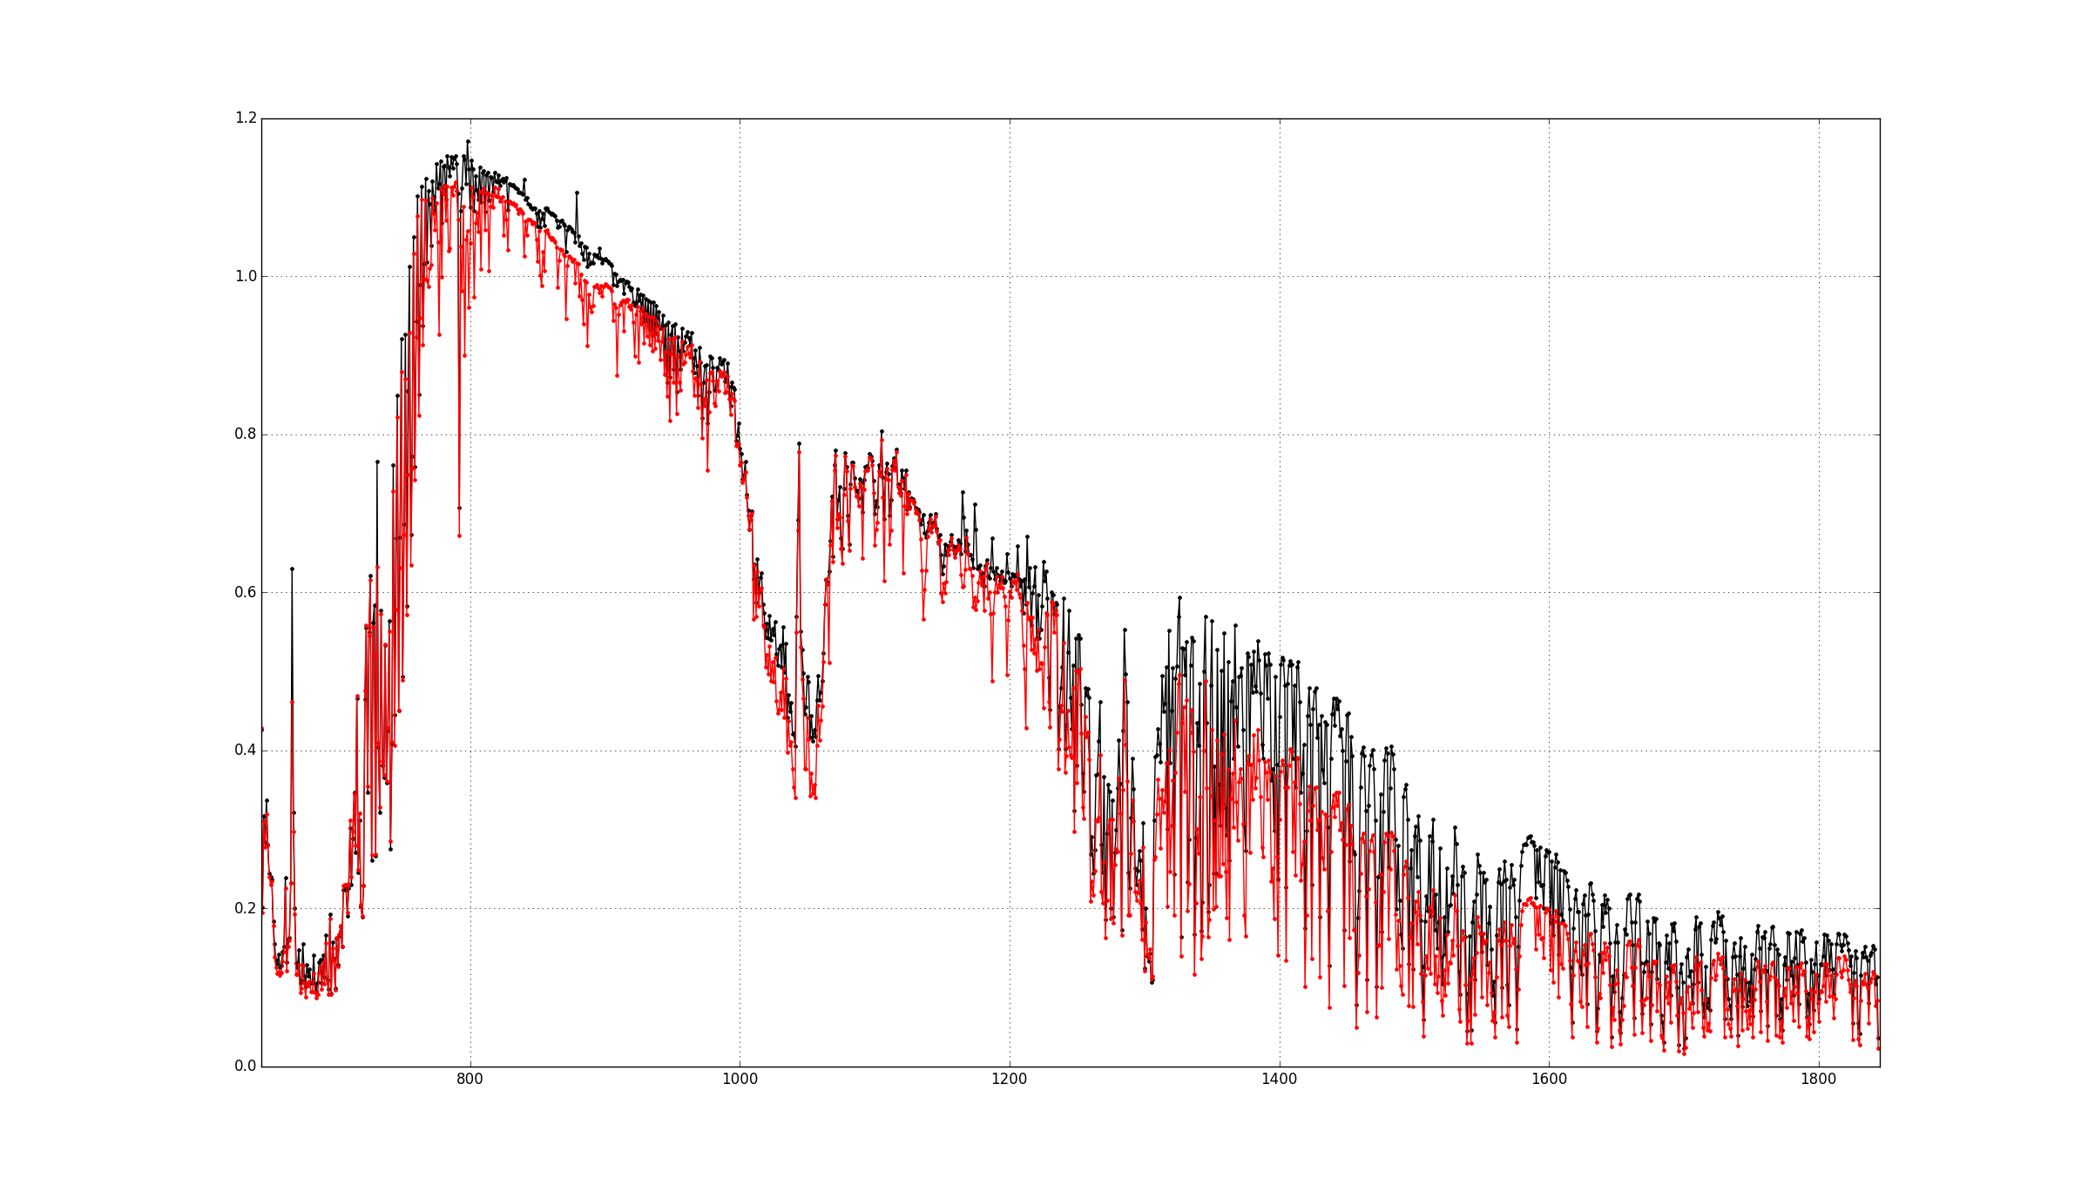
2. IASI L2 v6 performances Residual assessment
13/01/2014 :: clear-sky maritime situations
OBS – CALC(ECMWF ANA)
OBS – CALC(PWLR³)
1.0
mW/m²/sr/cm^{-!}
Surface
Better fit with PWLR³ in all spectral regionsns
Surface
Ozone
Temperature
Water-vapour
0
800
1000
1200
cm⁻¹
1400
1600
1800

Slide 34
The recent evolutions in the sounding products quality raised interests in the User community. The temperature and humidity products are commonly used in global and climate applications, where NRT~1.5h is sufficient.
Owing to its precision -comparable to OEM-, to the very high useful yield (85%) and minimal computation cost (one day processed within 8mn on a desktop PC), the PWLR³ has the potential to serve regional applications where more stringent timeliness is required.

Slide 35
Outlook
IASI within EUMETSAT Polar System
IASI Sounding Products
Processor and performance overview
EARS-IASI Level 2
From global to regional (direct read-out) service, in support to regional applications

Slide 36
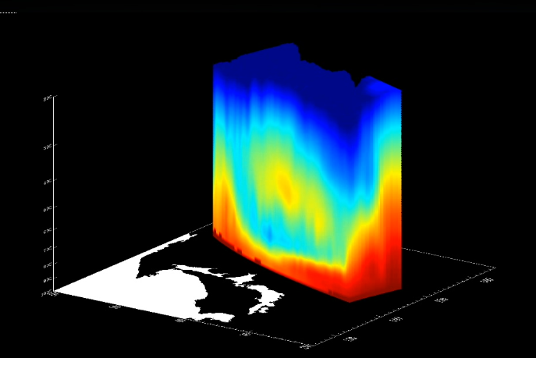
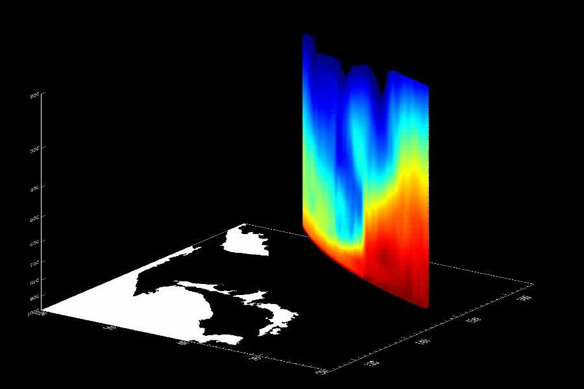
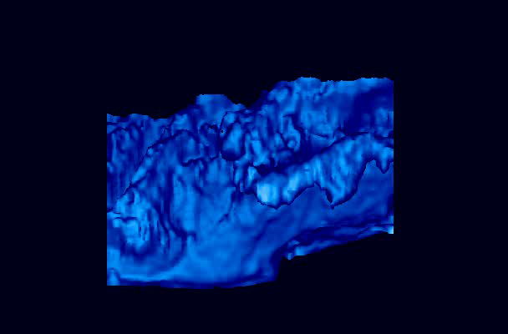
3. New utilisations of IASI L2 3D Humidity fields
29/09/2013 ~00UTC
The PWLR³ enables accurate “all-sky” retrievals of 3D WV fields, nominally exploiting MW and IR.

Slide 37
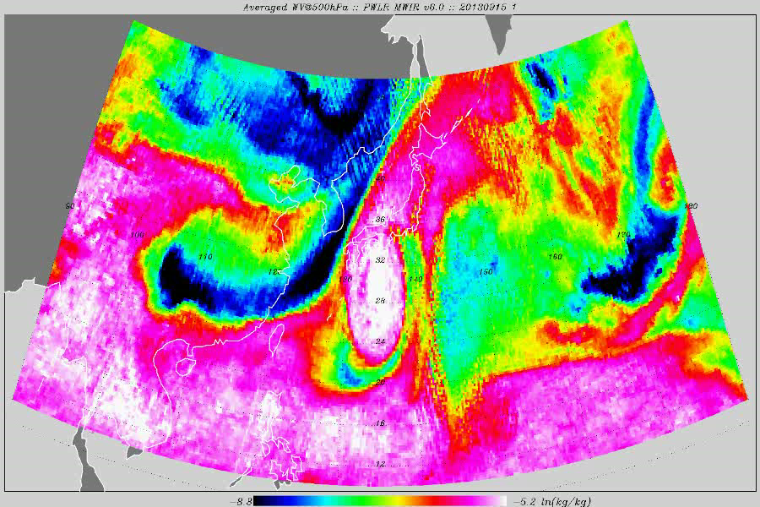
3. New utilisations of IASI L2 3D winds?
September 2013
H₂0 retrieved at 500hPa
The derivation of atmopsheric motion vectors profiles from the water-vapour 3D information is being studied, also taking advantage of the dual coverage with Metop-A and Metop-B.
Composite of
Metop-A and Metop-B products

Slide 38
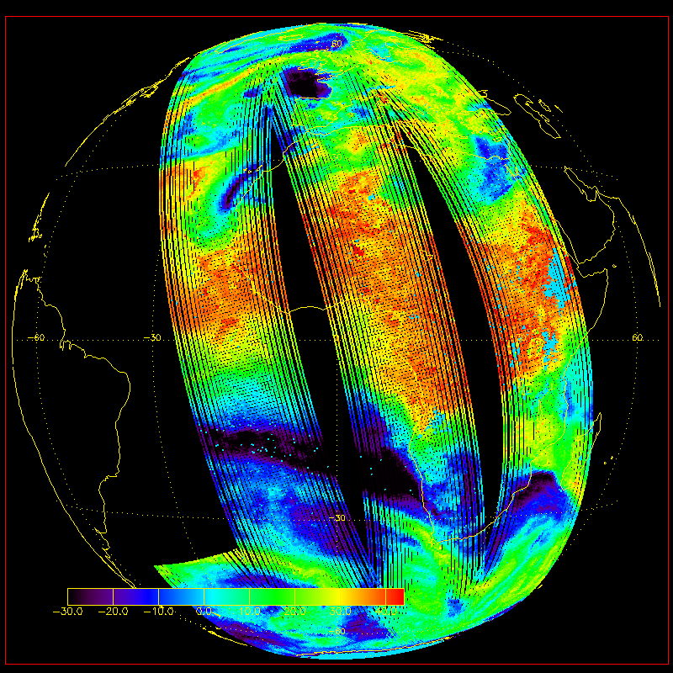
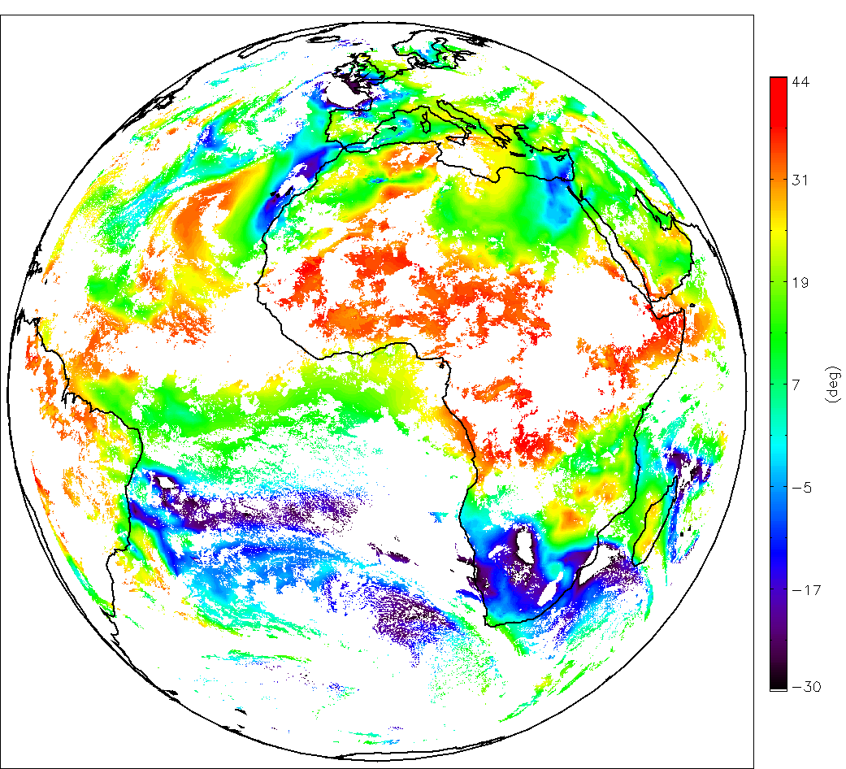
3. New utilisations of IASI L2 Tracking instabilities
MSG
Geo Instability Index
+
IASI v6
IASI L2 v6 is consistent with the GII and complementary as it provides information in the cloudy areas and at high latitudes.
Results: M. Koenig (EUMETSAT)

Slide 39
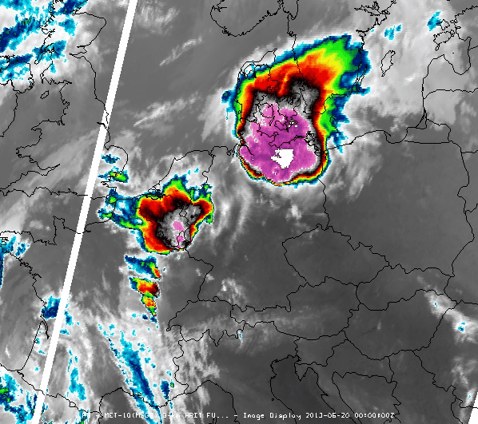
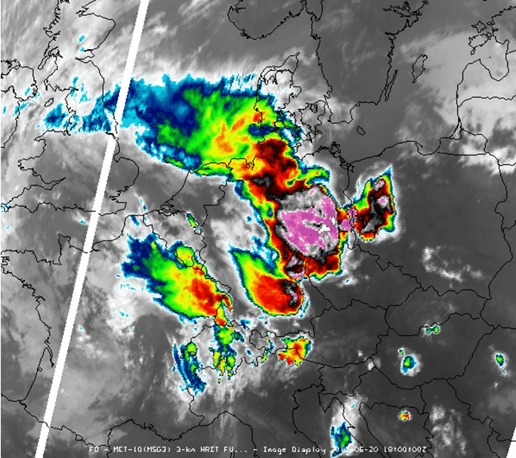
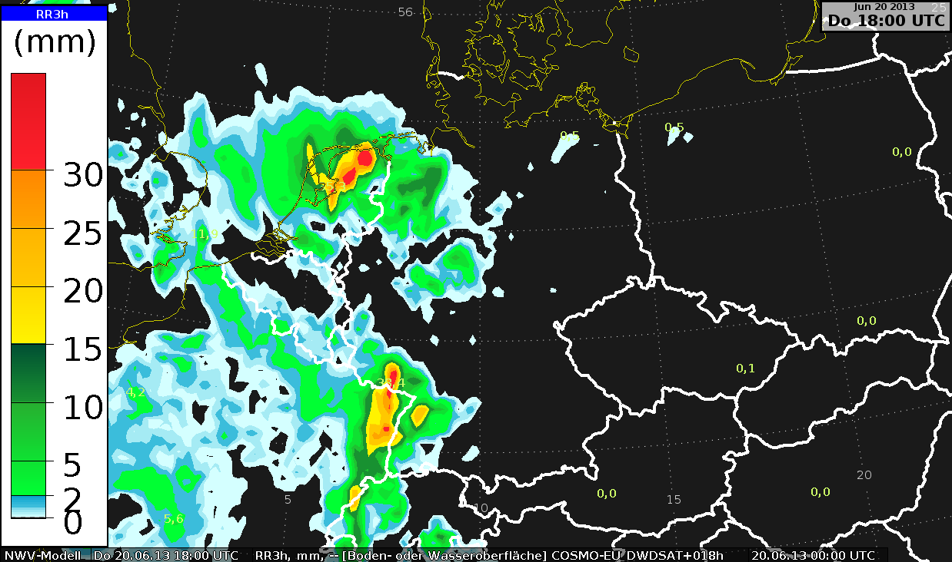
3. New utilisations of IASI L2 Tracking instabilities
Case study:
Central Europe Flooding 20 June 2013
Results: L. Cronce, R. Petersen
(Uni. Wisconsin)
MSG SEVIRI 00-23 UTC IR Loop
MSG SEVIRI 18:00 UTC IR
COSMO_EU 00Z forecast valid 1800UTC

Slide 40
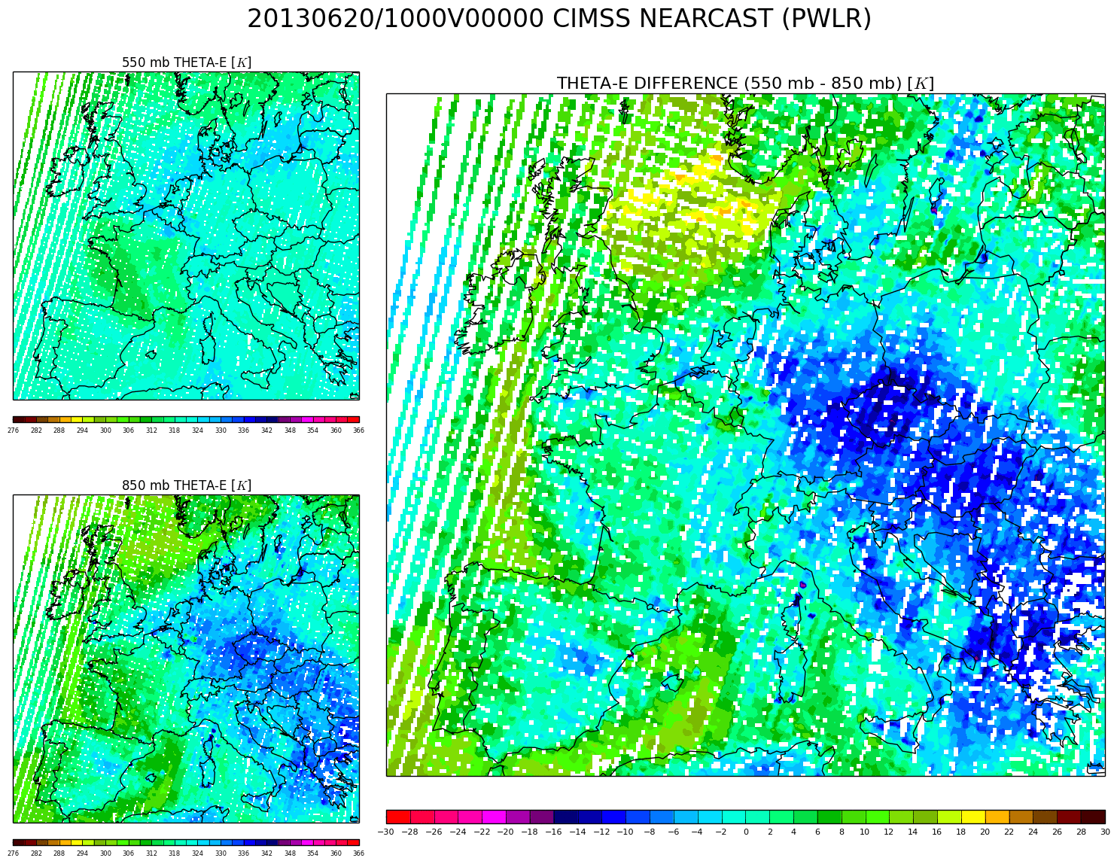
3. New utilisations of IASI L2 Tracking instabilities
20 June 2013
NearCasting
Short-term transport of satellite retrieved airmasses
Results:
L. Cronce, R. Petersen
(Uni. Wisconsin)
Instability

Slide 41

3. New utilisations of IASI L2 Tracking instabilities
Case study:
Central Europe Flooding 20 June 2013
Credits: L. Cronce, R. Petersen
(Uni. Wisconsin)
MSG SEVIRI 18:00 UTC IR
COSMO_EU 00Z forecast valid 1800UTC
IASI L2 v6 Morning
+
NearCast at 18:00

Slide 42

3. New utilisations Tracking Polar lows?
Results R. Randriamampianina (MetNo)

Slide 43


3. New utilisations Tracking Polar lows?
IASI L2 v6.2 (PWLR³)
for the same transect
on the 72°N parallel
(1h difference)

Slide 44
3. EARS-IASI L2, a new regional service
Opening
EARS-IASI L2 service
Regional: requirement < 30’
Under development for IASI Level 2
Global: NRT < 2h

Slide 45

The EUMETSAT advanced retransmission system

Slide 46

The current EARS-IASI coverage

Slide 47
Summary
IASI L2 v6 processor offers unprecedented sounding capabilities (yield and precision) at the IASI footprint resolution
MW+IR allow nearly all-sky T,q statistical retrievals: ~85% useful yield
T & q profiles typical precision in clear-sky precision of T<1K, H₂O<1.2g/kg throughout the troposphere. Well established operational product, since Sept. 2014 and release of v6.0
The v6.2 operational since 2 June 2016 includes PWLR³: a new generation of forecast-free retrieval operator, exploiting correlated info. in adjacent pixels.
➔ full details in “IASI L2 v6 Validation Report” EUM/TSS/REP/14/776443, 290pp
and “IASI L2 v6.2 Validation Report” EUM/RSP/REP/16/857500, 73pp
The PWLR³ provides accurate atmosheric and surface productsis: T & q profiles, Ts, surface emissivity, cloud signal, quality indicators. It is extremely fast (1day processed in 8mn on a desktop PC) and hence compatible with regional users timeliness requirements.
Work on-going to extend EARS-IASI service to L2, based on the all-sky PWLR³
¿¿ Increase temporal coverage with other sounders (AIRS, CrIS…) ??

Slide 49

PWLR AK :: Class 0 Temperature (clear) 137 levels

Slide 50

PWLR AK :: Class 1 Temperature (cloudy) 137 levels

Slide 51

PWLR AK :: Class 0 Water-Vapour (clear) 137 levels

Slide 52

PWLR AK :: Class 1 Water-Vapour (cloudy) 137 levels

