Slide 2
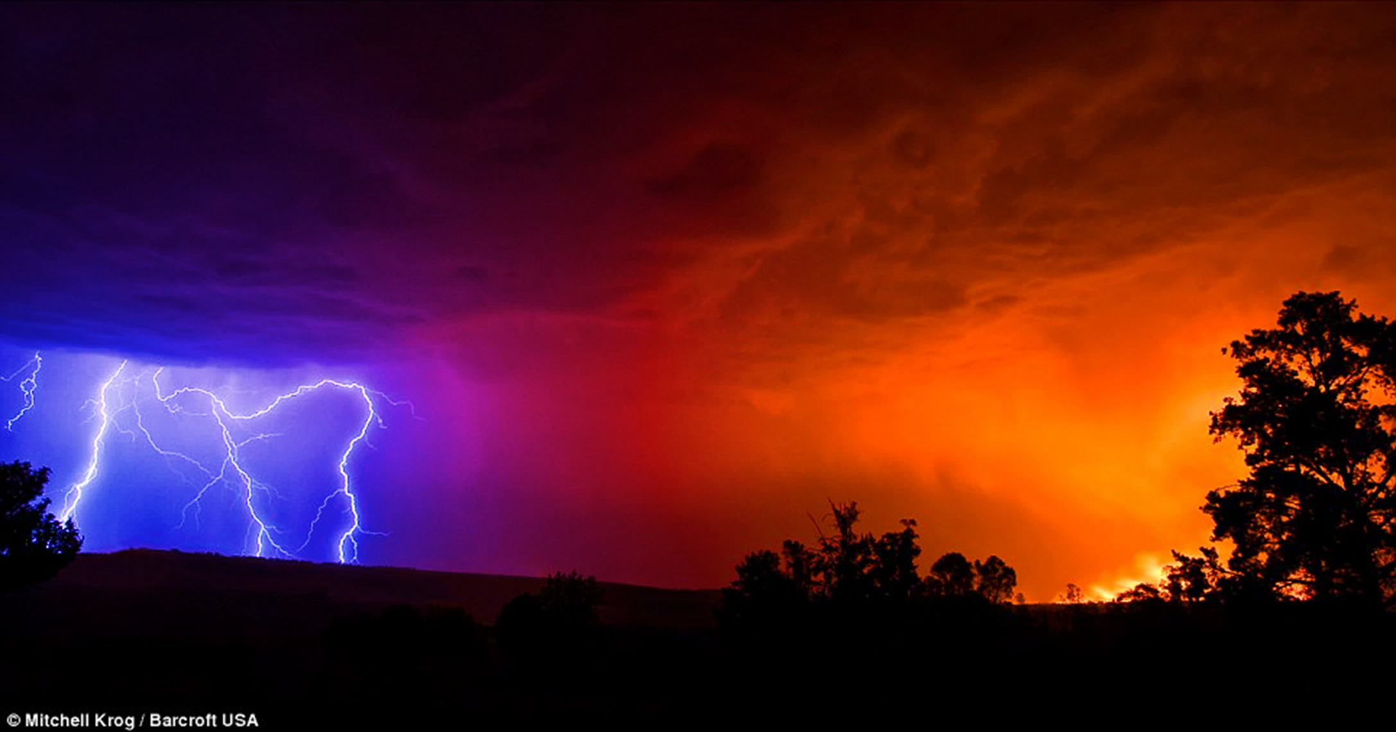

Slide 3
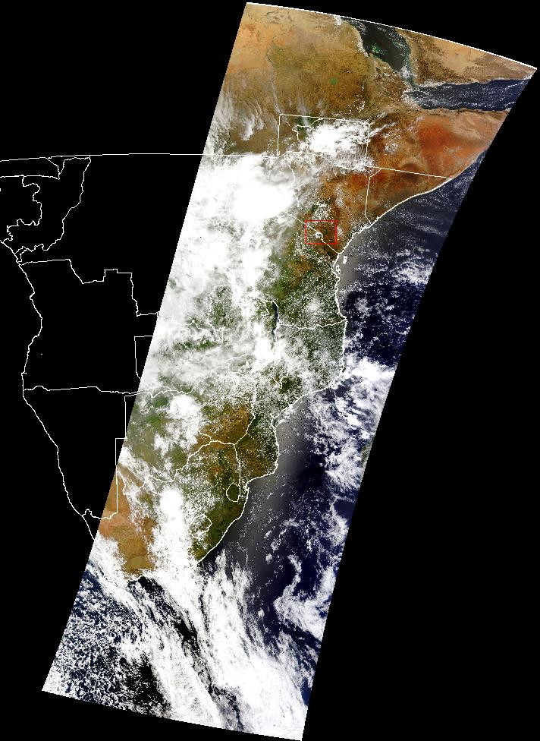

Slide 4
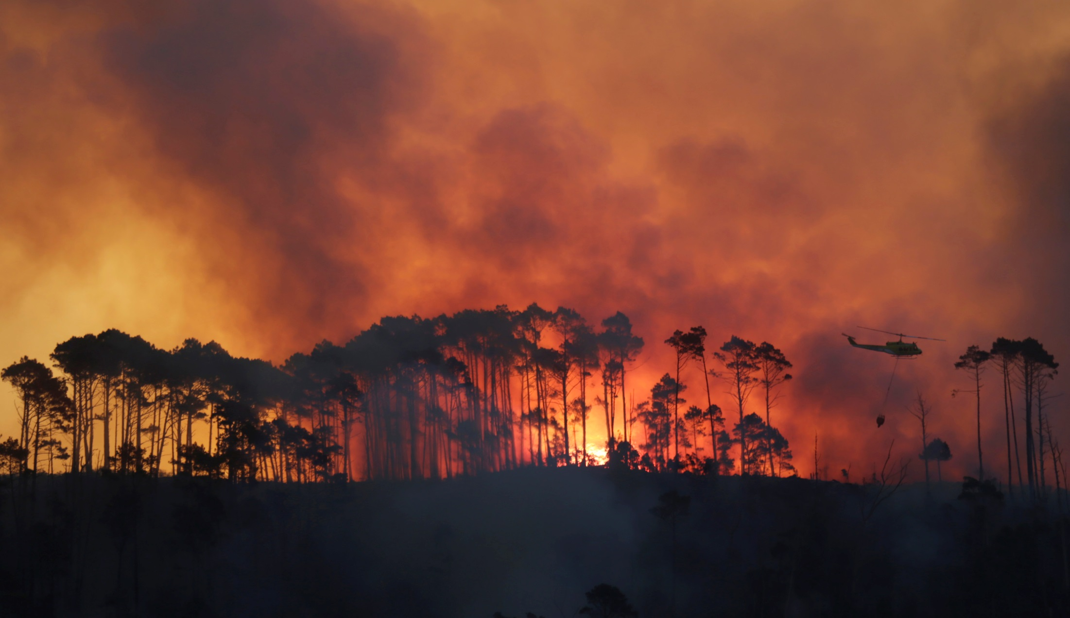
What is AFIS ….
Wildfire Information Monitoring and Visualization framework that allows for the integration of any data source
Developed in partnership with fire managers from the forestry and utilities domain over more than 10 years
Fully integrates satellite based and forest camera detections in to seamless detection network.
It supports both ground based resources through mobile solutions and dispatch control centers with the fire dashboard and integrates with any existing GIS platforms and CMS's
It dynamically links fire incidents with weather, fire danger and historical events for improved decision making
It is a hosted Software Solution which provides a proactive service with out the need for specialised IT support

Slide 5
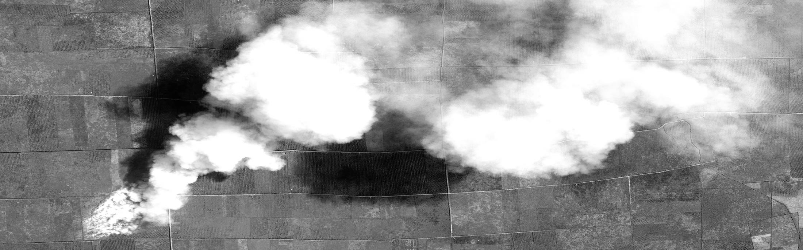
Value Proposition
01
02
03
AFIS Predict
proactive
Fire Weather/Danger Forecast 10 day hourly,
Fire Weather/Danger Nowcasting using Private weather stations
Fire Risk Model based on FDI, fuel load, condition, topography, high value areas
Vegetation condition estimates
AFIS Detect
multi-mode
GOES, MODIS,VIIRS plus Landsat 8, Sentinel 2, FireBird
Dynamic Fire Spread Modelling, Active Fire profiling
Alert – SMS/email/internet push notification
Crowd sourcing detection (app)
Integration with Forest Camera detections
AFIS Assess
rapid
Landsat/Sentinel 2/Deimos access
Automated Landsat/Sentinel Burn Area mapping
Fire Spread Analysis post fire
Post fire forensic analysis from high resolution satellite and in situ data

Slide 6
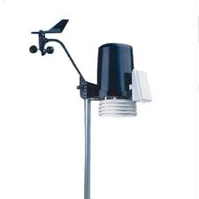
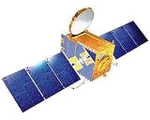
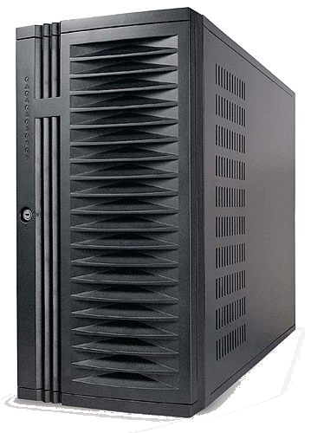
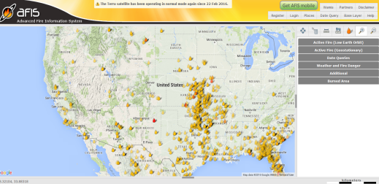
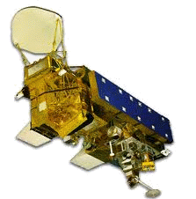
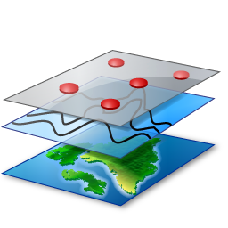
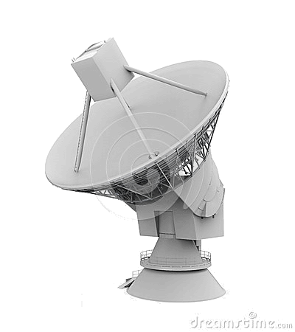
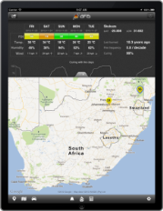
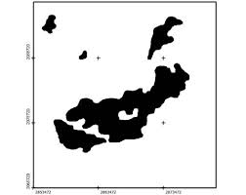
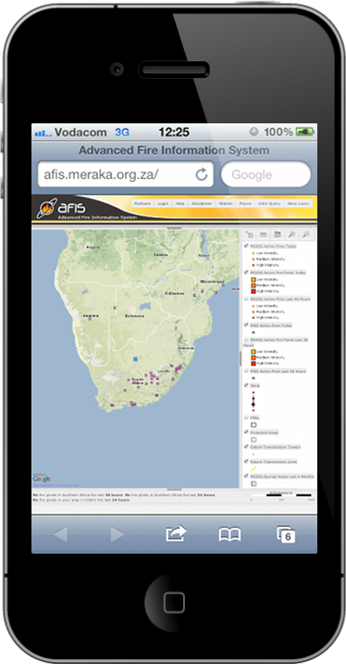
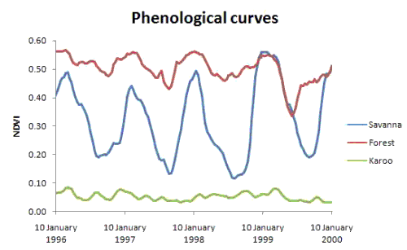
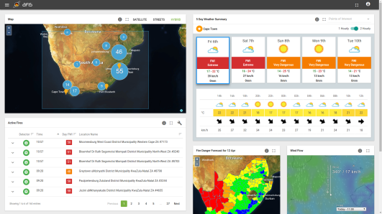
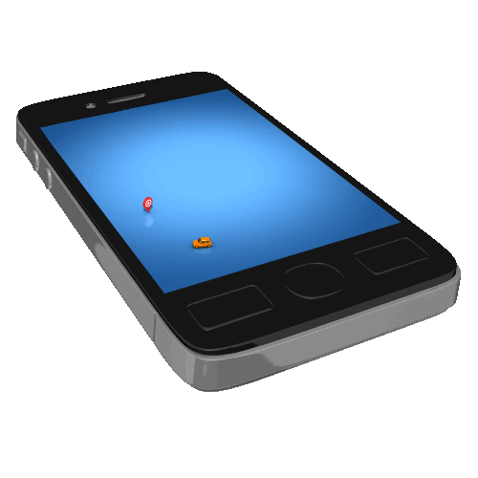
Data
ICT Core
Analytics
User Experience
WMS Custom data
uploads
Precision
Fire Danger
Forecasting
Multi Satellite
Active Fire
Monitoring
30m Burn
Area mapping
Dynamic Fire
Spread modelling
Mobile Alerting
and crowd sourcing
app
FDI and BA
Reporting &
Statistics

Slide 7
On line
Web viewer for correlating asset information with geolocated fire information
Mobile App
AFIS fire location and forecasting information delivered to smart phone
Alerting
Automated SMS, Email notifications of fires within your area of interest
Dashboard
Control room real-time fire information for management and situational awareness
USER EXPERIENCE
Our work with the fire management community over the past 10 years has guided the development of various user experience interfaces
Stats and Reports
Burn information related to land cover and area
Analytics
Scientific and peer reviewed analytical methods are applied to satellite data to rapidly produce information products
Crowd Sourced reports
Based on AFIS Watchtower mobile app

Slide 8
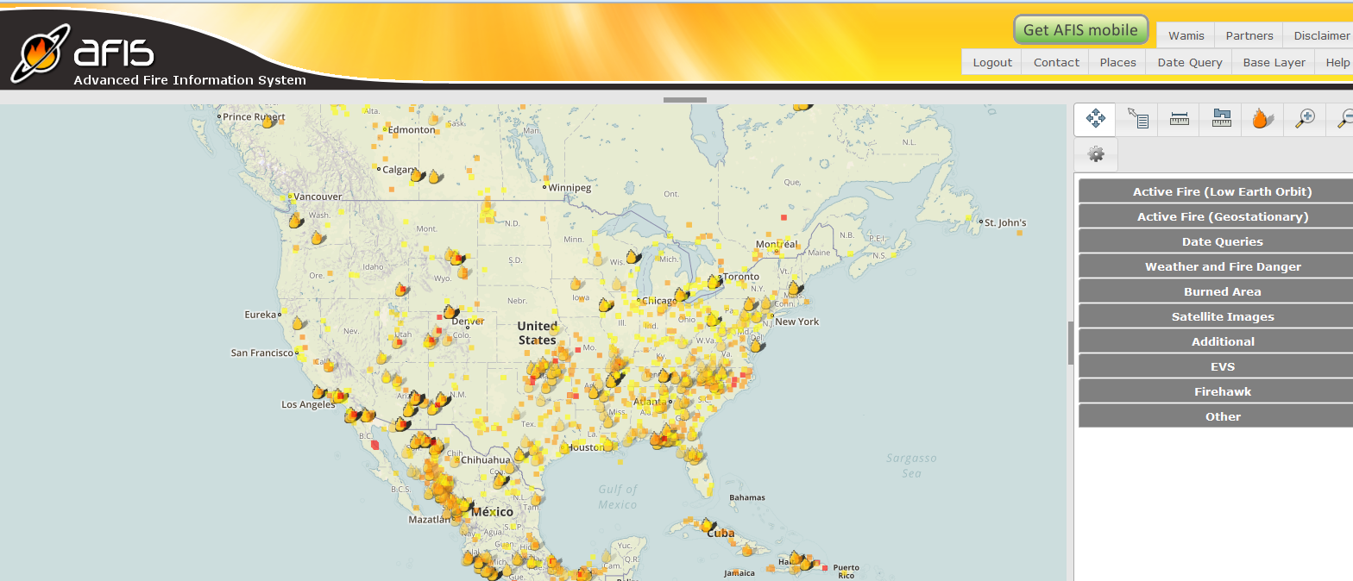
AFIS Online Webviewer
http://usa.afis.co.za
http://southernafrica.afis.co.za

Slide 9
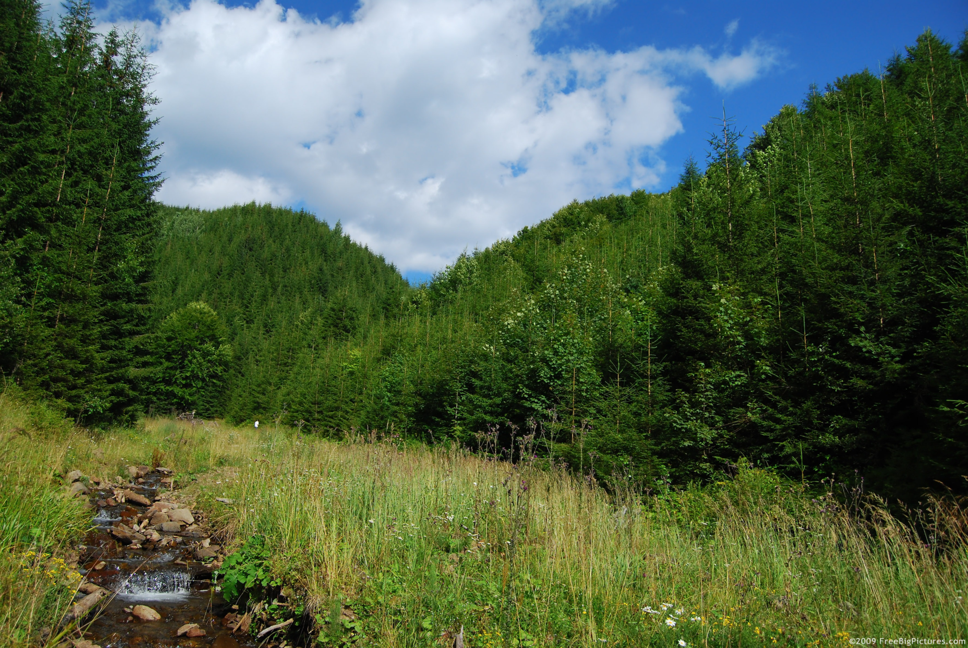
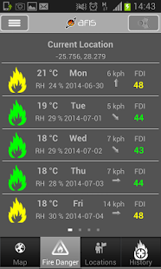
“Kruger MODIS Fires; 5.64 km NE of Reference Point ; 28.33E -25.885S At 2013-06-06 T13:45:00 +02:00”
“Kruger MODIS Fires; 5.64 km NE of Reference Point ; 28.33E -25.885S At 2013-06-06 T13:45:00 +02:00”
AFIS Services
Mobile apps
Available on both iOS and Android, AFISMobile brings critical fire
management information to you where ever you are.
Automated alerting to SMS, email or push notifications

Slide 10
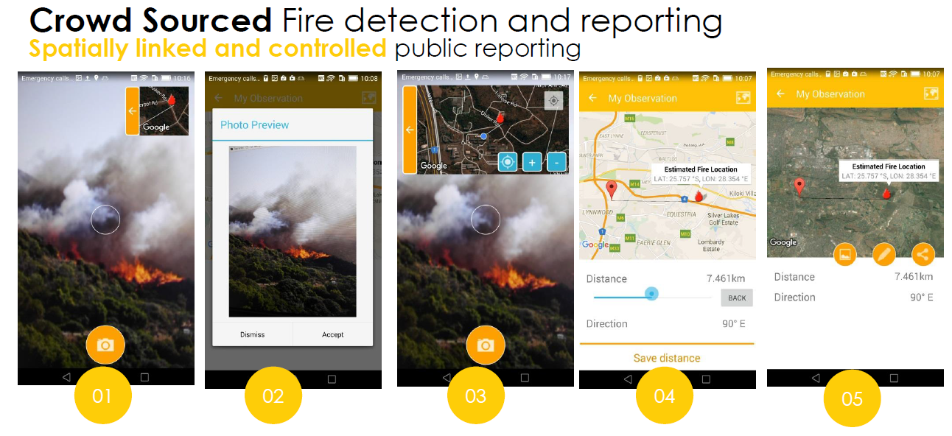
Crowd Sourced Fire detection and reporting
Spatially linked and controlled public reporting
The AFIS Watchtower app allows users to report the location of fires by pointing the Watchtower app in the direction of the fire through the phone camera. Both distance and direction to the fire is recorded and a latitude and longitude coordinate is produces and sent to the AFIS viewer

Slide 11
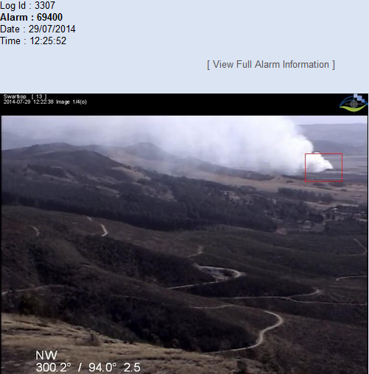
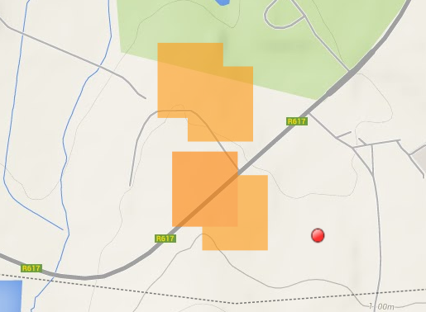
EVS Camera Fire Monitoring

Slide 12
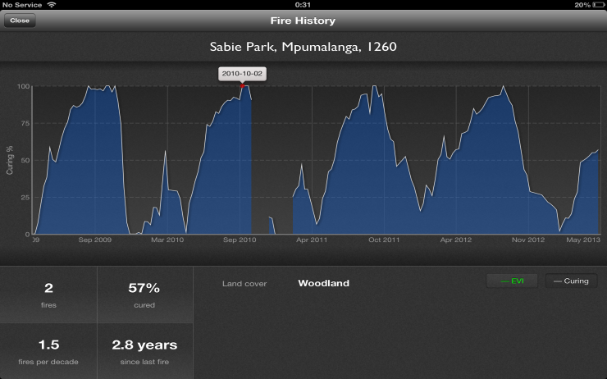
AFIS Mobile Apps
Notes:
Update with relevant area images

Slide 13
Fire Danger Forecasting
Interactive layer with the daily point/area FDI/FWI, including a 5 day forecast.
Active Fire
Fully interactive map with location and
number of fire events per area.
Define Points of interest
02
Weather Forecasts
Regional forecast temperature, and wind speed/direction
01
03
Forecasting of fire danger
Data from AFIS is fed into regional Models to produce FDI maps
Active Fire Incident Table
Interactive list of active fires, detection times and link to the fire location.
05
Wind flow animation
Regional wind flow map from global model
04
06

Slide 14
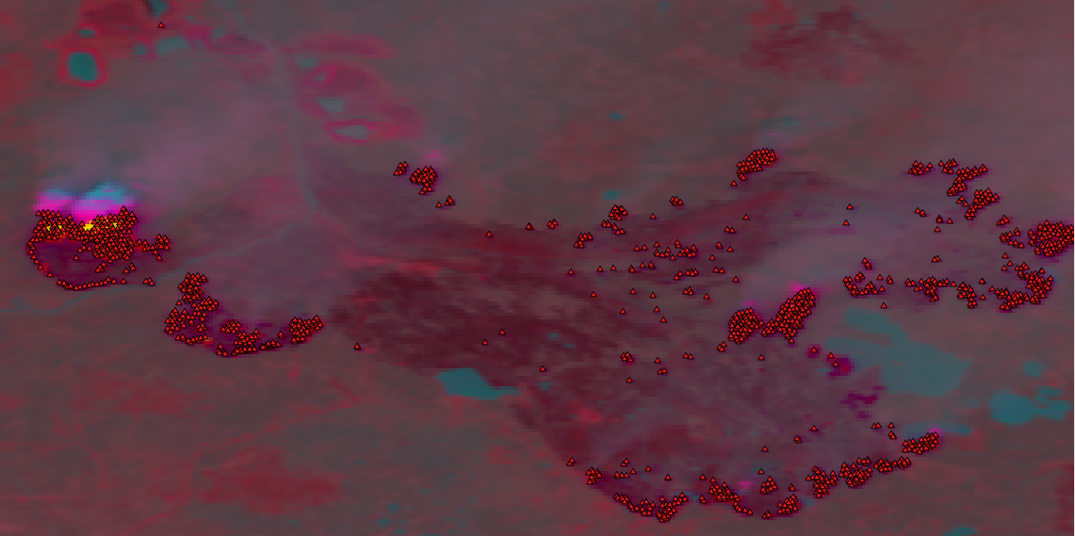
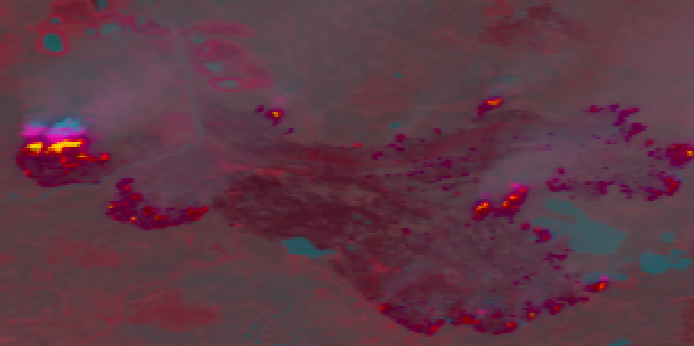
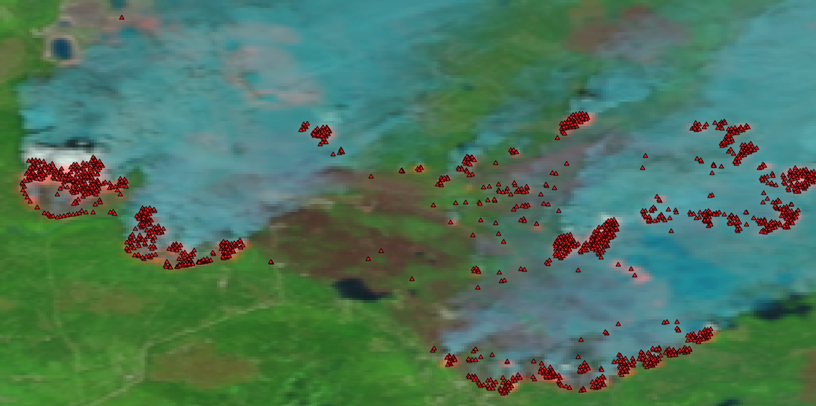
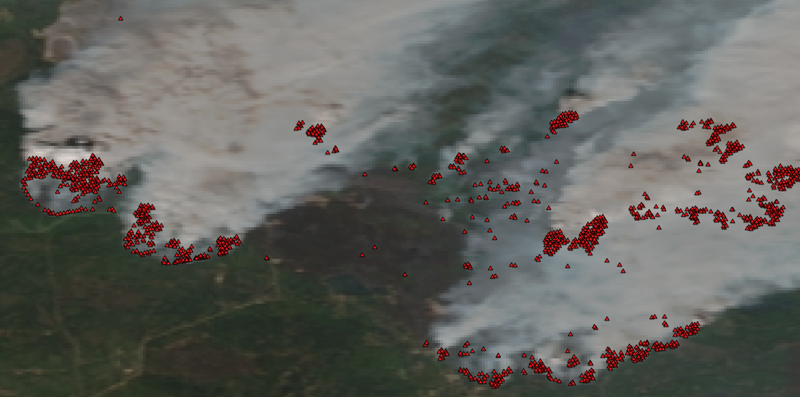
Proprietary Machine Learning algorithms
Scientific and peer reviewed analytical methods are applied to satellite data to rapidly produce information products that assist in the fire fighting efforts
AFIS Analytics

Slide 15
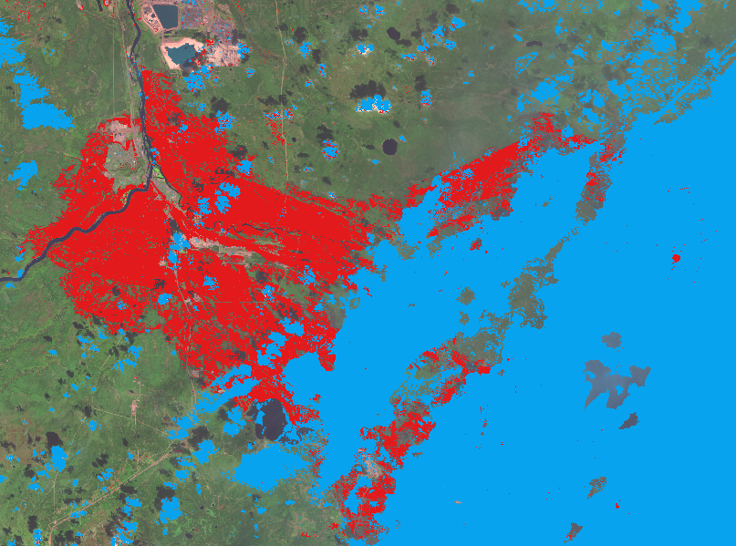
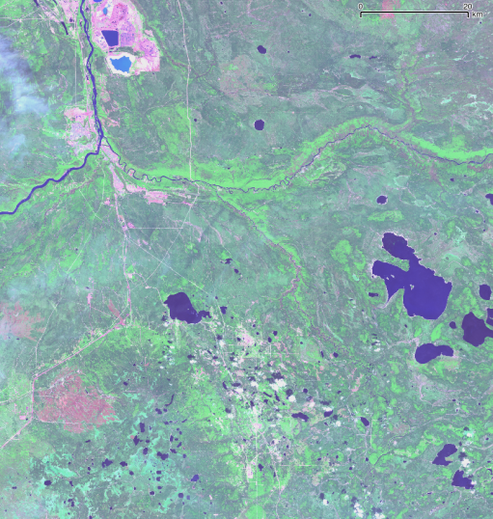
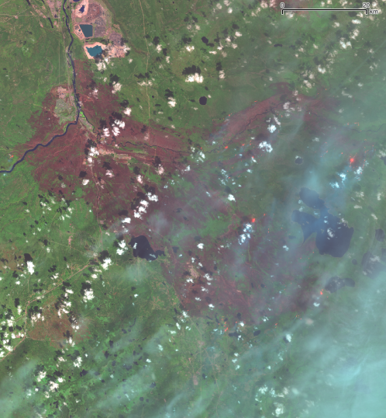
Analytics
Statistics and Reports are auto generated for users and available in the dashboard, online viewer or direct email
Algorithms developed for LandSat 8 and Sentinal. With a 7 day revisit rapid burn scar maps are generated for priority events
AFIS Dashboard able to retrieve and display all burn scar areas on request. Priority fires can be escalated for rapid assessments
AFIS Reports generated automatically and sent out to user with stats on area and vegetation type burned
Auto loaded into AFIS online viewer and linked to users profile. Routine burn area maps generated monthly.

Slide 16
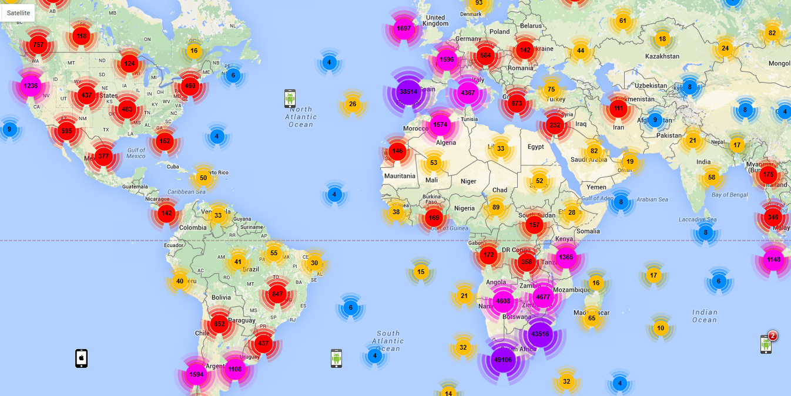
AFIS Usage: 2015
Mobile + online
Notes:
Do an animation for usage over time.

Slide 17
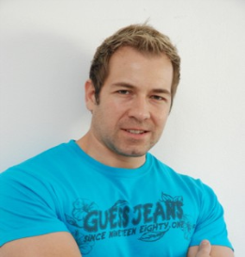
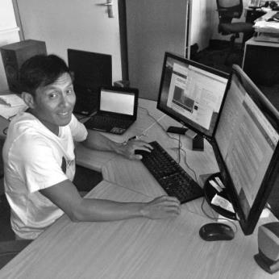
Meet our Team
Business and Technical skills that drive the AFIS development
CAM EO
Head of AFIS
Lee Annamalai
Competence Area Manager
Earth Observation Systems and ICT
Philip Frost
Product Manager
Innovation and R & D
14 years of experience in technology & business management. Internationally recognised in the Space and Geospatial domain.
14 years of involvement in Fire information system. Internationally recognised Deeply embedded in the fire management and response domain
Senior Developer
System Analysist
Cheewai Lai
Linda Klein
Sys Admin
Satellite Product Production
Front End and User Admin
System Security
System and Requirements analysis
Remote Sensing, Innovation and R & D
18 years of experience in hosted ICT System Administration and Geo-spatial and Satellite Product production systems
20 years of experience in Remote Sensing, Geo-spatial and Satellite Product production systems

Slide 18
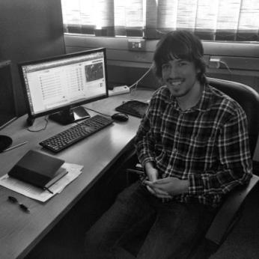
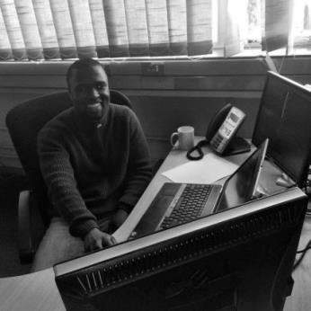
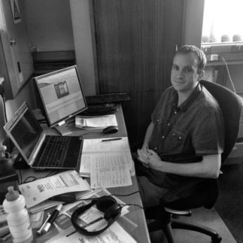
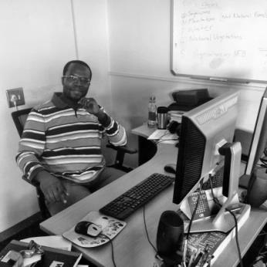
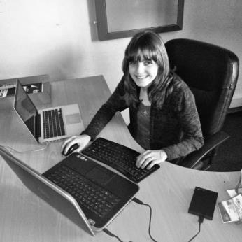
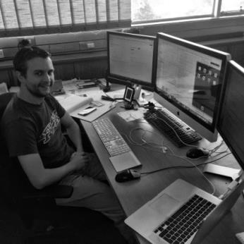
Meet our Team
Passionate team of Developers and R&D Remote Sensing Scientists
UI Developer
Report Engine Developer
Senior Developer
Werner Raath
Ndumiso Booi
Riaan vd Dool
Frontend and Android app developer
User Support
Report and Stats Engine developer
User Pilot Projects
AFIS Backend Db and Web Front End
User Support
Senior Developer
R&D Analytics Developer
R&D Analytics Developer
Derrick Swanepoel
Lufuno Vhengani
Melissa Henkel
Remote Sensing modelling, Burn area algorithm development
Remote Sensing modelling, Algorithm development
High performance Back End software, cube server. iOS app

