Slide 1
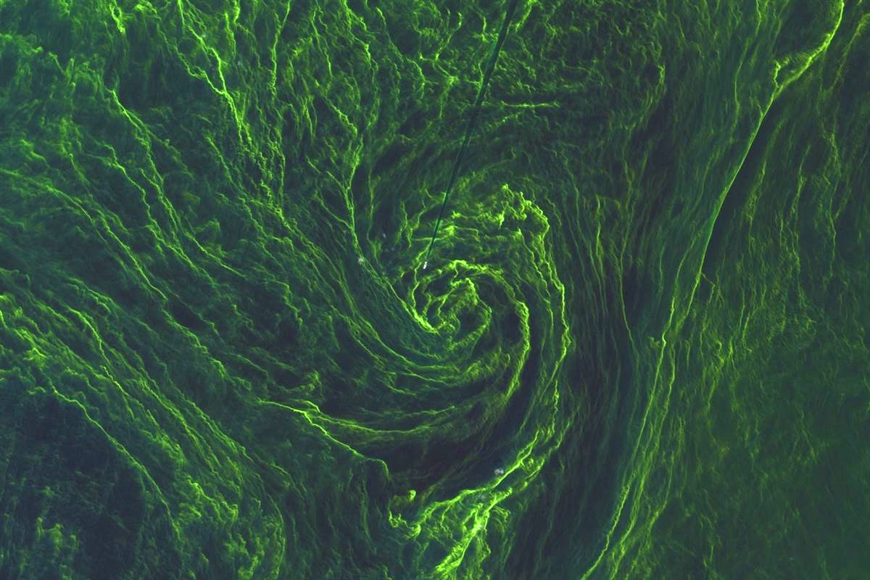

Monitoring for Ecosystems and Human Health
How to Create an Interoperable Network for Coastal/Inland Waters?
Erin Urquhart¹, Blake Schaeffer²
¹US EPA ORISE Fellow, ²US EPA ORD

Slide 2
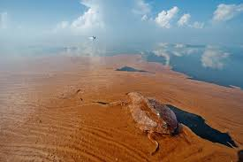
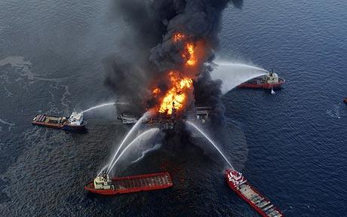
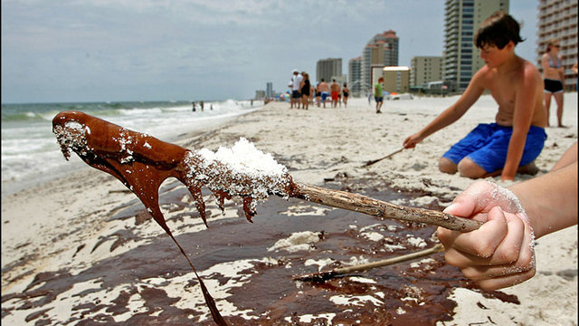

Scenario (Deepwater Horizon 2010)
Urquhart, E. NASA Direct Readout Conference (NDRC-9)
June 23, 2016 Real Time Oceans/Fresh Water Remote Sensing

Slide 3
Scenario (Deepwater Horizon 2010)
Spill Began
Experts called for help
Experts arrived at well head
RS data supplied by USF
Briefed National Incident Command
Response
  RS data supplied by private, govt., and academic groups
    Not able to extract quantifiable info. within allotted time frame to make decisions on the spill
      Ariel images were used instead
        NIC relied on and made decisions using images available within 30mins
Urquhart, E. NASA Direct Readout Conference (NDRC-9)
June 23, 2016 Real Time Oceans/Fresh Water Remote Sensing

Slide 4
Scenario (Deepwater Horizon 2010)
Assets for oil spills
  How fast?
  How big?
  Where?
  Info. on oil state (weathered, emulsified) and thickness?
In the case of oil spills time is NOT the only asset
  Aerial efforts will go out first
    Need RS sensors that can be used in combination with aerial efforts
    Clouds/ False Pos. and False Neg.
  Size of spill (Spills of National Significance)-size is both in duration and geographical extent
  What do we do when spills happen in places that we cannot easily access to respond?
    Arctic Spills…
Urquhart, E. NASA Direct Readout Conference (NDRC-9)
June 23, 2016 Real Time Oceans/Fresh Water Remote Sensing

Slide 5
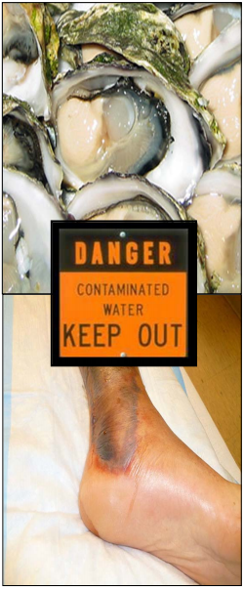
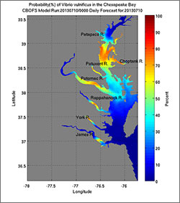
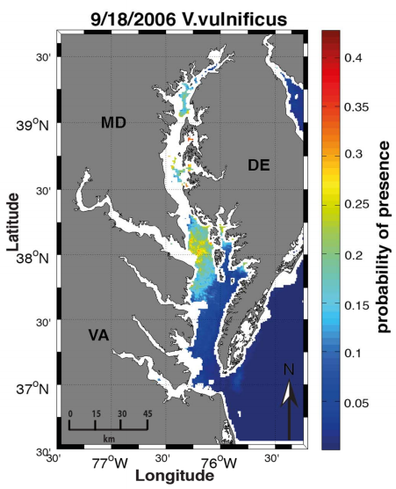
Vibrio bacteria monitoring
Modeling derived V. vulnificus
MODIS derived V. vulnificus
NOAA-NCCOS
Urquhart et. al. (2014)
Urquhart, E. NASA Direct Readout Conference (NDRC-9)
June 23, 2016 Real Time Oceans/Fresh Water Remote Sensing

Slide 6
Vibrio bacteria monitoring
DR technology for recreational water:
  “Direct” field sampling/testing campaigns
  Same-day beach/shellfish bed closures
  Recreational use
    Cautionary tool for end users
    Mobile applications
Urquhart, E. NASA Direct Readout Conference (NDRC-9)
June 23, 2016 Real Time Oceans/Fresh Water Remote Sensing

Slide 7
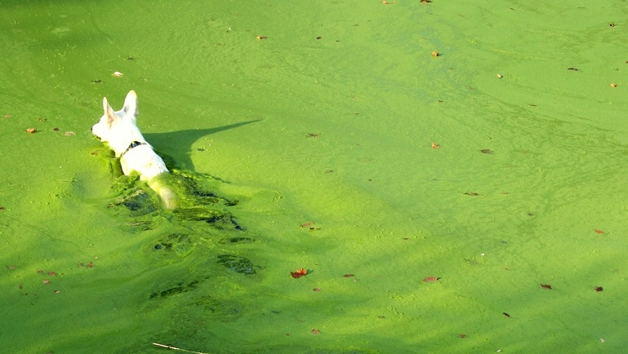
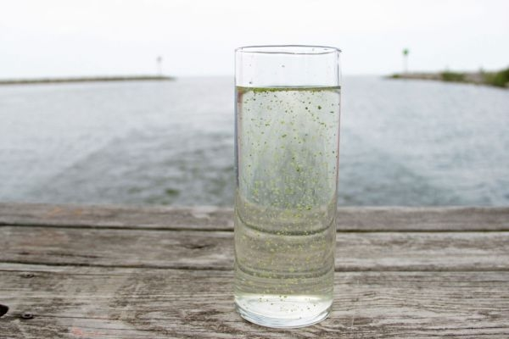
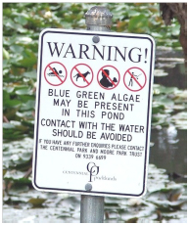
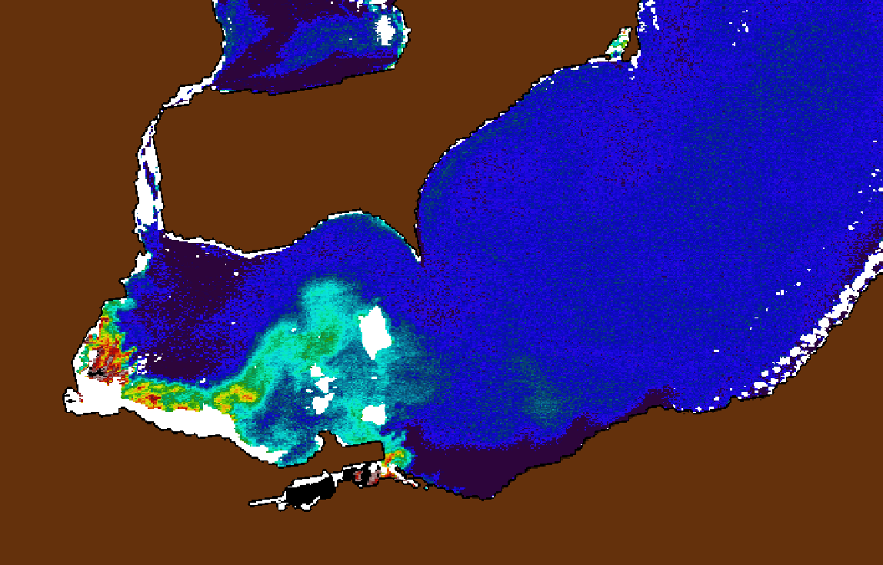
Harmful Algal Bloom Monitoring
Urquhart, E. NASA Direct Readout Conference (NDRC-9)
June 23, 2016 Real Time Oceans/Fresh Water Remote Sensing

Slide 8
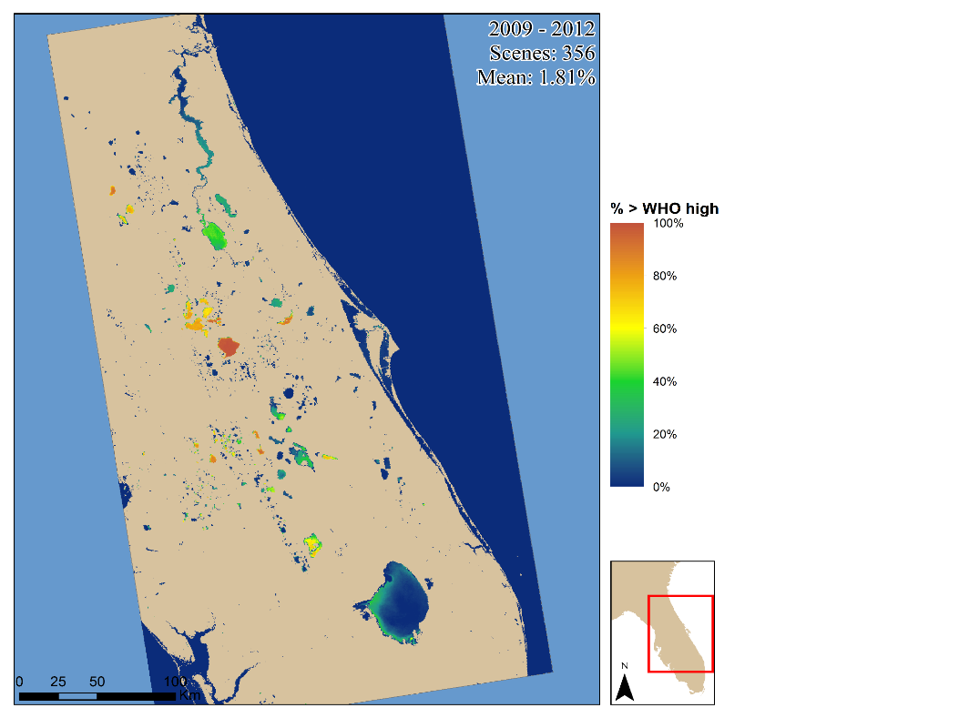
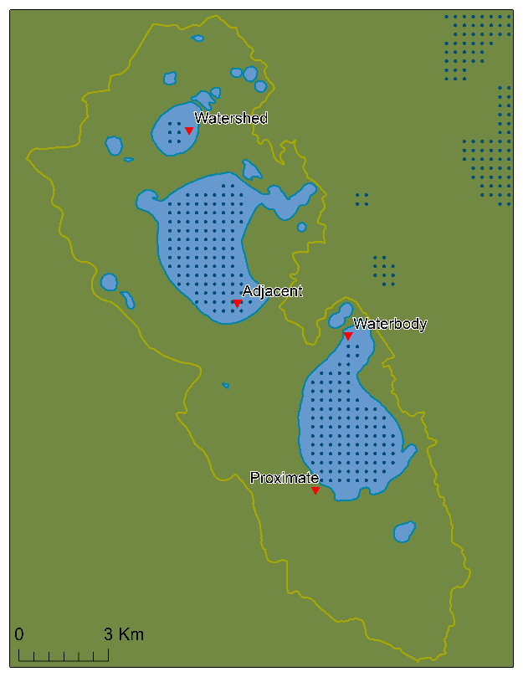
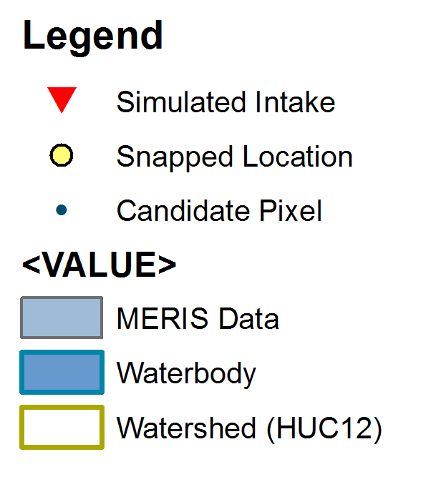
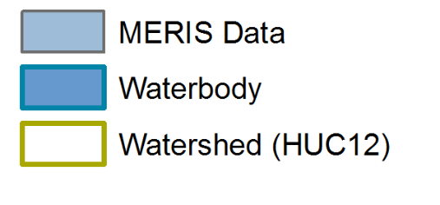
Harmful Algal Bloom Monitoring
DR technology for drinking water:
  Information about the source waters
  Informing utilities
    Big and Small in terms of population served
  Managers want the data the day of the bloom.
Urquhart, E. NASA Direct Readout Conference (NDRC-9)
June 23, 2016 Real Time Oceans/Fresh Water Remote Sensing

Slide 9
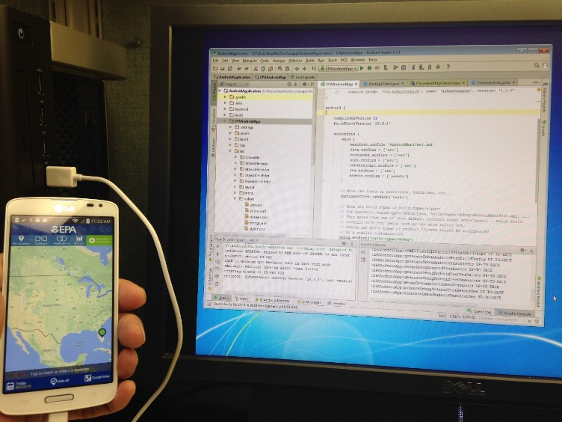
Data Dissemination (Needs & Limitations)
Data that end user can understand
  Data Format
  Data Size
  Training
  Software
Data delivery in a timely fashion
Interoperability of data networks
Mobile applications
Urquhart, E. NASA Direct Readout Conference (NDRC-9)
June 23, 2016 Real Time Oceans/Fresh Water Remote Sensing

Slide 10

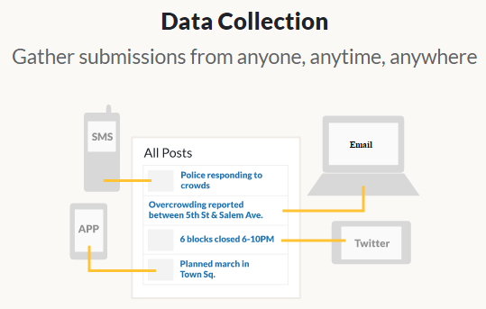
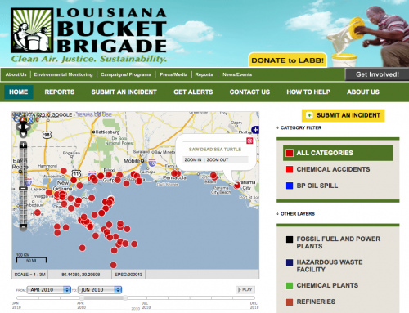
Citizen Science (Ushahidi)
Urquhart, E. NASA Direct Readout Conference (NDRC-9)
June 23, 2016 Real Time Oceans/Fresh Water Remote Sensing

Slide 11
Discussion topics:
Accessibility to DR alone isn’t the issue, rather it’s about getting the data processed…
How to use multiple assets in combination with DR technology…
How to coordinate between multiple agency so that DR data can be used…
Transitioning from large resolution open water issues to inland and coastal scales…
Data -> User vs. User -> Data, central repository/cloud space accessible by EVERYONE.
How to Create an Interoperable Network for Coastal/Inland Waters?

