Slide 1

Fisheries applications of
NRT Satellite Data
Cara Wilson
NOAA/NMFS/SWFSC
Environmental Research Division
Monterey, CA USA
Notes:
A

Slide 2
Fisheries applications of
Direct Readout Data
Cara Wilson
NOAA/NMFS/SWFSC
Environmental Research Division
Monterey, CA USA
Notes:
A

Slide 3
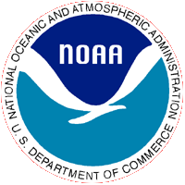
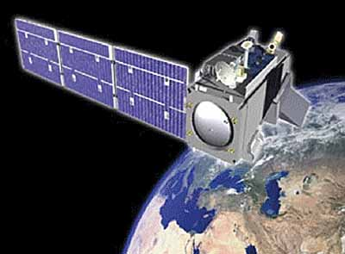
What is Fisheries?
There are three principal aspects of fisheries:
  Harvesting (catching “fish”)
  Stock Assessment (counting “fish”)
  Management & Conservation (saving “fish”)
  Fisheries is more than just fish, it encompasses all living marine resources (LMRs), i.e. marine mammals, sea turtles and invertebrates.
Notes:
3
Most people think of just harvesting when they think of fisheries, however the stock assessment and management/ & conservation aspects are vitally important. Currently ~90% of the global fisheries are overfished or are at fishing capacity. Without proper stock assessment and conservation/management there will not be any fish to catch in the future.

Slide 4
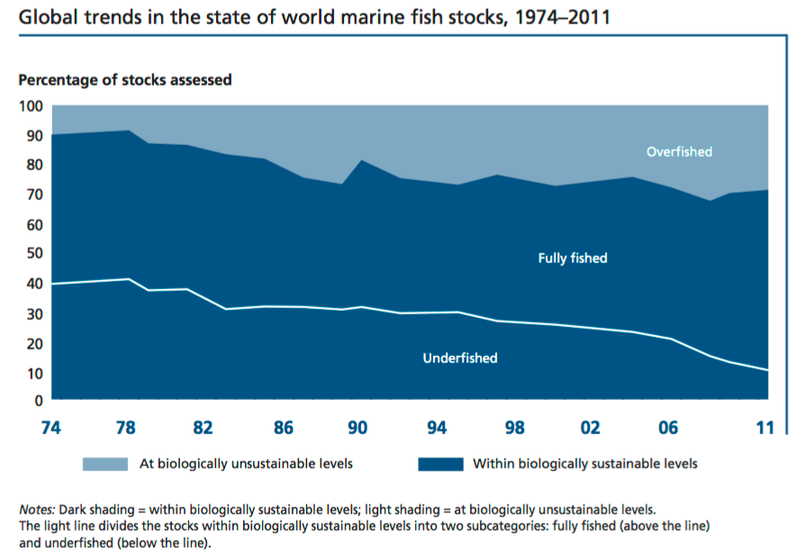
Overfishing
From FAO The State of World Fisheries and Aquaculture (SOFIA) 2014
Notes:
4
Most people think of just harvesting when they think of fisheries, however the stock assessment and management/ & conservation aspects are vitally important. Currently ~90% of the global fisheries are overfished or at fishing capacity. Without proper stock assessment and conservation/management there will not be any fish to catch in the future.

Slide 5
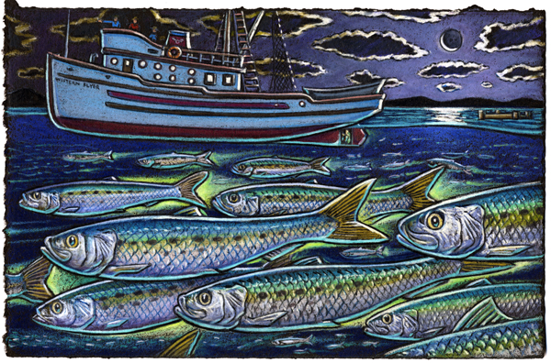
1. Harvesting
Notes:
5
Image from the Green Seas Blue Seas mural by Ray Troll and Roberto Salas, which is on the building formerly occupied by SWFSC/ERD.
https://swfsc.noaa.gov/greenseas-blueseas/

Slide 6
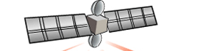
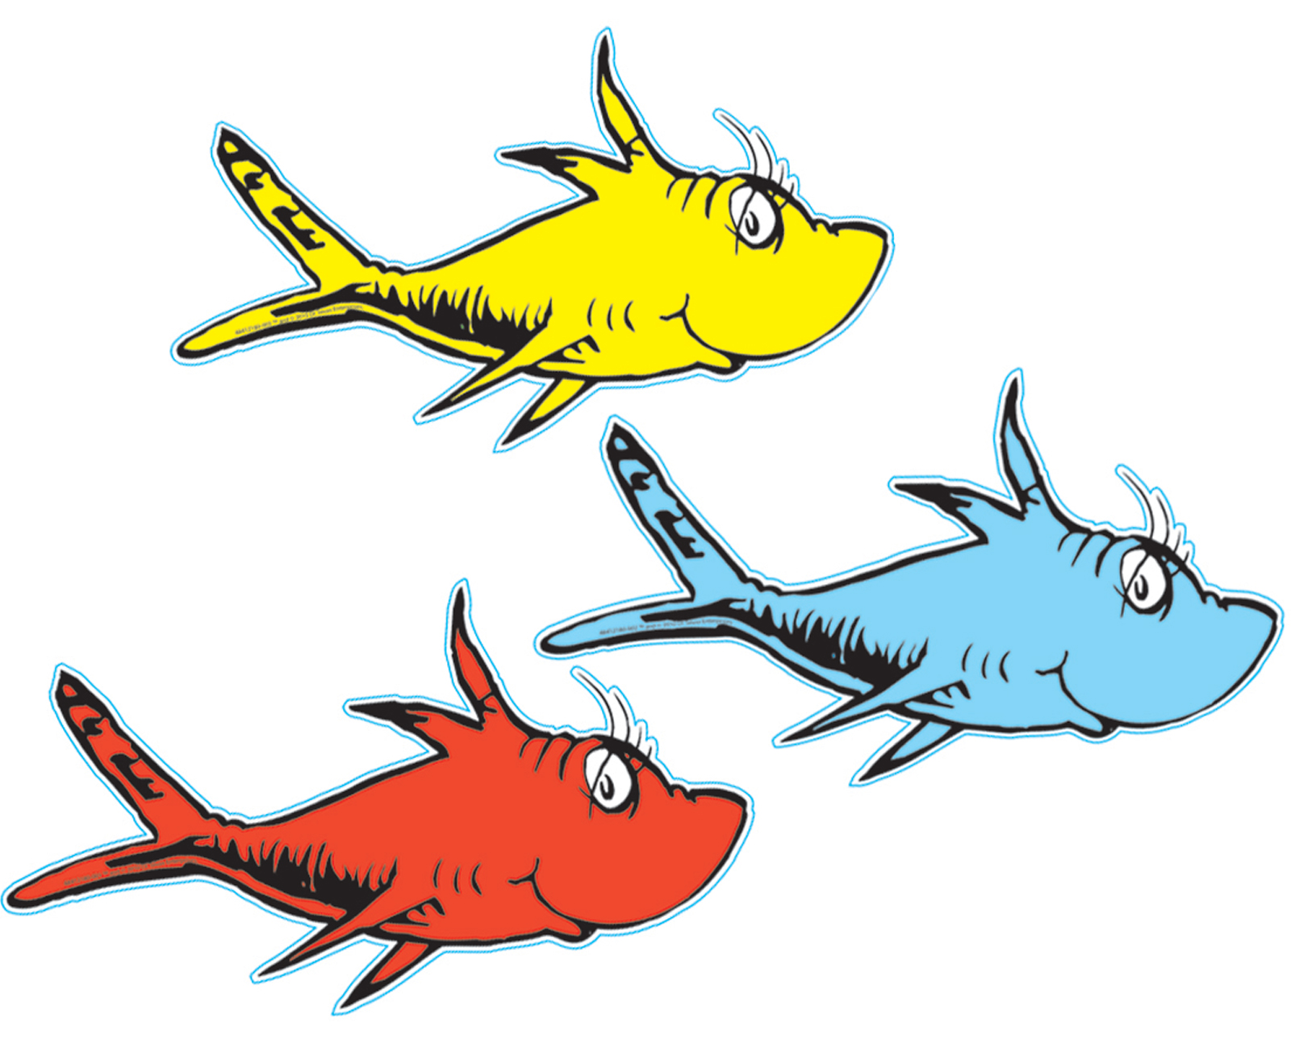
Harvesting
X
Notes:
6

Slide 7
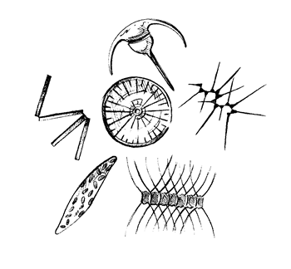
Harvesting
X
chlorophyll-a
in phytoplankton
(different sizes and types)
Notes:
7

Slide 8
Oceanic Food Web
Fishing
4
3
2
1
Tuna,
billfish
Marine
mammals
Large
squids
Misc.
fish
Small
squids
Trophic Level
Small
pelagics
Mesopelagics
Benthic
fish
Large
zooplankton
Benthic
invertebrates
Small
zooplankton
Detritus
Phytoplankton
Modified from Pauly & Christensen [1993]
Notes:
8

Slide 9
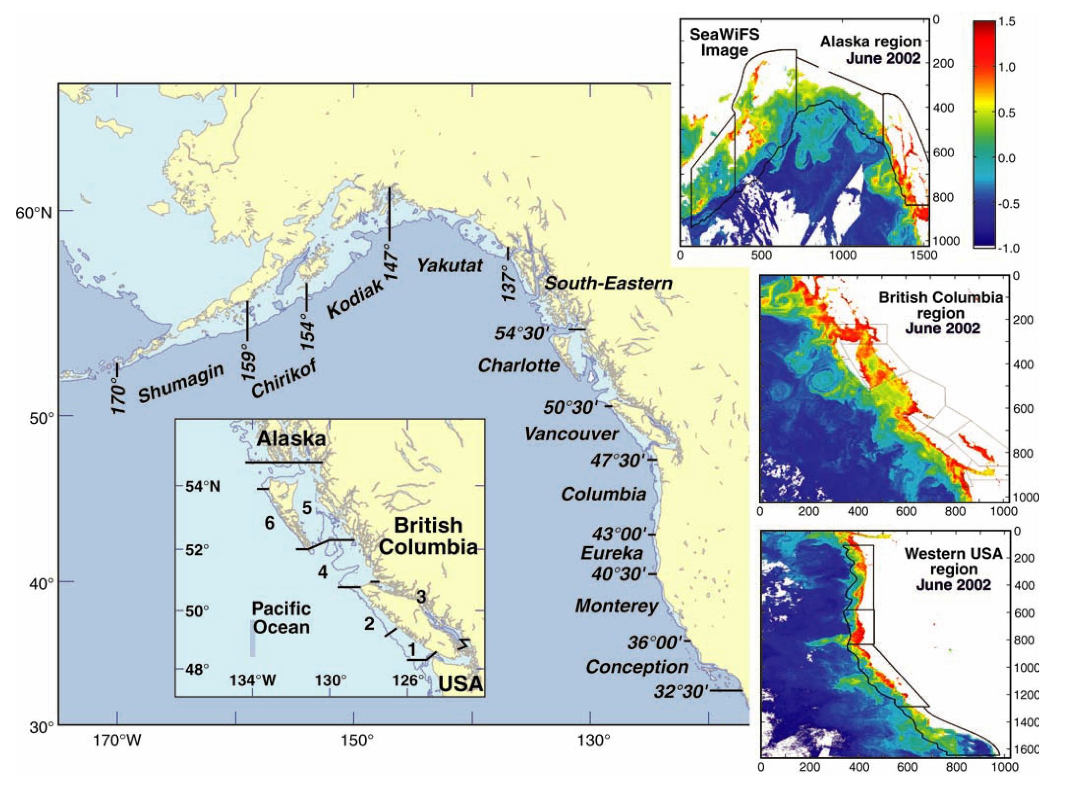
Linkages
From Ware & Thomson, Science, 2003
Notes:
9

Slide 10
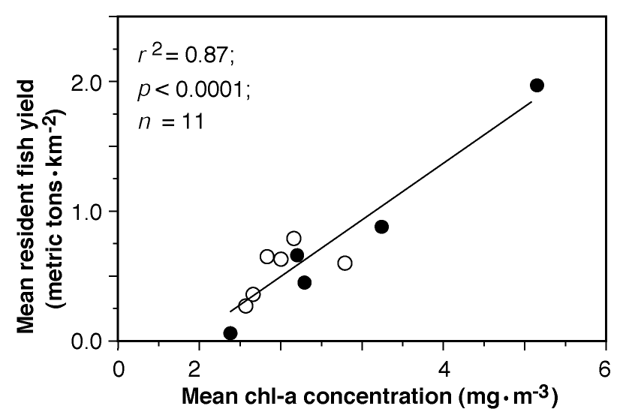
Linkages
Upwelling
Downwelling
From Ware & Thomson, Science, 2003
Notes:
10

Slide 11
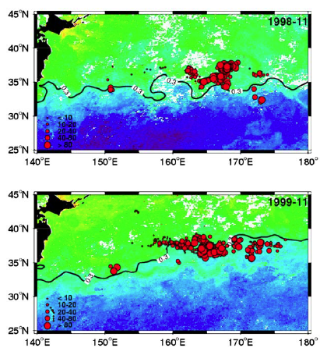
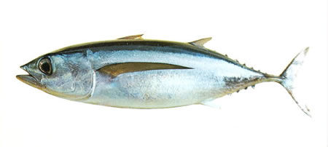
Frontal Zones
Albacore CPUE (catch per unit effort) overlain on SeaWiFS chlorophyll, showing that the longline fishery largely operates along the transitional zone chlorophyll front (TZCF)
Zainuddin et al., DSR-II, 2006
Notes:
11

Slide 12
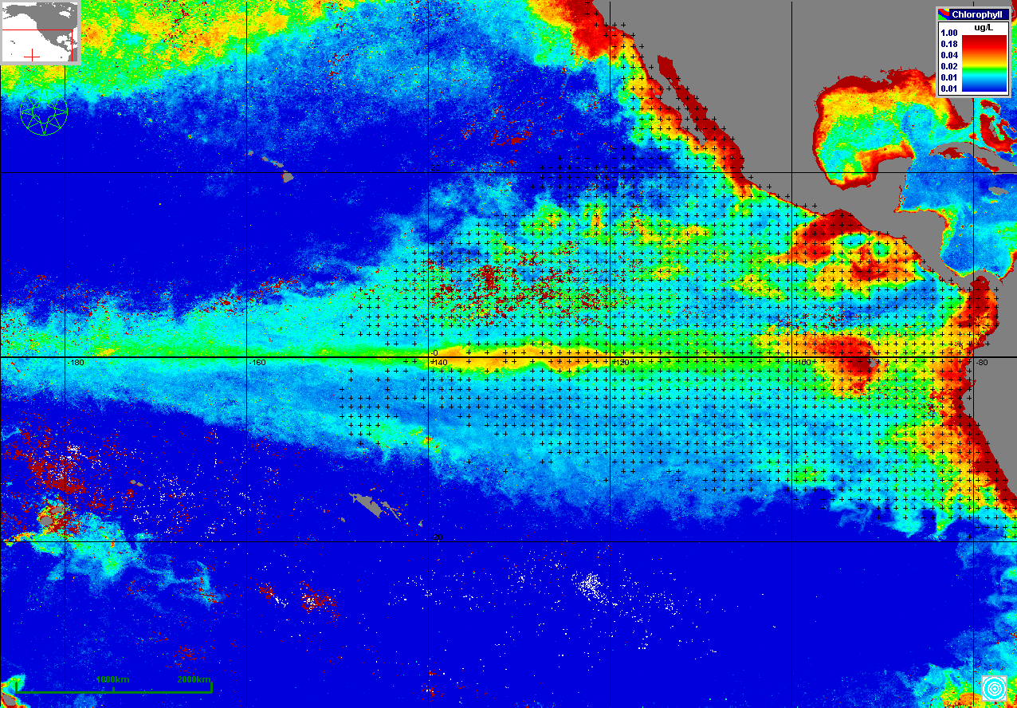
Upwelling Areas
Dots show the distribution of the tuna purse seine fishery in the Pacific.
From Dale Kiefer’s poster (poster #70)
Notes:
12
2007 February composite of MODIS chlorophyll underlying the recording stations of the tuna purse seine fishery of the Inter-American Tropical Tuna Commission. The data from these stations consist of a 50 year record of monthly catch and effort. (from NASA’s Tuna Stock Assessment Support System project)

Slide 13
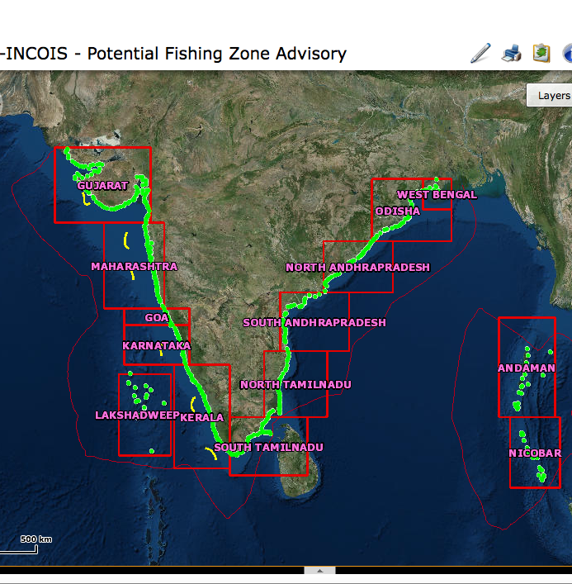
INCOIS – Potential Fishing Zone
(PFZ) Advisories
Indian National Centre for Ocean Information Services (INCOIS) generates and distributes Potential Fishing Zone (PFZ) advisories to the Indian Fishing Community.
The PFZs are generated using SST and chlorophyll data.
http://www.incois.gov.in/MarineFisheries/MarineFisheryAdvisory
Notes:
13

Slide 14
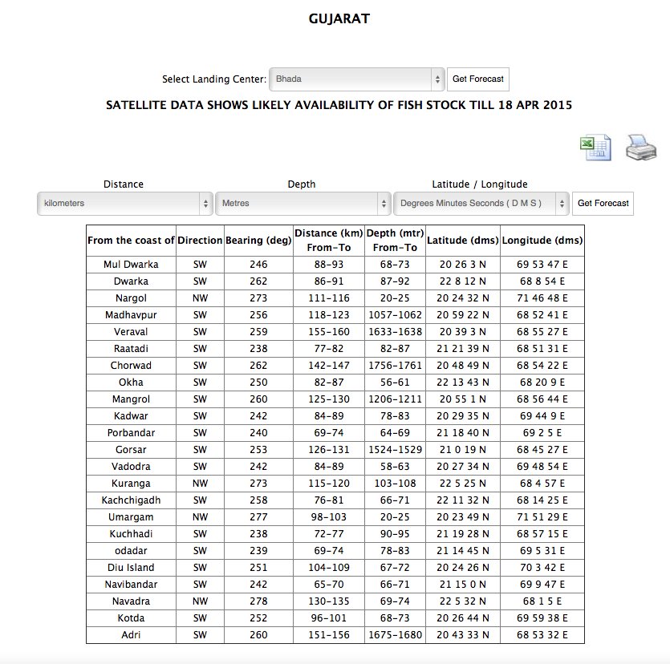
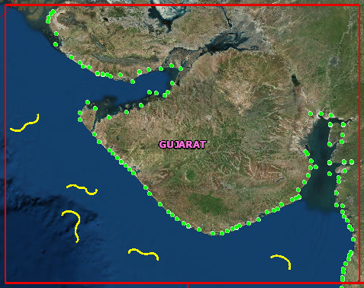
INCOIS – Potential Fishing Zone
(PFZ) Advisories
http://www.incois.gov.in/MarineFisheries/MarineFisheryAdvisory
Notes:
14

Slide 15
INCOIS – Potential Fishing Zone
(PFZ) Advisories
Notes:
15

Slide 16
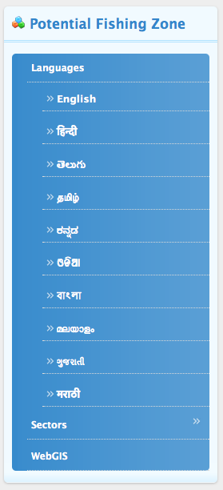
INCOIS – Potential Fishing Zone
(PFZ) Advisories
Notes:
16

Slide 17
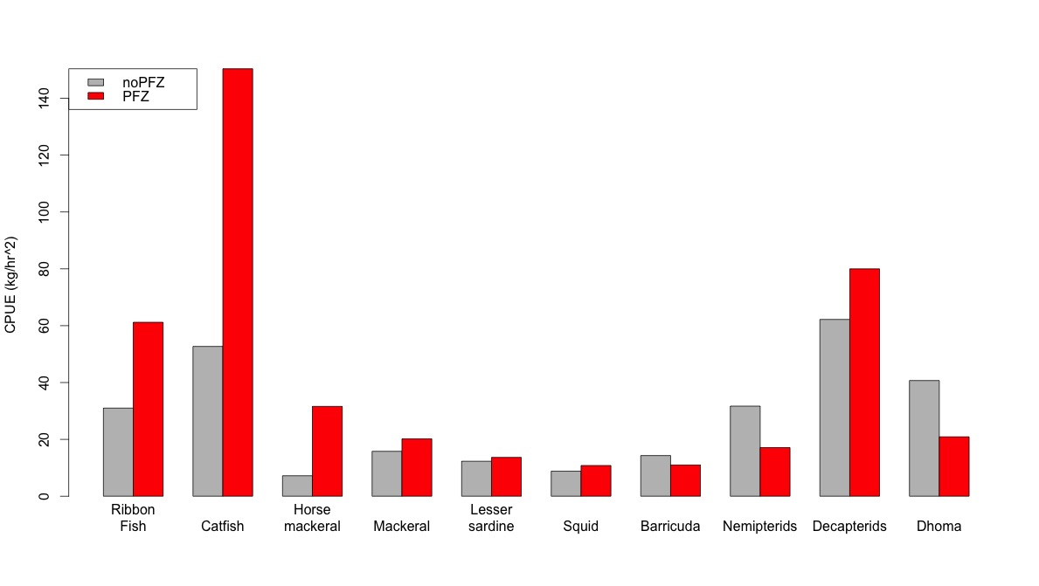
Impact of PFZ on CPUE
Without PFZ
With PFZ
Catch Per Unit Effort (kg/hr²)
From Solanki et al., CSR, 2005
Notes:
17
Figure made from data in Table 4.

Slide 18
International Differences
PFZ generation is probably the best known satellite application for fisheries.
There are significant international differences in how PFZ data are generated and disseminated.
In some countries, such as India, PFZs are generated and disseminated by government agencies.
In the USA the government (NOAA) is tasked with regulating fisheries, not with aiding them, and PFZs are are generated and disseminated by commercial companies.
Notes:
18

Slide 19
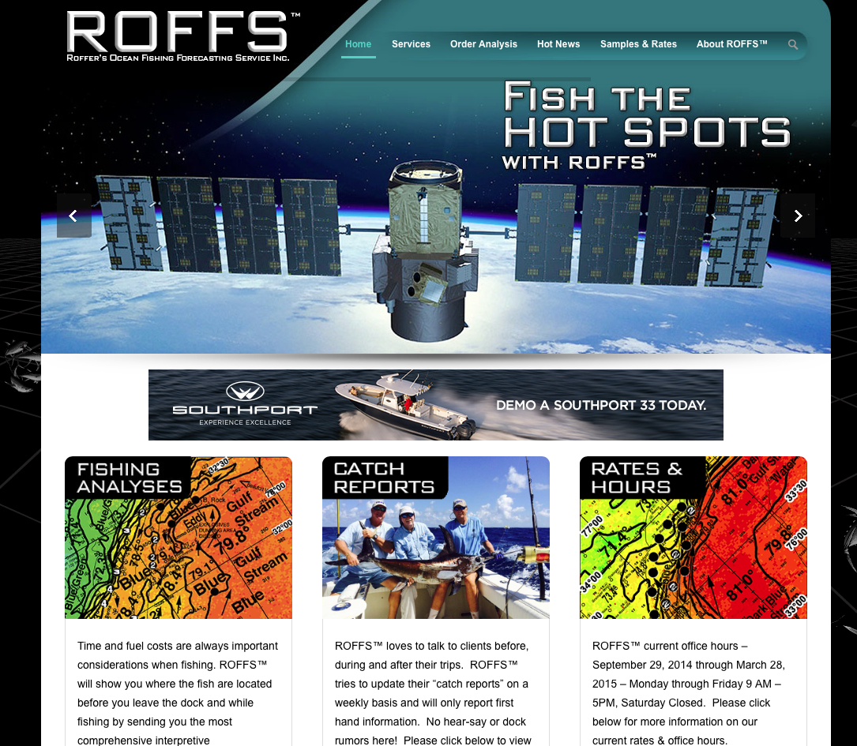
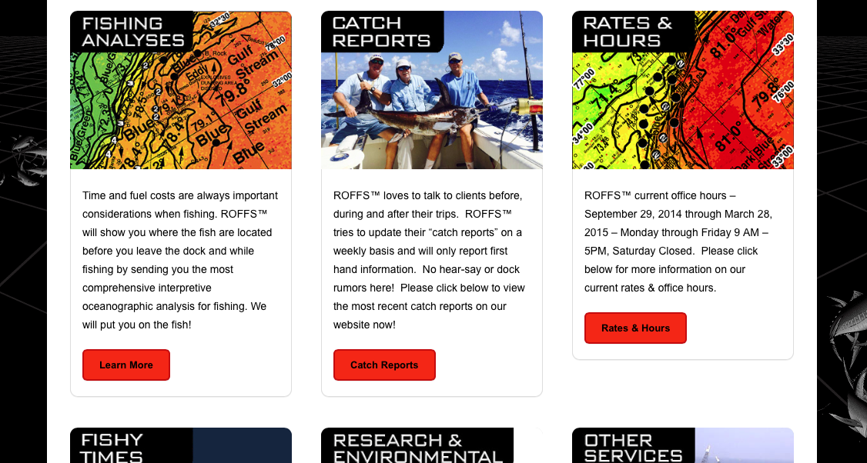
Harvesting
Notes:
19
In the US fish advisories are a commercial enterprise, and are not generated by government agencies.

Slide 20
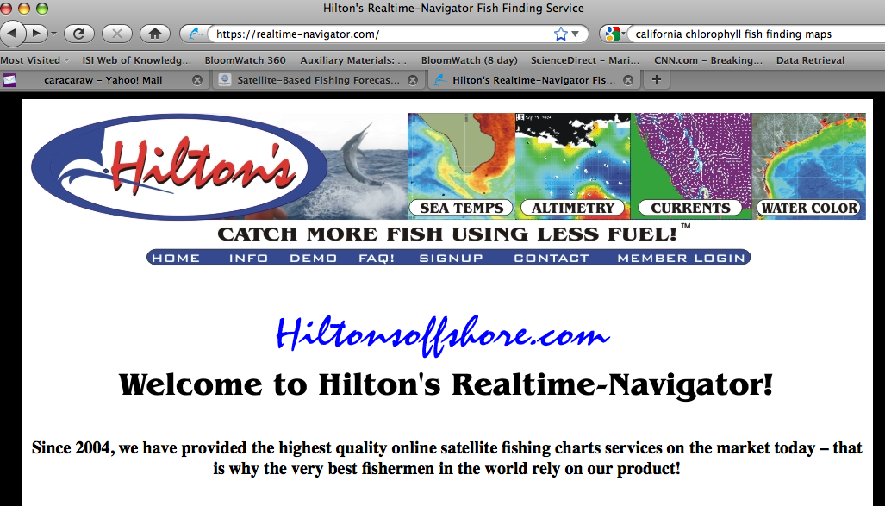
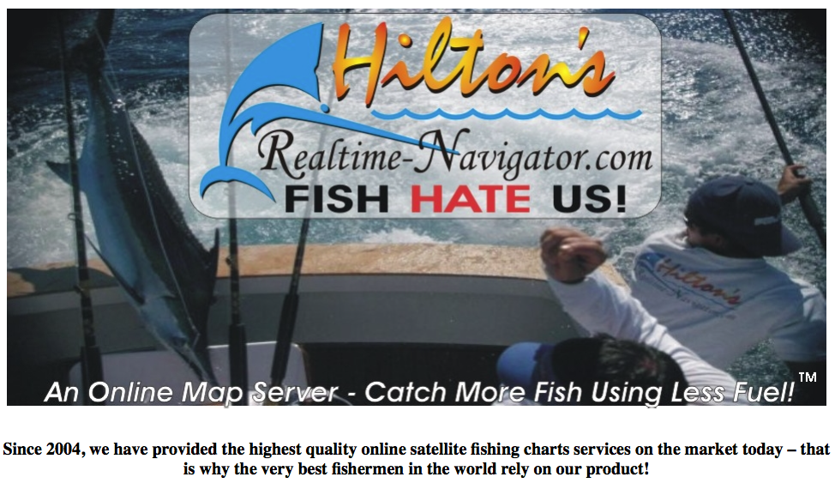
INCOIS – Potential Fishing Zone
(PFZ) Advisories
Notes:
20
In the US fish advisories are a commercial enterprise, and are not generated by government agencies.

Slide 21
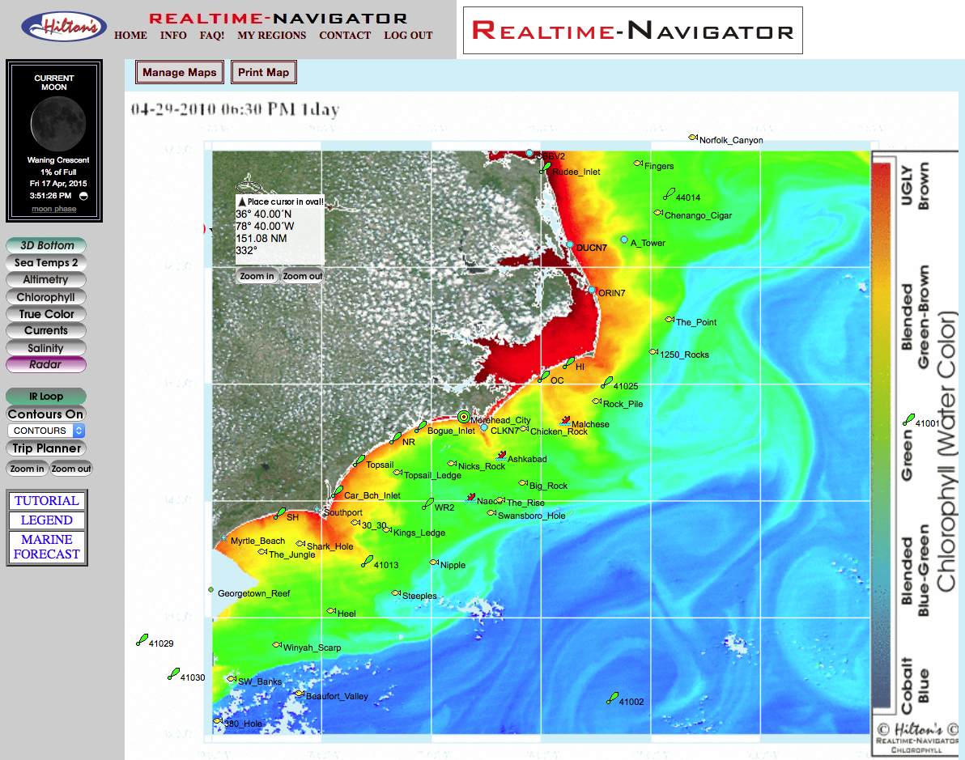
INCOIS – Potential Fishing Zone
(PFZ) Advisories
Notes:
21
In the US fish advisories are a commercial enterprise, and are not generated by government agencies.

Slide 22

2. Stock Assessment
Stock Assessment?
Notes:
22

Slide 23
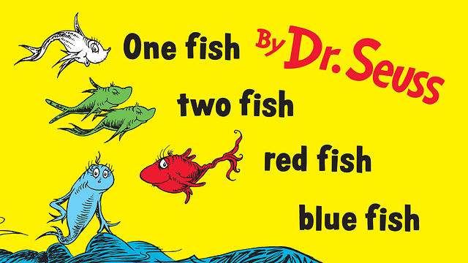
Stock Assessment
Stock Assessment is a fancy way of saying “counting fish”
Notes:
23

Slide 24
Stock Assessment
NOAA Fisheries (National Marine Fisheries Service) is responsible for managing ~450 fish stocks. In addition, NMFS manages ~200 protected or endangered species (marine mammals and turtles).
Notes:
24

Slide 25

Stock Assessment
In theory, counting fish seems relatively straightforward.
Notes:
25

Slide 26
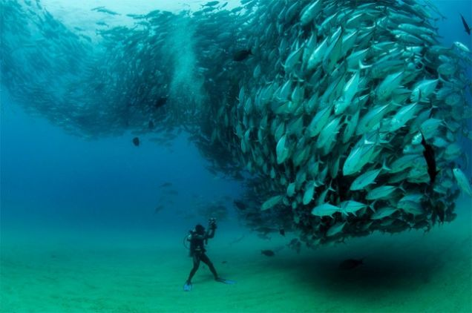
Stock Assessment
Photo credit: Octavio Aburto
In practice, it’s much more complicated.
Notes:
26

Slide 27

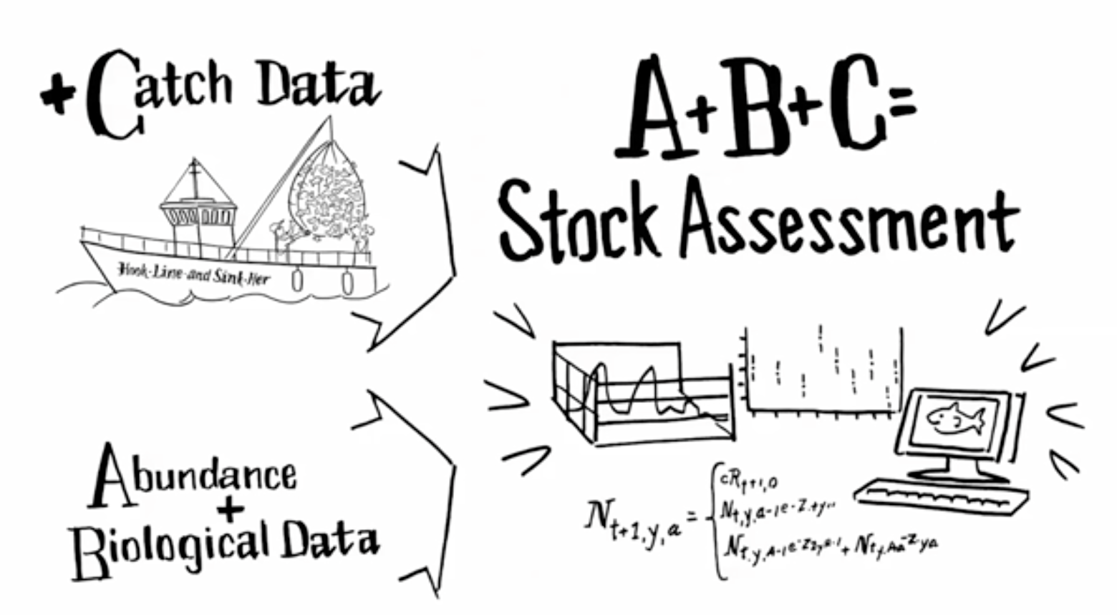
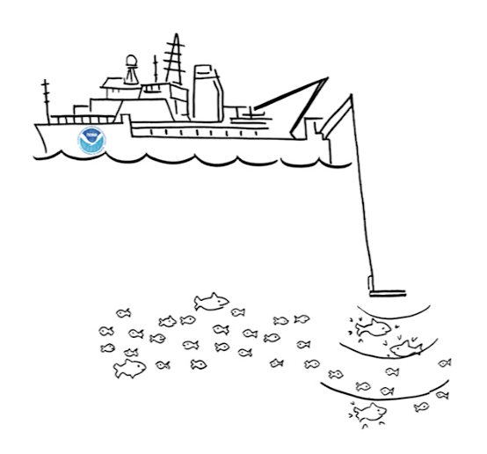


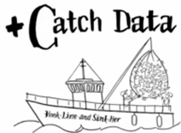
Stock Assessment
from http://www.st.nmfs.noaa.gov/stock-assessment/index
=
Assessments provide the technical basis for setting annual fishery harvest levels
Notes:
27
From the video “The ABCs of Stock Assessment” at http://www.st.nmfs.noaa.gov/stock-assessment/index

Slide 28
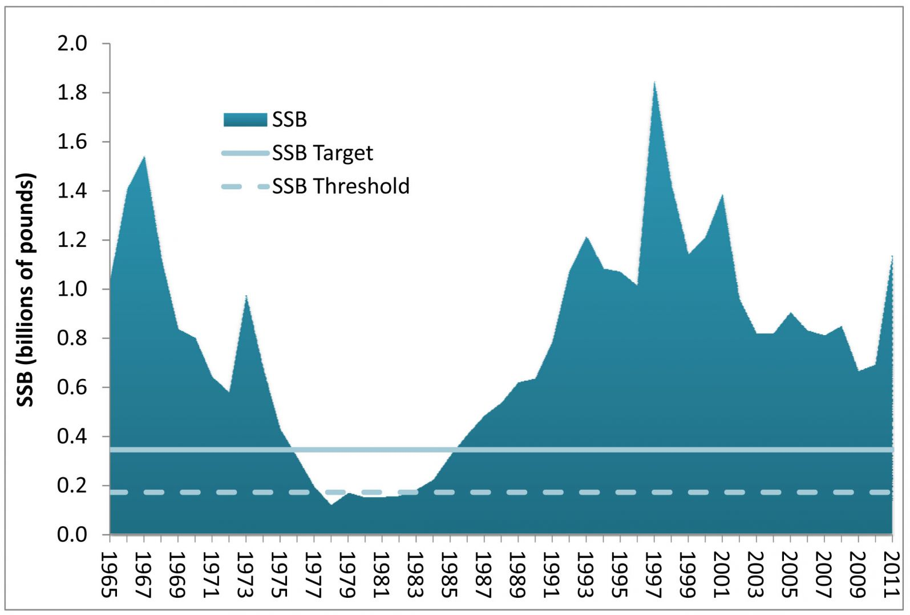
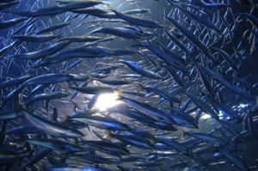
Stock Assessment
Atlantic Herring Spawning Stock Biomass (SSB)
What drives the interannual variability in biomass?
Annual catch limit (ACL) for 2013-2015 set at 238 million pounds
Source: 54th Northeast Regional Stock Assessment Workshop, 2012
Notes:
28
Note the length of the timeseries – it started over 50 years long. The fundamental question in fisheries is “What drives the interannual variability in biomass?”

Slide 29
Stock Assessment
from http://www.st.nmfs.noaa.gov/stock-assessment/index
=
Where’s the E (Environment)?
Notes:
29
From the video “The ABCs of Stock Assessment” at http://www.st.nmfs.noaa.gov/stock-assessment/index

Slide 30
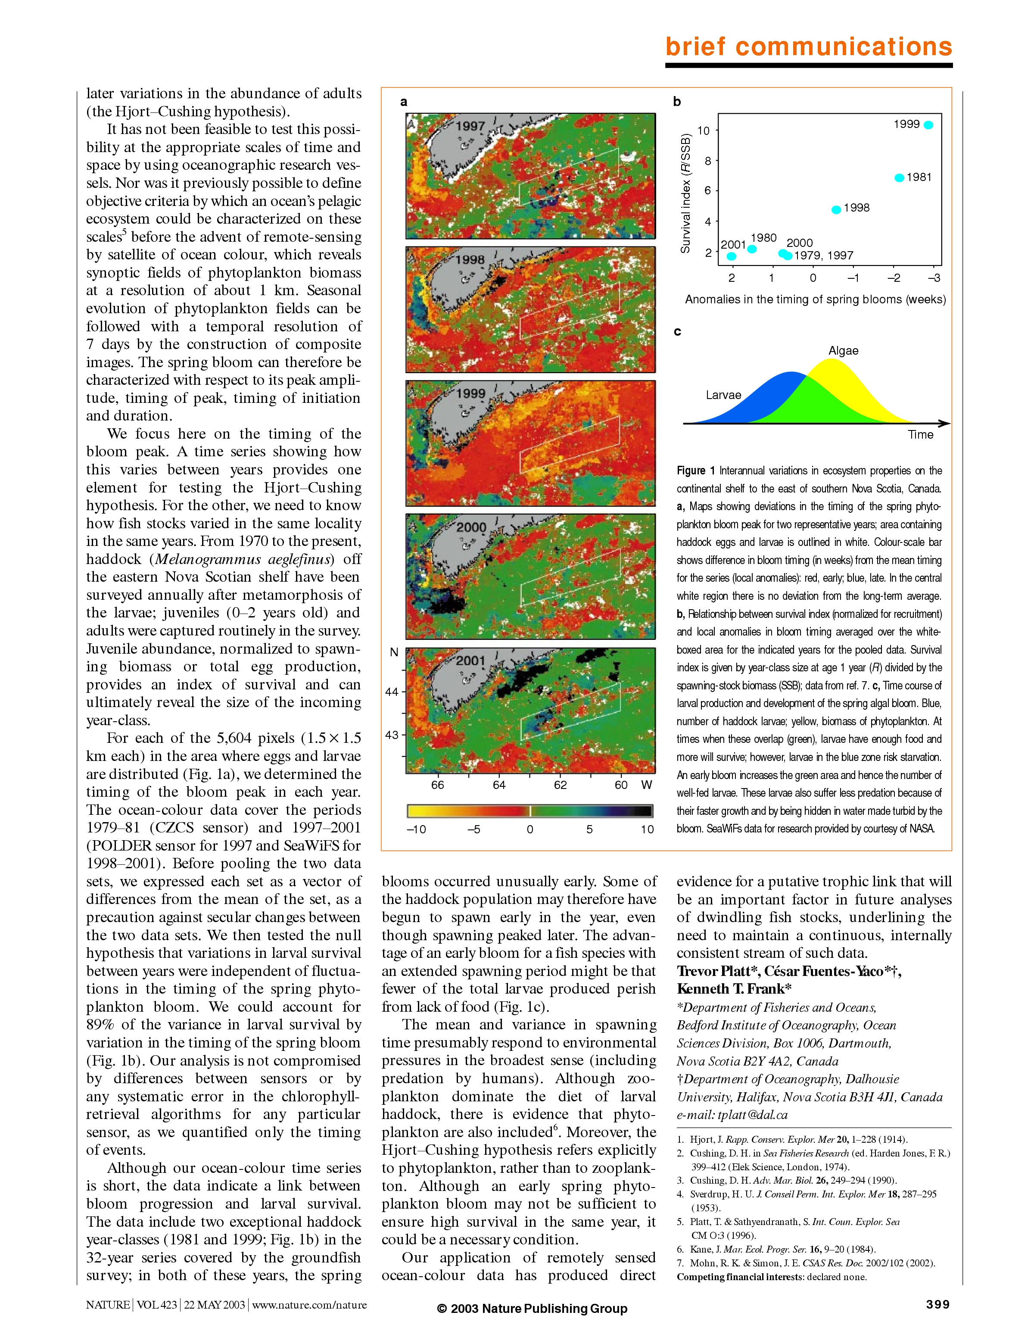
Match-Mismatch Hypothesis
Late Early
Timing of the spring bloom & Haddock survival
Annual anomaly in the timing of the spring bloom based on SeaWiFS chlorophyll data.
Earlier bloom means more time in the ‘green’ zone
From Platt et al., Nature, 2003
Early Late
Notes:
30

Slide 31
Long timescales
Species composition of CA landings
Data from 1928-2000
15 years
Urchin Squid
Sardine
Anchovy
Mackerel (blue & green)
Figure courtesy of Jan Mason, NOAA/NMFS/SWFSC/ERD
Notes:
31

Slide 32
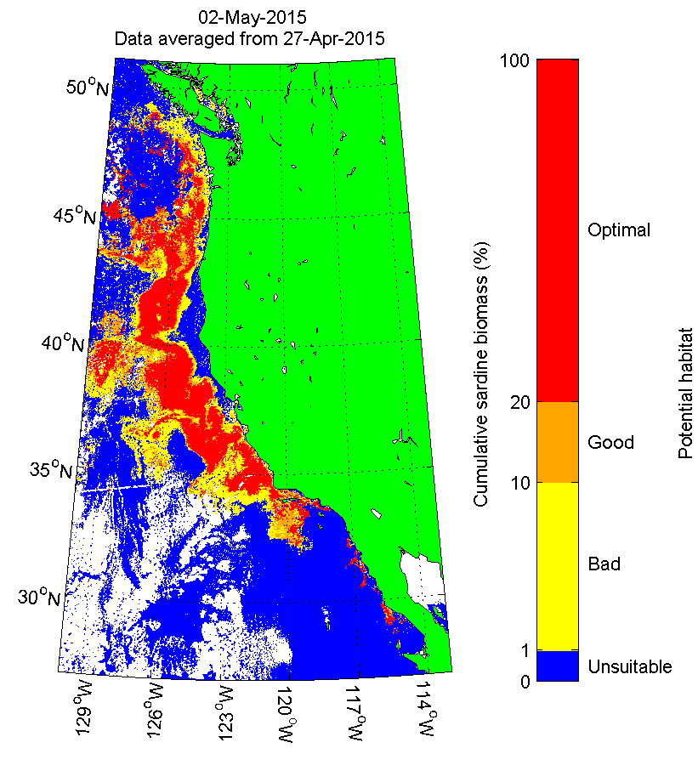
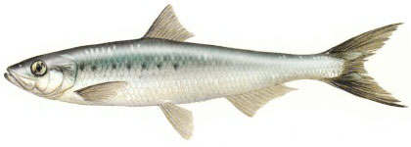
Habitat Modeling
Potential Sardine Habitat
Model predicts sardine occurrence based on satellite SST, chlorophyll and SSH
Was developed to optimize the timing and location of ship surveys for sardine stock assessment (i.e., to improve the “A” part of the stock assessment)
From Zwolinski et al., ICES JMS, 2011
Notes:
32
Sardine habitat maps available at http://swfscdata.nmfs.noaa.gov/AST/sardineHabitat/habitat.asp

Slide 33
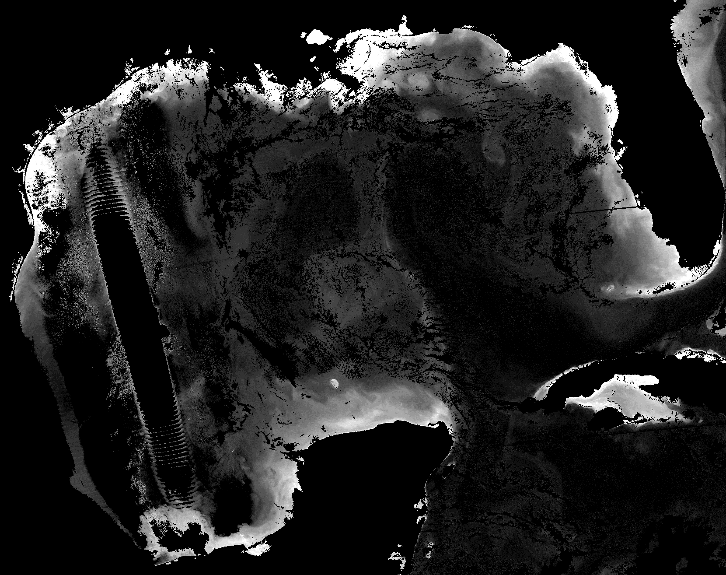

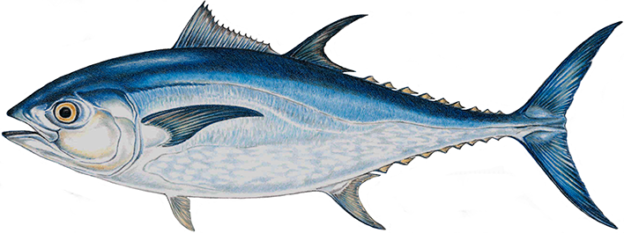
NRT Cruise support
VIIRS chl image generated by NESDIS in support of a SEFSC survey cruise looking for bluefin tuna larvae.
Images are used to position stations to cover frontal features, small and mesoscale oceanographic features, and to ensure as many different water masses as possible are sampled.
They requested the images in gray scale.
2015/5/20 19:21-19:25 UTC (orig)
John Lamkin, NOAA/NMFS/SEFSC
Notes:
33
We prefer black and white, actually greytone, because we can more easily control the contrast and brightness at the full value range of the image data. Colors and color changes in the color palettes can often provide false impressions of the image data. We often use color to depict the image data after we have analyzed it for our use. The 256 greytone palette never has to be changed when there are seasonal changes in the chlorophyll. Color palettes are optimized for a particular range of chlorophyll.

Slide 34
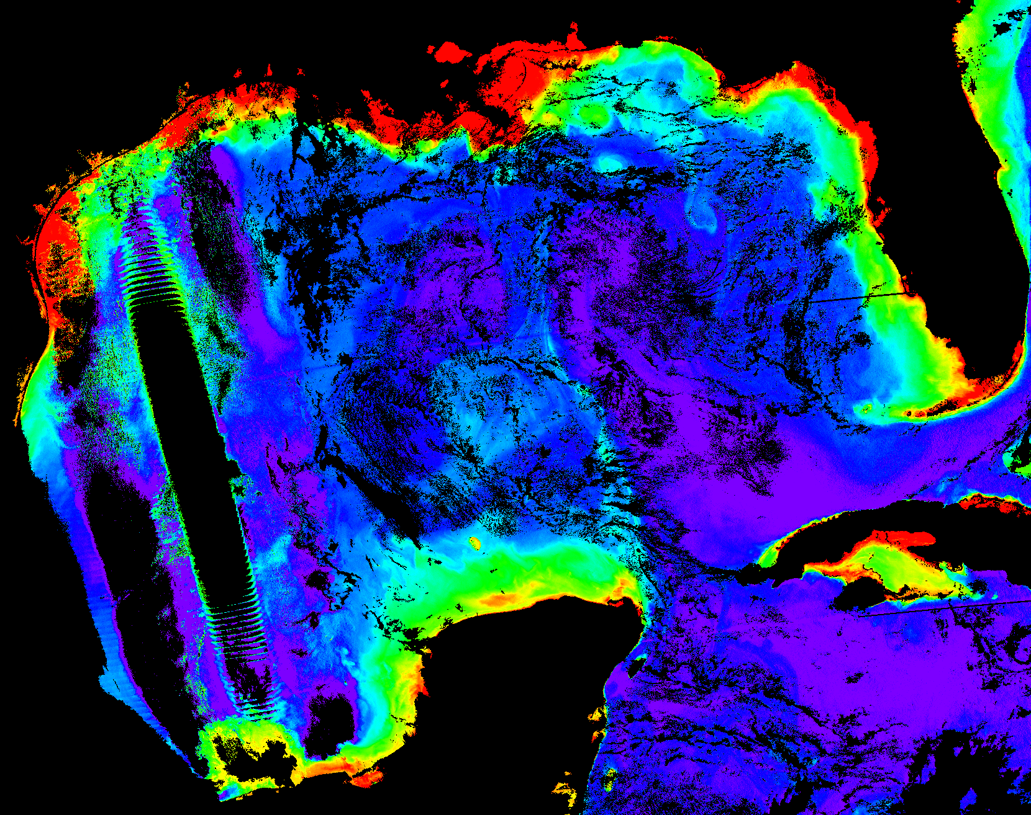

NRT Cruise support
VIIRS chl image generated by NESDIS in support of a SEFSC survey cruise looking for bluefin tuna larvae.
Images are used to position stations to cover frontal features, small and mesoscale oceanographic features, and to ensure as many different water masses as possible are sampled.
They requested the images in gray scale.
2015/5/20 19:21-19:25 UTC (color)
John Lamkin, NOAA/NMFS/SEFSC
Notes:
34
We prefer black and white, actually greytone, because we can more easily control the contrast and brightness at the full value range of the image data. Colors and color changes in the color palettes can often provide false impressions of the image data. We often use color to depict the image data after we have analyzed it for our use. The 256 greytone palette never has to be changed when there are seasonal changes in the chlorophyll. Color palettes are optimized for a particular range of chlorophyll.

Slide 35
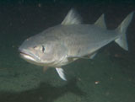
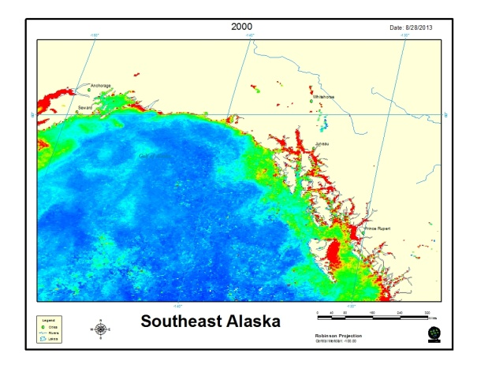
Recruitment Variability
Developing ecological indicators for sablefish recruitment
Objectives
Support an ecosystem approach to management
$ 142 million fishery for sablefish in U.S.
Develop indicators for sablefish recruitment
Use satellite color data to index chl-a, blooms
Quantify blooms in rearing areas
Link to future sablefish recruitment
Model Prediction
High age-2 recruitment in 2002 was linked to high chlorophyll-a in the late summer in 2000.
Sablefish
Predicted
Residuals
Age-2 sablefish modeled as a function of Chl-a (t-2), sea temperature (ST) (t-2), and age-2 sablefish (t-1) with data collected in situ, 1999-2010 (Martinson et al. 2013).
Coastal rearing habitat for young sablefish
Ellen Martinson, NMFS/AFSC/ABL
Notes:
35
Martinson et al. 2013. Linking SECM ecosystem indicators to sablefish recruitment. In: S. Zador (Ed.), Ecosystem Considerations for 2013.
Appendix C of the BSAI/GOA Stock Assessment and Fishery Evaluation Report. Technical report, North Pacific Fishery Management Council,
605W. 4th Ave., Suite 306, Anchorage, AK 99501.

Slide 36
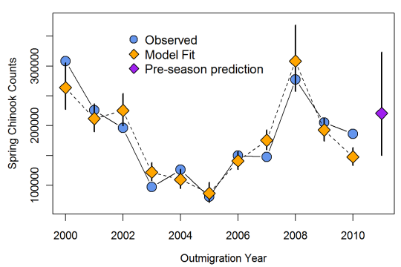
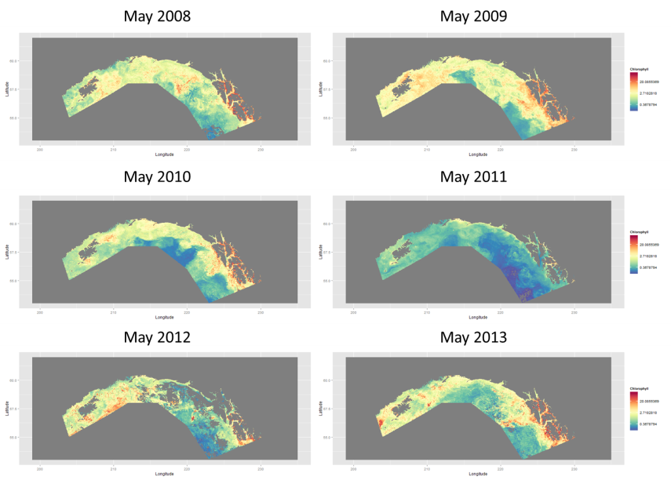
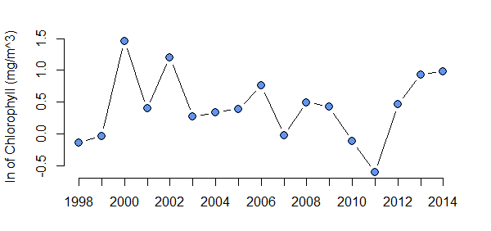
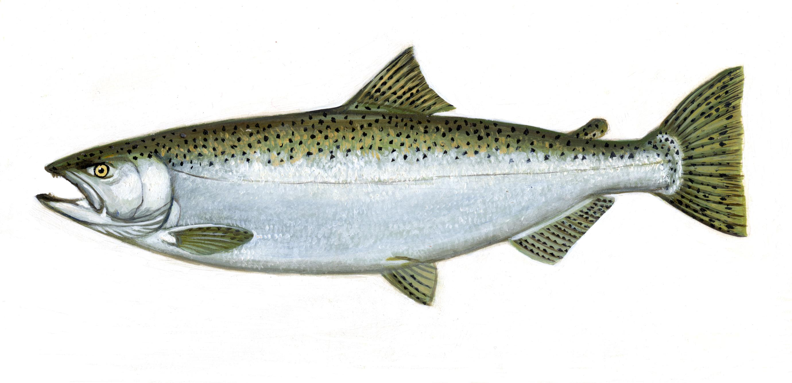
Salmon Survival in 2011
Adult Chinook Returns – What happened in 2011?
May 2008 May 2009
Forecasted
return
May 2010 May 2011
Observed
return
2002 2004 2006 2008 2010
May 2012 May 2013
2011
Brian Burke
Fish Ecology Division
NWFSC, NOAA Fisheries
Time series of average April-May chlorophyll concentrations in coastal Gulf of Alaska. The lowest value (2011) suggests that low productivity could have negatively influenced salmon survival that year.
Notes:
36
Based on a suite of ocean indicators (http://www.nwfsc.noaa.gov/oceanconditions) and a multivariate model of salmon returns (http://www.plosone.org/article/info%3Adoi%2F10.1371%2Fjournal.pone.0054134), we expected over 200,000 adult spring-run Chinook salmon to return to the Columbia River (Figure 1). But the observed return was less than 90,000 fish. One potential explanation is that ocean conditions off of Oregon and Washington were indeed above average (as our local and regional ocean indices suggested), but when fish migrated north into the Gulf of Alaska, low productivity in Alaskan waters resulted in low transfer of biomass to higher trophic levels and, ultimately, unusually high late-summer salmon mortality. My goal was to use satellite data to get a better idea of interannual variability in chlorophyll levels during the spring phytoplankton bloom in coastal Gulf of Alaska (for this, I am assuming a relationship between phytoplankton abundance in the spring and biomass of salmon prey organisms later in the summer and fall). More specifically, could chlorophyll levels partially explain the low observed salmon returns in 2011 ?

Slide 37
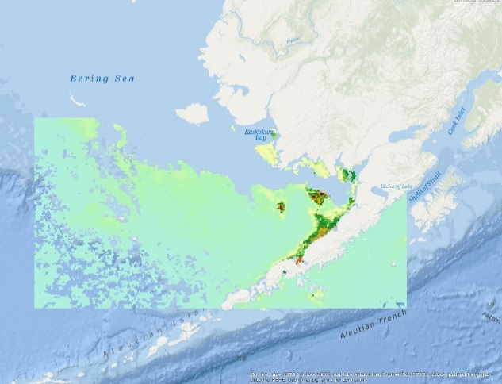
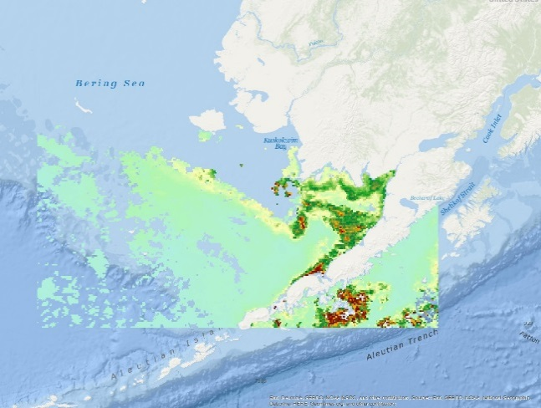
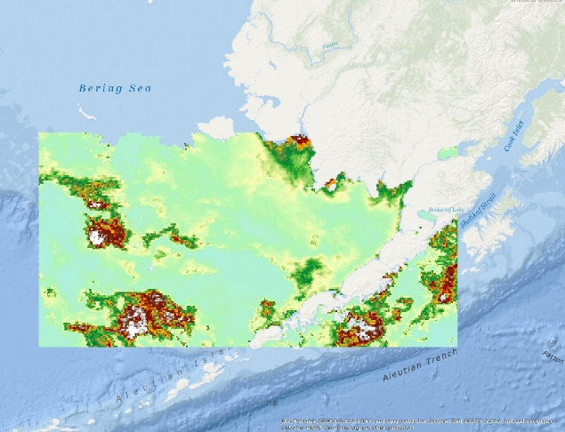
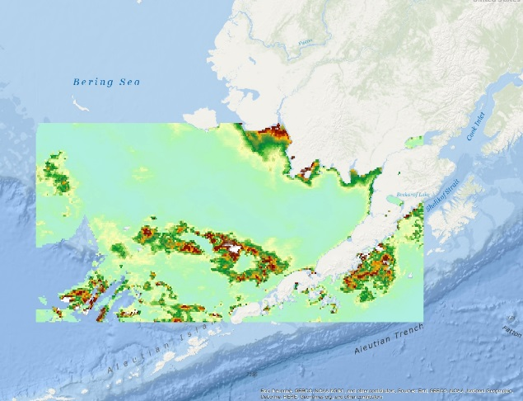
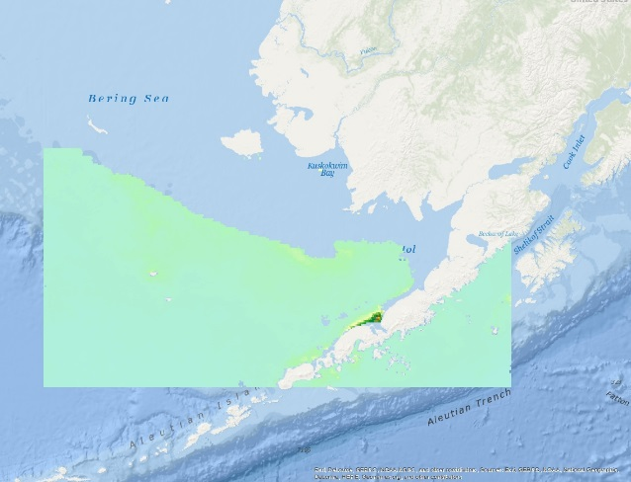
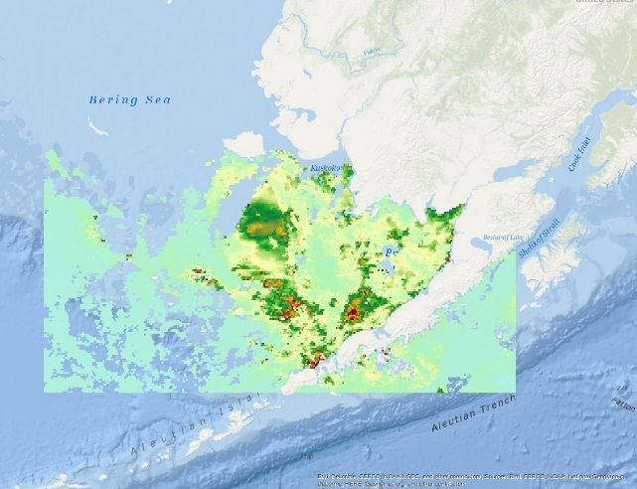
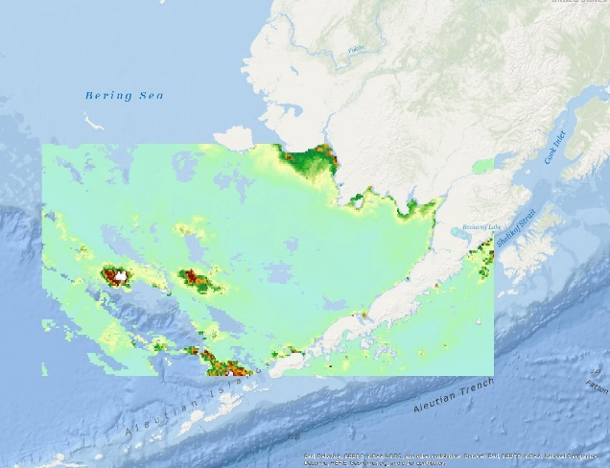

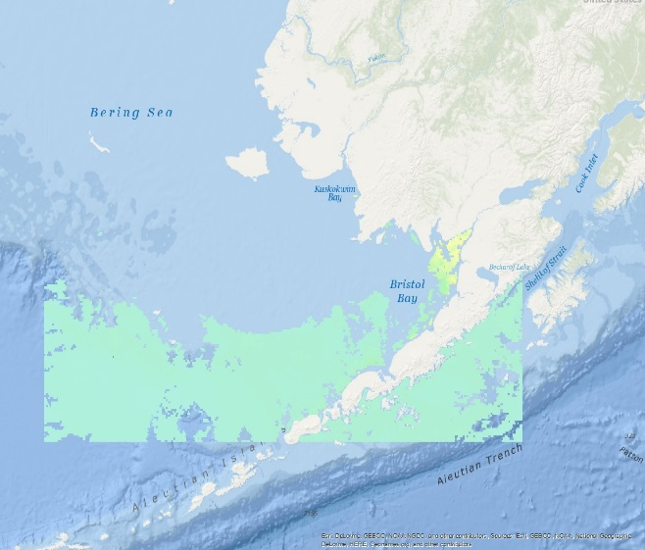
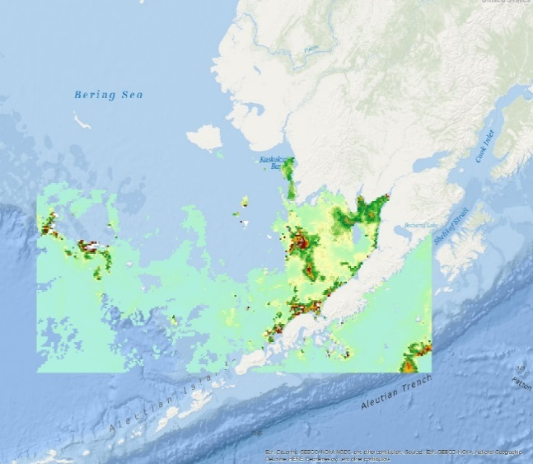










Jeanette Gann, NMFS/AFSC
April
May
June
July
2007 was an anomalous year for primary production, low nutrients, and low recruitment for pollock. Satellite data is crucial to fill in data gaps as our datasets and surveys are restricted to primarily late summer/early fall.
2006
2007
2008
2009
2010

Slide 38
CA Current
Integrated Ecosystem Assessment (IEA)
From the 2013 California Current System IEA report
Notes:
38
The anomaly on the left was kind of a key to one story presented elsewhere in the report, connecting the really strong upwelling during the summer of 2013, to productivity…or really, the lack thereof.
The idea is that upwelling was so strong that it actually mixed stuff up and transported offshore, so we did not get a resulting strong anomaly of chl-a biomass (but we may well have had really strong production, since fish production was pretty good that year).
So essentially, we used the chl and chl anomaly maps to make a connection between upwelling, nutrients, and primary productivity.
Oddly enough, even though its suppposed to be “integrated” I could not find an example in the other sections of the report where anyone else referred to ocean color, chl-a, or these particular figures…

Slide 39

3. Management & Conservation
Notes:
39
Image from the Green Seas Blue Seas mural by Ray Troll and Roberto Salas, which is on the building formerly occupied by SWFSC/ERD.
https://swfsc.noaa.gov/greenseas-blueseas/

Slide 40

Dynamic Ocean Management (DOM)
Remote Sensing
Scales et al. 2014 J Appl Ecol
Notes:
40

Slide 41
Dynamic Ocean Management (DOM)
Some Examples
TurtleWatch
WhaleWatch (NASA funded)
EcoCast (NASA funded)
Notes:
41

Slide 42























Tagged Species
Electronic tagging is a key methodology used by NOAA Fisheries to gather information on stock productivity and recruitment, fish behavior, feeding ecology and habitat selection– information needed for accurate and responsible fisheries management.¹
Satellite data, such as ocean color, SST, SSH and SVW, are necessary to place the telemetric data from tags in an environmental context as part of the transition to an ecosystem approach to management.
¹Report of the NMFS Workshop on advancing electronic tag technologies and their use in stock assessment. NOAA Tech. Memo. NMFS-F/SPO-82, 82 pp, 2007.
http://spo.nmfs.noaa.gov/tm
Notes:
42

Slide 43


Top Predator Exploration of the Pacific Ocean
TAGGING OF
PACIFIC
PELAGICS
23 species; 4,000 tags; >1 Million profiles
Tracking, conservation, ocean observation
From Block et al, 2011, Nature 475, 86–90
Notes:
43
So, let’s look at what the animals are doing. This is a map showing a subset of the locations of 19 different species that we’ve tagged in TOPP. This is a combination of tag data over the period 2002-2006. The list of animals is on the right --- we have whales, seabirds, sharks, tuna, turtles, ..., and their positions are color-coded on the map.
See a couple of things: (1) the vast expanse of the Pacific Ocean covered by this set of species, and (2) very specific niche separation amongst species:
a) Two distinct populations of leatherback sea turtles;
b) Three different species of tuna (yellowfin, albacore, and bluefin) occupy different habitat, with some overlap seasonally; the bluefin also make migrations clear across the Pacific between California and Japan;
c) The seabirds cover a tremendous amount of space in relatively short times; the sooty shearwaters go from the high southern to the high northern latitudes in the course of a year, in search of the “endless summer”; albatross cover the entire North Pacific from their nesting beaches in the central Pacific.
So far, we have over 4000 animal tracks in TOPP, over 250,000 animal-tracking days, and well over one million water column profiles!
We’re getting fundamental information on the distribution, movement and behavior of this suite of animals. And this information has tremendous value in developing conservation strategies and contributing to global ocean observing systems.

Slide 44

TOPP Synthesis: Marine Predator Migrations
From Block et al, 2011, Nature 475, 86–90
Notes:
44
SSM across all taxa and tag types to get robust position estimates.
Tracks normalized by number of individuals per species, and by track length (to account for tag bias).

Slide 45



TZCF
Transitional Zone Chlorophyll Front
2012
Migration route for sea turtles, squid and tuna (Ichii et al, 2009, Polovina et al, 2015, Zainunddin et al, 2008)
It’s interannual variability affects the population of the endangered monk seal in the Hawaiian islands (Baker et al., 2007, 2012)

Slide 46

http://www.pifsc.noaa.gov/eod/turtlewatch.php
Notes:
The 18°C isotherm is used as a proxy for the chl=0.2 isocline that delineates that TZCF

Slide 47



Whale Watch
High spatial overlap between shipping intensity and blue whale hotspots
Blue whale hotspots. From Irvine et al. 2014
Shipping Intensity. From Hazen et al., in review
http://www.westcoast.fisheries.noaa.gov/whalewatch/index.html
Notes:
One of the first steps is identifying the greatest risks to each species, and we have a manuscript submitted to Nature communications that examines these hotspots and finds they are often in marine sanctuaries, a “protected area” that is not doing a good job protecting these highly migratory species.
We can use sat. data to model the environmental relationships and then predict where species are most likely to be found in near real time, e.g. monthly averages which could inform fisheries fleets to reduce bycatch, move ship traffic / vessel speeds, or naval exercises.

Slide 48

Whale Watch
Use satellite telemetry and oceanographic data to develop near-real time (8-day to monthly) habitat models for blue whales in the California Current System
.
This will assist management efforts to mitigate against human impacts, such as ship strikes and entanglements. Working closely with NOAA/NMFS West Coast Regional Office.
A NASA funded project
http://www.westcoast.fisheries.noaa.gov/whalewatch/index.html
Notes:
One of the first steps is identifying the greatest risks to each species, and we have a manuscript submitted to Nature communications that examines these hotspots and finds they are often in marine sanctuaries, a “protected area” that is not doing a good job protecting these highly migratory species.
We can use sat. data to model the environmental relationships and then predict where species are most likely to be found in near real time, e.g. monthly averages which could inform fisheries fleets to reduce bycatch, move ship traffic / vessel speeds, or naval exercises.

Slide 49


EcoCast
  California Drift Gillnet Fishery
Large seasonal closure put into place in 2001 to protect leatherbacks (<1000 left)
….leatherback bycatch dropped to zero since closure but large economic cost
Notes:
One of the first steps is identifying the greatest risks to each species, and we have a manuscript submitted to Nature communications that examines these hotspots and finds they are often in marine sanctuaries, a “protected area” that is not doing a good job protecting these highly migratory species. We can use sat. data to model the environmental relationships and then predict where species are most likely to be found in near real time, e.g. monthly averages which could inform fisheries fleets to reduce bycatch, move ship traffic / vessel speeds, or naval exercises.

Slide 50






EcoCast
Predicting fishery bycatch for management
Predicted catch + Predicted bycatch ➔ EcoCast
Using remotely sensed products, these surfaces can be predicted in near-real time for use by managers and fishers. A NASA funded project.
Elliott Hazen et al., NMFS/SWFSC
Notes:
One of the first steps is identifying the greatest risks to each species, and we have a manuscript submitted to Nature communications that examines these hotspots and finds they are often in marine sanctuaries, a “protected area” that is not doing a good job protecting these highly migratory species.
We can use sat. data to model the environmental relationships and then predict where species are most likely to be found in near real time, e.g. monthly averages which could inform fisheries fleets to reduce bycatch, move ship traffic / vessel speeds, or naval exercises.

Slide 51




Harmful Algal Blooms (HABs)
NOAA National Ocean Service
Operational Monitoring and Forecasting of HABs in the Gulf of Mexico
Orbimage - SeaWiFS
Courtesy of Rick Stumpf, NOS
Notes:
HABs are caused by several organisms with differing characteristics and life histories, which can complicate the ability to detect and monitor these events by remote sensing.
For remote sensing to be effective, the organism responsible for the HAB must be detectable, either directly, through its effect on ocean color, or indirectly by correlation with other algal blooms, or in association with a water mass that can be detected by other satellite data such as SST or SSH.
The NOS operational HAB forecast in GOM uses a combination of satellite data, field observations, buoy data and modeling
Field observations needed to ground-truth satellite observed blooms as HABs; chlorophyll data is not sufficient to distinguish harmful from non-harmful algae.
The dominant species varies with geographical location, and hence algorithms to detect HABs have to be regionally specific. For example algorithms developed to detect Karenia brevis in the Gulf of Mexico will not necessarily detect blooms of Pseudo-nitzschia off the US west coast
Contributed by Rick Stumpf, NOAA/NOS

Slide 52



HABs & mortality events
Are southern right whale calf deaths at Península Valdés caused by HABs?
The chlorophyll maximum of the spring phytoplankton bloom at PV has increased by an order of magnitude in the past 10 years.
Nov 2004
Península Valdés
In the past 10 years there has been a dramatic increase in the number of SRW deaths at their calving ground in Argentina. Most of the deaths (~90%) are calves less than 3 months old.
See Wilson et al. poster
Marine Mammal Science
Notes:
52

Slide 53




Timescales
VIIRS Chl 750 m
May 17, 2016
1 day composite
VIIRS Chl 750 m
May 16-18, 2016
3 day composite
VIIRS Ocean Color
Managers will not be sold on the utility of satellite data
when shown the 1-day ocean color composite from May 17, 2016!
VIIRS Chl 750 m
May 13-20, 2016
weekly composite
VIIRS Chl 750 m
May 2016
monthly composite
Images obtained from ERDDAP at coastwatch.pfeg.noaa.gov/erddap

Slide 54




Geostationary
MODIS & GOES SST
The biggest advantage of geostationary measurements is not increased temporal resolution, but rather the increased spatial coverage that can be obtained on shorter timescales
MODIS SST
May 17, 2016
1 day composite
MODIS SST
May 13-20, 2016
weekly composite
GOES SST
May 17, 2016
1-day composite
GOES SST
May 13-20, 2016
weekly composite
Images obtained from ERDDAP at coastwatch.pfeg.noaa.gov/erddap

Slide 55

MUR SST
MUR SST
Multi-scale Ultra-high Resolution (MUR) dataset produced by JPL
Daily, global, 1 km resolution
Image obtained from ERDDAP at coastwatch.pfeg.noaa.gov/erddap
most recent image at 6/23/16 5:00 am UTC+1
June 21, 2016

Slide 56
Take Home Points
  “Fisheries” is more than just catching fish; stock assessment, management and conservation are important aspects to fisheries, which encompasses all living marine resources.
  NRT ocean color data are needed for:
  - optimizing harvesting,
  - optimizing assessment surveys,
  - detecting and monitoring HABs, and
  - Dynamic Ocean Management (making forecasts)
  Long-term Climate Quality ocean color data are needed for use in stock assessments, ecosystem assessments, and management and conservation applications.
Notes:
56

Slide 57
Product Wish List
  Geostationary ocean color would provide much daily coverage
  Common time-step for different products for temporal composites (SST, Chl, winds, SSH ect)
  Better spatial resolution for SSH data
  Better spatial resolution for salinity data
  Coastal SSH products
  Frontal products – strength and persistence
Notes:
57

Slide 58

Reprints Available
Notes:
58

Slide 59

Thanks!
Gracias!
Notes:
Image from the Green Seas Blue Seas mural by Ray Troll and Roberto Salas, which is on the building formerly occupied by SWFSC/ERD.
https://swfsc.noaa.gov/greenseas-blueseas/

