Slide 1

Possibility of Day-Night-Band of VIIRS to Detect Fishing Activities
Ichio ASANUMA*, Takashi YAMAGUCHI*, John-goel PARK*,
Kenneth J. MACKIN*, and John MITTLEMAN**
*The Tokyo University of Information Sciences
**Naval Research Laboratory, USA

Slide 2
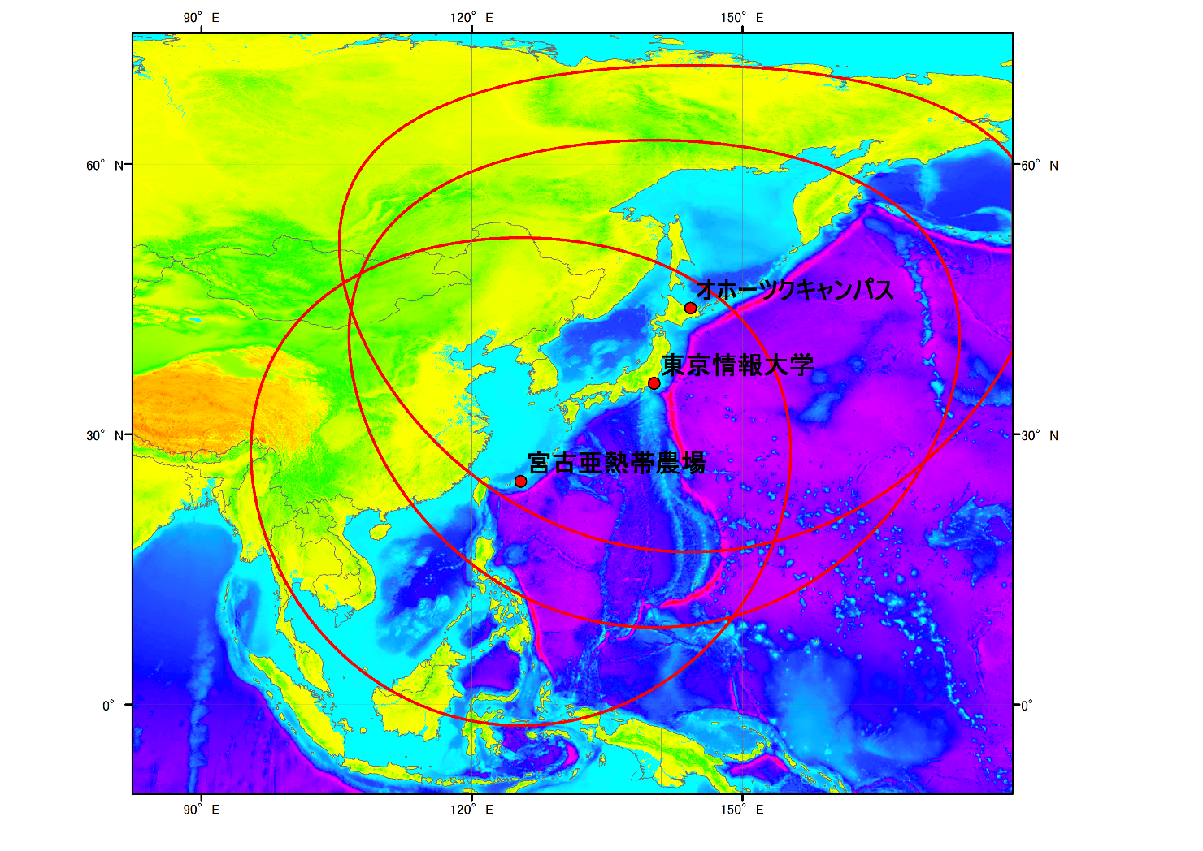
Three receiving stations operated by
Tokyo University of Information Sciences
Notes:
The Tokyo University of Information Sciences has been operating three receiving stations along
the western boundary of the Pacific ocean to cover the Sea of Okhotsk, the Japan Sea, the East
China Sea, and the South China Sea.
Each stations are assigned for the different priorities for three satellites of Terra, Aqua, and
Suomi-NPP to capture all possible data of the surface.

Slide 3
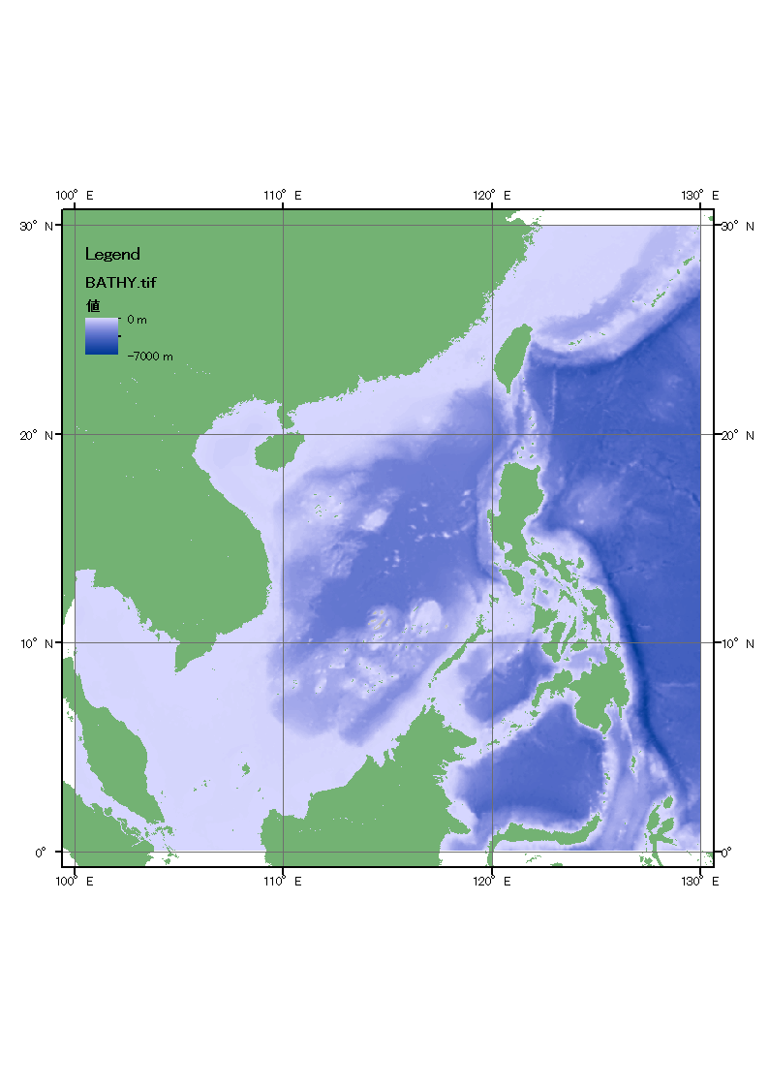
Bathymetry of Study Area
South China Sea (SCS)
SCS Basin
  Northern half : to -5000 m
  Southern half : less -200 m
Surrounded by continental margins and shelves
Large Marine Ecosystem is maintained by rivers and terrestrial inputs (UN, 2006)
Notes:
The South China Sea
Fishing field as well as the sea lanes to connect the far east and the middle east.
A format of management over the maritime resources in the South China Sea should
be taken into consideration in a flexible and diverse way. Given the national rights on
the maritime resources of absolute ownership could not be accepted and adopted in
the common sense, we should put this dispute aside.

Slide 4
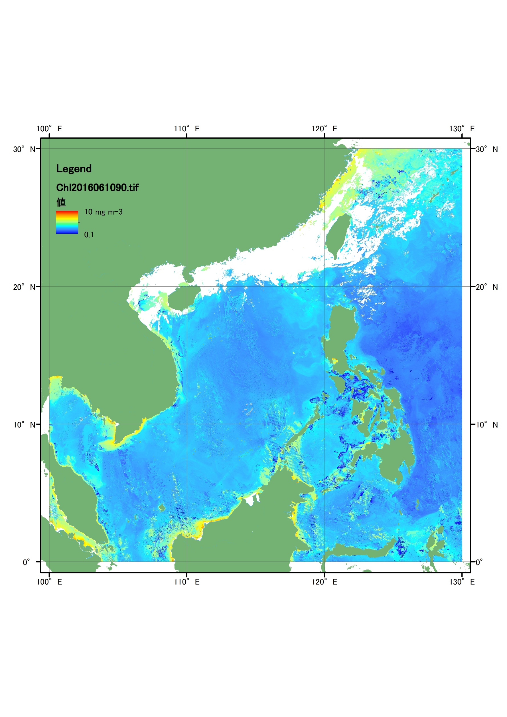
Chlorophyll-a concentration by VIIRS/Suomi-NPP
Monthly composite for March 2016
Potential transboundary
  Mackerels, Scads, Torpedo Scad, Sardines, Jacks, Spanish mackerel, Small tunas
Coastal water
  Anchovies, Bombay-duck, Hairtails, Wolf-herring, Barracudas, Pomfrets, Flyingfishes, Mullets
(Khemakorn, 2006)
Notes:
The South China Sea could be divided into two regions as the potential transboundary
And the coastal waters.
Each regions provides a diverse of fishes for peoples.
Potential transboundary
Mackerels （マサバ）, Scads(ｱｼﾞ), Torpedo Scad（オニアジ）, Sardines, Jacks（ギンガメアジ）,
Spanish mackerel, Small tunas
Coastal water
Anchovies, Bombay-duck（テナガミズテング）, Hairtails（タチウオ）, Wolf-herring（オキイワシ）,
Barracudas（オニカマス）, Pomfrets（マナガツオ）, Flyingfishes（トビウオ）, Mullets（ボラ）

Slide 5
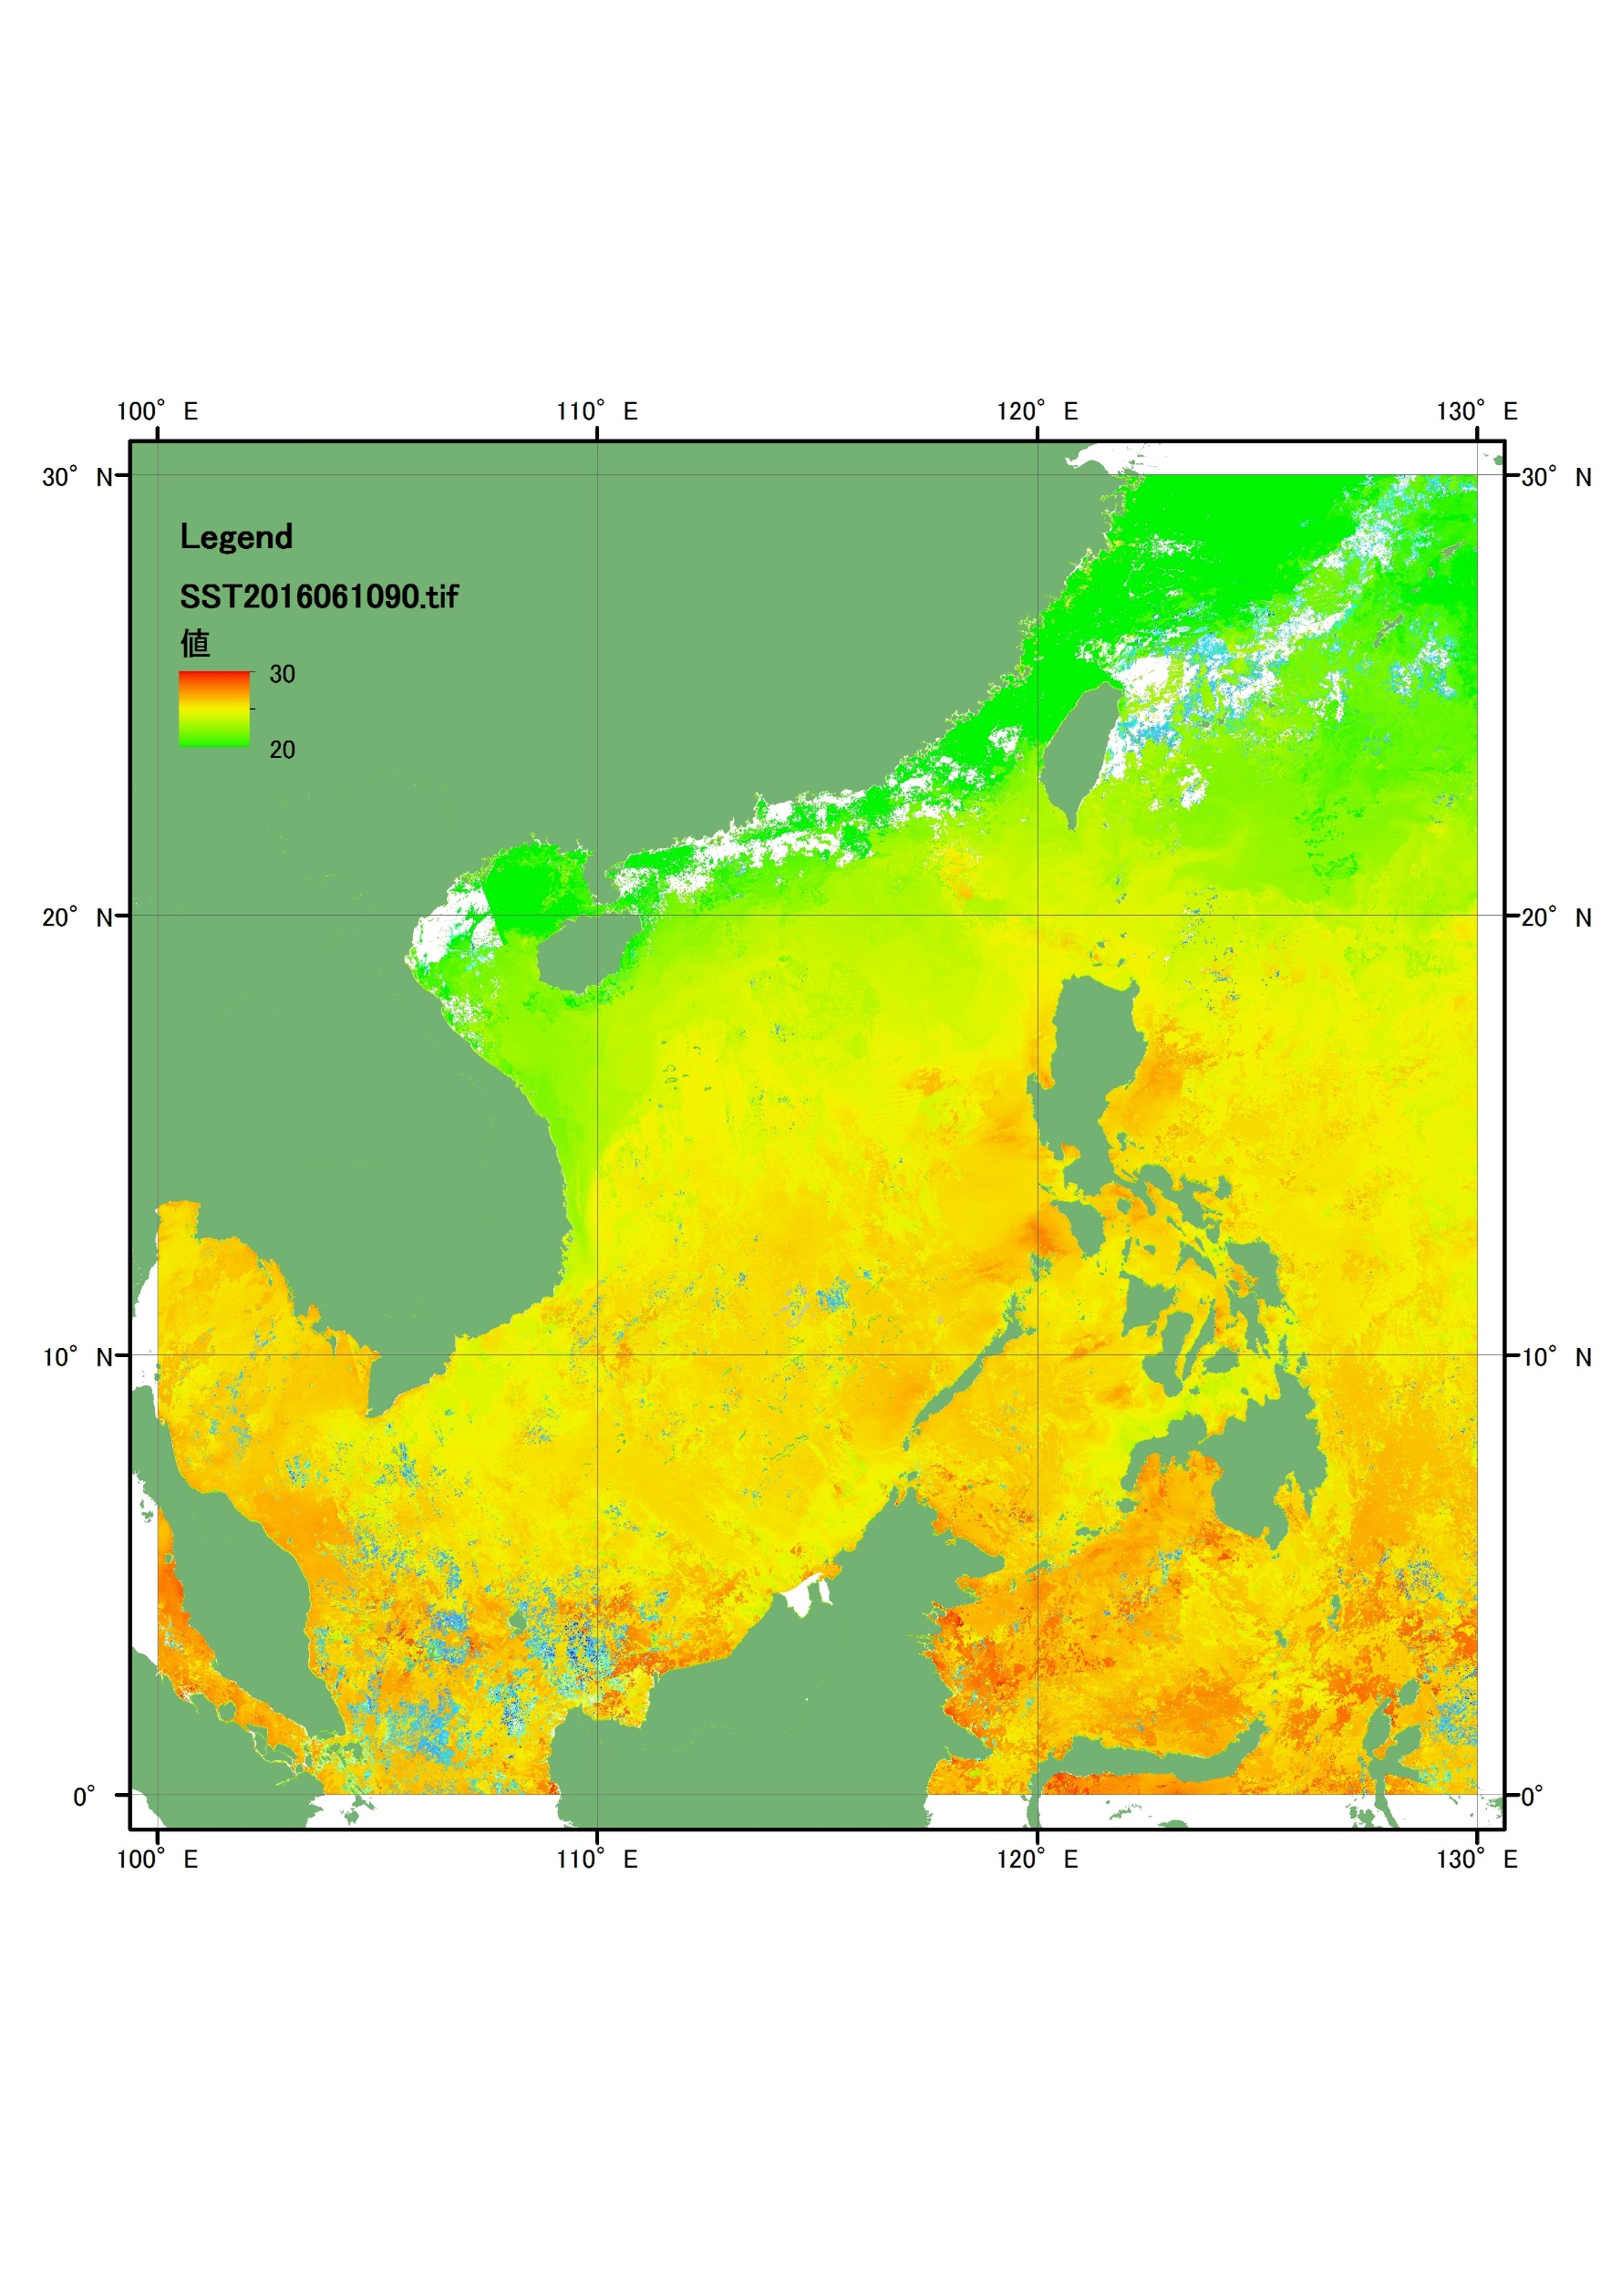
Sea Surface Temperature by VIIRS/Suomi-NPP
Monthly composite for March 2016
Fishing vessels
  1.77 million fishing vessels are estimated on the SCS (Funge-Smith et al. 2012).
Amount of catches
  Reported catches are constant around 10 to 11 million t from 2000 to 2010. Un-reported catches has decreased but 7 million t in 2010 (Witter et al., 2015).
Notes:
The South China Sea
Huge number of fishing boats are activated on the SCS, may includes
small boats.
Problem goes to the un-reported catches, which makes difficult to
discuss the protection of future production of fishing resources in the
SCS. The backgrounds goes to the political conflicts in this water.

Slide 6
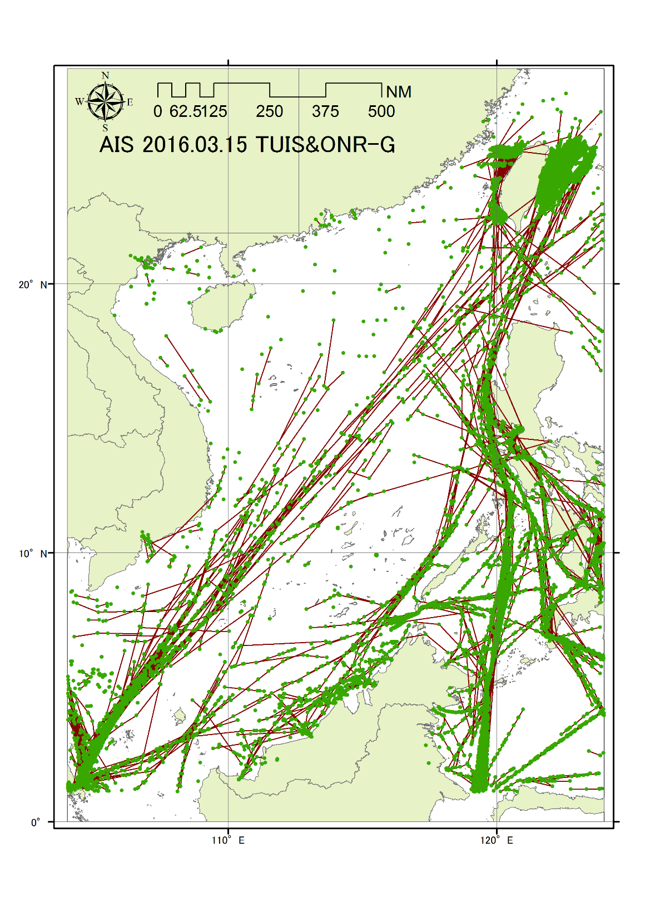
Ships locations by
Automatic Identification System (AIS) on March 15, 2016
International Sea Lanes (Rosenberg, 1999).
AIS is supported by vessels greater than 300 ton and passenger boats
Unreliability of AIS includes Maritime Mobile Service Identity (MMSI)(Lecornu, 2013)
Notes:
The South China Sea
The SCS provides the international sea lanes to carry pet resources from
The far east to Japan.

Slide 7
Objectives
Preceding researches using DNB
Fishing boats :
Town lights :
Meteorological applications :
To identify fishing activities on the South China Sea related to the water region of potential transboundary and coastal waters.
To discuss a possibility of DNB detection of fishing activities under the Lunar illumination.

Slide 8
Period affected by the Lunar illumination on the SCS for March 2016, at 17Z on each day, and at 15N, 120E.
=Half of the month.

Slide 9
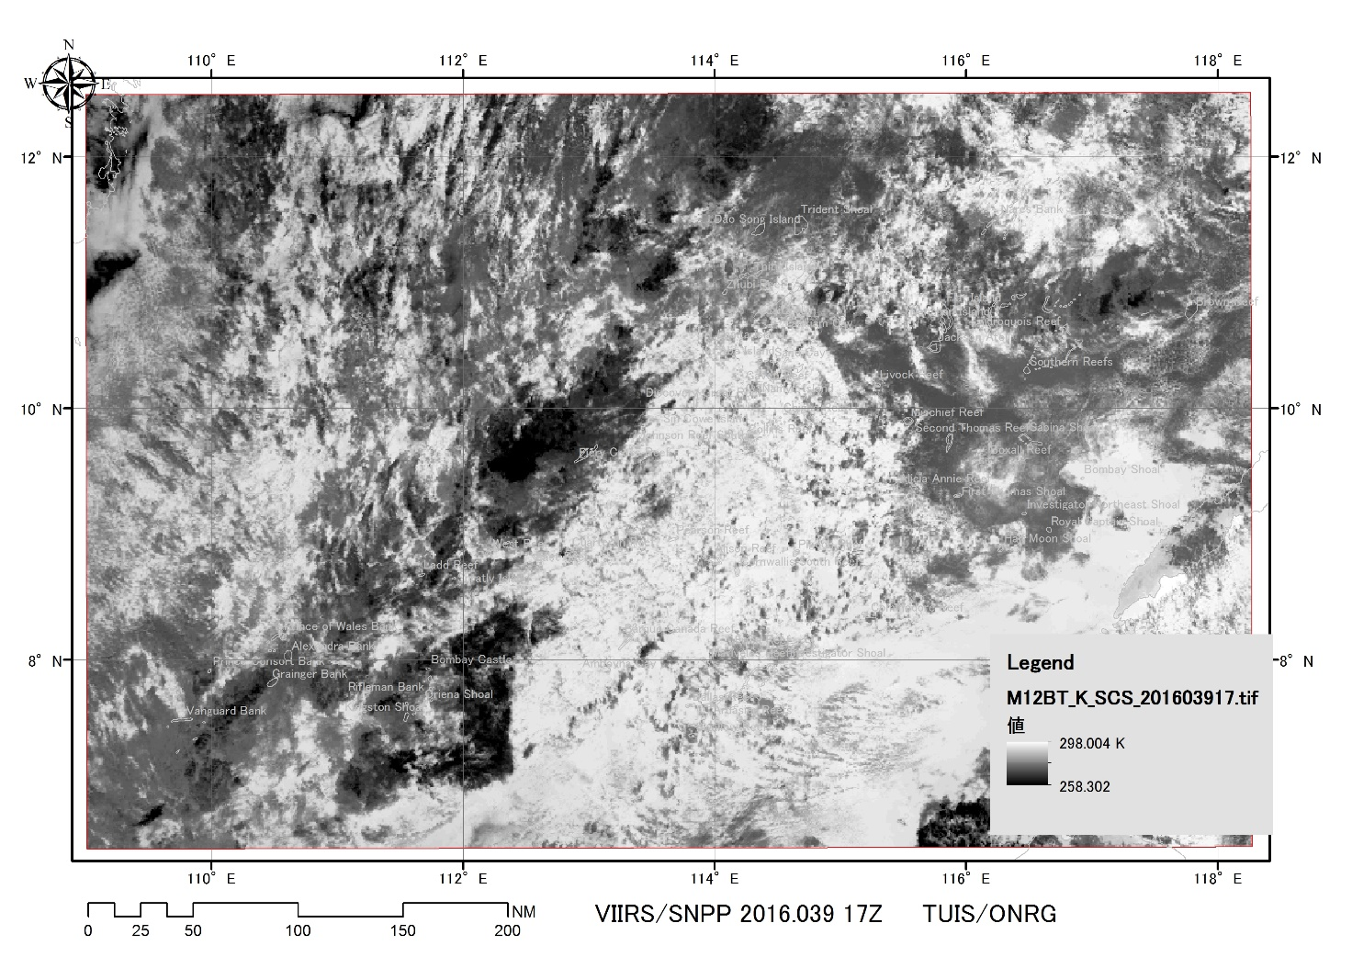
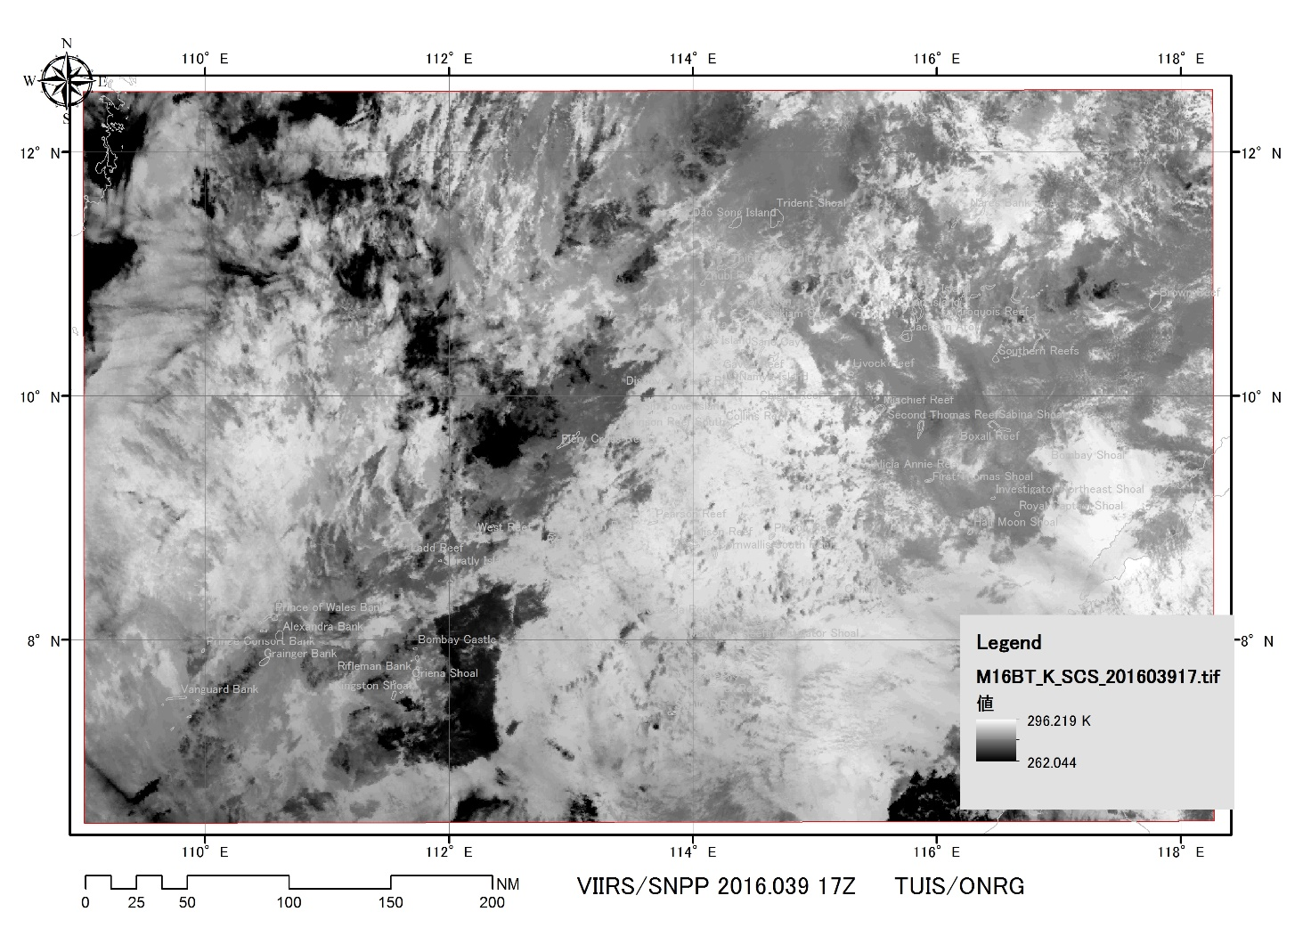
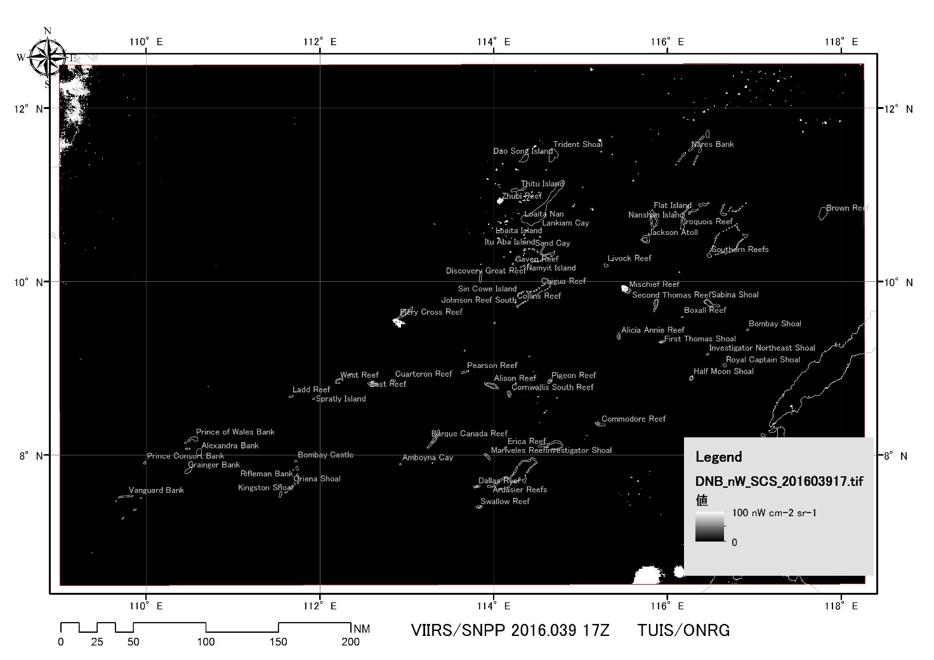
M12(3.7μm) M16(12.0μm)
DNB (500 – 900nm)
16.039
0%
2016.039.17Z(2.8)
Moon (New) 0%

Slide 10
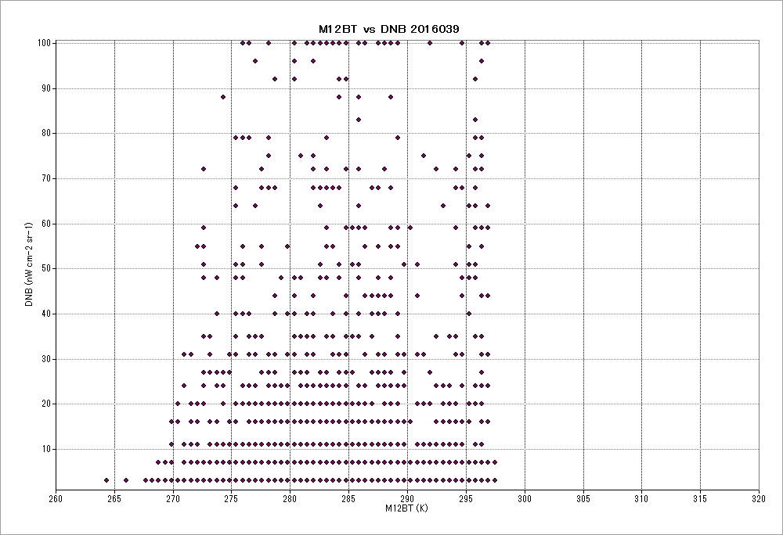
DNB (nW cm⁻² sr⁻¹)
2016.039.17Z(2.8)
Moon (New) 0%
16.039
0%
M12BT (K)
Notes:
As there is a report that 3 nW cm-2 sr-1 is not the noise level, all the plots excluding
The bottom line goes to the lights from fishing boats and town activities.

Slide 11
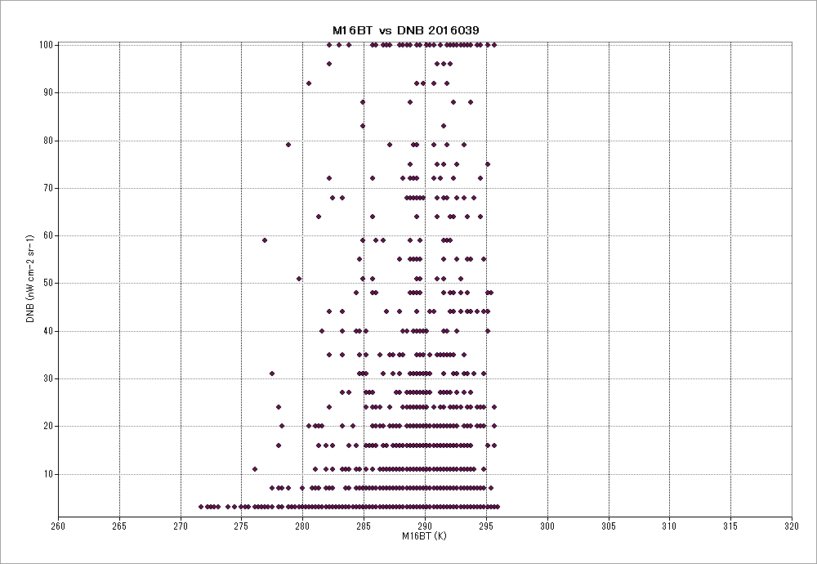
DNB (nW cm⁻² sr⁻¹)
2016.039.17Z(2.8)
Moon (New) 0%
16.039
0%
M16BT (K)

Slide 12
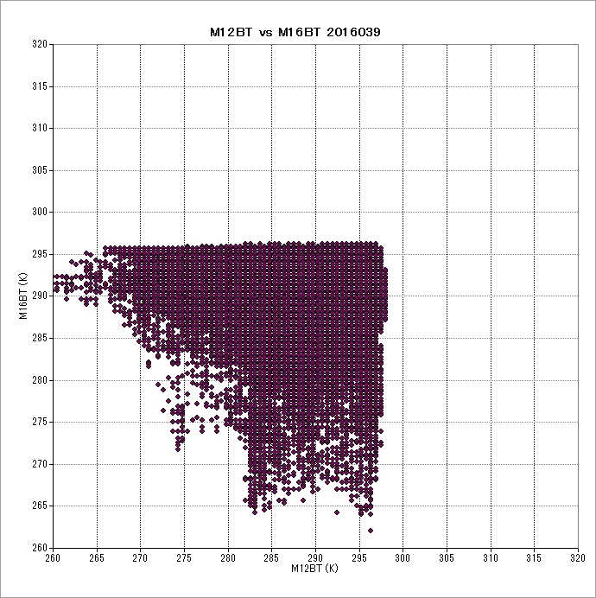
M16BT (K)
2016.039.17Z(2.8)
Moon (New) 0%
16.039
0%
M12BT (K)

Slide 13
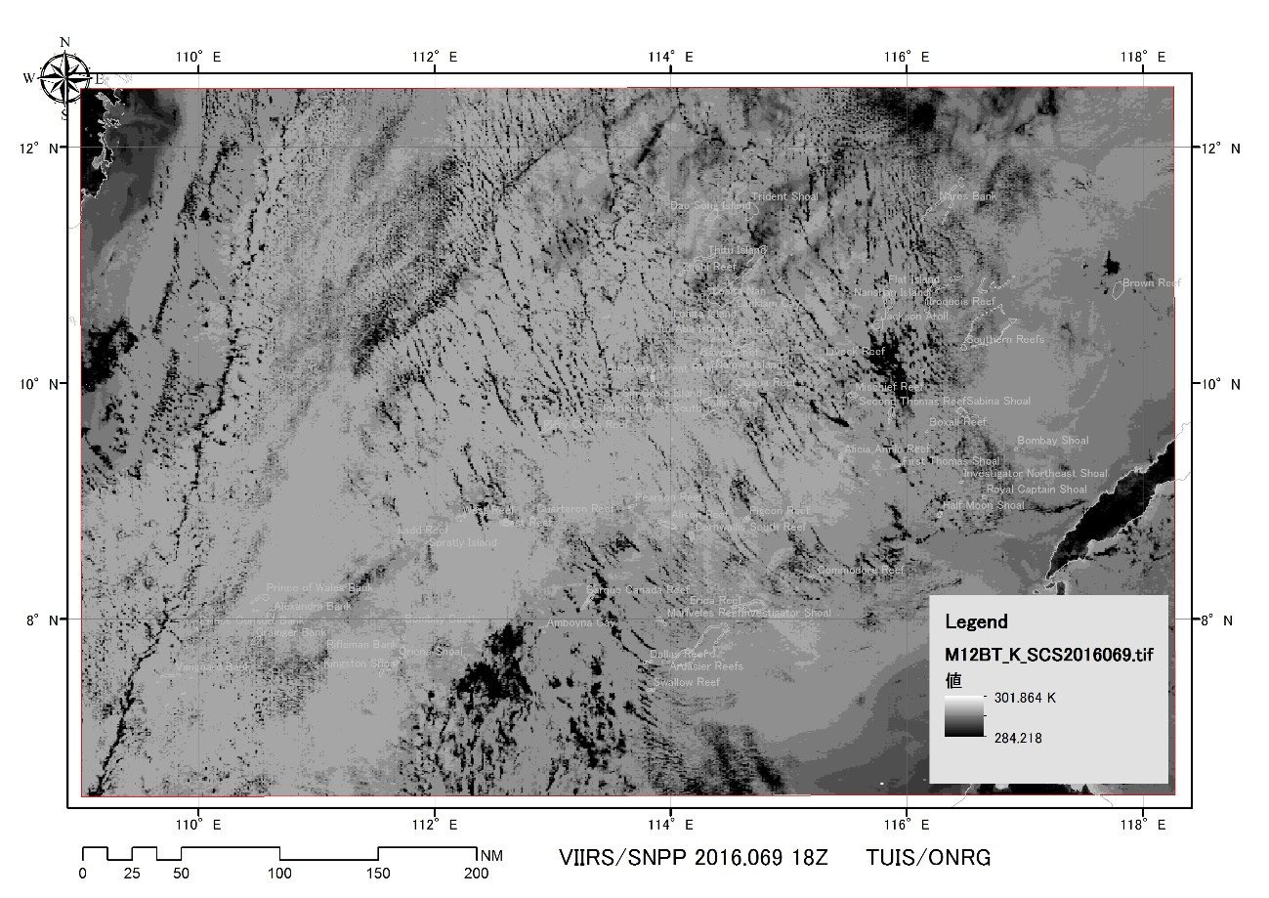
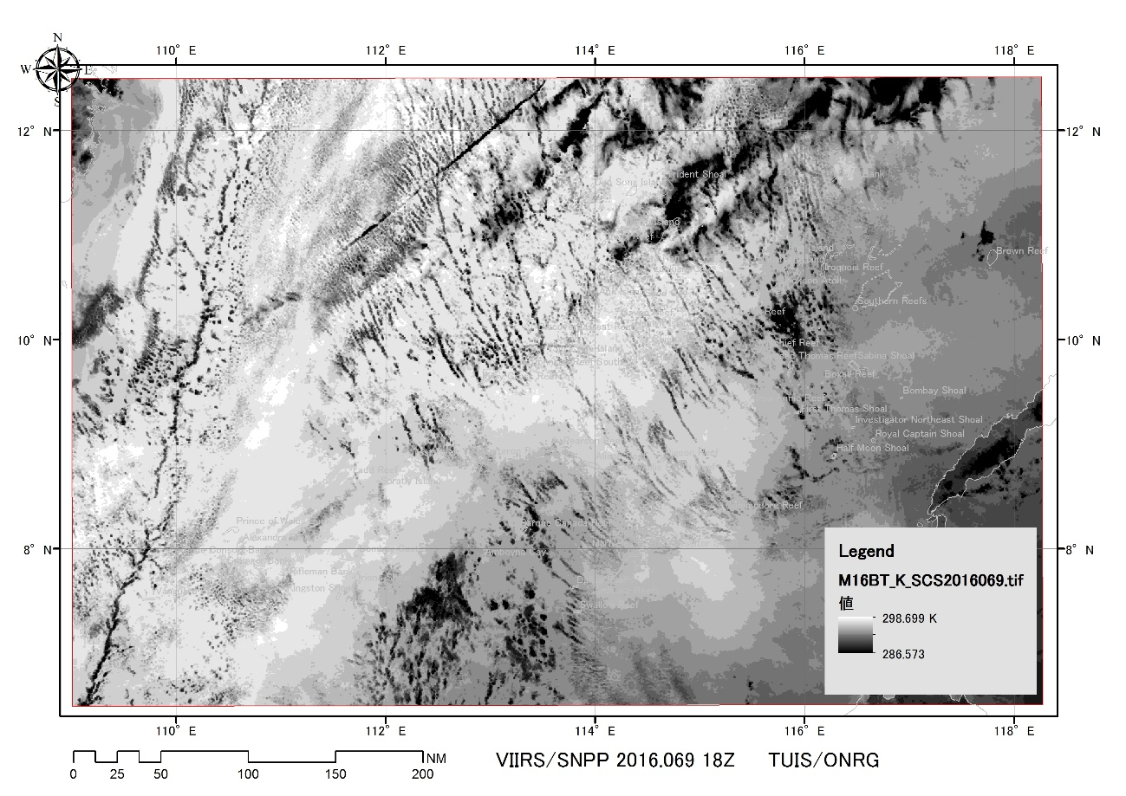
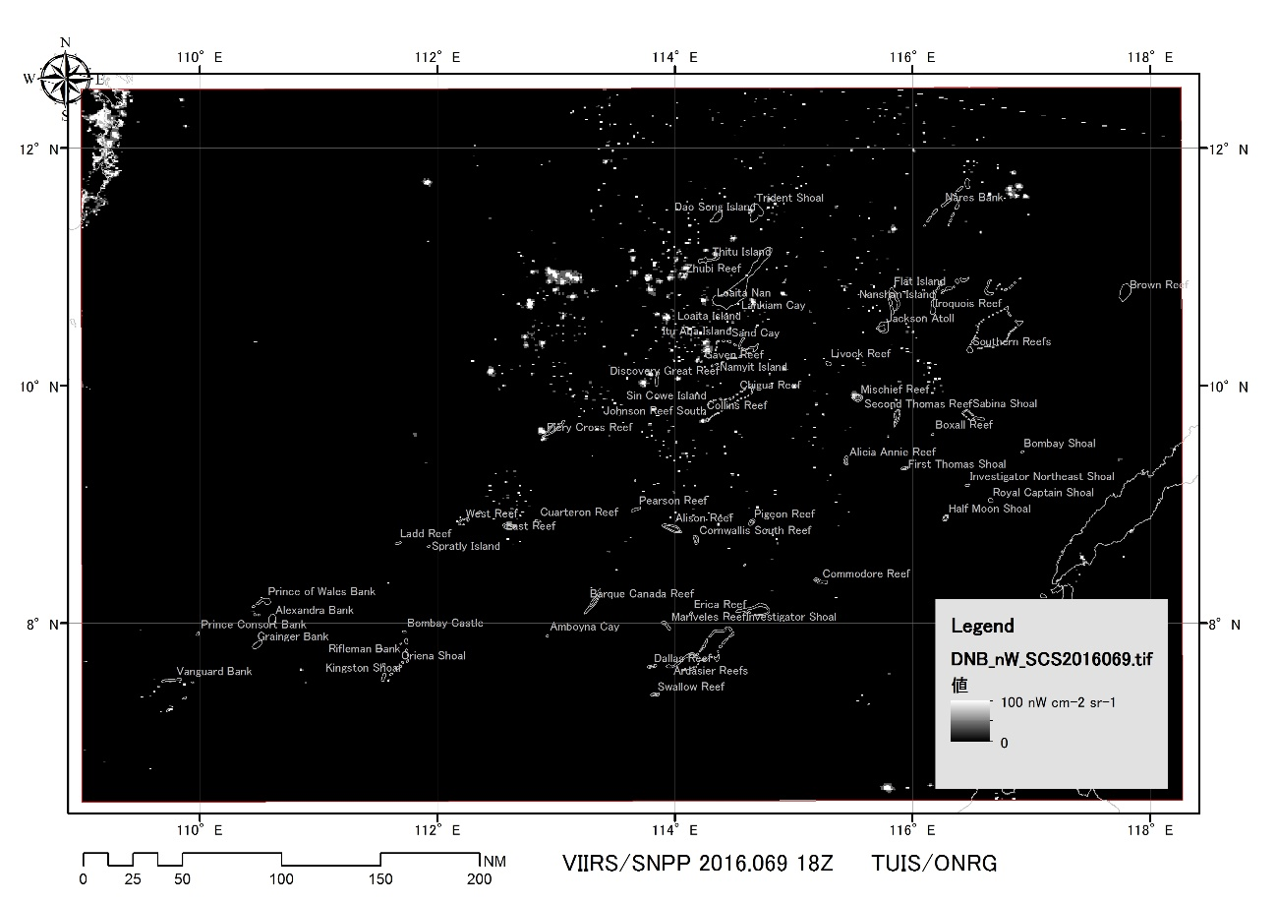
M12(3.7μm) M16(12.0μm)
DNB (500 – 900nm)
16.069
0%
2016.069.18Z(3.22)
New Moon 0%

Slide 14
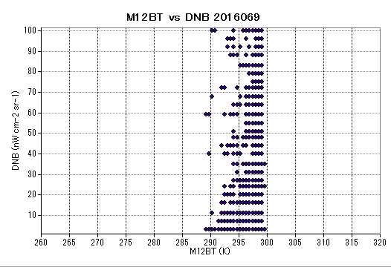
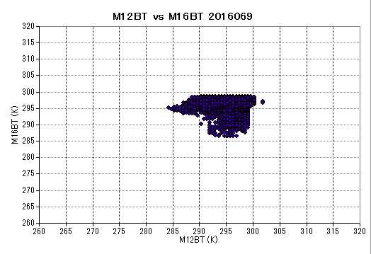
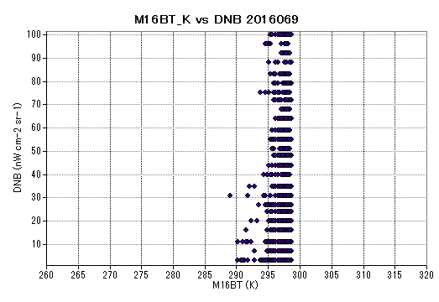
DNB (nW cm⁻² sr⁻¹)
M12BT (K)
M16BT (K)
16.069
0%
DNB (nW cm⁻² sr⁻¹)
M12BT (K)
2016.069.18Z(3.22)
New Moon 0%
M16BT (K)

Slide 15
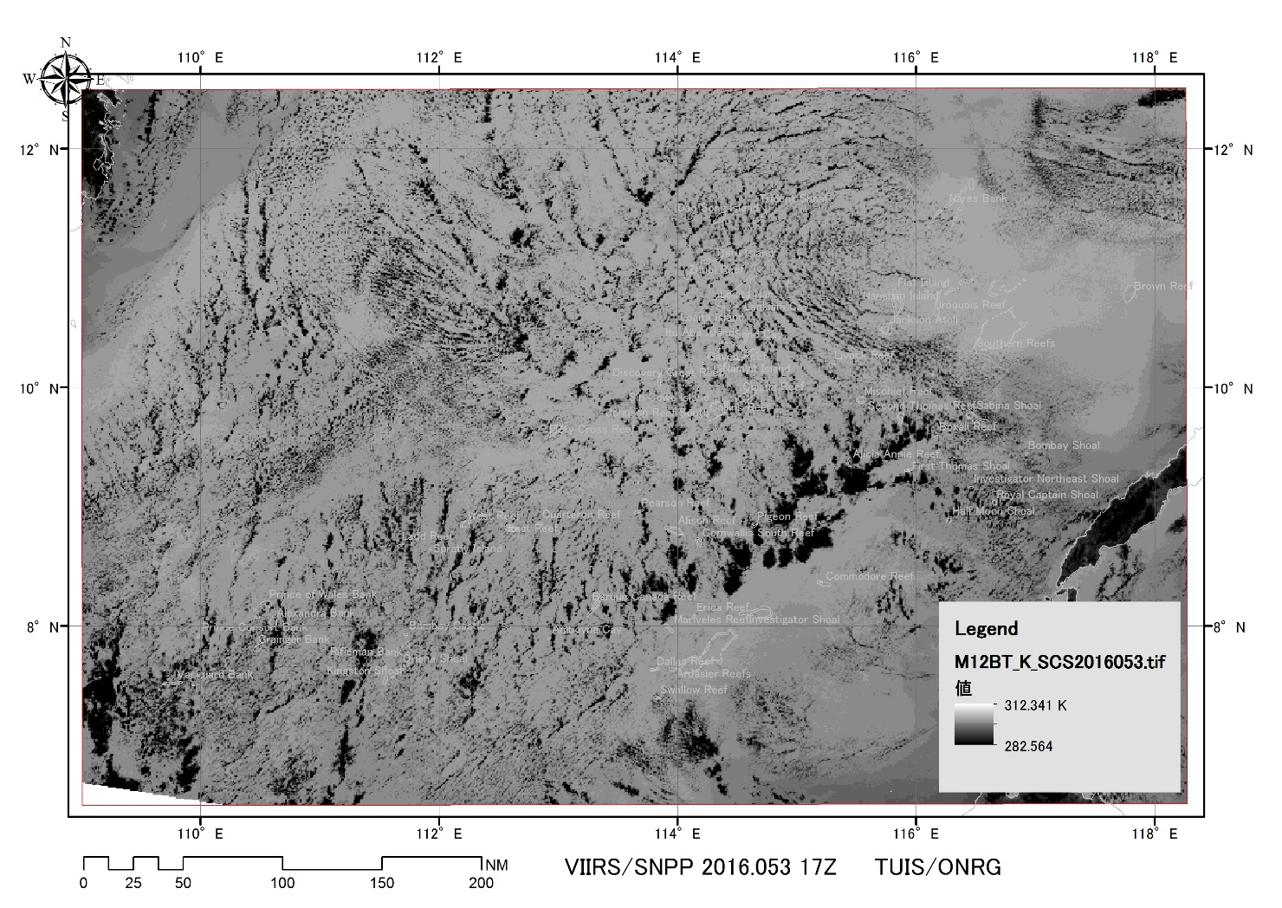
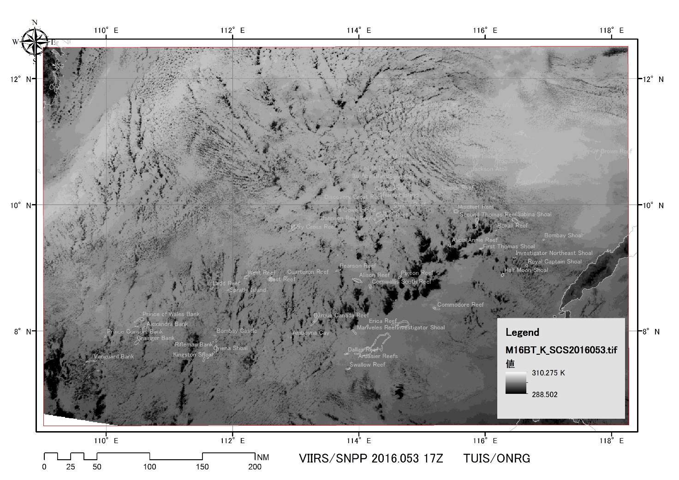
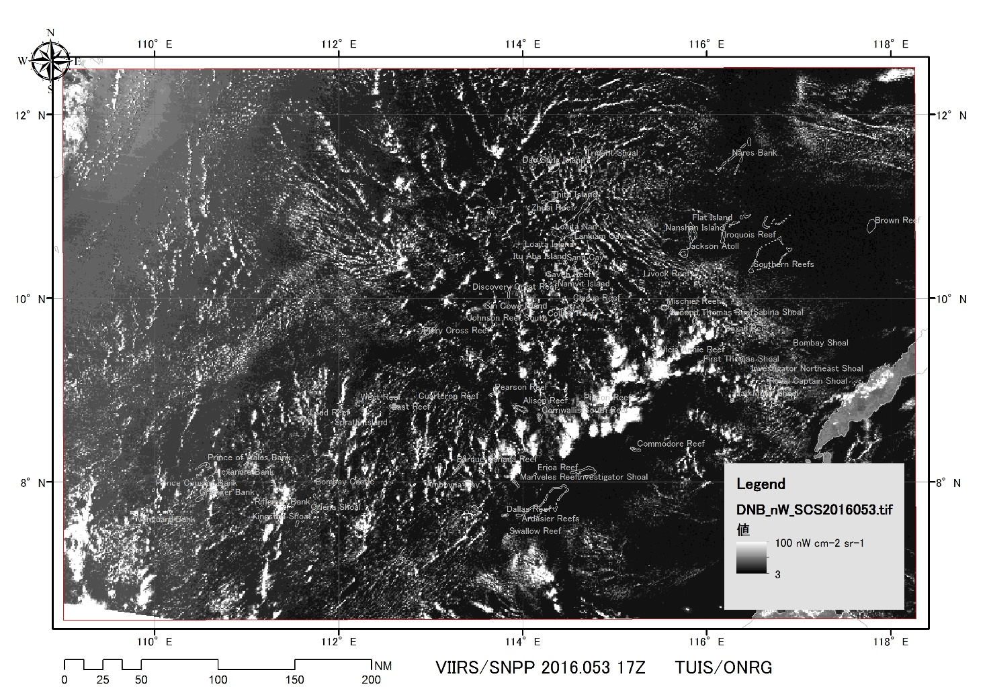
M12(3.7μm) M16(12.0μm)
DNB (500 – 900nm)
16.053
100%
2016.053.17Z(2.22)
Moon (Full Moon) 100%

Slide 16
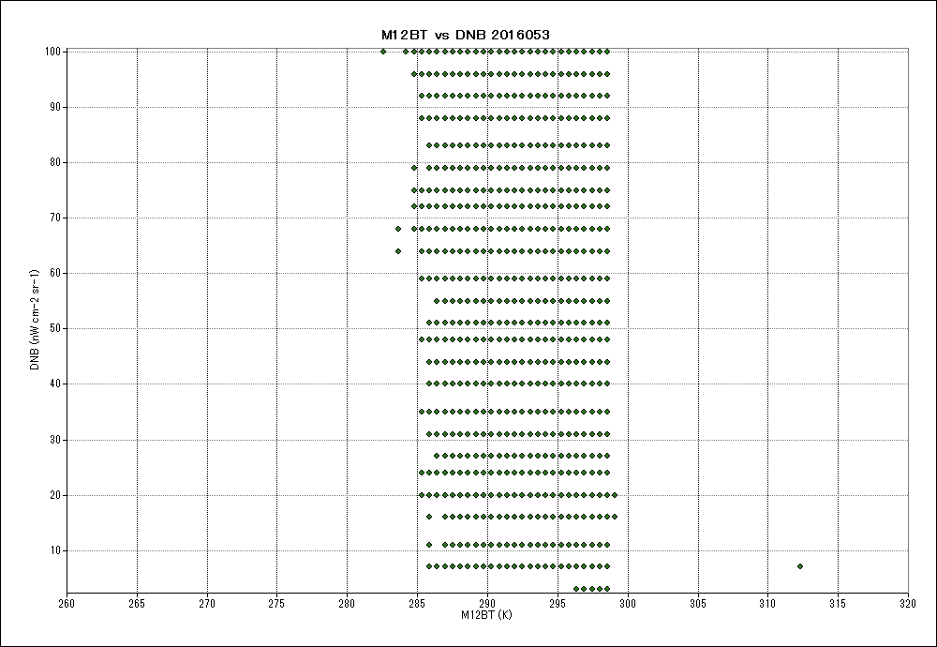
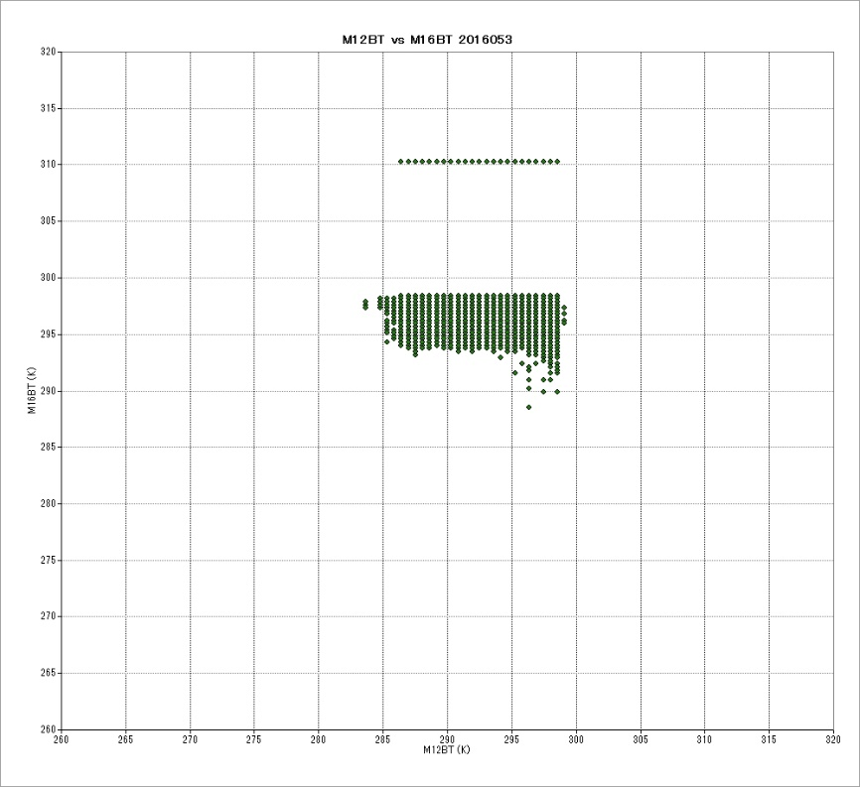
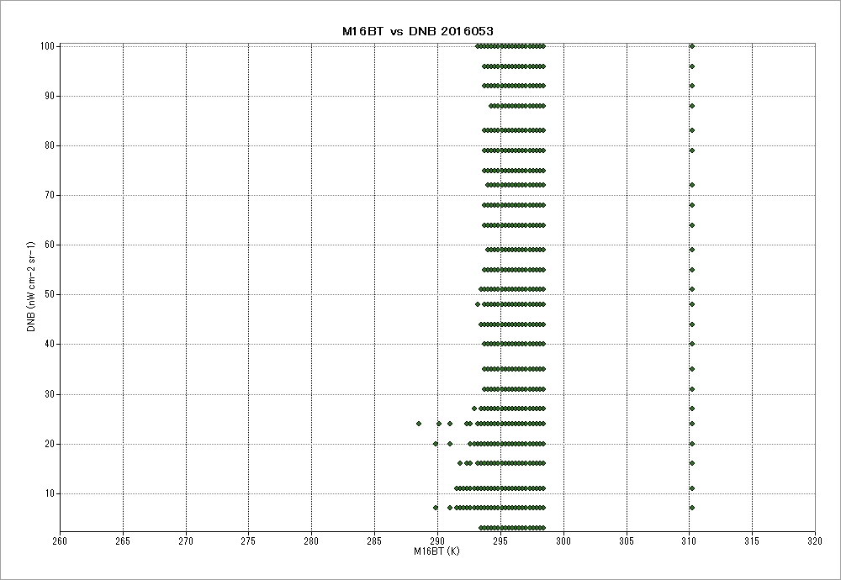
DNB (nW cm⁻² sr⁻¹)
M12BT (K)
M16BT (K)
16.053
100%
DNB (nW cm⁻² sr⁻¹)
M12BT (K)
2016.053.17Z(2.22)
Moon (Full Moon) 100%
M16BT (K)

Slide 17
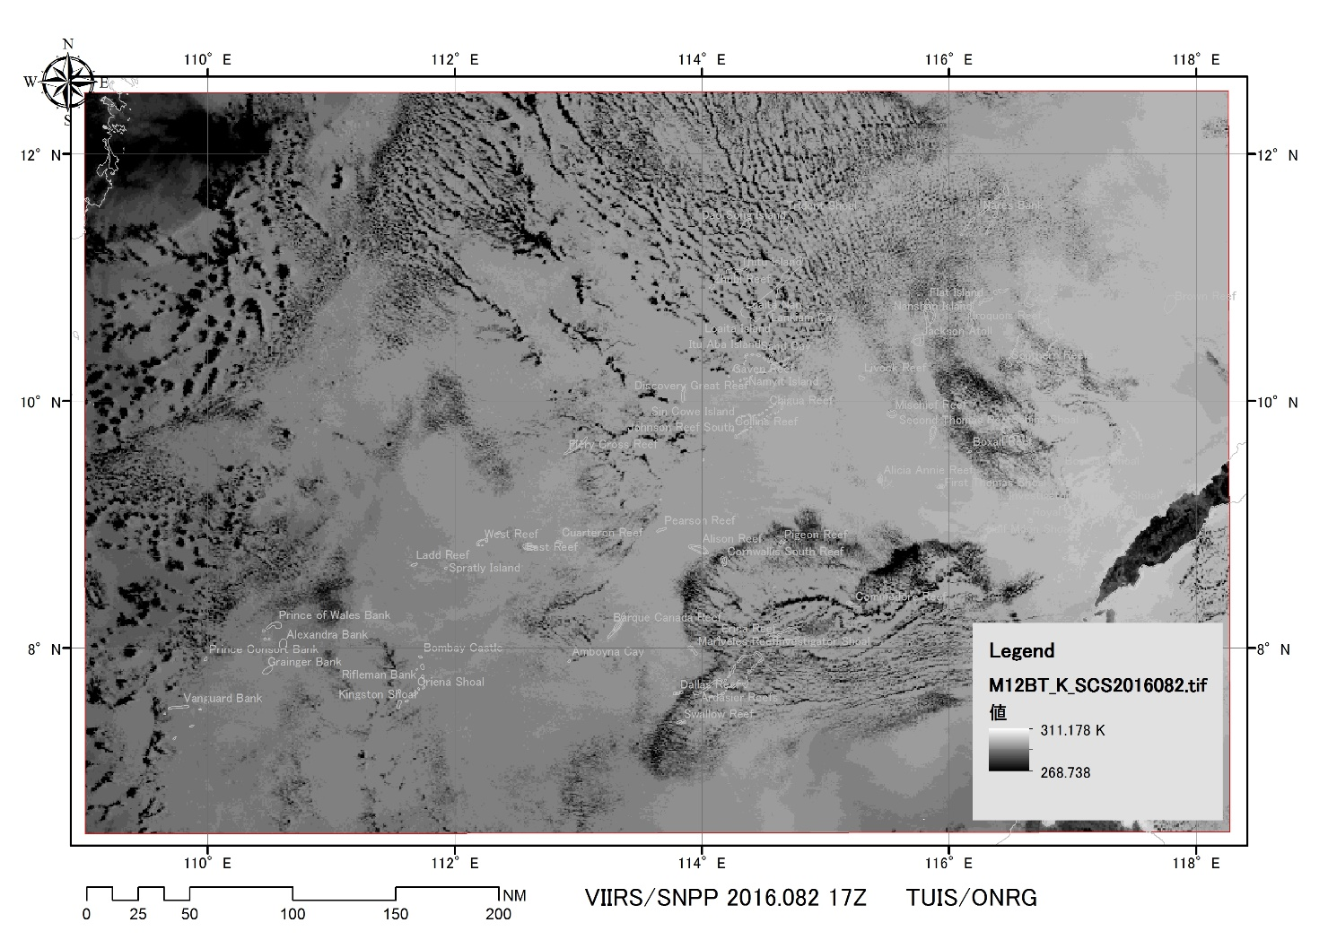
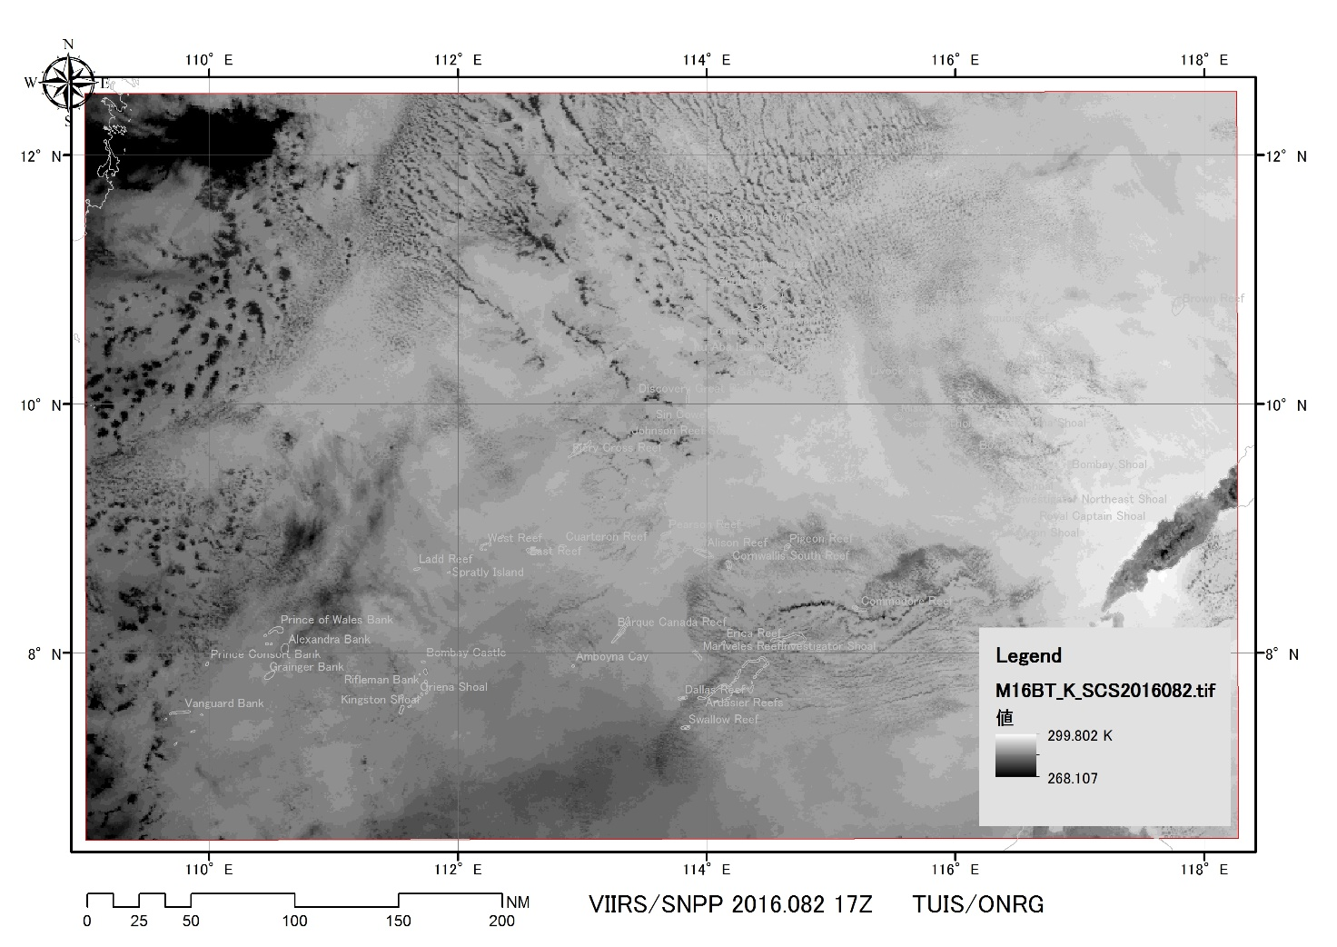
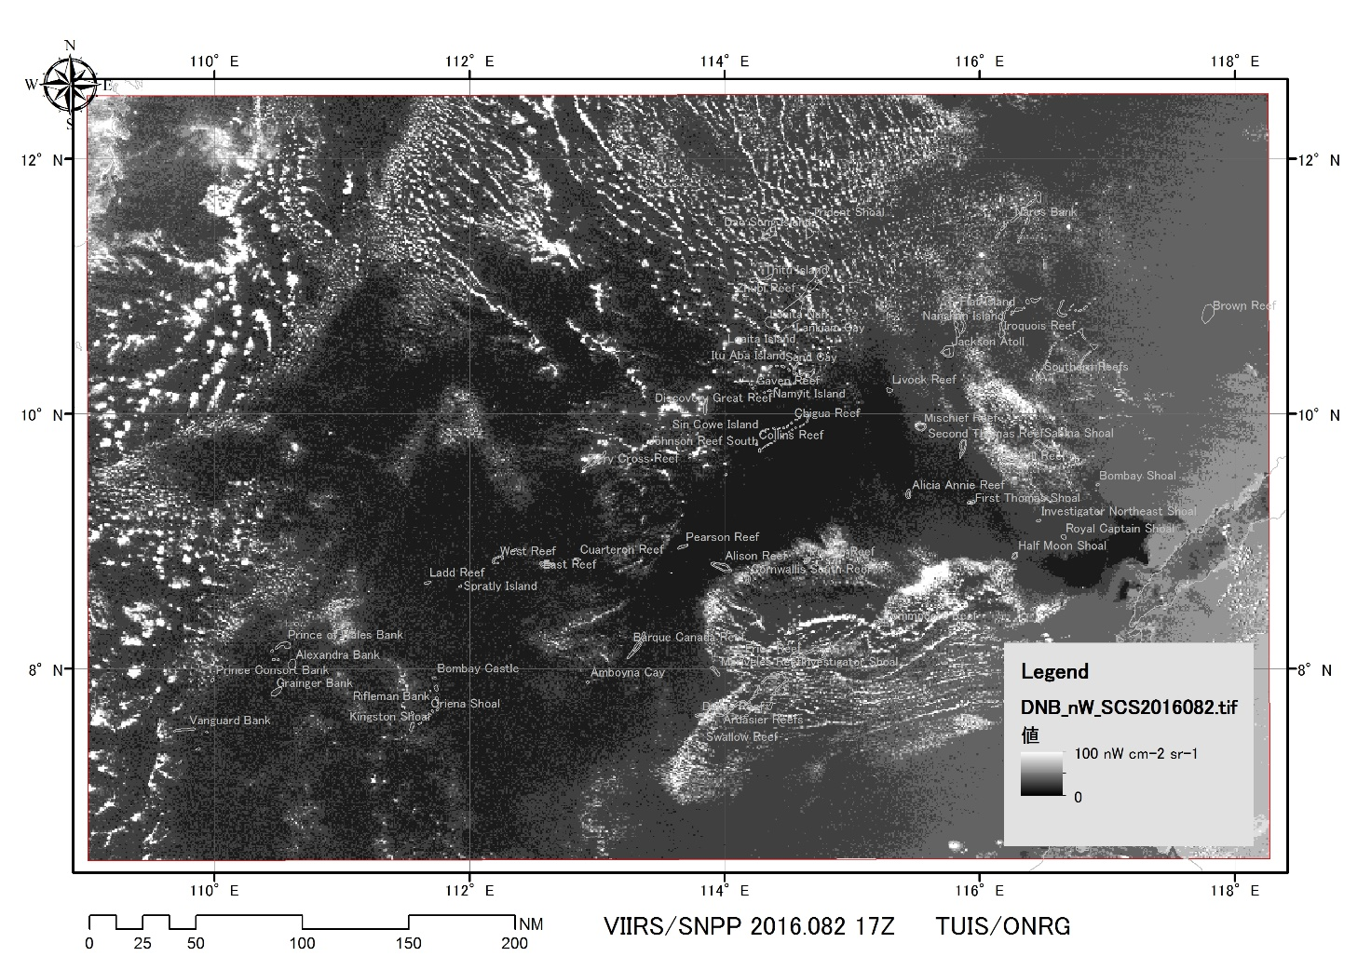
M12(3.7μm) M16(12.0μm)
DNB (500 – 900nm)
16.082
99%
2016.082.17Z(3.22)
Moon (Waxing Gibbous) 99%

Slide 18
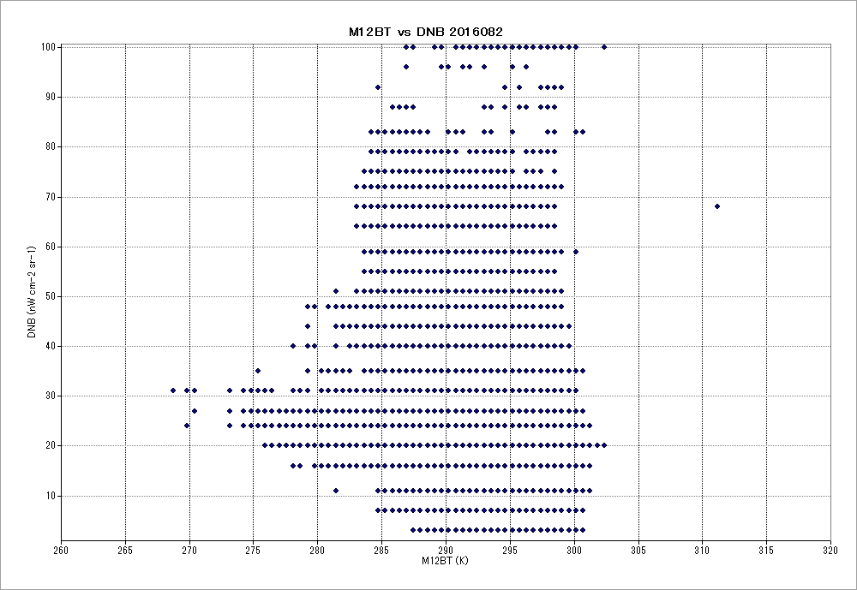
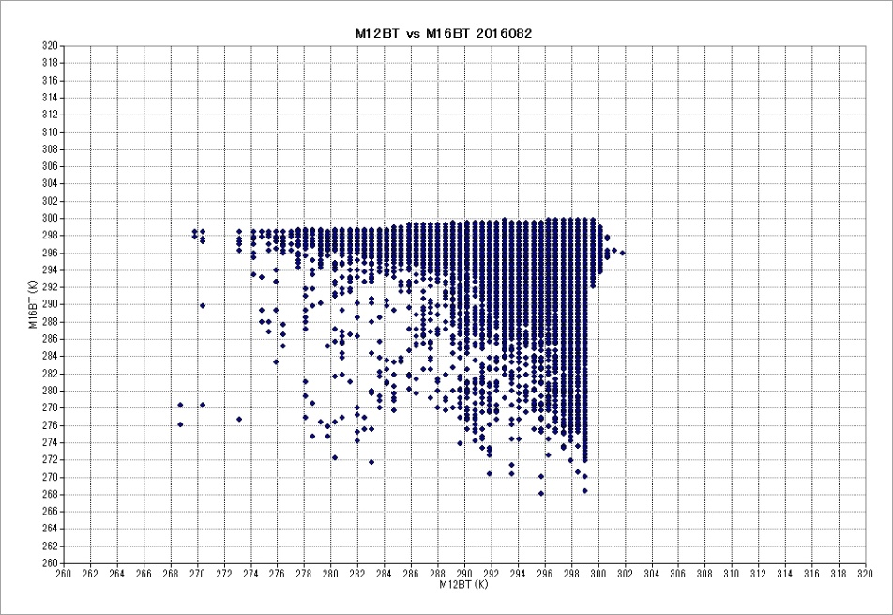
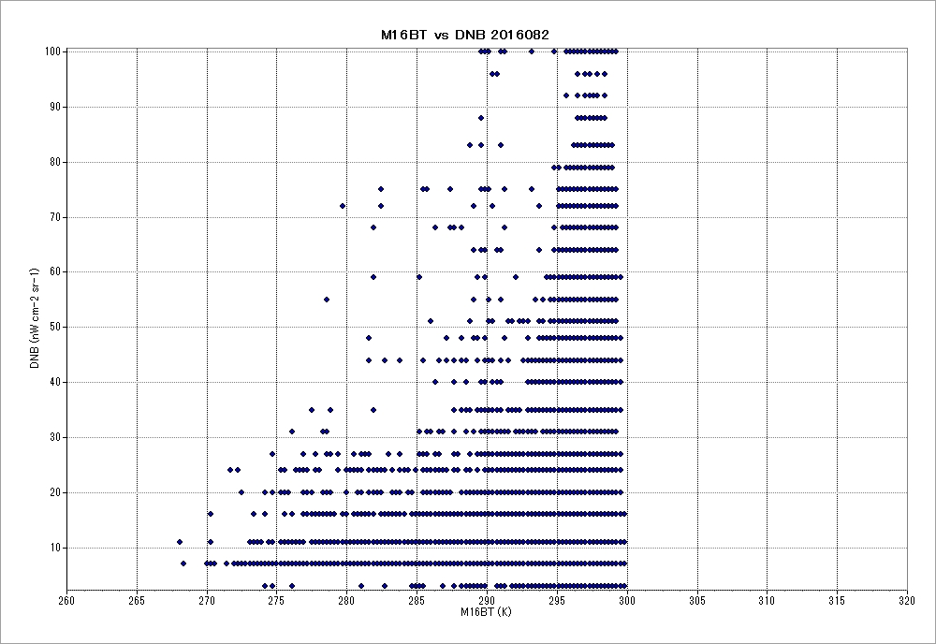
DNB (nW cm⁻² sr⁻¹)
M12BT (K)
M16BT (K)
DNB (nW cm⁻² sr⁻¹)
16.082
99%
M12BT (K)
2016.082.17Z(3.22)
Moon (Waxing Gibbous) 99%
M16BT (K)

Slide 19
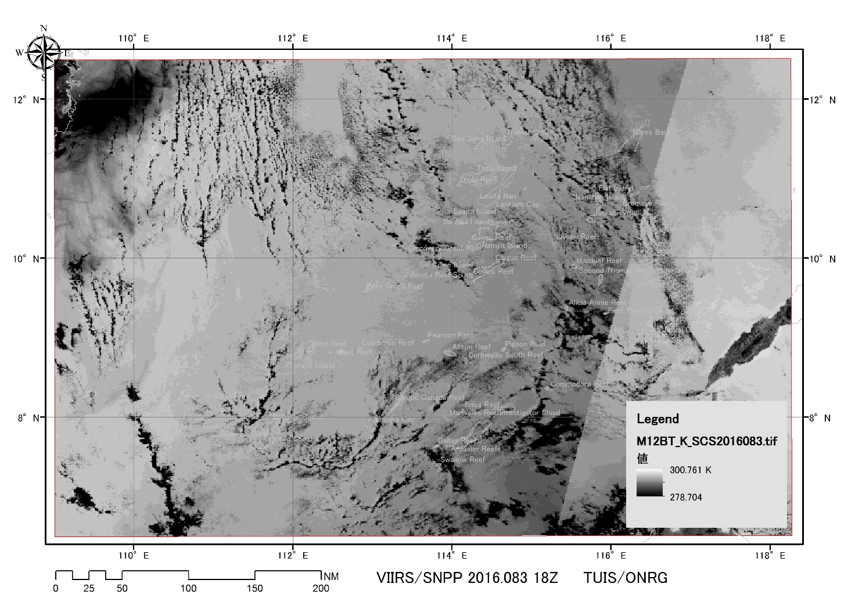
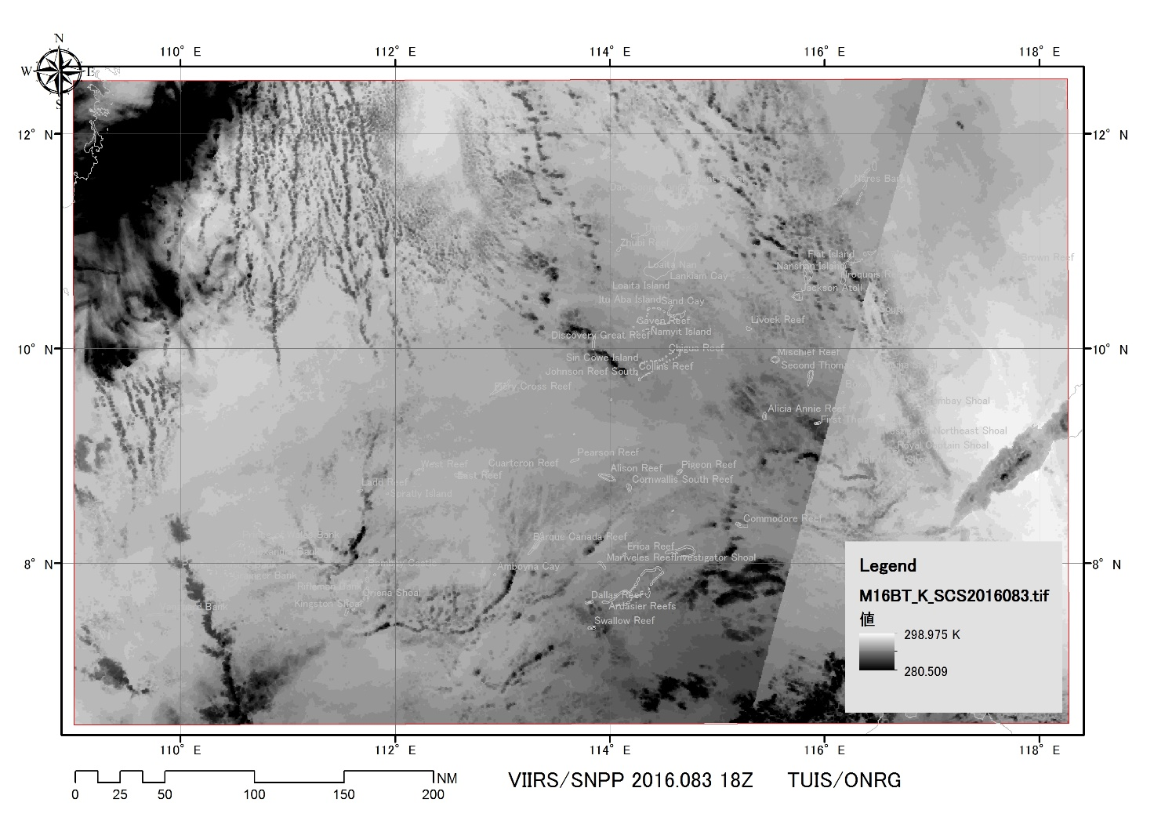
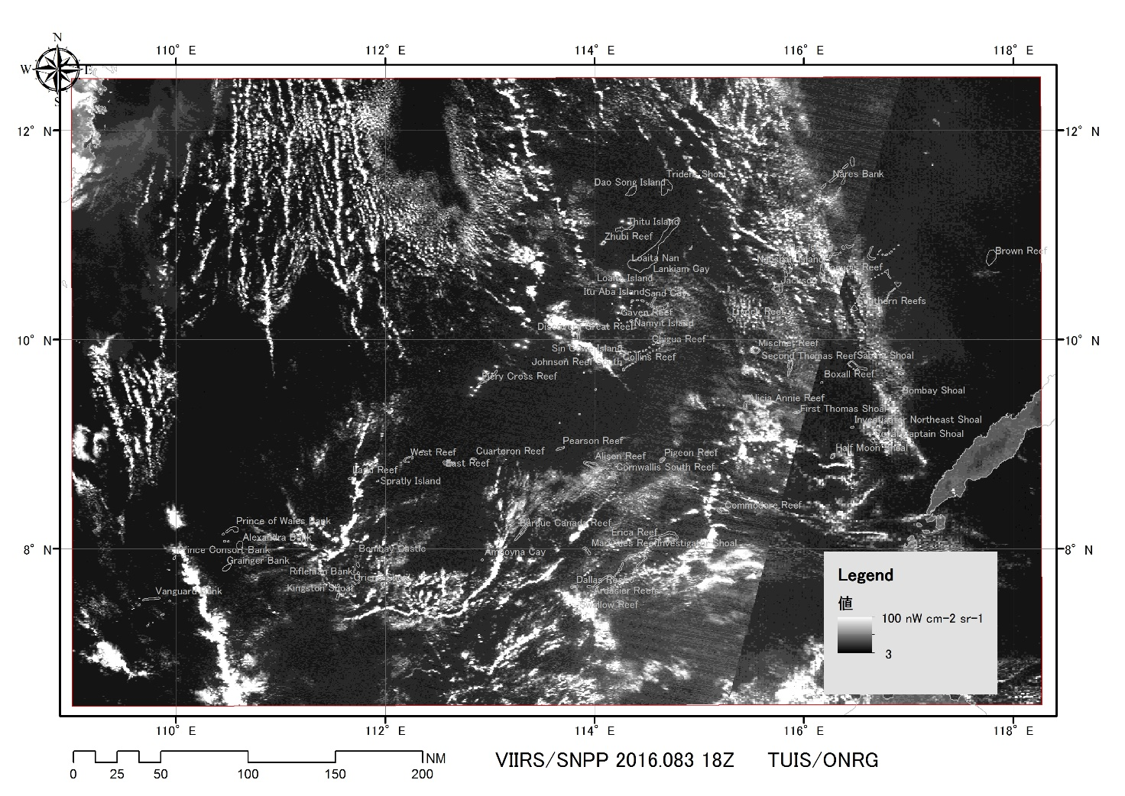
M12(3.7μm) M16(12.0μm)
DNB (500 – 900nm)
16.083
100%
2016.083.18Z(3.23)
Moon (Full Moon) 100%

Slide 20
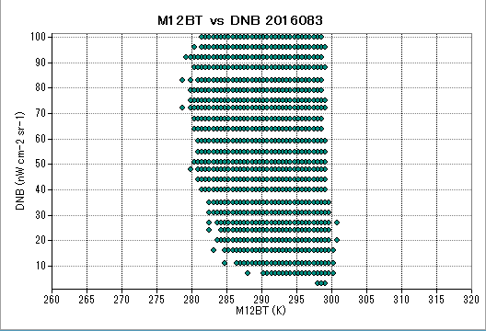
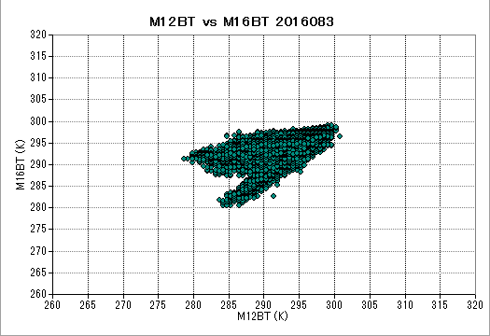
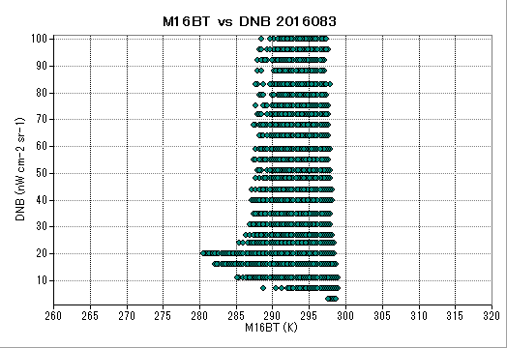
DNB (nW cm⁻² sr⁻¹)
M12BT (K)
M16BT (K)
16.083
100%
DNB (nW cm⁻² sr⁻¹)
M12BT (K)
2016.083.18Z(3.23)
Moon (Full Moon) 100%
M16BT (K)

Slide 21
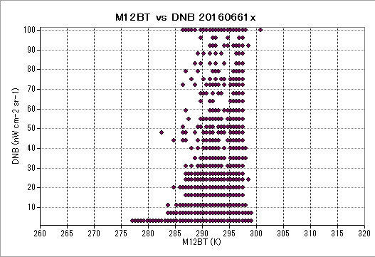
Bright targets under clouds
in saturation level in DNB,
although attenuated by clouds
Bright targets, with higher temperature than sea water, and sometimes under clouds
Bright targets without clouds around 25 ℃
ff SST (BT)
Surface targets under clouds
wit lower SST (BT)
Completely dark targets,
regardless the presence of clouds
from 0 to 30 ℃ of SST (BT).

Slide 22
Empirical approach to identify lights from clouds reflecting lunar lights

Slide 23
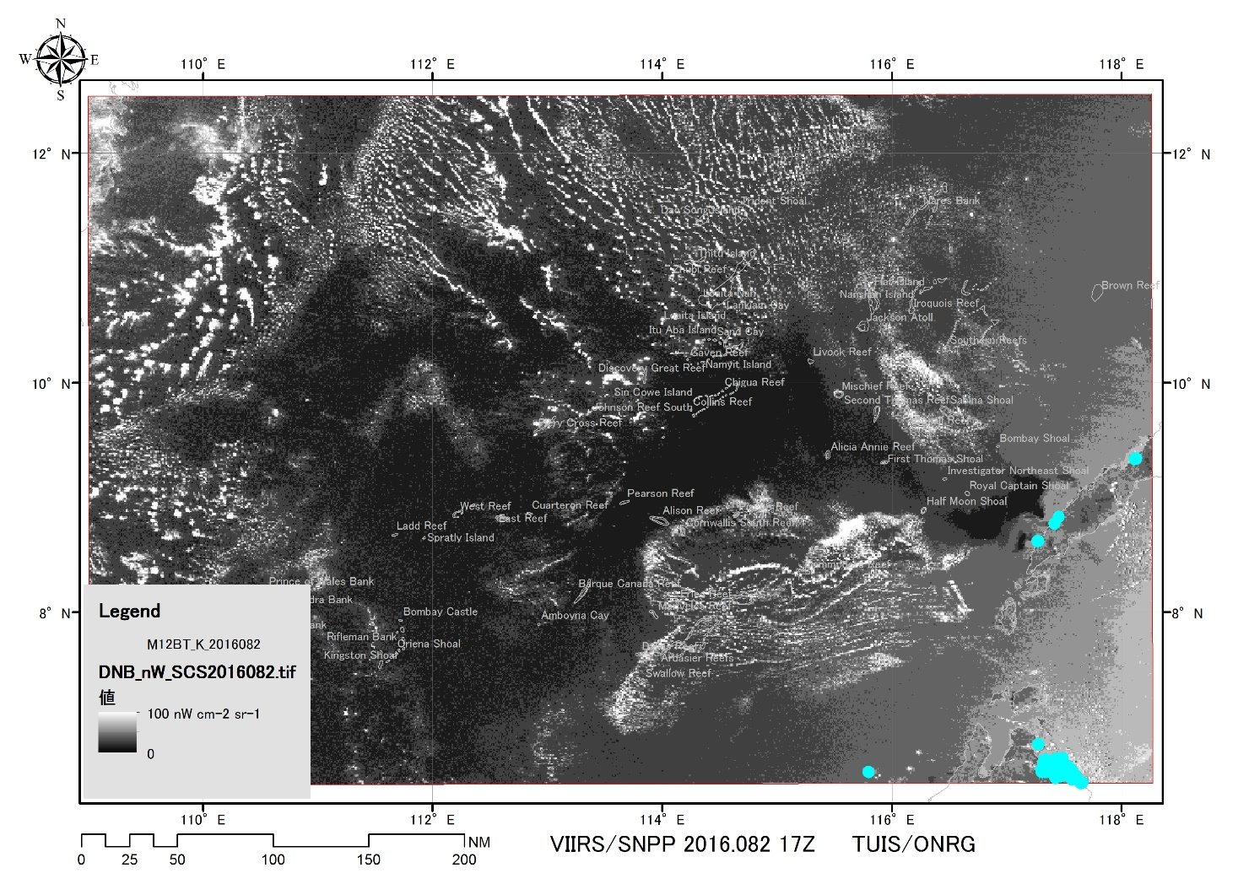
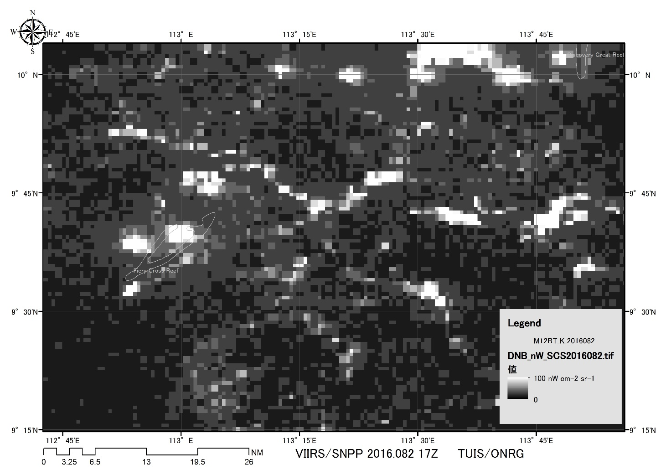
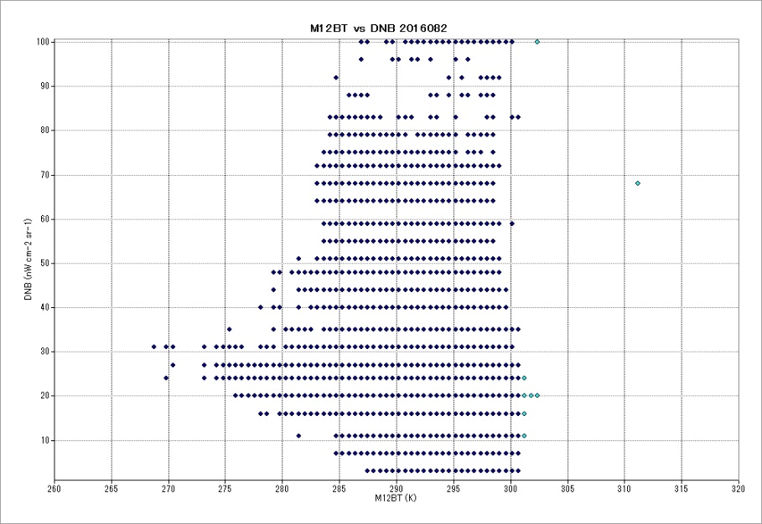
16.082
99%
M12BT > 301 K and DNB > 5 nW cm⁻² sr⁻¹
2016.082.17Z(3.22)
Moon (Waxing Gibbous) 99%

Slide 24
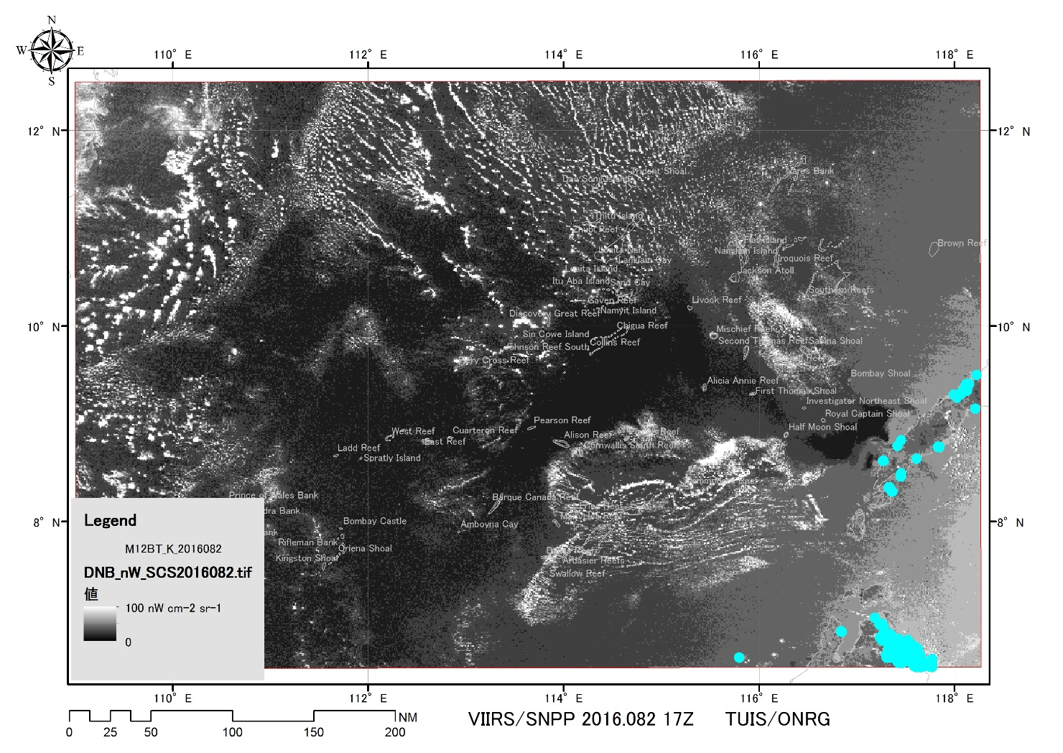
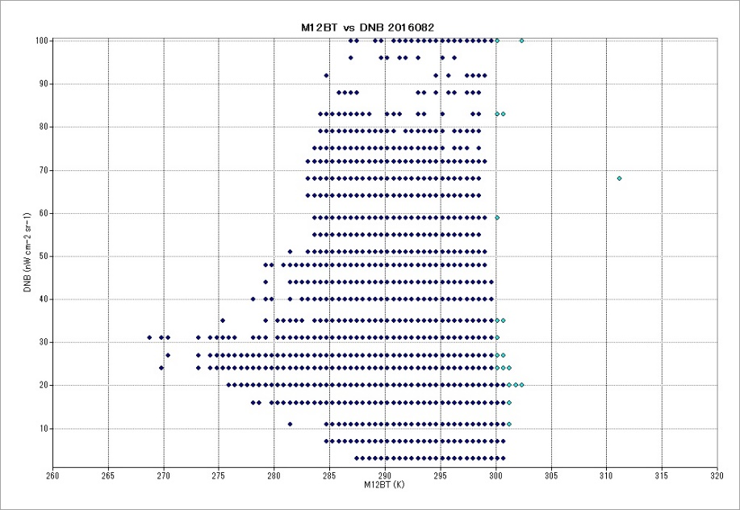
16.082
99%
M12BT > 301 K and DNB > 5 nW cm⁻² sr⁻¹
M12BT > 300 K and DNB > 20 nW cm⁻² sr⁻¹
2016.082.17Z(3.22)
Moon (Waxing Gibbous) 99%

Slide 25
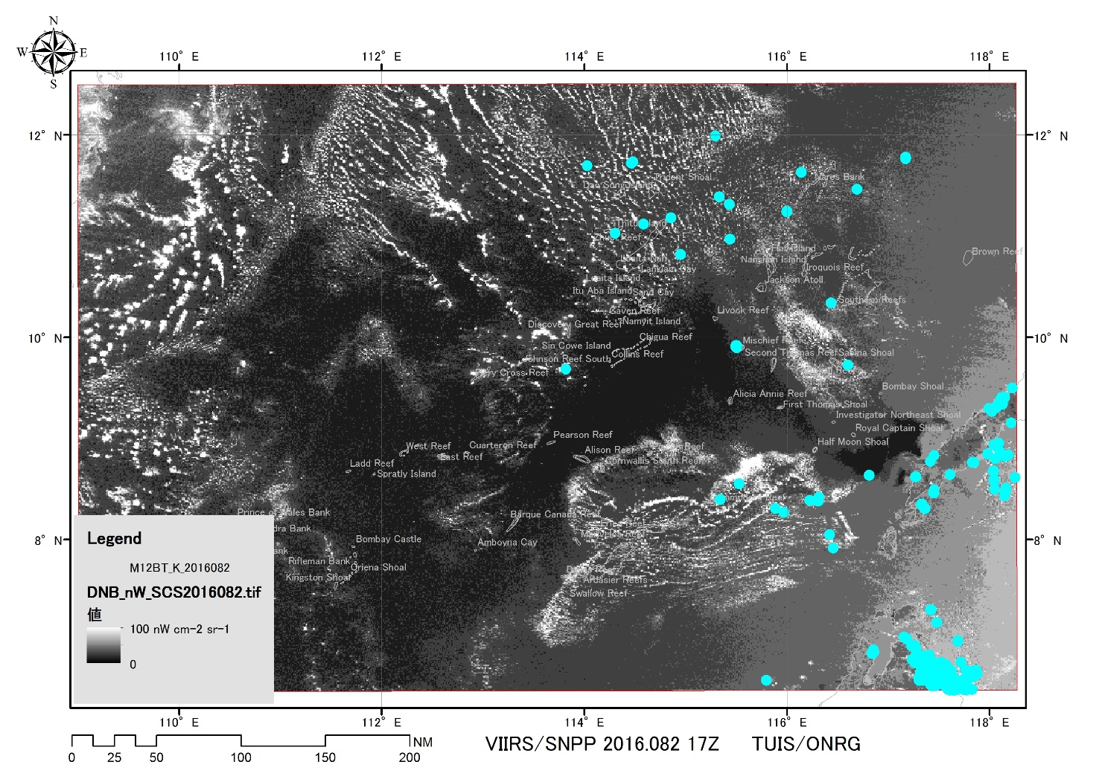
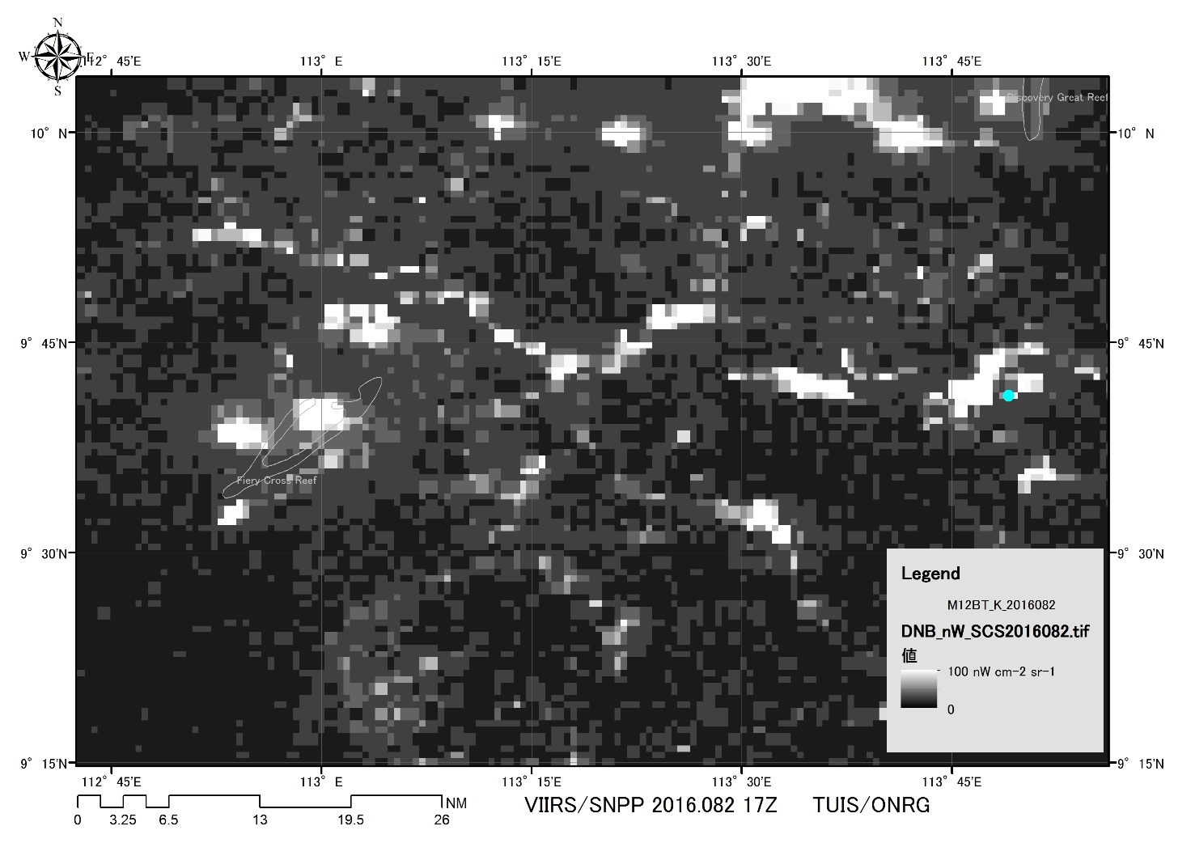
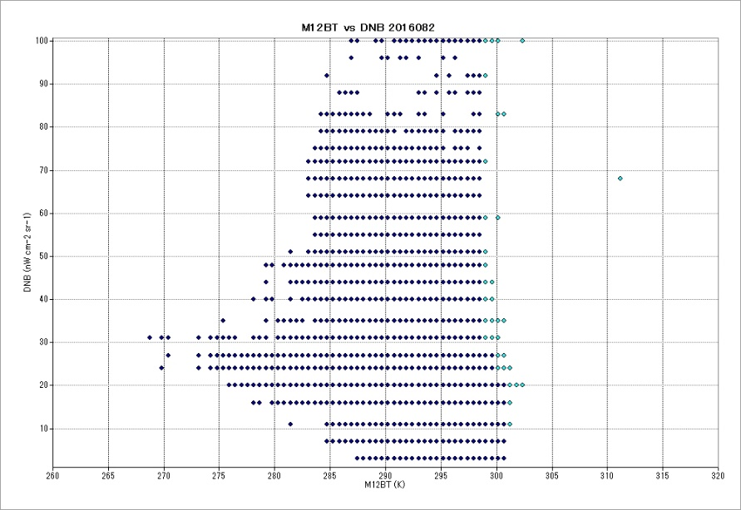
16.082
99%
M12BT > 301 K and DNB > 5 nW cm⁻² sr⁻¹
M12BT > 300 K and DNB > 20 nW cm⁻² sr⁻¹
M12BT > 299 K and DNB > 30 nW cm⁻² sr⁻¹
2016.082.17Z(3.22)
Moon (Waxing Gibbous) 99%

Slide 26
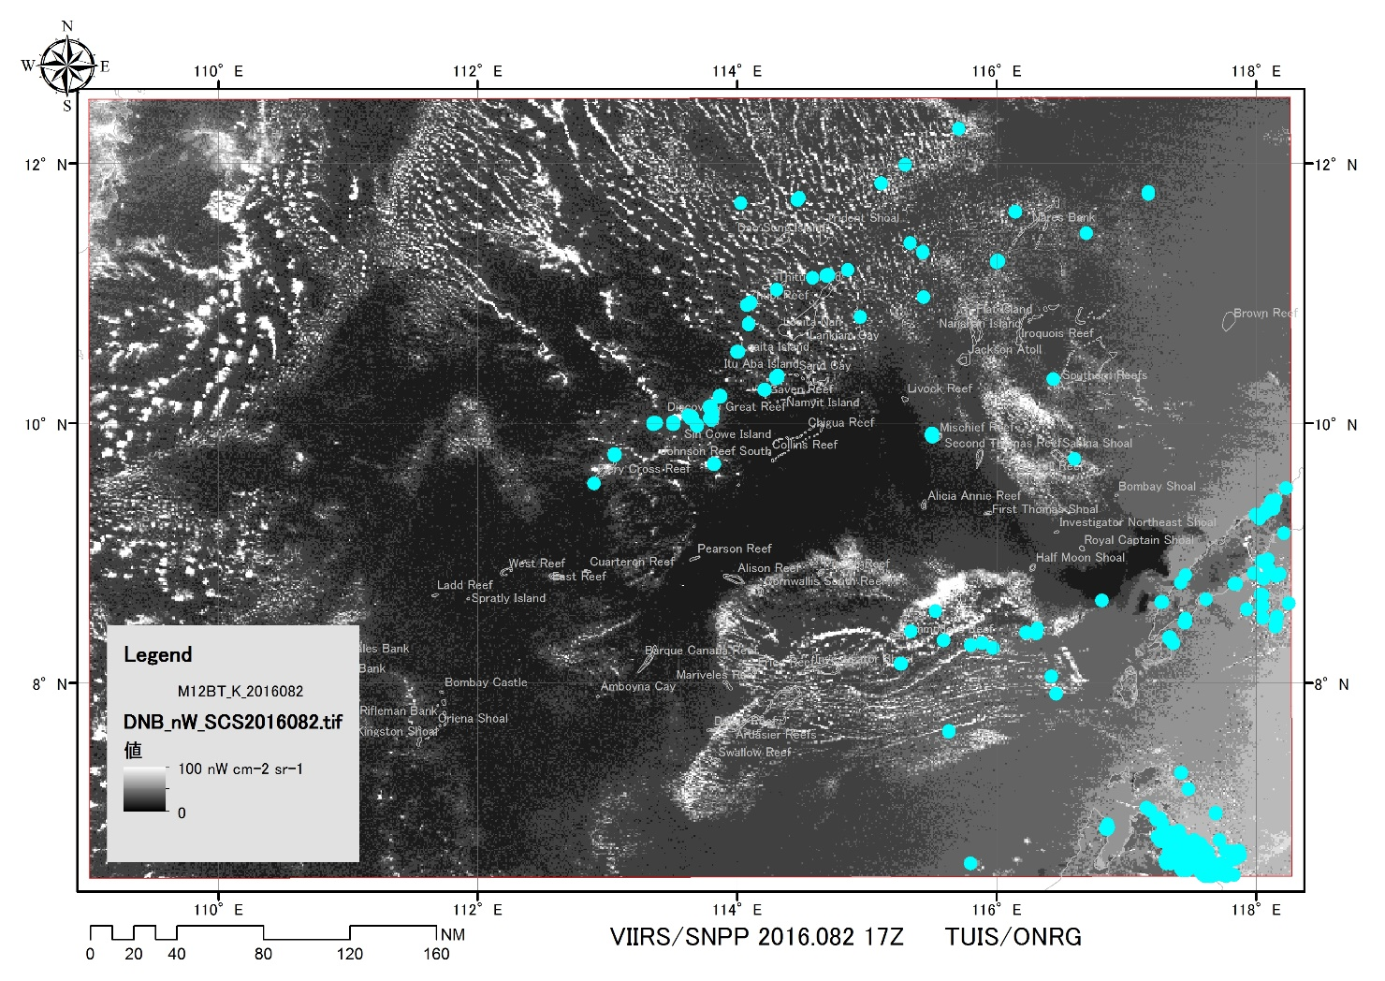
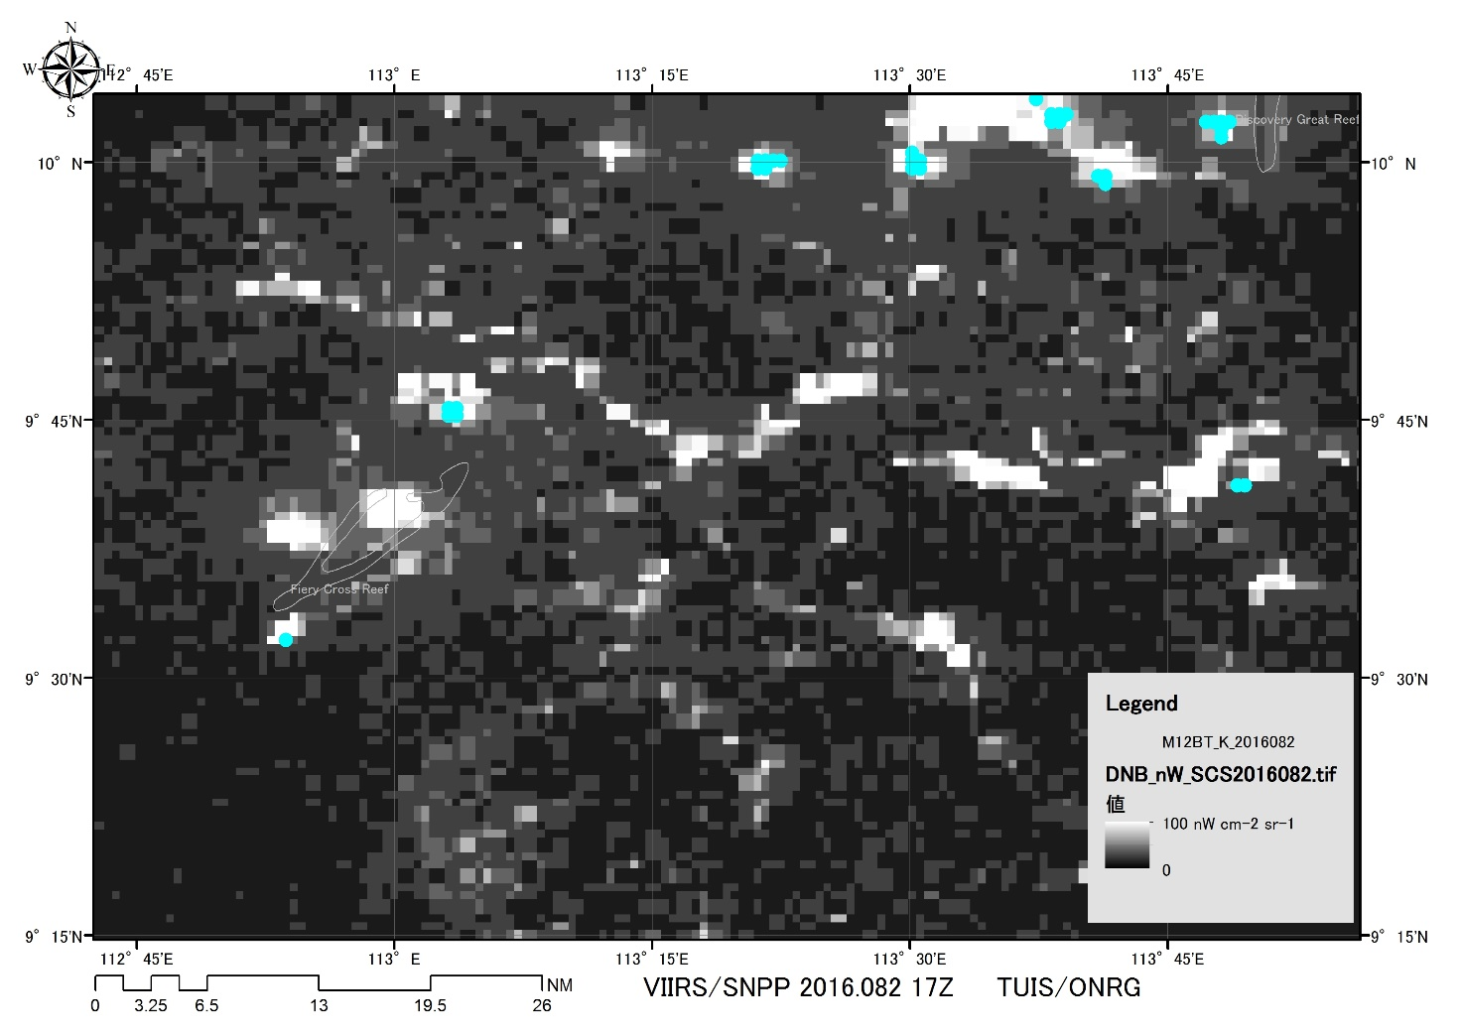
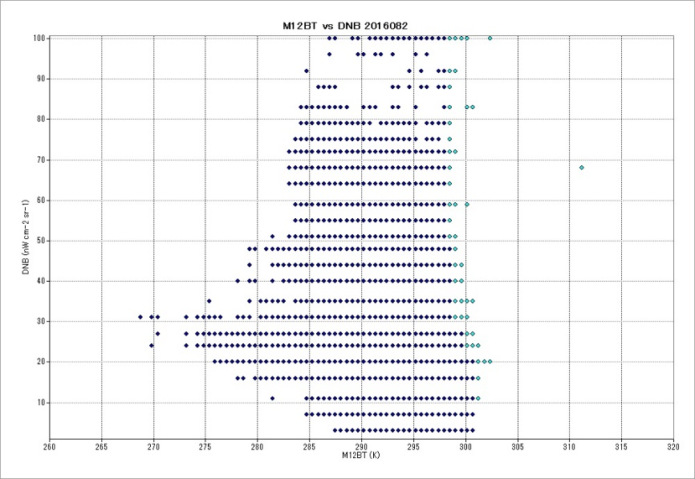
16.082
99%
M12BT > 301 K and DNB > 5 nW cm⁻² sr⁻¹
M12BT > 300 K and DNB > 20 nW cm⁻² sr⁻¹
M12BT > 299 K and DNB > 30 nW cm⁻² sr⁻¹
M12BT > 298 K and DNB > 50 nW cm⁻² sr⁻¹
2016.082.17Z(3.22)
Moon (Waxing Gibbous) 99%

Slide 27
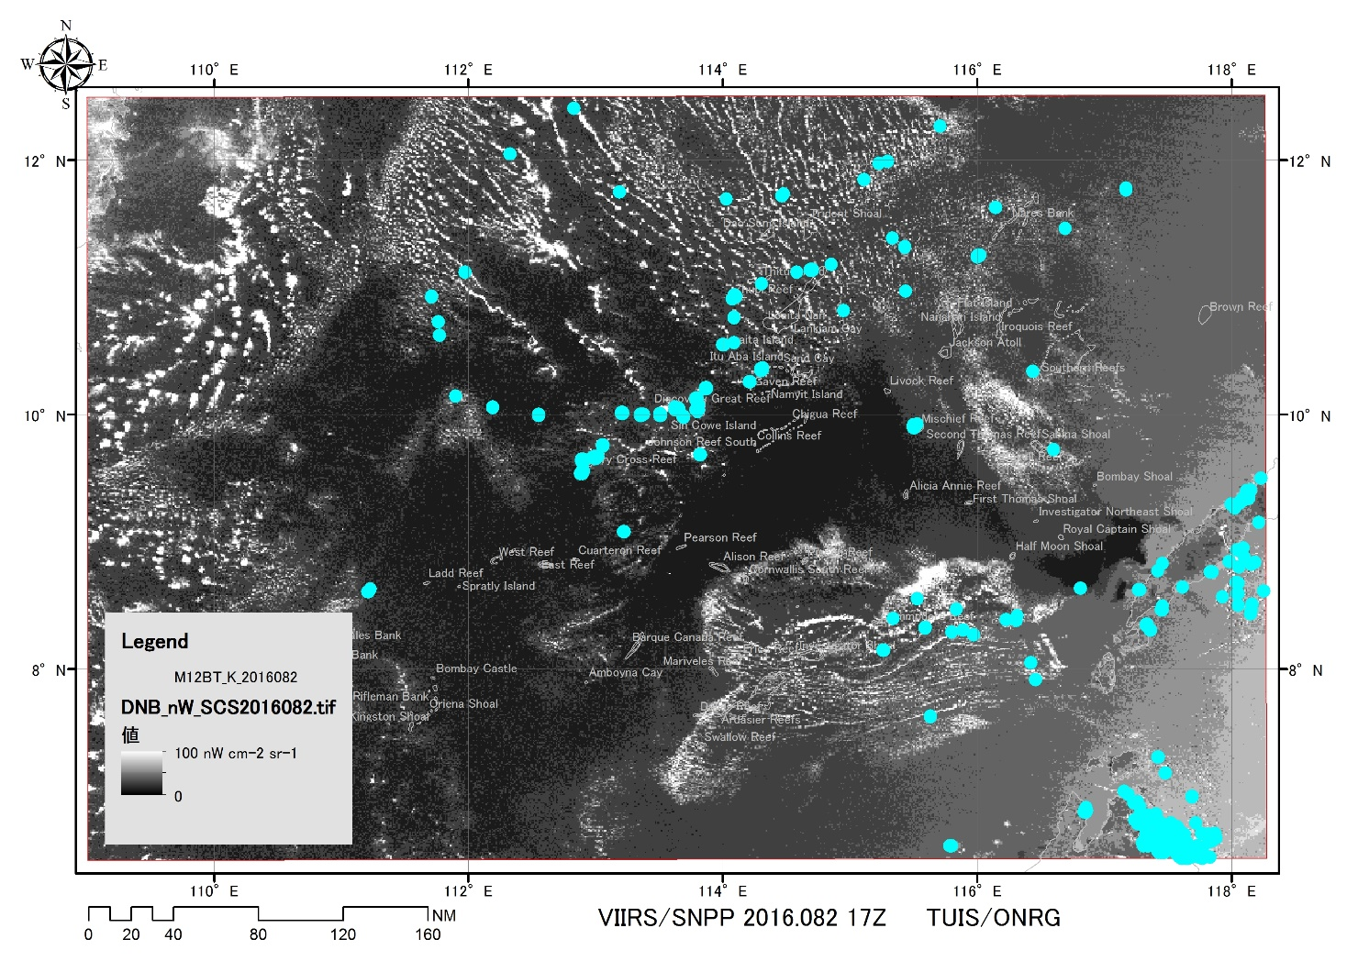
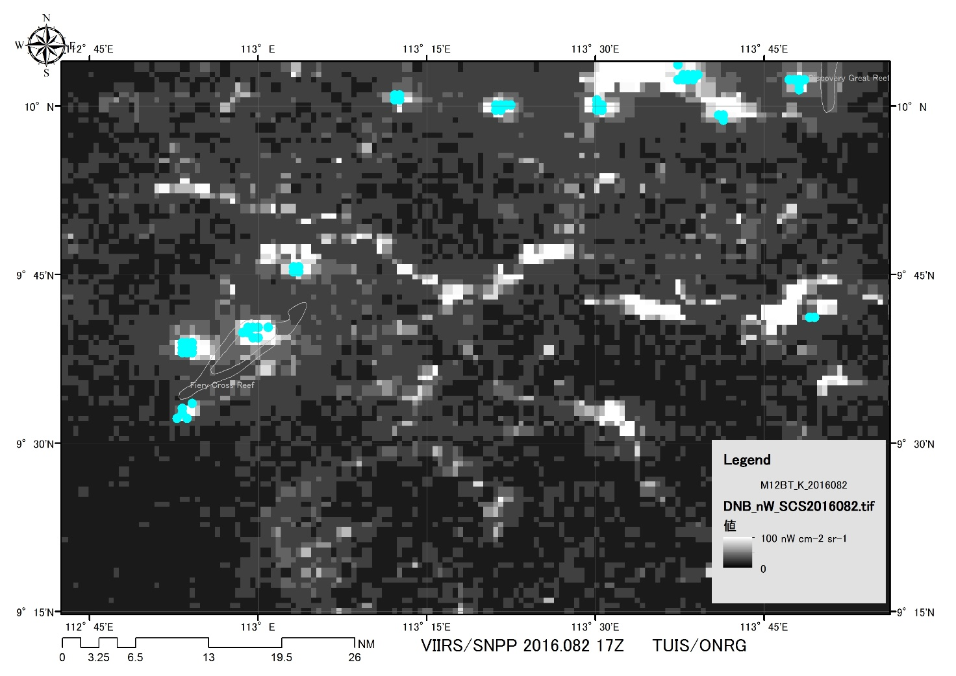
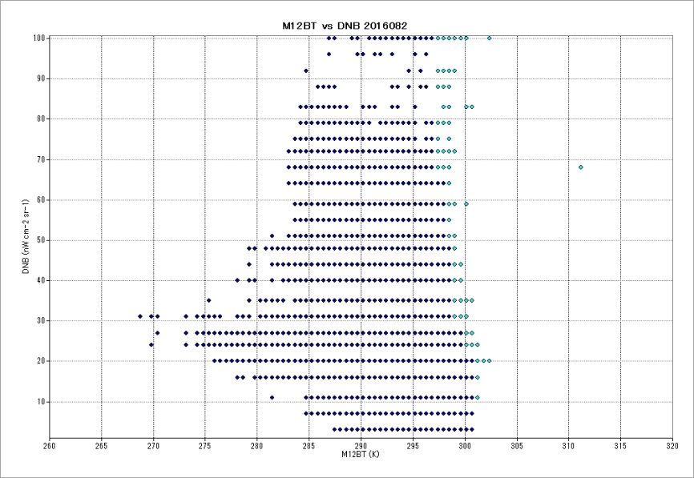
16.082
99%
M12BT > 301 K and DNB > 5 nW cm⁻² sr⁻¹
M12BT > 300 K and DNB > 20 nW cm⁻² sr⁻¹
M12BT > 299 K and DNB > 30 nW cm⁻² sr⁻¹
M12BT > 298 K and DNB > 50 nW cm⁻² sr⁻¹
M12BT > 297 K and DNB > 65 nW cm⁻² sr⁻¹
2016.082.17Z(3.22)
Moon (Waxing Gibbous) 99%

Slide 28



16.082
99%
M12BT > 301 K and DNB > 5 nW cm⁻² sr⁻¹
M12BT > 300 K and DNB > 20 nW cm⁻² sr⁻¹
M12BT > 299 K and DNB > 30 nW cm⁻² sr⁻¹
M12BT > 298 K and DNB > 50 nW cm⁻² sr⁻¹
M12BT > 297 K and DNB > 65 nW cm⁻² sr⁻¹
M12BT > 295 K and DNB > 80 nW cm⁻² sr⁻¹
2016.082.17Z(3.22)
Moon (Waxing Gibbous) 99%

Slide 29
Light observed as a function of brightness temperature with assuming that the optical property of cloud is given only by BT_{3.7}
DNB(⊿BT_{3.7}) = E_{d}^{lunar}ρ(⊿BT_{3.7})＋L_{u}^{ships}t(⊿BT_{3.7}),
where
DNB is the day night band radiance in nW cm⁻² sr⁻¹,
⊿BT_{3.7} is the difference of brightness temperature from the cloud free area in K,
E_{d}^{lunar} is the downwelling Lunar light,
L_{u}^{ships} is the upwelling light from ships,
t(⊿BT_{3.7}) is the transmittance of cloud,
ρ(⊿BT_{3.7}) = 1 - t(⊿BT_{3.7}) is the reflectance of cloud,
t(⊿BT_{3.7}) =exp(-(a⊿BT_{3.7}+b⊿BT_{3.7}+c)),
a⊿BT_{3.7}+b⊿BT_{3.7}+c is the optical depth at ⊿BT_{3.7} with the empirical parameters of a and b.

Slide 30
DNB radiance simulation
Notes:
A colored portion is recognized as the lights from ships manually.
The most right column is the cloud free DNB.
We have to find a rule what is the threshold of manual determination.

Slide 31

Detection limit as a contrast between
DNB target and mean DNB
$$\frac{{DNB}_{target} −{DNB}_{mean}}{{DNB}_{target}+{DNB}_{mean}}>0.7$$
Notes:
A contrast of the manually selected data was greater than 0.7.
A colored portion includes the cloud free DNB.

Slide 32
Regression of detection limit defined by contrast >0.7
⊿BT = exp(aDNB+ b) , where a=0.07 and b=5.3

Slide 33
Effective DNB range
DNB(BT_{3.7}^{max}) ～ DNB(BT_{3.7}^{max}－ ⊿BT_{3.7})
Cloud free DNB,
BT_{3.7} = maximum
DNB with cloud,
BT_{3.7}^{max} ー ⊿BT_{3.7}
Detection limit at DNB radiance,
⊿BT = exp(aDNB+ b) , where a=0.07 and b=5.3

Slide 34
Implementation
Get BT_{3.7}^{max}
  Get mean, BT_{3.7}^{mean}, and standard deviation, BT_{3.7}^{σ}
  Get max, BT_{3.7}^{max} , within BT_{3.7}^{mean} ± BT_{3.7}^{σ}
Find DNB from ships
  Loop for all DNB from 20 to 100 nW cm⁻² sr ⁻¹
    Find cloud free DNB : DNB at BT_{3.7}^{max}
    Determine detection limit : ⊿BT_{3.7} = exp(0.07DNB+ 5.3)
    Find DNB between DNB at BT_{3.7}^{max} and DNB at BT_{3.7}^{max}－⊿BT_{3.7}
  End loop

Slide 35
Conclusion
Acknowledgement
An empirical equation was proposed to set the detection limit of DNB as a function of BT_{3.7}, where the optical properties of clouds are represented only by BT_{3.7}.
The new idea made it possible to detect the lights from the fishing boats under the full Moon although it depends on the cloud condition.
A validation is necessary for the future work, may be using some stable light source.
This research is partly supported by the Office of Naval Research Global of the USA with the grant number of N62909-15-1-2074.

