Slide 1
Real-Time Remote Sensing Oceans/Freshwater
Welcome & Logistics Thursday, June 23, 2016 Jasmine Nahorniak
NASA Direct Readout Conference
Valladolid, Spain
June 21-24, 2016

Slide 2
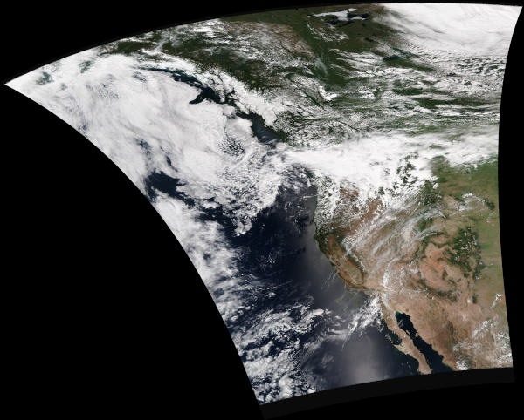
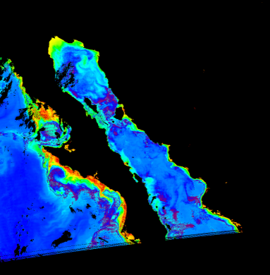
Oregon State University Direct Readout
http://omel-test.coas.oregonstate.edu/project/DB/VIIRS
Notes:
Much of the ILDRCC activities to this point have been conducted by the ILDRCC co-chairs.
Breakout session at 2008 EOS/NPP meeting. Leveraged opportunity to reach out to the international meeting attendees, particularly representatives from Asian DR ground stations for which DR ground station information and contact info is less reliable than other regions. Session informed attendees about ILDRCC objectives and discussed products needs. Listing of participants, contact info and product/application interests was compiled.
Ground station inventory leveraged knowledge of ILDRCC of operating ground stations. Additionally, a comprehensive internet search and verification was conducted on possible ground stations (list provided by NASA).

Slide 3
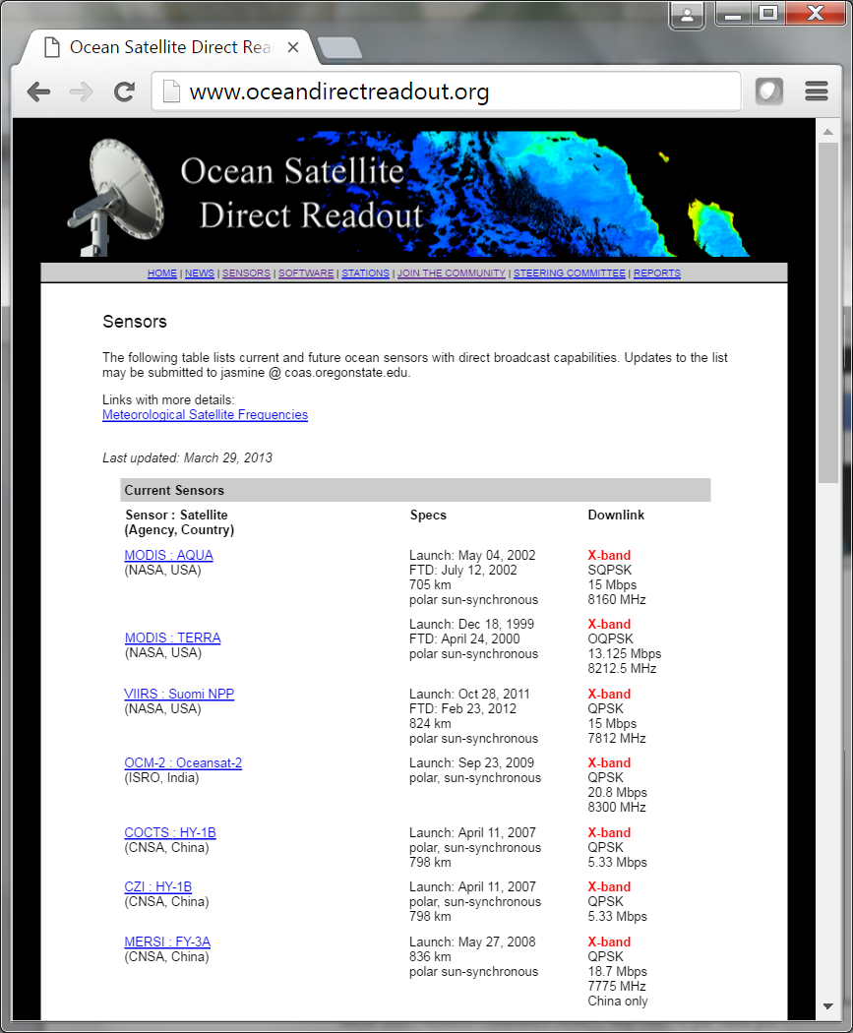
International Direct Readout Ocean Steering Committee www.oceandirectreadout.org
The role of the IDROSC is to act as a conduit between the ocean direct readout community and relevant
agencies. In addition to providing a
voice for this community, we also provide access to information about
ocean-specific satellite sensors and software on our website.
Committee Members
Jasmine Nahorniak (chair) Oregon State University, USA
Ichio Asanuma The Tokyo University of Information Sciences, Japan Frank Muller-Karger University of South Florida, USA
Edward King
CSIRO, Australia
Ricardo Letelier Oregon State University, USA Marcelo Colazo
CONAE, Argentina
IDROSC@coas.oregonstate.edu
Notes:
Much of the ILDRCC activities to this point have been conducted by the ILDRCC co-chairs.
Breakout session at 2008 EOS/NPP meeting. Leveraged opportunity to reach out to the international meeting attendees, particularly representatives from Asian DR ground stations for which DR ground station information and contact info is less reliable than other regions. Session informed attendees about ILDRCC objectives and discussed products needs. Listing of participants, contact info and product/application interests was compiled.
Ground station inventory leveraged knowledge of ILDRCC of operating ground stations. Additionally, a comprehensive internet search and verification was conducted on possible ground stations (list provided by NASA).

Slide 4
Schedule for Thursday, June 23
9:00 AM Welcome & Logistics 9:05 AM PRESENTATION: Orbital Systems – Carl Schoeneberger
9:20 AM PRESENTATION: Possibility of Day-Night-Band of VIIRS to Detect Fishing Activities Ichio Asanuma (TUIS)
9:50 AM WORKSHOP: Suomi-NPP VIIRS Nighttime Environmental Products for Land Science and Disaster Response Applications Miguel Roman (NASA) 10:45 AM Posters/Exhibits
11:15 AM PRESENTATION: Sentinel-3 Mission Overview Susanne Mecklenburg (ESA)
11:45 AM Group Photo 12:00 PM Lunch
1:00 PM WORKSHOP: SeaDAS 7 for Ocean Data Users
Fred Patt (NASA) 2:00 PM WORKSHOP: Fisheries Cara Wilson (NOAA) 3:00 PM Posters/Exhibits
3:30 PM PRESENTATION: VIIRS Ocean Color Products from Global Open Oceans and Coastal/Inland Turbid Waters
Menghua Wang (NOAA)
4:00 PM WORKSHOP: Monitoring for Ecosystem and Human Health Erin Urquhart (EPA) 5:00 PM Wrap-up

Slide 5
Workshop Objectives & Formats
Descriptive/Instructional Workshops
- examples include algorithm and software workshops
- longer presentation
- provides details of implementation and use
- questions are welcome throughout
B. Discussion Workshops
- examples include workshops on application topics
- short (10-15 min) presentation by the workshop lead
- discussion period
- the audience is encouraged to ask and answer questions, bring up topics, and generally contribute to the discussion
Microphones will be available for audience use. Please state your name and affiliation before speaking.

Slide 6
Possible Avenues of Discussion
What kinds of applications are you interested in seeing developed?
What types of data/algorithms are needed for your potential and/or existing application and information needs?
Provide information on the actual or potential use of the presented algorithms/product/application in the context of your organization’s needs.
Are there particular challenges/shortcomings/unmet needs? Where can things be made better?
Are there opportunities for collaboration with other attendees and workshop leads? (regional applications, data sharing, etc.)
Discuss scenarios with the broader group to identify innovative ideas, potential improvements, etc.

Slide 7
Schedule for Friday, June 24
!! CHANGE OF VENUE – UPSTAIRS !!
9:00 AM Atmosphere Discipline Welcome/Overview for the Day
Allen Huang (UW)/Anders Soerensen (EUMETSAT)
9:10 AM PRESENTATION: Status and Future Atmosphere Near Real-Time Applications
Allen Huang (UW)/Anders Soerensen (EUMETSAT)/
Carlos Cabanas (EUMETSAT)
9:40 AM PRESENTATION: Atmospheric Composition
Christian Retscher (EUMETSAT)
10:10 AM PRESENTATION: EUMETSAT EARS Network – Overview and the New
VIIRS Day Night Band Service
Anders Soerensen (EUMETSAT)
10:30 AM PRESENTATION: EUMETSAT EARS Network – the New FY-3-based Service
Carlos Cabanas (EUMETSAT)
10:50 AM Posters/Exhibits
11:30 AM WORKSHOP: Nowcasting - PPS Algorithms and Products
Adam Dybbroe (SMHI)
12:30 PM Lunch

Slide 8
Schedule for Friday, June 24
!! CHANGE OF VENUE – UPSTAIRS !!
12:30 PM Lunch
1:45 PM WORKSHOP: Direct Broadcast Data in NWP
William Bell (UK Met Office)
2:45 PM PRESENTATION: Transition from EOS to SNPP (IMAPP and Next Steps)
Allen Huang (UW)
3:15 PM WORKSHOP: IMAPP Training Workshop – From Theory to Applications
Kathy Strabala (UW)
4:00 PM Break
4:15 PM WORKSHOP: Community Software Tools
Martin Raspaud (SMHI)/David Hoese (UW)
5:30 PM Wrap-up
5:45 PM Adjourn

