Slide 1
Day-Night Monitoring of Volcanic SO₂ and Ash for Aviation Avoidance at Northern Polar Latitudes: Enhancing Direct Readout Capabilities from EOS, SNPP and NOAA20
NASA Applied Sciences Disasters Program: David Green (NASA HQ) , John Murray (NASA LaRC)
Principal Investigator: Nickolay Krotkov (NASA Goddard Space Flight Center)
Co-Investigators:
Kelvin Brentzel (Direct Readout Laboratory, NASA Goddard Space Flight Center),
Can Li (University of Maryland & NASA Goddard Space Flight Center),
Vincent J. Realmuto (Jet Propulsion Laboratory),
Martin Stuefer (Geographic Information Network of Alaska, University of Alaska Fairbanks),
David Schneider (Alaska Volcano Observatory, USGS)
Collaborators:
Johanna Tamminen (Finnish Meteorological Institute, FMI),
Seppo Hassinen (FMI), Timo Ryyppö (Sodankylä Satellite Data Centre , FMI),
Eugene Petrescu (NOAA’s National Weather Service Alaska Region)
Notes:
Objectives:
1. Transition NASA SNPP/OMPS Volcanic Ash (VA) and SO2 (VSO2) algorithms to NOAA/NESDIS for global processing and dissemination to operational users (VAACS, AVO, FMI, European SACS) and public;
2. Utilize Direct Broadcast capability of the Aura and SNPP satellites to locally process Direct Readout (DR) data at two high latitude locations in Northern Finland and Fairbanks, Alaska to enhance VA DSS in Europe and at USGS’s Alaska Volcano Observatory (AVO) and NWS’s Alaska-VAAC;
3. Demonstrate improved VA emission source estimates by assimilating satellite data;
4. Demonstrate quantitative VA and VSO2 density forecasts using GSFC GMAO GEOS-5/GOCART global Eulerian model;
5. Estimate cost benefits of dynamic re-routing aircraft around hazardous VA and VSO2 clouds.
Importance and Significance: The dangers that VA clouds pose on inflight air traffic safety can lead to prolonged flight cancellations that have a ripple effect on the airline industry’s economy and personal travel. This most notably occurred in the wake of the 2010 eruption of Eyjafjallajokull volcano, Iceland, which halted all flights across Northern Atlantic flight corridor for several days and had ripple effects on many more U.S. and European flights, causing public outcry from stranded travelers and the largest economic losses ever experienced by the global aviation industry due to VA clouds. Rerouting air traffic around advected VA clouds requires as input a quantitative characterization of the ash mass concentrations in order to construct an operational forecast of hazardous VA regions. Satellite observations provide crucial quantitative constrains on VA forecast models. When properly constrained, the models can produce quantitative 4D VA dispersion forecasts, required as input to air traffic flow management (ATFM) operational algorithms that can determine optimal paths for rerouting air traffic around VA clouds, thus minimizing economic losses.
End users: NOAA NESDIS, NOAA operational volcanic SO2/ash web site, WMO WS Volcanic Ash Advisory Centers, GINA/UAF, USGS AVO, Federal Aviation Administration, Finland Meteorological Institute, European Support to Aviation Control Service (SACS).
Earth observations applied: Aura/OMI, Aqua/AIRS, and SNPP/OMPS.
Key data sets, algorithms, and models applied: OMI/OMPS UV volcanic SO₂ (VSO2) and Ash Index (AI), trajectory models (HYSPLIT, GSFC), GSFC GMAO GEOS-5/GOCART global Eulerian model.

Slide 2
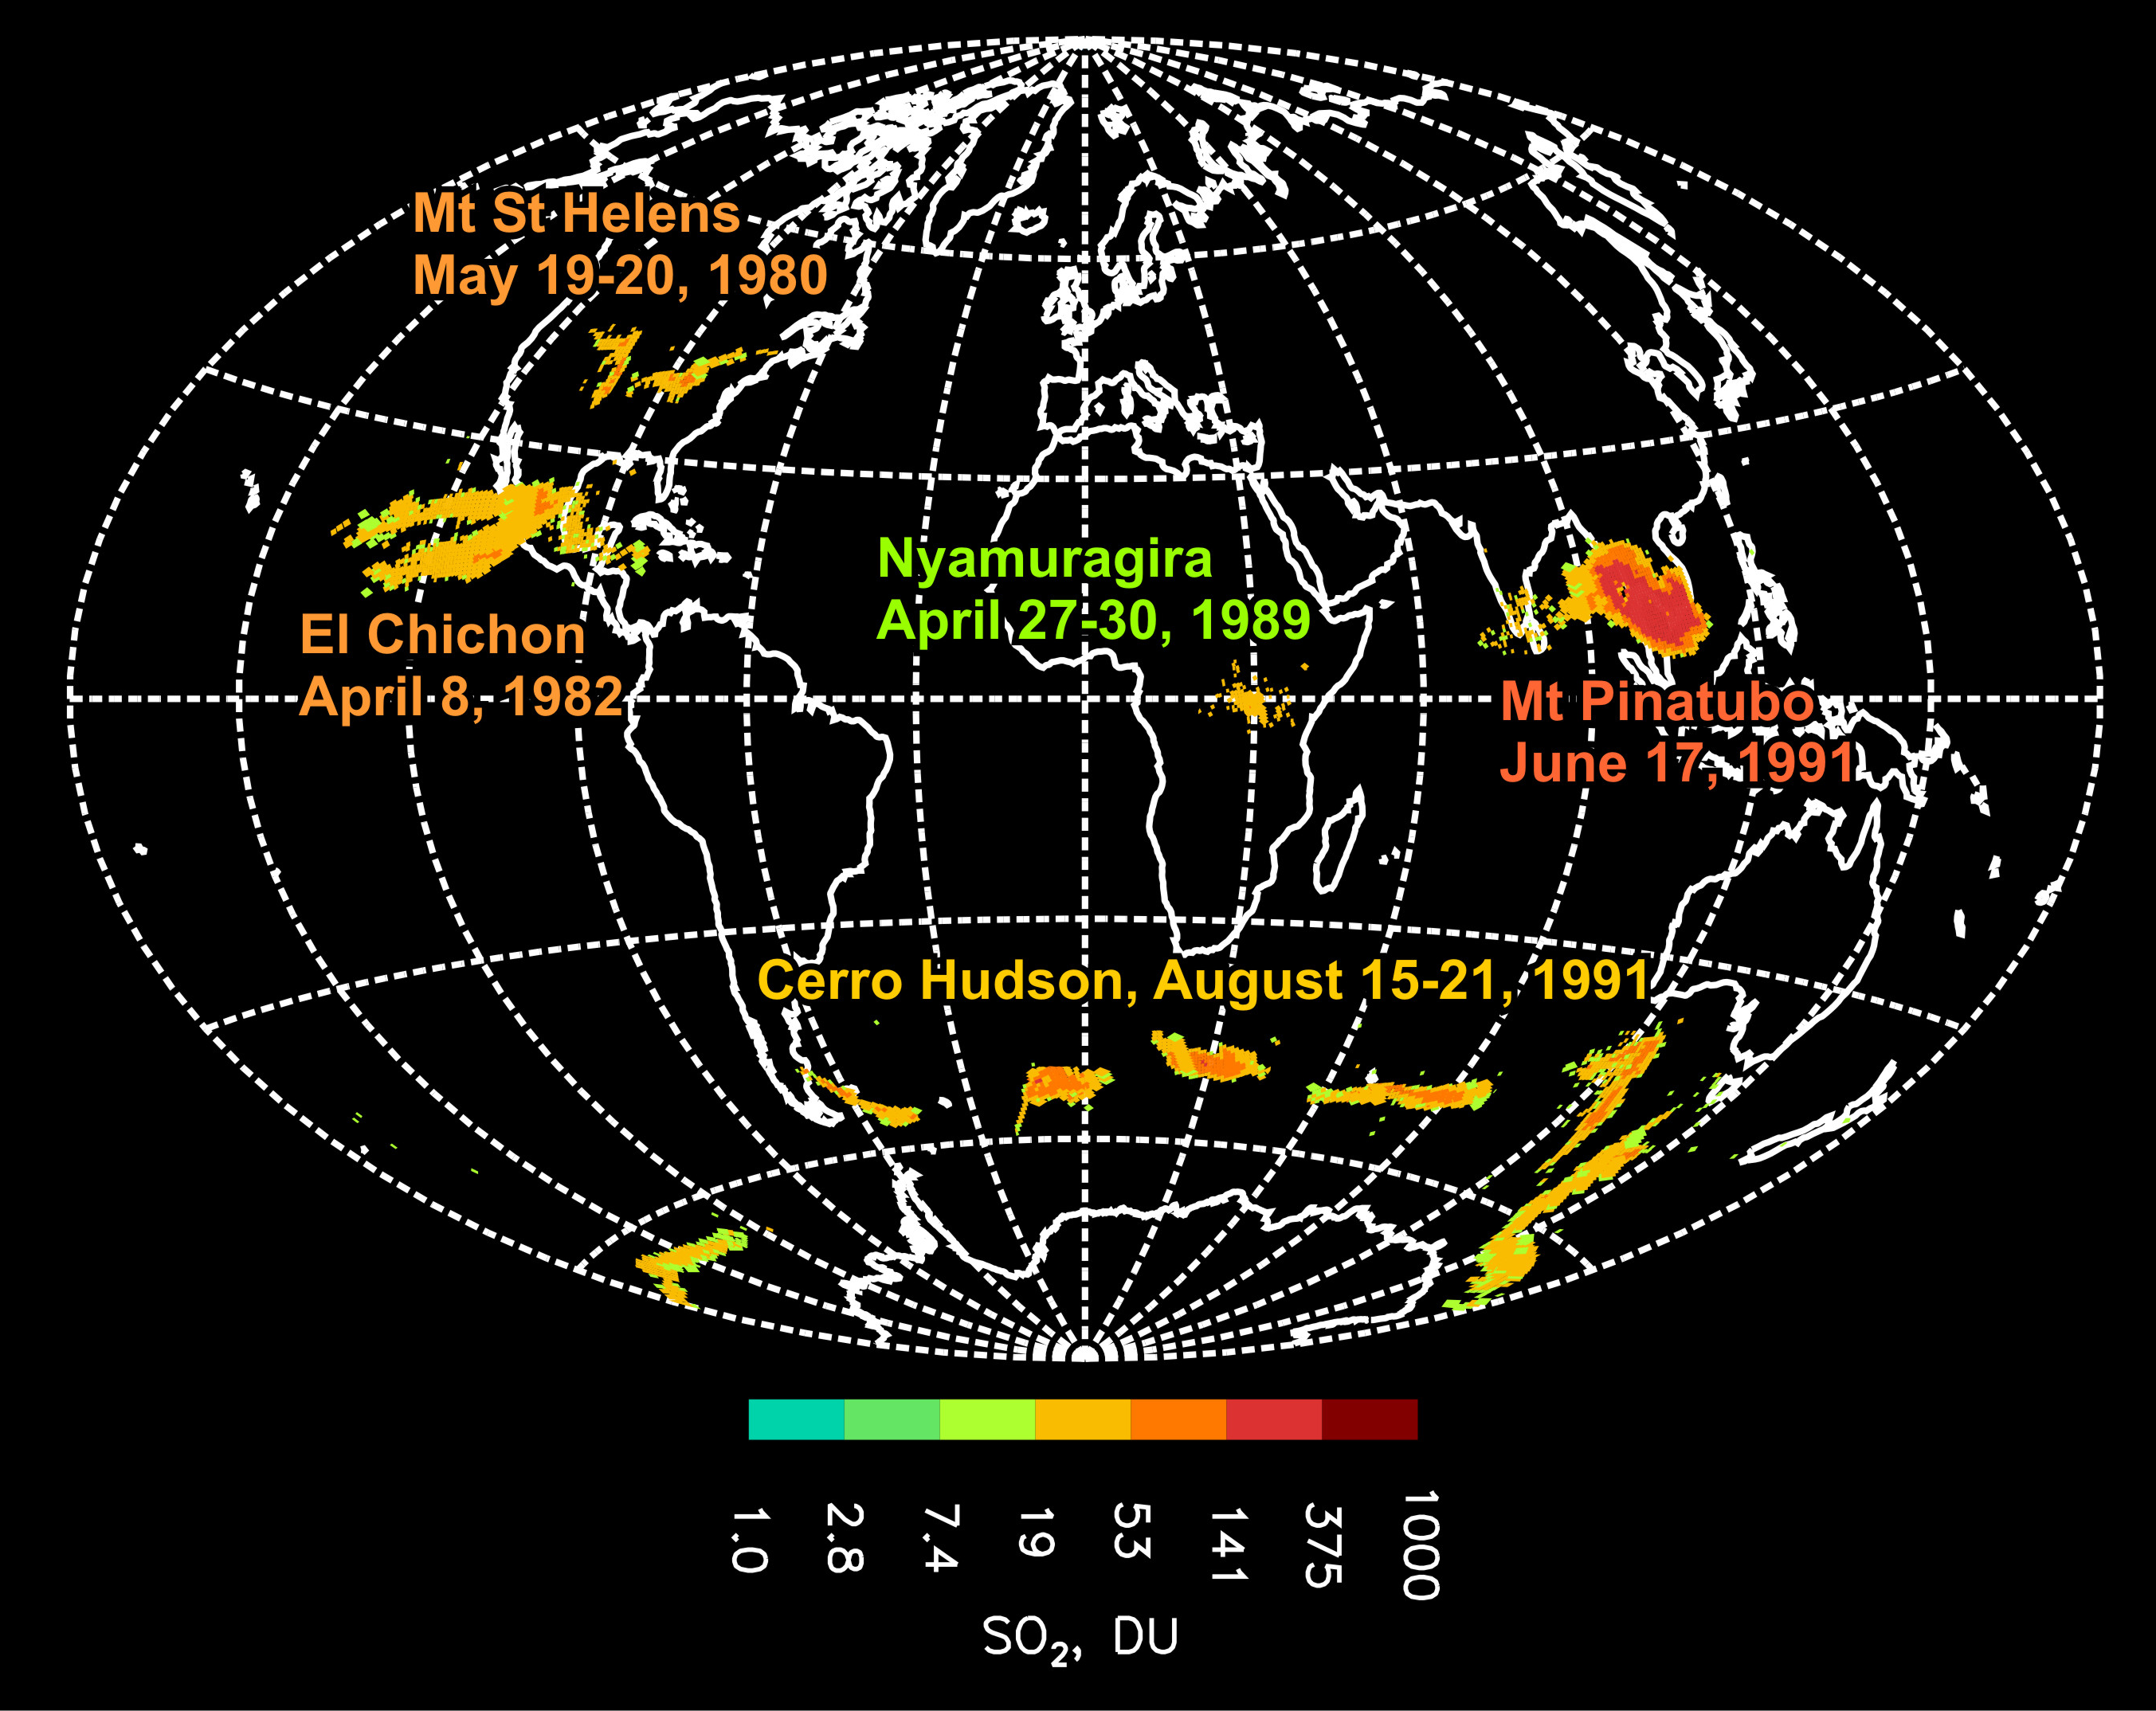
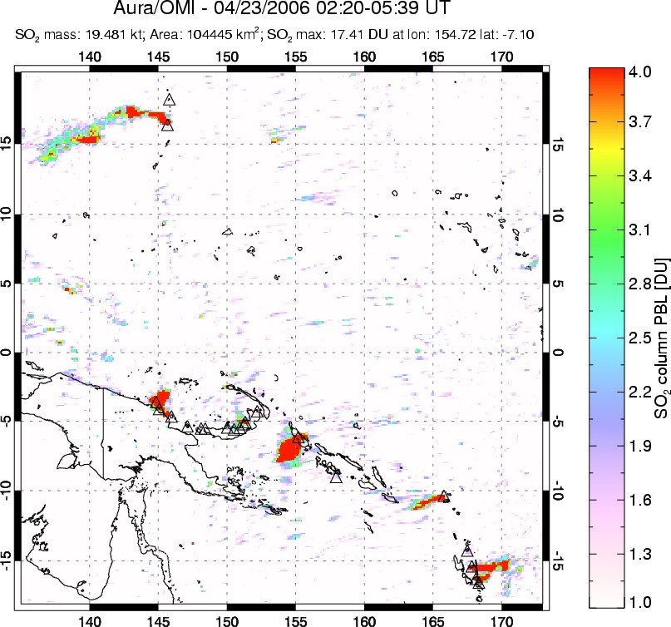

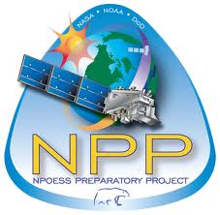
UV satellite remote sensing of volcanic SO₂
[Carn et al., 2008, 2013, 2016]
SW Pacific
April 23, 2006
1978-2005
Total Ozone Mapping Spectrometer (TOMS)
1995-2003
Global Ozone Monitoring Experiment (GOME)
2004-
Ozone Monitoring Instrument (OMI)
2012- & 2017-
Ozone Mapping and Profiler Suite (OMPS)
2015-
DSCOVR/EPIC
2017-
Sentinel 5P
TROPOMI
2006-
GOME-2

Slide 3
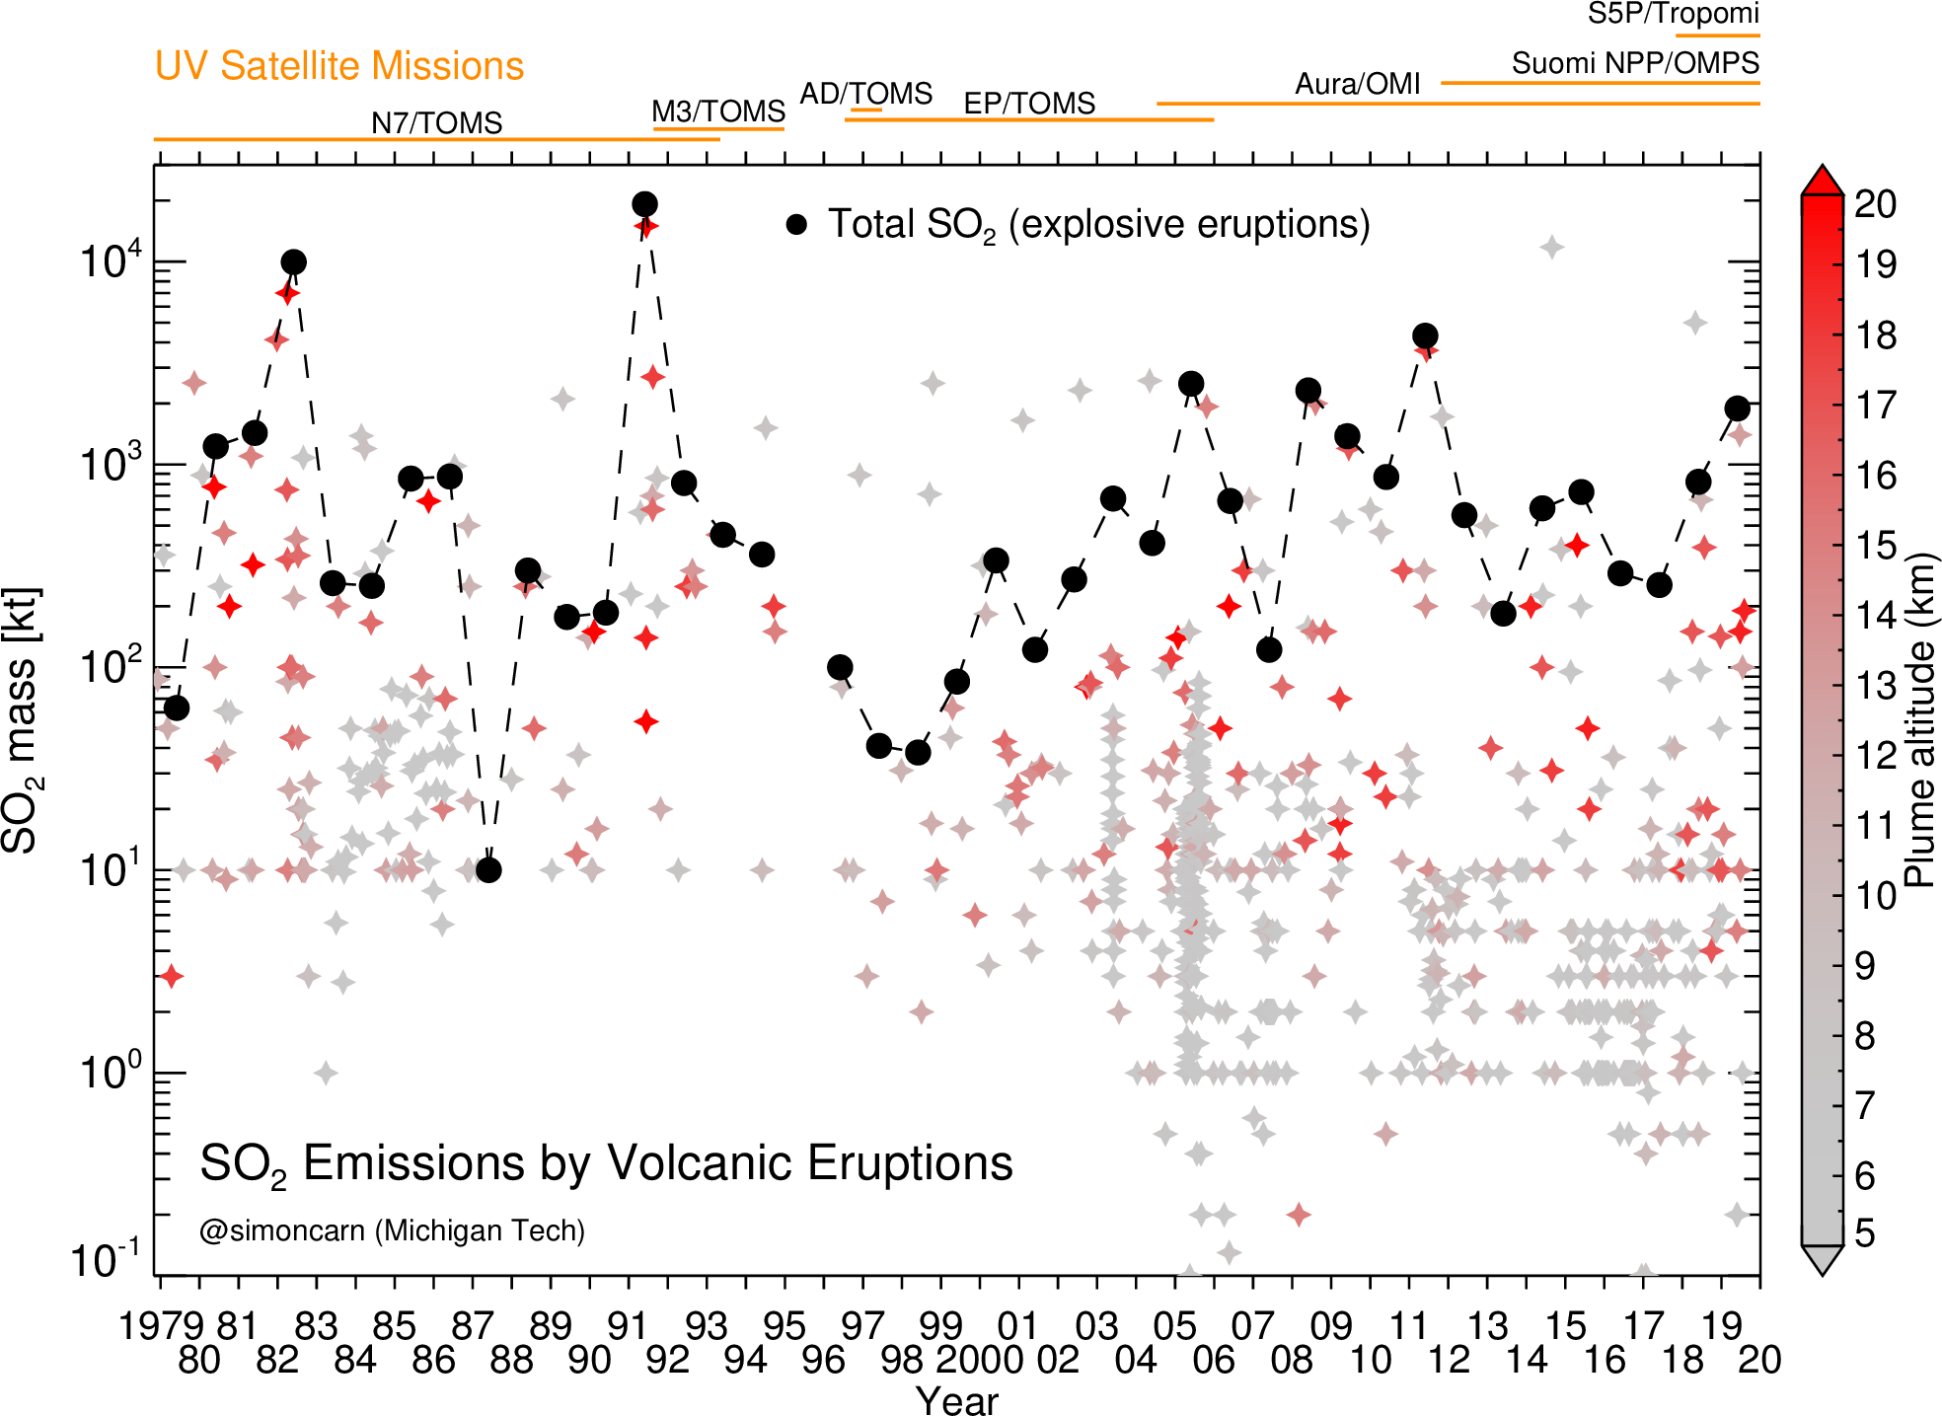
Explosive volcanic SO₂ emissions (1978 – present)
Carn et al., JVGR [2016]
~1000 eruptions; ~113 Tg total SO₂
[Carn et al., 2016; Fisher et al., AMT 2019]
Notes:
Aura/OMI – now the longest single UV mission (exceeded N7-TOMS)

Slide 4
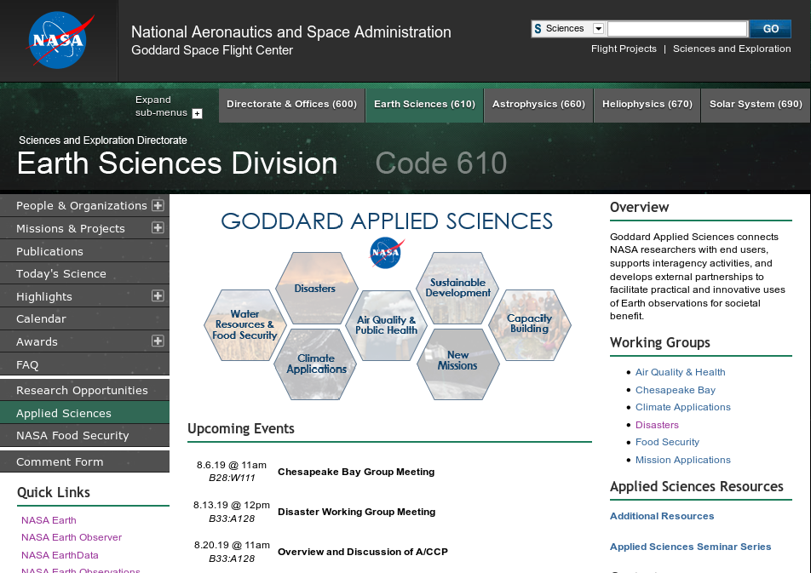
NASA Applied Sciences Program
  Both the Real-Time and Near Real-Time systems support NASA’s Applied Sciences Program (ASP):
    OMPS (and OMI) contribute through support of both the Disasters and Air Quality components of the program
  This program is a rapidly growing area of opportunity for the larger user community
  NASA ASP supports on-going project to develop ability to process SO₂ and Ash data in real time combing UV (OMI/OMPS) and TIR MODIS/VIIRS Direct Broadcast data
https://science.gsfc.nasa.gov/610/applied-sciences/index.html
Notes:
4

Slide 5
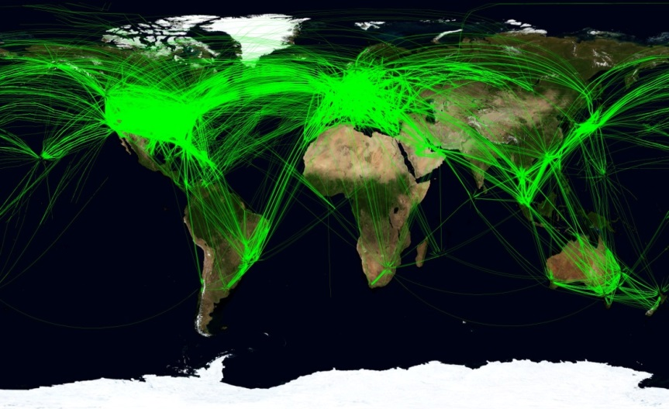
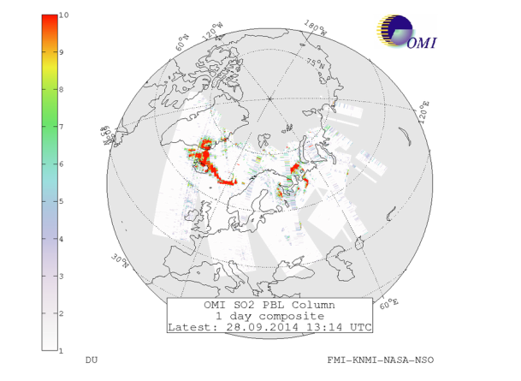
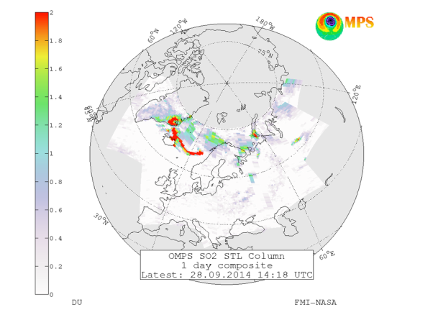
    ASP Volcanic Cloud Data for Aviation Hazards project
NASA established a program to develop ability to process SO₂ and Aerosol Index data in real time using Direct Broadcast data
  The OMI Science Team worked with GSFC’s Direct Readout Lab (DRL) to develop the capability
  It was provided to the Finish Meteorological Institute (FMI) with a ground station at Sodankyla, Finland
  Also provided to the Geolocation Information Network of Alaska (GINA) with a ground station at Fairbanks, Alaska
  Together, FMI and GINA provide coverage over much of the heavily traveled corridors in the northern hemisphere
    Particularly over volcanically active areas (Iceland, “Ring of Fire”, etc)
  The OMPS SIPS extended this capability to include S-NPP OMPS products
    Up until recently, this capability was limited to providing program “executables” to FMI and GINA
Global flight paths
Images taken from FMI’s SAMPO web site
    Eruption of Bardarbunga / Holuhraun in 2014
5

Slide 6
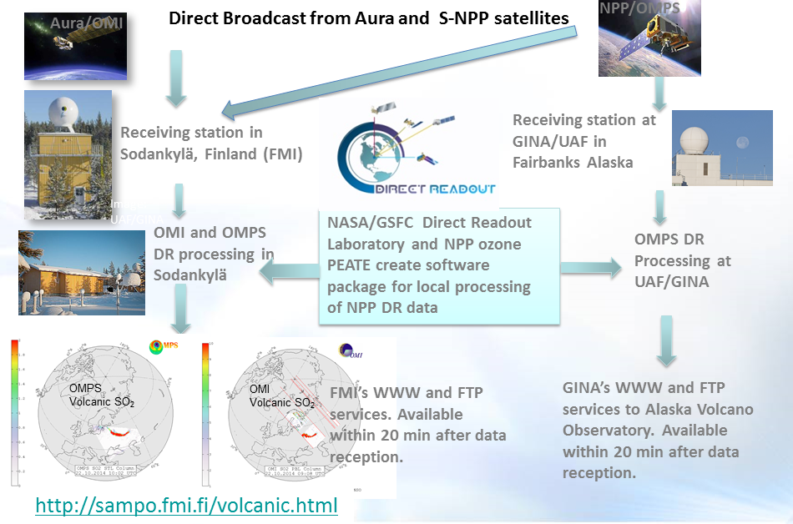
Currently Aura/OMI and SNPP/OMPS DR SO₂ and aerosol index (AI) data are locally processed in Finland (FMI) and Alaska (GINA)
DR coverage
Aura/OMI (since 2010) and SNPP/OMPS (since 2014) Direct Readout (DR) volcanic SO₂ and ash Index (AI) data have been used by Finnish Meteorological Institute (FMI) Very Fast Delivery Volcanic service
In addition, NASA-NOAA NPP/OMPS DR data are now received and processed by UAF-GINA in Alaska. DR data used by SACS, USGS/AVO
In 2017 FMI started posting OMPS DR data from GINA/UAF and provide these to the EUMETCast distribution service
Notes:
Objective 2: Enabled NASA’s Direct Readout (DR) volcanic data in Partner’s Decision-Making
The NASA’s EOS-Aura and S-NPP satellites have Direct Broadcast (DB) capability, i.e. the ability to broadcast data at the same time as it is measured. This possibility is utilized in the FMI’s Very Fast Delivery (VFD) Service for monitoring atmospheric composition in almost real time, within 20 minutes after the overpass. The service started in 2006 processing Aura OMI surface UV and ozone data. After the eruption of the Eyjafjallajökul the system was updated in 2010-11 with volcanic ash and VSO2 data. During Y1 our team provided software for processing DR OMPS volcanic data. Currently both OMI and OMPS DR data are processed at Sodankyla (Fig.). The VFD covers Northern Europe, Russia and Arctic Ocean, but the coverage is restricted by the fact that the satellite has to be visible from the Sodankylä ground station in northern Finland.
Through the established partnership between GINA, NASA GSFC Direct Readout Laboratory (DRL) and SNPP’s Ozone SIPS in Y2 we started processing DR OMPS data from GINA ground station in Fairbanks, Alaska. UAF-GINA has provided access to direct broadcast SNPP data in raw format, maintained hardware to run the International Polar Orbiting Processing Package (IPOPP), maintained IPOPP and the Ozone Mapping and Profiling Suite (OMPS) Science Processing Algorithm (SPA), and provided NASA Direct Readout Labs (DRL) with products produced by IPOPP and the OMPS SPA. In Y2 an updated version of the IPOPP OMPS SPA processor software was installed. Data and products have been provided to NASA DRL and have been used to generate analyses of events. In May 2016 GINA started capturing DR data from Aura OMI passes on a new Orbital Systems 3-meter antenna. The data are transferred to FMI for processing and imagery generation.
In Y3 (2017) updated OMPS SO2/AI Science Processing Algorithm (SPA) OMSNadir (v2.1) has been delivered to DRL, tested, proven operational and distributed to user community for operational processing. Extensive development was necessary for the OMSNadir prototype version (v2.0) since it also included alignment with the unique ACPS data formats defined to enhance scientific use and long-term record continuity. This approach insured NASA DR data are in sync with NASA’s scientific processing environment at ACPS. DRL continues working closely with GSFC’s Ozone SIPS to integrate updated OMSNadir (v2) SPA into NASA’s International Polar-Orbiter Processing Package (IPOPP) and to obtain feedback from collaborators at FMI and co-Is at GINA/UAF, as well as additional international collaborators. The new OMSNadir (v2.1) SPA improved measurement quality, as well as added features for the higher resolution processing when these data are made available in the downlink from the SNPP and JPSS-1 platforms. The SPA will be maintained by DRL and Ozone SIPS and updated when necessary as defined by user needs.

Slide 7
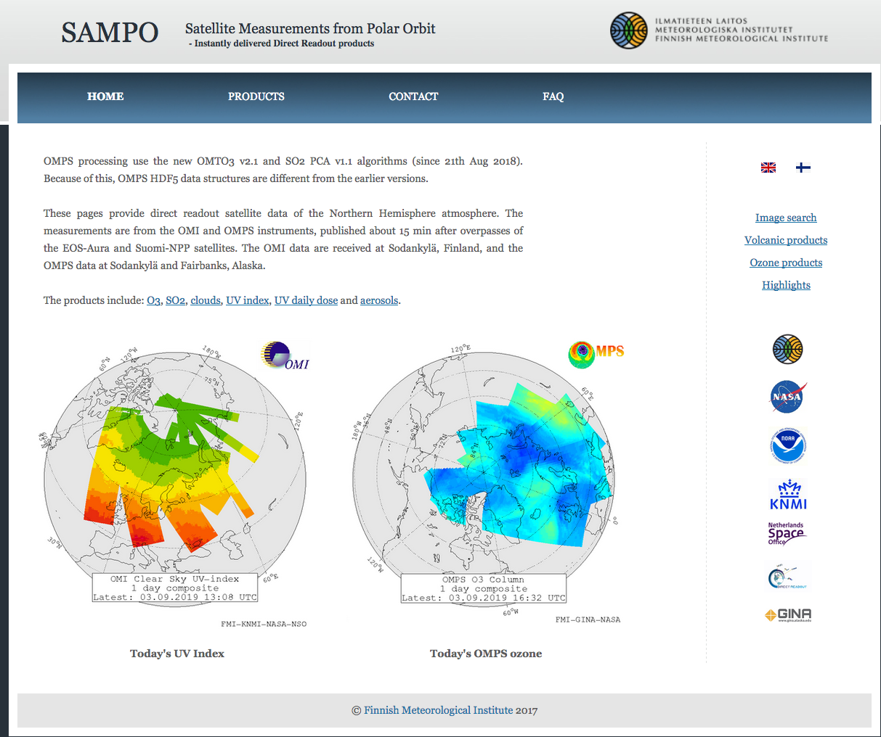
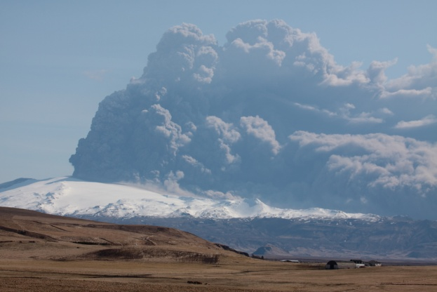
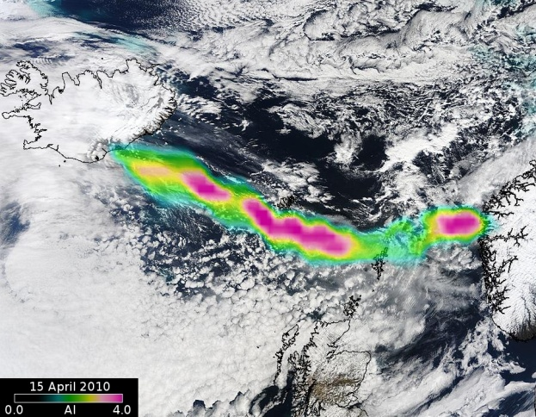
What OMI/OMPS UV-based DR products are currently available?
Total Ozone – O₃
Cloud/surface UV Lambertian Equivalent Reflectivity
Sulfur dioxide SO₂
Surface UV radiation
UV aerosol Index
  -smoke
  -dust
  -volcanic ash
2010 Eruption of Eyjafjallajökull in Iceland caused a massive disruption of aviation worldwide
http://sampo.fmi.fi/index.html
OMI aerosol index superimposed
on MODIS RGB image, 15 April 2010

Slide 8
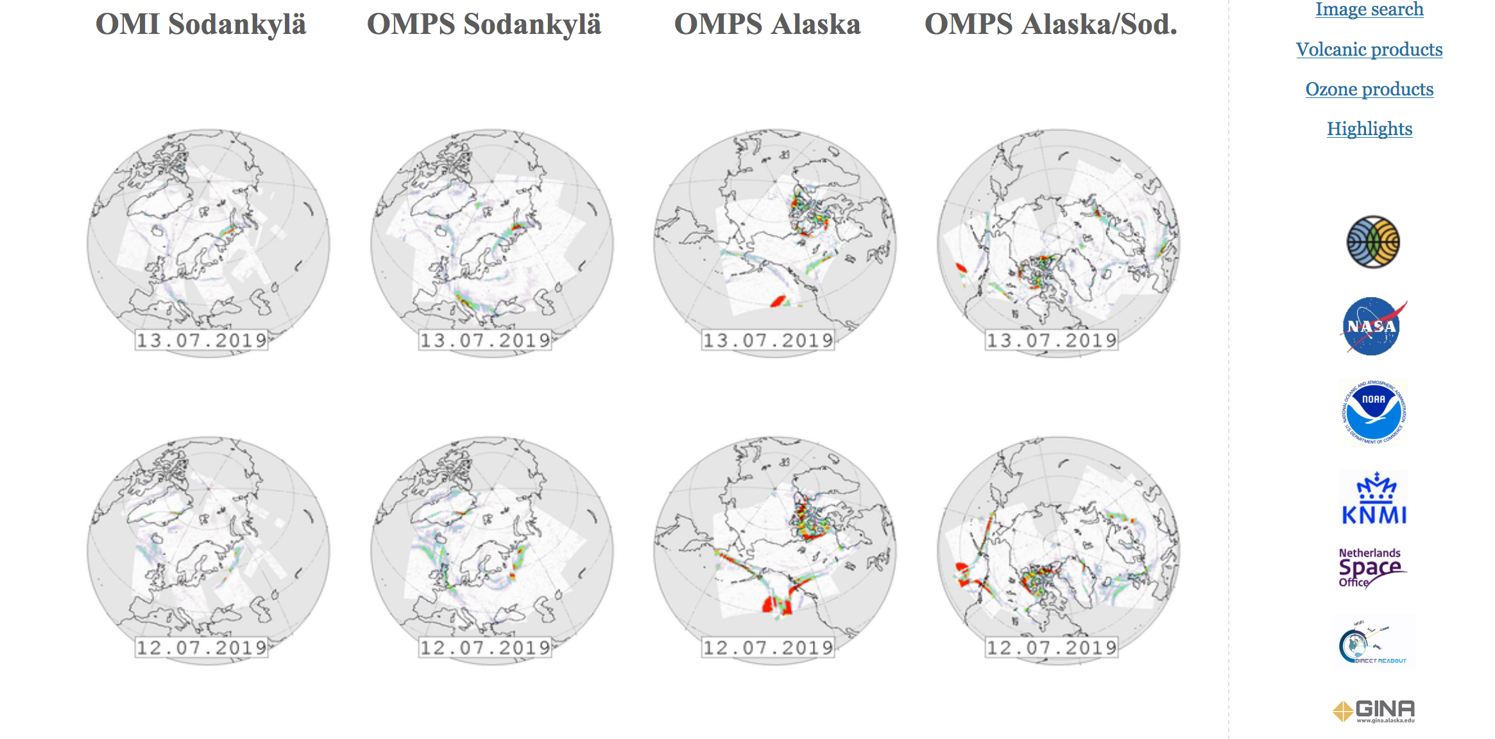
Near complete Arctic coverage from Alaska and Finland
http://sampo.fmi.fi/so2_comp.html
Notes:
Enabled NASA’s Direct Readout (DR) volcanic data in Partner’s Decision-Making
The NASA’s EOS-Aura and S-NPP satellites have Direct Broadcast (DB) capability, i.e. the ability to broadcast data at the same time as it is measured. This possibility is utilized in the FMI’s Very Fast Delivery (VFD) Service for monitoring atmospheric composition in almost real time, within 20 minutes after the overpass. The service started in 2006 processing Aura OMI surface UV and ozone data. After the eruption of the Eyjafjallajökul the system was updated in 2010-11 with volcanic ash and VSO2 data. During Y1 our team provided software for processing DR OMPS volcanic data. Currently both OMI and OMPS DR data are processed at Sodankyla (Fig.). The VFD covers Northern Europe, Russia and Arctic Ocean, but the coverage is restricted by the fact that the satellite has to be visible from the Sodankylä ground station in northern Finland.
Through the established partnership between GINA, NASA GSFC Direct Readout Laboratory (DRL) and SNPP’s Ozone SIPS in Y2 we started processing DR OMPS data from GINA ground station in Fairbanks, Alaska. UAF-GINA has provided access to direct broadcast SNPP data in raw format, maintained hardware to run the International Polar Orbiting Processing Package (IPOPP), maintained IPOPP and the Ozone Mapping and Profiling Suite (OMPS) Science Processing Algorithm (SPA), and provided NASA Direct Readout Labs (DRL) with products produced by IPOPP and the OMPS SPA. In Y2 an updated version of the IPOPP OMPS SPA processor software was installed. Data and products have been provided to NASA DRL and have been used to generate analyses of events. In May 2016 GINA started capturing DR data from Aura OMI passes on a new Orbital Systems 3-meter antenna. The data are transferred to FMI for processing and imagery generation.
In Y3 (2017) updated OMPS SO2/AI Science Processing Algorithm (SPA) OMSNadir (v2.1) has been delivered to DRL, tested, proven operational and distributed to user community for operational processing. Extensive development was necessary for the OMSNadir prototype version (v2.0) since it also included alignment with the unique ACPS data formats defined to enhance scientific use and long-term record continuity. This approach insured NASA DR data are in sync with NASA’s scientific processing environment at ACPS. DRL continues working closely with GSFC’s Ozone SIPS to integrate updated OMSNadir (v2) SPA into NASA’s International Polar-Orbiter Processing Package (IPOPP) and to obtain feedback from collaborators at FMI and co-Is at GINA/UAF, as well as additional international collaborators. The new OMSNadir (v2.1) SPA improved measurement quality, as well as added features for the higher resolution processing when these data are made available in the downlink from the SNPP and JPSS-1 platforms. The SPA will be maintained by DRL and Ozone SIPS and updated when necessary as defined by user needs.

Slide 9
SNPP/OMPS DR data integrated into USGS
Alaska Volcano Observatory (AVO) operational environment
Alaska Volcanic Observatory (USGS) integrated SNPP/OMPS Direct Readout (DR) data into volcanic hazard Decision Support System (DSS) – VolcView. SO₂ cloud from March 2016 Mt. Pavlof eruption observed by SNPP OMPS UV spectrometer.

Slide 10
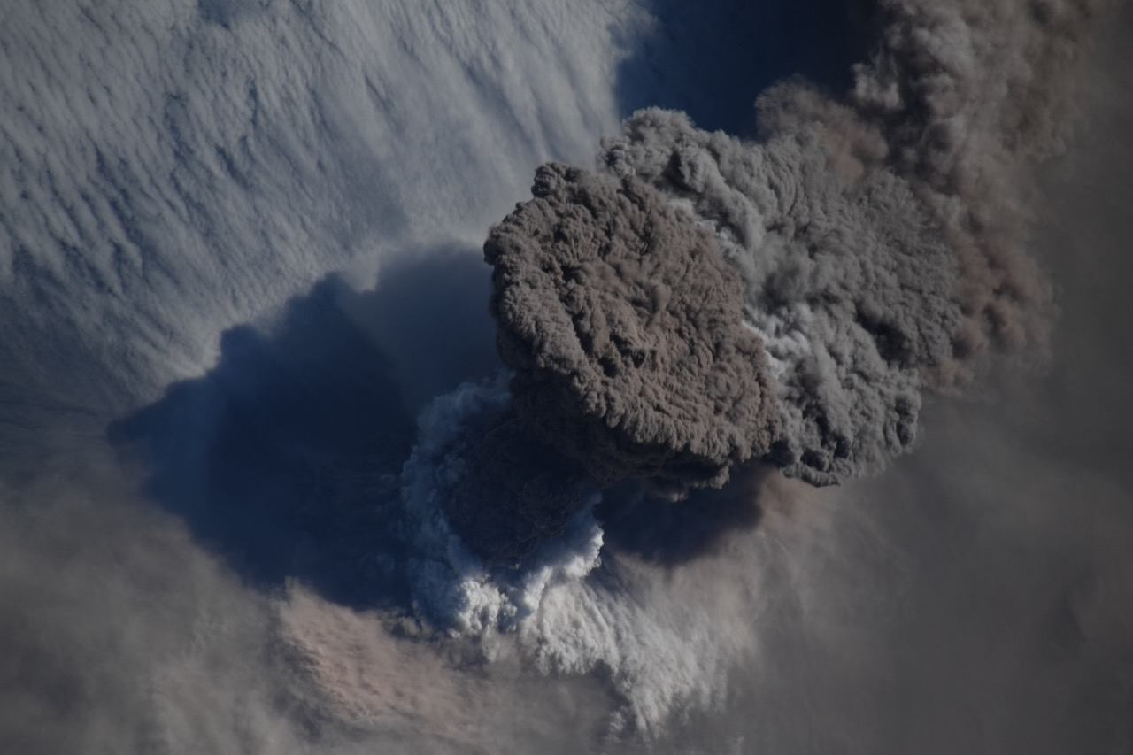
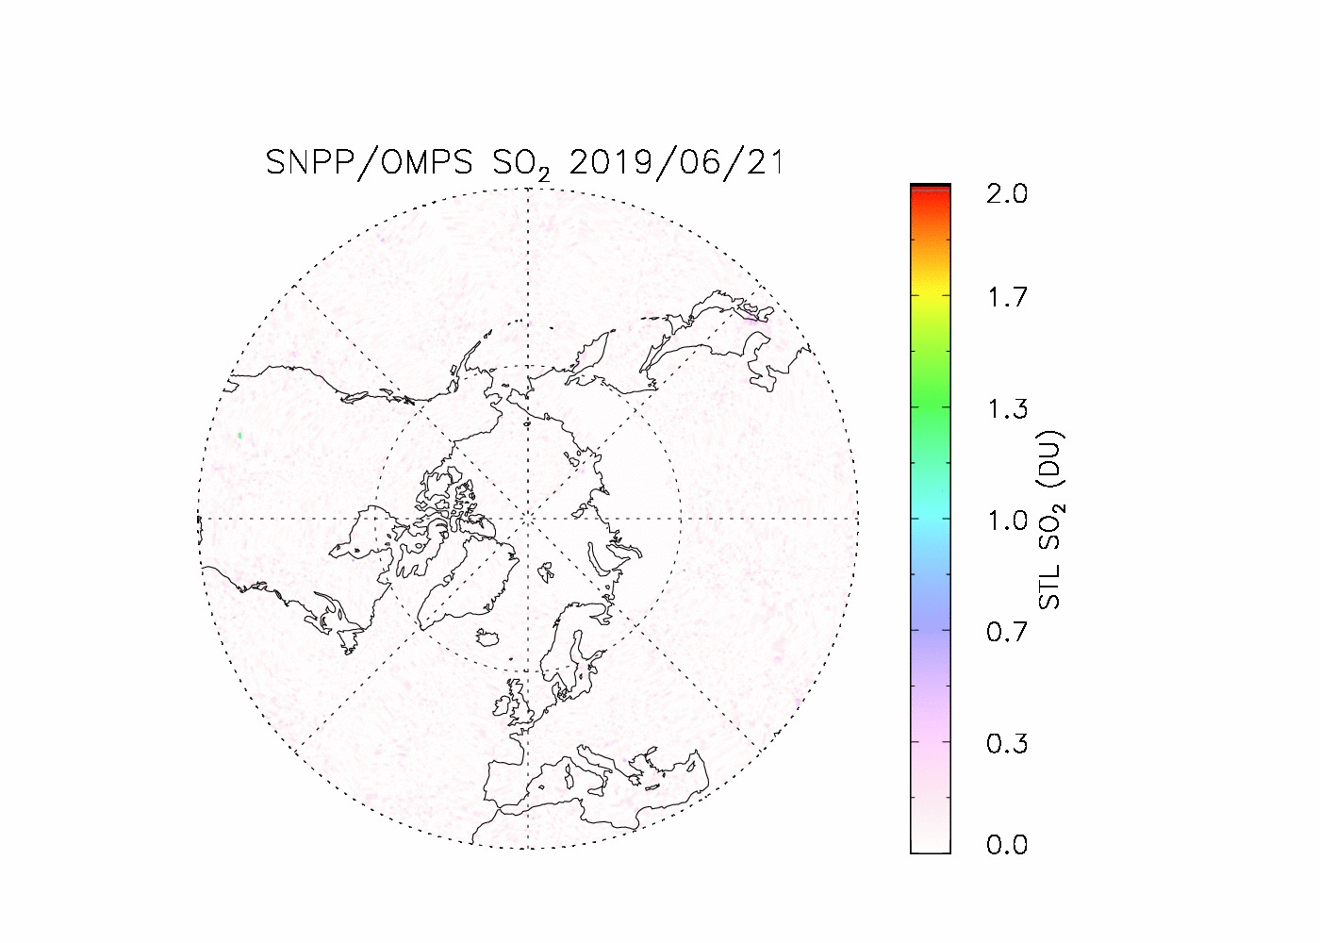
SNPP/OMPS tracks SO₂ cloud from June 21 Raikoke eruption
Backscattered solar UV radiation - daytime only coverage
Sulfur mine fire, Mosul Iraq
Raikoke volcano erupting
June 21 18:00 UTC –
June 22 morning local time
Credit: ISS photo
Stromboli eruption/ Etna SO₂ degassing
Notes:
Enabled NASA’s Direct Readout (DR) volcanic data in Partner’s Decision-Making
The NASA’s EOS-Aura and S-NPP satellites have Direct Broadcast (DB) capability, i.e. the ability to broadcast data at the same time as it is measured. This possibility is utilized in the FMI’s Very Fast Delivery (VFD) Service for monitoring atmospheric composition in almost real time, within 20 minutes after the overpass. The service started in 2006 processing Aura OMI surface UV and ozone data. After the eruption of the Eyjafjallajökul the system was updated in 2010-11 with volcanic ash and VSO2 data. During Y1 our team provided software for processing DR OMPS volcanic data. Currently both OMI and OMPS DR data are processed at Sodankyla (Fig.). The VFD covers Northern Europe, Russia and Arctic Ocean, but the coverage is restricted by the fact that the satellite has to be visible from the Sodankylä ground station in northern Finland.
Through the established partnership between GINA, NASA GSFC Direct Readout Laboratory (DRL) and SNPP’s Ozone SIPS in Y2 we started processing DR OMPS data from GINA ground station in Fairbanks, Alaska. UAF-GINA has provided access to direct broadcast SNPP data in raw format, maintained hardware to run the International Polar Orbiting Processing Package (IPOPP), maintained IPOPP and the Ozone Mapping and Profiling Suite (OMPS) Science Processing Algorithm (SPA), and provided NASA Direct Readout Labs (DRL) with products produced by IPOPP and the OMPS SPA. In Y2 an updated version of the IPOPP OMPS SPA processor software was installed. Data and products have been provided to NASA DRL and have been used to generate analyses of events. In May 2016 GINA started capturing DR data from Aura OMI passes on a new Orbital Systems 3-meter antenna. The data are transferred to FMI for processing and imagery generation.
In Y3 (2017) updated OMPS SO2/AI Science Processing Algorithm (SPA) OMSNadir (v2.1) has been delivered to DRL, tested, proven operational and distributed to user community for operational processing. Extensive development was necessary for the OMSNadir prototype version (v2.0) since it also included alignment with the unique ACPS data formats defined to enhance scientific use and long-term record continuity. This approach insured NASA DR data are in sync with NASA’s scientific processing environment at ACPS. DRL continues working closely with GSFC’s Ozone SIPS to integrate updated OMSNadir (v2) SPA into NASA’s International Polar-Orbiter Processing Package (IPOPP) and to obtain feedback from collaborators at FMI and co-Is at GINA/UAF, as well as additional international collaborators. The new OMSNadir (v2.1) SPA improved measurement quality, as well as added features for the higher resolution processing when these data are made available in the downlink from the SNPP and JPSS-1 platforms. The SPA will be maintained by DRL and Ozone SIPS and updated when necessary as defined by user needs.

Slide 11
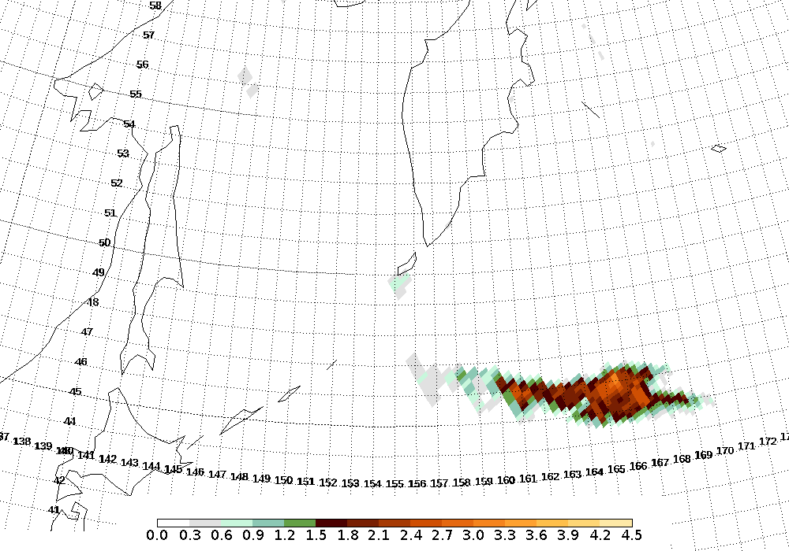
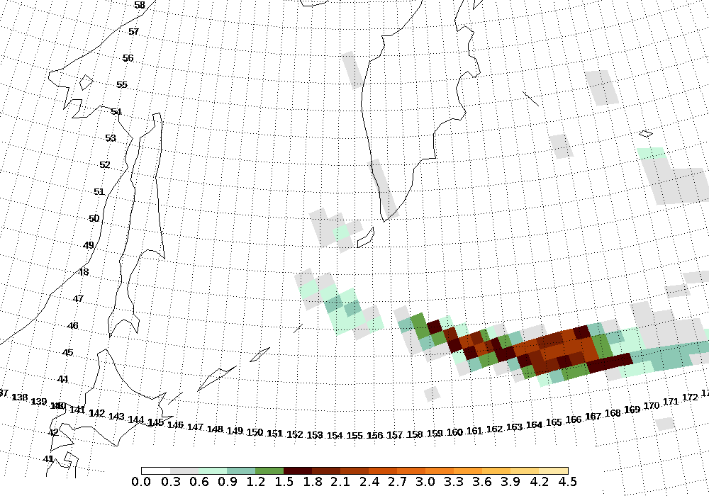
Why NOAA 20 OMPS? – UV Ash Index
Ash cloud from the eruption of Raikoke, 23 June 2019
NOAA 20 OMPS Aerosol Index
S-NPP OMPS Aerosol Index
S-NPP OMPS has 50x50 km FOV at nadir, NOAA 20 has 12.5x12.5 km FOV at nadir
9/3/19
11

Slide 12
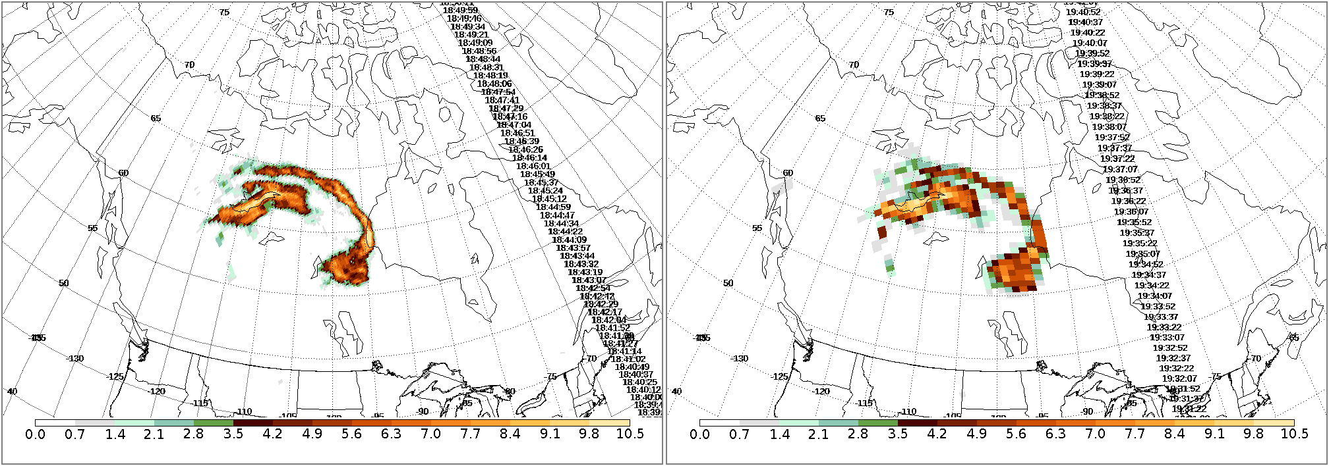
Why NOAA 20 OMPS? - UV smoke index (above clouds)
Smoke from Alberta fires, 20 May 2019
NOAA20 OMPS Aerosol Index
SNPP OMPS Aerosol Index
S-NPP OMPS has 50x50 km FOV at nadir, NOAA 20 has 12.5x12.5 km FOV at nadir
9/3/19
12

Slide 13
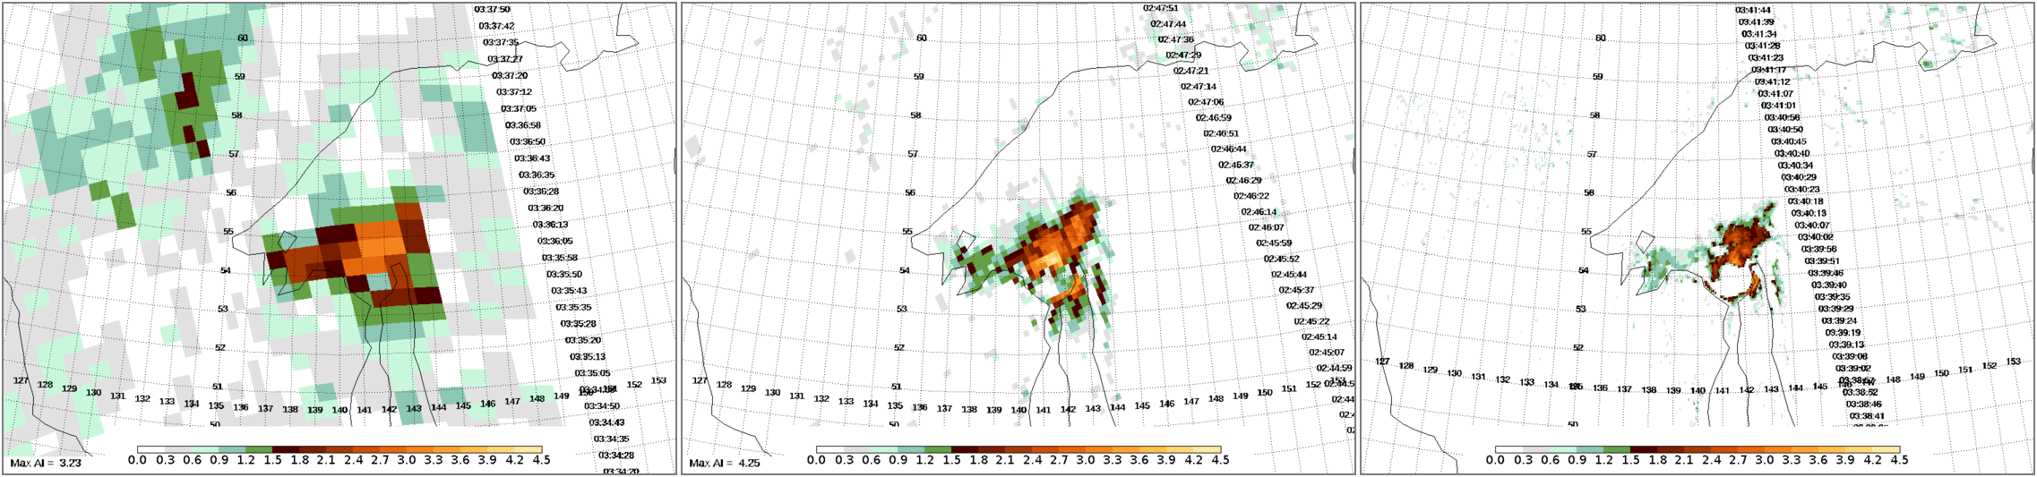
ESA/EU Sentinel 5 precursor (TROPOMI) currently has the highest ground resolution - 5.5km x 3.5km
Smoke from a pyroCb event in Russia, 1 May 2019
S-NPP OMPS
NOAA 20 OMPS
TROPOMI
9/3/19
13

Slide 14
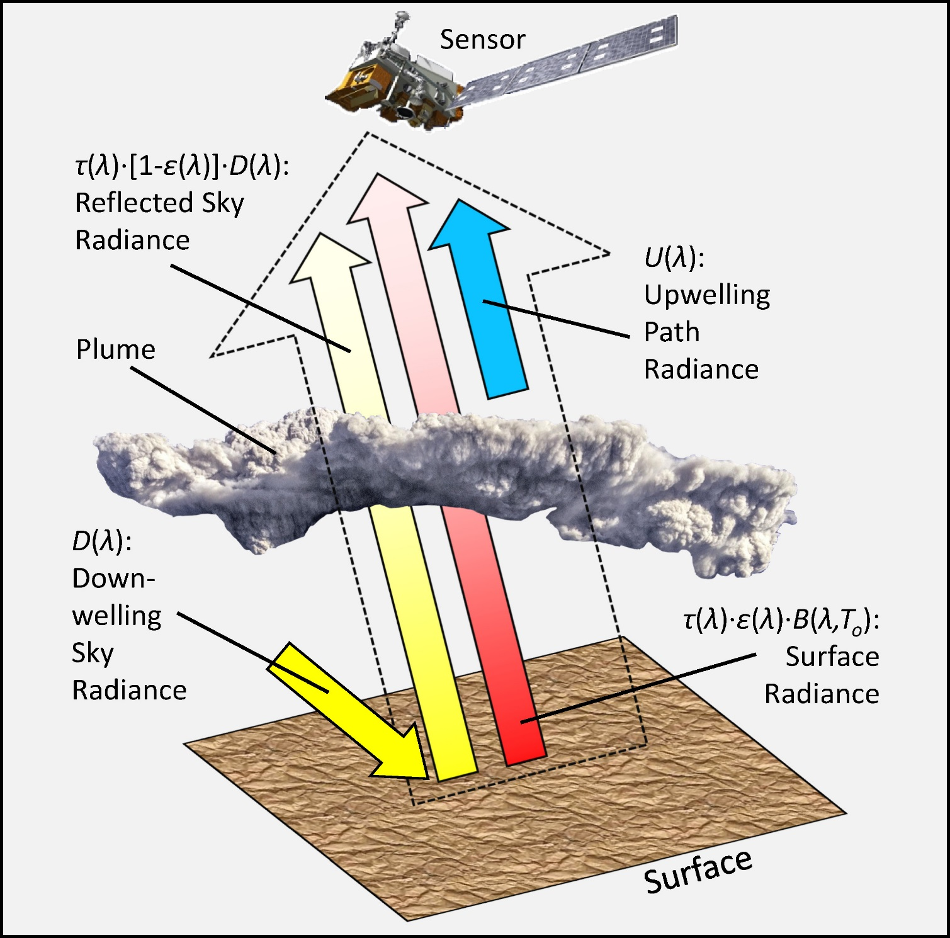
Day and Night TIR Remote Sensing of Volcanic Plumes
Detect plumes through transmission [t(λ)] - the attenuation of surface radiance passing through the plume en route to the sensor
The observed radiance (outlined arrow) includes the surface radiance (red arrow), reflected sky radiance (yellow arrow), and upwelling path radiance (blue arrow)
Transmission, sky radiance [D(λ)], and path radiance [U(λ)] are estimated through radiative transfer (RT) modeling

Slide 15
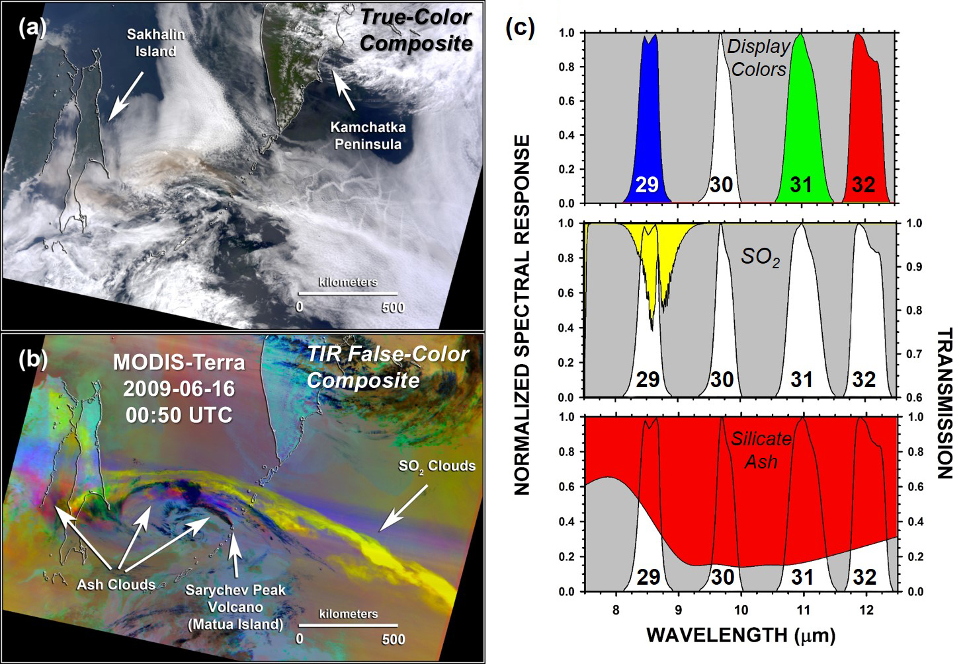
MODIS Observation of Sarychev Peak Volcano: 16 June 2009
True-color composite.
Volcanic plumes and meteor-ological clouds have similar appearance at visible wavelengths
(b) False-color composite of TIR data from Channels 32, 31, and 29, displayed in red, green, and blue.
SO₂ plumes appear yellow, while the display colors of ash plumes range between red and magenta
(c) Transmission spectra of SO₂ (middle) and silicate ash (bottom), superimposed on the spectral response of MODIS Channels 29, 30, 31, and 32

Slide 16
Day-night coverage:
Raikoke SO₂ data from MODIS-Terra, MODIS-Aqua, and VIIRS
• MODIS/VIIRS combination provides frequent day-night coverage of high-latitude volcanoes at fine spatial resolution: 1 km (nadir) for MODIS; 750 m for VIIRS
• Example of low-latency SO₂ BTD detection product: BT @ 8.6 μm channel – max BT over all
• Procedure (VIIRS-TIR) has been implemented at Direct Readout Laboratory

Slide 17
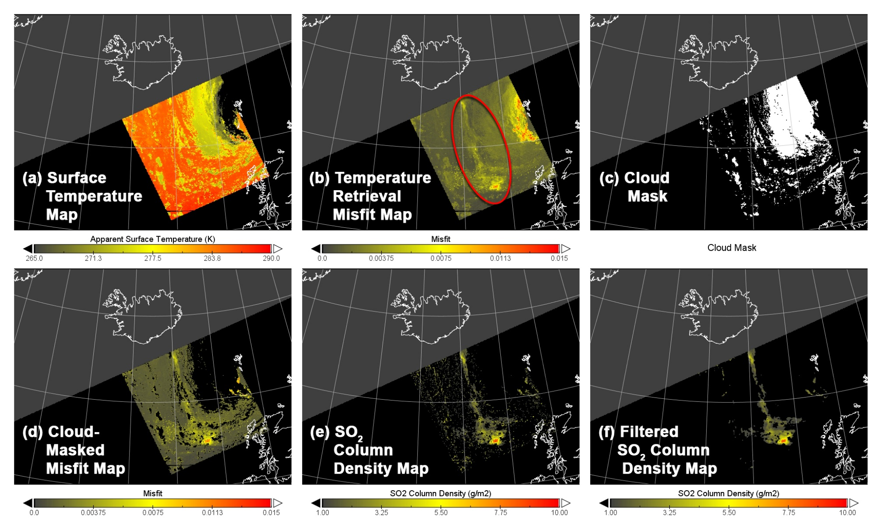
Narrative Description of TIR-SO₂ Retrieval Procedure
Surface temperature estimation does not consider volcanic plumes or met. clouds
Misfit map shows the locations of plumes (red oval) and met clouds
Met clouds are identified by comparing apparent surface temperature with air temperature at plume altitude
Combination of cloud mask and misfit map improves the detection of volcanic plumes
Estimation of SO₂ column density is confined to the locations identified by the masked misfit map
SO₂ map is filtered to minimize the “holes” corresponding to the locations of met clouds

Slide 18
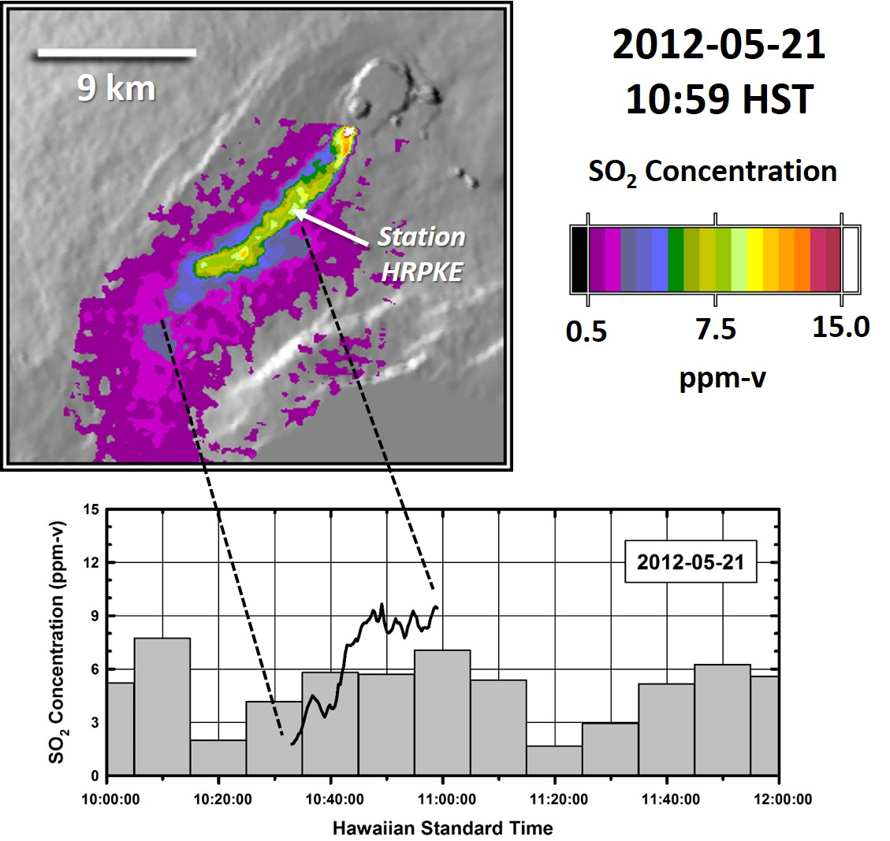
Kilauea Volcano: Field Validation of TIR-SO₂ Retrieval Procedure
Comparison between ASTER-based estimates of SO₂ concentration and the concentrations measured at ground level (Station HRPKE) at the time of the ASTER overpass.
The heavy line superimposed over the ground measurements (bar chart) represents a time-series of ASTER-based concentration estimates, based on measurements of wind speed and distance along the ASTER profile.
The ASTER time series is within ±50% of the corresponding ground-level concentrations.
Ground-level concentration measurements courtesy of USGS-Hawaiian Volcano Observatory

Slide 19
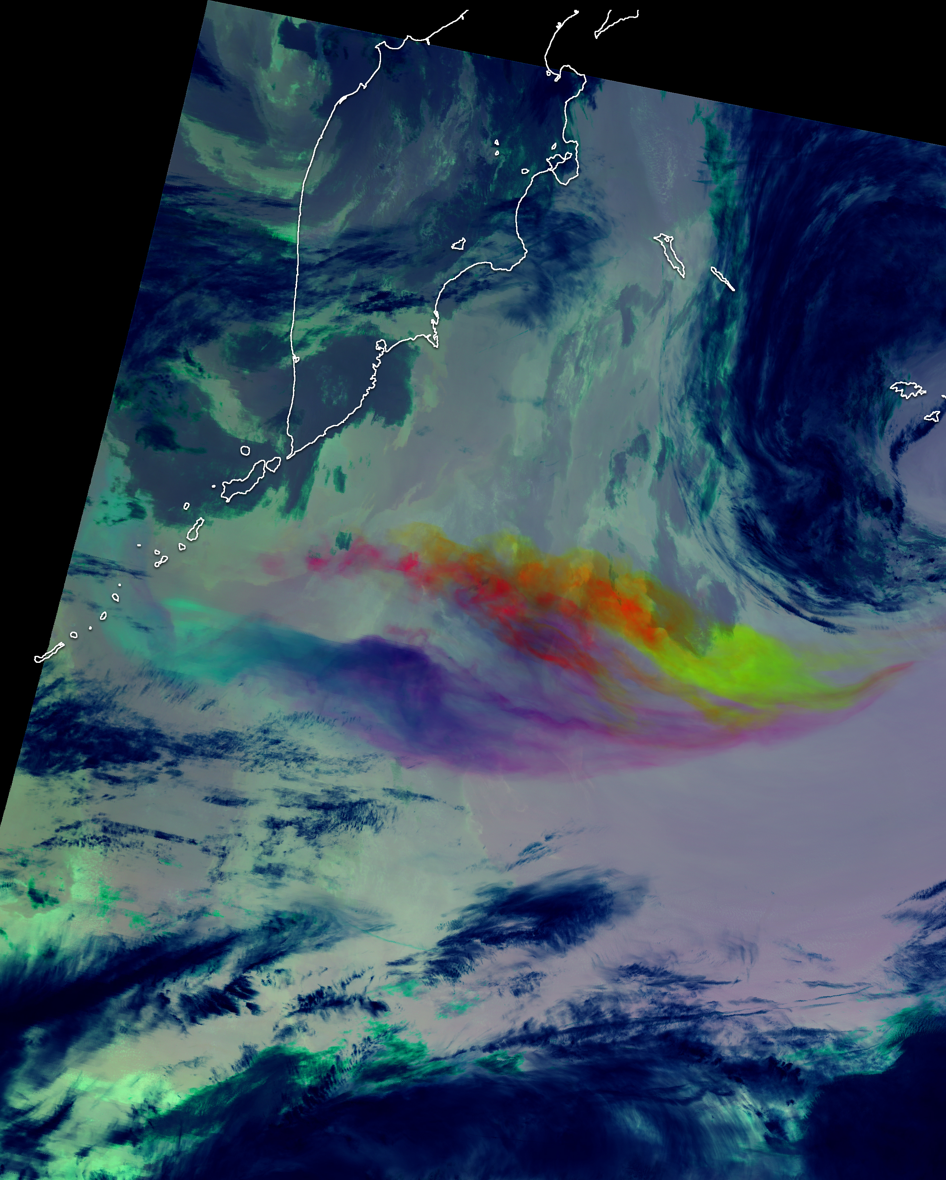
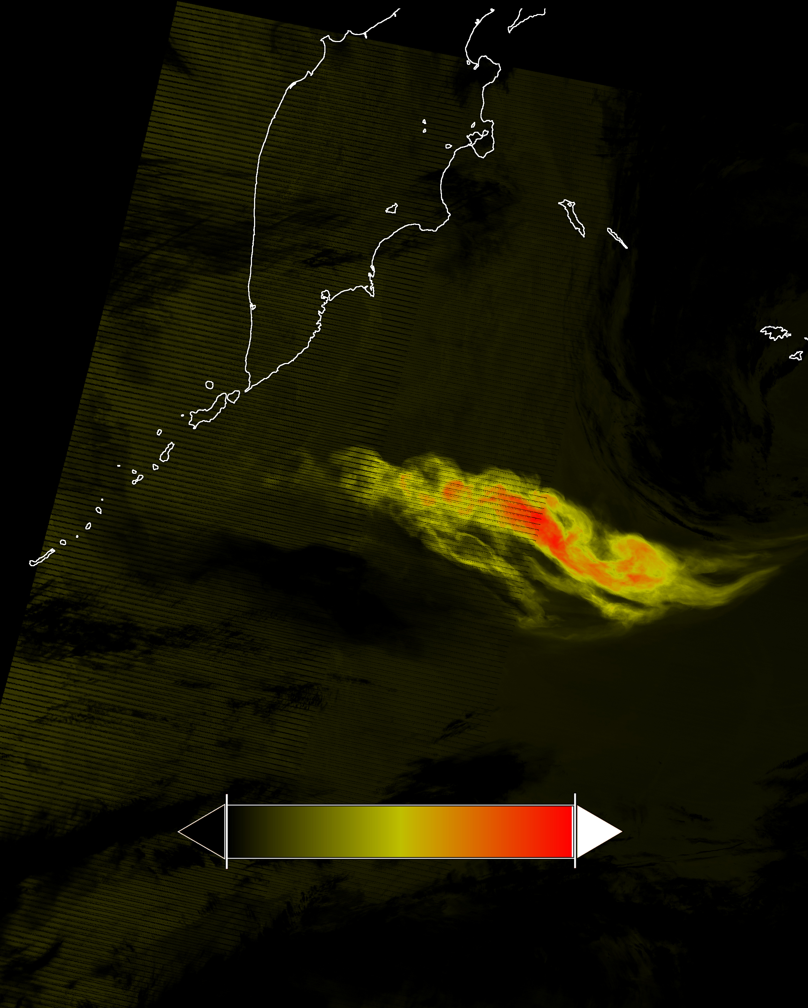
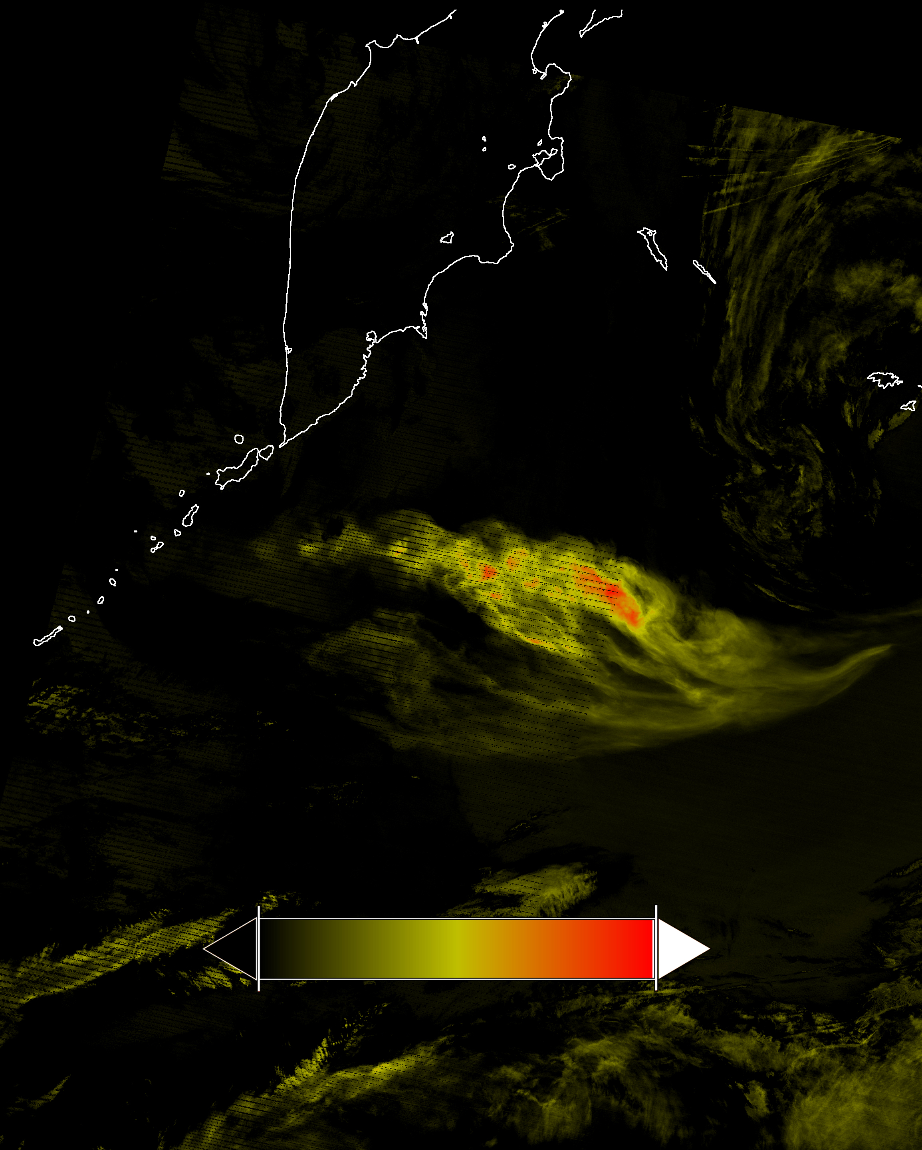
VIIRS Observations of Raikoke: 22 June 2019 – 14:30 UTC (Night)
Overlapping SO₂ and
ash (displayed in orange)
Potential over-estimation of SO₂ due to presence of ash
0 DU 1750
0 BTD (K) 40
0 BTD (K) 8
D-Stretch Color Composite
Disperse clouds transmitting
in the TIR; reveals separation of ash (red/purple) and SO₂ (yellow)
SO₂ (M14) Brightness Temperature Difference
Ash (M15) Brightness Temperature Difference

Slide 20
TIR-SO₂ Mass Retrieval Uncertainties

Slide 21
Latency of TIR-SO₂ retrievals
TIR technique

Slide 22
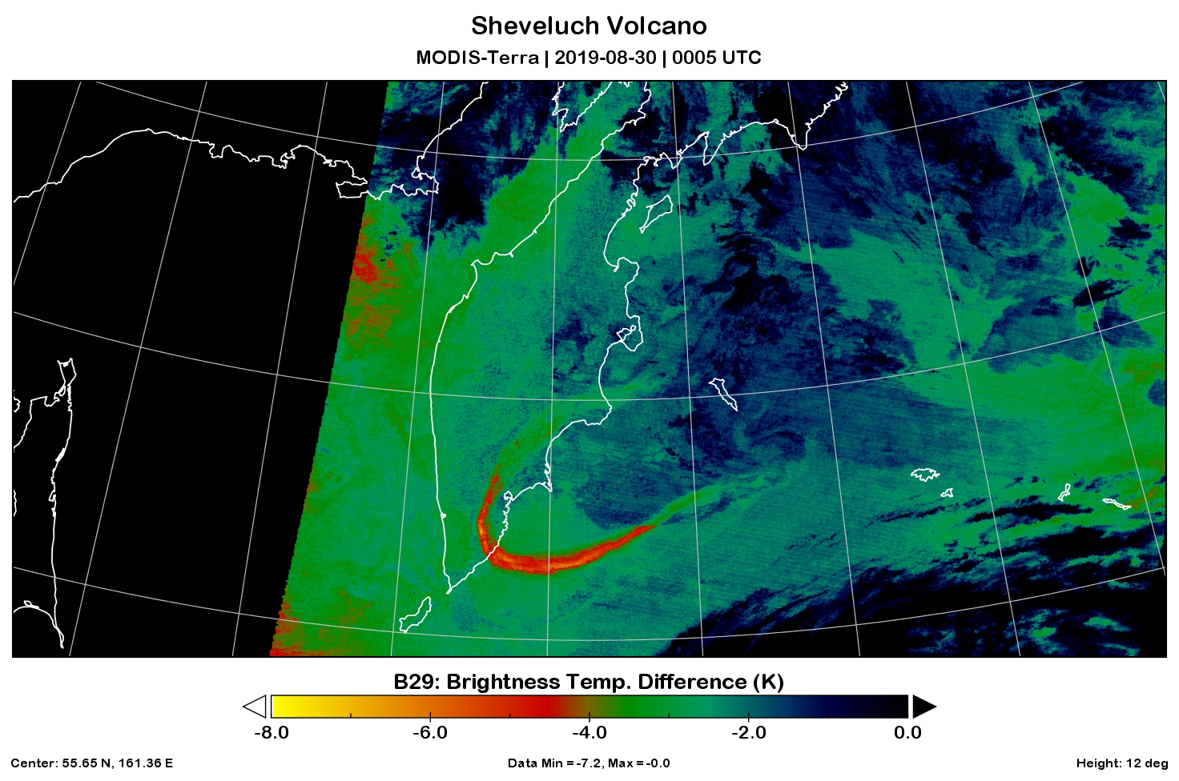
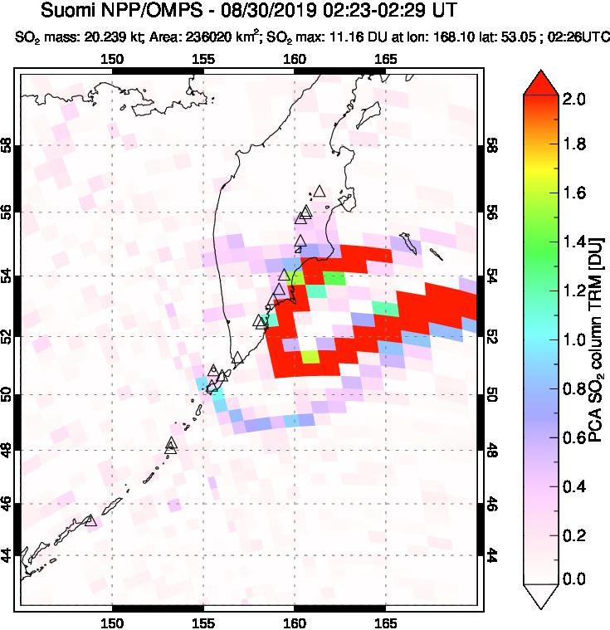
Combining UV and TIR Observations of Sheveluch: 30 August 2019
MODIS-Terra
00:05 UTC

Slide 23
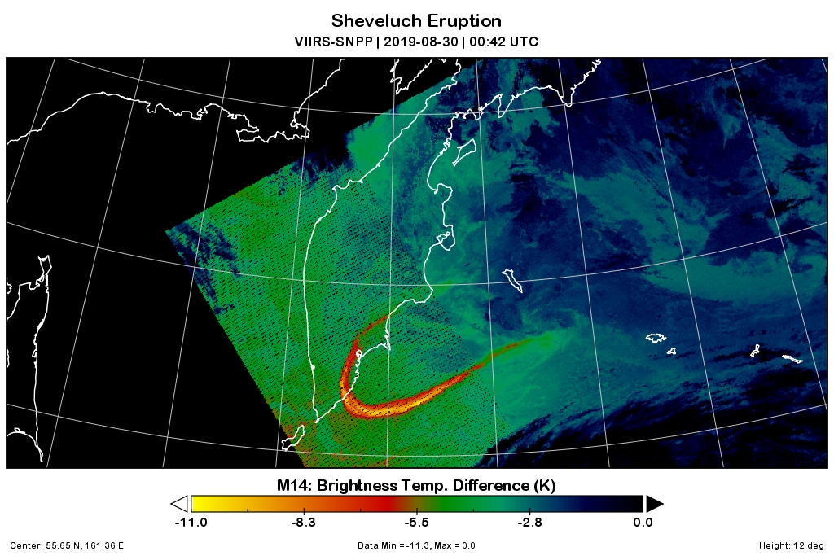
Terra/Aqua/SNPP Observations of Sheveluch: 30 August 2019
VIIRS-SNPP
00:42 UTC

Slide 24
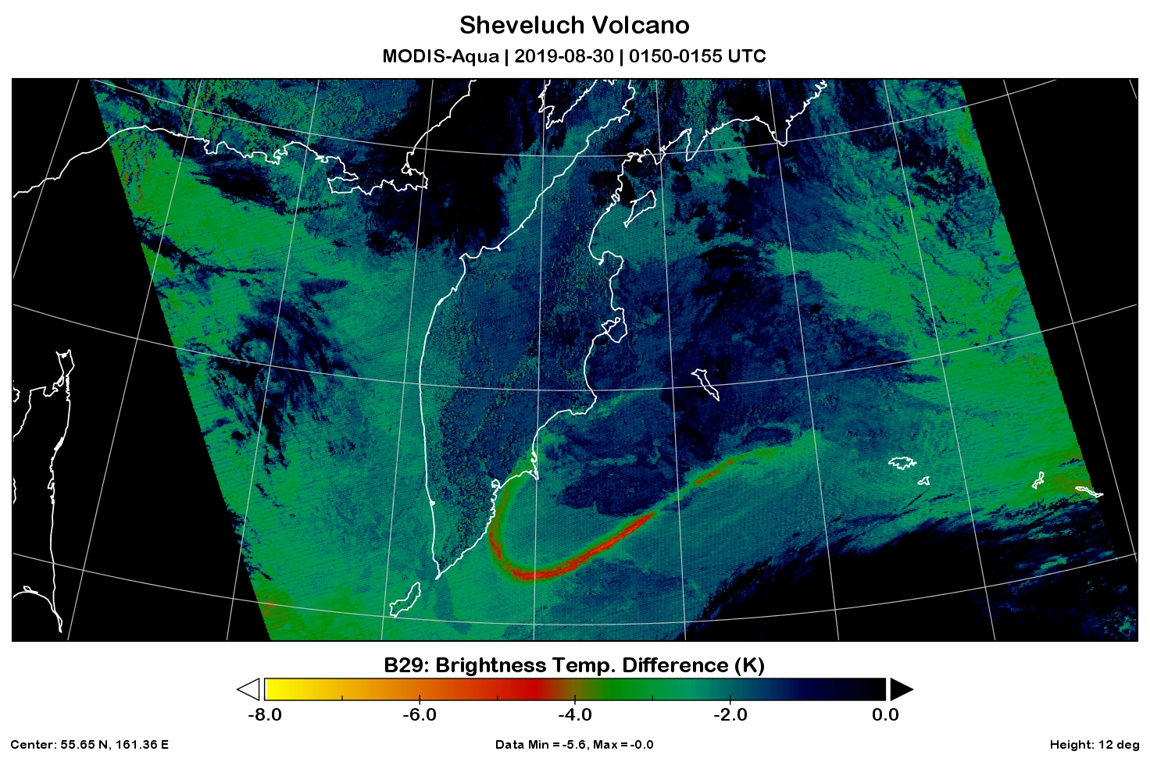
Terra/Aqua/SNPP Observations of Sheveluch: 30 August 2019
MODIS-Aqua
01:50 UTC

Slide 25
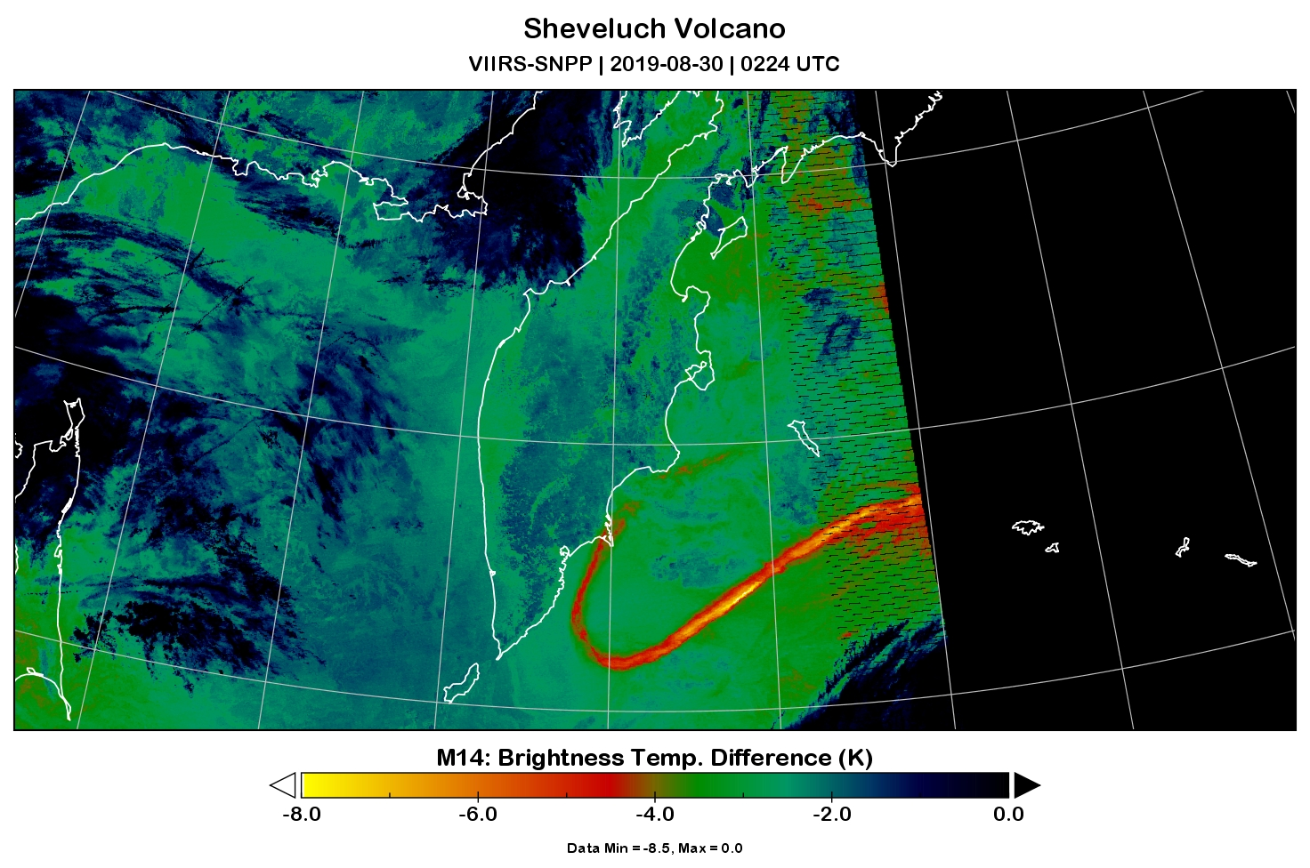
Terra/Aqua/SNPP Observations of Sheveluch: 30 August 2019
VIIRS-SNPP
02:24 UTC

Slide 26
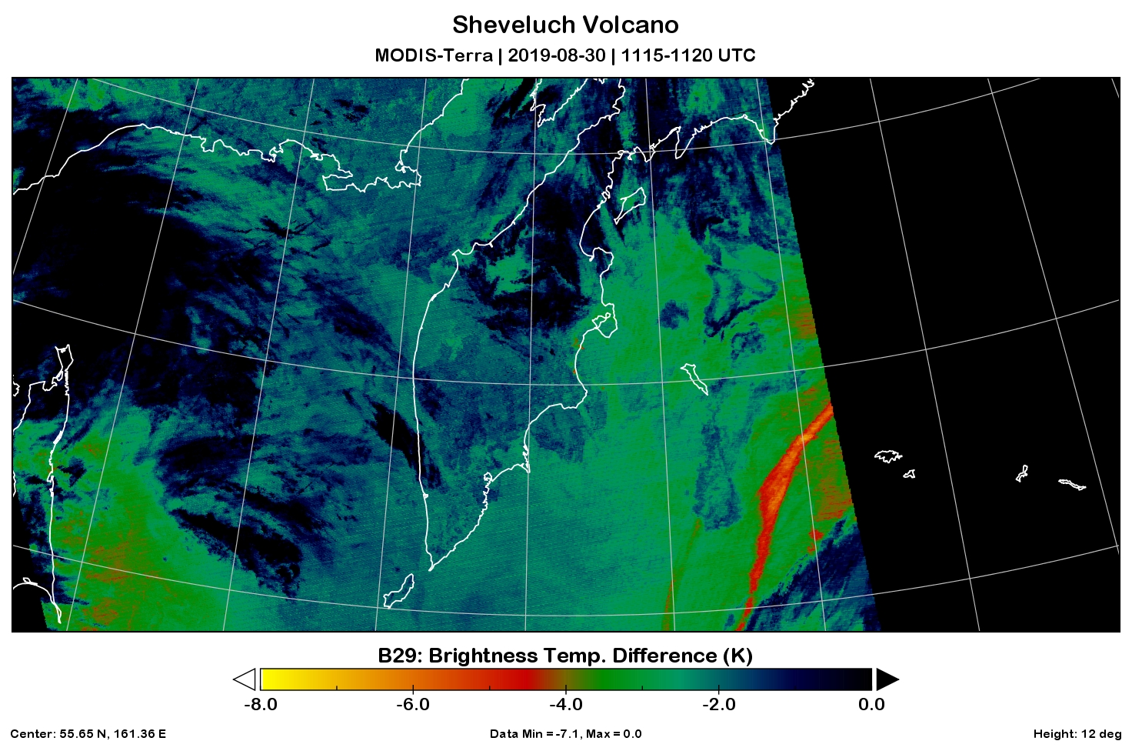
Terra/Aqua/SNPP Observations of Sheveluch: 30 August 2019
MODIS-Terra
11:15 UTC

Slide 27
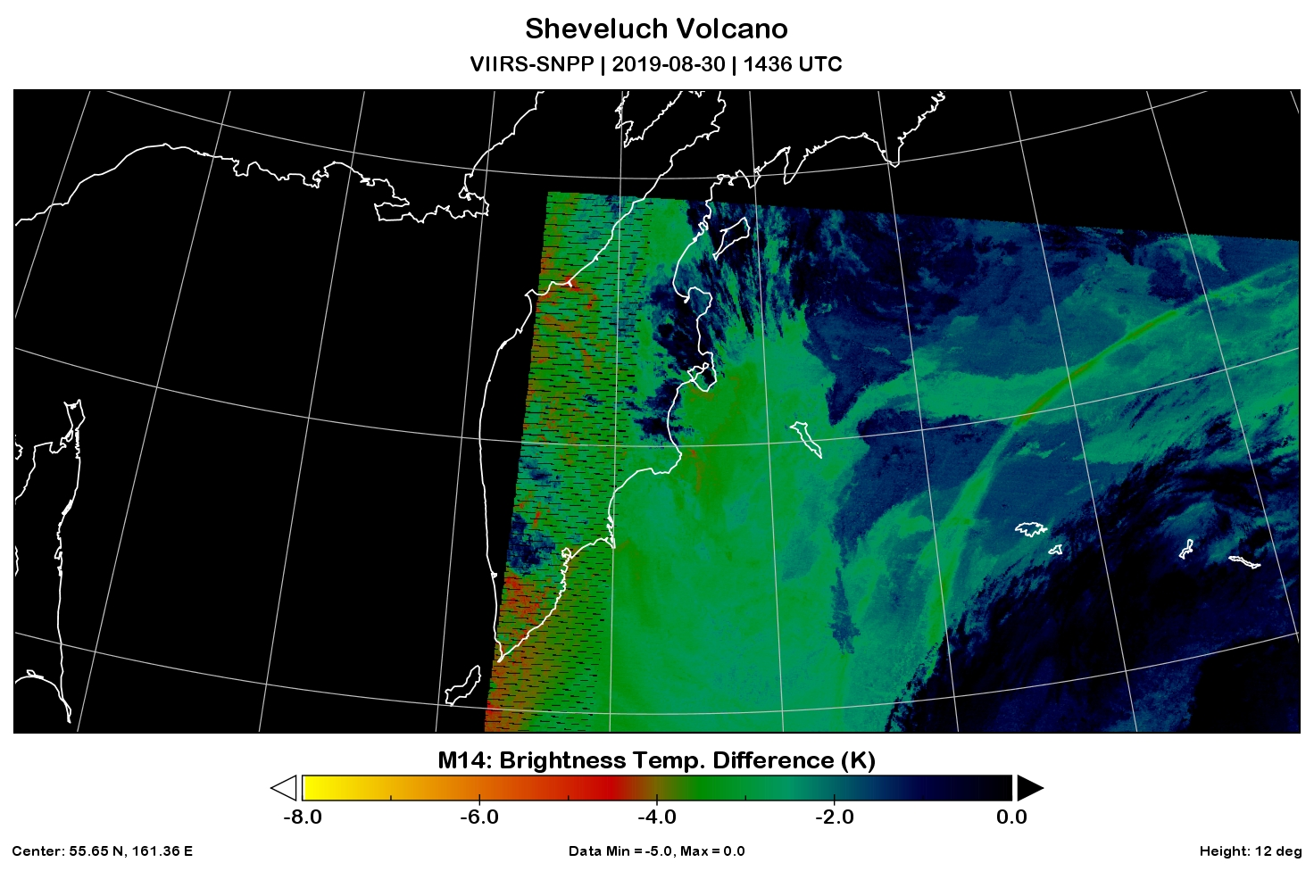
Terra/Aqua/SNPP Observations of Sheveluch: 30 August 2019
VIIRS-SNPP
14:36 UTC

Slide 28
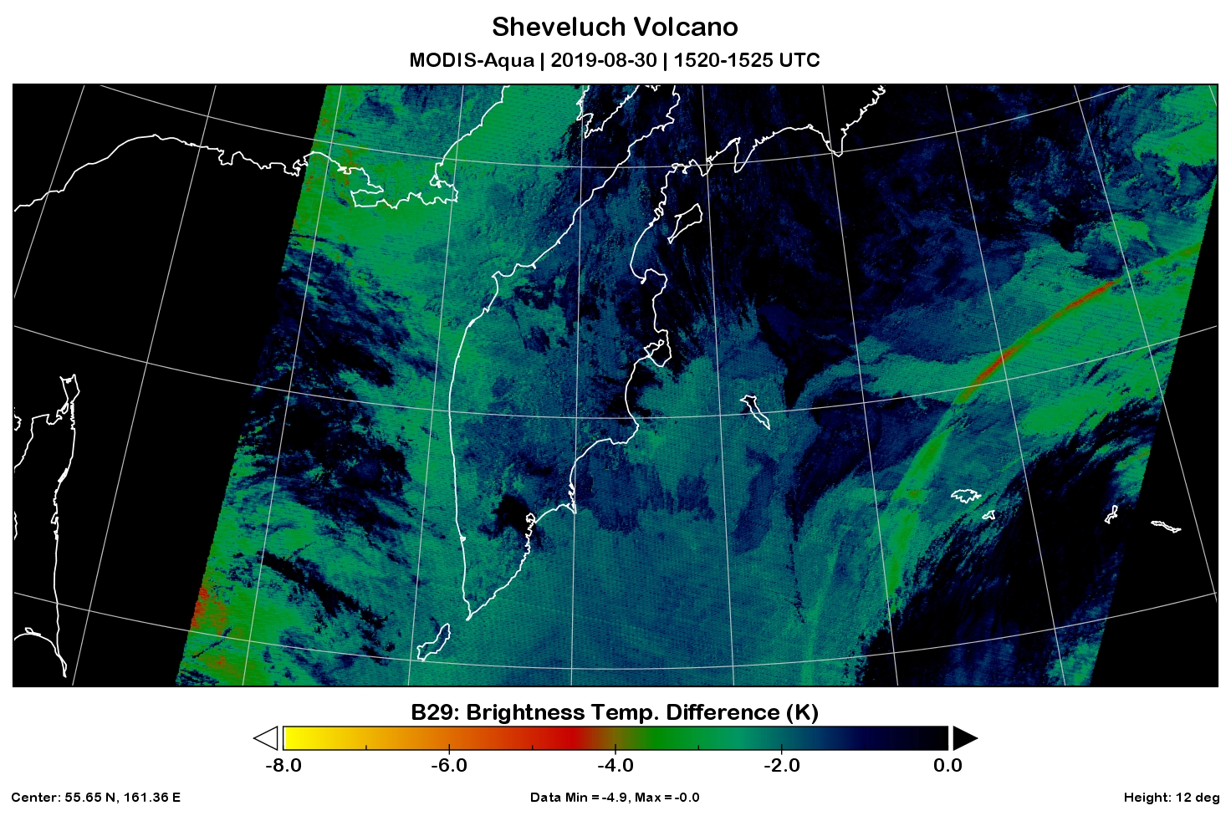
Terra/Aqua/SNPP Observations of Sheveluch: 30 August 2019
MODIS-Aqua
15:20 UTC

Slide 29
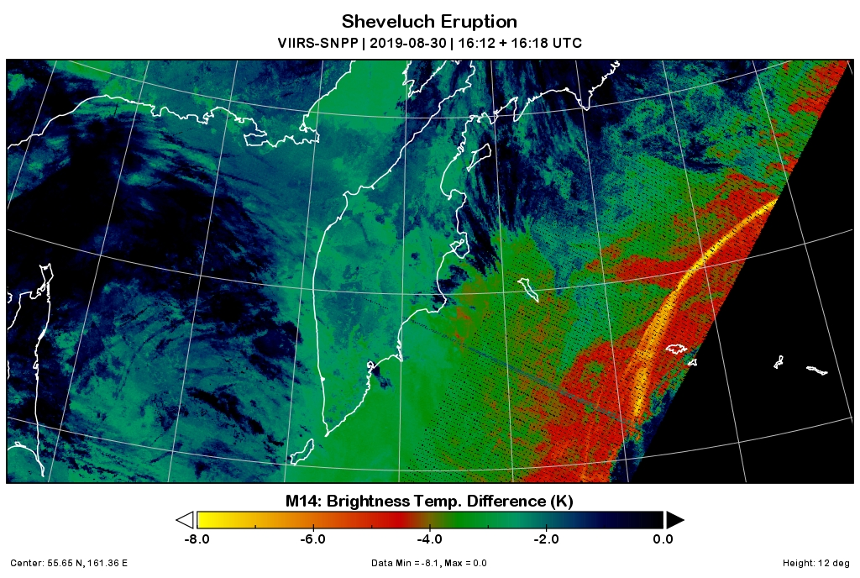
Terra/Aqua/SNPP Observations of Sheveluch: 30 August 2019
VIIRS-SNPP
16:12 UTC

Slide 30
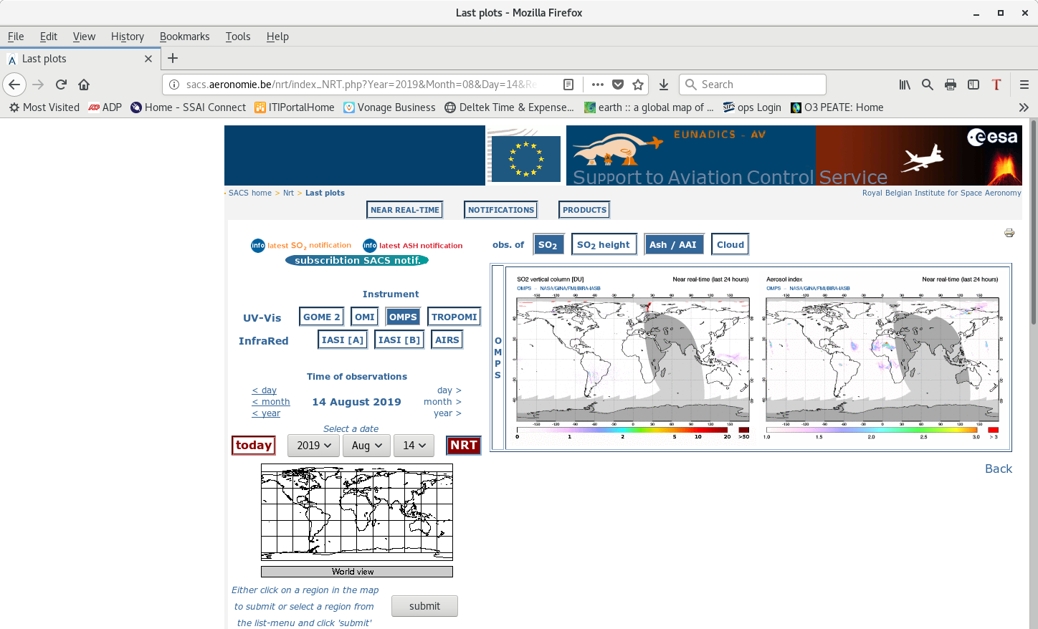
Support to Aviation Control Service (SACS)
SACS combines both NRT and DR volcanic SO₂ and ash data from UV and TIR polar orbiting satellites
9/3/19
30
Notes:
30

Slide 31
Summary
  Both Real-Time (DR) and Near Real-Time (NRT) distribution of NASA’s volcanic SO2 and Aerosol Index data offer access to MODIS/VIIRS/OMI/OMPS data to a large (and increasingly diverse) community of users
    NASA Applied Sciences program is a growth area
    The ability to support Applied Sciences with DR MODIS/VIIRS and OMPS/OMI volcanic So2 and ash products
  Development of low latency quantitative SO₂ and ash column mass products increases their visibility and value
9/3/19
31

