Slide 1
Welcome to the NASA Direct Readout Conference (NDRC) Webinar Series
The webinar will begin at 11:00 EDT/15:00 UTC

Slide 2
NASA Direct Readout Conference (NDRC) Webinar Series
Active Fire and MAIAC SPA/Product Updates May 29, 2018
Notes:
This webinar is an effort by NASA Goddard Space Flight Center Direct Readout Laboratory, NASA Land PIs and the NASA Direct Readout Conference Organizing Committee.
Thanks to Kelvin Brentzel and Bob Kannenberg of NASA DRL for supporting the logistics for this webinar (WebEx, telecon, etc.) and providing other technical support.

Slide 3
NDRC Webinar Ground Rules
Communications with presenters
Questions to each presenter will be coordinated by moderator (Brad Quayle), where you will be called on to speak
Please send questions to moderator via chat at any time
Conference call
Please keep your phone muted at all times unless called on by moderator
Webinar input/feedback
Input from participants is valued and requested
Please complete the post-webinar survey, where you will also have opportunity to influence future NDRC webinar topics
Notes:
For the benefit of all participants, please adhere to the following ground rules
Communications:
A Q&A period will be provided at the end of each individual presentation to receive verbal questions/comments.
The WebEx chat function can be used at anytime to submit questions/comments to myself and I will queue them to the presenters.
Phones:
Please mute your phones and do not put your phone on hold
Feedback:
As part of the feedback cycle and to receive necessary input for future NDRC webinars, we will be soliciting input from participants.
Given the large number of participants, we will not likely be able to accommodate a lenghthy discussion regarding future webinar topics and ask that you provide that input via the WebEx chat, email, and the post-webinar survey we will be distributing.

Slide 4
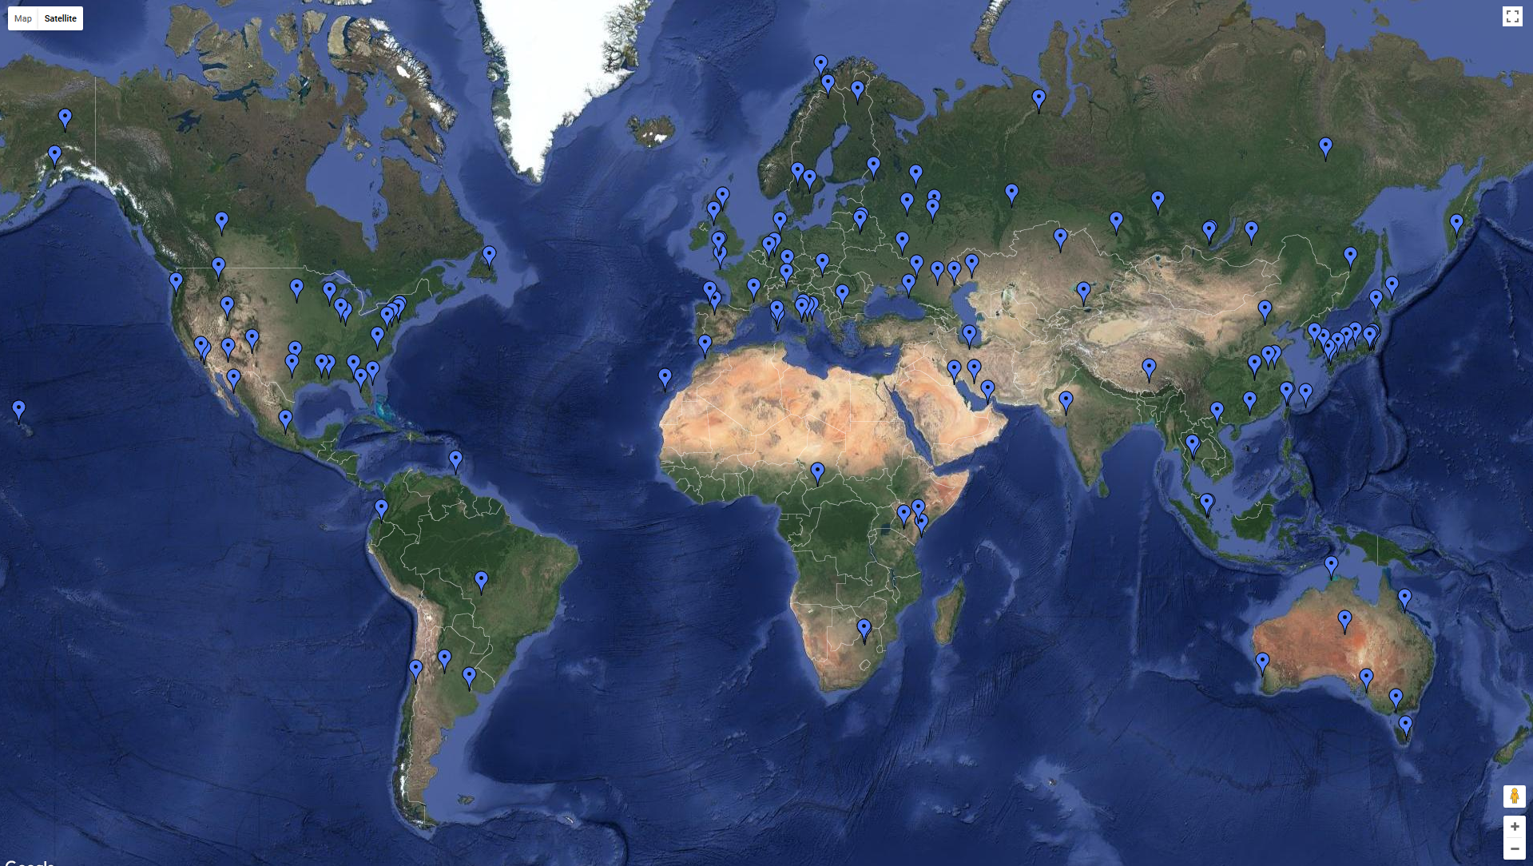
Direct Readout Locations
Ground Station Inventory Courtesy of NASA DRL
163 confirmed X-band direct readout ground stations world-wide
Notes:
Here is an update on the distribution and number of X-band ground stations world-wide.
There are currently 163 direct readout stations world-wide (~30% increase relative to the number of sites that were documented in 2016).
Some sites also have L band capability (HRPT sites). Most collect EOS and S-NPP/JPSS-1 DB data.
~Half of current ground stations are operated by government agencies, 1/3 by academia.

Slide 5
Direct Readout – Expanded Definition
Direct Readout (DR):
No longer just considered acquisition of direct broadcast from Earth observation satellites
Availability of remote sensing observations and derivative data products ranging from at time of observation (real time) to 3 hours after observation (near real-time)
Includes all available near real-time (NRT) data sources
Notes:
For the context of this discussion, and NDRC activities in general, the definition of “direct readout” has been expanded to include all sources of near real-time observation data and derivative products.
Examples of other types of non-direct readout data sources include:
NASA LANCE which provides EOS/S-NPP data <3 hours post-observation
ESA Sentinel Online services/data hubs which provide S3 data products <3 hours post-observation.
NOAA CLASS which provides polar and geostationary products with slightly more latency (3-6 hours)

Slide 6
NDRC Background
NASA Direct Readout Conference (NDRC)
Nine NDRC events held since 1997
International audience
Focus on all sources of DR/NRT data
NDRC Purpose
Provide awareness and exchange of remote sensing science research
Highlight associated applications that leverage low latency data
Demonstrate and provide access to enabling technologies
Foster collaboration to improve and/or enhance decision support systems (DSSs)
Notes:
NASA has held a sequence (9) direct readout conference events since 1997.
These are international events with participants from all over the world.
First conference was held at JPL in 1997 and the most recent, NDRC-9, held in 2016 in Valladolid, Spain.
The purpose of NDRC meetings is multi-faceted:
Increase awareness on state of the art RS research and product development
Provide examples of how NRT data are used in applications and DSSs to meet specific operational needs
Demonstrate new/updated technologies for the processing/visualization of DR/NRT data (data processing frameworks, exporting data to GIS-compatable formats, etc.)
Increase coordination among the global community, particularly identifying common interests and fostering collaboration (i.e. adoption of applications, data sharing, etc.).

Slide 7
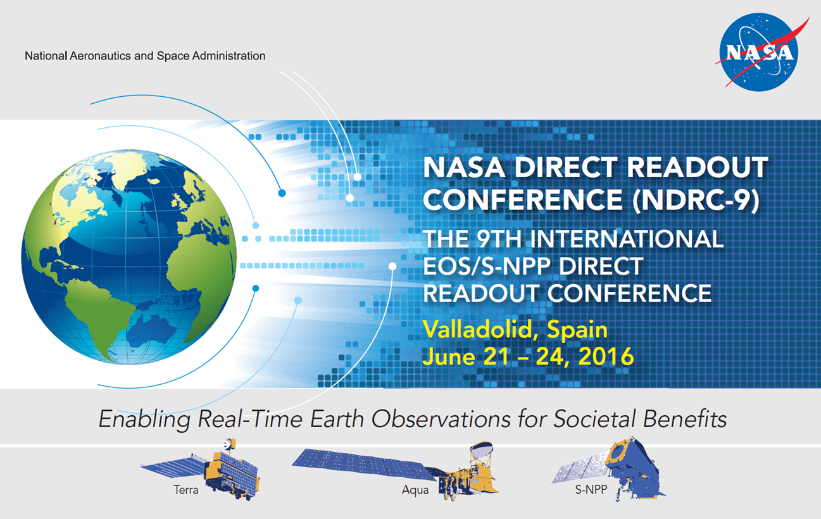
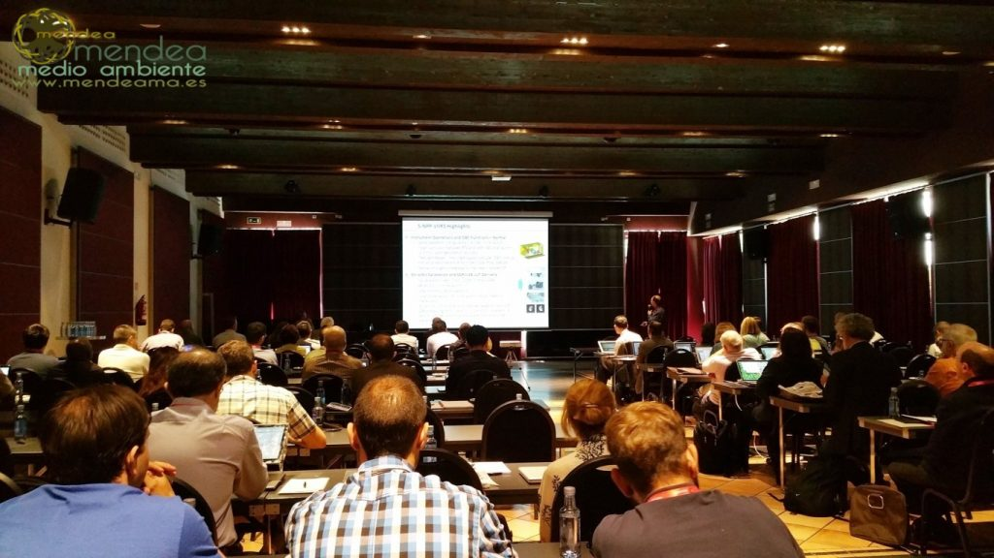
NDRC-9
Science and cross-cutting technologies with DR/NRT data
Environmental prediction and monitoring
Hazard mitigation/response
Data processing and visualization
Mission/instrument status updates
EOS, S-NPP, JPSS-1
Mission data delivery systems
NASA LANCE, ESA Sentinel
Science and application workshops with disciplinary emphasis
Land, Oceans and Atmosphere
Notes:
NDRC-9 was held June 21-24, 2016 in Valladolid, Spain and hosted by Remote Sensing Laboratory of the University of Valladolid, LATUV.
Approximately 190 attendees from 35 countries participated in NDRC-9.
A one day plenary session focused on how DR/NRT data are being used for science and management/response applications, available technologies for processing and visualizing data, status update of missions of interest, and available agency data dissemination streams/mechanisms (LANCE, ESA, etc.).
The three subsequent days each provided a discipline-specific workshop focusing on the use of real-time data derived from low latency observations to meet specific information needs.
Workshops consisted of presentations by PIs on the state of current science processing algorithms and data products as well as additional presentations by agency/organization representatives on decision support systems that use direct readout and/or other sources of low latency observation data and products.
Please access the NASA DRL website for conference presentations and proceedings.

Slide 8
NDRC Webinar Series
Objective(s)
Bridging activity between NDRC meetings.
Provide a “virtual” forum for ongoing communications among
DR/NRT data practitioners
Organizations that conduct relevant DSS operations
End user community
Planned Frequency and Topics
Will address and solicit input from webinar participants later in today’s wrap up session
Notes:
What are the motivations behind the NDRC webinar series?
Conferences and opportunities for the DR/NRT community to meet are fewer and farther between.
Also, given that technologies and data sources are constantly evolving, there is a need to provide a forum for ongoing communications among NRT data practitioners and organizations that provide DSSs and end users
Consequently, NDRC organization committee is launching the concept of the NDRC webinar series to address this need.
The topics of these webinars will be driven by the participants/global community, but will generally focus on the status/updates on relevant science, algorithms, technologies, applications and systems.
Land discipline data/applications, associated atmosphere data/applications and broader cross-cutting topics will likely be the primary focus of the webinars, but they can be expanded to include other applications/topics.
We will spend some time at the end of today’s webinar discussing future webinar topics and asking for your input.

Slide 9
Today’s Agenda
Fire Science Algorithms and Products Update for Low Latency Applications/Users
Presented by Louis Giglio (NASA/GSFC)
Status of the Multi-Angle Implementation of Atmospheric Correction (MAIAC) Algorithm for Low Latency Applications/Users
Presented by Alexei Lyapustin (NASA/GSFC)
Meeting Wrap Up and Planning for Next Webinar
Brad Quayle
Please hold verbal questions until the end of each individual presentation.
Written questions can be submitted anytime via chat to Brad Quayle or Bob Kannenberg.
Notes:
For today’s agenda, we have presentations on two land science algorithms and products by two NASA PIs, Louis Giglio and Alexei Lyapustin from NASA Goddard Space Flight Center.
Louis will be presenting about the status of fire science algorithms and products for MODIS and VIIRS that are available in the near real-time environment as well as other sensors with potential to provide fire data for low latency applications.
Alexei will and that will be discussing the MAIAC algorithm which is currently being ported into near real-time processing frameworks by NASA and its associated derivative products.
Presentations will be ~45 minutes each followed by 15 minute Q&A period. Questions can be received verbally or submitted via chat.
Please also note that presentations will also be made available after today’s webinar along with meeting notes on the NASA DRL website.

Slide 10
<Presentations>
Notes:
Presentations will be ~45 minutes each followed by 15 minute Q&A period

Slide 11
Meeting Wrap Up
Next Steps
Establish schedule/frequency of webinars
Identify desired topics for future webinars
Identify presenters
Participant input/recommendations are desired and essential
Notes:
We hope you have benefited from these presentations today.
At this time, I would like to briefly discuss considerations for future NDRC webinars, including their frequency/schedule and desired topics.
We would like the presentation of topics to be determined by webinar participants, so your input and recommendations are highly desired.

Slide 12
Meeting Wrap Up
Webinar Frequency
Semi-annual to quarterly basis
Future Webinar Topic Areas
Updates on relevant remote sensing science, algorithms and data products
Demonstrate relevant technologies for DR/NRT data
Status and availability of DR/NRT data sources
Spotlight applications and DSSs that use DR/NRT data
Collaboration opportunities (data sharing, Cal/Val activities, feedback to space agencies, etc.)
Notes:
Based on anticipated interest and participation, webinars I would propose webinar frequency be on a quarterly basis.
Duration of webinars would be relatively short (~2-3 hours) and likely focused on 2-3 presentations/topics per webinar.
Some suggested general topic areas are provided here that correspond to general topic areas addressed at NDRC meetings, but would not limited to these areas. So we are open to all relevant topics suggested by you.

Slide 13
Meeting Wrap Up
Please provide your input on future webinars:
Verbally now on the telecon
Chat now to Brad Quayle on the WebEx
Email to bquayle@fs.fed.us
Complete the post-webinar survey
Notes:
Please feel free to provide your suggestions for future webinars now via chat or later via email or the post-webinar survey we will be conducting.
We have some time remaining on the webinar today and would be happy to receive suggestions now over the phone too.

Slide 14
Thanks!
Please email with any questions and suggestions for future webinar topics
Brad Quayle (bquayle@fs.fed.us)
Kelvin Brentzel (kelvin.w.brentzel@nasa.gov)
Bob Kannenberg (robert.k.kannenberg@nasa.gov)
Notes:
Thanks again for joining today’s webinar.
Again, as a reminder, the presentations from today’s webinar will be posted on the NASA DRL website as well as the compiled notes.
Please feel free to reach out to me or the NASA DRL staff with any questions about today’s webinar as well as suggestions for future webinar topics.

