Slide 1
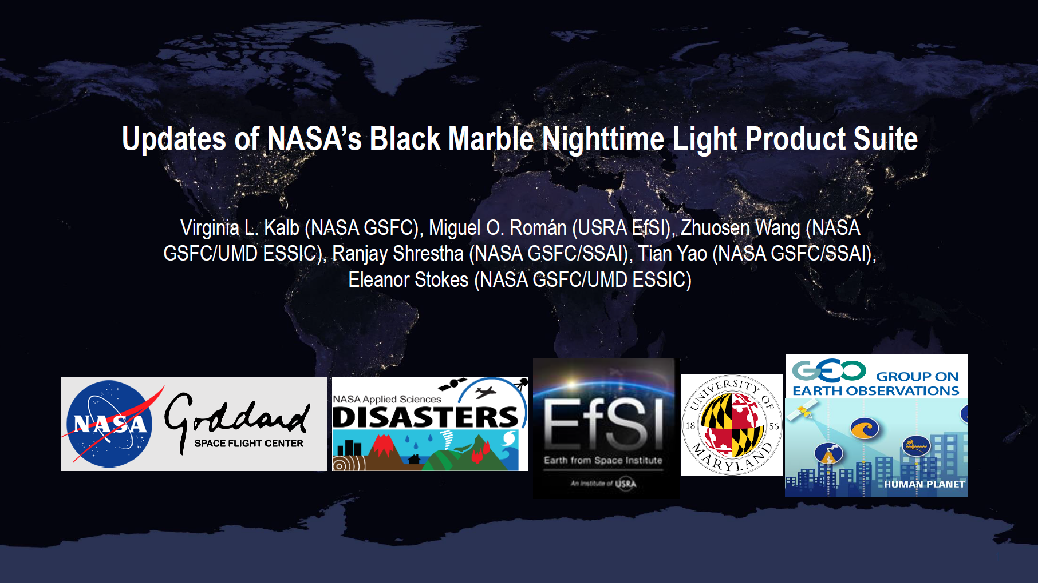
Notes:
This presentation is intended to be a short update on the status of the NASA Black Marble Nighttime Light Product Suite.
Unfortunately, Dr. Roman and others from the NASA Black Marble Team are unavailable today, but Dr. Roman and his team have generously compiled a few status slides and I will be presenting them.

Slide 2



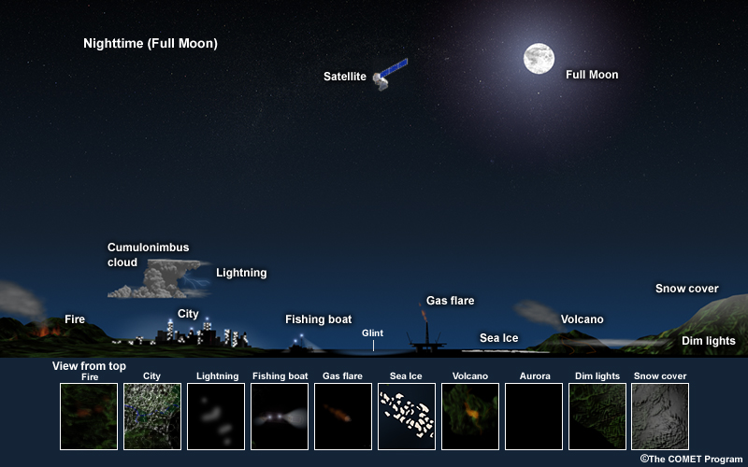


NASA’s Black Marble Science Objective:
To enable interdisciplinary research and applications of the Suomi-NPP VIIRS Day/Night Band.
Disciplines Covered:
Land/Cryosphere
Oceans
Clouds/Aerosols
Key Applications Areas:
Disasters Risk Reduction
Land Cover/Use Change
Urban Sustainability
Energy Access
Socioeconomic Impacts
Notes:
The Black Marble product uses the DNB data acquired by VIIRS to provide a new generation of satellite products that provide global measurement of nocturnal visible and near-infrared light that are suitable for Earth science and climate studies.
The VIIRS DNB's has ultra-sensitivity in low-light conditions allowing for the generation of new science-quality nighttime products due to significantly improved resolution and calibration compared to satellite nighttime light products such as those from DMSP.
Utility of the Black Marble product suite intersects land and the cryosphere (monitoring active fires, gas flares and snow/ice extent), atmosphere (cloud and aerosol properties) and ocean disciplines (sea ice and ship tracking) and it also has broad application uses. It has been used significantly of late in disaster risk reduction/impacts, primarily to assess the extent and duration of damage to power infrastructure due to severe weather impacts, such as hurricanes, and other disaster events. The products are also proving to be very useful to assess anthropogenic and socioeconomic impacts including monitoring human migration patterns related to routine events/seasonal cycles as well as a result of conflicts/wars.

Slide 3
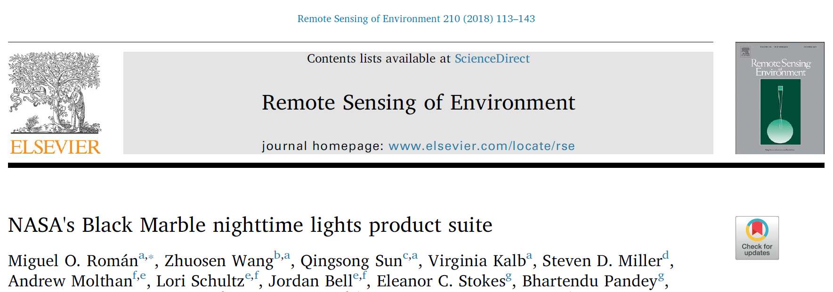
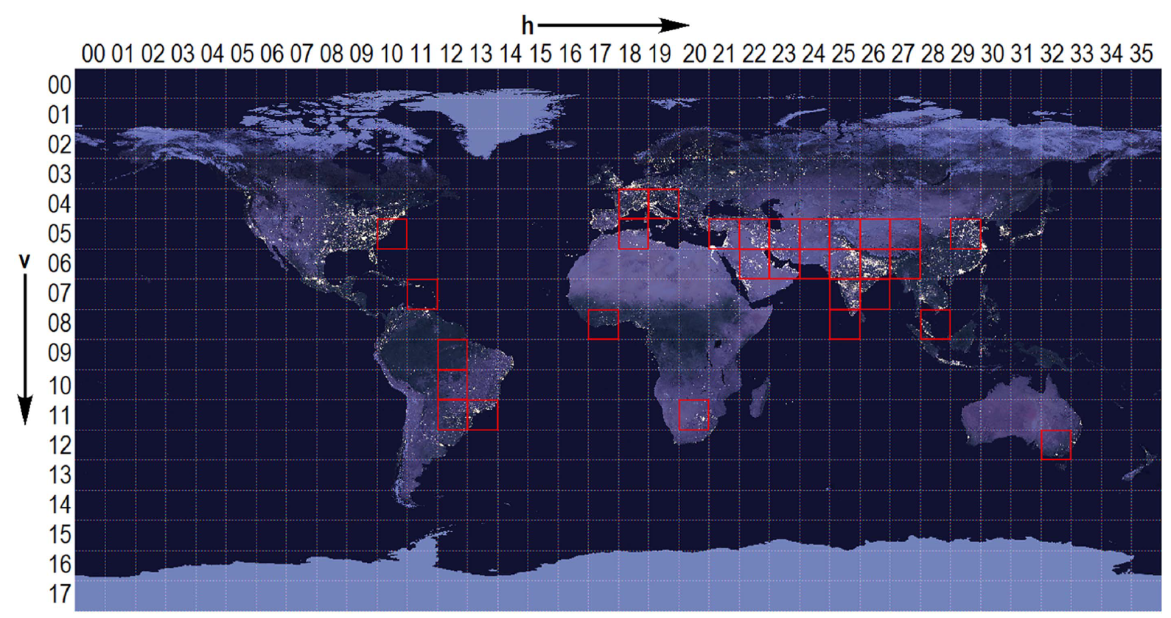
NASA Black Marble Product Status
ATBD Review and User’s Guide:
The Black Marble product suite (VNP46) algorithm theoretical basis document (ATBD) was recently published in peer reviewed literature: https://doi.org/10.1016/j.rse.2018.03.017.
ATBD and User’s Guide documents, following NASA Science Team guidelines, have been posted in the Black Marble product landing page:
https://viirsland.gsfc.nasa.gov/Products/NASA/BlackMarble.html
Science PGE Status:
VNP46A1 Daily At-sensor TOA Nighttime Radiance Product is under operational production. It will be transitioned into LAADS DAAC and LANCE-NRT, and will eventually replace the NOAA-based ENCC Imagery Algorithm on NASA Worldview.
VNP46A2 Daily Moonlight-adjusted Nighttime Lights Product will start the operational process from May, 2019.
Further information is available in Black Marble website:
https://blackmarble.gsfc.nasa.gov/
Suomi-NPP VIIRS geographic Lat/Lon grid system. 30 sample tiles (5-year time series) were used to conduct extensive benchmark tests on the Black Marble product.
Notes:
The algorithm for the VIIRS Black Marble product suite is VNP46.
A Black Marble ATBD and User Guide area published and accessible via the web. Dr. Roman’s team also published a peer reviewed article on the Black Marble product suite in 2018 in Remote Sensing of Environment. This article provides details on the algorithm approach, validation results, the structure of the products provided.
The Black Marble Standard Product Suite provides two products generated at 500 meters resolution including VNP46A1 which provides daily TOA nighttime radiances and can also be applied by users to generate their own customized nighttime lights. The VNP46A2 a daily nighttime lights product with seasonal and moonlight with seasonal and moonlight adjustments applied. In addition to daily products, multi-date L3 products will also be available.
Daily product availability is currently benchmarked at 3-5 hours after acquisition. Additionally, the Black Marble team is implementing specific product characteristics to make it more user friendly and appealing to a broader base of potential users. For example, the L2 and L3 gridded products are provided in a geographic/lat-long project and there are plans to make the gridded products easily ingestible into GIS applications.
Black Marble products are not quite ready for distribution yet, but are anticipated to be available soon on the LAADS DAAC and NASA LANCE. I just check both those sources in the past week and saw that the VNP46A1 daily product is available in the LAADS DAAC.
In addition to the Black Marble Standard Product there will also be a Black Marble High Definition (HD) product at a resolution of 30m. This value-added product utilizes the Standard Product along with data from finer resolution Earth observation assets such as Landsat 8 and Sentinel 2, as well as ancillary GIS data sources including details transportation and building footprint data. The HD product will allow for differentiation of human activity patterns at relatively local scales and assess sectors of urban areas specifically impacted by power outages.
The goal of the Black Marble team is to integrate the 30m product into NASA WorldView and provide coverage for settlements throughout the world.
As a complement to this presentation, we have compiled a VIIRS Black Marble References document that will be distributed with the notes from this webinar. The document contains references to the ATDB, User Guide, dataset examples for both the Standard and HD Black Marble products as well as relevant articles. Also, the Black Marble website is an excellent resource for learning more about the algorithm, product and potential applications.

Slide 4
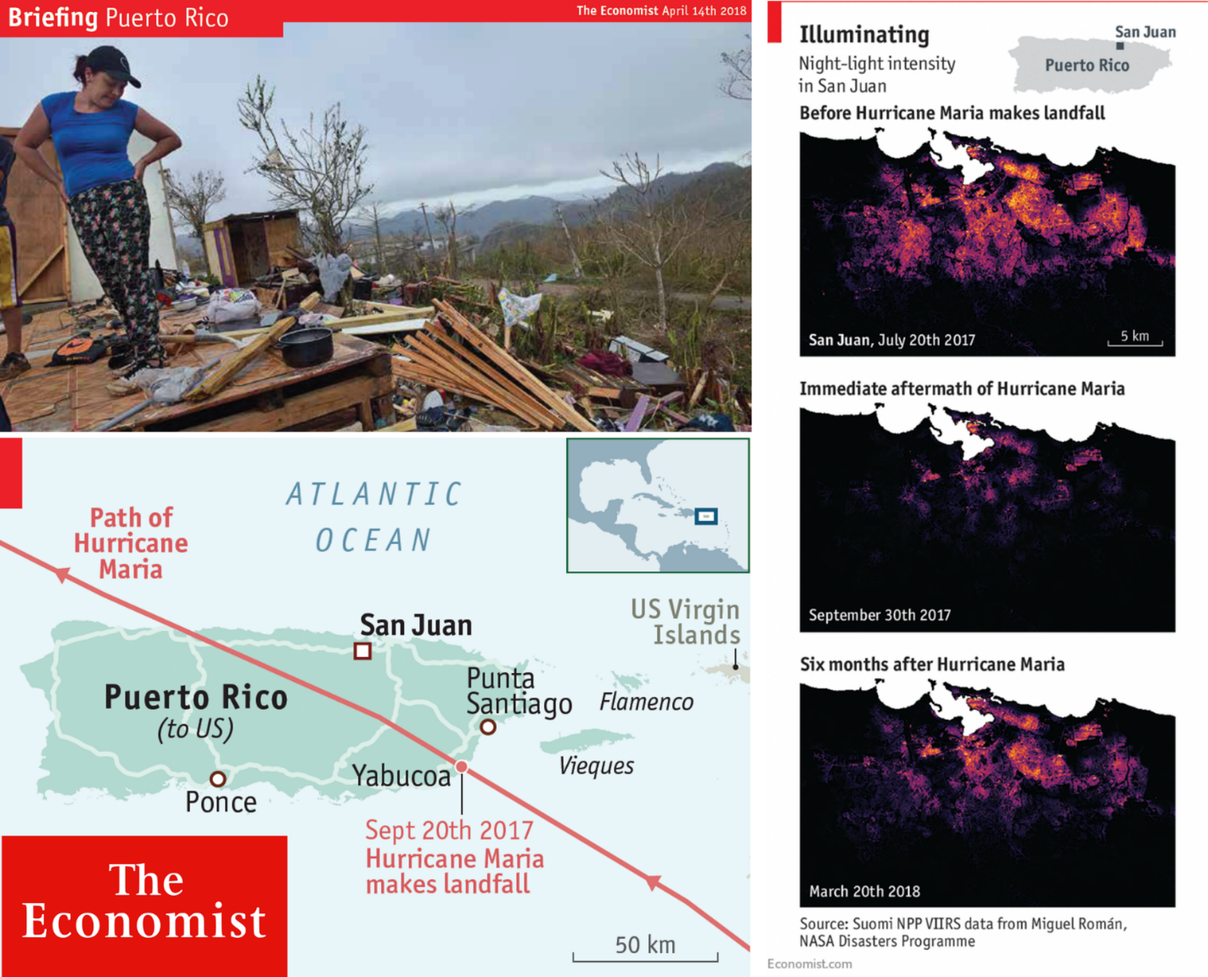


Recent Highlights - Hurricane Maria
The April 2018 issue of The Economist featured data and images from NASA’s Black Marble Science Team in an article about the recovery of Puerto Rico’s energy sector six months after Hurricane Maria devastated the island.
https://bit.ly/2IXJmfs
Notes:
Uses/applications of Black Marble products have been portrayed in several news articles and publications in the past year.
For example, an article in The Economist magazine (April, 2018) featured work from NASA’s Black Marble Science Team (619) following the recovery of Puerto Rico’s energy sector six months after Hurricane Maria struck the US Territory: https://bit.ly/2IXJmfs
Several references to other articles on the use of Black Marble are provided in the reference document mentioned earlier. There is a particularly fascinating story provided by the BBC that uses high resolution visible imagery and Black Marble products before and during the Syrian civil war to assess the humanitarian and infrastructure impact of the conflict.

Slide 5
Recent Highlights – Cyclone Idai
In response to the request from the Department of State and International Federation of Red Cross and Red Crescent Societies (IFRC), NASA’s Black Marble team provided the pre- and post-event nighttime light images, to track damage and power outage from Cyclone Idai in Mozambique.
Notes:
This is another recent example of the use of Black Marble...
30 meter Black Marble HD products were used to identify and assess damage and impacts to electricity infrastructure in Mozambique after Cyclone Idai in March 2019.
NASA provided these products in response to requests from government and international relief organizations.
The spatially refined Black Marble HD pre and post-event products, such as this example for Beira, Mozambique (cyclone landfall was March 15), helped identify the widespread impact of the cyclone on electric grids at the neighborhood level and aided disaster response/recovery, while the standard 500 meter products provided the outage maps at the regional level.

Slide 6

Early announcement of joint ARSET/Black Marble webinar series
3 week webinar series in Summer 2019.
Offers bilingual (English/Spanish) nighttime satellite remote sensing training that builds the skills to integrate Black Marble with additional data sources (e.g., Landsat-based and socioeconomic products) into an agency’s decision-making activities.
Webinars are usually 45 minutes, followed by 15-30 minutes Q/A.
Fore more info: https://arset.gsfc.nasa.gov/
Notes:
If you are interested in learning more about VIIRS Blue Marble products and their application, the NASA Applied Remote Sensing Training program (ARSET) have been working with the Black Marble team to develop a webinar series.
The webinar series is anticipated in Summer 2019. The webinars build off each other so please plan to participate in the entire series if you sign up. A 60-75 minute webinar will be hosted once a week over the 3 week period.
Please see the ARSET website provided here for more information on the webinar series.
One last thing to add before wrapping up this presentation, the Black Marble team is interested in learning about what potential use cases or thematic application areas are of interest to the user community. The objective of gathering this information is to make sure that the Black Marble products are designed, processed and provided so they meet the needs of as many potential users as possible.
In our post-webinar survey, we have provided a couple of questions that will allow you to provide this information. Received information will be provided to the Black Marble team, so please take time to complete the survey after the webinar.

