Slide 1

Multi-Angle Implementation of Atmospheric Correction (MAIAC)
Alexei Lyapustin, GSFC, code 613
Y. Wang (UMBC), S. Korkin (USRA)
NASA Direct Readout Webinar
May 29, 2018

Slide 2
MAIAC: General Information
Status:
  C6 MODAPS re-processing of MODIS is finished (MCD19)
  MAIAC is on NASA Near Real Time Processing System
  Products (gridded):
  Atmosphere (MCDA2 - daily): CWV, CM, AOD, aerosol type (background/smoke/dust), Smoke Plume Height @1km resolution;
  Land Surface (A1 – daily; A3 – 8-day):
    - (MCDA1): spectral BRF (surface reflectance) @1km (B1-B13) and 500m (B1-B7); SigBRFn_B1,B2. Will add 250m in C6.1;
    - (MCDA3 – 8-day): BRDF (RTLS model, naturally gap-filled), instantaneous albedo (B1-B8); Will drop B8 from C6.1, instead provide B3-scaling factor;
  Detected Snow (A1): snow grain size, and sub-pixel snow fraction (1km);

Slide 3
Multi-Angle Implementation of Atmospheric Correction (MAIAC)
Features
Grid TOA L1B data to 1km fixed grid – work with polar-orbit data as “geostationary-like”;
Sliding window algorithm – store 4-16 last days of measurements in memory;
RT with fully coupled BRDF model;
Accumulate surface-related information for each grid cell (spectral BRDF, BT-contrasts etc.)
Main Results
Advanced cloud (snow) detection – particular improvements over tropics and at northern lat. (vegetation analysis);
AOD data globally over dark and bright land surface;
Aerosol at 1km resolution & low urban bias – strong interest from AQ community;

Slide 4
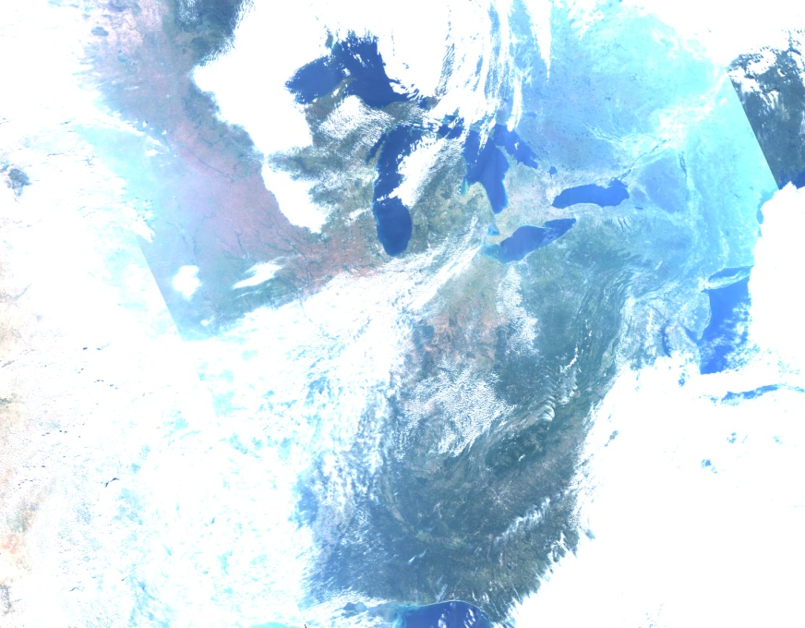
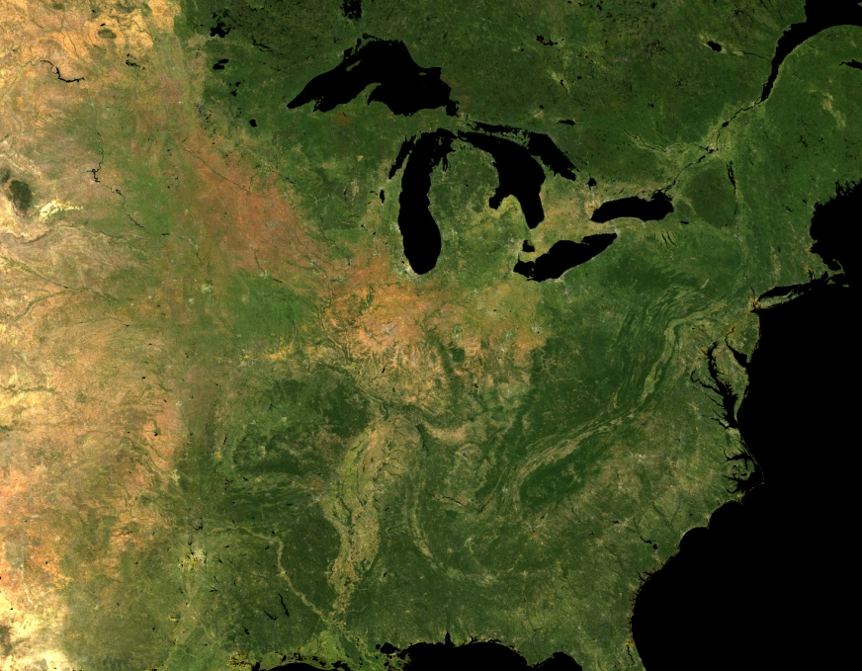
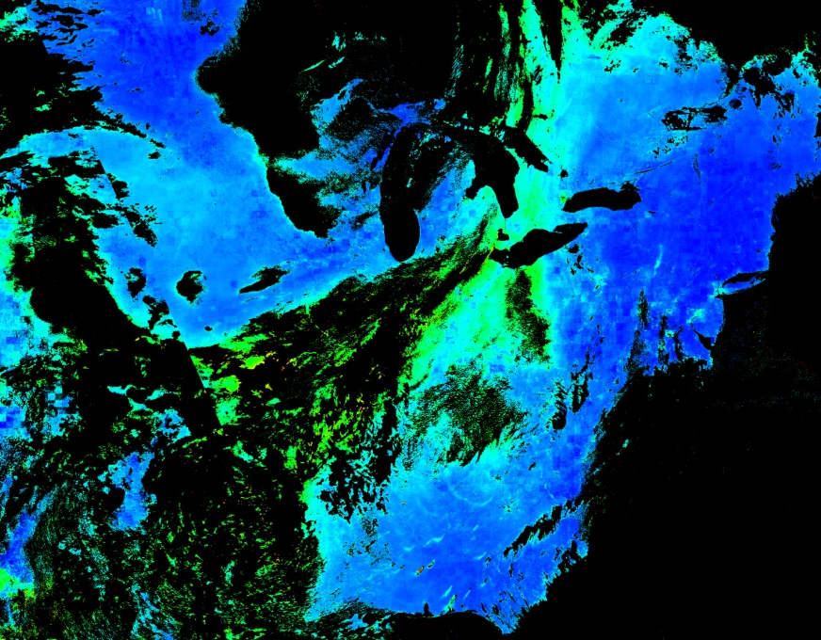
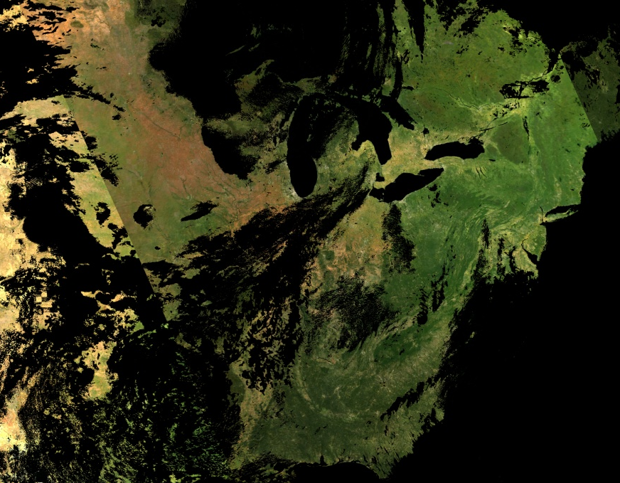
MAIAC = Time Series + Spatial Analysis
MODIS, TOA RGB
NBRF
AOT
BRF

Slide 5
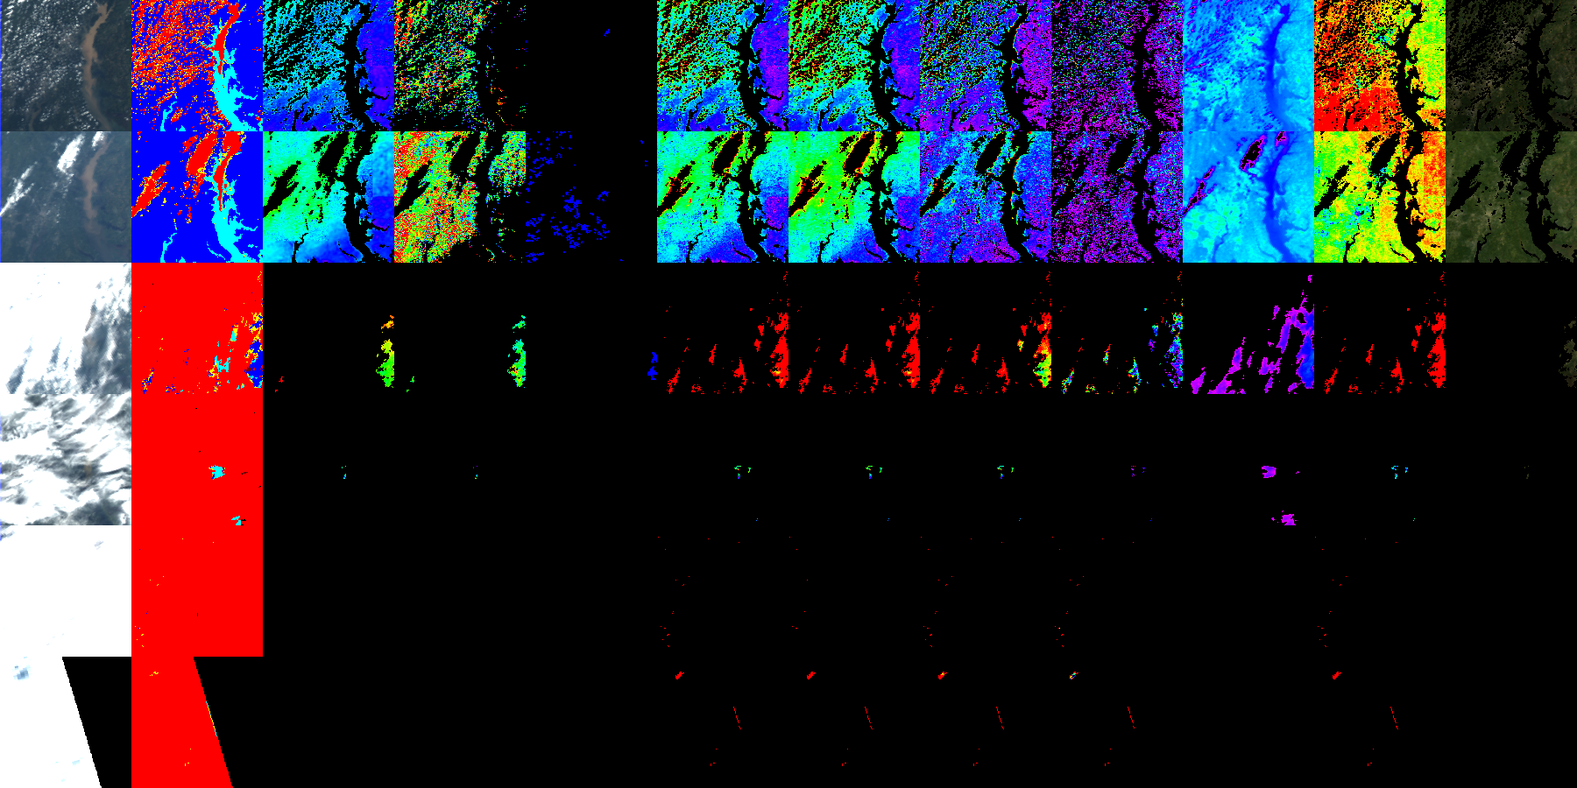
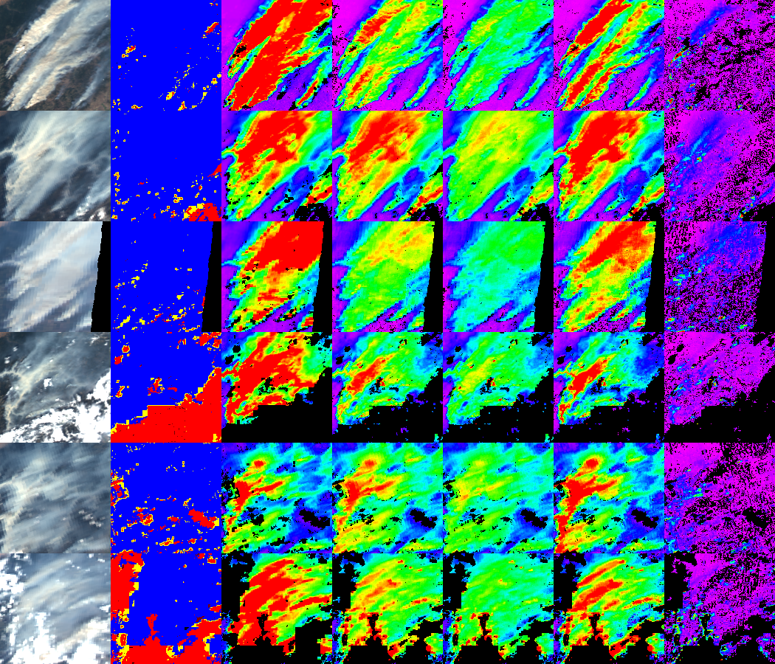
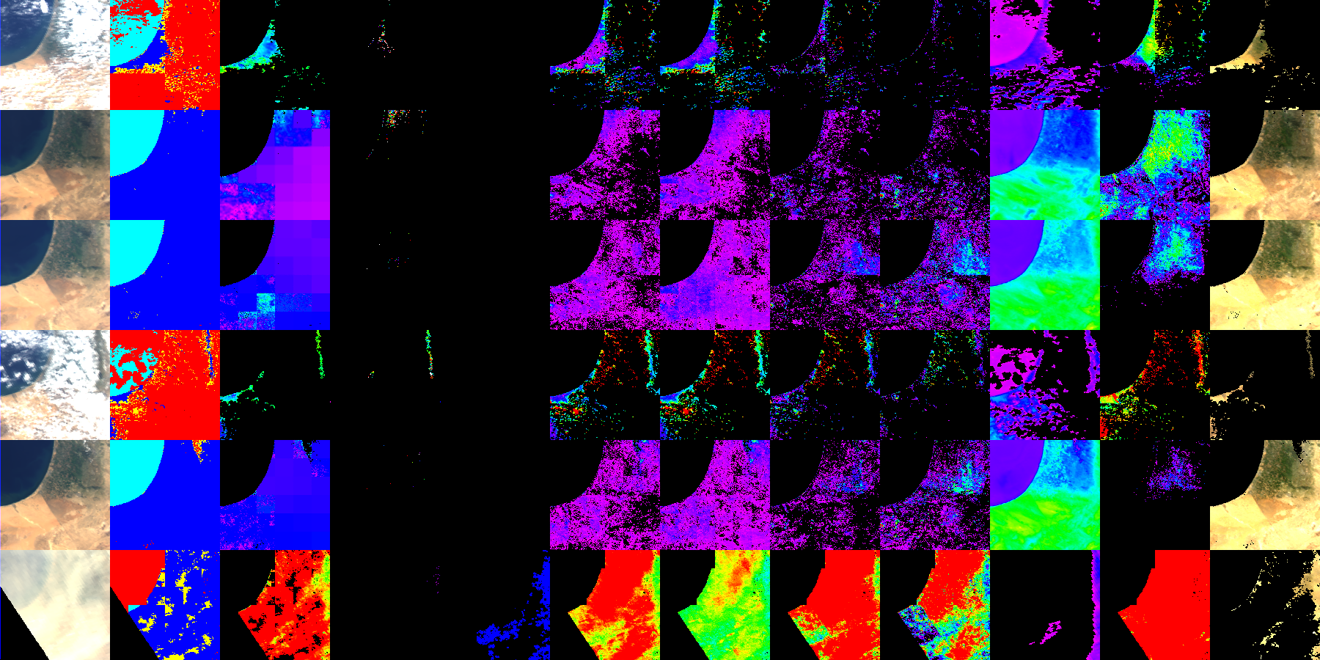
MAIAC Aerosol Type (Smoke/Dust)
Lyapustin, A. et al., 2012: Discrimination of biomass burning smoke and clouds in MAIAC algorithm, ACP, 12, 9679–9686.
Phys. principles (~OMI) – enhanced shortwave
absorption (Red →Blue →DB)
n_{i} increases R→DB for OC (smoke) and dust;
Multiple scattering, for absorbing aerosols.
R^{A,TOA}
Reduction from BrC
background
smoke
- proxy of aerosol
reflectance
dust
0.41
0.47
0.65
λ
TOA
CM
AOT
δ_{0.412}
δ_{0.47}
δ_{0.66}
δ_{2.13}
Backgr./Smoke/Dust
Model | Abs. | Size
Backgr. | No | Small
Smoke | Yes | Small
Dust | Yes | Large

Slide 6
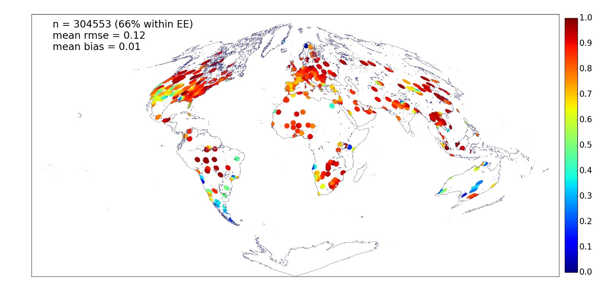
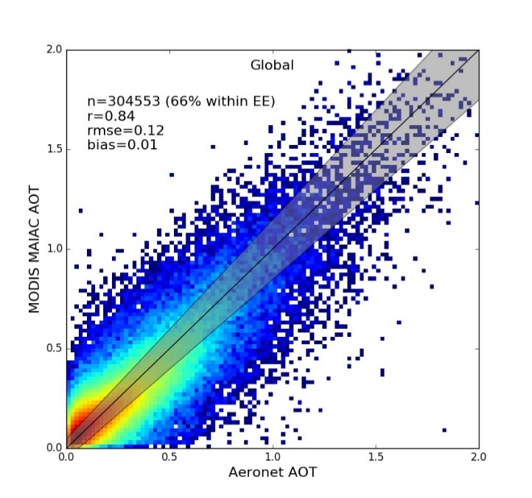
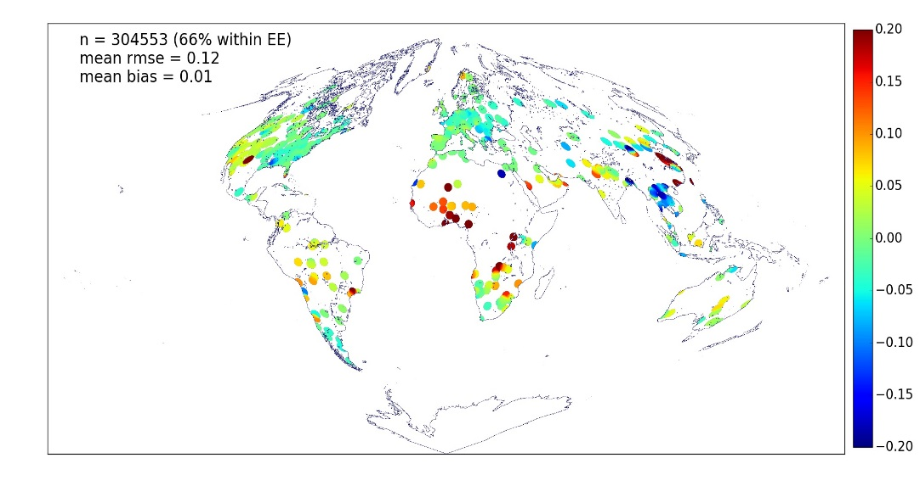
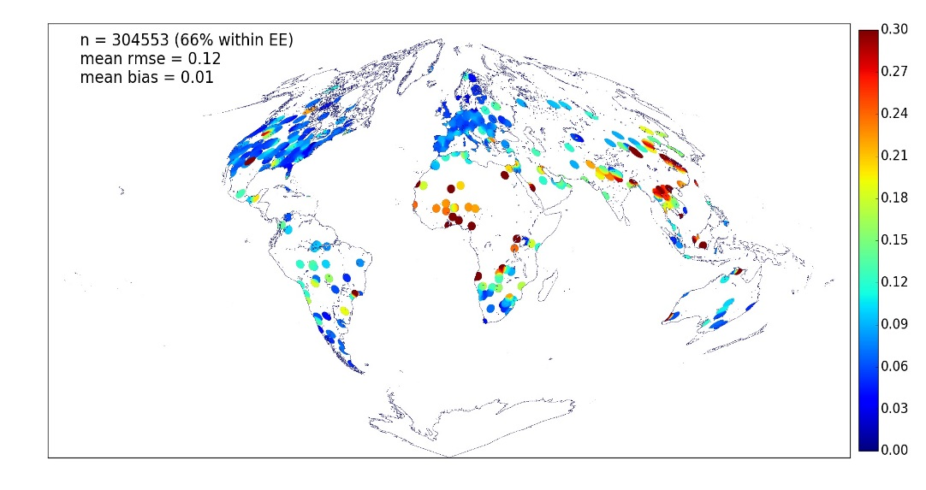
Aerosol Validation (2000-2016)
Lyapustin, A., et al..: MAIAC MODIS Collection 6 Algorithm, AMT, in review
R
bias
rmse

Slide 7
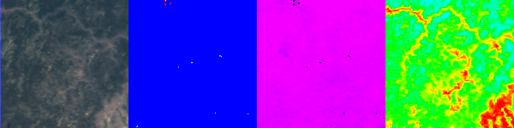

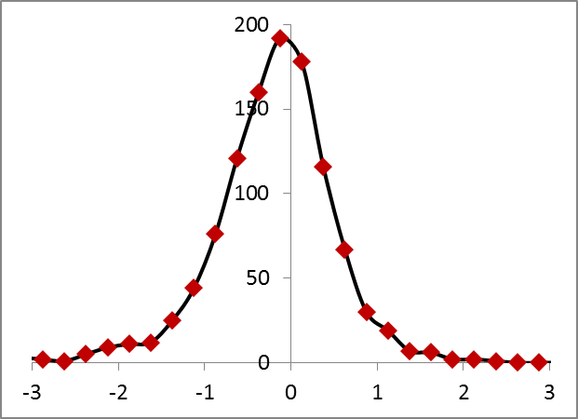
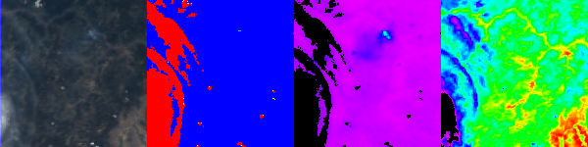
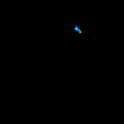
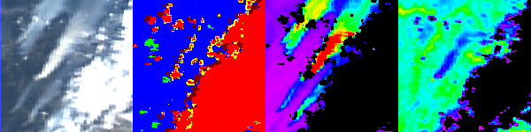
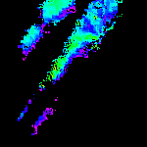
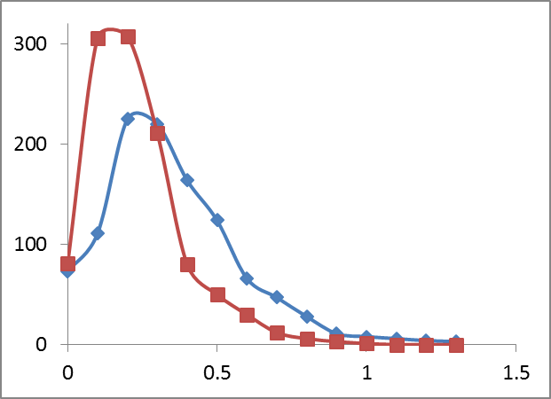
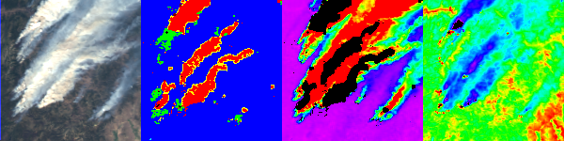
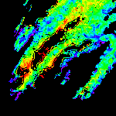
New: Aerosol Plume Height
Lyapustin, A.et al., Thermal Technique to Derive Smoke Plume Height from MODIS, Geophys. Res. Lett., to be submitted.
RGB CM AOD_{0.47} Tb₁₁ (K) H^{s} (km)
(a)
H^{MISR}-H^{MODIS}
km
a) Histogram of MODIS-MISR plume height difference (2000-2008);
σ^{MODIS}
σ ^{MISR}
(b)
km
b) Standard deviation of retrieved plume heights.
0 3.0
280 320
0 3.0
1. MAIAC is lower by about 200m in the histogram max, and by 448m on average.
2. 59.3% of MAIAC plume heights are found within ±500m of MISR MINX values.

Slide 8
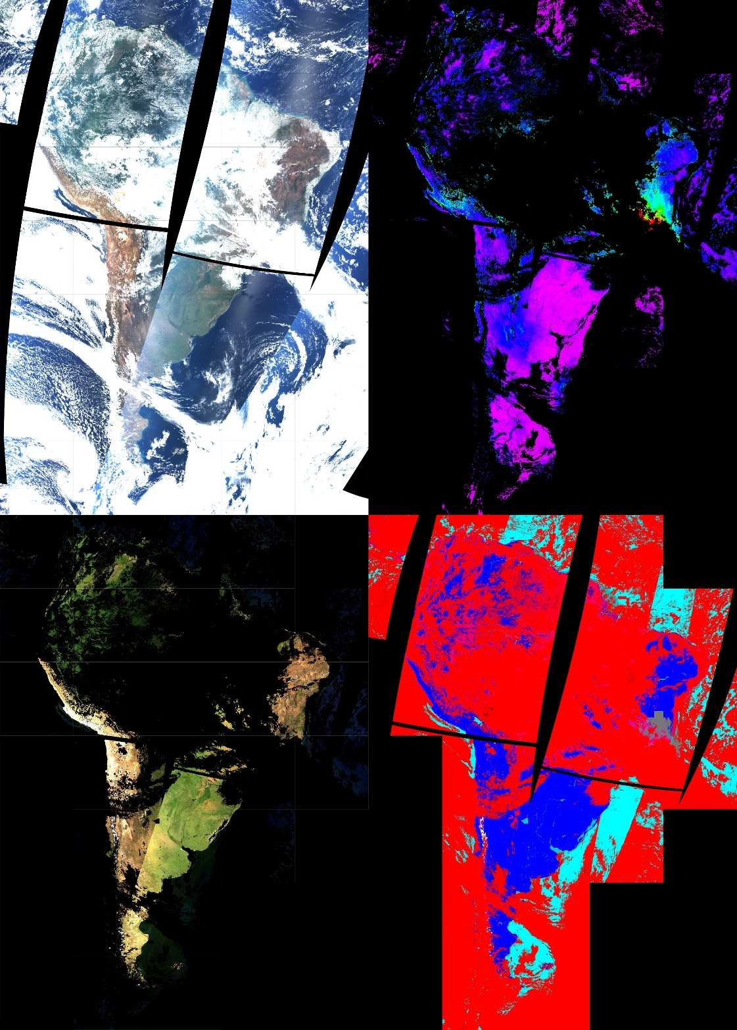
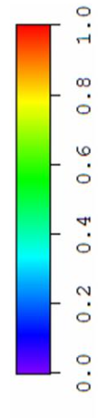
Quality of Atmospheric Correction
CM Legend
Clear Land
Clear Water
Detected Smoke
Clouds
Cloud Shadows
296 - 2003

Slide 9
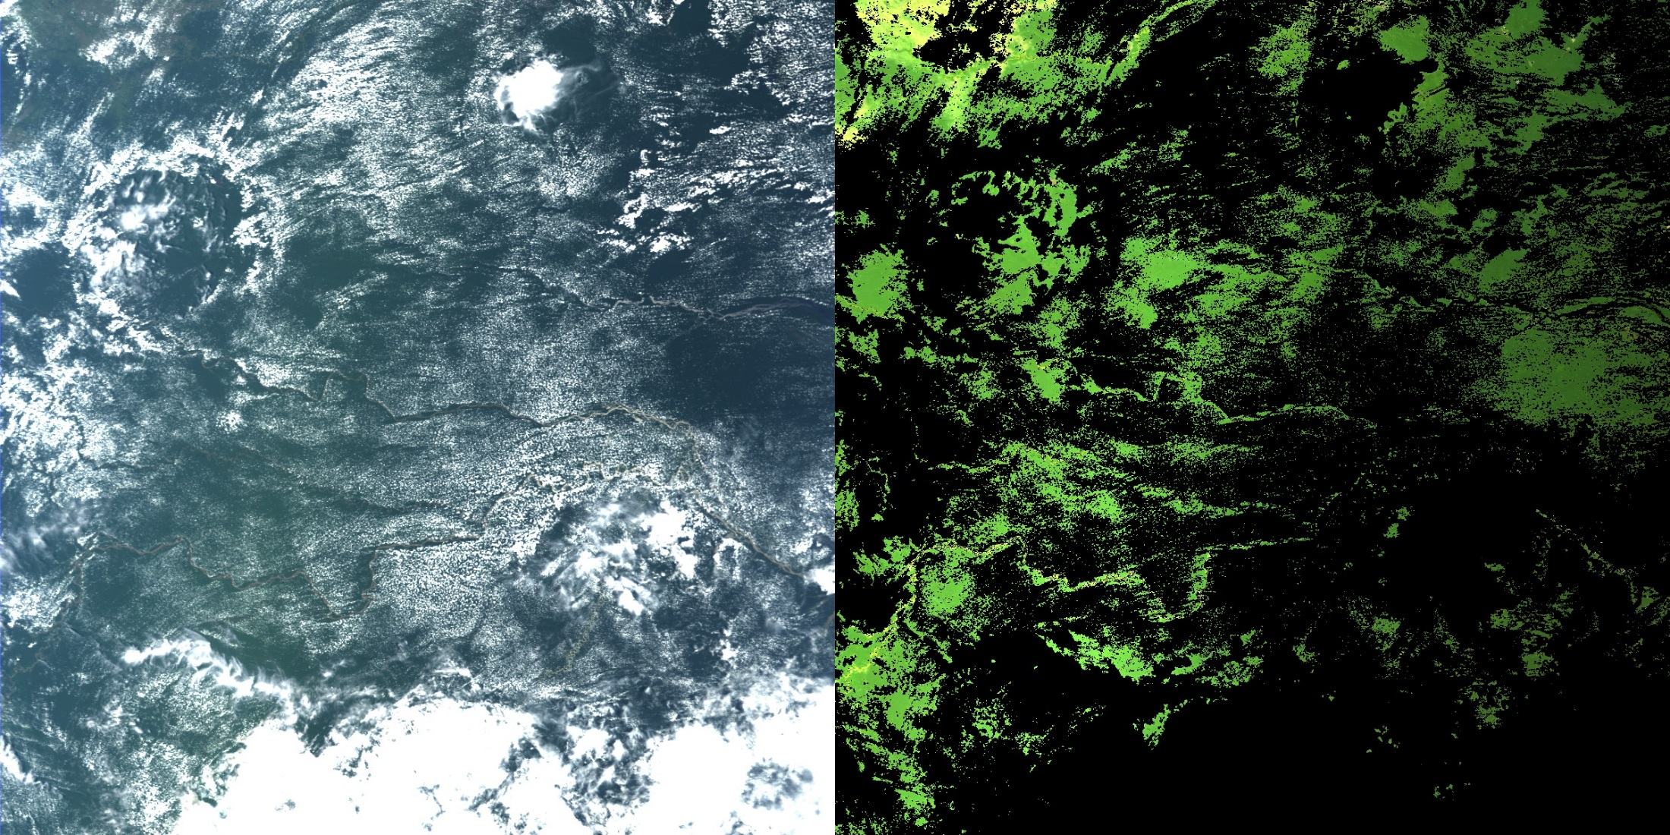
Quality of Atmospheric Correction …
TOA RGB
BRF RGB
1200 km
Decreasing brightness – moving from backscattering towards forward scattering

Slide 10
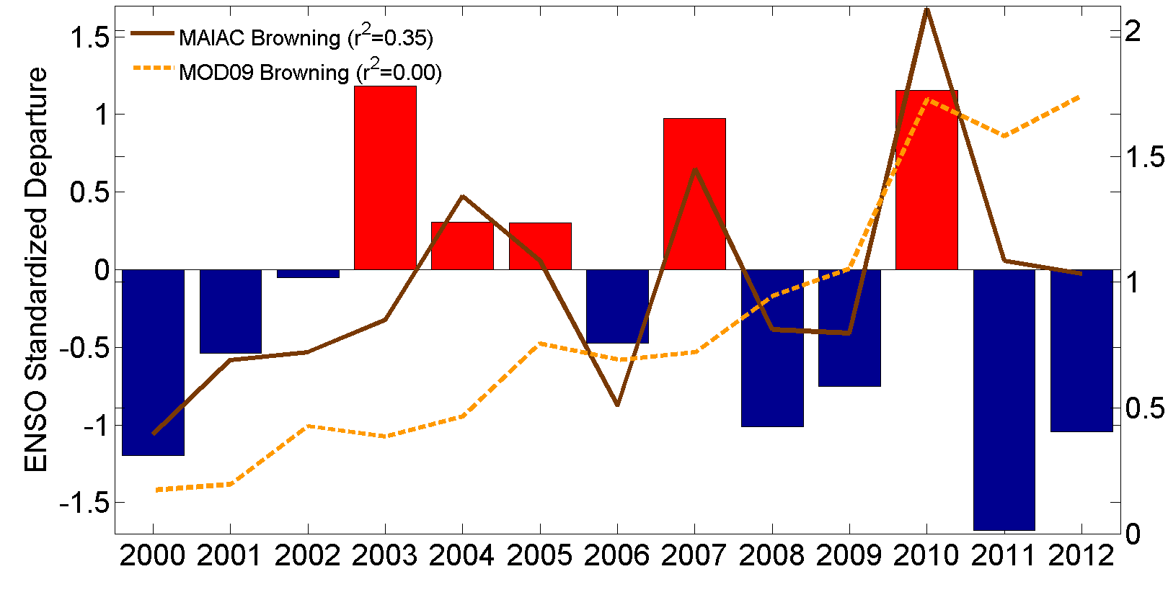
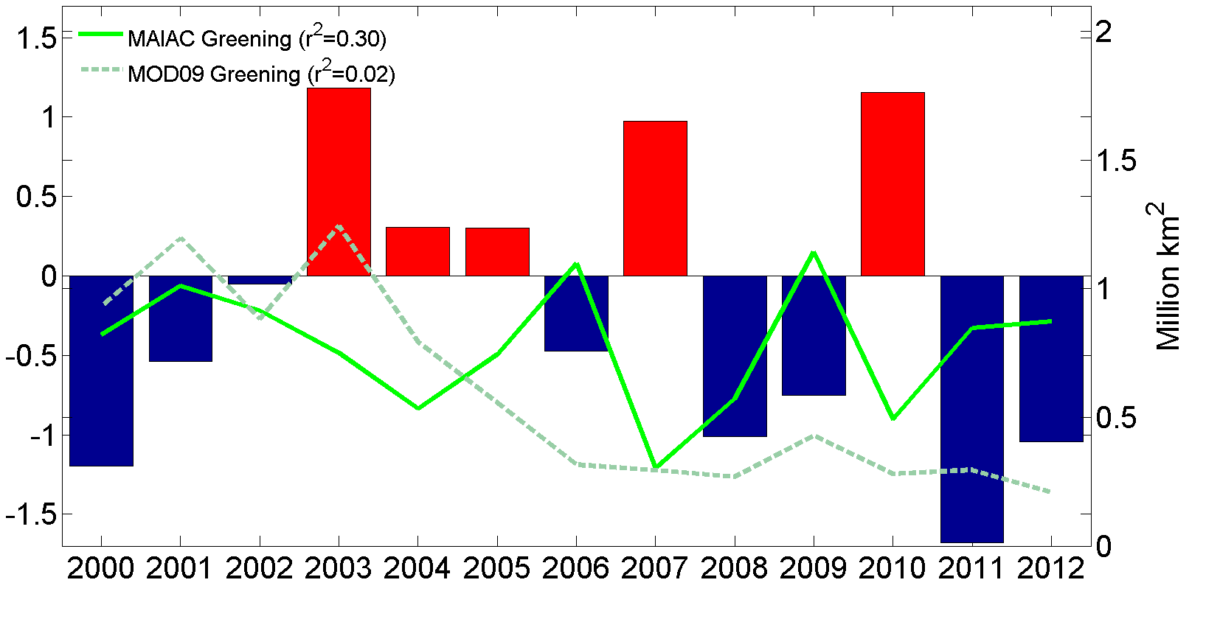
Interannual Variability
Hilker, T., A. I. Lyapustin, C. J. Tucker, F. G. Hall, R. B. Myneni, Y. Wang, J. Bi, Y. M. de Moura, P. J. Sellers (2014), Vegetation dynamics and rainfall sensitivity of the Amazon, PNAS, 111 (45), 16041-16046.
El Ninõ
Amazon Browning and Greening Anomalies from MOD09 C5 (dashed) and MAIAC C6 L1B data (solid).
Anomaly Analysis – Myneni & Jian (BU)
Correlation with MEI – Hilker & Lyapustin
La Ninã
Significant interannual variability in MAIAC B/G anomalies and expected physical correlation with the short-term climate variations.
Anomaly:

Slide 11
Interannual Variability
Bi, J., R. Myneni, A. Lyapustin, Y. Wang, T. Park, C. Chen, K. Yan, Y. Knyazikhin, Amazon forests’ response to droughts: a perspective from the MAIAC product, Remote Sens., 2016.
NDVI_{n}
EVI_{n}
Standardized anomalies for 2010 drought for MAIAC and MOD09 C5 and C6 NDVI, EVI
Amazon basin Greening and Browning area from MAIAC and MOD09 C5 and C6

Slide 12
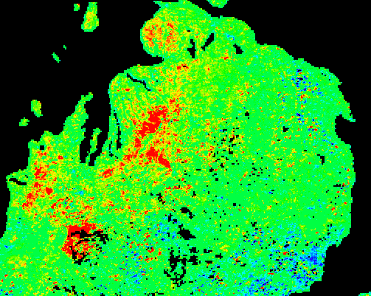
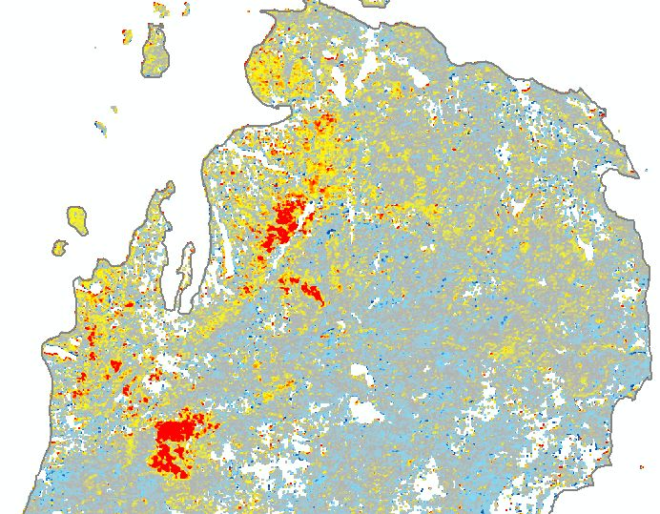
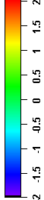
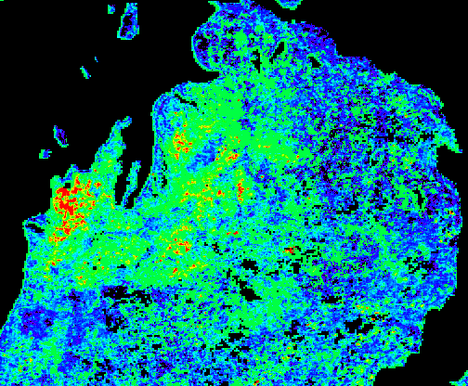
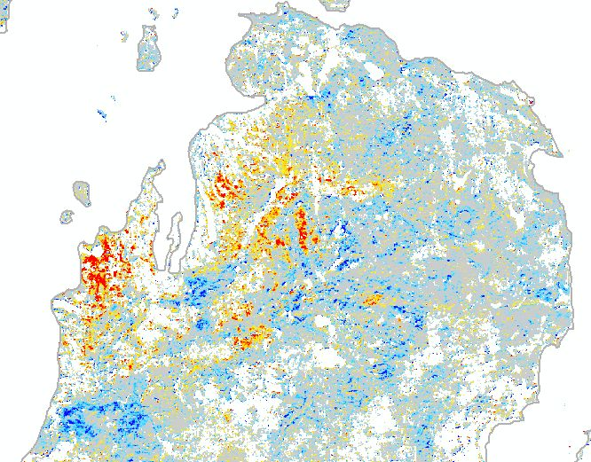
Insect Forest Damage, Michigan Area
MAIAC MODIS 500m NDVI
Standardized Anomaly
RSAC Change Index
from 30m Landsat Data
2009
2010

Slide 13
LAI/FPAR Alg. with MAIAC input
Chen, C., Y. Knyazikhin, T. Park, K. Yan, A. Lyapustin, Y. Wang, B. Yang and R. B. Myneni, Prototyping of LAI and FPAR Algorithm with MODIS MultiAngle Implementation of Atmospheric Correction (MAIAC) data, Rem. Sensing, 2017, 9, 370
Validation over NA and SA:
DIRECT (sites) data from CalValPortal OLIVE (On Line Interactive Validation Exercise)
MAIAC Red band BRF is higher than MOD09 9 – - so SSA in LUT was increased by up to 0.05;
No Red-NIR values outside of LUT boundaries;
Up to 10% more of high quality LAI/FPAR retrievals (main algorithm);
Improved LAI validation statistics:
- Slope: 0.89→0.97; Offset: 0.39→0.25;
- RMSE: 0.8→0.67; R²: 0.69→0.8

Slide 14
MAIAC Snow Detection
Cooper, M. J., Martin, R. V., Lyapustin, A. I., and McLinden, C. A.: Assessing snow extent data sets over North America to inform and improve trace gas retrievals from solar backscatter, AMT, 11, 2983-2994, 2018.
Evaluated against Global Historical Climatology Network Daily (GHCN-D) database, over 80 000 surface stations worldwide (Menne et al., 2012a)
CMC: Canadian Meteorological Centre (CMC) Daily Snow
Depth Analysis Data (25km)
IMS: Interactive Multisensor Snow and Ice Mapping System (4km)
NISE: Near-real-time Ice and Snow Extent (SSM/I: 25km)

Slide 15
MODIS De-Trending and X-Cal
New MCST RVS characterization for Aqua → new OBPG Terra Polarization Correction (PC) coefficients → MODAPS generated 50km L1B subsets for CEOS desert cal. sites;
Method: a) run MAIAC retrievals (AOT, BRDF etc.); 2) compute TOA reflectance (R_{n}) for fixed geometry (VZA=0°, SZA=45°) and evaluate trends in both Terra and Aqua; 3) Apply de-trending and compute T-A X-calibration factor (gain correction for T)
Lyapustin, A., Y. Wang, X. Xiong, G. Meister, S. Platnick, R. Levy et al, Science Impact of MODIS C5 Calibration Degradation and C6+ Improvements, AMT, 7, 7281-7319, 2014.
Average trend/year/unit_refl.
 | Δ_{Terra} | σ_{Terra} | Δ_{Aqua} | σ_{Aqua}
TOA_B01 | -1.6884E-03 | 2.6114E-04 | 1.5848E-06 | 3.9377E-04
TOA_B02 | 7.7780E-04 | 2.4303E-04 | -6.5120E-05 | 3.5583E-04
TOA_B03 | -8.8922E-04 | 4.5314E-04 | -3.1763E-04 | 2.8486E-04
TOA_B04 | -5.6629E-04 | 3.2829E-04 | -3.9831E-05 | 5.0202E-04
TOA_B05 | 1.9477E-04 | 3.3019E-04 | 4.5784E-06 | 3.3528E-04
TOA_B06 | -3.9516E-04 | 3.0211E-04 | -3.1194E-04 | 2.8191E-04
TOA_B07 | 2.0259E-04 | 2.4491E-04 | -5.8419E-04 | 3.2705E-04
TOA_B08 | -1.2627E-03 | 1.0018E-03 | -5.5178E-04 | 1.0915E-04
TOA_B09 | -3.9874E-04 | 5.2176E-04 | 1.3724E-04 | 2.1120E-04
TOA_B10 | -7.2800E-04 | 8.2601E-04 | -3.0632E-04 | 7.1498E-04

Slide 16
Terra-Aqua X-Calibration
After MCST RVS de-trending for Aqua, we see trend reduction (a factor of 12 in B1 and a factor of 2 in B3) compared to our previous analysis.
Average X-gain for Terra
 | Average | Stdev
TOA_B01 | 1.018776 | 0.000949
TOA_B02 | 1.000523 | 0.001054
TOA_B03 | 0.989436 | 0.001268
TOA_B04 | 1.00109 | 0.001448
TOA_B05 | 0.98862 | 0.001855
TOA_B06 | 0.997128 | 0.000898
TOA_B07 | 0.999368 | 0.000373
TOA_B08 | 1.003774 | 0.000948
TOA_B09 | 1.0014 | 0.001488
TOA_B10 | 1.014141 | 0.002077

Slide 17
MAIAC Global Products
https://landweb.modaps.eosdis.nasa.gov/cgi-bin/browse/browseMODIS.cgi
AOD
CWV
BRF
DOY 60
2005
SF
K_{i}: RGB RTLS
AOD
CWV
BRF
DOY 230
2005
SF
K_{i}: RGB RTLS

Slide 18
Atmospheric File: MCDA2 (daily)

Slide 19
Surface Reflectance File: MCDA1 (daily)

Slide 20
BRDF/Albedo File: MCDA3 (8-day)

Slide 21
MAIAC Products QA Bits
AOD QA Bits
Code Example:
Following c code pieces will retrieve Cloud Mask and Land Water Mask from QA:
unsigned short int qa;
unsigned char cm, lwmask;
cm = qa %8;
switch (cm):
{
case 0: //undefined
….
case 1: // clear
….
case 2: //Possibly cloud
}
lwmask = (qa/8)%4;
switch (lwmask)
{
case 0: //land
….
case 1: //water
….
}
Most Significant bit
Least Significant bit
15 | 14 | 13 | 12 | 11 | 10 | 9 | 8 | 7 | 6 | 5 | 4 | 3 | 2 | 1 | 0
AOD Model
AOD QA
Adjacency Mask
Land/ Water Mask
Cloud Mask
Glint
BRF QA Bits
Most Significant bit
Least Significant bit
15 | 14 | 13 | 12 | 11 | 10 | 9 | 8 | 7 | 6 | 5 | 4 | 3 | 2 | 1 | 0
Change Mask
Snow
BRF
AOD
Level
Adjacency Mask
Land/ Water Mask
Cloud Mask
High Altitude
Initialization status

Slide 22
Geometric Normalization of MAIAC BRF
In order to normalize MAIAC BRF to any give angle, one need MAIAC BRF file and 8-day RTLS file.
Assume:
BRF is the retrieved surface reflectance (read from BRF file)
BRFn is the normalized reflectance (to be calculated)
F_{v} , F_{g} are the RTLS kernel function values at satellite overpass geometry (can be read from BRF file at 5km resolution)
F_{0v}, F_{0g} are the kernel function values at geometry to be normalized to (table 1 in users guide gives those values for any solar angle at nadir view)
Ki, kv, kg are the RTLS model parameters (read from closest 8-day RTLS file)
Then:
BRFn = BRF*(Ki + Kv*F_{0v}+ Kg*F_{0g}) / (Ki + Kv*F_{v} + Kg*F_{g})

